Slide 1
MS&E 228: Causality in Observational Data
Vasilis Syrgkanis
MS&E, Stanford

Slide 2
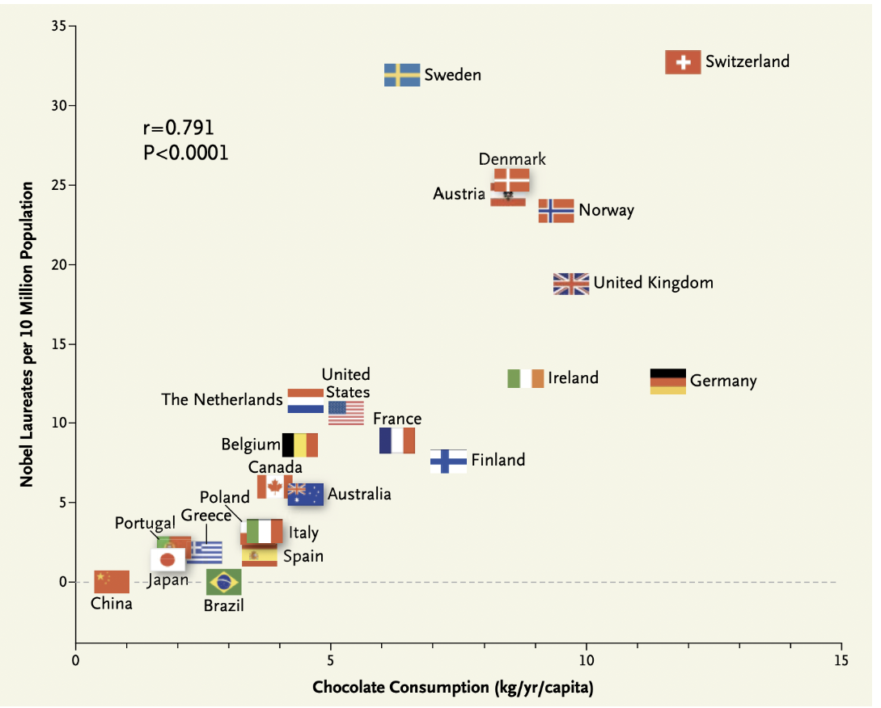

Slide 3
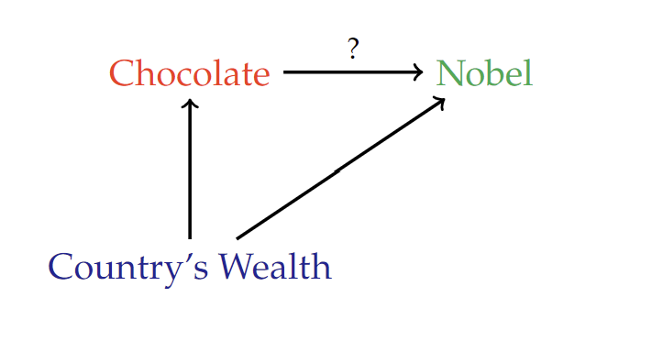

Slide 4
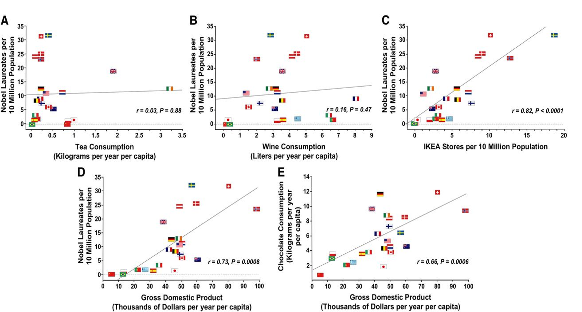

Slide 6
Through the Lens of Potential Outcomes

Slide 7




$$Y^{\left(0\right)}$$
$$Y|D=0$$
$$Y|D=1$$
$$Y^{\left(1\right)}$$
Counterfactual World
Observed World
Counterfactual World

Slide 8










$$X=1$$
$$Y^{\left(0\right)}$$
$$≠$$
$$Y|D=0$$
$$Y|D=1$$
$$≠$$
$$Y^{\left(1\right)}$$
$$X=0$$
$$P\left(D=0 | X=1\right)=1/4$$
$$P\left(D=1 | X=1\right)=3/4$$
$$P\left(D=0 | X\right)$$
$$P\left(D=1 | X\right)$$
Selection based on X
Selection based on X
$$P\left(D=0 | X=1\right)=3/4$$
$$P\left(D=1 | X=1\right)=1/4$$
Counterfactual World
Observed World
Counterfactual World

Slide 9











$$Y^{\left(0\right)}$$
$$Y^{\left(0\right)}|X$$
$$∼$$
$$Y|D=0, X$$
$$Y|D=0$$
$$Y|D=1$$
$$Y|D=1,X$$
$$∼$$
$$Y^{\left(1\right)}|X$$
$$Y^{\left(1\right)}$$
$$P\left(D=0 | X=1\right)=1/4$$
$$P\left(D=1 | X=1\right)=3/4$$
$$X=1$$
$$P\left(D=0 | X\right)$$
$$P\left(D=1 | X\right)$$
Selection based on X
Selection based on X
$$X=0$$
$$P\left(D=0 | X=1\right)=3/4$$
$$P\left(D=1 | X=1\right)=1/4$$
Counterfactual World
Observed World
Counterfactual World

Slide 10



$$Y^{\left(0\right)}$$
$$Y^{\left(0\right)}|X$$
$$\sim$$
$$Y|D=0, X$$
$$Y|D=1,X$$
$$\sim$$
$$Y^{\left(1\right)}|X$$
$$Y^{\left(1\right)}$$
$$P\left(D=0 | X=1\right)=1/4$$
$$P\left(D=1 | X=1\right)=3/4$$
$$X=1$$
$$P\left(D=0 | X\right)$$
$$P\left(D=1 | X\right)$$
Selection based on X
Selection based on X
$$X=0$$
$$P\left(D=0 | X=1\right)=3/4$$
$$P\left(D=1 | X=1\right)=1/4$$
Counterfactual World
Observed World
Counterfactual World

Slide 11

Conditional Ignorability
For sub-populations with the same $X$, treatment is assigned as if RCT
$$Y^{d}⊥⊥ D | X$$

Slide 12
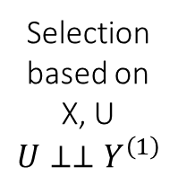
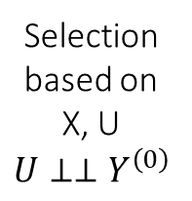
$$Y^{\left(0\right)}$$
$$Y^{\left(0\right)}|X$$
$$\sim$$
$$Y|D=0, X$$
$$Y|D=1,X$$
$$\sim$$
$$Y^{\left(1\right)}|X$$
$$Y^{\left(1\right)}$$
$$X=1$$
Selection based on X, U
$$U⊥⊥Y^{\left(0\right)}$$
Selection based on X, U
$$U⊥⊥Y^{\left(1\right)}$$
$$X=0$$
Counterfactual World
Observed World
Counterfactual World

Slide 13
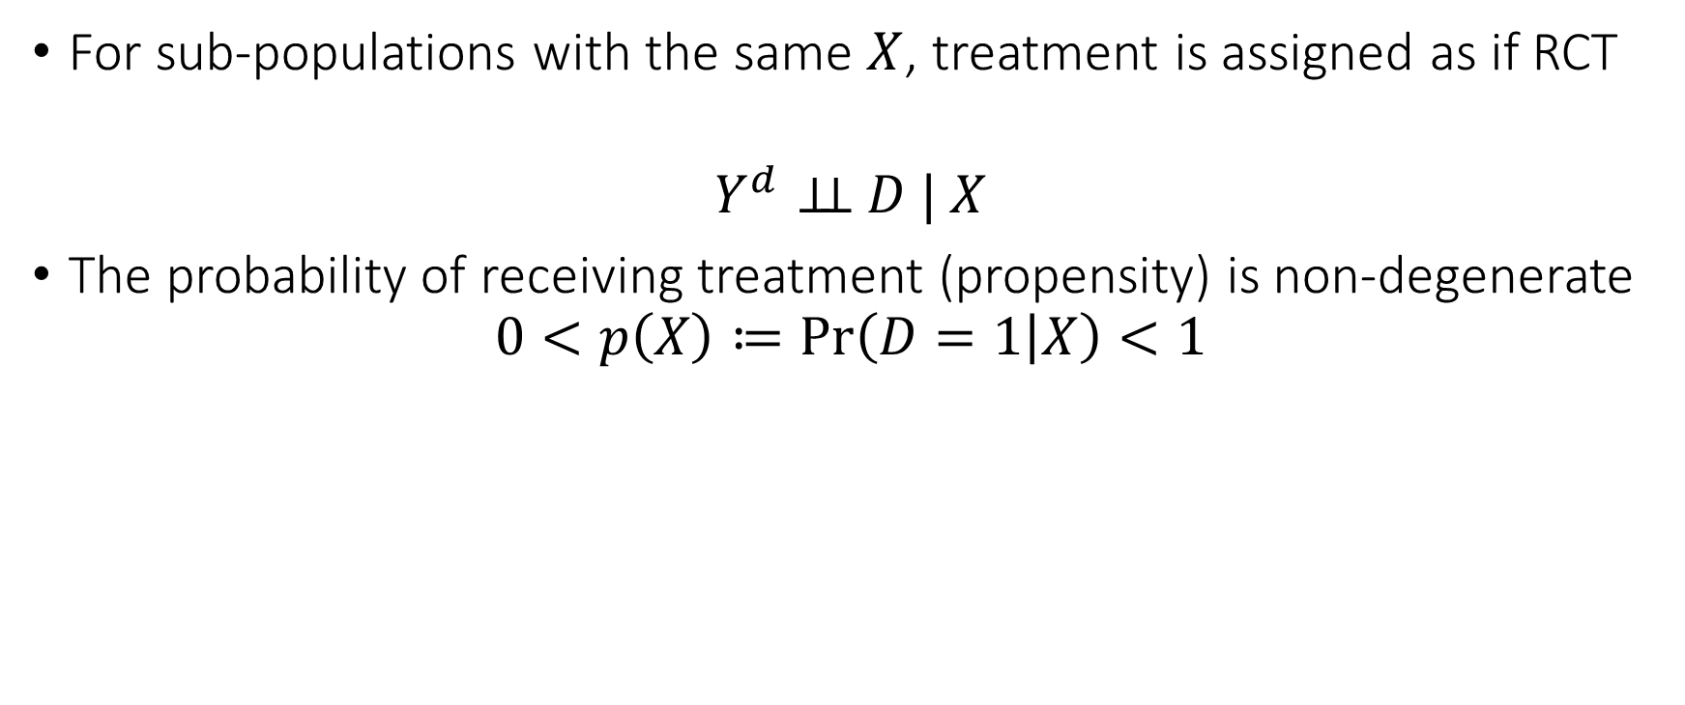
Conditional Ignorability
For sub-populations with the same $X$, treatment is assigned as if RCT
$$Y^{d}⊥⊥ D | X$$
The probability of receiving treatment (propensity) is non-degenerate
$$0<p\left(X\right)≔\operatorname{Pr}\left(D=1 | X\right)<1$$

Slide 14
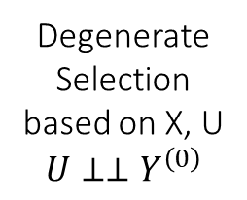
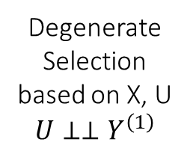
$$Y^{\left(0\right)}$$
$$Y^{\left(0\right)}|X$$
$$\sim$$
$$Y|D=0, X$$
$$Y|D=1,X$$
$$\sim$$
$$Y^{\left(1\right)}|X$$
$$Y^{\left(1\right)}$$
$$X=1$$
Degenerate Selection based on X, U
$$U⊥⊥Y^{\left(0\right)}$$
Degenerate Selection based on X, U
$$U⊥⊥Y^{\left(1\right)}$$
$$X=0$$
Counterfactual World
Observed World
Counterfactual World

Slide 15
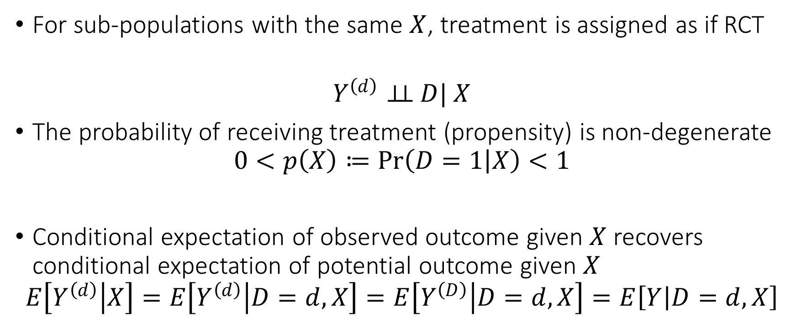
Conditional Ignorability
For sub-populations with the same $X$, treatment is assigned as if RCT
$$Y^{\left(d\right)}⊥⊥ D| X$$
The probability of receiving treatment (propensity) is non-degenerate
$$0<p\left(X\right)≔\operatorname{Pr}\left(D=1 | X\right)<1$$
Conditional expectation of observed outcome given $X$ recovers conditional expectation of potential outcome given $X$
$$E\left[Y^{\left(d\right)} | X\right]=E\left[Y^{\left(d\right)} | D=d,X\right]=E\left[Y^{\left(D\right)} | D=d,X\right]=E\left[Y | D=d,X\right]$$

Slide 16
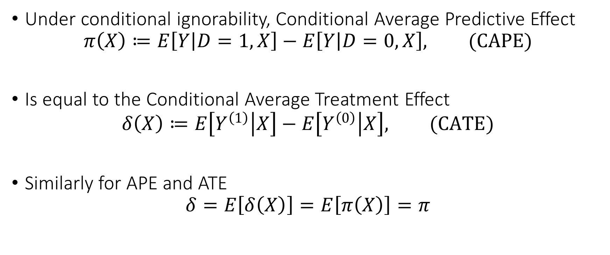
Identification of Conditional Average Treatment Effect
Under conditional ignorability, Conditional Average Predictive Effect
$$π\left(X\right)≔E\left[Y | D=1,X\right]−E\left[Y | D=0,X\right], (CAPE)$$
Is equal to the Conditional Average Treatment Effect
$$δ\left(X\right)≔E\left[Y^{\left(1\right)} | X\right]−E\left[Y^{\left(0\right)} | X\right], (CATE)$$
Similarly for APE and ATE
$$δ=E\left[δ\left(X\right)\right]=E\left[π\left(X\right)\right]=π$$

Slide 17
Causal Diagrams

Slide 18








RCTs and Causal Diagrams
Causal diagrams can help visualize how our assumptions imply the identification of a causal effect
First instances in work of Sewall and Philip Wright’28
Pioneered and fully developed by Pearl and Robins [80s-90s]
$$D$$
Easy to visualize that
$$Y^{\left(d\right)}⊥⊥ D$$
$$D$$
$$d$$
$$X$$
$$Y$$
$$X$$
$$Y^{\left(d\right)}$$
Causal Diagram (Graph)
Single World Intervention Graph (SWIG)

Slide 19

Conditional Ignorability and Causal Diagrams
Causal diagrams can help visualize how our assumptions imply the identification of a causal effect
First instances in work of Sewall and Philip Wright’28
Pioneered and fully developed by Pearl and Robins [80s-90s]
Easy to visualize that
$$Y^{\left(d\right)}⊥⊥ D$$
$$Y^{\left(d\right)}⊥⊥ D|X$$
$$D$$
$$D$$
$$d$$
$$X$$
$$Y$$
$$X$$
$$Y^{\left(d\right)}$$
Causal Diagram (Graph)
Single World Intervention Graph (SWIG)

Slide 20
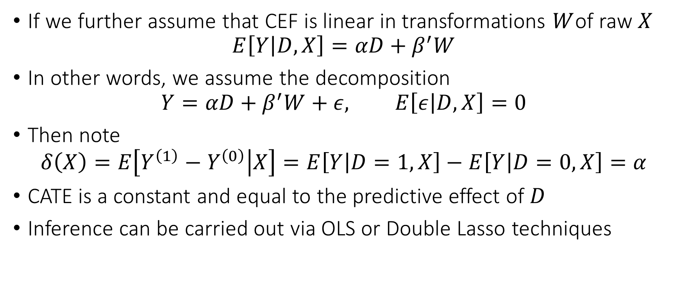
Connection to Linear Regression
If we further assume that CEF is linear in transformations $W$of raw $X$
$$E\left[Y | D,X\right]=αD+β^{′}W$$
In other words, we assume the decomposition
$$Y=αD+β^{′}W+ε, E\left[ε | D, X\right]=0$$
Then note
$$δ\left(X\right)=E\left[Y^{\left(1\right)}−Y^{\left(0\right)} | X\right]=E\left[Y | D=1,X\right]−E\left[Y | D=0,X\right]=α$$
CATE is a constant and equal to the predictive effect of $D$
Inference can be carried out via OLS or Double Lasso techniques

Slide 21
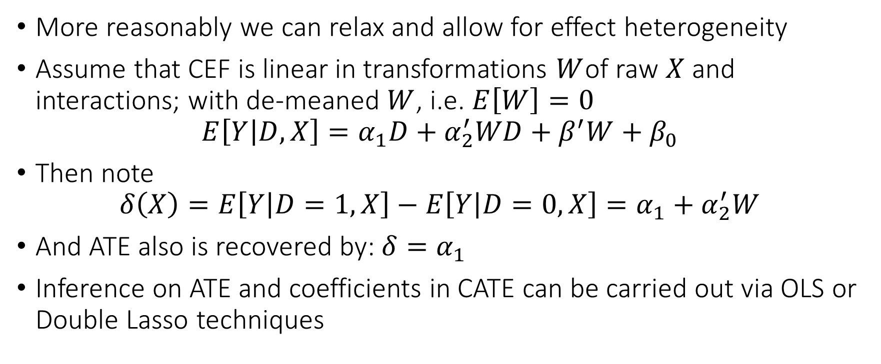
Connection to Linear Regression
More reasonably we can relax and allow for effect heterogeneity
Assume that CEF is linear in transformations $W$of raw $X$ and interactions; with de-meaned $W$, i.e. $E\left[W\right]=0$
$$E\left[Y | D,X\right]=α_{1}D+α_{2}^{′}WD+β^{′}W+β_{0}$$
Then note
$$δ\left(X\right)=E\left[Y | D=1,X\right]−E\left[Y | D=0,X\right]=α_{1}+α_{2}^{′}W$$
And ATE also is recovered by: $δ=α_{1}$
Inference on ATE and coefficients in CATE can be carried out via OLS or Double Lasso techniques

Slide 22
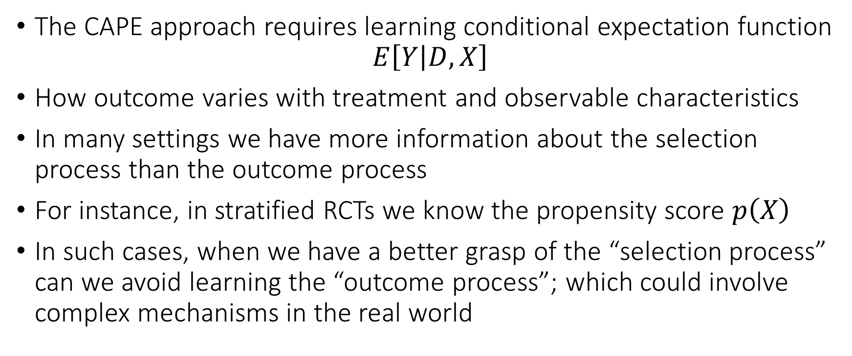
Identification via Propensity Scores
The CAPE approach requires learning conditional expectation function
$$E\left[Y | D,X\right]$$
How outcome varies with treatment and observable characteristics
In many settings we have more information about the selection process than the outcome process
For instance, in stratified RCTs we know the propensity score $p\left(X\right)$
In such cases, when we have a better grasp of the “selection process” can we avoid learning the “outcome process”; which could involve complex mechanisms in the real world

Slide 23


We know we are under-sampling from the blue points
Say we select a blue point with prob 1/4. We can duplicate any blue point four times
$$Y^{\left(0\right)}$$
$$Y^{\left(0\right)}|X$$
$$∼$$
$$Y|D=0, X$$
$$Y|D=0$$
$$Y|D=1$$
$$Y|D=1,X$$
$$∼$$
$$Y^{\left(1\right)}|X$$
$$Y^{\left(1\right)}$$
$$X=1$$
$$P\left(D=0 | X\right)$$
$$P\left(D=1 | X\right)$$
Selection based on X
Selection based on X
$$X=0$$
We know we are over-sampling from the blue points
Say we select an orange point with prob 3/4. We can duplicate any orange point 4/3 times
Counterfactual World
Observed World
Counterfactual World

Slide 24






$$Y^{\left(0\right)}$$
$$HY|D=0$$
$$HY|D=1$$
$$Y^{\left(1\right)}$$
$$P\left(D=0 | X=1\right)=1/4$$
$$P\left(D=1 | X=1\right)=3/4$$
$$P\left(D=0 | X\right)$$
$$P\left(D=1 | X\right)$$
Selection based on X
Selection based on X
$$P\left(D=0 | X=1\right)=3/4$$
$$P\left(D=1 | X=1\right)=1/4$$
Counterfactual World
Observed World
Counterfactual World

Slide 25
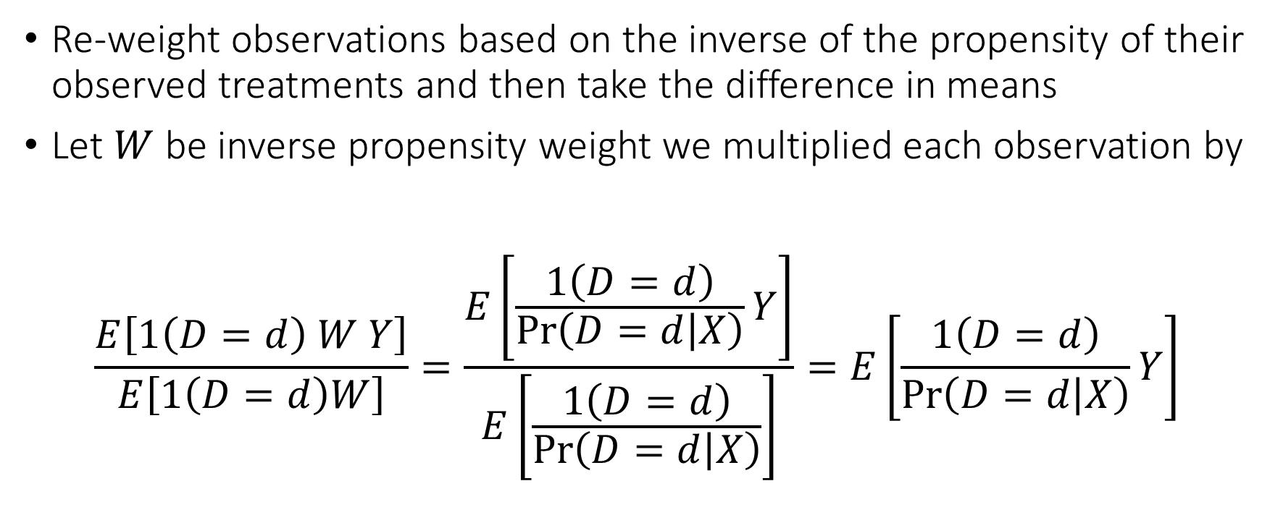
Identification via Propensity Scores
Re-weight observations based on the inverse of the propensity of their observed treatments and then take the difference in means
Let $W$ be inverse propensity weight we multiplied each observation by
$$\frac{E\left[1\left(D=d\right) W Y\right]}{E\left[1\left(D=d\right)W\right]}=\frac{E\left[\frac{1\left(D=d\right)}{\operatorname{Pr}\left(D=d | X\right)}Y\right]}{E\left[\frac{1\left(D=d\right)}{\operatorname{Pr}\left(D=d | X\right)}\right]}=E\left[\frac{1\left(D=d\right)}{\operatorname{Pr}\left(D=d | X\right)}Y\right]$$

Slide 26
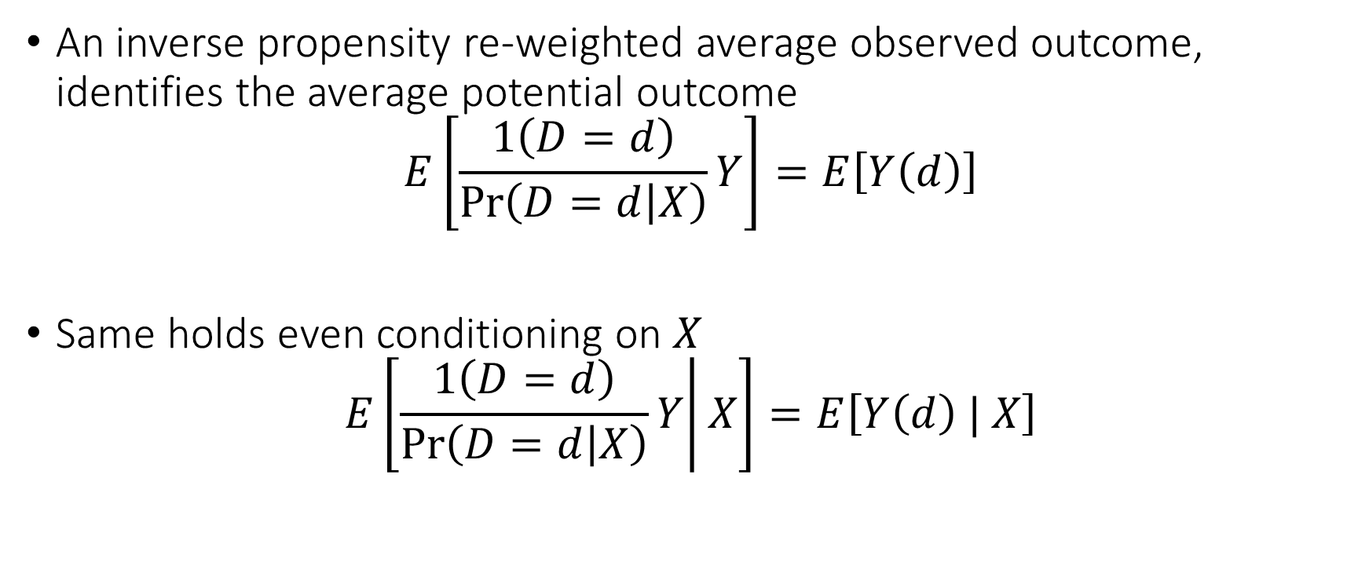
Horvitz-Thompson Reweighting
An inverse propensity re-weighted average observed outcome, identifies the average potential outcome
$$E\left[\frac{1\left(D=d\right)}{\operatorname{Pr}\left(D=d | X\right)}Y\right]=E\left[Y\left(d\right)\right]$$
Same holds even conditioning on $X$
$$E\left[\left.\frac{1\left(D=d\right)}{\operatorname{Pr}\left(D=d | X\right)}Y\right|X\right]=E\left[Y\left(d\right) | X\right]$$

Slide 27

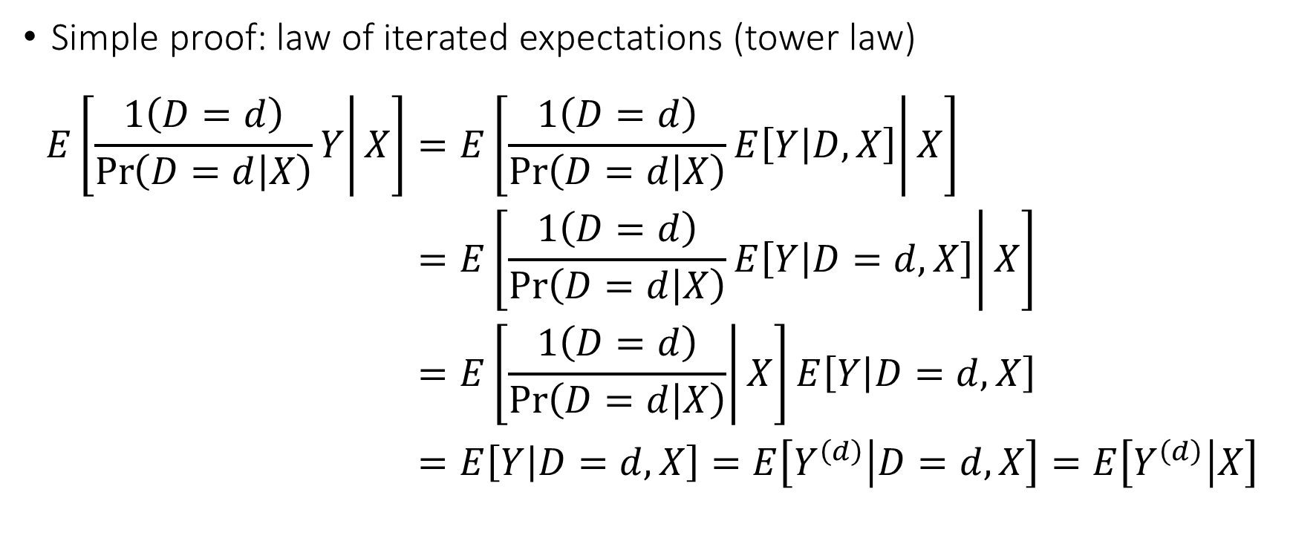
Horvitz-Thompson Reweighting
Tower Law. For any random variables $Z, V, U$
$$E\left[Z|V\right]=E\left[\left.E\left[Z | U,V\right]\right|V\right]$$
Simple proof: law of iterated expectations (tower law)
$$\begin{aligned}E\left[\left.\frac{1\left(D=d\right)}{\operatorname{Pr}\left(D=d | X\right)}Y\right|X\right]=&E\left[\left.\frac{1\left(D=d\right)}{\operatorname{Pr}\left(D=d | X\right)}E\left[Y | D,X\right]\right|X\right] \\ =&E\left[\left.\frac{1\left(D=d\right)}{\operatorname{Pr}\left(D=d | X\right)}E\left[Y | D=d,X\right]\right|X\right] \\ =&E\left[\left.\frac{1\left(D=d\right)}{\operatorname{Pr}\left(D=d | X\right)}\right|X\right]E\left[Y | D=d,X\right] \\ =&E\left[Y | D=d,X\right]=E\left[Y^{\left(d\right)} | D=d,X\right]=E\left[Y^{\left(d\right)} | X\right]\end{aligned}$$

Slide 28
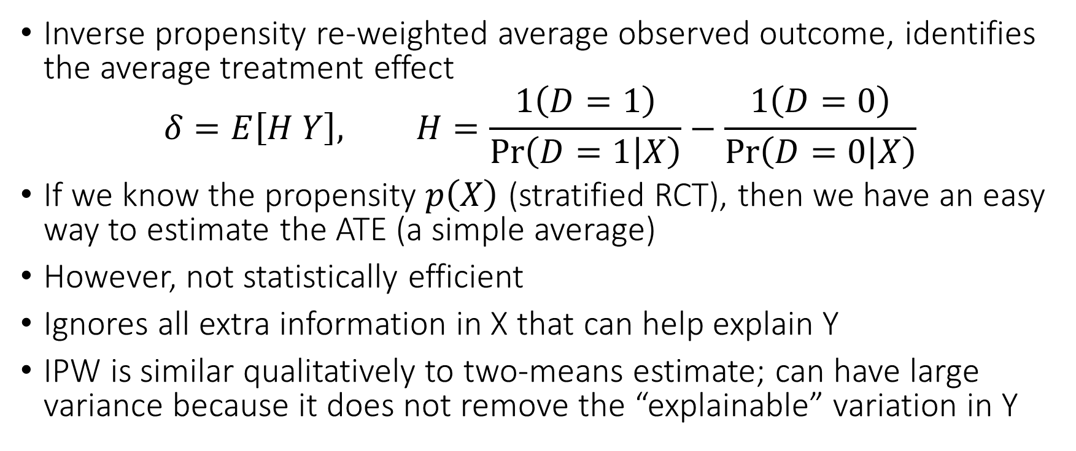
Horvitz-Thompson Reweighting
Inverse propensity re-weighted average observed outcome, identifies the average treatment effect
$$δ=E\left[H Y\right], H=\frac{1\left(D=1\right)}{\operatorname{Pr}\left(D=1 | X\right)}−\frac{1\left(D=0\right)}{\operatorname{Pr}\left(D=0 | X\right)}$$
If we know the propensity $p\left(X\right)$ (stratified RCT), then we have an easy way to estimate the ATE (a simple average)
However, not statistically efficient
Ignores all extra information in X that can help explain Y
IPW is similar qualitatively to two-means estimate; can have large variance because it does not remove the “explainable” variation in Y

Slide 29
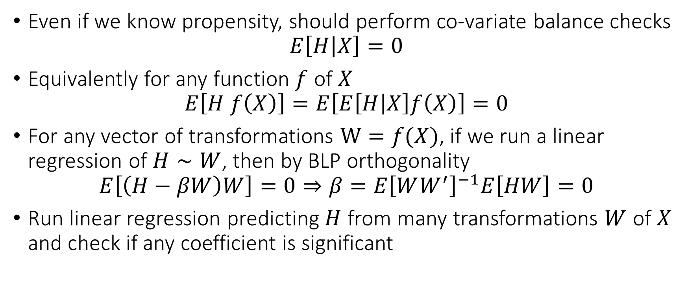
Sensitive to Violations of Randomization
Even if we know propensity, should perform co-variate balance checks
$$E\left[H | X\right]=0$$
Equivalently for any function $f$ of $X$
$$E\left[H f\left(X\right)\right]=E\left[E\left[H | X\right]f\left(X\right)\right]=0$$
For any vector of transformations $W=f(X)$, if we run a linear regression of $H∼W$, then by BLP orthogonality
$$E\left[\left(H−βW\right)W\right]=0⇒β=E{\left[WW^{′}\right]}^{−1}E\left[HW\right]=0$$
Run linear regression predicting $H$ from many transformations $W$ of $X$ and check if any coefficient is significant

Slide 30
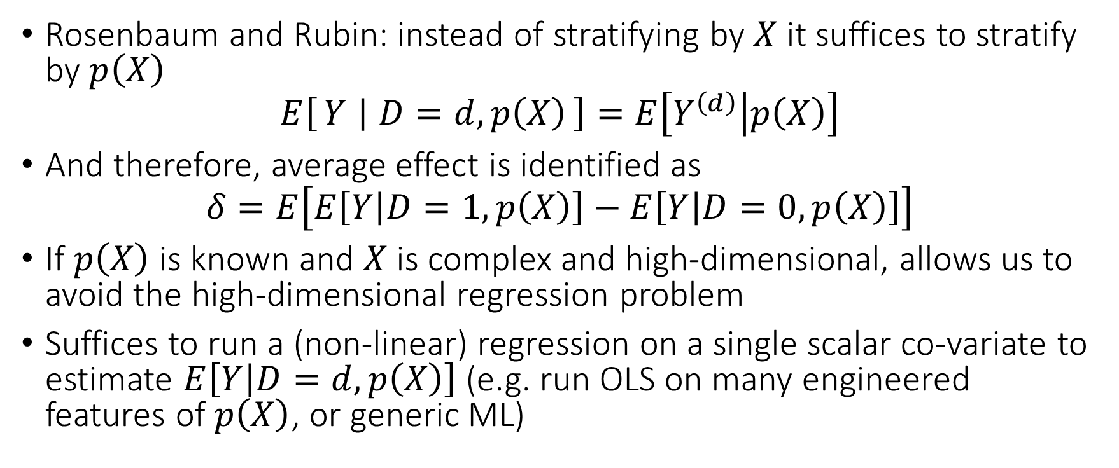
Alternative: Conditioning on Propensity
Rosenbaum and Rubin: instead of stratifying by $X$ it suffices to stratify by $p\left(X\right)$
$$E\left[Y ∣ D=d,p\left(X\right)\right]=E\left[Y^{\left(d\right)} | p\left(X\right)\right]$$
And therefore, average effect is identified as
$$δ=E\left[E\left[Y | D=1,p\left(X\right)\right]−E\left[Y | D=0,p\left(X\right)\right]\right]$$
If $p\left(X\right)$ is known and $X$ is complex and high-dimensional, allows us to avoid the high-dimensional regression problem
Suffices to run a (non-linear) regression on a single scalar co-variate to estimate $E\left[Y | D=d,p\left(X\right)\right]$ (e.g. run OLS on many engineered features of $p\left(X\right)$, or generic ML)

Slide 31
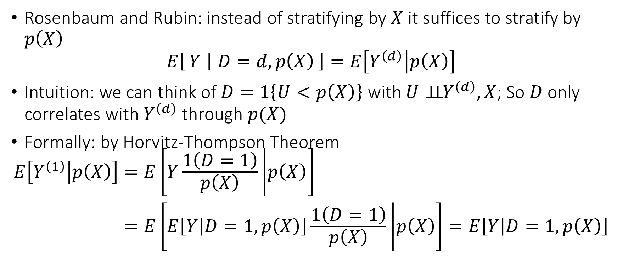
Alternative: Conditioning on Propensity
Rosenbaum and Rubin: instead of stratifying by $X$ it suffices to stratify by $p\left(X\right)$
$$E\left[Y ∣ D=d,p\left(X\right)\right]=E\left[Y^{\left(d\right)} | p\left(X\right)\right]$$
Intuition: we can think of $D=1\left\{U<p\left(X\right)\right\}$ with $U⊥⊥{ Y}^{\left(d\right)},X$; So $D$ only correlates with $Y^{\left(d\right)}$ through $p(X)$
Formally: by Horvitz-Thompson Theorem
$$\begin{aligned}E\left[Y^{\left(1\right)} | p\left(X\right)\right]=&E\left[Y\frac{1\left(D=1\right)}{p\left(X\right)} | p\left(X\right)\right] \\ =&E\left[E\left[Y | D=1,p\left(X\right)\right]\frac{1\left(D=1\right)}{p\left(X\right)} | p\left(X\right)\right]=E\left[Y | D=1,p\left(X\right)\right]\end{aligned}$$

Slide 32
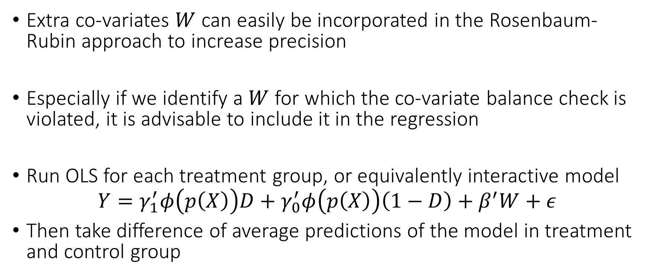
Improving precision
Extra co-variates $W$ can easily be incorporated in the Rosenbaum-Rubin approach to increase precision
Especially if we identify a $W$ for which the co-variate balance check is violated, it is advisable to include it in the regression
Run OLS for each treatment group, or equivalently interactive model
$$Y=γ_{1}^{′}φ\left(p\left(X\right)\right)D+γ_{0}^{′}φ\left(p\left(X\right)\right)\left(1−D\right)+β^{′}W+ε$$
Then take difference of average predictions of the model in treatment and control group

Slide 33
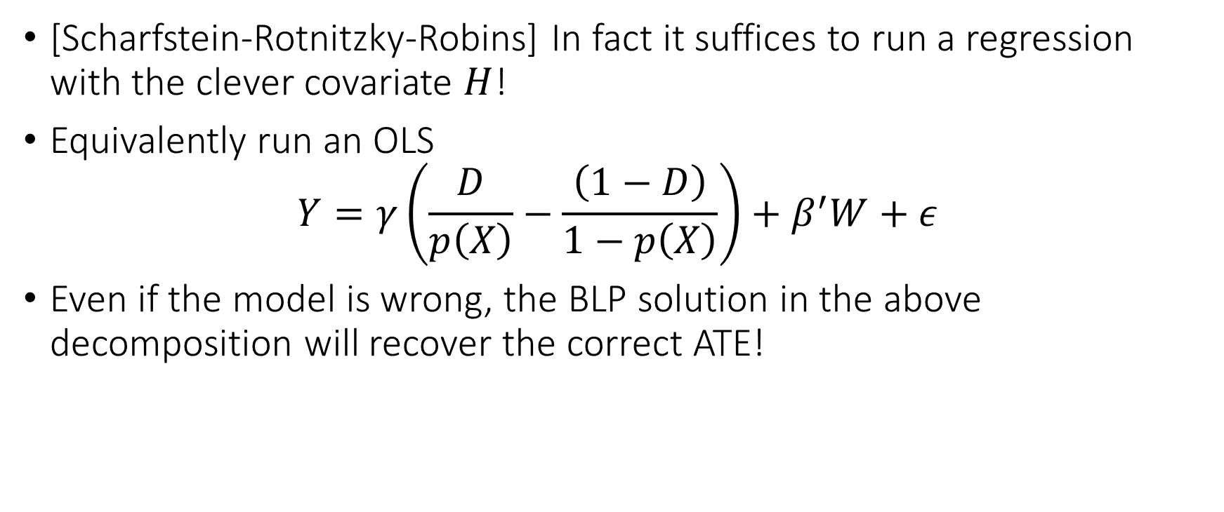
Clever Co-Variate Approach
[Scharfstein-Rotnitzky-Robins] In fact it suffices to run a regression with the clever covariate $H$!
Equivalently run an OLS
$$Y=γ\left(\frac{D}{p\left(X\right)}−\frac{\left(1−D\right)}{1−p\left(X\right)}\right)+β^{′}W+ε$$
Even if the model is wrong, the BLP solution in the above decomposition will recover the correct ATE!

Slide 34
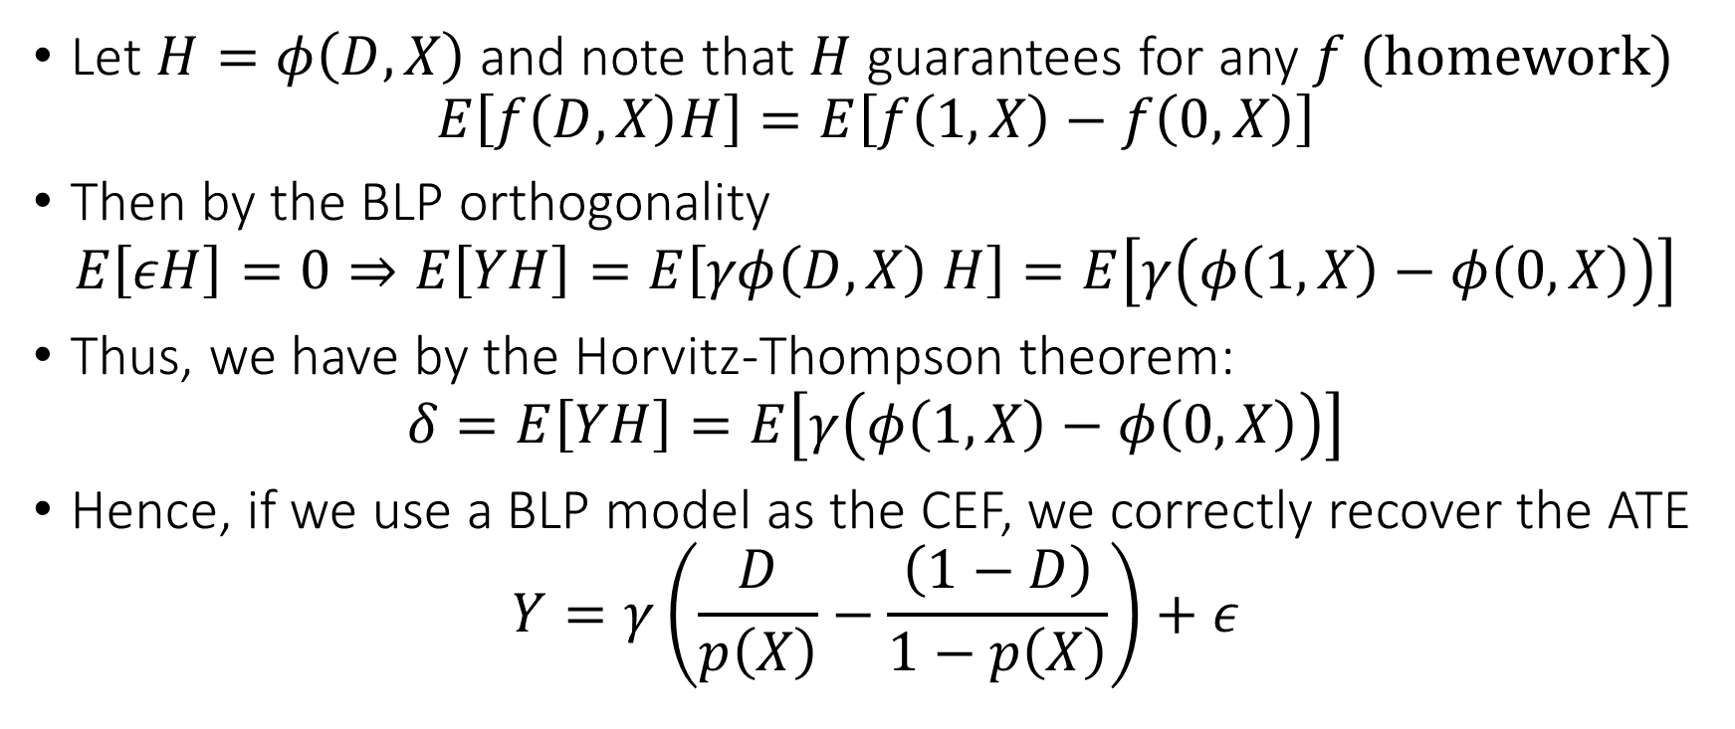
Clever Co-Variate Approach
Let $H=φ\left(D,X\right)$ and note that $H$ guarantees for any $f$ (homework)
$$E\left[f\left(D,X\right)H\right]=E\left[f\left(1,X\right)−f\left(0,X\right)\right]$$
Then by the BLP orthogonality
$$E\left[εH\right]=0⇒E\left[YH\right]=E\left[γφ\left(D,X\right) H\right]=E\left[γ\left(φ\left(1,X\right)−φ\left(0,X\right)\right)\right]$$
Thus, we have by the Horvitz-Thompson theorem:
$$δ=E\left[YH\right]=E\left[γ\left(φ\left(1,X\right)−φ\left(0,X\right)\right)\right]$$
Hence, if we use a BLP model as the CEF, we correctly recover the ATE
$$Y=γ\left(\frac{D}{p\left(X\right)}−\frac{\left(1−D\right)}{1−p\left(X\right)}\right)+ε$$

Slide 35
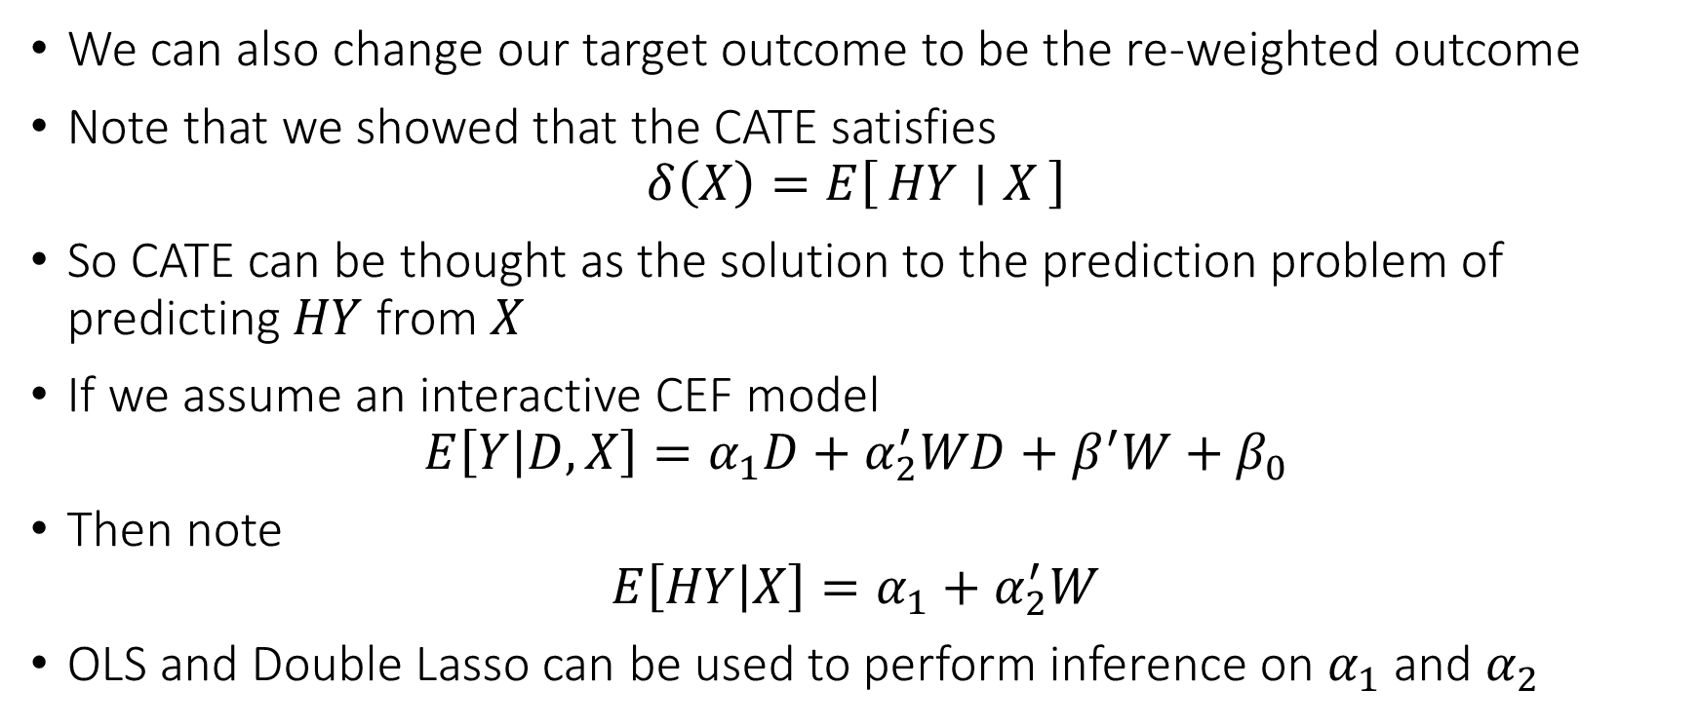
Clever Target Outcome Approach
We can also change our target outcome to be the re-weighted outcome
Note that we showed that the CATE satisfies
$$δ\left(X\right)=E\left[HY ∣ X\right]$$
So CATE can be thought as the solution to the prediction problem of predicting $HY$ from $X$
If we assume an interactive CEF model
$$E\left[Y | D,X\right]=α_{1}D+α_{2}^{′}WD+β^{′}W+β_{0}$$
Then note
$$E\left[HY | X\right]=α_{1}+α_{2}^{′}W$$
OLS and Double Lasso can be used to perform inference on $α_{1}$ and $α_{2}$

Slide 36
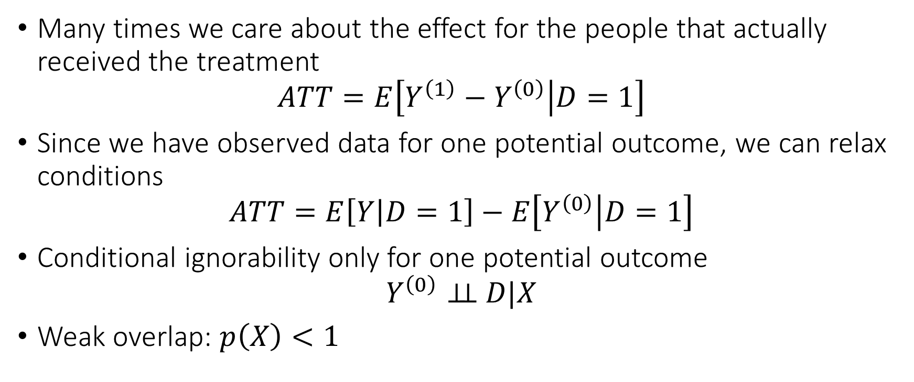
Average Treatment Effect on the Treated ATT
Many times we care about the effect for the people that actually received the treatment
$$ATT=E\left[Y^{\left(1\right)}−Y^{\left(0\right)} | D=1\right]$$
Since we have observed data for one potential outcome, we can relax conditions
$$ATT=E\left[Y | D=1\right]−E\left[Y^{\left(0\right)} | D=1\right]$$
Conditional ignorability only for one potential outcome
$$Y^{\left(0\right)}⊥⊥ D|X$$
Weak overlap: $p\left(X\right)<1$

Slide 37
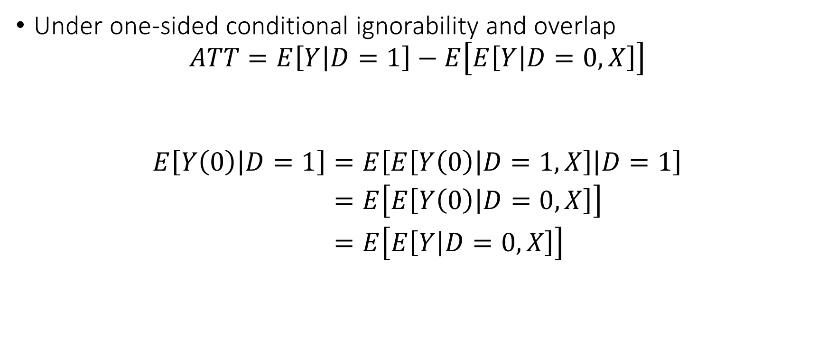
Identification of ATT
Under one-sided conditional ignorability and overlap
$$ATT=E\left[Y | D=1\right]−E\left[E\left[Y | D=0,X\right]\right]$$
$$\begin{aligned}E\left[Y\left(0\right) | D=1\right]=&E\left[E\left[Y\left(0\right) | D=1,X\right] | D=1\right] \\ =&E\left[E\left[Y\left(0\right) | D=0,X\right]\right] \\ =&E\left[E\left[Y | D=0,X\right]\right]\end{aligned}$$

Slide 38
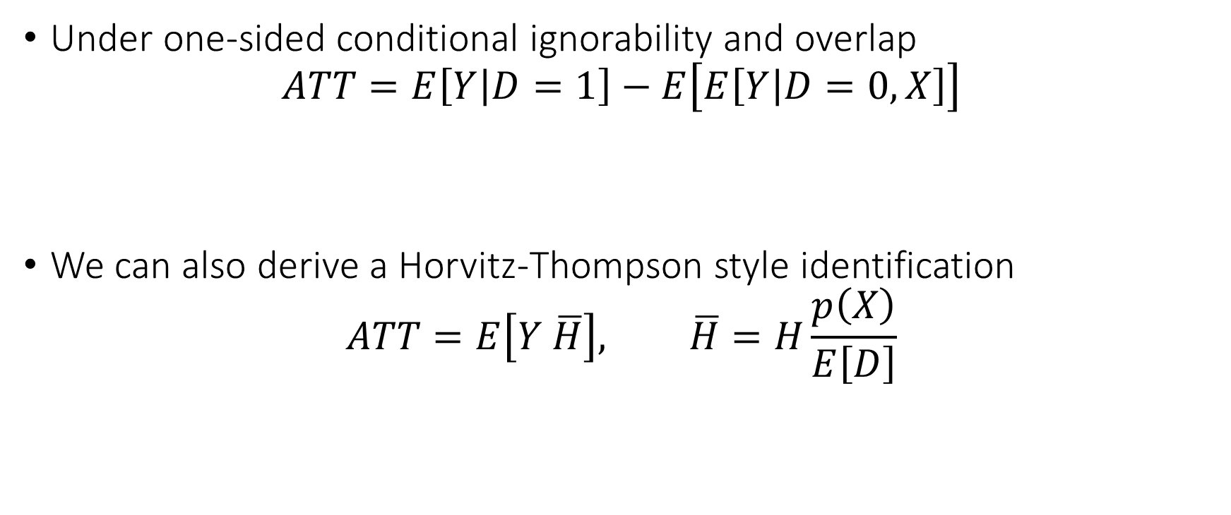
Identification of ATT
Under one-sided conditional ignorability and overlap
$$ATT=E\left[Y | D=1\right]−E\left[E\left[Y | D=0,X\right]\right]$$
We can also derive a Horvitz-Thompson style identification
$$ATT=E\left[Y \overline{H}\right], \overline{H}=H\frac{p\left(X\right)}{E\left[D\right]}$$

