Slide 1
MS&E 228: Unobserved Confounding and Instruments
Vasilis Syrgkanis
MS&E, Stanford

Slide 2
Causal Inference with Experiments
Prediction with Linear Models
Prediction with High-Dim Linear Models
Inference on Causal and Predictive Effects with High-Dim Linear Models
Potential Outcomes and Conditional Ignorability
Structural Equation Models and Conditional Exogeneity
Directed Acyclic Graphs
Prediction with Non-Linear Models
Inference on Causal Effects with Non-Linear Models
Un-observed Confounding and Instruments
Estimation of Heterogeneous Causal Effects
Identification of Causal Effects in Longitudinal Data
Linear Predictive Models and Statistical Inference
Causal Identification in Observational Data
Non-Linear Predictive Models and Statistical Inference
Topics

Slide 3
Causal Inference with Experiments
Prediction with Linear Models
Prediction with High-Dim Linear Models
Inference on Causal and Predictive Effects with High-Dim Linear Models
Potential Outcomes and Conditional Ignorability
Structural Equation Models and Conditional Exogeneity
Directed Acyclic Graphs
Prediction with Non-Linear Models
Inference on Causal Effects with Non-Linear Models
Un-observed Confounding and Instruments
Estimation of Heterogeneous Causal Effects
Identification of Causal Effects in Longitudinal Data
Linear Predictive Models and Statistical Inference
Causal Identification in Observational Data
Non-Linear Predictive Models and Statistical Inference
Topics

Slide 4
Goals for Today
Meta-Learners for Heterogeneous Treatment Effects
Neural Network Approaches for Heterogeneous Effects
Out-of-sample validation and testing

Slide 5








Causal Inference Pipeline
Data Collection
Estimation
(training)
Validation
(testing)
Domain Assumption Elicitation
Identification
Inference (Confidence Intervals)
DAGs/ASEMs
Construct estimate $\hat{g}\left(d,z\right)$ of predictive model
$$E\left[Y ∣ D=d,Z=z\right]$$
Estimate mean counterfactual
$${\hat{a}}_{d}=E_{n}\left[\hat{g}\left(d,Z\right)\right]$$
Theory
$$a_{d}$$
$$E\left[E\left[Y | D=d,Z\right]\right]$$
$$D$$
$$=$$
$$a_{d}∈{\hat{a}}_{d}±2\hat{σ}$$
$$Z$$
$$Y$$
Who should we treat?
Sensitivity Analysis
Practice
$$a_{d}∈{\hat{a}}_{d}±(2\hat{σ}+ε)$$
Adaptive Experiments
Decision
Policy

Slide 6
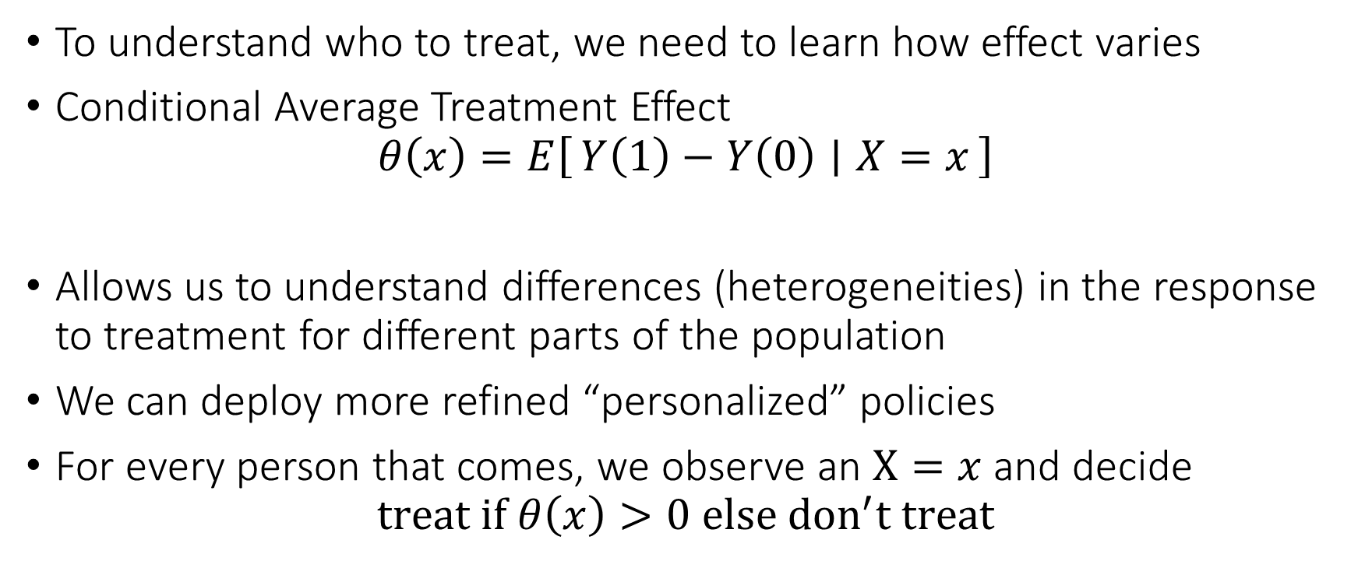
Personalized (Refined) Policies
To understand who to treat, we need to learn how effect varies
Conditional Average Treatment Effect
$$θ\left(x\right)=E\left[Y\left(1\right)−Y\left(0\right) ∣ X=x\right]$$
Allows us to understand differences (heterogeneities) in the response to treatment for different parts of the population
We can deploy more refined “personalized” policies
For every person that comes, we observe an $X=x$ and decide
$$treat if θ\left(x\right)>0 else don^{′}t treat$$

Slide 7
The intrinsic hardness of CATE
Estimating CATE at least as hard as estimating the best prediction rule
Inherently harder than estimating an “average”
So far for our target causal quantities we wanted fast estimation rates and confidence intervals
We were only ok with “decent” estimation rates for the auxiliary (nuisance) predictive models that entered our analysis
We might want to relax our goals…

Slide 8
Different Approaches to Relaxing our Goals
Goal 1: Maybe estimate a simpler projection (e.g. analogue of BLP)
Goal 2: Confidence intervals for predictions of this simple projection
Goal 3: Simultaneous confidence bands for predictions of this simple projection
Goal 4: Estimation error rate for the true CATE
Goal 5: Confidence intervals for the prediction of a CATE model
Goal 6: Simultaneous confidence bands for joint predictions of CATE model
Policy Learning
Goal 7: Go after optimal simple treatment policies; give me a policy with value close to the best
Goal 8: Inference on value of candidate treatment policies
Goal 9: Inference on value of optimal policy
Goal 10: Identify responder or heterogeneous sub-groups; policies with statistical significance;
Linear Doubly Robust Learner
Meta-learner approaches: S-Learner, T-Learner, X-Learner, R-Learner, DR-Learner
Neural Network approaches: TARNet, CFR
Random Forest approaches: BART
Modified (honest) ML methods: Generalized Random Forest, Orthogonal Random Forest, Sub-sampled Nearest Neighbor Regression
?? (only classical non-parametric statistic results on confidence bands of non-parametric functions)
Doubly Robust Policy Learning
Doubly Robust Policy Evaluation

Slide 9
Different Approaches to Relaxing our Goals
Goal 1: Maybe estimate a simpler projection (e.g. analogue of BLP)
Goal 2: Confidence intervals for predictions of this simple projection
Goal 3: Simultaneous confidence bands for predictions of this simple projection
Goal 4: Estimation error rate for the true CATE
Goal 5: Confidence intervals for the prediction of a CATE model
Goal 6: Simultaneous confidence bands for joint predictions of CATE model
Policy Learning
Goal 7: Go after optimal simple treatment policies; give me a policy with value close to the best
Goal 8: Inference on value of candidate treatment policies
Goal 9: Inference on value of optimal policy
Goal 10: Identify responder or heterogeneous sub-groups; policies with statistical significance;
Linear Doubly Robust Learner
Meta-learner approaches: S-Learner, T-Learner, X-Learner, R-Learner, DR-Learner
Neural Network approaches: TARNet, CFR
Random Forest approaches: BART
Modified (honest) ML methods: Generalized Random Forest, Orthogonal Random Forest, Sub-sampled Nearest Neighbor Regression
?? (only classical non-parametric statistic results on confidence bands of non-parametric functions)
Doubly Robust Policy Learning
Doubly Robust Policy Evaluation

Slide 10
Meta-Learning Approaches for CATE

Slide 11
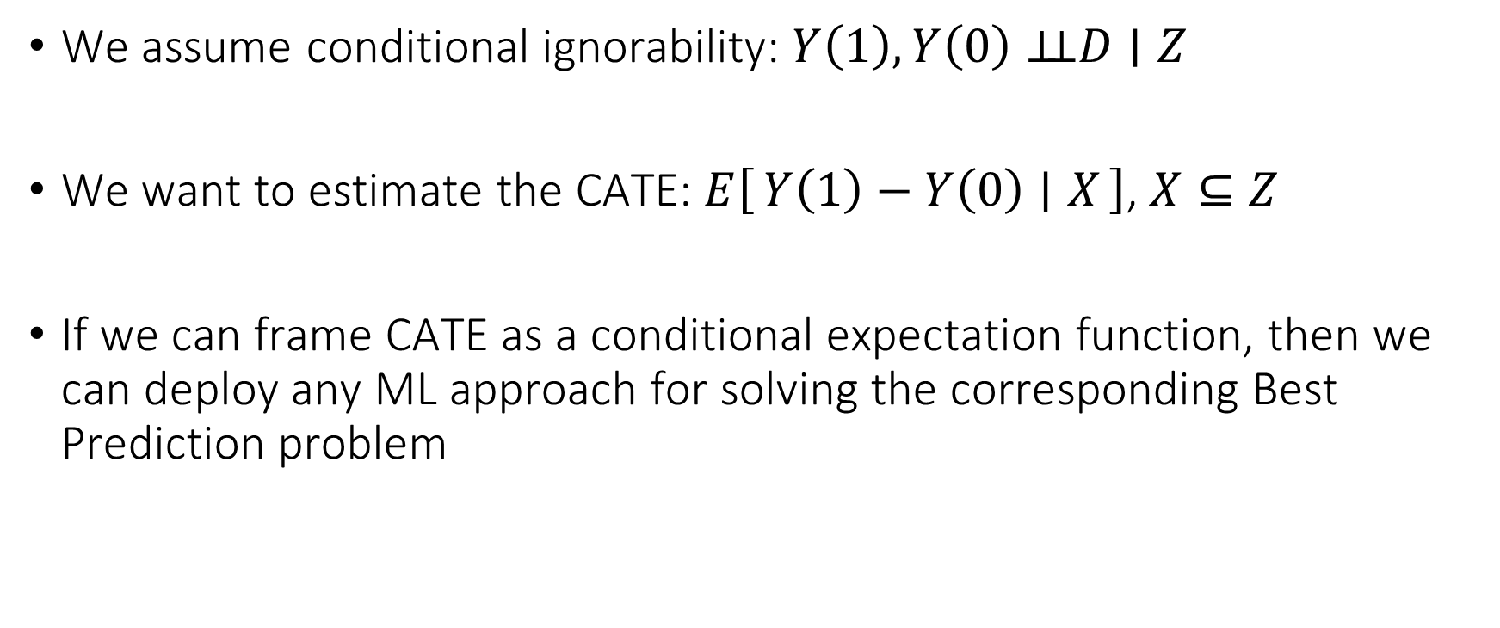
Meta-Learning Idea
We assume conditional ignorability: $Y\left(1\right),Y\left(0\right)⊥⊥D∣Z$
We want to estimate the CATE: $E\left[Y\left(1\right)−Y\left(0\right) ∣ X\right]$, $X⊆Z$
If we can frame CATE as a conditional expectation function, then we can deploy any ML approach for solving the corresponding Best Prediction problem

Slide 12
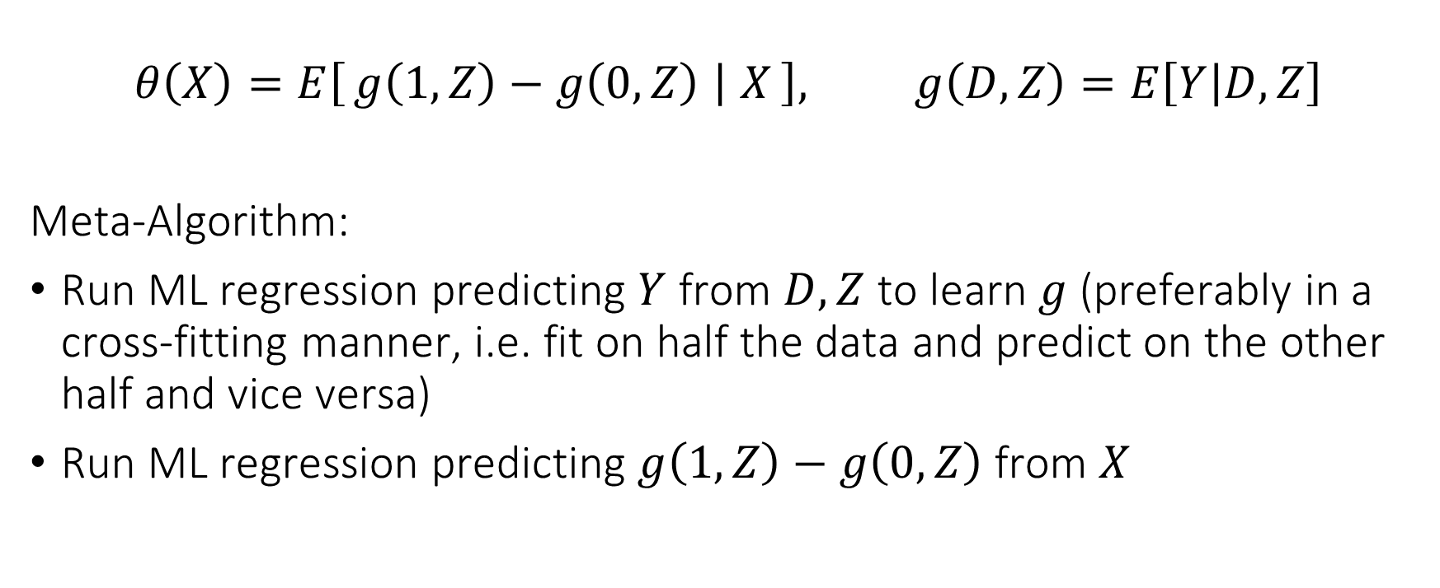
Single Learner (S-Learner)
$$θ\left(X\right)=E\left[g\left(1, Z\right)−g\left(0, Z\right) ∣ X\right], g\left(D,Z\right)=E\left[Y | D,Z\right]$$
Meta-Algorithm:
Run ML regression predicting $Y$ from $D, Z$ to learn $g$ (preferably in a cross-fitting manner, i.e. fit on half the data and predict on the other half and vice versa)
Run ML regression predicting $g\left(1,Z\right)−g\left(0,Z\right)$ from $X$

Slide 13
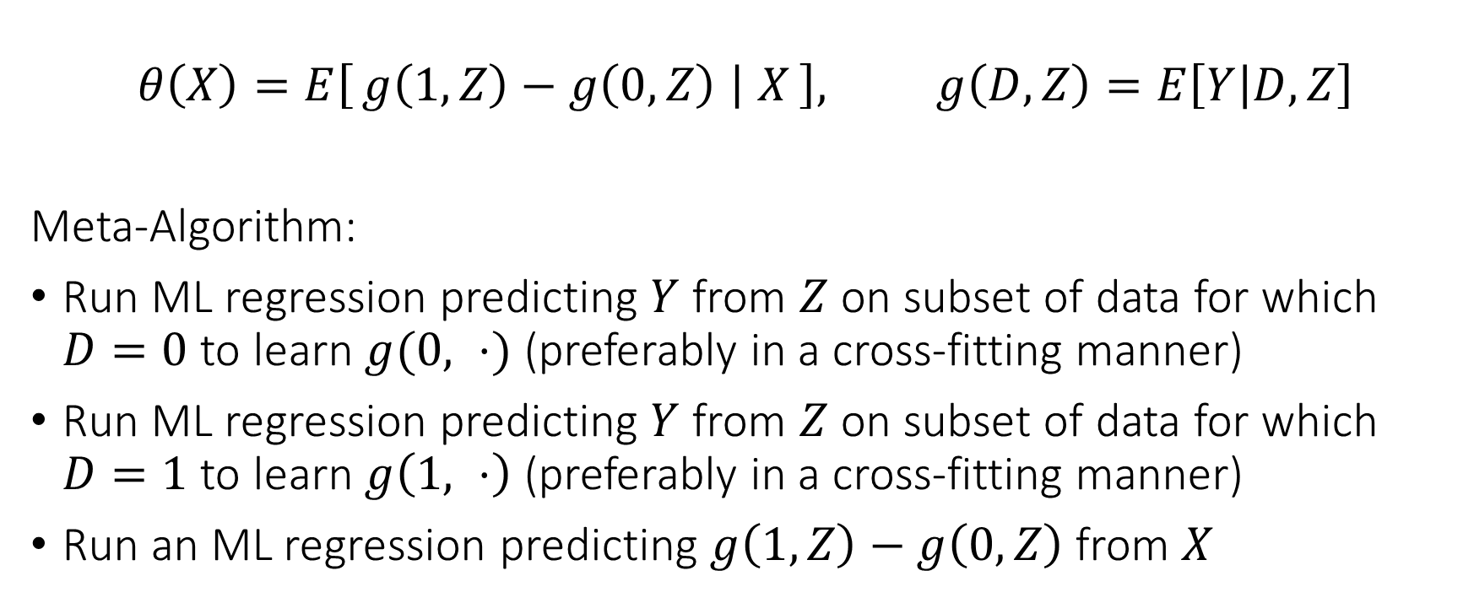
Two Learner (T-Learner)
$$θ\left(X\right)=E\left[g\left(1, Z\right)−g\left(0, Z\right) ∣ X\right], g\left(D,Z\right)=E\left[Y | D,Z\right]$$
Meta-Algorithm:
Run ML regression predicting $Y$ from $Z$ on subset of data for which $D=0$ to learn $g(0, ⋅)$ (preferably in a cross-fitting manner)
Run ML regression predicting $Y$ from $Z$ on subset of data for which $D=1$ to learn $g\left(1, ⋅\right)$ (preferably in a cross-fitting manner)
Run an ML regression predicting $g\left(1, Z\right)−g\left(0,Z\right)$ from $X$

Slide 14
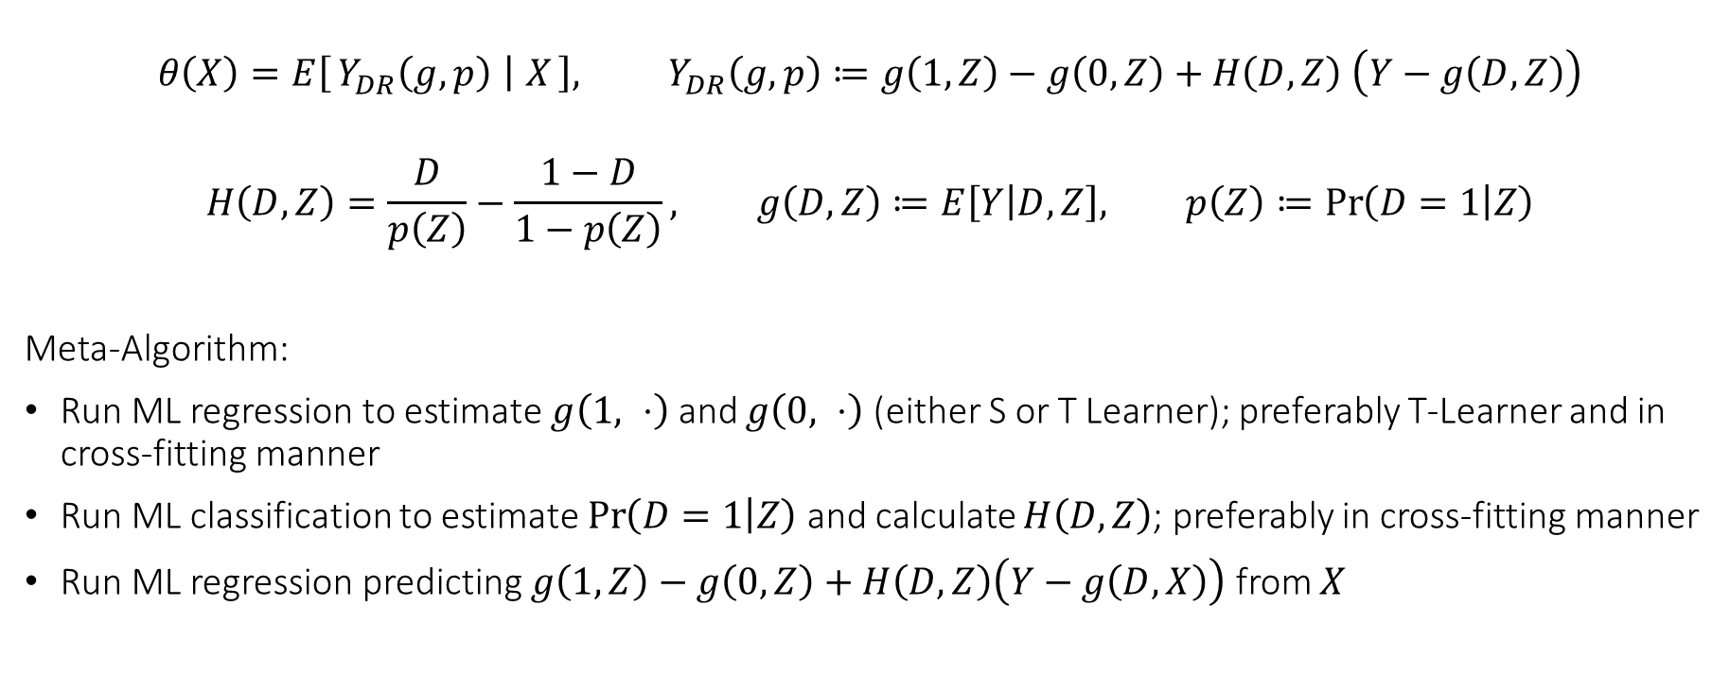
Doubly Robust Learner (DR-Learner)
$$θ\left(X\right)=E\left[Y_{DR}\left(g,p\right) ∣ X\right], Y_{DR}\left(g,p\right)≔g\left(1, Z\right)−g\left(0, Z\right)+H\left(D,Z\right) \left(Y−g\left(D,Z\right)\right)$$
$$H\left(D,Z\right)=\frac{D}{p\left(Z\right)}−\frac{1−D}{1−p\left(Z\right)}, g\left(D,Z\right)≔E\left[Y | D,Z\right], p\left(Z\right)≔\operatorname{Pr}\left(D=1 | Z\right)$$
Meta-Algorithm:
Run ML regression to estimate $g\left(1, ⋅\right)$ and $g\left(0, ⋅\right)$ (either S or T Learner); preferably T-Learner and in cross-fitting manner
Run ML classification to estimate $\operatorname{Pr}\left(D=1 | Z\right)$ and calculate $H\left(D, Z\right)$; preferably in cross-fitting manner
Run ML regression predicting $g\left(1, Z\right)−g\left(0, Z\right)+H\left(D,Z\right)\left(Y−g\left(D,X\right)\right)$ from $X$

Slide 15
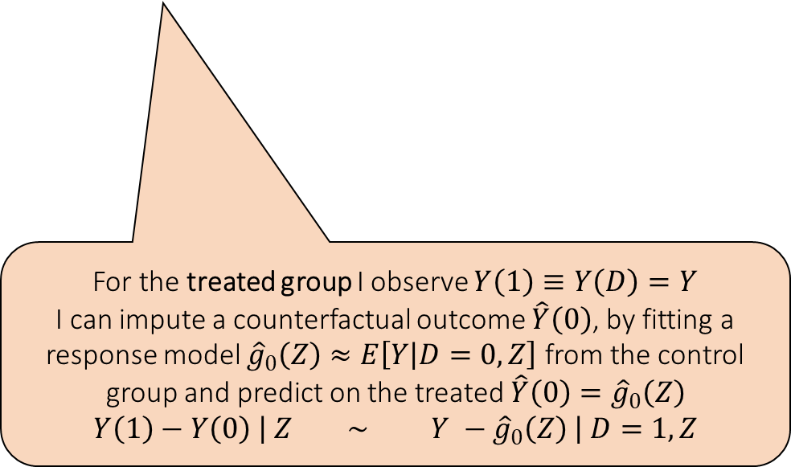

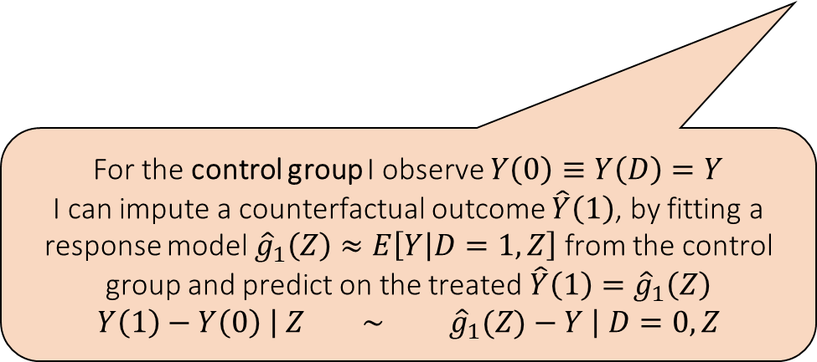
Cross Learner (X-Learner)
$$τ\left(Z\right)=τ_{1}\left(Z\right)≔E\left[Y−E\left[Y ∣ D=0,Z\right] ∣ D=1, Z\right]$$
$$τ\left(Z\right)=τ_{0}\left(Z\right)≔E\left[E\left[Y ∣ D=1,Z\right]−Y ∣ D=0, Z\right]$$
For the control group I observe $Y\left(0\right)≡Y\left(D\right)=Y$
I can impute a counterfactual outcome $\hat{Y}\left(1\right)$, by fitting a response model ${\hat{g}}_{1}\left(Z\right)≈E\left[Y | D=1,Z\right]$ from the control group and predict on the treated $\hat{Y}\left(1\right)={\hat{g}}_{1}\left(Z\right)$
$$Y\left(1\right)−Y\left(0\right) \left| Z ∼ {\hat{g}}_{1}(Z)−Y \right| D=0, Z$$
For the treated group I observe $Y\left(1\right)≡Y\left(D\right)=Y$
I can impute a counterfactual outcome $\hat{Y}\left(0\right)$, by fitting a response model ${\hat{g}}_{0}\left(Z\right)≈E\left[Y | D=0,Z\right]$ from the control group and predict on the treated $\hat{Y}\left(0\right)={\hat{g}}_{0}\left(Z\right)$
$$Y\left(1\right)−Y\left(0\right) \left| Z ∼ Y −{\hat{g}}_{0}\left(Z\right) \right| D=1, Z$$

Slide 16
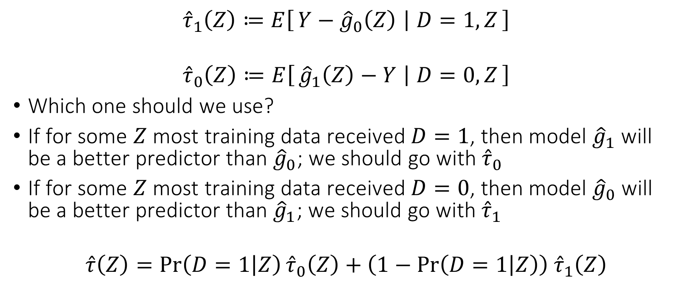
Cross Learner (X-Learner)
$${\hat{τ}}_{1}\left(Z\right)≔E\left[Y−{\hat{g}}_{0}\left(Z\right) ∣ D=1, Z\right]$$
$${\hat{τ}}_{0}\left(Z\right)≔E\left[{\hat{g}}_{1}\left(Z\right)−Y ∣ D=0, Z\right]$$
Which one should we use?
If for some $Z$ most training data received $D=1$, then model ${\hat{g}}_{1}$ will be a better predictor than ${\hat{g}}_{0}$; we should go with ${\hat{τ}}_{0}$
If for some $Z$ most training data received $D=0$, then model ${\hat{g}}_{0}$ will be a better predictor than ${\hat{g}}_{1}$; we should go with ${\hat{τ}}_{1}$
$$\hat{τ}\left(Z\right)=\operatorname{Pr}\left(D=1 | Z\right){\hat{τ}}_{0}\left(Z\right)+\left(1−\operatorname{Pr}\left(D=1 | Z\right)\right) {\hat{τ}}_{1}\left(Z\right)$$

Slide 17
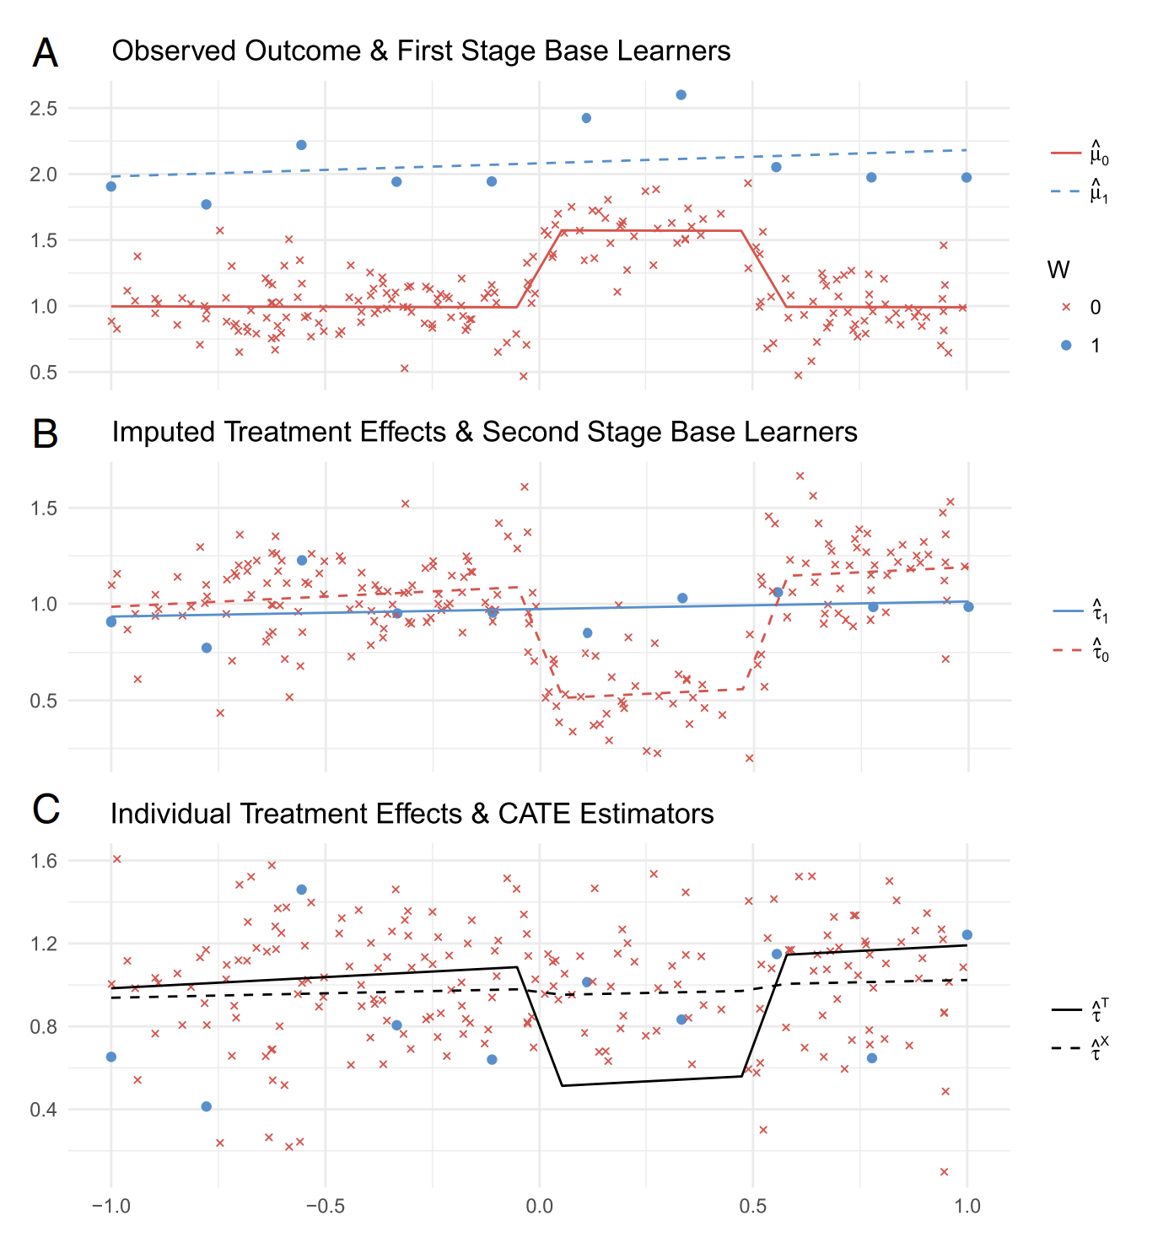
X-Learner Kunzel et al, 2019

Slide 18
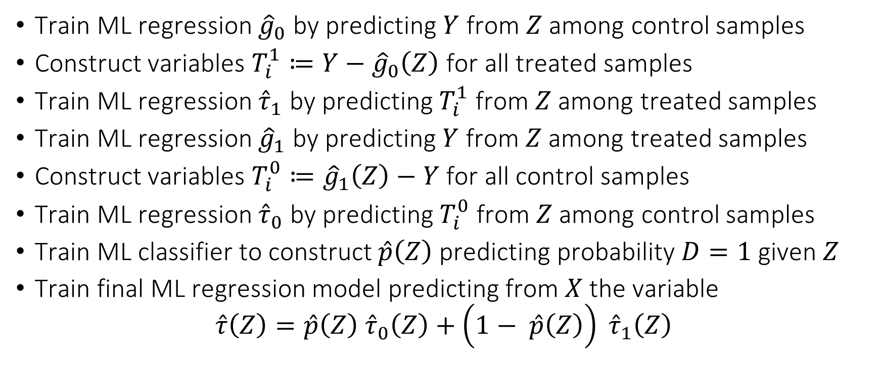
Cross Learner (X-Learner) Meta Algorithm
Train ML regression ${\hat{g}}_{0}$ by predicting $Y$ from $Z$ among control samples
Construct variables $T_{i}^{1}≔Y−{\hat{g}}_{0}\left(Z\right)$ for all treated samples
Train ML regression ${\hat{τ}}_{1}$ by predicting $T_{i}^{1}$ from $Z$ among treated samples
Train ML regression ${\hat{g}}_{1}$ by predicting $Y$ from $Z$ among treated samples
Construct variables $T_{i}^{0}≔{\hat{g}}_{1}\left(Z\right)−Y$ for all control samples
Train ML regression ${\hat{τ}}_{0}$ by predicting $T_{i}^{0}$ from $Z$ among control samples
Train ML classifier to construct $\hat{p}\left(Z\right)$ predicting probability $D=1$ given $Z$
Train final ML regression model predicting from $X$ the variable
$$\hat{τ}\left(Z\right)=\hat{p}\left(Z\right) {\hat{τ}}_{0}\left(Z\right)+\left(1− \hat{p}\left(Z\right)\right) {\hat{τ}}_{1}\left(Z\right)$$

Slide 19
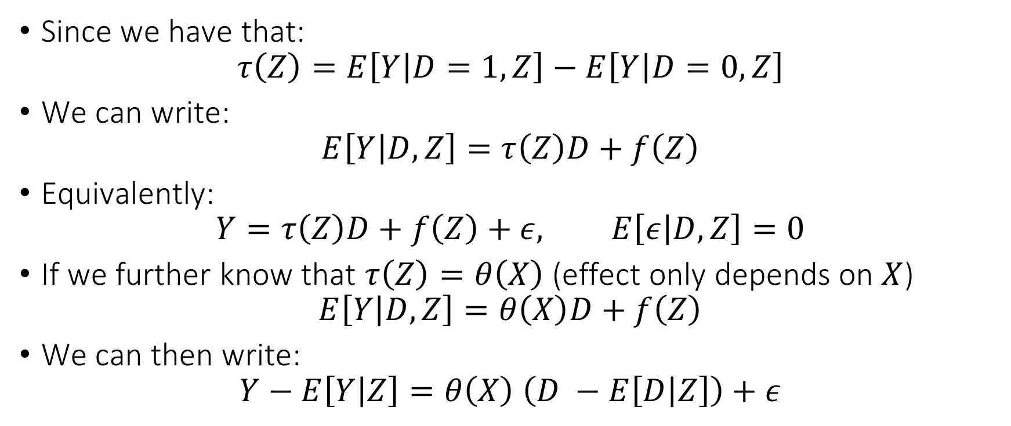
Residual Learner (R-Learner)
Since we have that:
$$τ\left(Z\right)=E\left[Y | D=1,Z\right]−E\left[Y | D=0,Z\right]$$
We can write:
$$E\left[Y | D,Z\right]=τ\left(Z\right)D+f\left(Z\right)$$
Equivalently:
$$Y=τ\left(Z\right)D+f\left(Z\right)+ε, E\left[ε | D,Z\right]=0$$
If we further know that $τ\left(Z\right)=θ\left(X\right)$ (effect only depends on $X$)
$$E\left[Y | D,Z\right]=θ\left(X\right)D+f\left(Z\right)$$
We can then write:
$$Y−E\left[Y | Z\right]=θ\left(X\right) \left(D −E\left[D | Z\right]\right)+ε$$

Slide 20
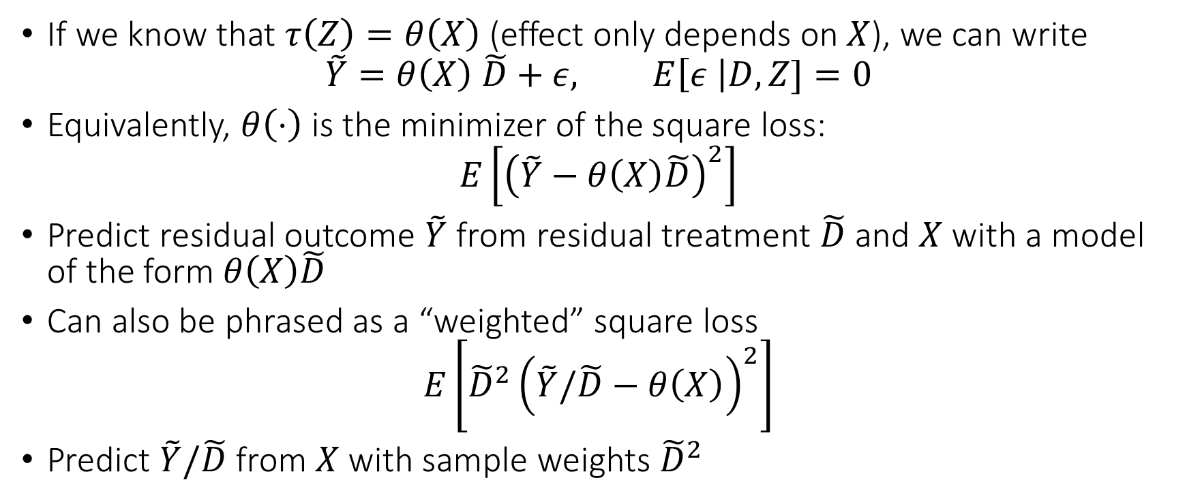
Residual Learner (R-Learner)
If we know that $τ\left(Z\right)=θ\left(X\right)$ (effect only depends on $X$), we can write
$$\tilde{Y}=θ\left(X\right) \tilde{D}+ε, E\left[ε \right|D,Z]=0$$
Equivalently, $θ\left(⋅\right)$ is the minimizer of the square loss:
$$E\left[{\left(\tilde{Y}−θ\left(X\right)\tilde{D}\right)}^{2}\right]$$
Predict residual outcome $\tilde{Y}$ from residual treatment $\tilde{D}$ and $X$ with a model of the form $θ\left(X\right)\tilde{D}$
Can also be phrased as a “weighted” square loss
$$E\left[{\tilde{D}}^{2}{\left(\tilde{Y}/\tilde{D}−θ\left(X\right)\right)}^{2}\right]$$
Predict $\tilde{Y}/\tilde{D}$ from $X$ with sample weights ${\tilde{D}}^{2}$

Slide 21
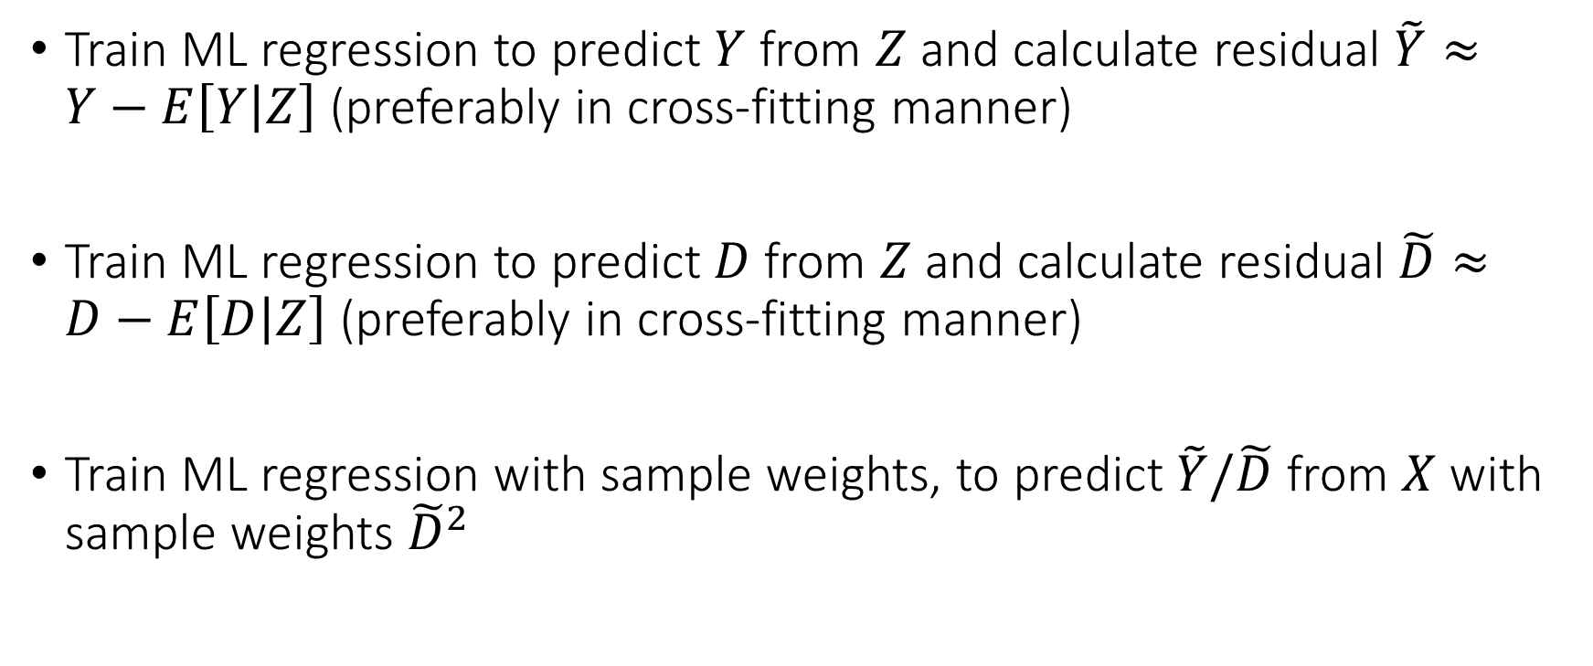
Residual Learner (R-Learner) Meta Algorithm
Train ML regression to predict $Y$ from $Z$ and calculate residual $\tilde{Y}≈Y−E\left[Y | Z\right]$ (preferably in cross-fitting manner)
Train ML regression to predict $D$ from $Z$ and calculate residual $\tilde{D}≈D−E\left[D | Z\right]$ (preferably in cross-fitting manner)
Train ML regression with sample weights, to predict $\tilde{Y}/\tilde{D}$ from $X$ with sample weights ${\tilde{D}}^{2}$

Slide 22
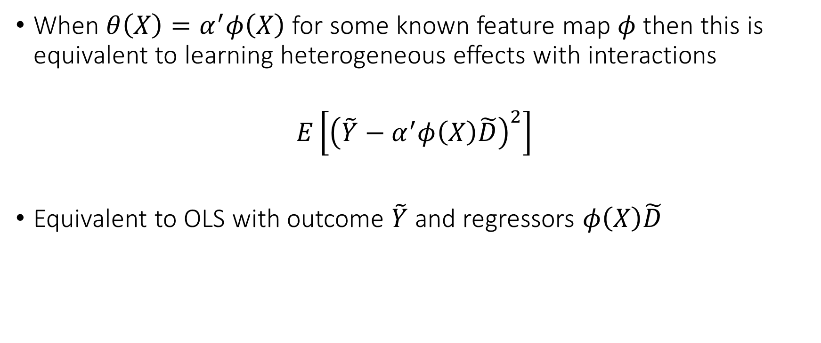
Residual Learner (R-Learner)
When $θ\left(X\right)=α^{′}φ\left(X\right)$ for some known feature map $φ$ then this is equivalent to learning heterogeneous effects with interactions
$$E\left[{\left(\tilde{Y}−α^{′}φ\left(X\right)\tilde{D}\right)}^{2}\right]$$
Equivalent to OLS with outcome $\tilde{Y}$ and regressors $φ\left(X\right)\tilde{D}$

Slide 23
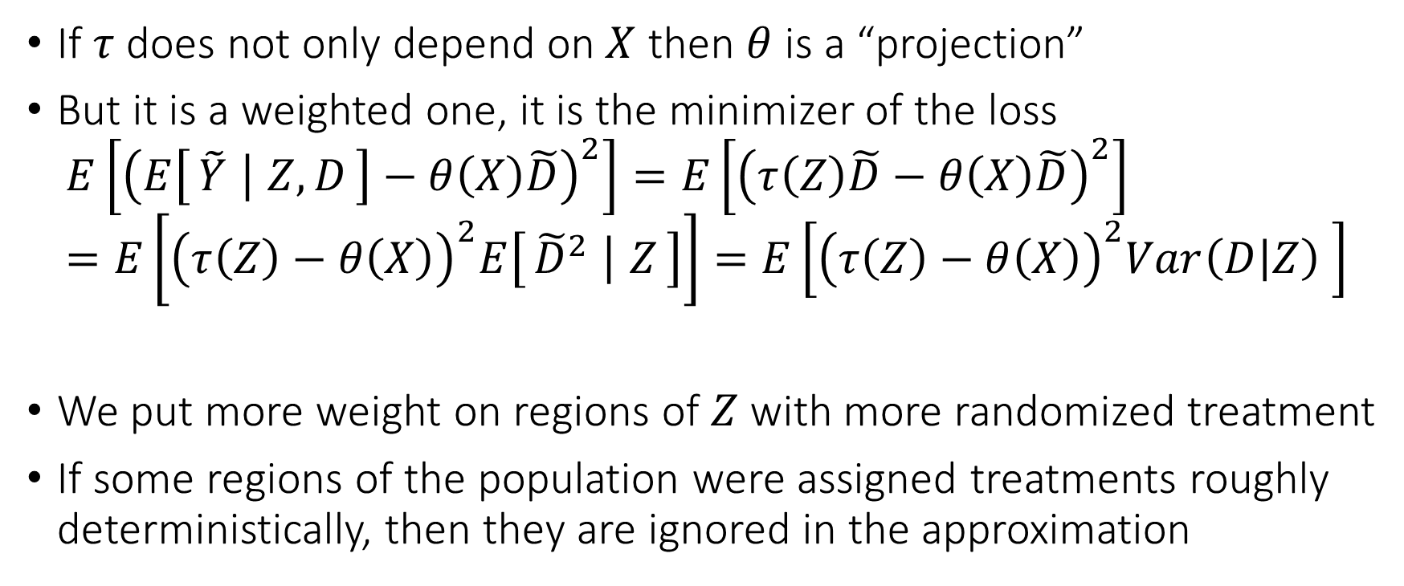
Residual Learner (R-Learner)
If $τ$ does not only depend on $X$ then $θ$ is a “projection”
But it is a weighted one, it is the minimizer of the loss
$$E\left[{\left(E\left[\tilde{Y} ∣ Z,D\right]−θ\left(X\right)\tilde{D}\right)}^{2}\right]=E\left[{\left(τ\left(Z\right)\tilde{D}−θ\left(X\right)\tilde{D}\right)}^{2}\right]=E\left[{\left(τ\left(Z\right)−θ\left(X\right)\right)}^{2}E\left[{\tilde{D}}^{2} ∣ Z\right]\right]=E\left[{\left(τ\left(Z\right)−θ\left(X\right)\right)}^{2}Var\left(D | Z\right) \right]$$
We put more weight on regions of $Z$ with more randomized treatment
If some regions of the population were assigned treatments roughly deterministically, then they are ignored in the approximation

Slide 24
Comparing Meta-Learners
S and T-Learners are typically poor performing as they heavily depend on outcome modelling; among them the T-Learner should be preferred
X-Learner is a better version of S and T as it incorporates propensity knowledge
DR-Learner and R-Learner, both possess “Neyman orthogonality” properties as they carefully combine outcome and treatment assignment modelling
The error of the final cate model is not heavily impacted by the errors in the auxiliary models (Orthogonal Statistical Learning)
DR-Learner estimates un-weighted projection of true CATE on model space, but can be “high-variance” due to inverse propensity
R-Learner estimates variance weighted projection but is much more stable to extreme propensities as it never divides by propensity.

Slide 25
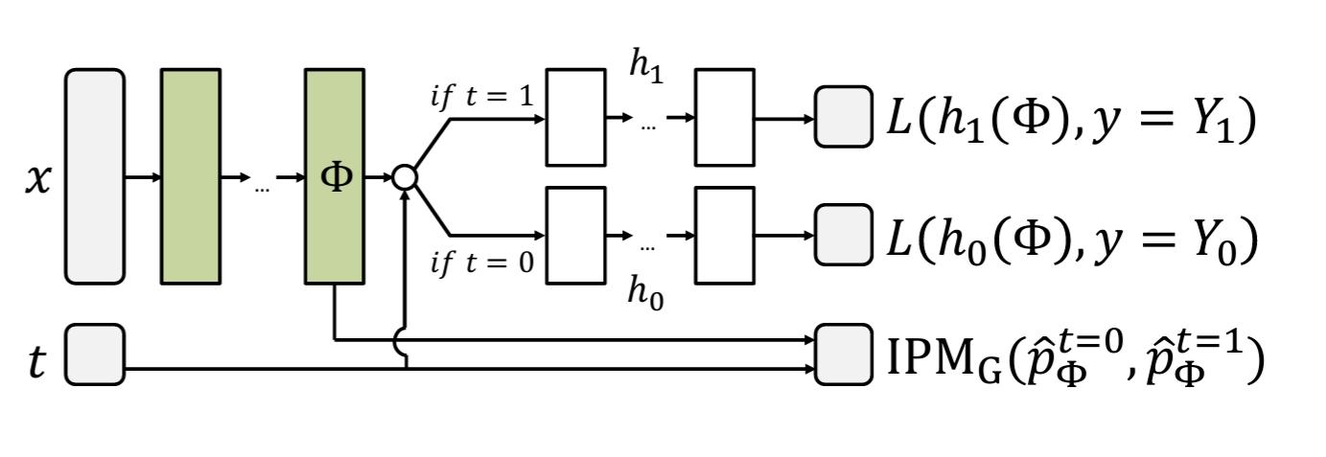
Neural Network CATE Learners (CFR Net) Shalit et al. 17

Slide 26
Model Selection and Evaluation

Slide 27
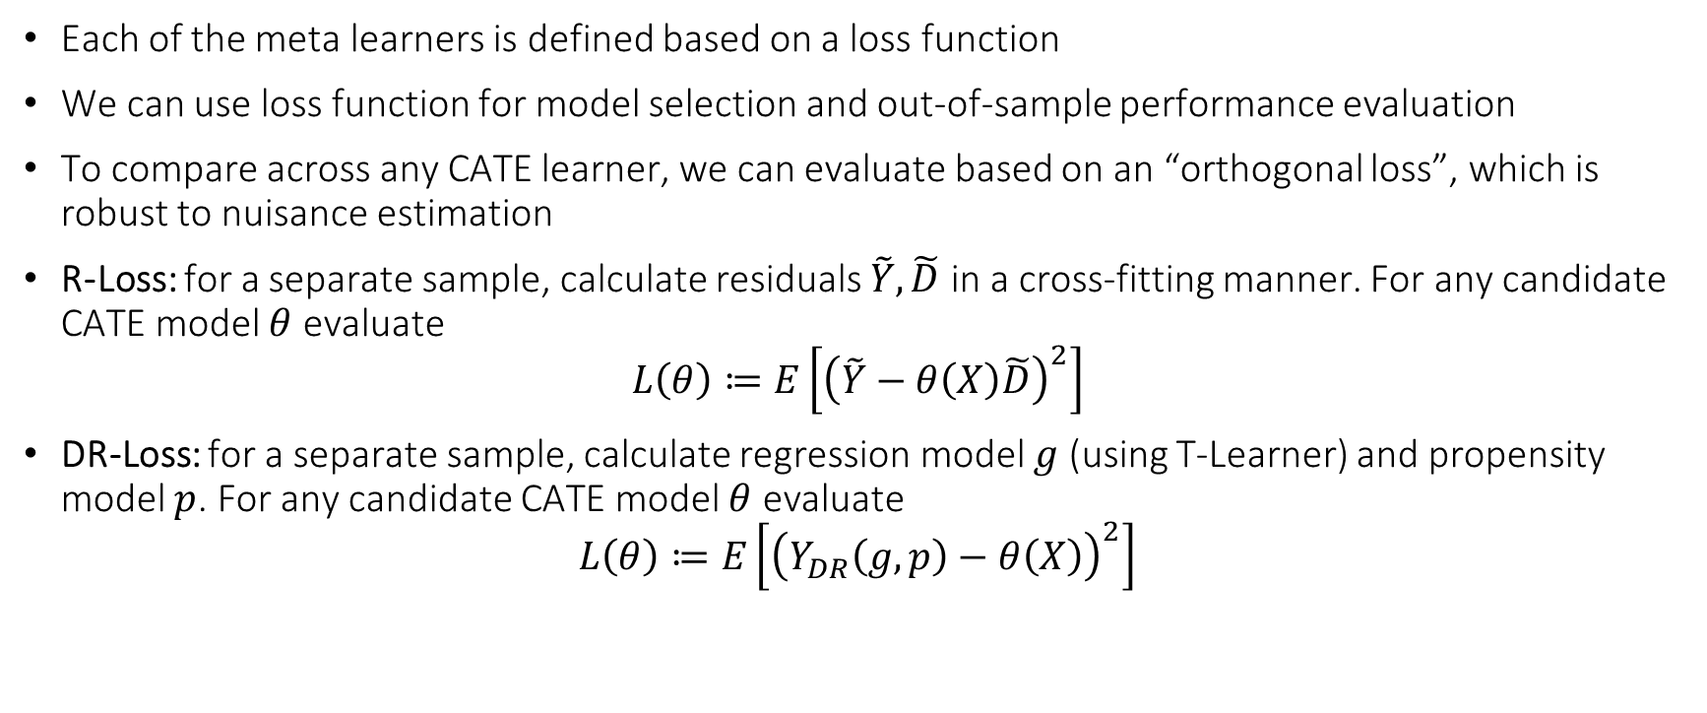
Model Selection and Evaluation
Each of the meta learners is defined based on a loss function
We can use loss function for model selection and out-of-sample performance evaluation
To compare across any CATE learner, we can evaluate based on an “orthogonal loss”, which is robust to nuisance estimation
R-Loss: for a separate sample, calculate residuals $\tilde{Y},\tilde{D}$ in a cross-fitting manner. For any candidate CATE model $θ$ evaluate
$$L\left(θ\right)≔E\left[{\left(\tilde{Y}−θ\left(X\right)\tilde{D}\right)}^{2}\right]$$
DR-Loss: for a separate sample, calculate regression model $g$ (using T-Learner) and propensity model $p$. For any candidate CATE model $θ$ evaluate
$$L\left(θ\right)≔E\left[{\left(Y_{DR}\left(g,p\right)−θ\left(X\right)\right)}^{2}\right]$$

Slide 28
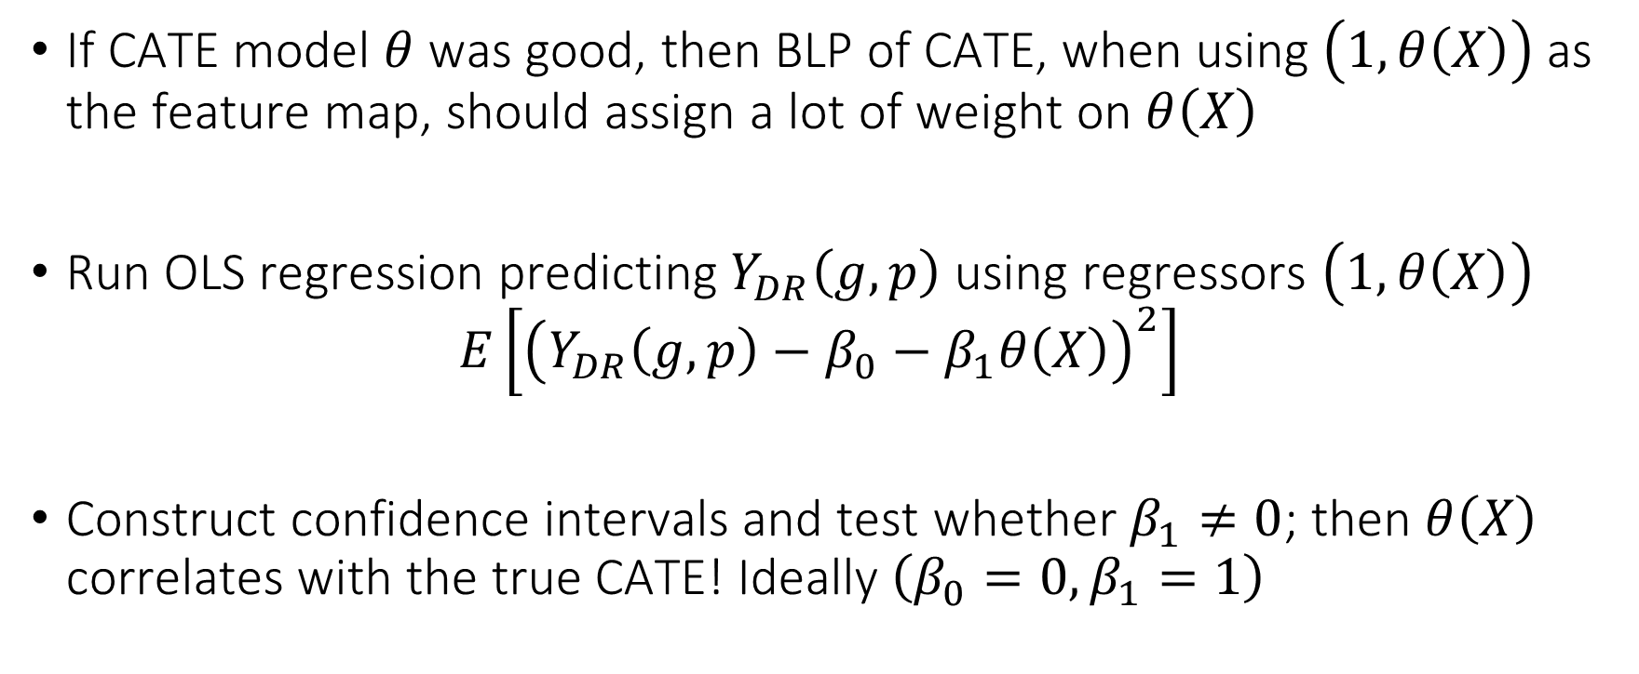
Evaluation via Testing Approaches
If CATE model $θ$ was good, then BLP of CATE, when using $\left(1, θ\left(X\right)\right)$ as the feature map, should assign a lot of weight on $θ\left(X\right)$
Run OLS regression predicting$Y_{DR}\left(g,p\right)$ using regressors $\left(1, θ\left(X\right)\right)$
$$E\left[{\left(Y_{DR}\left(g,p\right)−β_{0}−β_{1}θ\left(X\right)\right)}^{2}\right]$$
Construct confidence intervals and test whether $β_{1}≠0$; then $θ\left(X\right)$ correlates with the true CATE! Ideally $\left(β_{0}=0,β_{1}=1\right)$

Slide 29
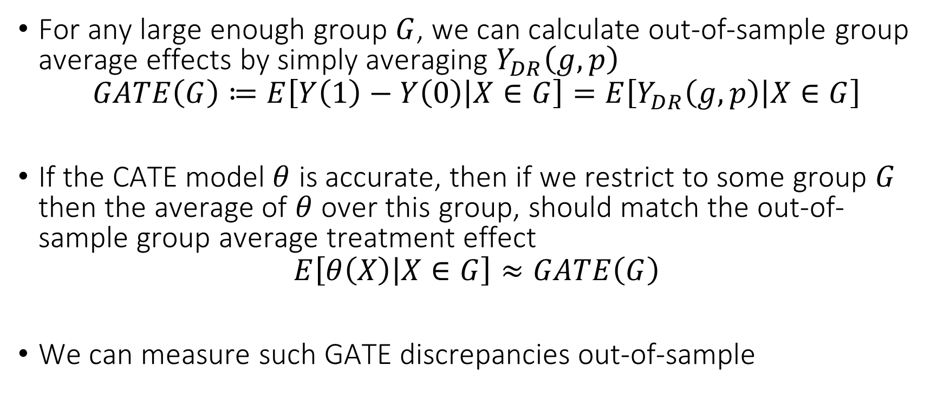
Validation via GATEs
For any large enough group $G$, we can calculate out-of-sample group average effects by simply averaging $Y_{DR}\left(g,p\right)$
$$GATE\left(G\right)≔E\left[Y\left(1\right)−Y\left(0\right) | X∈G\right]=E\left[Y_{DR}\left(g,p\right) | X∈G\right]$$
If the CATE model $θ$ is accurate, then if we restrict to some group $G$ then the average of $θ$ over this group, should match the out-of-sample group average treatment effect
$$E\left[θ\left(X\right) | X∈G\right]≈GATE\left(G\right)$$
We can measure such GATE discrepancies out-of-sample

Slide 30
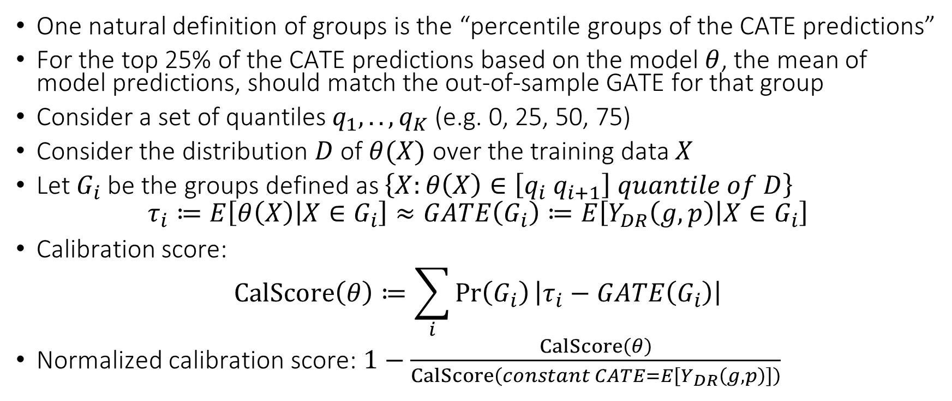
Validation via Calibration
One natural definition of groups is the “percentile groups of the CATE predictions”
For the top 25% of the CATE predictions based on the model $θ$, the mean of model predictions, should match the out-of-sample GATE for that group
Consider a set of quantiles $q_{1},..,q_{K}$ (e.g. 0, 25, 50, 75)
Consider the distribution $D$ of $θ(X)$ over the training data $X$
Let $G_{i}$ be the groups defined as $\left\{X:θ\left(X\right)∈\left[q_{i} q_{i+1}\right] quantile of D\right\}$
$$τ_{i}≔E\left[θ\left(X\right) | X∈G_{i}\right]≈GATE\left(G_{i}\right)≔E\left[Y_{DR}\left(g,p\right) | X∈G_{i}\right]$$
Calibration score:
$$CalScore\left(θ\right)≔\sum_{i}{\operatorname{Pr}\left(G_{i}\right)\left|τ_{i}−GATE\left(G_{i}\right)\right|}$$
Normalized calibration score: $1−\frac{CalScore\left(θ\right)}{CalScore\left(constant CATE=E\left[Y_{DR}\left(g,p\right)\right]\right)}$

Slide 31
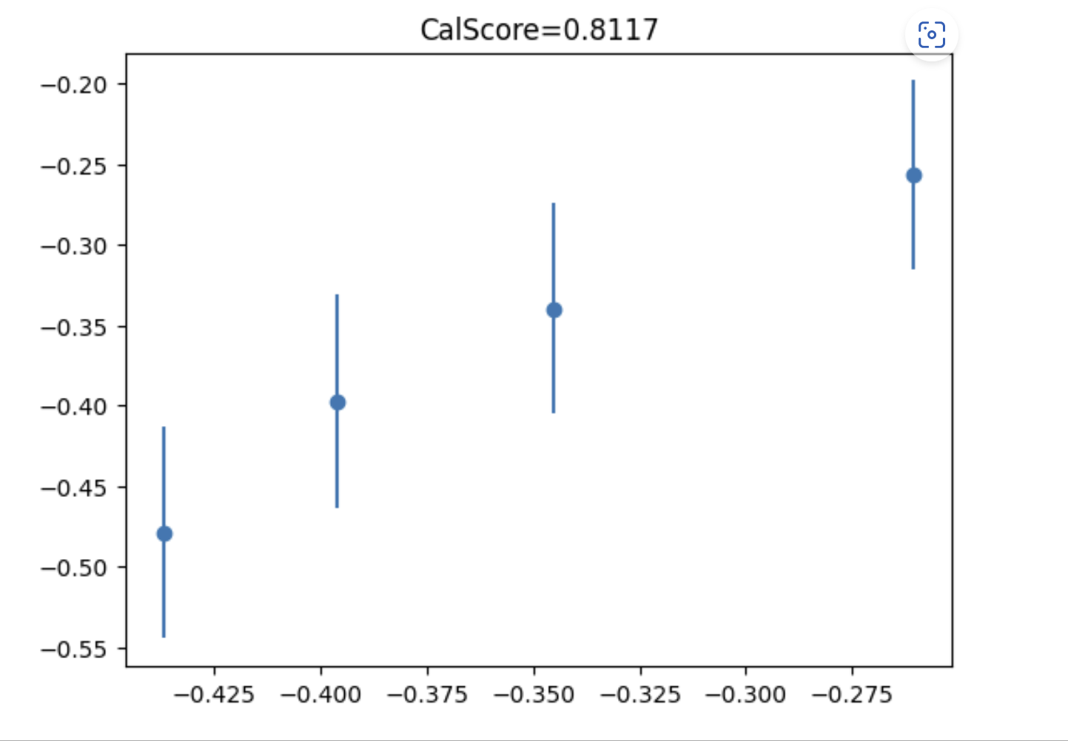

Testing for Heterogeneity
We can easily construct joint confidence intervals for all the GATEs
GATEs are the coefficients in the BLP of CATE using group one-hot-encoding as features
$$E\left[{\left(Y_{DR}\left(g,p\right)−β^{′}\left(1\left\{X∈G_{1}\right\},…, 1\left\{X∈G_{K}\right\}\right)\right)}^{2}\right]$$
We can use joint confidence intervals for BLP via the DR-Learner
If there was heterogeneity, then we should have that there are GATEs whose confidence intervals are non-overlapping

Slide 32
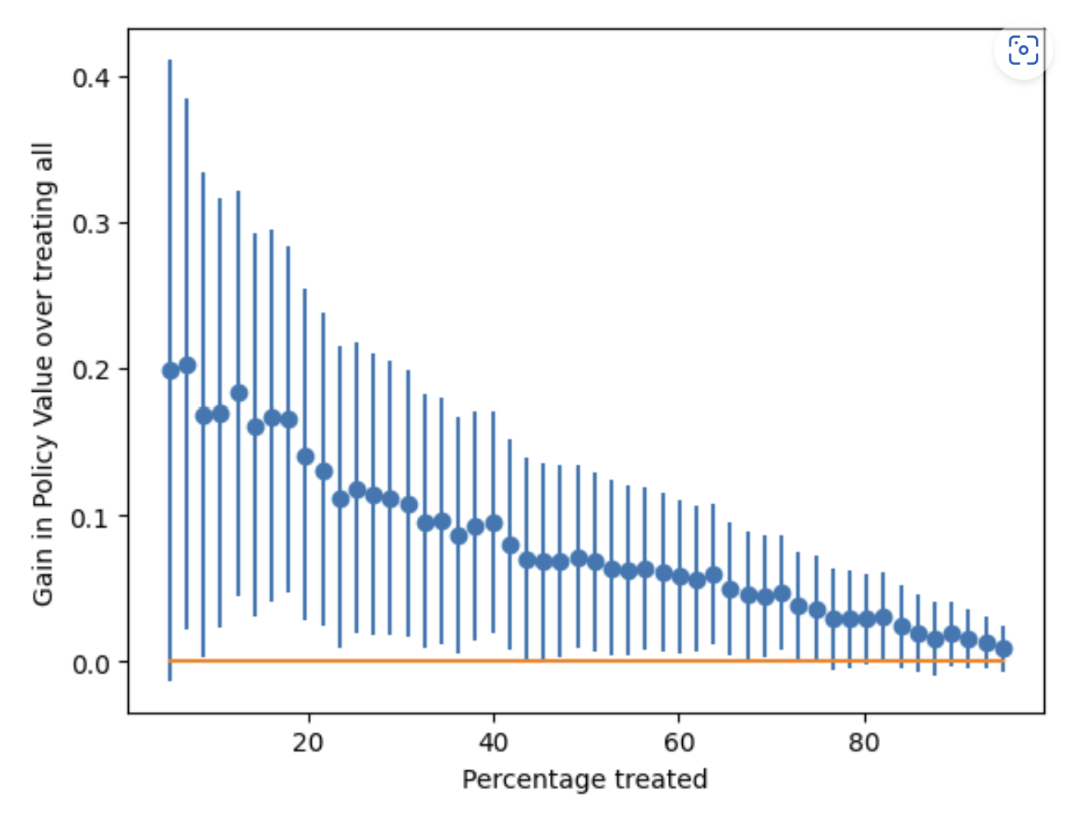
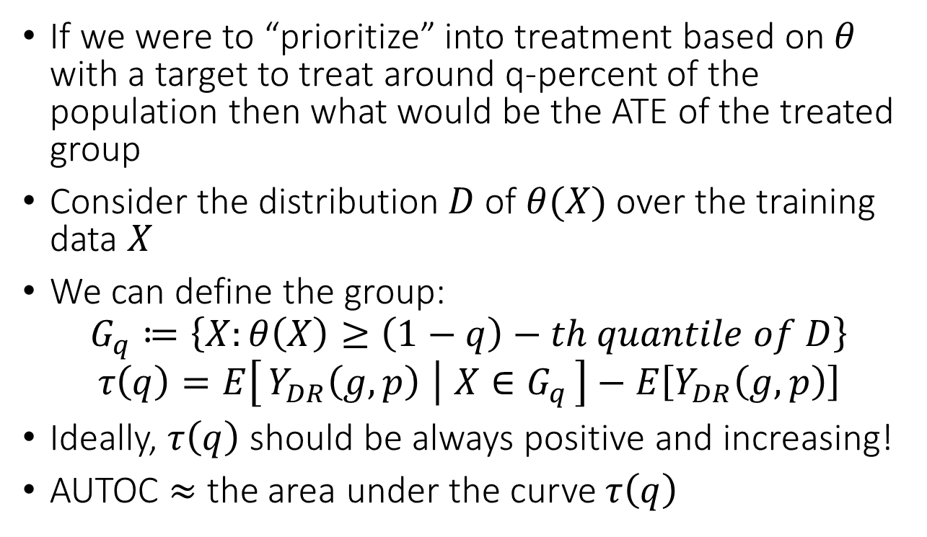
Stratification Motivated Evaluation
If we were to “prioritize” into treatment based on $θ$ with a target to treat around q-percent of the population then what would be the ATE of the treated group
Consider the distribution $D$ of $θ(X)$ over the training data $X$
We can define the group:
$$G_{q}≔\left\{X:θ\left(X\right)≥\left(1−q\right)−th quantile of D\right\}$$
$$τ\left(q\right)=E\left[Y_{DR}\left(g,p\right) ∣ X∈G_{q}\right]−E\left[Y_{DR}\left(g,p\right)\right]$$
Ideally, $τ\left(q\right)$ should be always positive and increasing!
AUTOC $≈$ the area under the curve $τ\left(q\right)$

Slide 33
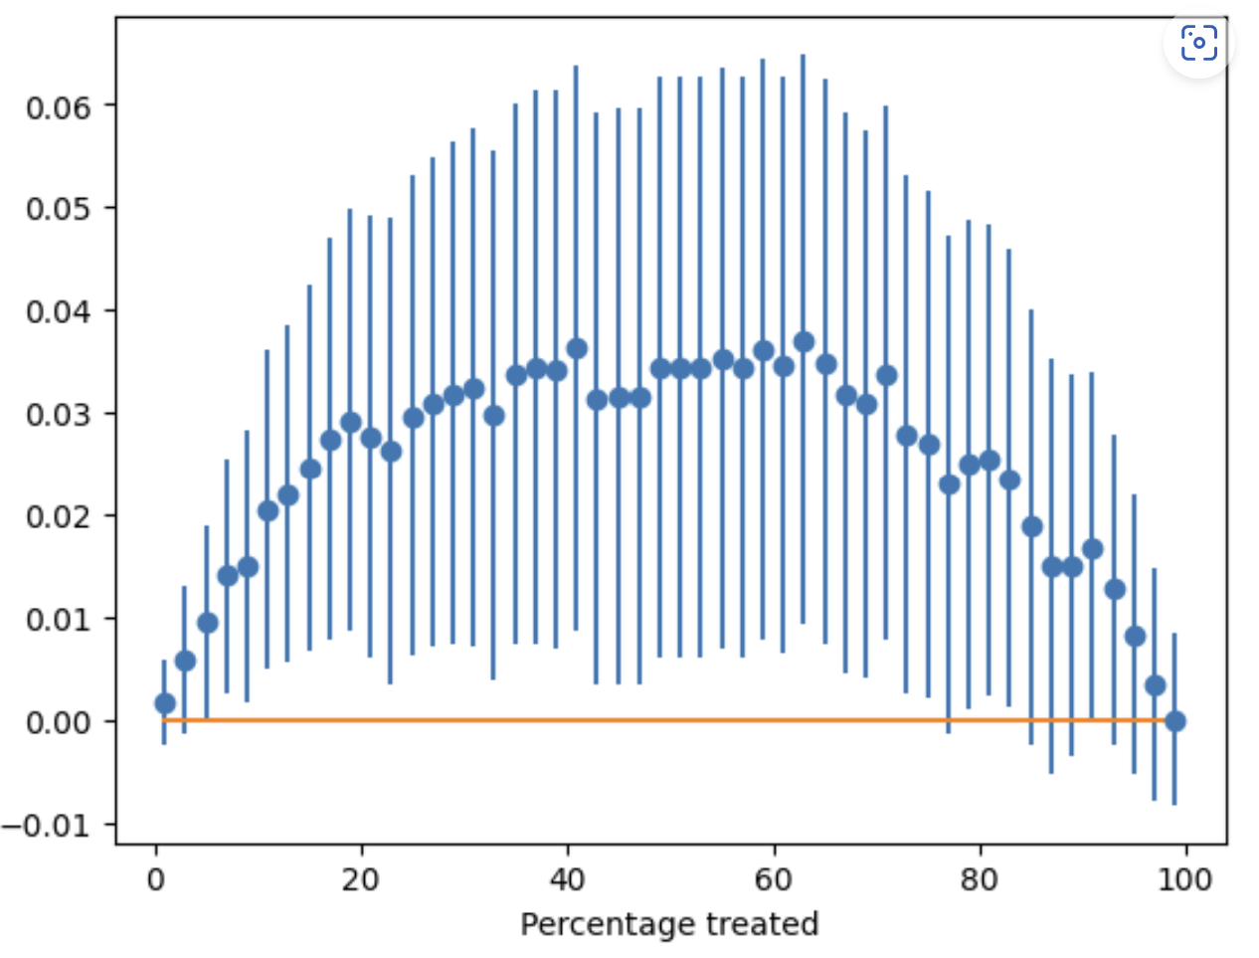
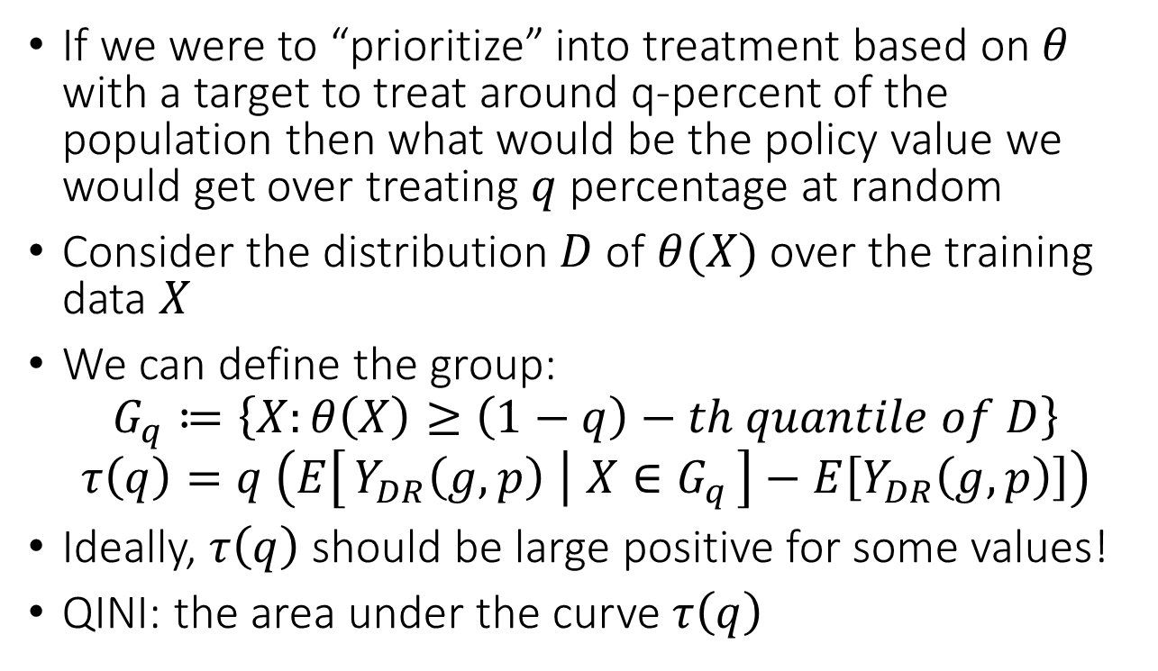
Stratification Motivated Evaluation
If we were to “prioritize” into treatment based on $θ$ with a target to treat around q-percent of the population then what would be the policy value we would get over treating $q$ percentage at random
Consider the distribution $D$ of $θ(X)$ over the training data $X$
We can define the group:
$$G_{q}≔\left\{X:θ\left(X\right)≥\left(1−q\right)−th quantile of D\right\}$$
$$τ\left(q\right)=q \left(E\left[Y_{DR}\left(g,p\right) ∣ X∈G_{q}\right]−E\left[Y_{DR}\left(g,p\right)\right]\right)$$
Ideally, $τ\left(q\right)$ should be large positive for some values!
QINI: the area under the curve $τ\left(q\right)$

Slide 34
Policy Learning

Slide 35
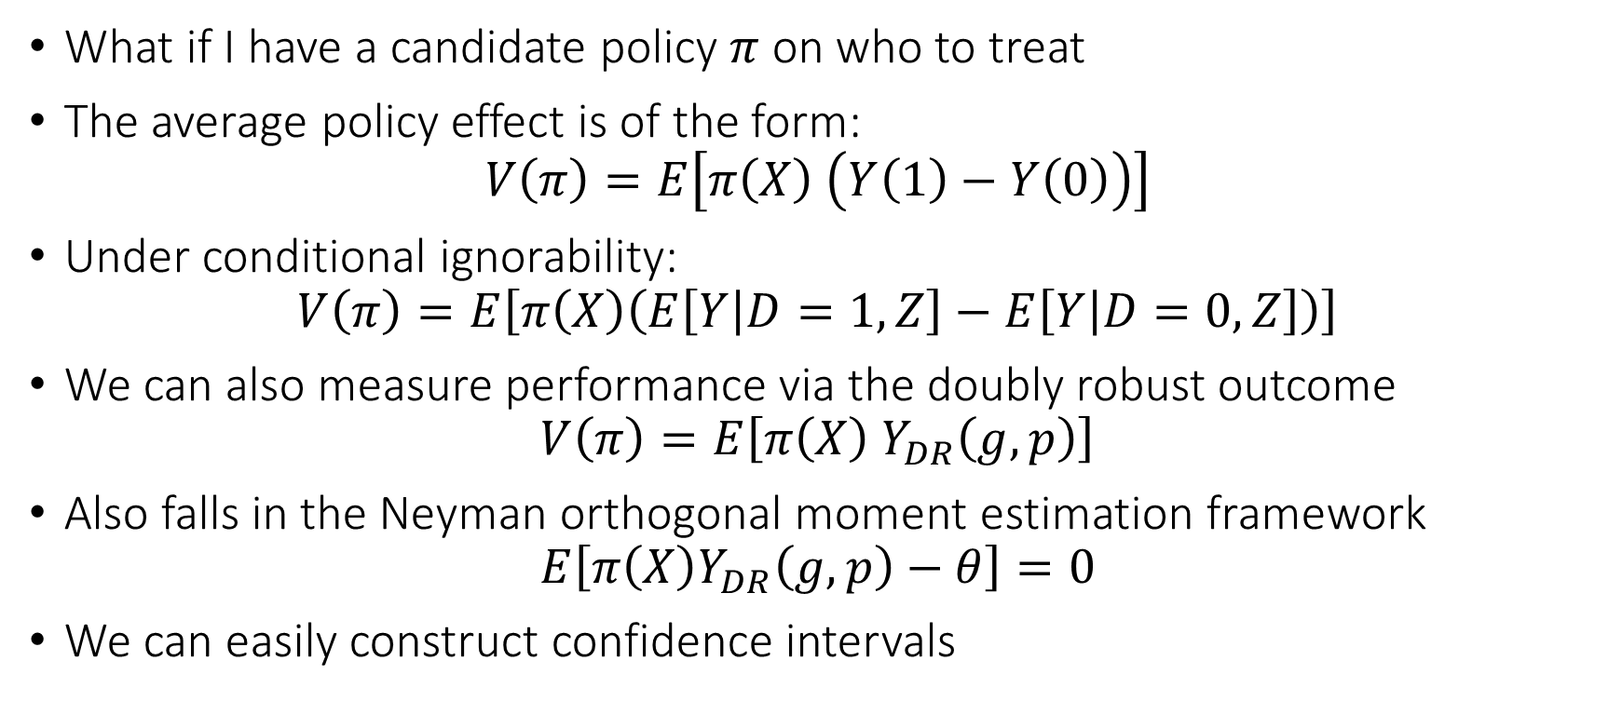
Candidate Policy
What if I have a candidate policy $π$ on who to treat
The average policy effect is of the form:
$$V\left(π\right)=E\left[π\left(X\right) \left(Y\left(1\right)−Y\left(0\right)\right)\right]$$
Under conditional ignorability:
$$V\left(π\right)=E\left[π\left(X\right)\left(E\left[Y | D=1,Z\right]−E\left[Y | D=0,Z\right]\right)\right]$$
We can also measure performance via the doubly robust outcome
$$V\left(π\right)=E\left[π\left(X\right) Y_{DR}\left(g,p\right)\right]$$
Also falls in the Neyman orthogonal moment estimation framework
$$E\left[π\left(X\right)Y_{DR}\left(g,p\right)−θ\right]=0$$
We can easily construct confidence intervals

Slide 36
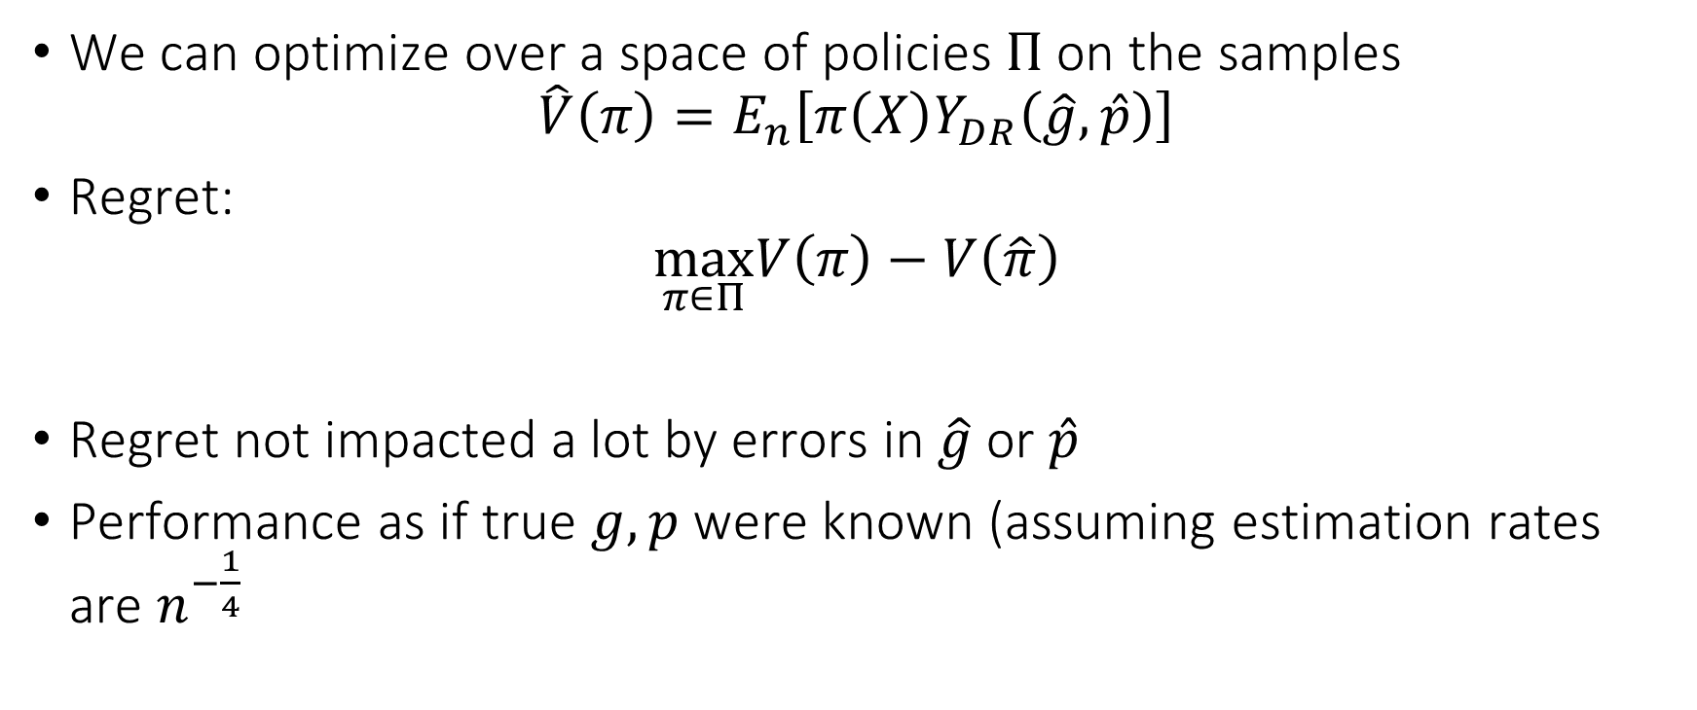
Policy Optimization
We can optimize over a space of policies $Π$ on the samples
$$\hat{V}\left(π\right)=E_{n}\left[π\left(X\right)Y_{DR}\left(\hat{g},\hat{p}\right)\right]$$
Regret:
$$\max_{π∈Π}V\left(π\right)−V\left(\hat{π}\right)$$
Regret not impacted a lot by errors in $\hat{g}$ or $\hat{p}$
Performance as if true $g,p$ were known (assuming estimation rates are $n^{−\frac{1}{4}}$

Slide 37
Non-Parametric Confidence Intervals

Slide 38
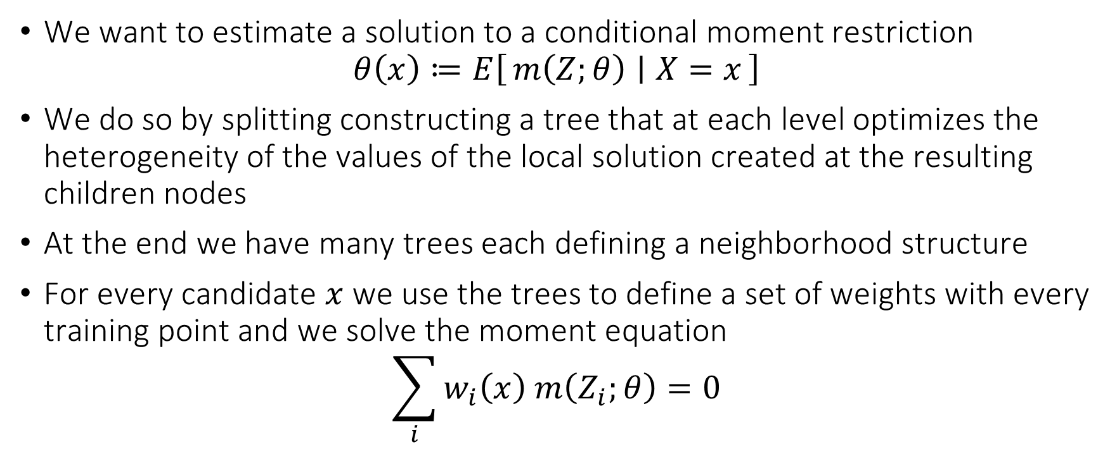
Generalized Random Forest
We want to estimate a solution to a conditional moment restriction
$$θ\left(x\right)≔E\left[m\left(Z;θ\right) ∣ X=x\right]$$
We do so by splitting constructing a tree that at each level optimizes the heterogeneity of the values of the local solution created at the resulting children nodes
At the end we have many trees each defining a neighborhood structure
For every candidate $x$ we use the trees to define a set of weights with every training point and we solve the moment equation
$$\sum_{i}{w_{i}\left(x\right) m\left(Z_{i};θ\right)}=0$$

Slide 39
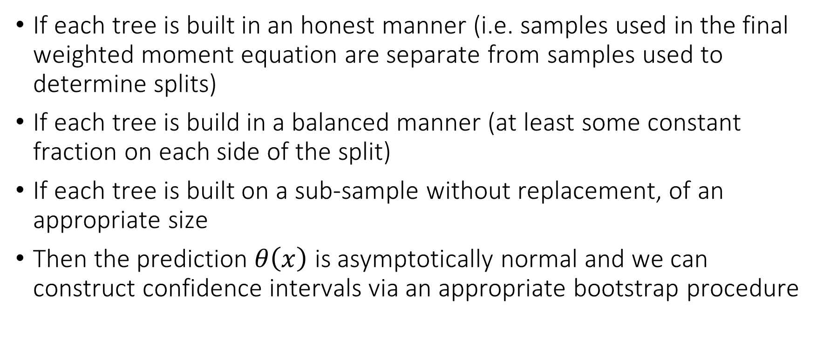
Generalized Random Forest
If each tree is built in an honest manner (i.e. samples used in the final weighted moment equation are separate from samples used to determine splits)
If each tree is build in a balanced manner (at least some constant fraction on each side of the split)
If each tree is built on a sub-sample without replacement, of an appropriate size
Then the prediction $θ\left(x\right)$ is asymptotically normal and we can construct confidence intervals via an appropriate bootstrap procedure

Slide 40
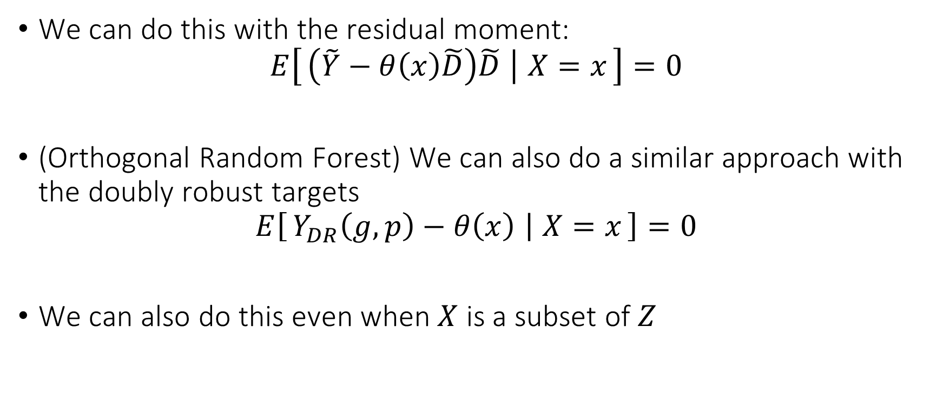
GRF for CATE
We can do this with the residual moment:
$$E\left[\left(\tilde{Y}−θ\left(x\right)\tilde{D}\right)\tilde{D} ∣ X=x\right]=0$$
(Orthogonal Random Forest) We can also do a similar approach with the doubly robust targets
$$E\left[Y_{DR}\left(g,p\right)−θ\left(x\right) ∣ X=x\right]=0$$
We can also do this even when $X$ is a subset of $Z$

