Slide 1
MS&E 228: Unobserved Confounding and Instruments
Vasilis Syrgkanis
MS&E, Stanford

Slide 2
Causal Inference with Experiments
Prediction with Linear Models
Prediction with High-Dim Linear Models
Inference on Causal and Predictive Effects with High-Dim Linear Models
Potential Outcomes and Conditional Ignorability
Structural Equation Models and Conditional Exogeneity
Directed Acyclic Graphs
Prediction with Non-Linear Models
Inference on Causal Effects with Non-Linear Models
Un-observed Confounding and Instruments
Estimation of Heterogeneous Causal Effects
Identification of Causal Effects in Longitudinal Data
Linear Predictive Models and Statistical Inference
Causal Identification in Observational Data
Non-Linear Predictive Models and Statistical Inference
Topics

Slide 3
Causal Inference with Experiments
Prediction with Linear Models
Prediction with High-Dim Linear Models
Inference on Causal and Predictive Effects with High-Dim Linear Models
Potential Outcomes and Conditional Ignorability
Structural Equation Models and Conditional Exogeneity
Directed Acyclic Graphs
Prediction with Non-Linear Models
Inference on Causal Effects with Non-Linear Models
Un-observed Confounding and Instruments
Estimation of Heterogeneous Causal Effects
Identification of Causal Effects in Longitudinal Data
Linear Predictive Models and Statistical Inference
Causal Identification in Observational Data
Non-Linear Predictive Models and Statistical Inference
Topics

Slide 4
Goals for Today
Heterogeneous Treatment Effects
Statement of the problem
A basic solution

Slide 5








Causal Inference Pipeline
Data Collection
Estimation
(training)
Validation
(testing)
Domain Assumption Elicitation
Identification
Inference (Confidence Intervals)
DAGs/ASEMs
Estimate approximate residuals $\check{Y}$, $\check{Z}$, $\check{D}$ using cross-fitting
Solve moment restriction
$$E_{n}\left[\left(\check{Y}−\hat{a}\check{D}\right)\check{Z}\right]=0$$
Theory
$$Z$$
$$D$$
$$α=\frac{E\left[\tilde{Y}\tilde{Z}\right]}{E\left[\tilde{D}\tilde{Z}\right]}$$
$$a∈\hat{a}±2\hat{σ}$$
$$X$$
$$Y$$
Instrumental Variable: any random variable Z that affects the treatment (log-price) D but does not affect the outcome (log-demand) Y other than through the treatment
Sensitivity Analysis
Practice
$$a∈\hat{a}±(2\hat{σ}+ε)$$
Adaptive Experiments
Decision
Policy

Slide 6






Causal Inference Pipeline
Data Collection
Estimation
(training)
Validation
(testing)
Domain Assumption Elicitation
Identification
Inference (Confidence Intervals)
DAGs/ASEMs
Construct estimate $\hat{g}\left(d,z\right)$ of predictive model
$$E\left[Y ∣ D=d,Z=z\right]$$
Estimate mean counterfactual
$${\hat{a}}_{d}=E_{n}\left[\hat{g}\left(d,Z\right)\right]$$
Theory
$$a_{d}$$
$$E\left[E\left[Y | D=d,Z\right]\right]$$
$$D$$
$$=$$
$$a_{d}∈{\hat{a}}_{d}±2\hat{σ}$$
$$Z$$
$$Y$$
Who should we treat?
Sensitivity Analysis
Practice
$$a_{d}∈{\hat{a}}_{d}±(2\hat{σ}+ε)$$
Adaptive Experiments
Decision
Policy

Slide 7
Conditional Average Treatment Effects (CATE)
aka Heterogeneous Treatment Effects

Slide 8
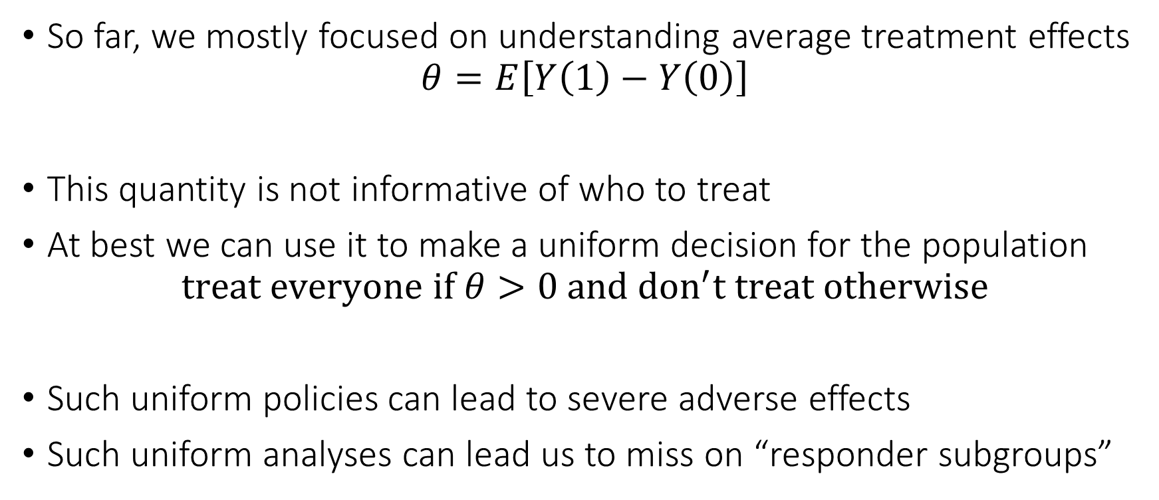
Problem with Average Treatment Effect
So far, we mostly focused on understanding average treatment effects
$$θ=E\left[Y\left(1\right)−Y\left(0\right)\right]$$
This quantity is not informative of who to treat
At best we can use it to make a uniform decision for the population
$$treat everyone if θ>0 and don^{′}t treat otherwise$$
Such uniform policies can lead to severe adverse effects
Such uniform analyses can lead us to miss on “responder subgroups”

Slide 9
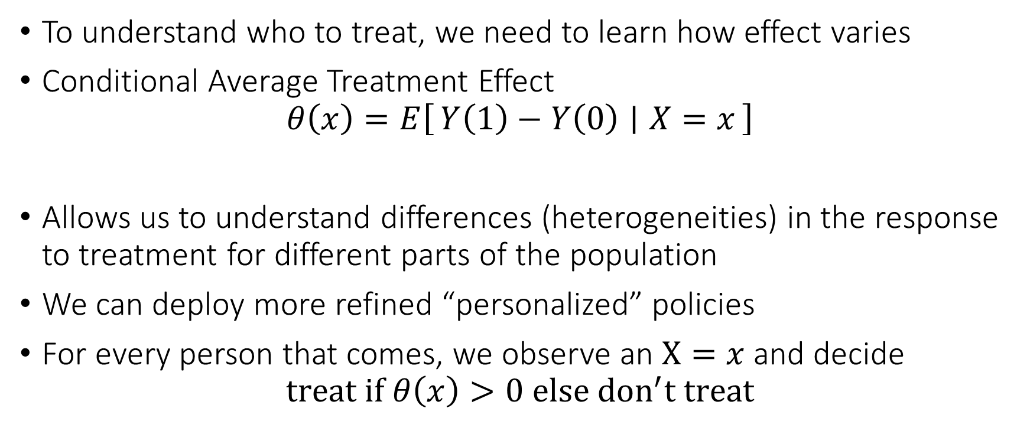
Personalized (Refined) Policies
To understand who to treat, we need to learn how effect varies
Conditional Average Treatment Effect
$$θ\left(x\right)=E\left[Y\left(1\right)−Y\left(0\right) ∣ X=x\right]$$
Allows us to understand differences (heterogeneities) in the response to treatment for different parts of the population
We can deploy more refined “personalized” policies
For every person that comes, we observe an $X=x$ and decide
$$treat if θ\left(x\right)>0 else don^{′}t treat$$

Slide 10
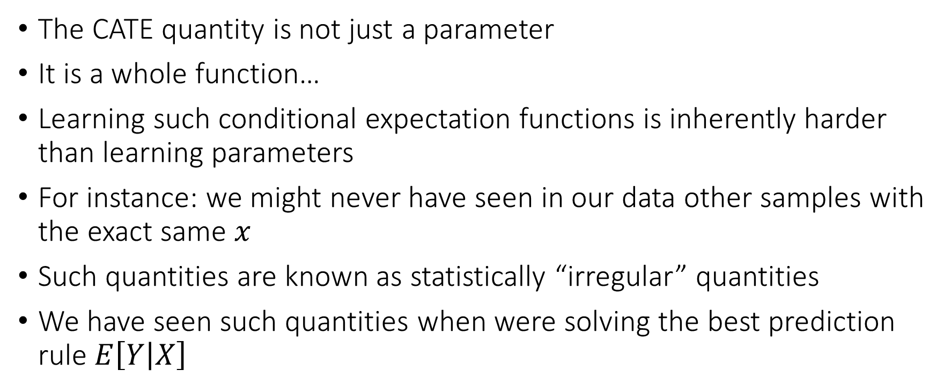
The intrinsic hardness of CATE
The CATE quantity is not just a parameter
It is a whole function…
Learning such conditional expectation functions is inherently harder than learning parameters
For instance: we might never have seen in our data other samples with the exact same $x$
Such quantities are known as statistically “irregular” quantities
We have seen such quantities when were solving the best prediction rule $E\left[Y | X\right]$

Slide 11
The intrinsic hardness of CATE
Estimating CATE at least as hard as estimating the best prediction rule
Inherently harder than estimating an “average”
So far for our target causal quantities we wanted fast estimation rates and confidence intervals
We were only ok with “decent” estimation rates for the auxiliary (nuisance) predictive models that entered our analysis
We might want to relax our goals…

Slide 12
Different Approaches to Relaxing our Goals
Goal 1: Maybe estimate a simpler projection (e.g. analogue of BLP)
Goal 2: Confidence intervals for predictions of this simple projection
Goal 3: Simultaneous confidence bands for predictions of this simple projection
Goal 4: Estimation error rate for the true CATE
Goal 5: Confidence intervals for the prediction of a CATE model
Goal 6: Simultaneous confidence bands for joint predictions of CATE model
Policy Learning
Goal 7: Go after optimal simple treatment policies; give me a policy with value close to the best
Goal 8: Inference on value of candidate treatment policies
Goal 9: Inference on value of optimal policy
Goal 10: Identify responder or heterogeneous sub-groups; policies with statistical significance;
Linear Doubly Robust Learner
Meta-learner approaches: S-Learner, T-Learner, X-Learner, R-Learner, DR-Learner
Neural Network approaches: TARNet, CFR
Random Forest approaches: BART
Modified (honest) ML methods: Generalized Random Forest, Orthogonal Random Forest, Sub-sampled Nearest Neighbor Regression
?? (only classical non-parametric statistic results on confidence bands of non-parametric functions)
Doubly Robust Policy Learning
Doubly Robust Policy Evaluation

Slide 13
Different Approaches to Relaxing our Goals
Goal 1: Maybe estimate a simpler projection (e.g. analogue of BLP)
Goal 2: Confidence intervals for predictions of this simple projection
Goal 3: Simultaneous confidence bands for predictions of this simple projection
Goal 4: Estimation error rate for the true CATE
Goal 5: Confidence intervals for the prediction of a CATE model
Goal 6: Simultaneous confidence bands for joint predictions of CATE model
Policy Learning
Goal 7: Go after optimal simple treatment policies; give me a policy with value close to the best
Goal 8: Inference on value of candidate treatment policies
Goal 9: Inference on value of optimal policy
Goal 10: Identify responder or heterogeneous sub-groups; policies with statistical significance;
Linear Doubly Robust Learner
Meta-learner approaches: S-Learner, T-Learner, X-Learner, R-Learner, DR-Learner
Neural Network approaches: TARNet, CFR
Random Forest approaches: BART
Modified (honest) ML methods: Generalized Random Forest, Orthogonal Random Forest, Sub-sampled Nearest Neighbor Regression
?? (only classical non-parametric statistic results on confidence bands of non-parametric functions)
Doubly Robust Policy Learning
Doubly Robust Policy Evaluation

Slide 14
Best Linear Projection of CATE

Slide 15
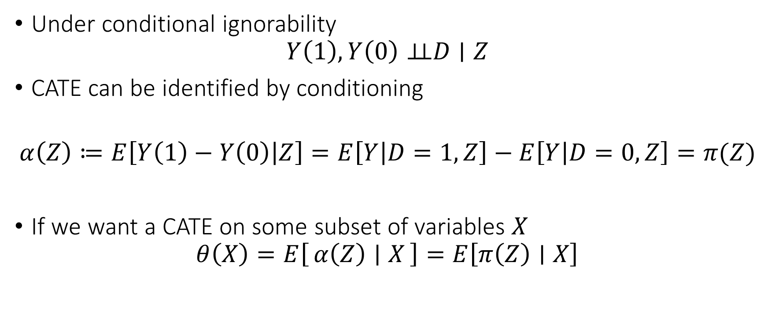
Identification by Conditioning
Under conditional ignorability
$$Y\left(1\right),Y\left(0\right)⊥⊥D∣Z$$
CATE can be identified by conditioning
$$α\left(Z\right)≔E\left[Y\left(1\right)−Y\left(0\right) | Z\right]=E\left[Y | D=1,Z\right]−E\left[Y | D=0,Z\right]=π(Z)$$
If we want a CATE on some subset of variables $X$
$$θ\left(X\right)=E\left[α\left(Z\right) ∣ X\right]=E\left[π\left(Z\right)∣X\right]$$

Slide 16
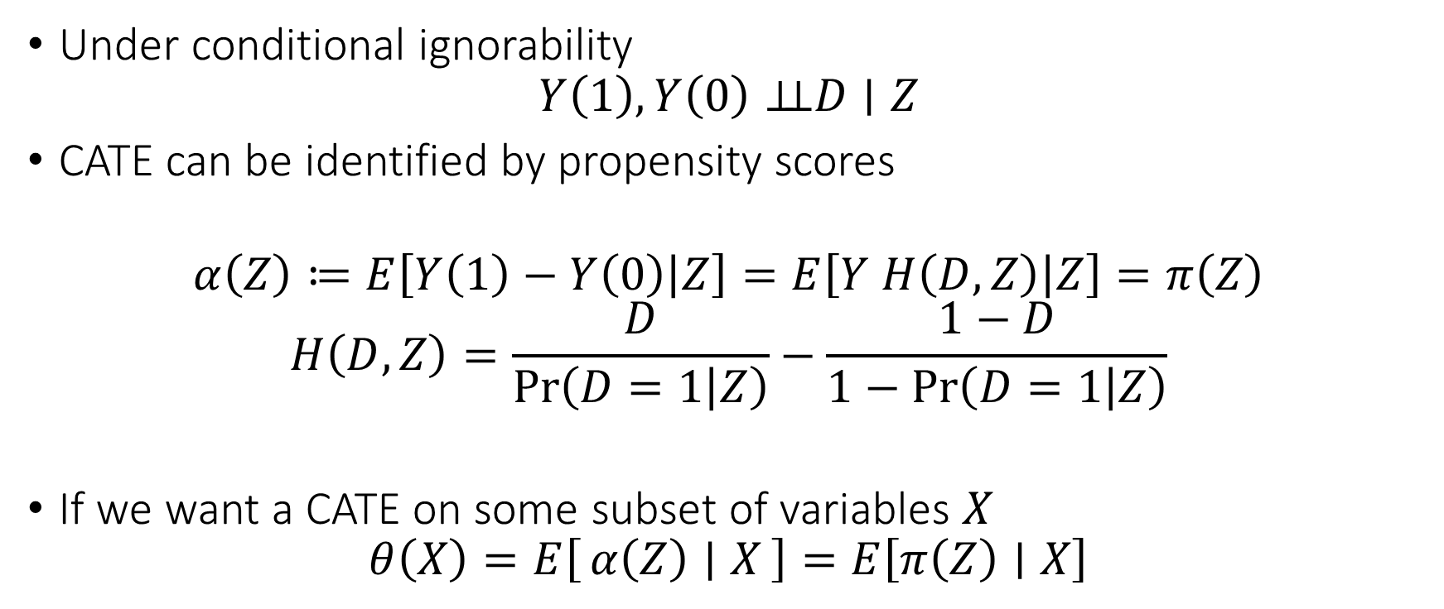
Identification with Propensity Scores
Under conditional ignorability
$$Y\left(1\right),Y\left(0\right)⊥⊥D∣Z$$
CATE can be identified by propensity scores
$$α\left(Z\right)≔E\left[Y\left(1\right)−Y\left(0\right) | Z\right]=E\left[Y H\left(D, Z\right) | Z\right]=π\left(Z\right)$$
$$H\left(D,Z\right)=\frac{D}{\operatorname{Pr}\left(D=1 | Z\right)}−\frac{1−D}{1−\operatorname{Pr}\left(D=1 | Z\right)}$$
If we want a CATE on some subset of variables $X$
$$θ\left(X\right)=E\left[α\left(Z\right) ∣ X\right]=E\left[π\left(Z\right)∣X\right]$$

Slide 17
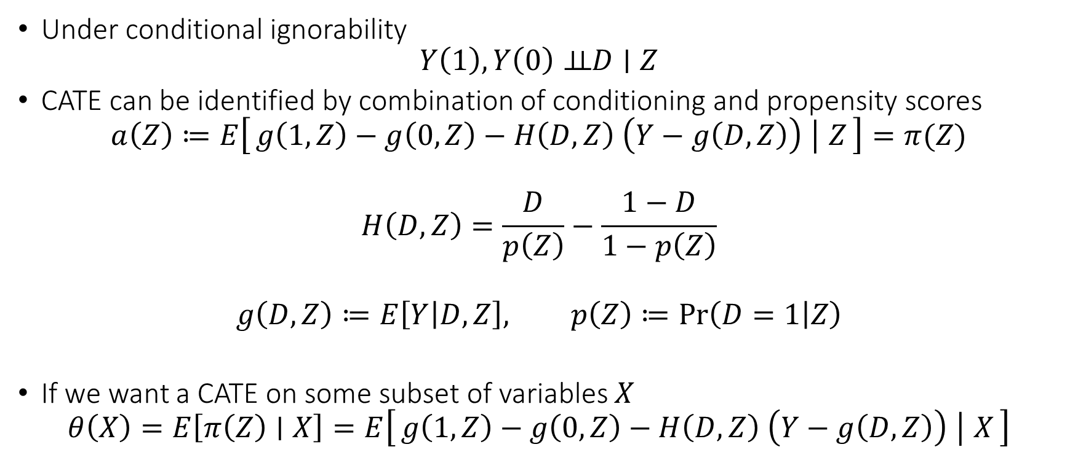
Doubly Robust Identification
Under conditional ignorability
$$Y\left(1\right),Y\left(0\right)⊥⊥D∣Z$$
CATE can be identified by combination of conditioning and propensity scores
$$a\left(Z\right)≔E\left[g\left(1, Z\right)−g\left(0, Z\right)−H\left(D,Z\right) \left(Y−g\left(D,Z\right)\right) ∣ Z\right]=π(Z)$$
$$H\left(D,Z\right)=\frac{D}{p\left(Z\right)}−\frac{1−D}{1−p\left(Z\right)}$$
$$g\left(D,Z\right)≔E\left[Y | D,Z\right], p\left(Z\right)≔\operatorname{Pr}\left(D=1 | Z\right)$$
If we want a CATE on some subset of variables $X$
$$θ\left(X\right)=E\left[π\left(Z\right)∣X\right]=E\left[g\left(1, Z\right)−g\left(0, Z\right)−H\left(D,Z\right) \left(Y−g\left(D,Z\right)\right) ∣ X\right]$$

Slide 18
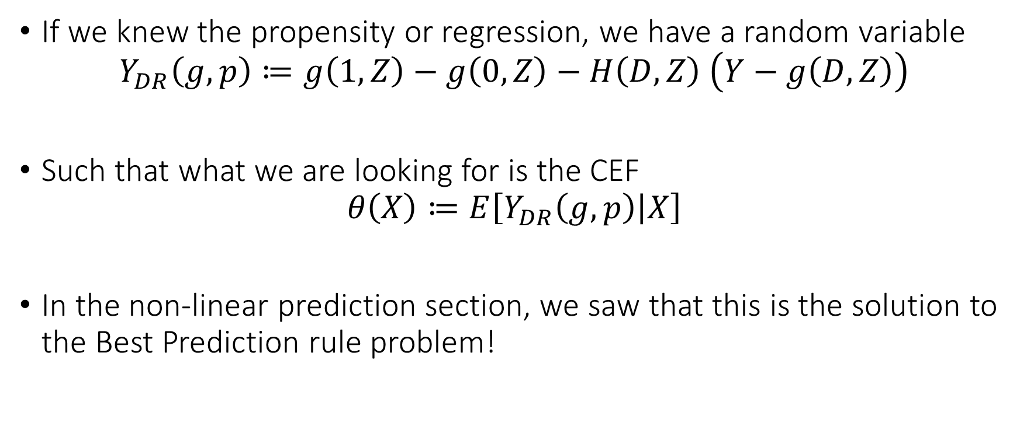
From Identification to Estimation
If we knew the propensity or regression, we have a random variable
$$Y_{DR}\left(g,p\right)≔g\left(1, Z\right)−g\left(0, Z\right)−H\left(D,Z\right) \left(Y−g\left(D,Z\right)\right)$$
Such that what we are looking for is the CEF
$$θ\left(X\right)≔E\left[Y_{DR}\left(g,p\right) | X\right]$$
In the non-linear prediction section, we saw that this is the solution to the Best Prediction rule problem!

Slide 19
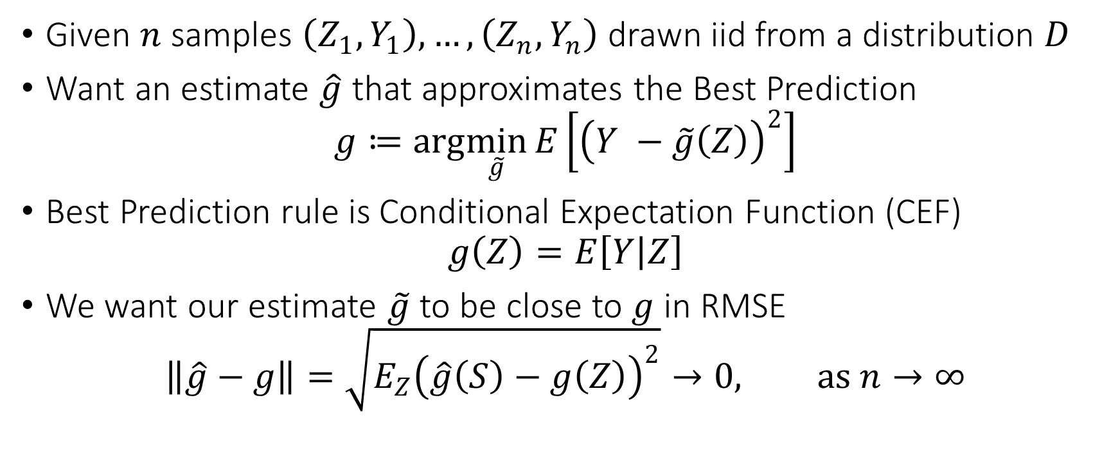
Blast from the Past: Best Prediction Rule
Given $n$ samples $\left(Z_{1},Y_{1}\right),…,\left(Z_{n},Y_{n}\right)$ drawn iid from a distribution $D$
Want an estimate $\hat{g}$ that approximates the Best Prediction
$$g≔arg\min_{\tilde{g}}{E\left[{\left(Y −\tilde{g}\left(Z\right)\right)}^{2}\right]}$$
Best Prediction rule is Conditional Expectation Function (CEF)
$$g\left(Z\right)=E\left[Y | Z\right]$$
We want our estimate $\tilde{g}$ to be close to $g$ in RMSE
$$\left\|\hat{g}−g\right\|=\sqrt{E_{Z}{\left(\hat{g}\left(S\right)−g\left(Z\right)\right)}^{2}}→0, as n→∞$$

Slide 20
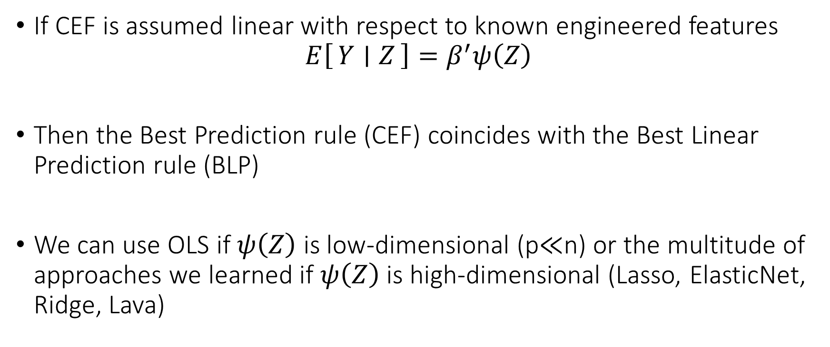
Blast from the Past: Linear CEF
If CEF is assumed linear with respect to known engineered features
$$E\left[Y ∣ Z\right]=β^{′}ψ\left(Z\right)$$
Then the Best Prediction rule (CEF) coincides with the Best Linear Prediction rule (BLP)
We can use OLS if $ψ\left(Z\right)$ is low-dimensional (p$≪$n) or the multitude of approaches we learned if $ψ\left(Z\right)$ is high-dimensional (Lasso, ElasticNet, Ridge, Lava)

Slide 21
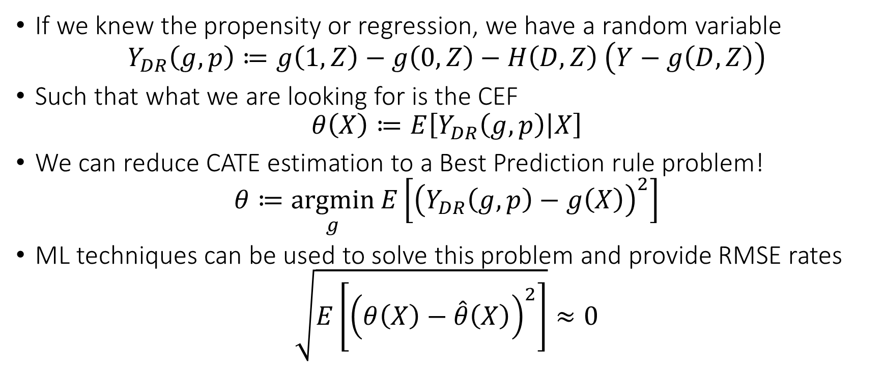
From Identification to Estimation
If we knew the propensity or regression, we have a random variable
$$Y_{DR}\left(g,p\right)≔g\left(1, Z\right)−g\left(0, Z\right)−H\left(D,Z\right) \left(Y−g\left(D,Z\right)\right)$$
Such that what we are looking for is the CEF
$$θ\left(X\right)≔E\left[Y_{DR}\left(g,p\right) | X\right]$$
We can reduce CATE estimation to a Best Prediction rule problem!
$$θ≔\underset{g}{argmin}{E\left[{\left(Y_{DR}\left(g,p\right)−g\left(X\right)\right)}^{2}\right]}$$
ML techniques can be used to solve this problem and provide RMSE rates
$$\sqrt{E\left[{\left(θ\left(X\right)−\hat{θ}\left(X\right)\right)}^{2}\right]}≈0$$

Slide 22


Doubly Robust Learning [Foster, Syrgkanis, ‘19 Orthogonal Statistical Learning]
Split your data in half
Train ML model $\hat{g}$ for $g_{0}\left(D,Z\right)≜E\left[Y | D,Z\right]$ on the first, predict on the second and calculate regression estimate of each potential outcome
$${\tilde{Y}}_{i}^{(d)}=\hat{g}\left(d, Z_{i}\right)$$
and vice versa
Train ML classification model ${\hat{p}}_{d}$ for $p_{d}\left(Z\right)≜Pr\left[D=d \right|Z]$ on the first, predict on the second, calculate propensity ${\hat{p}}_{d,i}=Pr⁡[D=d|Z_{i}]$ and vice versa
Calculate doubly robust values:
$${\tilde{Y}}_{i,DR}^{(d)}={\tilde{Y}}_{i}^{(d)}+\frac{\left(Y_{i}−{\tilde{Y}}_{i}^{\left(D_{i}\right)}\right)1\left\{D_{i}=d\right\}}{{\hat{p}}_{d,i}}$$
Any ML algorithm to solve the regression:
$${\tilde{Y}}_{i,DR}^{\left(1\right)}−{\tilde{Y}}_{i,DR}^{\left(0\right)} \sim X$$

Slide 23
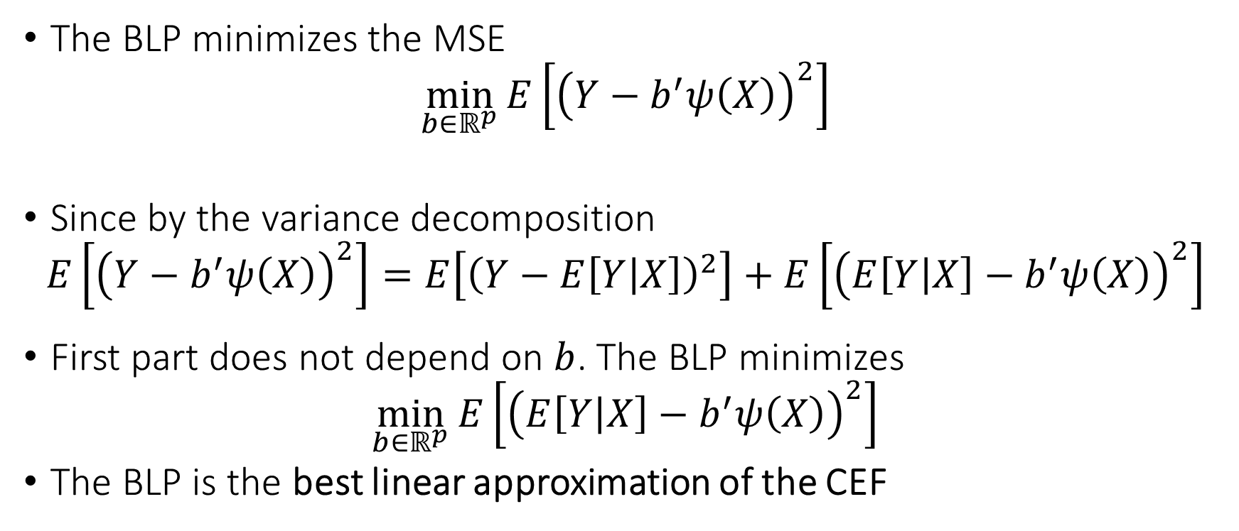
Blast from the Past: Best Linear Prediction (BLP) Problem
The BLP minimizes the MSE
$$\min_{b∈ℝ^{p}}{E\left[{\left(Y−b^{′}ψ\left(X\right)\right)}^{2}\right]}$$
Since by the variance decomposition
$$E\left[{\left(Y−b^{′}ψ\left(X\right)\right)}^{2}\right]=E\left[{\left(Y−E\left[Y | X\right]\right)}^{2}\right]+E\left[{\left(E\left[Y | X\right]−b^{′}ψ\left(X\right)\right)}^{2}\right]$$
First part does not depend on $b$. The BLP minimizes
$$\min_{b∈ℝ^{p}}{E\left[{\left(E\left[Y | X\right]−b^{′}ψ\left(X\right)\right)}^{2}\right]}$$
The BLP is the best linear approximation of the CEF

Slide 24
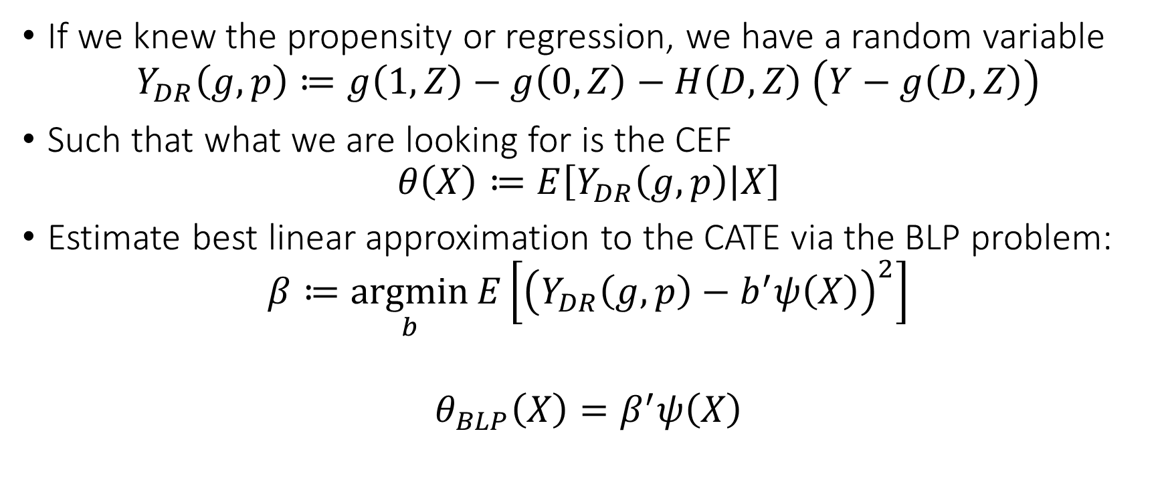
From Identification to Estimation
If we knew the propensity or regression, we have a random variable
$$Y_{DR}\left(g,p\right)≔g\left(1, Z\right)−g\left(0, Z\right)−H\left(D,Z\right) \left(Y−g\left(D,Z\right)\right)$$
Such that what we are looking for is the CEF
$$θ\left(X\right)≔E\left[Y_{DR}\left(g,p\right) | X\right]$$
Estimate best linear approximation to the CATE via the BLP problem:
$$β≔\underset{b}{argmin}{E\left[{\left(Y_{DR}\left(g,p\right)−b^{′}ψ\left(X\right)\right)}^{2}\right]}$$
$$θ_{BLP}\left(X\right)=β^{′}ψ\left(X\right)$$

Slide 25
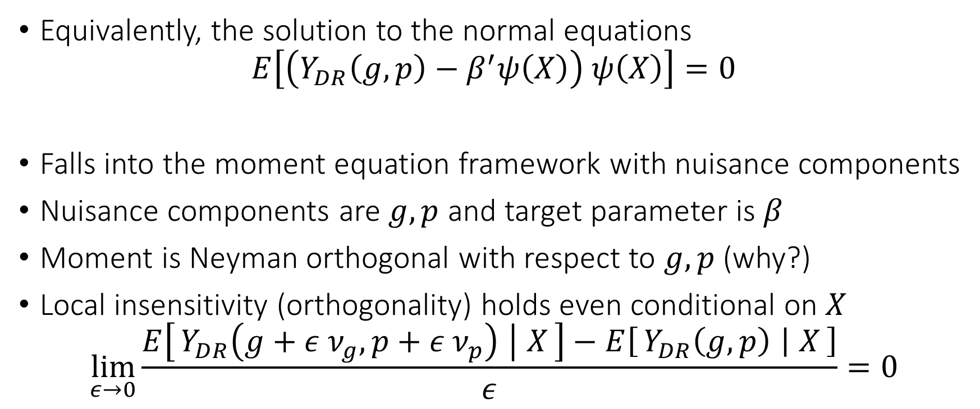
Normal Equations
Equivalently, the solution to the normal equations
$$E\left[\left(Y_{DR}\left(g,p\right)−β^{′}ψ\left(X\right)\right) ψ\left(X\right)\right]=0$$
Falls into the moment equation framework with nuisance components
Nuisance components are $g,p$ and target parameter is $β$
Moment is Neyman orthogonal with respect to $g,p$ (why?)
Local insensitivity (orthogonality) holds even conditional on $X$
$$\lim_{ε→0}{\frac{E\left[Y_{DR}\left(g+ε ν_{g},p+ε ν_{p}\right) ∣ X\right]−E\left[Y_{DR}\left(g,p\right) ∣ X\right]}{ε}}=0$$

Slide 26
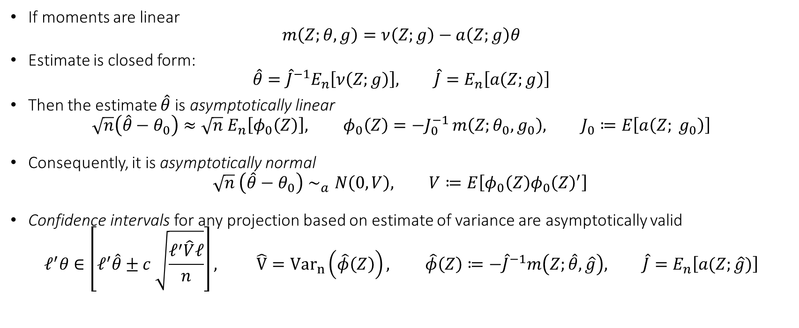
Main Theorem (linear moments)
If moments are linear
$$m\left(Z;θ,g\right)=ν\left(Z;g\right)−a\left(Z;g\right)θ$$
Estimate is closed form:
$$\hat{θ}={\hat{J}}^{−1}E_{n}\left[ν\left(Z;g\right)\right], \hat{J}=E_{n}\left[a\left(Z;g\right)\right]$$
Then the estimate $\hat{θ}$ is asymptotically linear
$$\sqrt{n}\left(\hat{θ}−θ_{0}\right)≈\sqrt{n} E_{n}\left[φ_{0}\left(Z\right)\right], φ_{0}\left(Z\right)=−J_{0}^{−1 }m\left(Z;θ_{0},g_{0}\right), J_{0}≔E\left[a\left(Z; g_{0}\right)\right]$$
Consequently, it is asymptotically normal
$$\sqrt{n} \left(\hat{θ}−θ_{0}\right)∼_{a}N\left(0, V\right), V≔E\left[φ_{0}\left(Z\right)φ_{0}{\left(Z\right)}^{′}\right]$$
Confidence intervals for any projection based on estimate of variance are asymptotically valid
$$ℓ^{′}θ∈\left[ℓ^{′}\hat{θ}±c \sqrt{\frac{ℓ^{′}\hat{V}ℓ}{n}}\right], \hat{V}={Var}_{n}\left(\hat{φ}\left(Z\right)\right), \hat{φ}\left(Z\right)≔−{\hat{J}}^{−1}m\left(Z;\hat{θ},\hat{g}\right), \hat{J}=E_{n}\left[a(Z;\hat{g})\right]$$

Slide 27
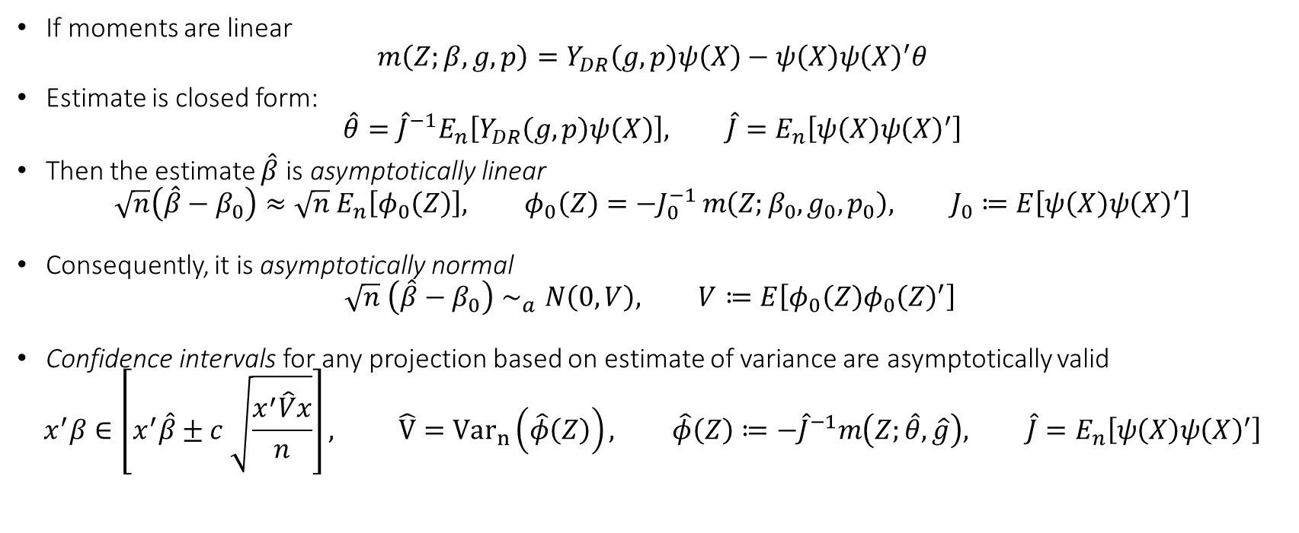
Main Theorem (linear moments)
If moments are linear
$$m\left(Z;β,g,p\right)=Y_{DR}\left(g,p\right)ψ\left(X\right)−ψ\left(X\right)ψ{\left(X\right)}^{′}θ$$
Estimate is closed form:
$$\hat{θ}={\hat{J}}^{−1}E_{n}\left[Y_{DR}\left(g,p\right)ψ\left(X\right)\right], \hat{J}=E_{n}\left[ψ\left(X\right)ψ{\left(X\right)}^{′}\right]$$
Then the estimate $\hat{β}$ is asymptotically linear
$$\sqrt{n}\left(\hat{β}−β_{0}\right)≈\sqrt{n} E_{n}\left[φ_{0}\left(Z\right)\right], φ_{0}\left(Z\right)=−J_{0}^{−1 }m\left(Z;β_{0},g_{0},p_{0}\right), J_{0}≔E\left[ψ\left(X\right)ψ{\left(X\right)}^{′}\right]$$
Consequently, it is asymptotically normal
$$\sqrt{n} \left(\hat{β}−β_{0}\right)∼_{a}N\left(0, V\right), V≔E\left[φ_{0}\left(Z\right)φ_{0}{\left(Z\right)}^{′}\right]$$
Confidence intervals for any projection based on estimate of variance are asymptotically valid
$$x^{′}β∈\left[x^{′}\hat{β}±c \sqrt{\frac{x^{′}\hat{V}x}{n}}\right], \hat{V}={Var}_{n}\left(\hat{φ}\left(Z\right)\right), \hat{φ}\left(Z\right)≔−{\hat{J}}^{−1}m\left(Z;\hat{θ},\hat{g}\right), \hat{J}=E_{n}\left[ψ\left(X\right)ψ{\left(X\right)}^{′}\right]$$

Slide 28
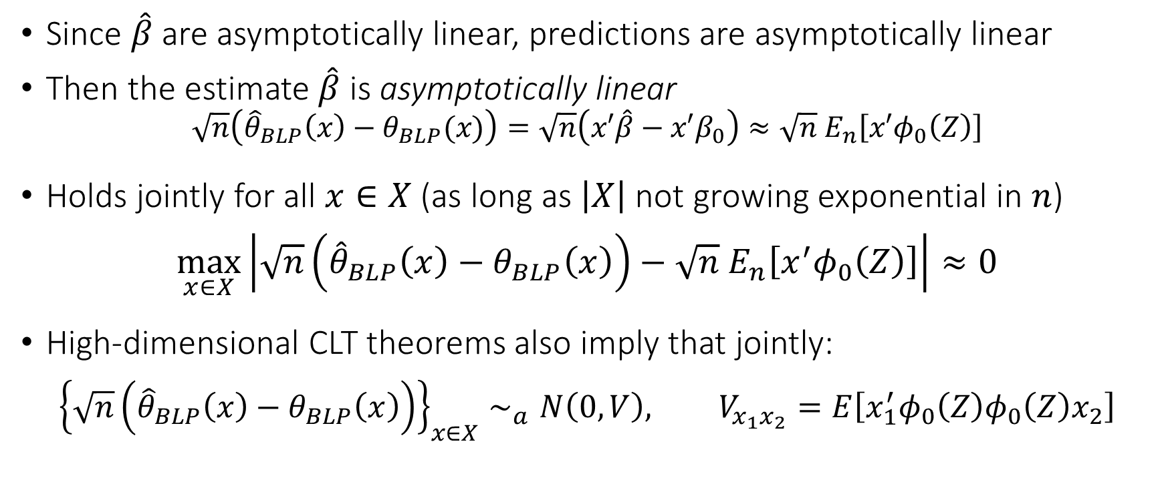
Confidence Bands
Since $\hat{β}$ are asymptotically linear, predictions are asymptotically linear
Then the estimate $\hat{β}$ is asymptotically linear
$$\sqrt{n}\left({\hat{θ}}_{BLP}\left(x\right)−θ_{BLP}(x)\right)=\sqrt{n}\left(x′\hat{β}−x′β_{0}\right)≈\sqrt{n} E_{n}\left[x′φ_{0}\left(Z\right)\right]$$
Holds jointly for all $x∈X$ (as long as $\left|X\right|$ not growing exponential in $n$)
$$\max_{x∈X}\left|\sqrt{n}\left({\hat{θ}}_{BLP}\left(x\right)−θ_{BLP}\left(x\right)\right)−\sqrt{n} E_{n}\left[x^{′}φ_{0}\left(Z\right)\right]\right|≈0$$
High-dimensional CLT theorems also imply that jointly:
$${\left\{\sqrt{n}\left({\hat{θ}}_{BLP}\left(x\right)−θ_{BLP}\left(x\right)\right)\right\}}_{x∈X}∼_{a}N\left(0,V\right), V_{x_{1}x_{2}}=E\left[x_{1}^{′}φ_{0}\left(Z\right)φ_{0}\left(Z\right)x_{2}\right]$$

Slide 29
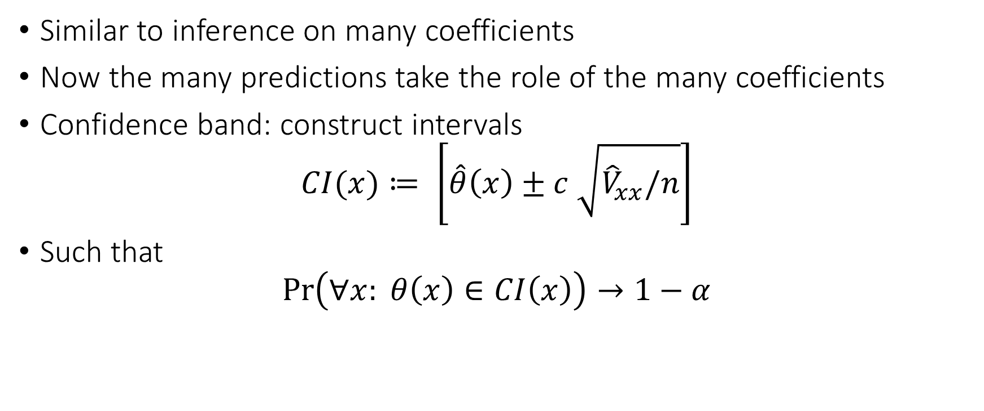
Confidence Bands
Similar to inference on many coefficients
Now the many predictions take the role of the many coefficients
Confidence band: construct intervals
$$CI(x)≔ \left[\hat{θ}\left(x\right)±c \sqrt{{\hat{V}}_{xx}/n}\right]$$
Such that
$$\operatorname{Pr}\left(∀x: θ\left(x\right)∈CI\left(x\right)\right)→1−α$$

Slide 30
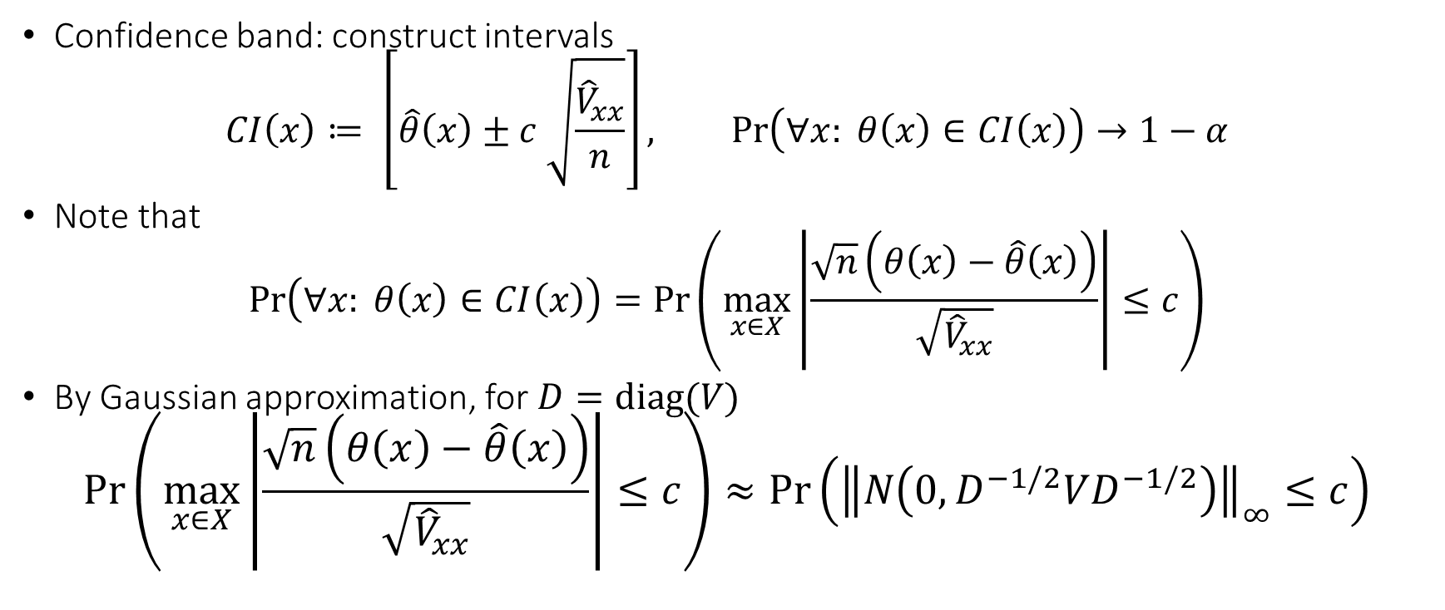
Confidence Bands
Confidence band: construct intervals
$$CI\left(x\right)≔ \left[\hat{θ}\left(x\right)±c \sqrt{\frac{{\hat{V}}_{xx}}{n}}\right], \operatorname{Pr}\left(∀x: θ\left(x\right)∈CI\left(x\right)\right)→1−α$$
Note that
$$\operatorname{Pr}\left(∀x: θ\left(x\right)∈CI\left(x\right)\right)=\operatorname{Pr}\left(\max_{x∈X}\left|\frac{\sqrt{n}\left(θ\left(x\right)−\hat{θ}\left(x\right)\right)}{\sqrt{{\hat{V}}_{xx}}}\right|≤c\right)$$
By Gaussian approximation, for $D=diag(V)$
$$\operatorname{Pr}\left(\max_{x∈X}\left|\frac{\sqrt{n}\left(θ\left(x\right)−\hat{θ}\left(x\right)\right)}{\sqrt{{\hat{V}}_{xx}}}\right|≤c\right)≈\operatorname{Pr}\left({\left\|N\left(0, D^{−1/2}VD^{−1/2}\right)\right\|}_{∞}≤c\right)$$

Slide 31

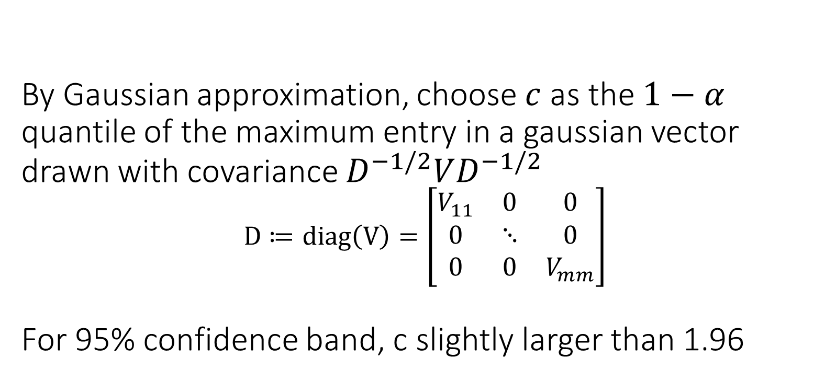
By Gaussian approximation, choose $c$ as the $1−α$ quantile of the maximum entry in a gaussian vector drawn with covariance $D^{−1/2}VD^{−1/2}$ $$D≔diag\left(V\right)=\left[\begin{matrix}V_{11} & 0 & 0 \\ 0 & ⋱ & 0 \\ 0 & 0 & V_{mm}\end{matrix}\right]$$ For 95% confidence band, c slightly larger than 1.96

Slide 32
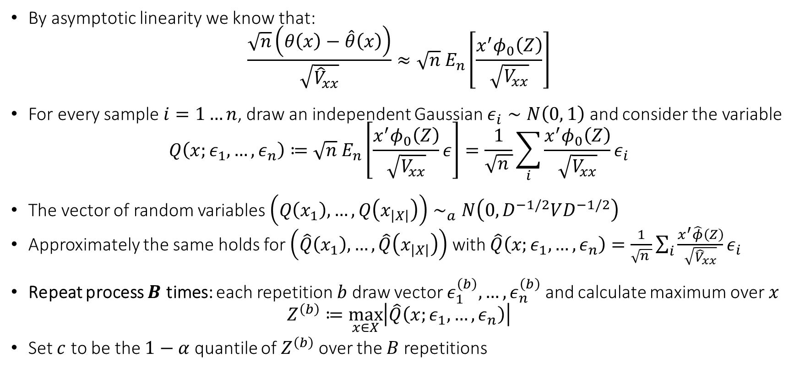
Computationally Friendlier Version: Multiplier Bootstrap
By asymptotic linearity we know that:
$$\frac{\sqrt{n}\left(θ\left(x\right)−\hat{θ}\left(x\right)\right)}{\sqrt{{\hat{V}}_{xx}}}≈\sqrt{n} E_{n}\left[\frac{x^{′}φ_{0}\left(Z\right)}{\sqrt{V_{xx}}}\right]$$
For every sample $i=1…n$, draw an independent Gaussian $ε_{i}∼N\left(0, 1\right)$ and consider the variable
$$Q\left(x;ε_{1},…,ε_{n}\right)≔\sqrt{n} E_{n}\left[\frac{x^{′}φ_{0}\left(Z\right)}{\sqrt{V_{xx}}}ε\right]=\frac{1}{\sqrt{n }}\sum_{i}{\frac{x^{′}φ_{0}\left(Z\right)}{\sqrt{V_{xx}}}ε_{i}}$$
The vector of random variables $\left(Q\left(x_{1}\right), …, Q\left(x_{\left|X\right|}\right)\right)∼_{a}N\left(0, D^{−1/2}VD^{−1/2}\right)$
Approximately the same holds for $\left(\hat{Q}\left(x_{1}\right), …, \hat{Q}\left(x_{\left|X\right|}\right)\right)$ with $\hat{Q}\left(x;ε_{1},…,ε_{n}\right)=\frac{1}{\sqrt{n }}\sum_{i}{\frac{x^{′}\hat{φ}\left(Z\right)}{\sqrt{{\hat{V}}_{xx}}}ε_{i}}$
Repeat process $B$ times: each repetition $b$ draw vector $ε_{1}^{\left(b\right)},…,ε_{n}^{\left(b\right)}$ and calculate maximum over $x$
$$Z^{\left(b\right)}≔\max_{x∈X}\left|\hat{Q}\left(x;ε_{1},…,ε_{n}\right)\right|$$
Set $c$ to be the $1−α$ quantile of $Z^{\left(b\right)}$ over the $B$ repetitions

