Slide 1
MS&E 228: Unobserved Confounding
Vasilis Syrgkanis
MS&E, Stanford

Slide 2
Causal Inference with Experiments
Prediction with Linear Models
Prediction with High-Dim Linear Models
Inference on Causal and Predictive Effects with High-Dim Linear Models
Potential Outcomes and Conditional Ignorability
Structural Equation Models and Conditional Exogeneity
Directed Acyclic Graphs
Prediction with Non-Linear Models
Inference on Causal Effects with Non-Linear Models
Un-observed Confounding and Instruments
Identification of Causal Effects in Longitudinal Data
Estimation of Heterogeneous Causal Effects
Linear Predictive Models and Statistical Inference
Causal Identification in Observational Data
Non-Linear Predictive Models and Statistical Inference
Topics

Slide 3
Causal Inference with Experiments
Prediction with Linear Models
Prediction with High-Dim Linear Models
Inference on Causal and Predictive Effects with High-Dim Linear Models
Potential Outcomes and Conditional Ignorability
Structural Equation Models and Conditional Exogeneity
Directed Acyclic Graphs
Prediction with Non-Linear Models
Inference on Causal Effects with Non-Linear Models
Un-observed Confounding and Instruments
Identification of Causal Effects in Longitudinal Data
Estimation of Heterogeneous Causal Effects
Linear Predictive Models and Statistical Inference
Causal Identification in Observational Data
Non-Linear Predictive Models and Statistical Inference
Topics

Slide 4
Goals for Today
What can we do when we have un-observed confounding
Omitted variable bias bounds
Introduction to “Instruments”

Slide 5
Recap of Last Lecture

Slide 6





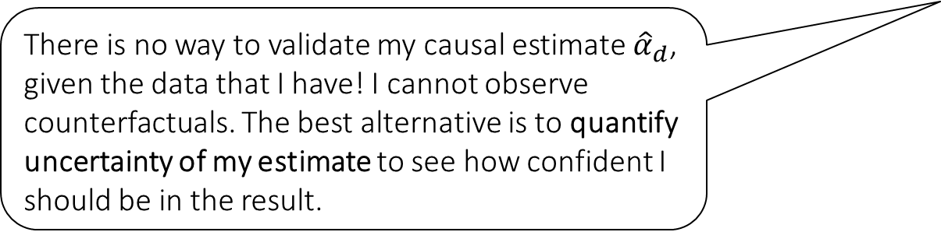



Causal Inference Pipeline
Data Collection
Estimation
(training)
Validation
(testing)
Domain Assumption Elicitation
Identification
Inference (Confidence Intervals)
DAGs/ASEMs
Construct estimate $\hat{g}\left(d,z\right)$ of predictive model
$$E\left[Y ∣ D=d,Z=z\right]$$
Estimate mean counterfactual
$${\hat{a}}_{d}=E_{n}\left[\hat{g}\left(d,Z\right)\right]$$
Theory
$$a_{d}$$
$$E\left[E\left[Y | D=d,Z\right]\right]$$
$$D$$
$$=$$
$$a_{d}∈{\hat{a}}_{d}±2\hat{σ}$$
$$Z$$
$$Y$$
There is no way to validate my causal estimate ${\hat{α}}_{d}$, given the data that I have! I cannot observe counterfactuals. The best alternative is to quantify uncertainty of my estimate to see how confident I should be in the result.
Sensitivity Analysis
Practice
$$a_{d}∈{\hat{a}}_{d}±(2\hat{σ}+ε)$$
Adaptive Experiments
Decision
Policy

Slide 7
Causal Inference Pipeline
Data Collection
Estimation
(training)
Validation
(testing)
Domain Assumption Elicitation
Identification
Inference (Confidence Intervals)
DAGs/ASEMs
Construct estimate $\hat{g}\left(d,z\right)$ of predictive model
$$E\left[Y ∣ D=d,Z=z\right]$$
Estimate mean counterfactual
$${\hat{a}}_{d}=E_{n}\left[\hat{g}\left(d,Z\right)\right]$$
Theory
$$a_{d}$$
$$E\left[E\left[Y | D=d,Z\right]\right]$$
$$D$$
$$=$$
$$a_{d}∈{\hat{a}}_{d}±2\hat{σ}$$
$$Z$$
$$Y$$
What if my conditional ignorability assumption was violated? How much would the estimate change?
Sensitivity Analysis
Practice
$$a_{d}∈{\hat{a}}_{d}±(2\hat{σ}+ε)$$
Adaptive Experiments
Decision
Policy

Slide 8
Causal Inference Pipeline
Data Collection
Estimation
(training)
Validation
(testing)
Domain Assumption Elicitation
Identification
Inference (Confidence Intervals)
DAGs/ASEMs
Construct estimate $\hat{g}\left(d,z\right)$ of predictive model
$$E\left[Y ∣ D=d,Z=z\right]$$
Estimate mean counterfactual
$${\hat{a}}_{d}=E_{n}\left[\hat{g}\left(d,Z\right)\right]$$
Theory
$$a_{d}$$
$$E\left[E\left[Y | D=d,Z\right]\right]$$
$$D$$
$$=$$
$$a_{d}∈{\hat{a}}_{d}±2\hat{σ}$$
$$Z$$
$$Y$$
Are there other ways of identifying the treatment effect I care about (other than identification by conditioning) when I have un-observed confounding?
Sensitivity Analysis
Practice
$$a_{d}∈{\hat{a}}_{d}±(2\hat{σ}+ε)$$
Adaptive Experiments
Decision
Policy

Slide 9
Application: Effect of 401k

Slide 10
Problem
Impact of 401k eligibility on financial assets
Working for a firm that offers access to 401k eligibility not randomly assigned
After conditioning on important characteristics of the worker and job, assignment can be thought as exogenous
Most important: income
At least around 1991 (early in 401k deployment), workers would not really base their employment decision on 401k eligibility

Slide 11
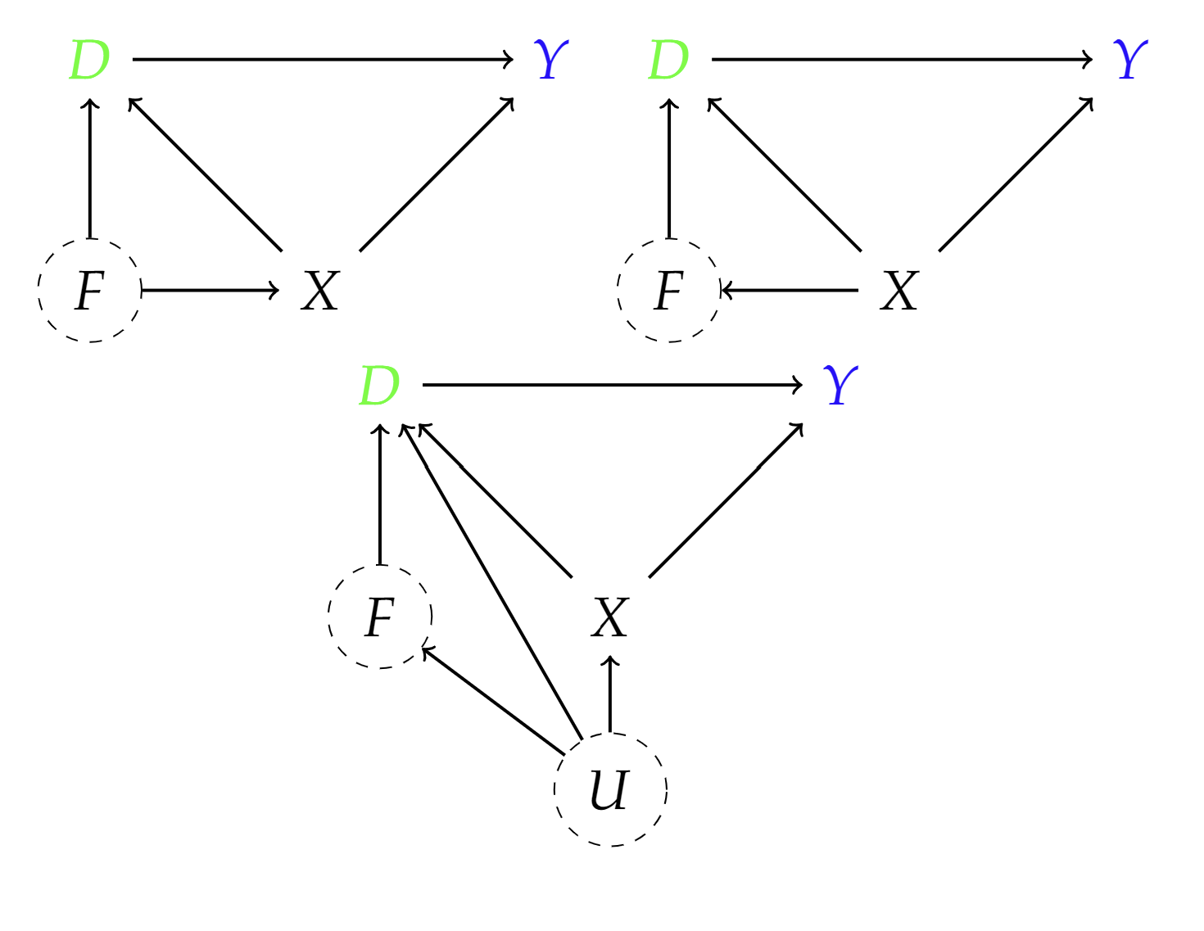
Causal Diagrams
F: firm characteristics
D: eligibility for 401k
Y: net financial assets
X: age, income, family size, years of education, a married indicator, a two-earner status indicator, a defined benefit pension status indicator, an IRA participation indicator, and a home ownership indicator
Let’s try it out!

Slide 12
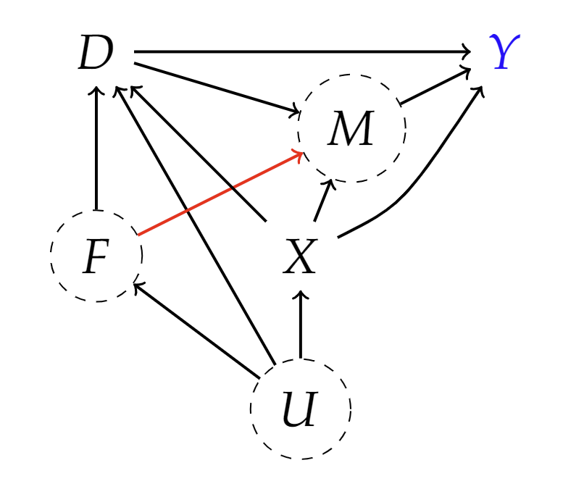
Possible Violations
F: firm characteristics
D: eligibility for 401k
Y: net financial assets
X: age, income, family size, years of education, a married indicator, a two-earner status indicator, a defined benefit pension status indicator, an IRA participation indicator, and a home ownership indicator
M: match amount

Slide 13
Unobserved Confounding: Overview of Today’s Content

Slide 14
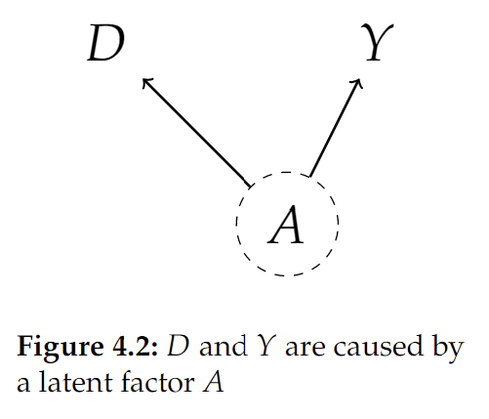
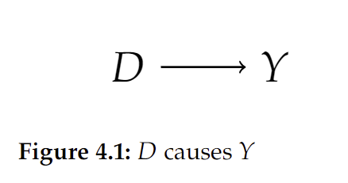
Unobserved Confounding
If there are confounding factors that are un-observed, we cannot distinguish between an effect and a spurious correlation, without further structure

Slide 15
Unobserved Confounding
If there are confounding factors that are un-observed, we cannot distinguish between an effect and a spurious correlation, without further structure

Slide 16
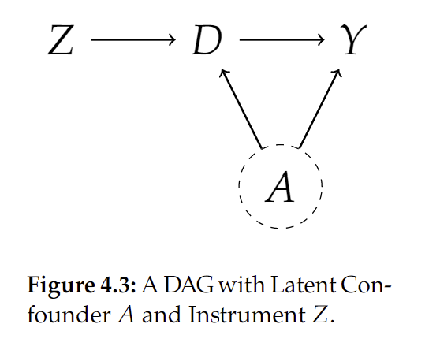
One Type of Structure: Instruments
We already saw one example of more structure in the assignments (which one?)
The structure we will investigate today are instruments

Slide 17
Bias Bounds

Slide 18

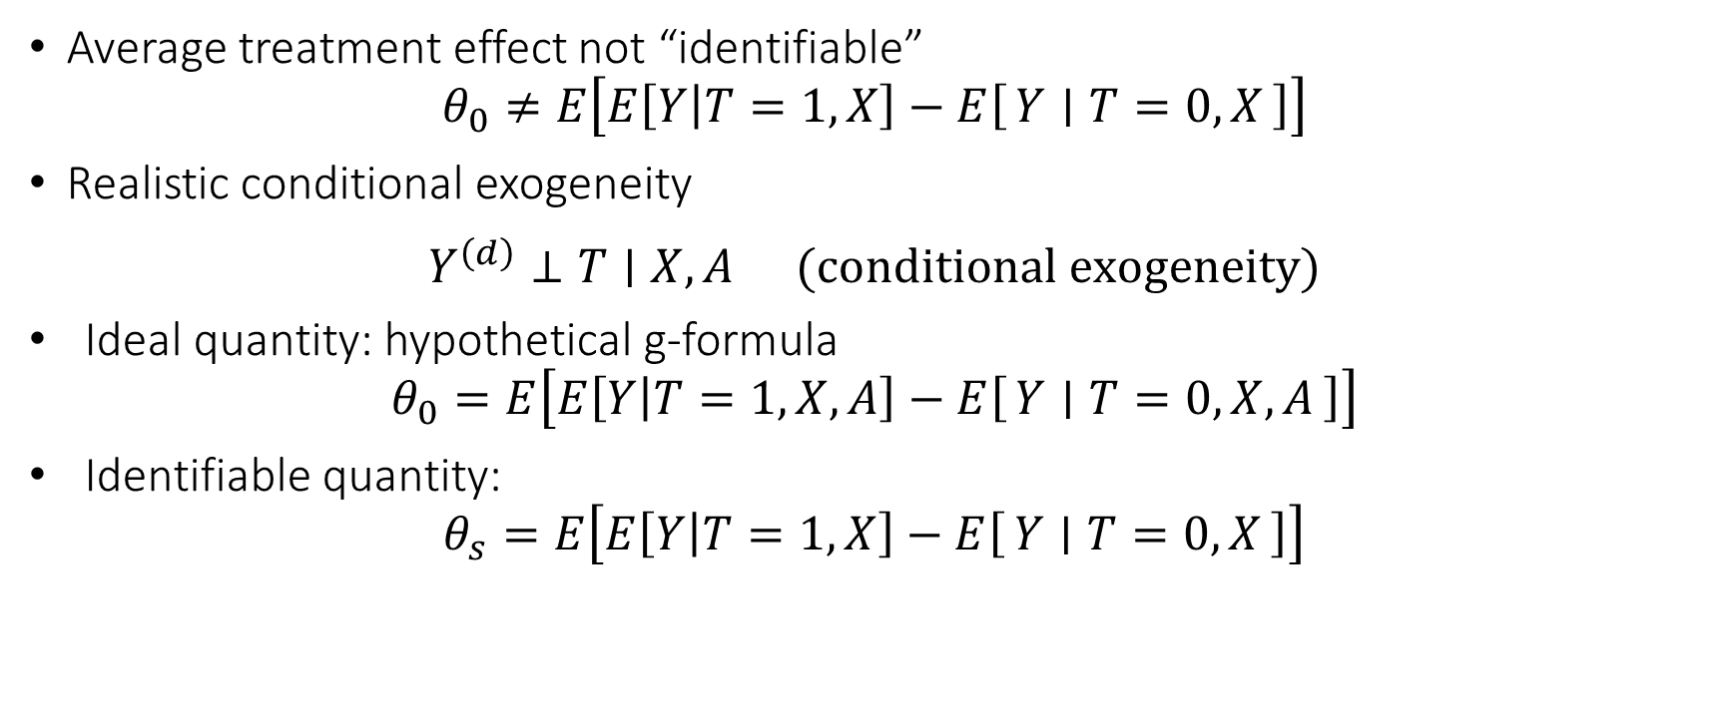


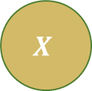
Very Frequently Unobserved Confounders
Average treatment effect not “identifiable”
$$θ_{0}≠E\left[E\left[Y | T=1,X\right]−E\left[Y ∣ T=0,X\right]\right]$$
Realistic conditional exogeneity
$$\begin{matrix}Y^{\left(d\right)}⊥T∣X,A & (conditional exogeneity)\end{matrix}$$
Ideal quantity: hypothetical g-formula
$$θ_{0}=E\left[E\left[Y | T=1,X,A\right]−E\left[Y ∣ T=0,X,A\right]\right]$$
Identifiable quantity:
$$θ_{s}=E\left[E\left[Y | T=1,X\right]−E\left[Y ∣ T=0,X\right]\right]$$
$$T$$
$$X$$
$$Y$$
$$A$$

Slide 19

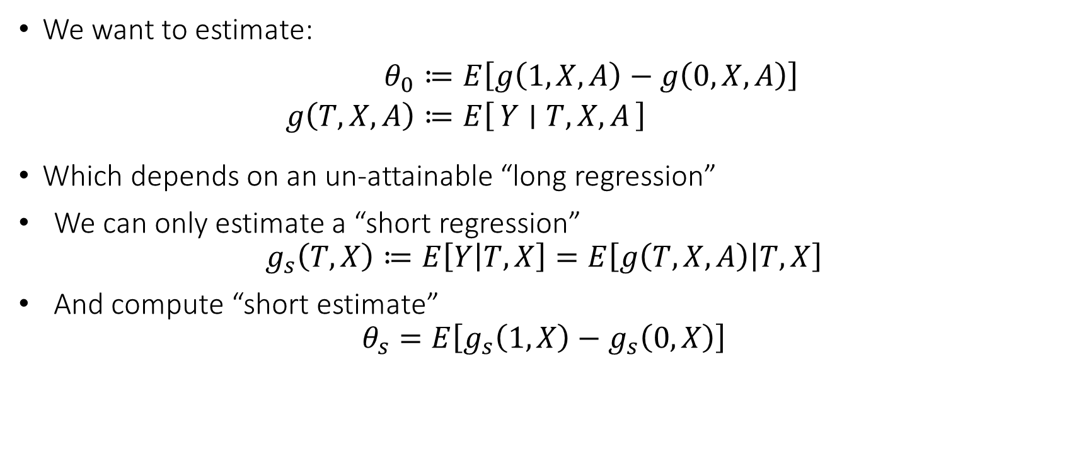



Omitted Variable Bias
We want to estimate:
$$\begin{aligned}θ_{0}≔&E\left[g\left(1,X,A\right)−g\left(0,X,A\right)\right] \\ g\left(T,X,A\right)≔&E\left[Y ∣ T,X,A\right]\end{aligned}$$
Which depends on an un-attainable “long regression”
We can only estimate a “short regression”
$$g_{s}\left(T,X\right)≔E\left[Y | T,X\right]=E\left[g\left(T,X,A\right) | T,X\right]$$
And compute “short estimate”
$$θ_{s}=E\left[g_{s}\left(1,X\right)−g_{s}\left(0,X\right)\right]$$
$$T$$
$$X$$
$$Y$$
$$A$$

Slide 20
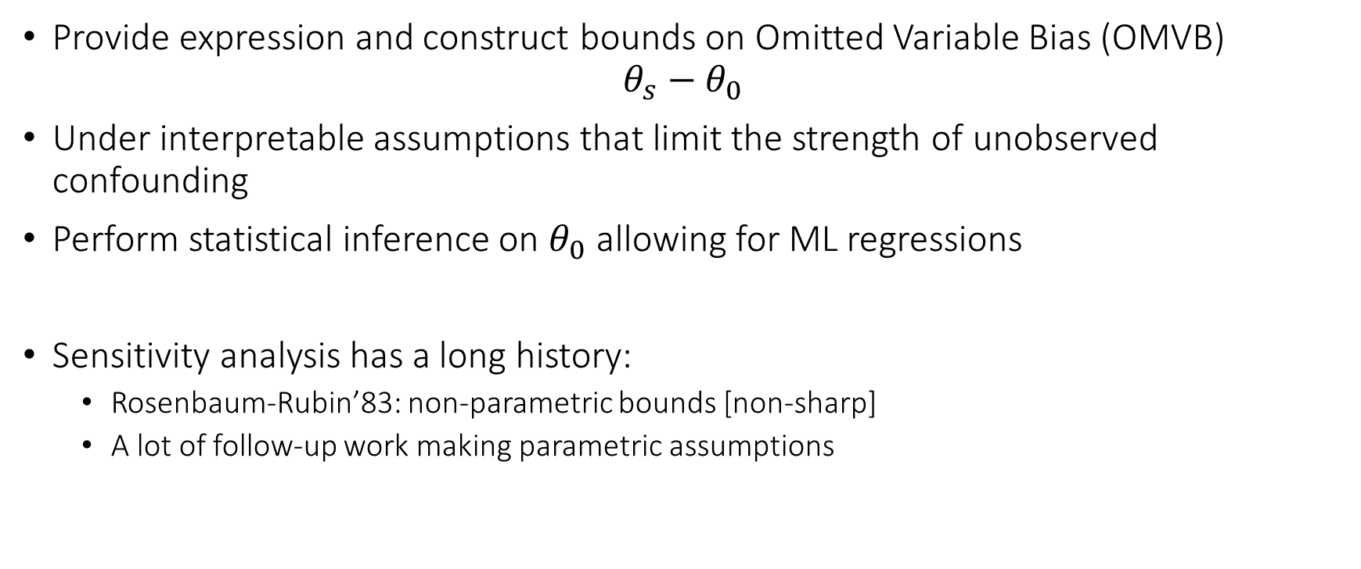
Omitted Variable Bias Bounds
Provide expression and construct bounds on Omitted Variable Bias (OMVB)
$$θ_{s}−θ_{0}$$
Under interpretable assumptions that limit the strength of unobserved confounding
Perform statistical inference on $θ_{0}$ allowing for ML regressions
Sensitivity analysis has a long history:
Rosenbaum-Rubin’83: non-parametric bounds [non-sharp]
A lot of follow-up work making parametric assumptions

Slide 21


Slide 22


Slide 23
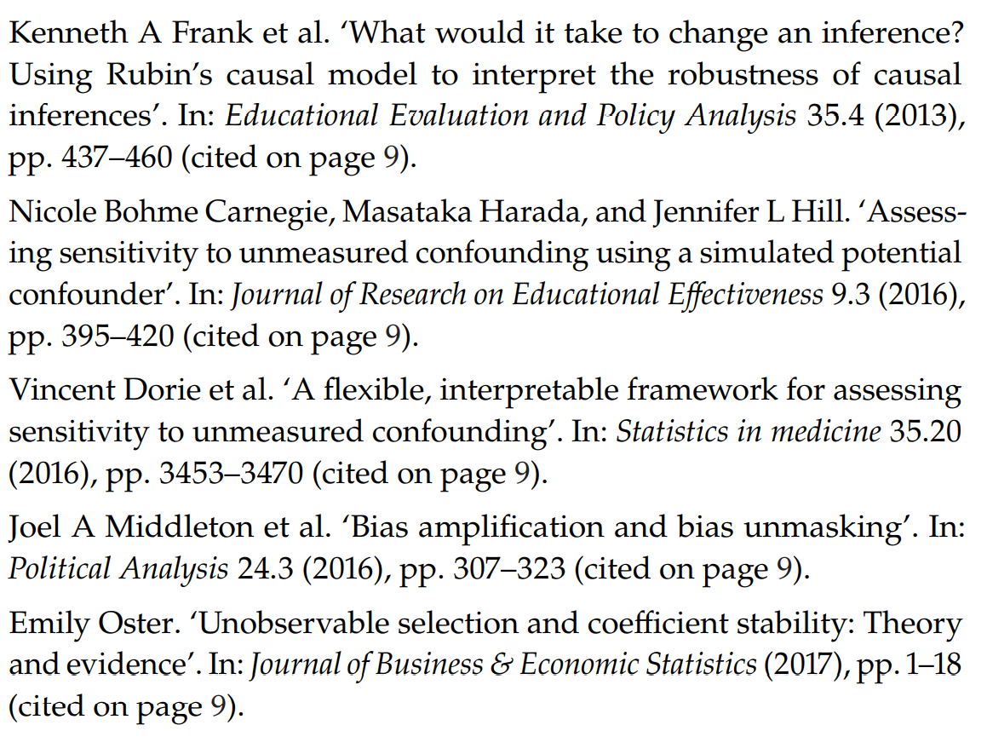

Slide 24
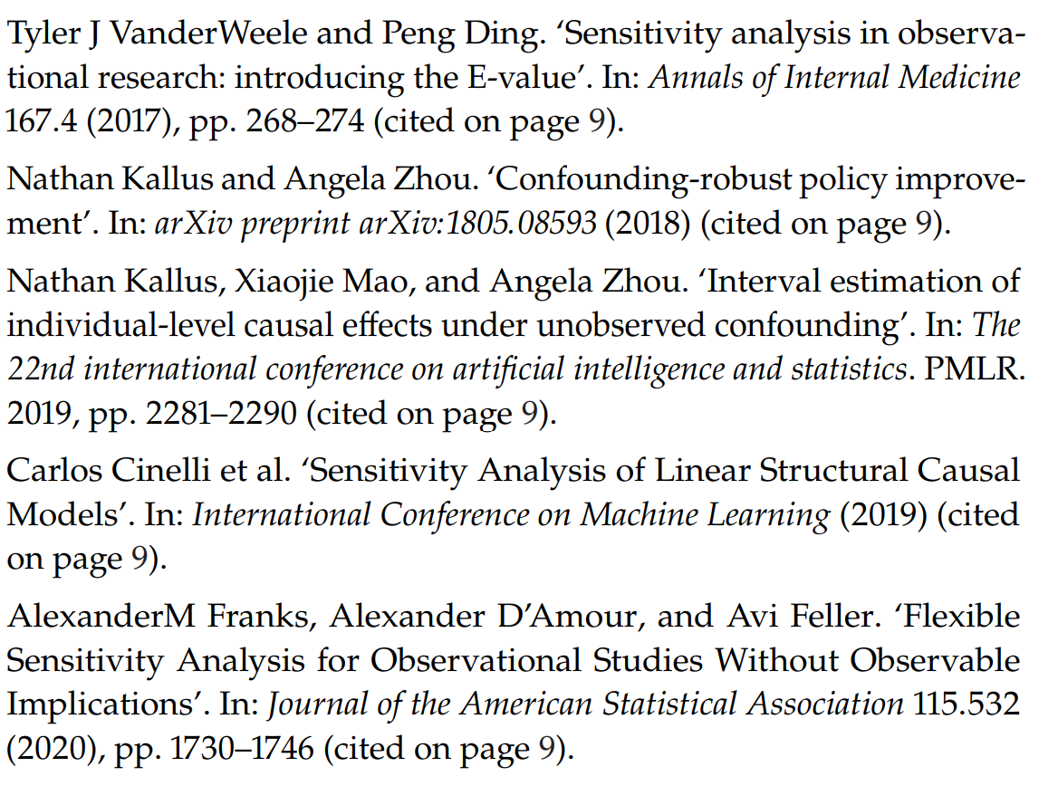

Slide 25
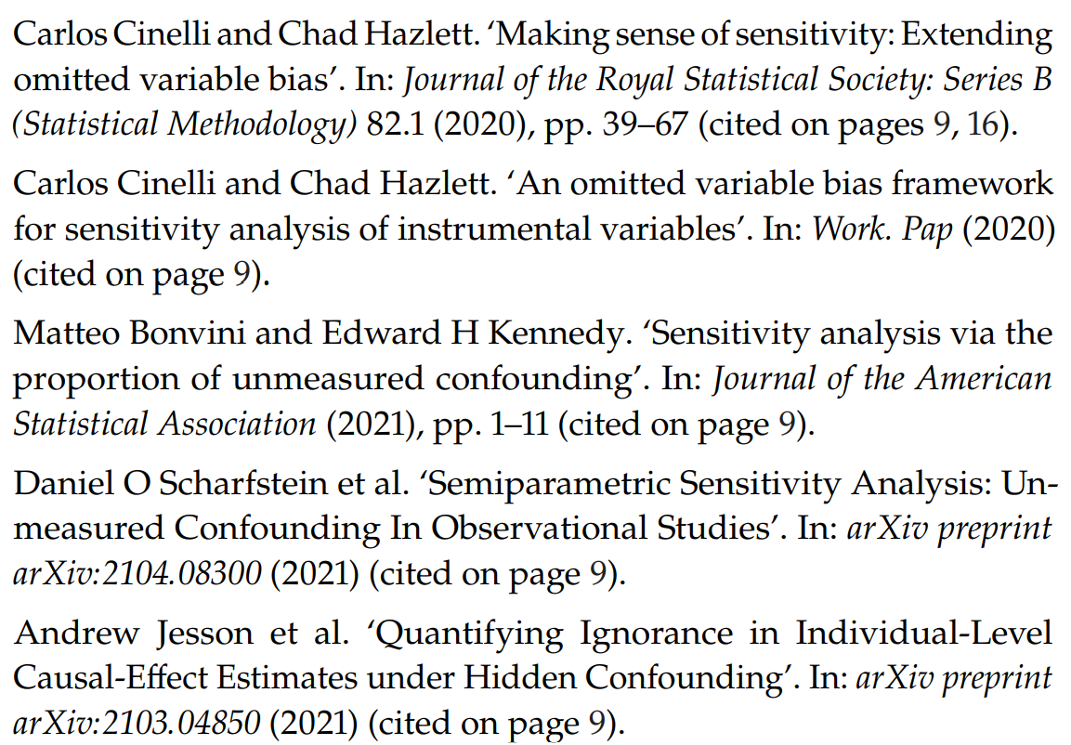

Slide 26
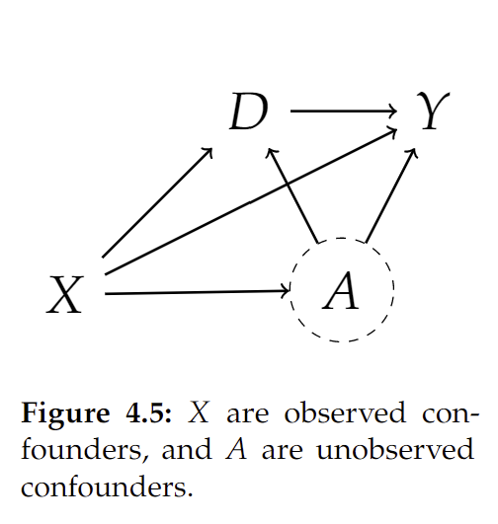

Omitted Variable Bias: Partially Linear Models
Let’s consider a simpler structural equation model
$$\begin{aligned}Y≔&aD+δA+f_{Y}\left(X\right)+ε_{Y} \\ D≔&γA+f_{D}\left(X\right)+ε_{D} \\ A≔&f_{A}\left(X\right)+ε_{A} \\ X≔&ε_{X}\end{aligned}$$

Slide 27
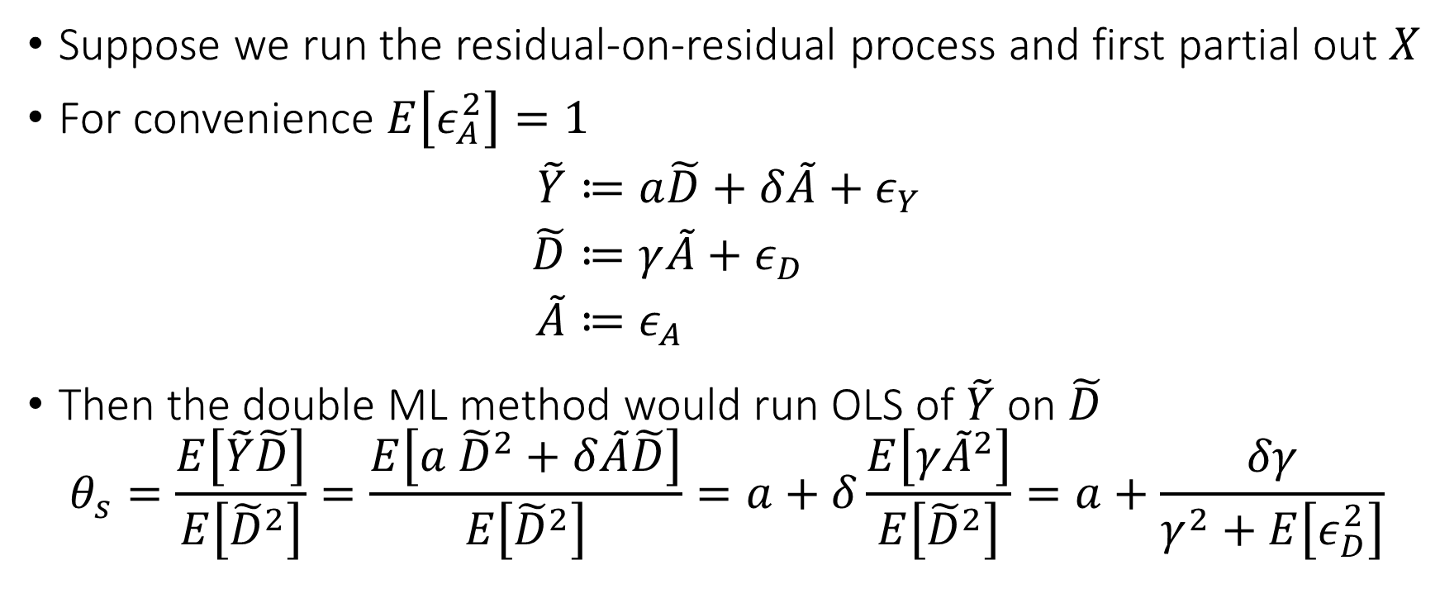
Omitted Variable Bias: Partially Linear Models
Suppose we run the residual-on-residual process and first partial out $X$
For convenience $E\left[ε_{A}^{2}\right]=1$
$$\begin{aligned}\tilde{Y}≔&a\tilde{D}+δ\tilde{A}+ε_{Y} \\ \tilde{D}≔&γ\tilde{A}+ε_{D} \\ \tilde{A}≔&ε_{A}\end{aligned}$$
Then the double ML method would run OLS of $\tilde{Y}$ on $\tilde{D}$
$$θ_{s}=\frac{E\left[\tilde{Y}\tilde{D}\right]}{E\left[{\tilde{D}}^{2}\right]}=\frac{E\left[a {\tilde{D}}^{2}+δ\tilde{A}\tilde{D}\right]}{E\left[{\tilde{D}}^{2}\right]}=a+δ\frac{E\left[γ{\tilde{A}}^{2}\right]}{E\left[{\tilde{D}}^{2}\right]}=a+\frac{δγ}{γ^{2}+E\left[ε_{D}^{2}\right]}$$

Slide 28
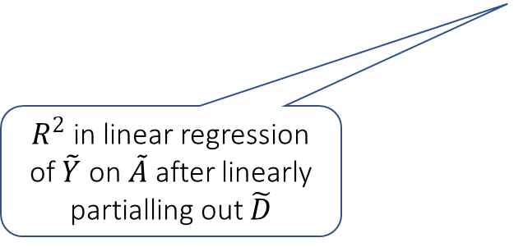
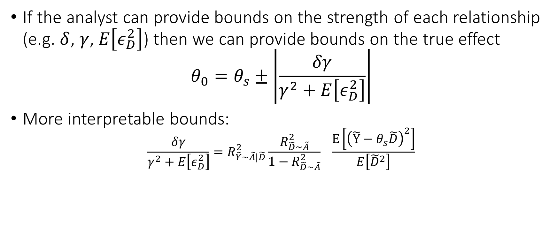
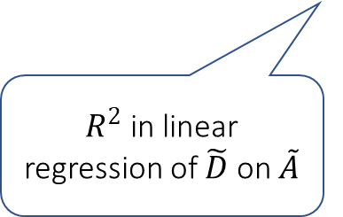
Bias Bounds
If the analyst can provide bounds on the strength of each relationship (e.g. $δ$, $γ$, $E\left[ε_{D}^{2}\right]$) then we can provide bounds on the true effect
$$θ_{0}=θ_{s}±\left|\frac{δγ}{γ^{2}+E\left[ε_{D}^{2}\right]}\right|$$
More interpretable bounds:
$$\frac{δγ}{γ^{2}+E\left[ε_{D}^{2}\right]}=R_{\tilde{Y}\sim \tilde{A}|\tilde{D}}^{2}\frac{R_{\tilde{D}\sim \tilde{A}}^{2}}{1−R_{\tilde{D}\sim \tilde{A}}^{2}} \frac{E\left[{\left(\tilde{Y}−θ_{s}\tilde{D}\right)}^{2}\right]}{E\left[{\tilde{D}}^{2}\right]}$$
Measurable from the data
$R^{2}$ in linear regression of $\tilde{Y}$ on $\tilde{A}$ after linearly partialling out $\tilde{D}$
$R^{2}$ in linear regression of $\tilde{D}$ on $\tilde{A}$

Slide 29
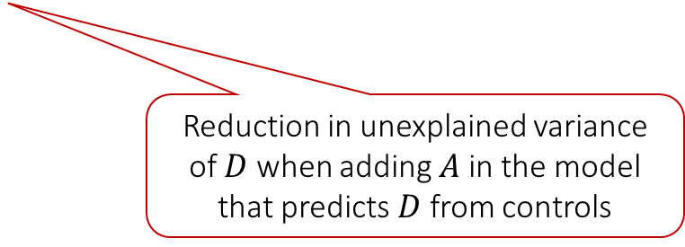
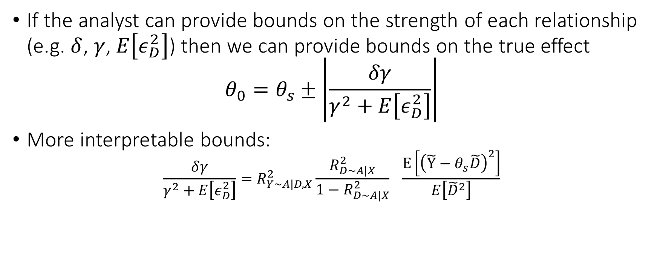
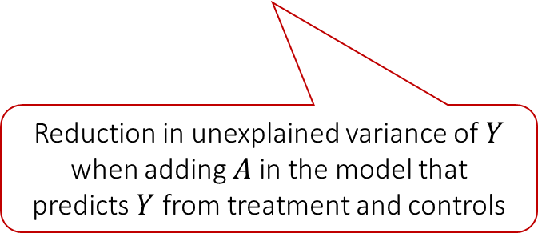
Bias Bounds
If the analyst can provide bounds on the strength of each relationship (e.g. $δ$, $γ$, $E\left[ε_{D}^{2}\right]$) then we can provide bounds on the true effect
$$θ_{0}=θ_{s}±\left|\frac{δγ}{γ^{2}+E\left[ε_{D}^{2}\right]}\right|$$
More interpretable bounds:
$$\frac{δγ}{γ^{2}+E\left[ε_{D}^{2}\right]}=R_{Y\sim A|D,X}^{2}\frac{R_{D\sim A|X}^{2}}{1−R_{D∼A|X}^{2}} \frac{E\left[{\left(\tilde{Y}−θ_{s}\tilde{D}\right)}^{2}\right]}{E\left[{\tilde{D}}^{2}\right]}$$
Measurable from the data
For more details:
Making Sense of Sensitivity: Extending Omitted Variable Bias
For more general analysis see:
Long Story Short: Omitted Variable Bias in Causal Machine Learning
Reduction in unexplained variance of $Y$ when adding $A$ in the model that predicts $Y$ from treatment and controls
Reduction in unexplained variance of $D$ when adding $A$ in the model that predicts $D$ from controls

Slide 30
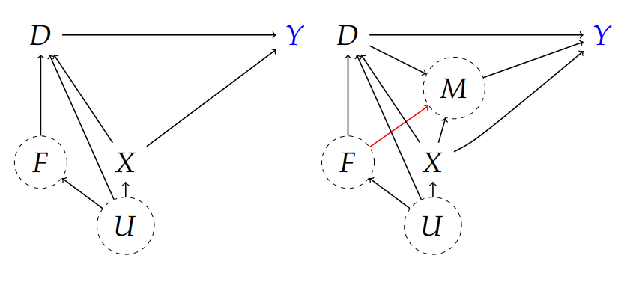
Application: 401k eligibility
Y=net financial assets
D=eligibility to enroll in 401(k) program
X=pre-treatment worker-level covariates (observed)
F=pre-treatment firm-level covariates (unobserved)
M=amount of contribution matched by employer
U=general latent factors
Controlling for X is sufficient in top figure but not bottom

Slide 31
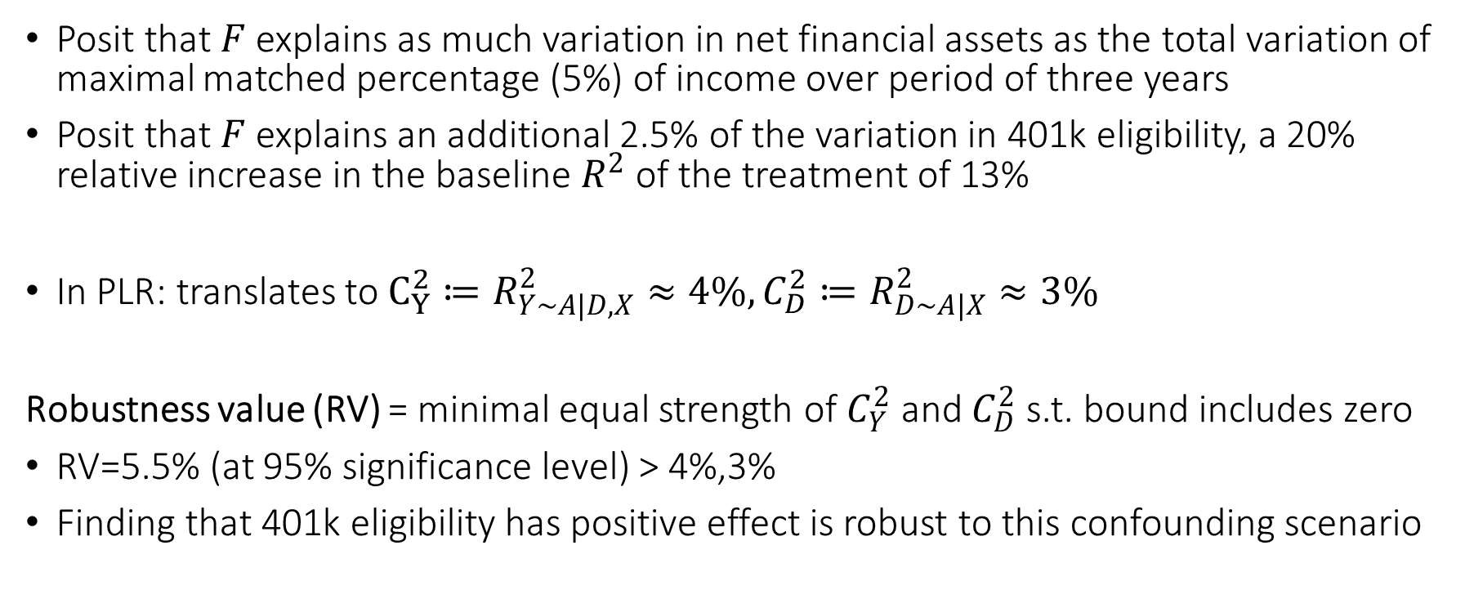
Confounding Scenario
Posit that $F$ explains as much variation in net financial assets as the total variation of maximal matched percentage (5%) of income over period of three years
Posit that $F$ explains an additional 2.5% of the variation in 401k eligibility, a 20% relative increase in the baseline $R^{2}$ of the treatment of 13%
In PLR: translates to $C_{Y}^{2}≔R_{Y\sim A|D,X}^{2}≈4\%, C_{D}^{2}≔R_{D∼A|X}^{2}≈3\%$
Robustness value (RV) = minimal equal strength of $C_{Y}^{2}$ and $C_{D}^{2}$ s.t. bound includes zero
RV=5.5% (at 95% significance level) > 4%,3%
Finding that 401k eligibility has positive effect is robust to this confounding scenario

Slide 32
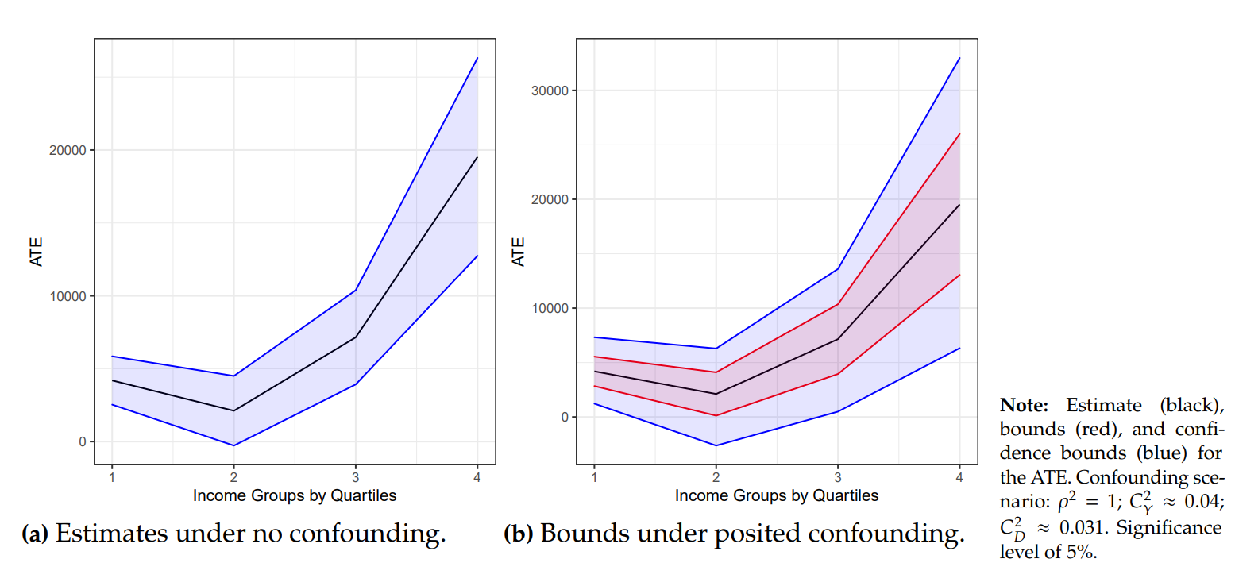

Slide 33
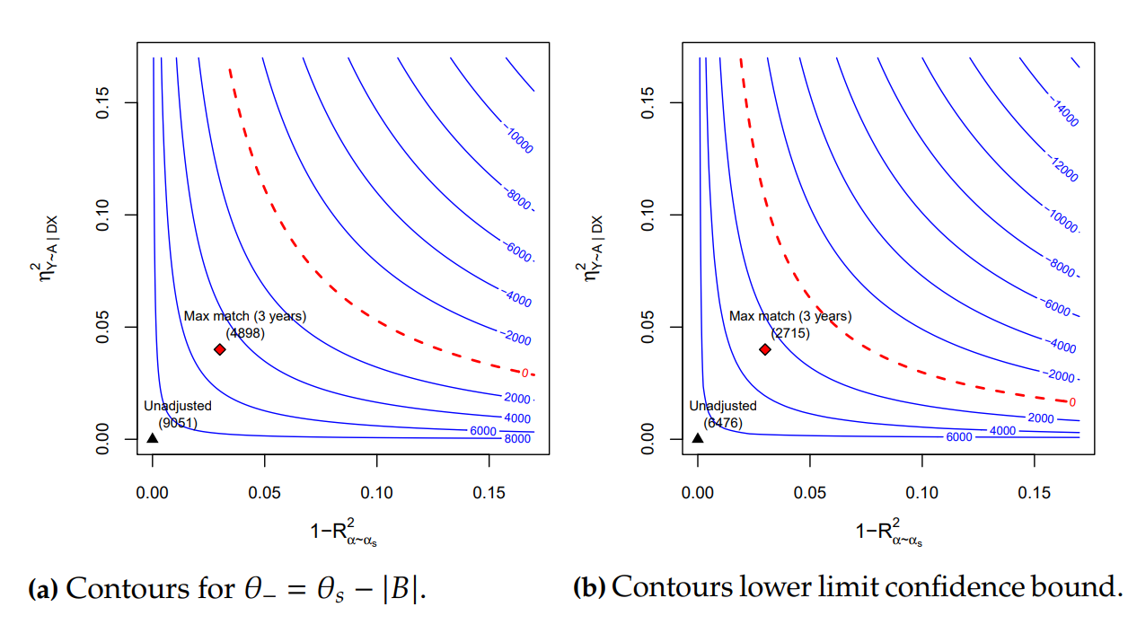




$$R_{Y∼A|D,X}^{2}$$
$$R_{Y∼A|D,X}^{2}$$
$$R_{D∼A|X}^{2}$$
$$R_{D∼A|X}^{2}$$

Slide 34
Can we recover the true effect? Instrumental Variables

Slide 35
Instrumental Variables and 2SLS
U
unobserved confounder
Instrumental Variable: any random variable Z that affects the treatment (log-price) D but does not affect the outcome (log-demand) Y other than through the treatment [Wright’28, Bowden-Turkington’90, Angrist-Krueger’91, Imbens-Angrist’94]
instrument
treatment
Z
D
Y
outcome
causal
model
predictive
model
Z= lenient approver
demand
demand
Z= strict approver
mean demand
with strict approver
price
mean price
with strict approver
price

Slide 36
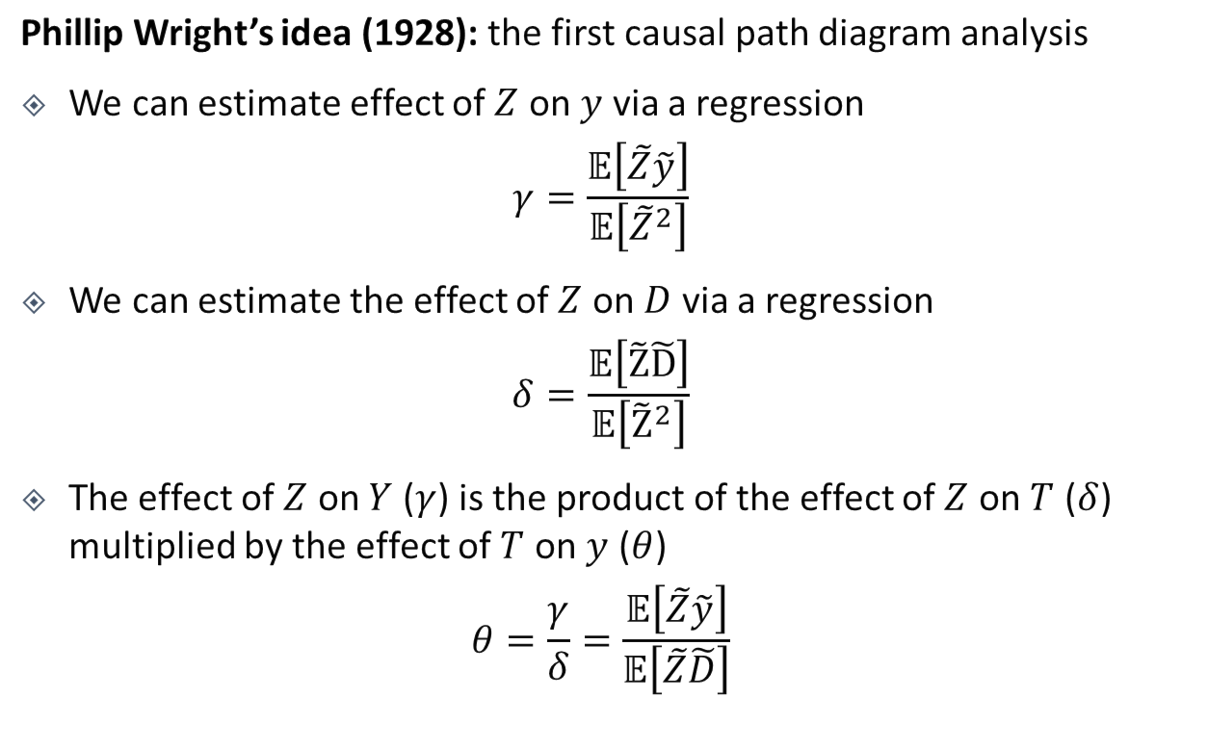
Identification of Causal Effects via Instruments
U
unobserved confounder
Phillip Wright’s idea (1928): the first causal path diagram analysis
We can estimate effect of $Z$ on $y$ via a regression
$$γ=\frac{𝔼\left[\tilde{Z}\tilde{y}\right]}{𝔼\left[{\tilde{Z}}^{2}\right]}$$
We can estimate the effect of $Z$ on $D$ via a regression
$$δ=\frac{𝔼\left[\tilde{Z}\tilde{D}\right]}{𝔼\left[{\tilde{Z}}^{2}\right]}$$
The effect of $Z$ on $Y$ ($γ$) is the product of the effect of $Z$ on $T$ ($δ$) multiplied by the effect of $T$ on $y$ ($θ$)
$$θ=\frac{γ}{δ}=\frac{𝔼\left[\tilde{Z}\tilde{y}\right]}{𝔼\left[\tilde{Z}\tilde{D}\right]}$$
instrument
treatment
Z
D
Y
outcome

Slide 37
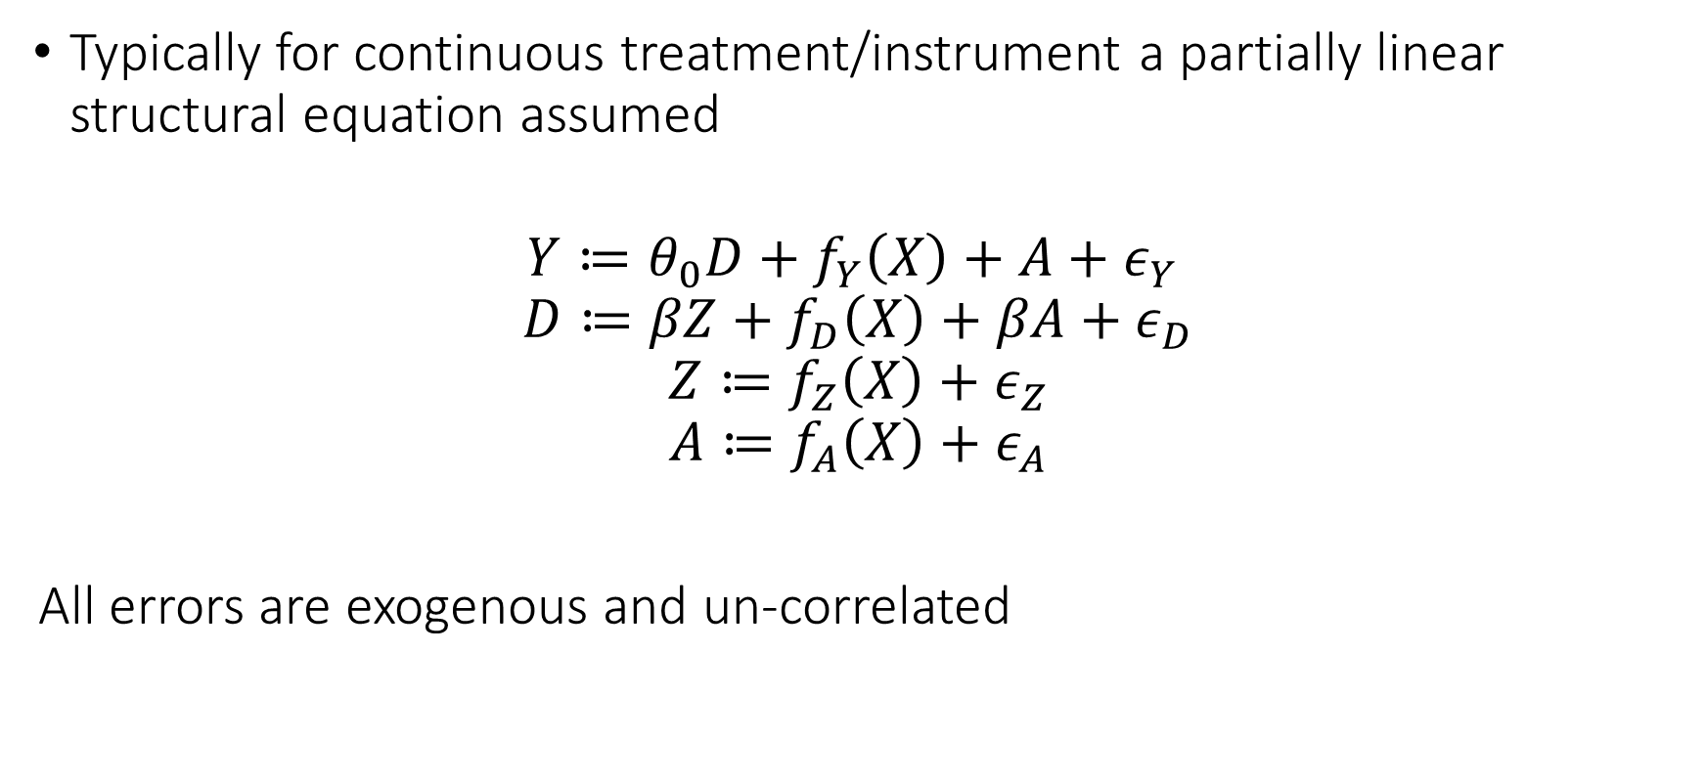
Partially Linear Instrumental Variable Model
Typically for continuous treatment/instrument a partially linear structural equation assumed
$$Y≔θ_{0}D+f_{Y}\left(X\right)+A+ε_{Y}$$
$$D≔βZ+f_{D}\left(X\right)+βA+ε_{D}$$
$$Z≔f_{Z}\left(X\right)+ε_{Z}$$
$$A≔f_{A}\left(X\right)+ε_{A}$$
All errors are exogenous and un-correlated

Slide 38
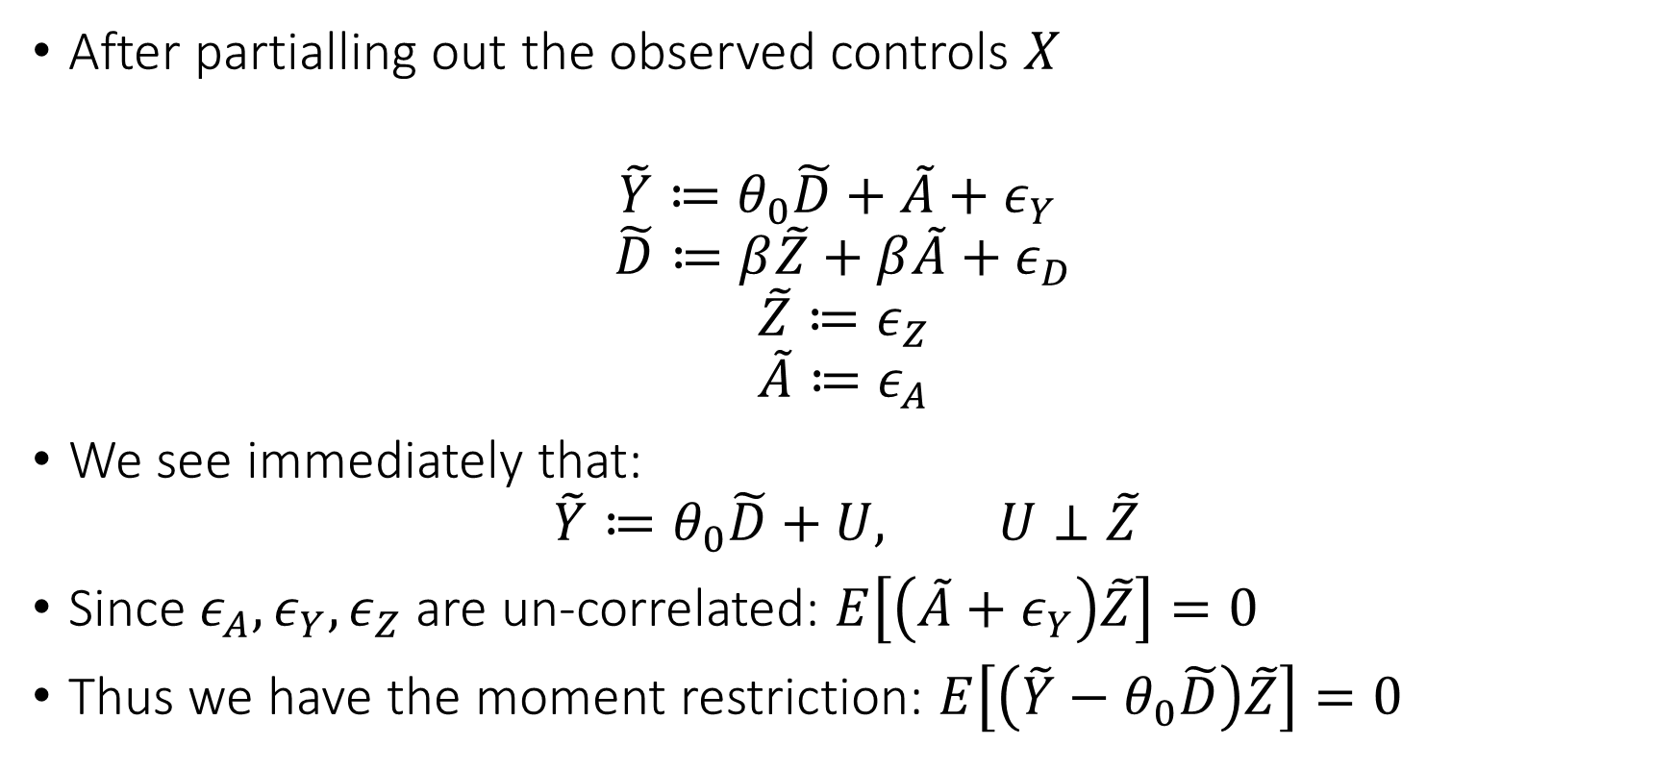
Partially Linear Instrumental Variable Model
After partialling out the observed controls $X$
$$\tilde{Y}≔θ_{0}\tilde{D}+\tilde{A}+ε_{Y}$$
$$\tilde{D}≔β\tilde{Z}+β\tilde{A}+ε_{D}$$
$$\tilde{Z}≔ε_{Z}$$
$$\tilde{A}≔ε_{A}$$
We see immediately that:
$$\tilde{Y}≔θ_{0}\tilde{D}+U, U⊥\tilde{Z}$$
Since $ε_{A},ε_{Y},ε_{Z}$ are un-correlated: $E\left[\left(\tilde{A}+ε_{Y}\right)\tilde{Z}\right]=0$
Thus we have the moment restriction: $E\left[\left(\tilde{Y}−θ_{0}\tilde{D}\right)\tilde{Z}\right]=0$

Slide 39
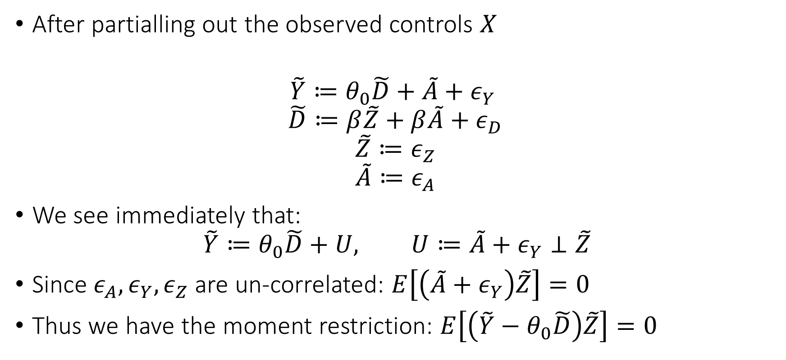
Partially Linear Instrumental Variable Model
After partialling out the observed controls $X$
$$\tilde{Y}≔θ_{0}\tilde{D}+\tilde{A}+ε_{Y}$$
$$\tilde{D}≔β\tilde{Z}+β\tilde{A}+ε_{D}$$
$$\tilde{Z}≔ε_{Z}$$
$$\tilde{A}≔ε_{A}$$
We see immediately that:
$$\tilde{Y}≔θ_{0}\tilde{D}+U, U≔\tilde{A}+ε_{Y}⊥\tilde{Z}$$
Since $ε_{A},ε_{Y},ε_{Z}$ are un-correlated: $E\left[\left(\tilde{A}+ε_{Y}\right)\tilde{Z}\right]=0$
Thus we have the moment restriction: $E\left[\left(\tilde{Y}−θ_{0}\tilde{D}\right)\tilde{Z}\right]=0$

Slide 40
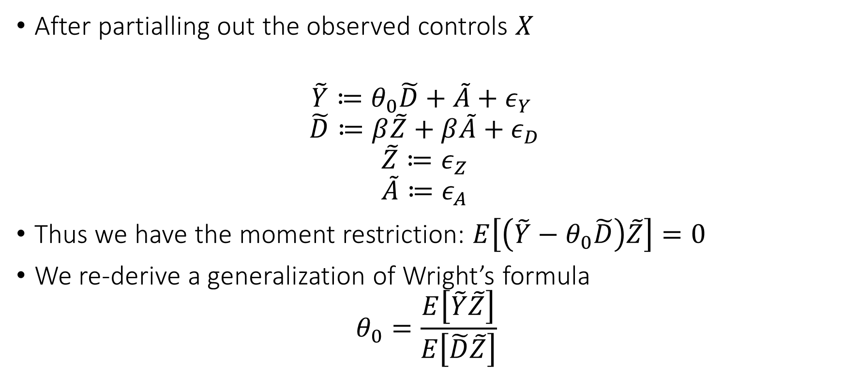
Partially Linear Instrumental Variable Model
After partialling out the observed controls $X$
$$\tilde{Y}≔θ_{0}\tilde{D}+\tilde{A}+ε_{Y}$$
$$\tilde{D}≔β\tilde{Z}+β\tilde{A}+ε_{D}$$
$$\tilde{Z}≔ε_{Z}$$
$$\tilde{A}≔ε_{A}$$
Thus we have the moment restriction: $E\left[\left(\tilde{Y}−θ_{0}\tilde{D}\right)\tilde{Z}\right]=0$
We re-derive a generalization of Wright’s formula
$$θ_{0}=\frac{E\left[\tilde{Y}\tilde{Z}\right]}{E\left[\tilde{D}\tilde{Z}\right]}$$

Slide 41
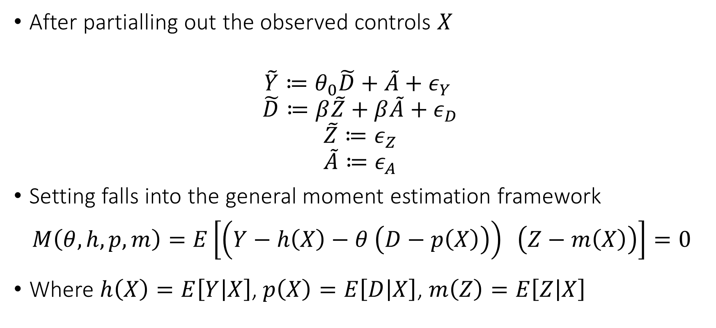
Partially Linear Instrumental Variable Model
After partialling out the observed controls $X$
$$\tilde{Y}≔θ_{0}\tilde{D}+\tilde{A}+ε_{Y}$$
$$\tilde{D}≔β\tilde{Z}+β\tilde{A}+ε_{D}$$
$$\tilde{Z}≔ε_{Z}$$
$$\tilde{A}≔ε_{A}$$
Setting falls into the general moment estimation framework
$$M\left(θ, h, p,m\right)=E\left[\left(Y−h\left(X\right)−θ \left(D−p\left(X\right)\right)\right) \left(Z−m\left(X\right)\right)\right]=0$$
Where $h\left(X\right)=E\left[Y | X\right]$, $p\left(X\right)=E\left[D | X\right]$, $m\left(Z\right)=E\left[Z | X\right]$

Slide 42
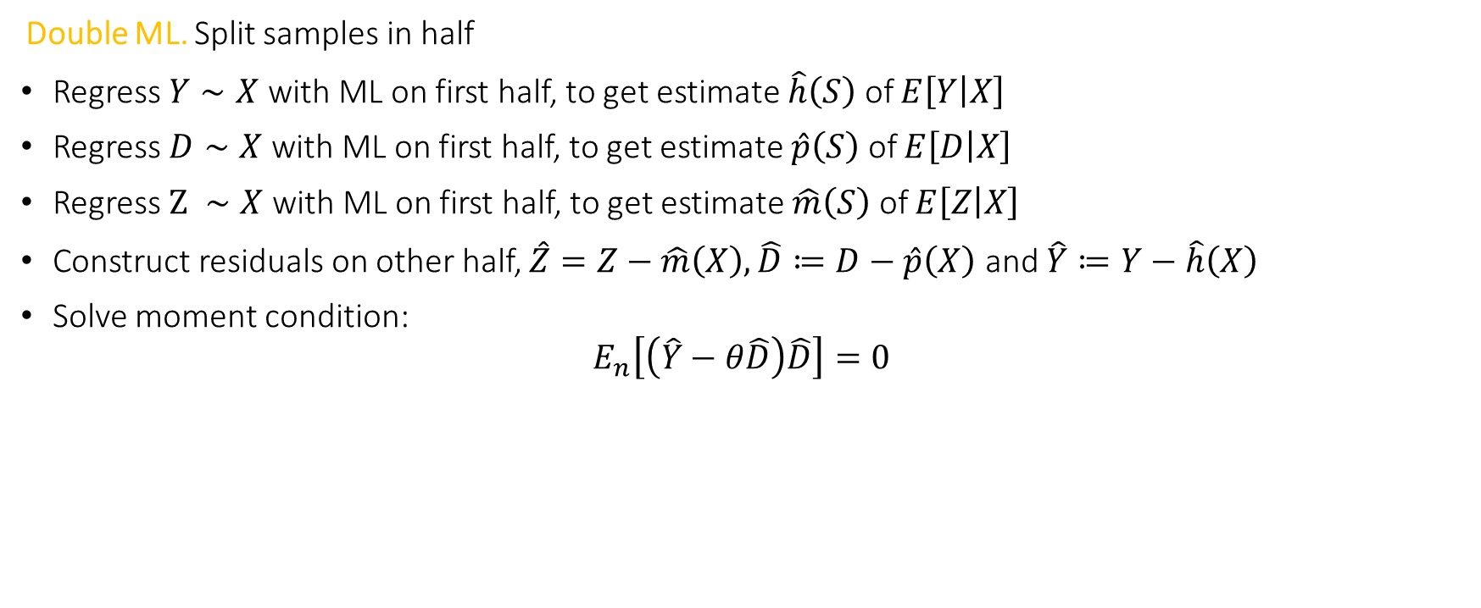
Orthogonal Method: Double ML for IV
Double ML. Split samples in half
Regress $Y∼X$ with ML on first half, to get estimate $\hat{h}\left(S\right)$ of $E\left[Y | X\right]$
Regress $D∼X$ with ML on first half, to get estimate $\hat{p}\left(S\right)$ of $E\left[D | X\right]$
Regress $Z ∼X$ with ML on first half, to get estimate $\hat{m}\left(S\right)$ of $E\left[Z | X\right]$
Construct residuals on other half, $\hat{Z}=Z−\hat{m}\left(X\right),\hat{D}≔D−\hat{p}\left(X\right)$ and $\hat{Y}≔Y−\hat{h}\left(X\right)$
Solve moment condition:
$$E_{n}\left[\left(\hat{Y}−θ\hat{D}\right)\hat{D}\right]=0$$
from econml.iv.dml import OrthoIV orthoiv = OrthoIV()
orthoiv.fit(y, D, Z, W=X).effect_inference()

Slide 43
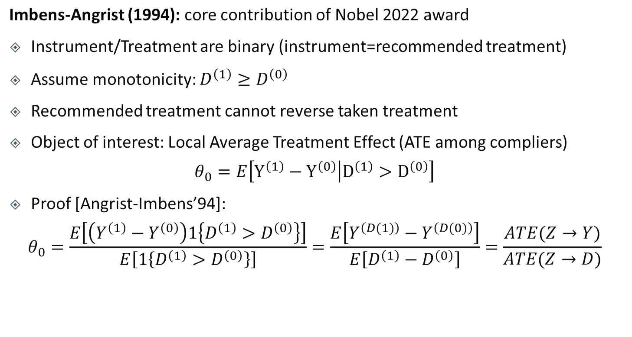


The Binary Case
U
unobserved confounder
instrument
treatment
Z
D
Y
outcome
Imbens-Angrist (1994): core contribution of Nobel 2022 award
Instrument/Treatment are binary (instrument=recommended treatment)
Assume monotonicity: $D^{\left(1\right)}≥D^{\left(0\right)}$
Recommended treatment cannot reverse taken treatment
Object of interest: Local Average Treatment Effect (ATE among compliers)
$$θ_{0}=E\left[Y^{\left(1\right)}−Y^{\left(0\right)} | D^{\left(1\right)}>D^{\left(0\right)}\right]$$
Proof [Angrist-Imbens’94]:
$$θ_{0}=\frac{E\left[\left(Y^{\left(1\right)}−Y^{\left(0\right)}\right)1\left\{D^{\left(1\right)}>D^{\left(0\right)}\right\}\right]}{E\left[1\left\{D^{\left(1\right)}>D^{\left(0\right)}\right\}\right]}=\frac{E\left[Y^{\left(D(1)\right)}−Y^{\left(D(0)\right)}\right]}{E\left[D^{\left(1\right)}−D^{\left(0\right)}\right]}=\frac{ATE(Z→Y)}{ATE(Z→D)}$$
$$γ=\frac{𝔼\left[\tilde{Z}\tilde{y}\right]}{𝔼\left[{\tilde{Z}}^{2}\right]}$$
$$δ=\frac{𝔼\left[\tilde{Z}\tilde{D}\right]}{𝔼\left[{\tilde{Z}}^{2}\right]}$$

Slide 44
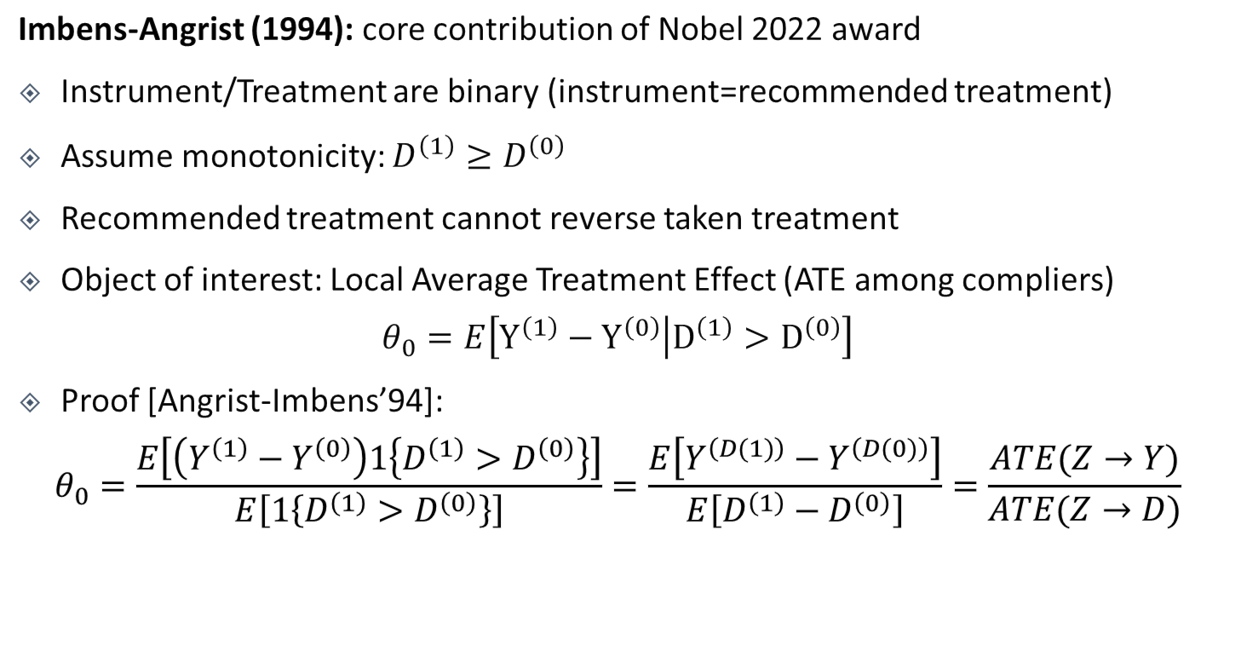


The Binary Case
U
unobserved confounder
instrument
treatment
Z
D
Y
outcome
Imbens-Angrist (1994): core contribution of Nobel 2022 award
Instrument/Treatment are binary (instrument=recommended treatment)
Assume monotonicity: $D^{\left(1\right)}≥D^{\left(0\right)}$
Recommended treatment cannot reverse taken treatment
Object of interest: Local Average Treatment Effect (ATE among compliers)
$$θ_{0}=E\left[Y^{\left(1\right)}−Y^{\left(0\right)} | D^{\left(1\right)}>D^{\left(0\right)}\right]$$
Proof [Angrist-Imbens’94]:
$$θ_{0}=\frac{E\left[\left(Y^{\left(1\right)}−Y^{\left(0\right)}\right)1\left\{D^{\left(1\right)}>D^{\left(0\right)}\right\}\right]}{E\left[1\left\{D^{\left(1\right)}>D^{\left(0\right)}\right\}\right]}=\frac{E\left[Y^{\left(D(1)\right)}−Y^{\left(D(0)\right)}\right]}{E\left[D^{\left(1\right)}−D^{\left(0\right)}\right]}=\frac{ATE(Z→Y)}{ATE(Z→D)}$$
X
$$E\left[E\left[Y | Z=1,X\right]−E\left[Y | Z=0,X\right]\right]$$
$$E\left[E\left[D | Z=1,X\right]−E\left[D | Z=0,X\right]\right]$$

Slide 45
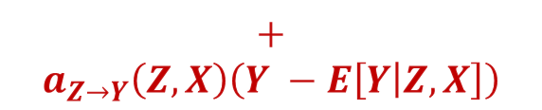
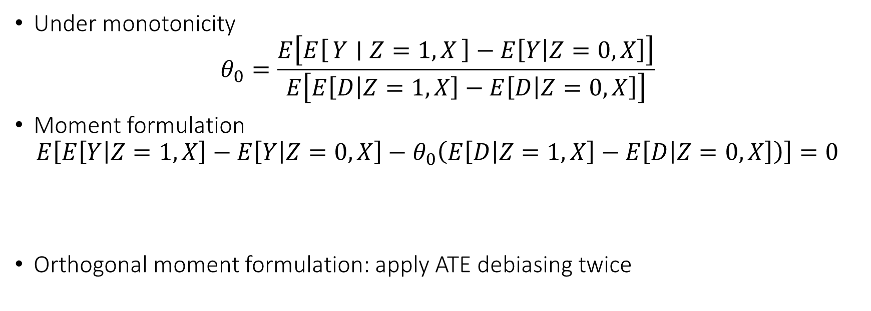
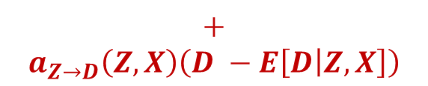
LATE in the Binary Case
Under monotonicity
$$θ_{0}=\frac{E\left[E\left[Y ∣ Z=1,X\right]−E\left[Y | Z=0,X\right]\right]}{E\left[E\left[D | Z=1,X\right]−E\left[D | Z=0,X\right]\right]}$$
Moment formulation
$$E\left[E\left[Y | Z=1,X\right]−E\left[Y | Z=0,X\right]−θ_{0}\left(E\left[D | Z=1,X\right]−E\left[D | Z=0,X\right]\right)\right]=0$$
Orthogonal moment formulation: apply ATE debiasing twice
$$+$$
$$a_{Z→Y}\left(Z,X\right)\left(Y −E\left[Y | Z,X\right]\right)$$
$$+$$
$$a_{Z→D}\left(Z,X\right)\left(D −E\left[D | Z,X\right]\right)$$

