Slide 1
MS&E 228: Inference in Linear Models
Vasilis Syrgkanis
MS&E, Stanford

Slide 2
Linear Regression and the Best Linear Prediction (BLP) Problem

Slide 3
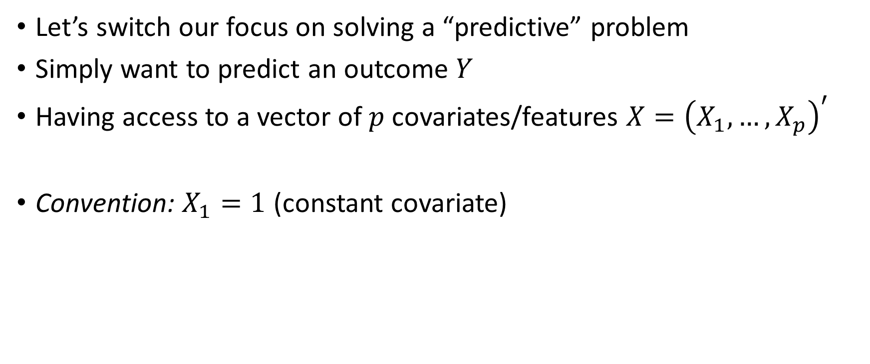
Predictive Modelling
Let’s switch our focus on solving a “predictive” problem
Simply want to predict an outcome $Y$
Having access to a vector of $p$ covariates/features $X={\left(X_{1},…,X_{p}\right)}^{′}$
Convention: $X_{1}=1$ (constant covariate)

Slide 4
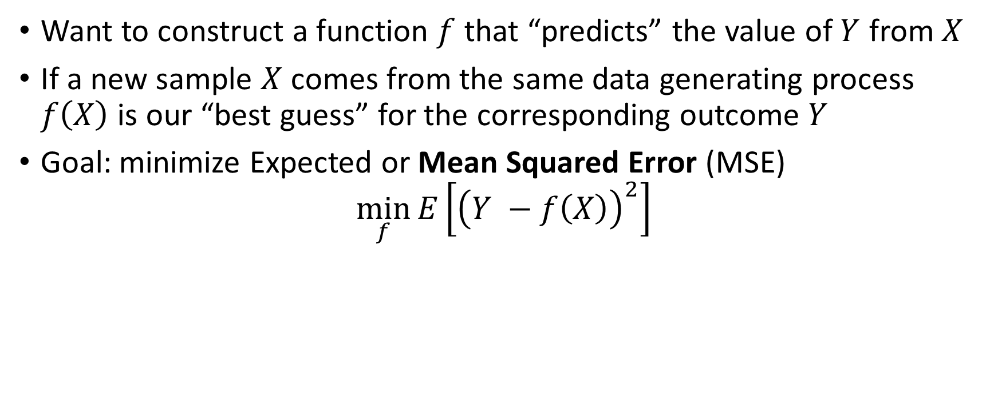
Predictive Modelling: Mean Squared Error
Want to construct a function $f$ that “predicts” the value of $Y$ from $X$
If a new sample $X$ comes from the same data generating process $f\left(X\right)$ is our “best guess” for the corresponding outcome $Y$
Goal: minimize Expected or Mean Squared Error (MSE)
$$\min_{f}{E\left[{\left(Y −f\left(X\right)\right)}^{2}\right]}$$

Slide 5
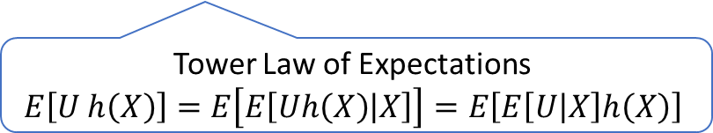
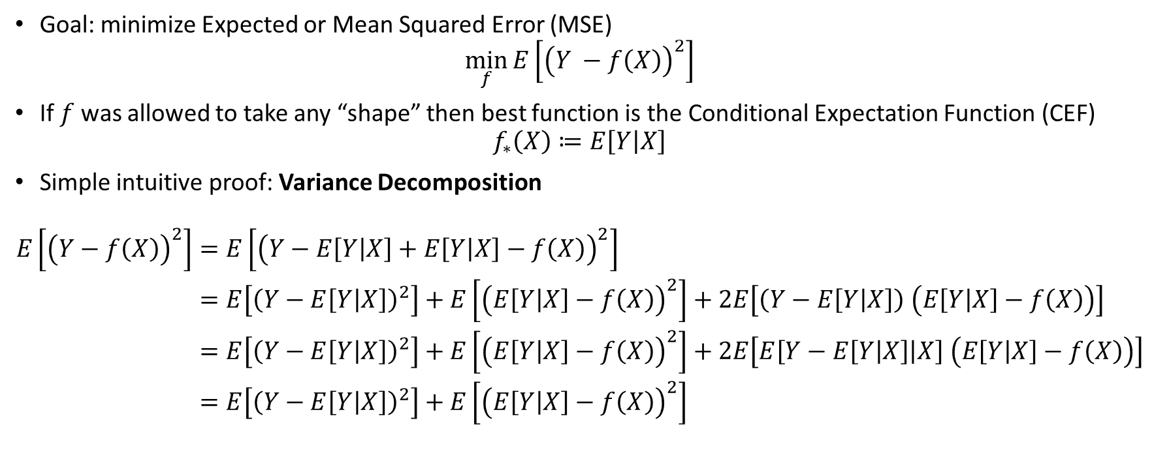
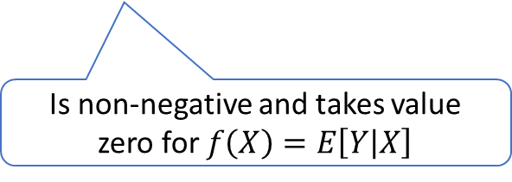
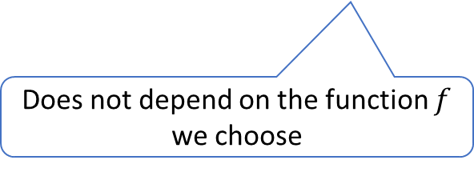
Best Predictive Model
Goal: minimize Expected or Mean Squared Error (MSE)
$$\min_{f}{E\left[{\left(Y −f\left(X\right)\right)}^{2}\right]}$$
If $f$ was allowed to take any “shape” then best function is the Conditional Expectation Function (CEF)
$$f_{∗}\left(X\right)≔E\left[Y | X\right]$$
Simple intuitive proof: Variance Decomposition
$$\begin{aligned}E\left[{\left(Y−f\left(X\right)\right)}^{2}\right]=&E\left[{\left(Y−E\left[Y | X\right]+E\left[Y | X\right]−f\left(X\right)\right)}^{2}\right] \\ =&E\left[{\left(Y−E\left[Y | X\right]\right)}^{2}\right]+E\left[{\left(E\left[Y | X\right]−f\left(X\right)\right)}^{2}\right]+2E\left[\left(Y−E\left[Y | X\right]\right) \left(E\left[Y | X\right]−f\left(X\right)\right)\right] \\ =&E\left[{\left(Y−E\left[Y | X\right]\right)}^{2}\right]+E\left[{\left(E\left[Y | X\right]−f\left(X\right)\right)}^{2}\right]+2E\left[E\left[Y−E\left[Y | X\right] | X\right] \left(E\left[Y | X\right]−f\left(X\right)\right)\right] \\ =&E\left[{\left(Y−E\left[Y | X\right]\right)}^{2}\right]+E\left[{\left(E\left[Y | X\right]−f\left(X\right)\right)}^{2}\right]\end{aligned}$$
Tower Law of Expectations
$$E\left[U h\left(X\right)\right]=E\left[E\left[Uh\left(X\right) | X\right]\right]=E\left[E\left[U | X\right]h\left(X\right)\right]$$
Does not depend on the function $f$ we choose
Is non-negative and takes value zero for $f\left(X\right)=E\left[Y | X\right]$

Slide 6
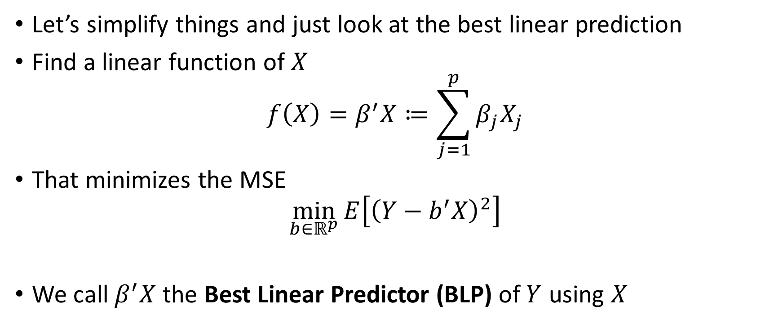
Best Linear Prediction (BLP) Problem
Let’s simplify things and just look at the best linear prediction
Find a linear function of $X$
$$f\left(X\right)=β^{′}X≔\sum_{j=1}^{p}{β_{j}X_{j}}$$
That minimizes the MSE
$$\min_{b∈ℝ^{p}}{E\left[{\left(Y−b^{′}X\right)}^{2}\right]}$$
We call $β^{′}X$ the Best Linear Predictor (BLP) of $Y$ using $X$

Slide 7
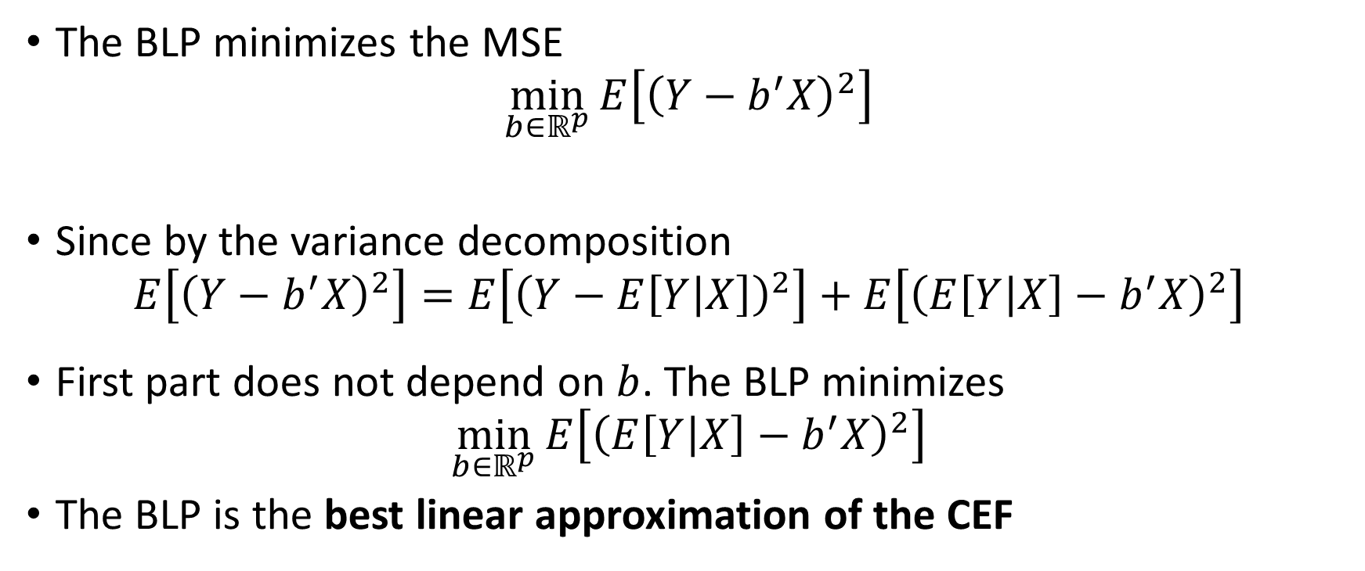
Best Linear Prediction (BLP) Problem
The BLP minimizes the MSE
$$\min_{b∈ℝ^{p}}{E\left[{\left(Y−b^{′}X\right)}^{2}\right]}$$
Since by the variance decomposition
$$E\left[{\left(Y−b^{′}X\right)}^{2}\right]=E\left[{\left(Y−E\left[Y | X\right]\right)}^{2}\right]+E\left[{\left(E\left[Y | X\right]−b^{′}X\right)}^{2}\right]$$
First part does not depend on $b$. The BLP minimizes
$$\min_{b∈ℝ^{p}}{E\left[{\left(E\left[Y | X\right]−b^{′}X\right)}^{2}\right]}$$
The BLP is the best linear approximation of the CEF

Slide 8
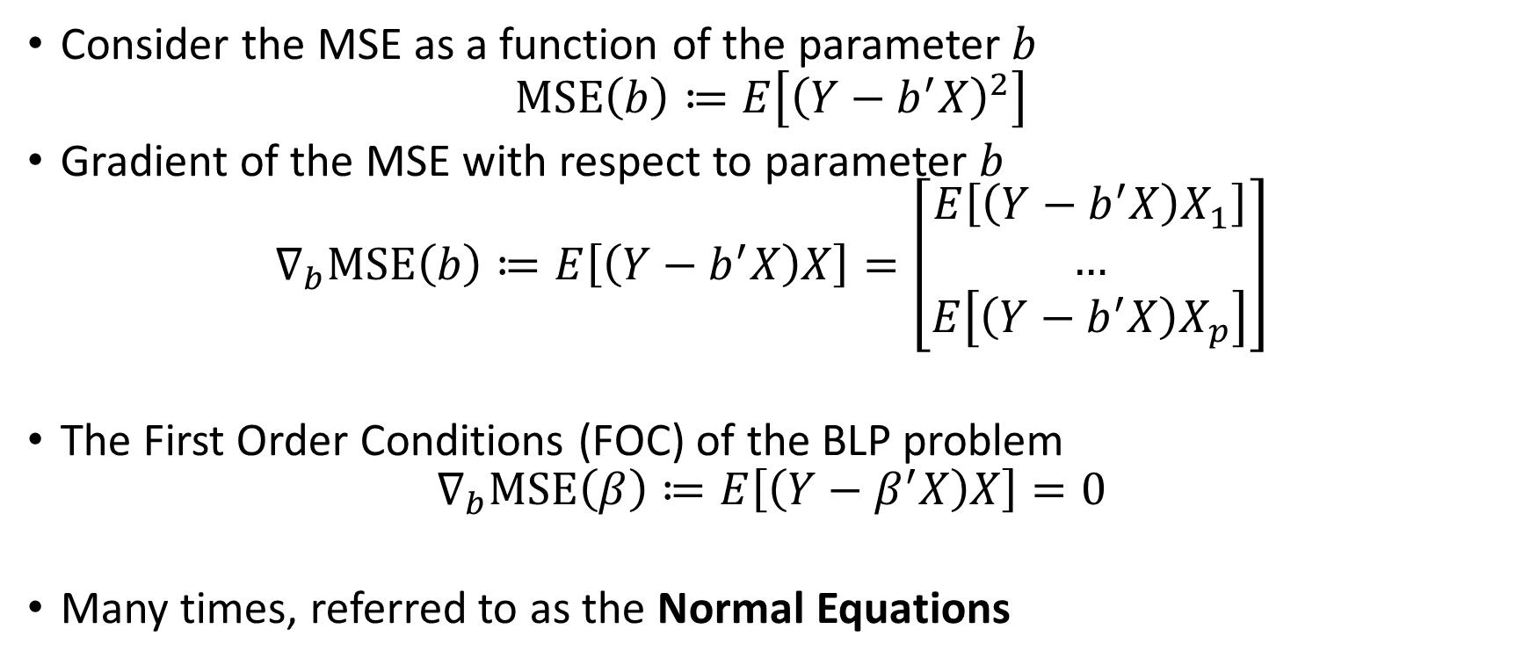
Solving for the BLP
Consider the MSE as a function of the parameter $b$
$$MSE\left(b\right)≔E\left[{\left(Y−b^{′}X\right)}^{2}\right]$$
Gradient of the MSE with respect to parameter $b$
$$∇_{b}MSE\left(b\right)≔E\left[\left(Y−b^{′}X\right)X\right]=\left[\begin{matrix}E\left[\left(Y−b^{′}X\right)X_{1}\right] \\ … \\ E\left[\left(Y−b^{′}X\right)X_{p}\right]\end{matrix}\right]$$
The First Order Conditions (FOC) of the BLP problem
$$∇_{b}MSE\left(β\right)≔E\left[\left(Y−β^{′}X\right)X\right]=0$$
Many times, referred to as the Normal Equations

Slide 9
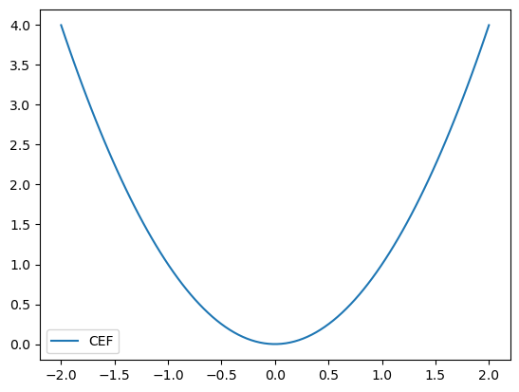
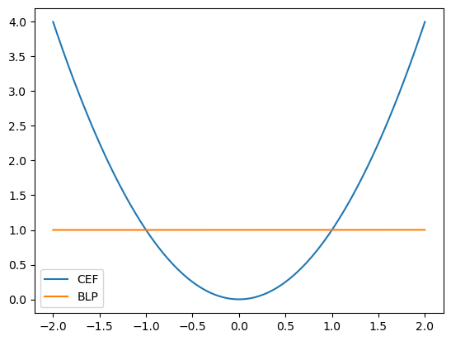

Numerical Example
Suppose $X=\left(1,W\right)$
$$Y=γ W^{2}+η, η∼N\left(0, 1\right), W∼N\left(0, 1\right)$$
The Normal Equations
$$\begin{aligned}E\left[\left(Y −β^{′}X\right) X\right]=&E\left[\left(γW^{2}+η−β^{′}X\right)X\right] \\ =&E\left[\left(γW^{2}−β^{′}X\right)X\right]=0\end{aligned}$$
Since $E\left[W\right]=0, E\left[W^{2}\right]=1, E\left[W^{3}\right]=0$
$$E[\left(γW^{2}−β^{′}X) 1\right]=γ−β_{1}=0$$
$$E\left[\left(γW^{2}−β^{′}X\right)W\right]=γ⋅0−β_{2}=0$$
So $β_{1}=γ, β_{2}=0$ and the BLP takes the form:
$$β^{′}X=γ, (a constant prediction)$$

Slide 10
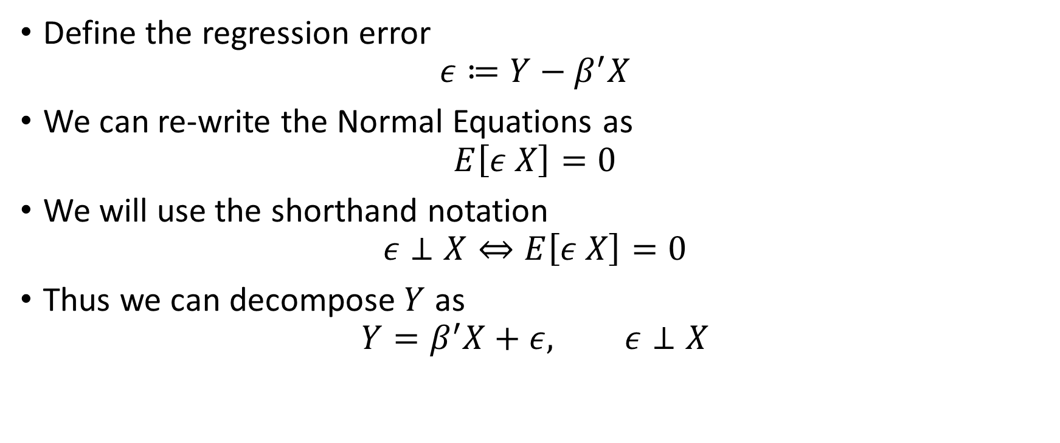

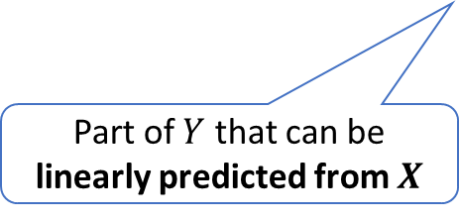
Decomposition of $Y$
Define the regression error
$$ε≔Y−β^{′}X$$
We can re-write the Normal Equations as
$$E\left[ε X\right]=0$$
We will use the shorthand notation
$$ε⊥X⇔E\left[ε X\right]=0$$
Thus we can decompose $Y$ as
$$Y=β^{′}X+ε, ε⊥X$$
Part of $Y$ that can be linearly predicted from $X$
Remaining un-explained or residual part

Slide 11

Numerical Example
Suppose $X=\left(1,W\right)$
$$Y=γ W^{2}+η, η∼N\left(0, 1\right), W∼N\left(0, 1\right)$$
Reminder $β_{1}=γ, β_{2}=0$ and the BLP takes the form:
$$β^{′}X=γ, (a constant prediction)$$
We can decompose $Y$ as
$$Y=γ+ε, ε≔γ\left(W^{2}−1\right)+η$$
Note that
$$E\left[ε\right]=γ\left(E\left[W^{2}\right]−1\right)=0$$
$$E\left[εW\right]=γ\left(E\left[W^{3}\right]−E\left[W\right]\right)=0$$

Slide 12

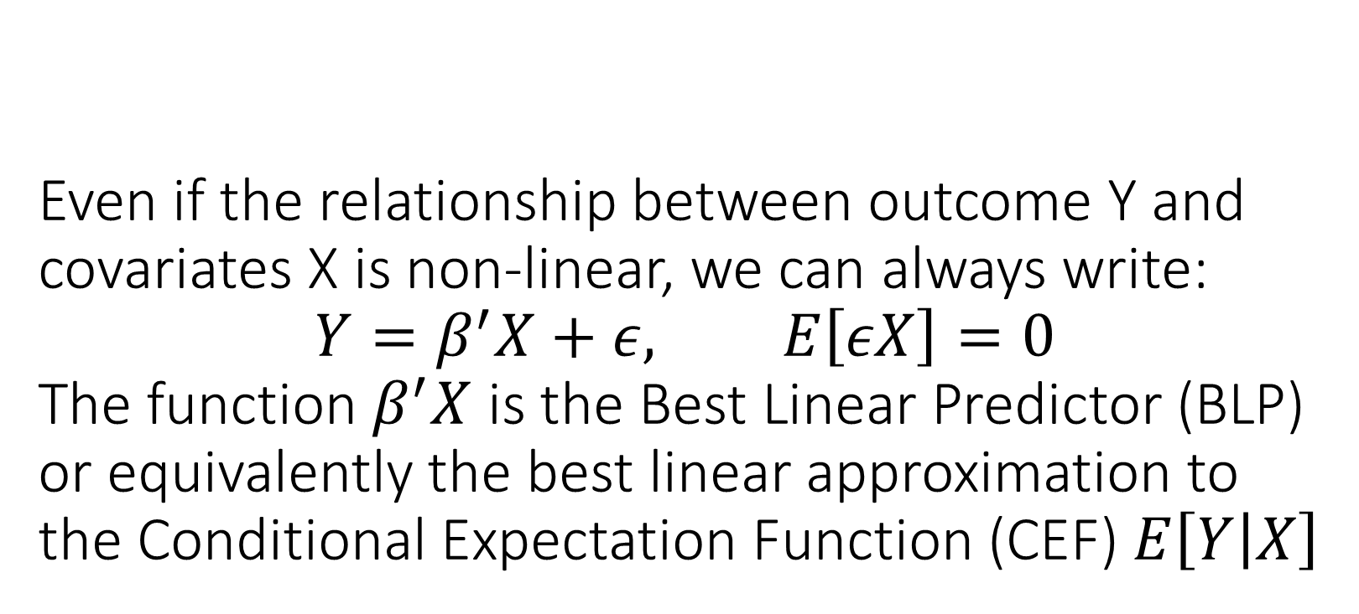
Even if the relationship between outcome Y and covariates X is non-linear, we can always write: $$Y=β^{′}X+ε, E\left[εX\right]=0$$ The function $β^{′}X$ is the Best Linear Predictor (BLP) or equivalently the best linear approximation to the Conditional Expectation Function (CEF) $E\left[Y | X\right]$

Slide 13
Finite Sample Estimation

Slide 14
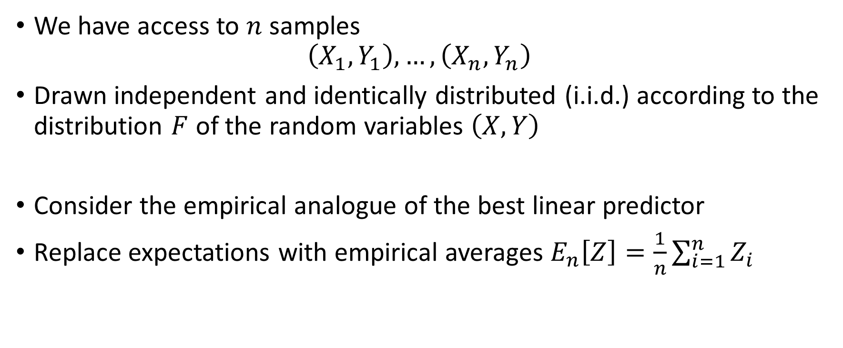
BLP in Sample
We have access to $n$ samples
$$\left(X_{1},Y_{1}\right),…, \left(X_{n},Y_{n}\right)$$
Drawn independent and identically distributed (i.i.d.) according to the distribution $F$ of the random variables $\left(X, Y\right)$
Consider the empirical analogue of the best linear predictor
Replace expectations with empirical averages $E_{n}\left[Z\right]=\frac{1}{n}\sum_{i=1}^{n}{Z_{i}}$

Slide 15
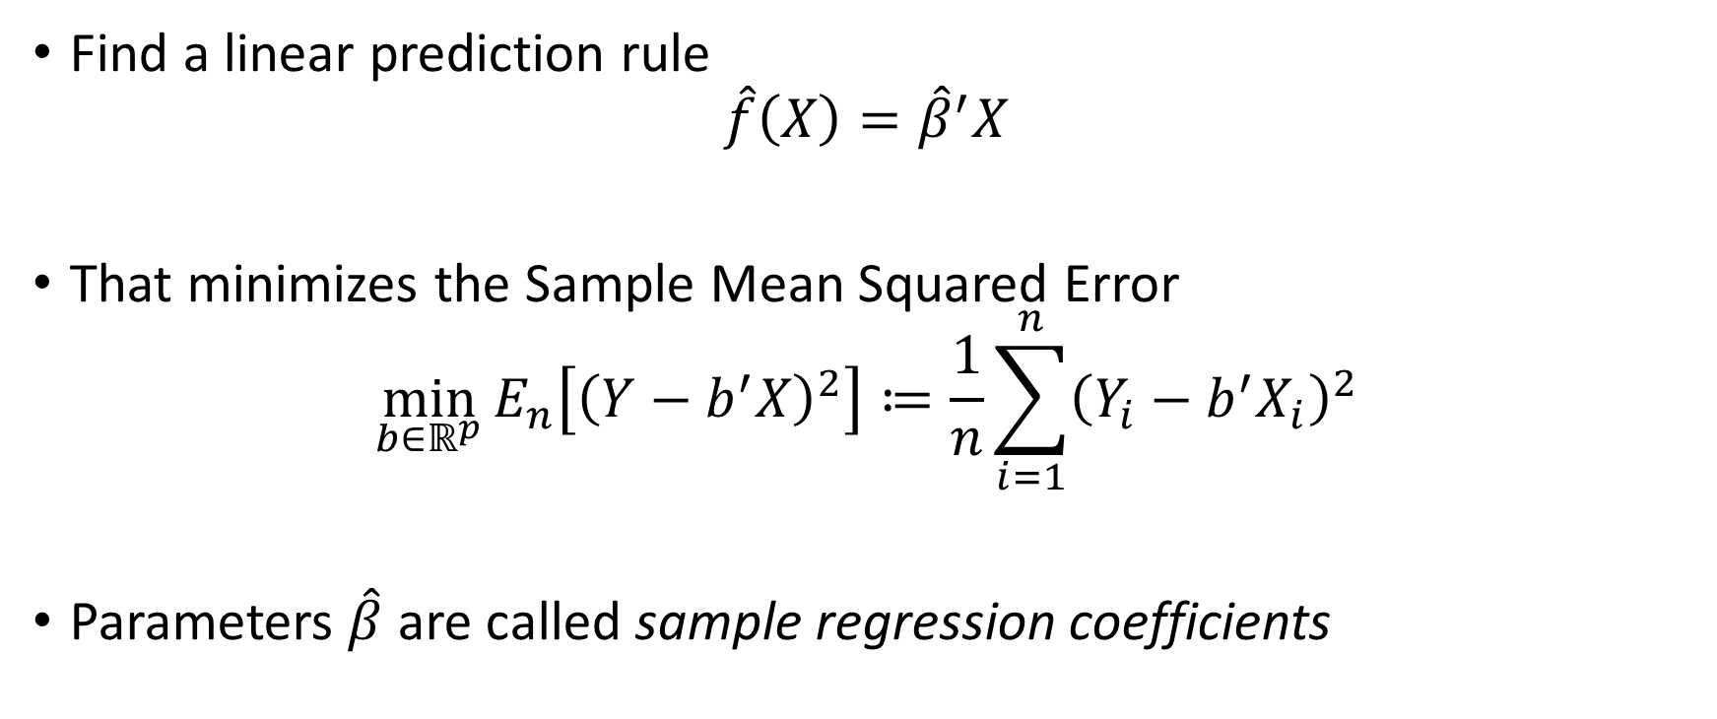
BLP in Sample: Ordinary Least Squares (OLS)
Find a linear prediction rule
$$\hat{f}\left(X\right)={\hat{β}}^{′}X$$
That minimizes the Sample Mean Squared Error
$$\min_{b∈ℝ^{p}}{E_{n}\left[{\left(Y−b^{′}X\right)}^{2}\right]≔\frac{1}{n}\sum_{i=1}^{n}{{\left(Y_{i}−b^{′}X_{i}\right)}^{2}}}$$
Parameters $\hat{β}$ are called sample regression coefficients

Slide 16
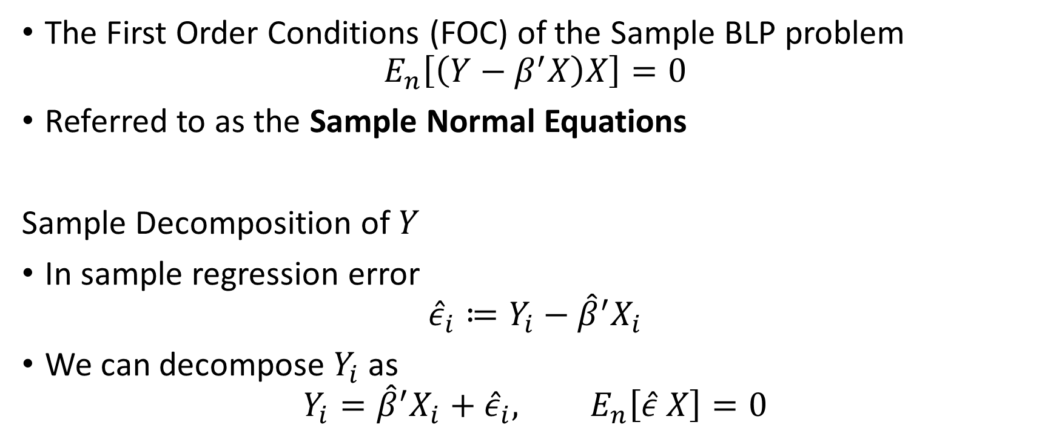
Sample Normal Equations
The First Order Conditions (FOC) of the Sample BLP problem
$$E_{n}\left[\left(Y−β^{′}X\right)X\right]=0$$
Referred to as the Sample Normal Equations
Sample Decomposition of $Y$
In sample regression error
$${\hat{ε}}_{i}≔Y_{i}−{\hat{β}}^{′}X_{i}$$
We can decompose $Y_{i}$ as
$$Y_{i}={\hat{β}}^{′}X_{i}+{\hat{ε}}_{i}, E_{n}\left[\hat{ε} X\right]=0$$

Slide 17
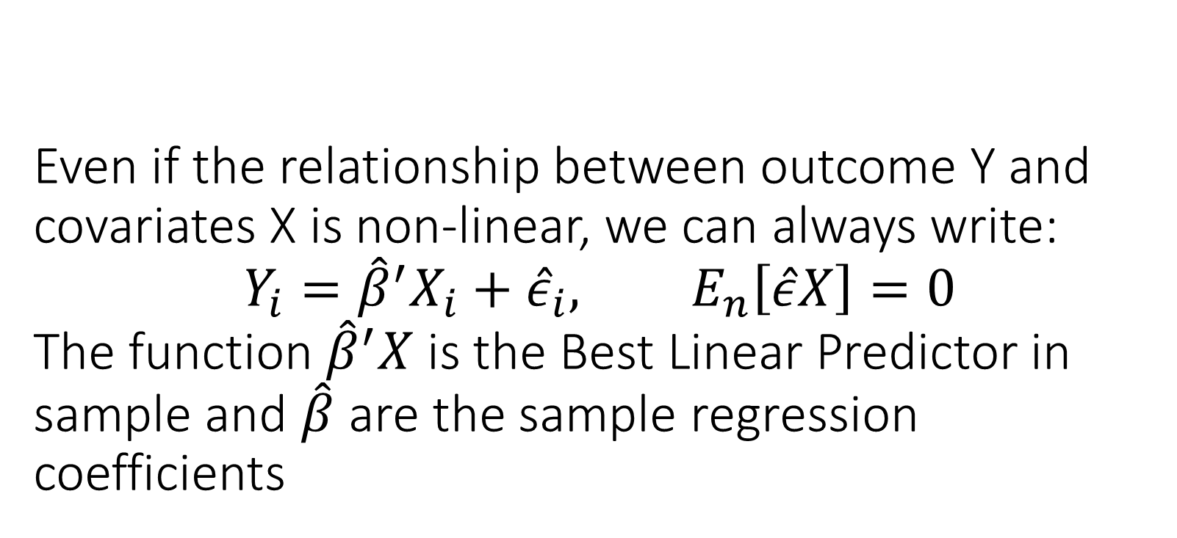
Even if the relationship between outcome Y and covariates X is non-linear, we can always write: $$Y_{i}={\hat{β}}^{′}X_{i}+{\hat{ε}}_{i}, E_{n}\left[\hat{ε}X\right]=0$$ The function ${\hat{β}}^{′}X$ is the Best Linear Predictor in sample and $\hat{β}$ are the sample regression coefficients

Slide 18
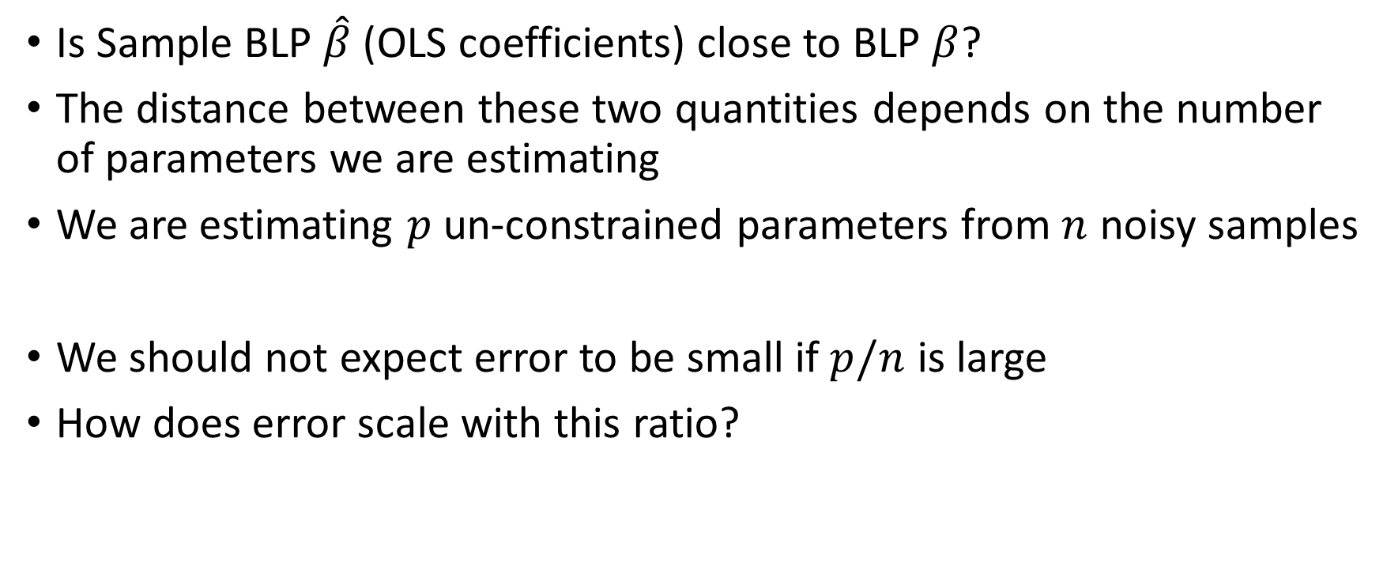
How Good is OLS in Recovering BLP
Is Sample BLP $\hat{β}$ (OLS coefficients) close to BLP $β$?
The distance between these two quantities depends on the number of parameters we are estimating
We are estimating $p$ un-constrained parameters from $n$ noisy samples
We should not expect error to be small if $p/n$ is large
How does error scale with this ratio?

Slide 19

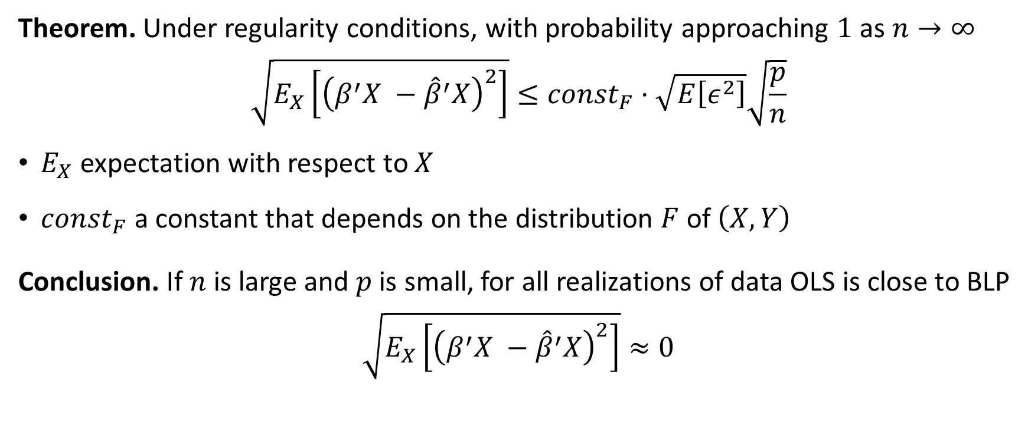
Approximation of BLP by OLS
Theorem. Under regularity conditions, with probability approaching $1$ as $n→∞$
$$\sqrt{E_{X}\left[{\left(β^{′}X −{\hat{β}}^{′}X\right)}^{2}\right]}≤{const}_{F}⋅\sqrt{E\left[ε^{2}\right]}\sqrt{\frac{p}{n}}$$
$E_{X}$ expectation with respect to $X$
$const_{F}$ a constant that depends on the distribution $F$ of $\left(X, Y\right)$
Conclusion. If $n$ is large and $p$ is small, for all realizations of data OLS is close to BLP
$$\sqrt{E_{X}\left[{\left(β^{′}X −{\hat{β}}^{′}X\right)}^{2}\right]}≈0$$
$A_{n}≈B_{n}$ means that distance of $A_{n},B_{n}$ concentrates around $0$for some measure of distance $d$:
$$∀ε>0:\lim_{n→∞}{P\left(d\left(A_{n},B_{n}\right)≤ε\right)=1}$$

Slide 20
You should expect OLS to produce accurate predictions in the worst-case only if the number of variables is small compared to number of samples. Its predictions converge to the predictions of the BLP in the population

Slide 21
Interpretable Performance Measures via Analysis of Variance (ANOVA)

Slide 22
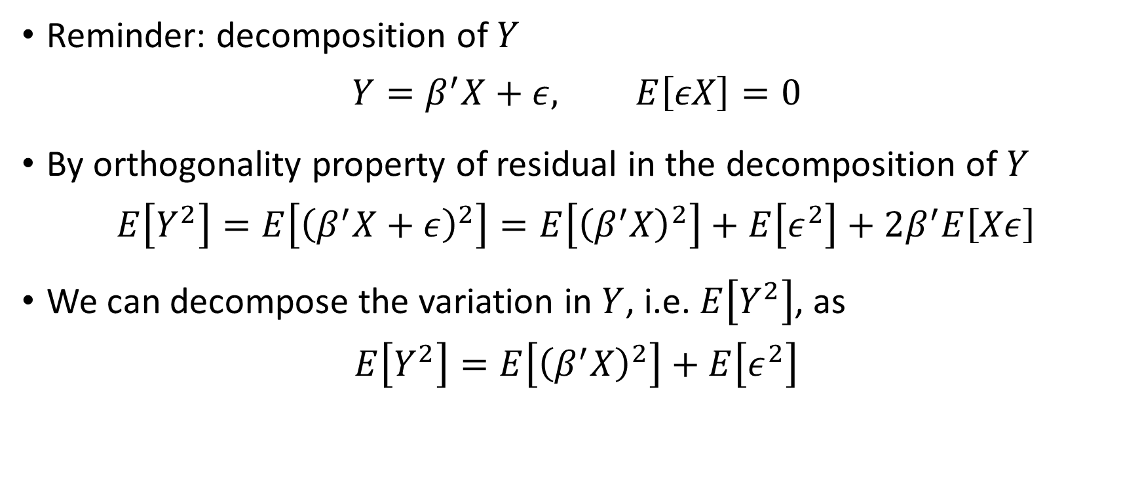
Analysis of Variance (ANOVA)
Reminder: decomposition of $Y$
$$Y=β^{′}X+ε, E\left[εX\right]=0$$
By orthogonality property of residual in the decomposition of $Y$
$$E\left[Y^{2}\right]=E\left[{\left(β^{′}X+ε\right)}^{2}\right]=E\left[{\left(β^{′}X\right)}^{2}\right]+E\left[ε^{2}\right]+2β^{′}E\left[Xε\right]$$
We can decompose the variation in $Y$, i.e. $E\left[Y^{2}\right]$, as
$$E\left[Y^{2}\right]=E\left[{\left(β^{′}X\right)}^{2}\right]+E\left[ε^{2}\right]$$
explained variation
residual variation

Slide 23
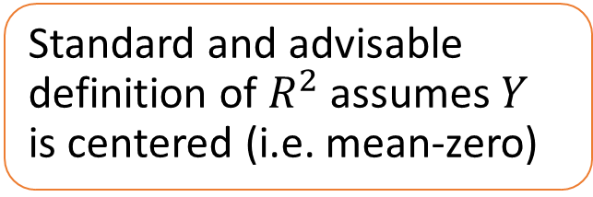
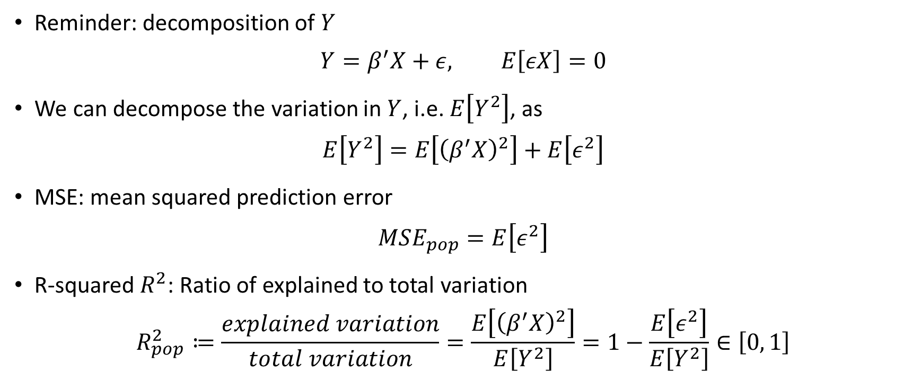
Analysis of Variance (ANOVA)
Reminder: decomposition of $Y$
$$Y=β^{′}X+ε, E\left[εX\right]=0$$
We can decompose the variation in $Y$, i.e. $E\left[Y^{2}\right]$, as
$$E\left[Y^{2}\right]=E\left[{\left(β^{′}X\right)}^{2}\right]+E\left[ε^{2}\right]$$
MSE: mean squared prediction error
$$MSE_{pop}=E\left[ε^{2}\right]$$
R-squared $R^{2}$: Ratio of explained to total variation
$$R_{pop}^{2}≔\frac{explained variation}{total variation}=\frac{E\left[{\left(β^{′}X\right)}^{2}\right]}{E\left[Y^{2}\right]}=1−\frac{E\left[ε^{2}\right]}{E\left[Y^{2}\right]}∈\left[0, 1\right]$$
Standard and advisable definition of $R^{2}$ assumes $Y$ is centered (i.e. mean-zero)

Slide 24
Performance Evaluation

Slide 25
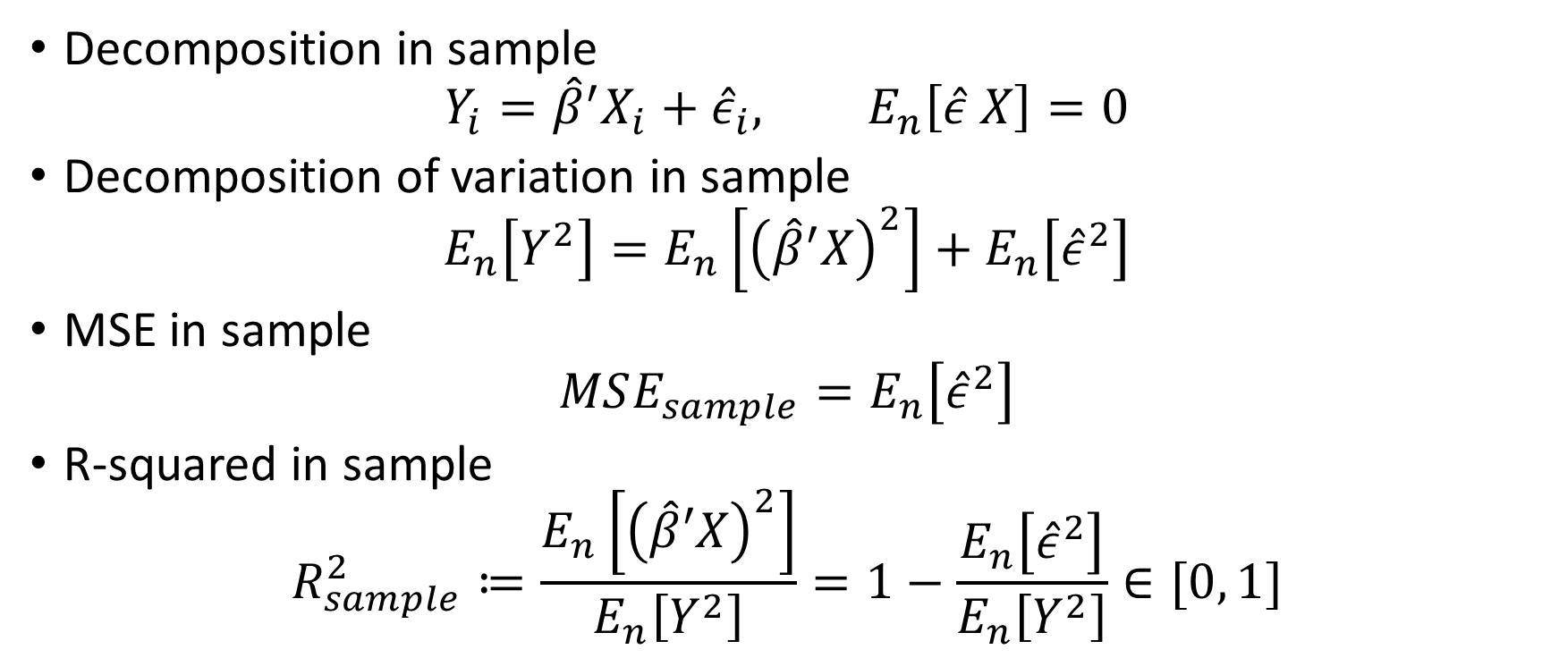
In Sample R-squared and MSE
Decomposition in sample
$$Y_{i}={\hat{β}}^{′}X_{i}+{\hat{ε}}_{i}, E_{n}\left[\hat{ε} X\right]=0$$
Decomposition of variation in sample
$$E_{n}\left[Y^{2}\right]=E_{n}\left[{\left({\hat{β}}^{′}X\right)}^{2}\right]+E_{n}\left[{\hat{ε}}^{2}\right]$$
MSE in sample
$$MSE_{sample}=E_{n}\left[{\hat{ε}}^{2}\right]$$
R-squared in sample
$$R_{sample}^{2}≔\frac{E_{n}\left[{\left(\hat{β}′X\right)}^{2}\right]}{E_{n}\left[Y^{2}\right]}=1−\frac{E_{n}\left[{\hat{ε}}^{2}\right]}{E_{n}\left[Y^{2}\right]}∈[0, 1]$$
Standard and advisable definition of $R^{2}$ assumes $Y$ is centered (i.e. mean-zero)

Slide 26
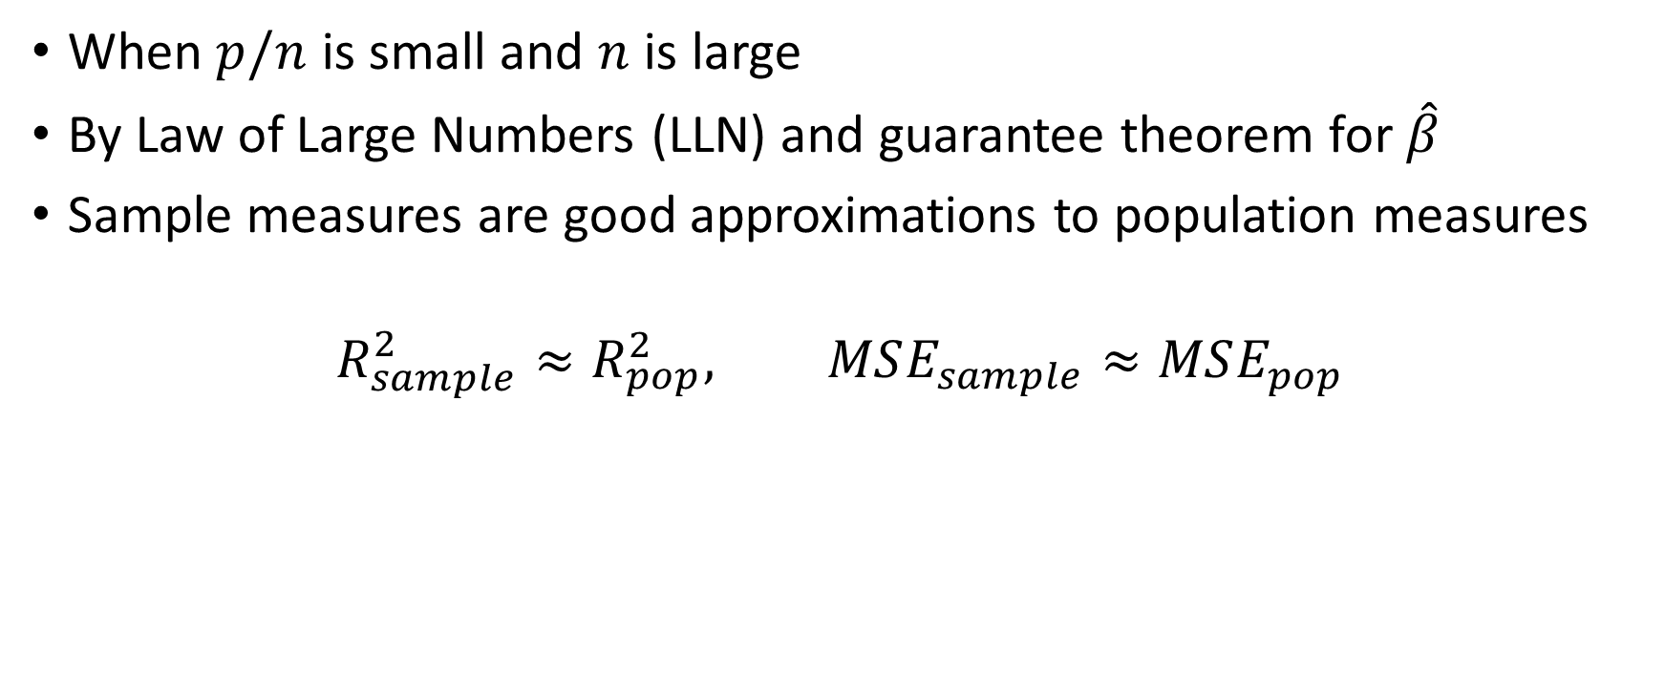
When are these good proxies?
When $p/n$ is small and $n$ is large
By Law of Large Numbers (LLN) and guarantee theorem for $\hat{β}$
Sample measures are good approximations to population measures
$$R_{sample}^{2}≈R_{pop}^{2}, MSE_{sample}≈MSE_{pop}$$

Slide 27
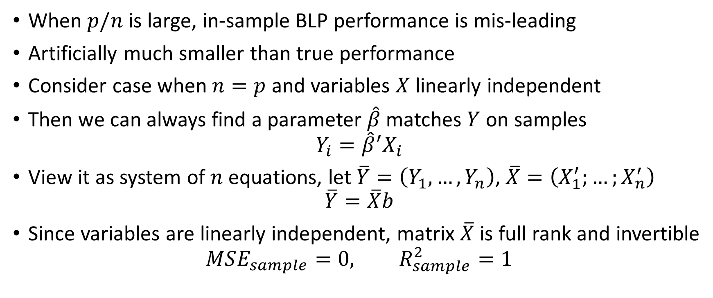

Overfitting: $p/n$ large
When $p/n$ is large, in-sample BLP performance is mis-leading
Artificially much smaller than true performance
Consider case when $n=p$ and variables $X$ linearly independent
Then we can always find a parameter $\hat{β}$ matches $Y$ on samples
$$Y_{i}={\hat{β}}^{′}X_{i}$$
View it as system of $n$ equations, let $\overline{Y}=\left(Y_{1},…,Y_{n}\right)$, $\overline{X}=\left(X_{1}^{′};…;X_{n}^{′}\right)$
$$\overline{Y}=\overline{X}b$$
Since variables are linearly independent, matrix $\overline{X}$ is full rank and invertible
$$MSE_{sample}=0, R_{sample}^{2}=1$$

Slide 28
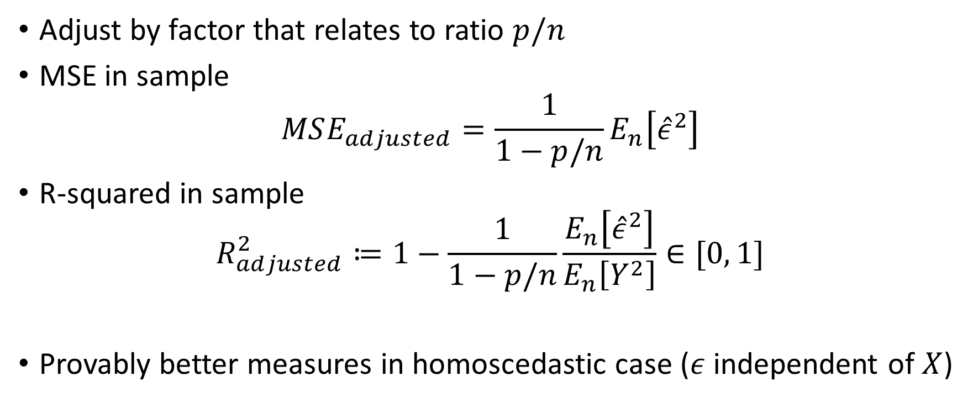
An Improvement: Adjusted Measures
Adjust by factor that relates to ratio $p/n$
MSE in sample
$$MSE_{adjusted}=\frac{1}{1−p/n}E_{n}\left[{\hat{ε}}^{2}\right]$$
R-squared in sample
$$R_{adjusted}^{2}≔1−\frac{1}{1−p/n}\frac{E_{n}\left[{\hat{ε}}^{2}\right]}{E_{n}\left[Y^{2}\right]}∈[0, 1]$$
Provably better measures in homoscedastic case ($ε$ independent of $X$)

Slide 29
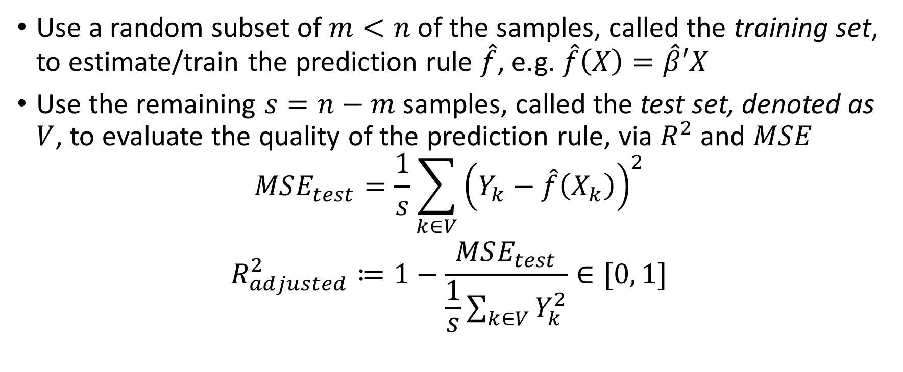
Sample Splitting: Reliable Performance Measure
Use a random subset of $m<n$ of the samples, called the training set, to estimate/train the prediction rule $\hat{f}$, e.g. $\hat{f}\left(X\right)=\hat{β}′X$
Use the remaining $s=n−m$ samples, called the test set, denoted as $V$, to evaluate the quality of the prediction rule, via $R^{2}$ and $MSE$
$$MSE_{test}=\frac{1}{s}\sum_{k∈V}{{\left(Y_{k}−\hat{f}\left(X_{k}\right)\right)}^{2}}$$
$$R_{adjusted}^{2}≔1−\frac{MSE_{test}}{\frac{1}{s}\sum_{k∈V}{Y_{k}^{2}}}∈[0, 1]$$

Slide 30
Stratification
In moderately sized samples it helps to ensure that train and test set are similar
In large samples, randomness will guarantee that
In small samples and with categorical variables, it is advisable to stratify, i.e. split samples in a manner that proportion of samples with each categorical value are similar on each of the two samples

Slide 31
Almost always measure predictive performance of your estimated model on a held-out sample

Slide 32
Inference on Predictive Effects

Slide 33
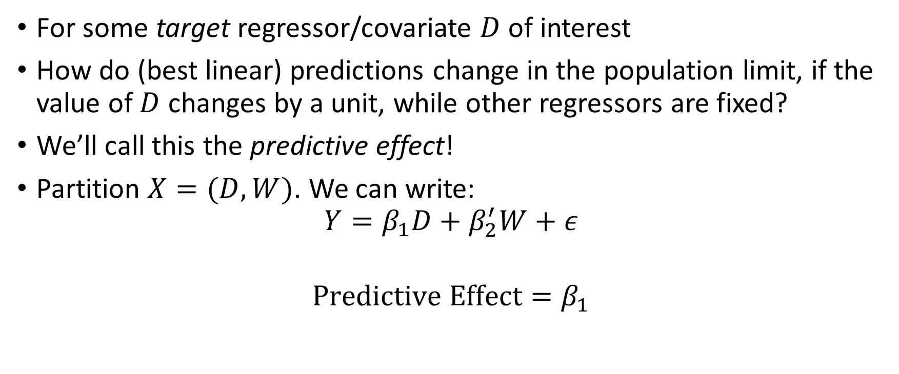
Predictive Effect
For some target regressor/covariate $D$ of interest
How do (best linear) predictions change in the population limit, if the value of $D$ changes by a unit, while other regressors are fixed?
We’ll call this the predictive effect!
Partition $X=(D, W)$. We can write:
$$Y=β_{1}D+β_{2}^{′}W+ε$$
$$Predictive Effect=β_{1}$$

Slide 34
Partialling-Out

Slide 35
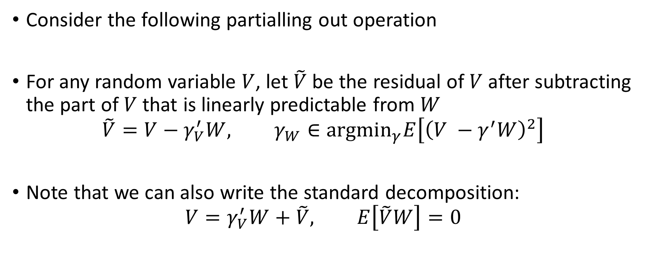

Understanding $β_{1}$
Consider the following partialling out operation
For any random variable $V$, let $\tilde{V}$ be the residual of $V$ after subtracting the part of $V$ that is linearly predictable from $W$
$$\tilde{V}=V−γ_{V}^{′}W, γ_{W}∈{argmin}_{γ}E\left[{\left(V −γ^{′}W\right)}^{2}\right]$$
Note that we can also write the standard decomposition:
$$V=γ_{V}^{′}W+\tilde{V}, E\left[\tilde{V}W\right]=0$$

Slide 36
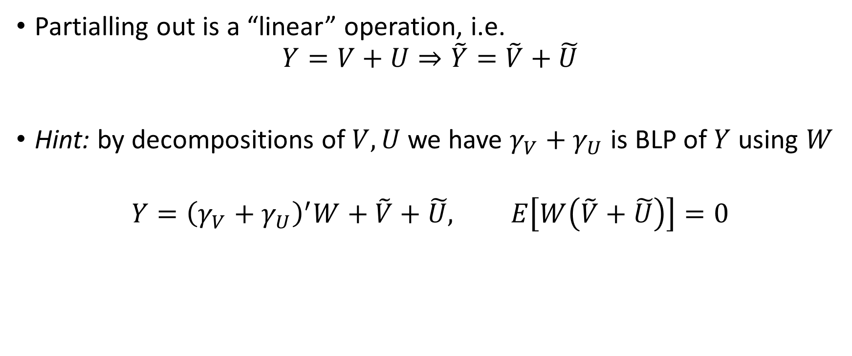
Linearity of Partialling-Out
Partialling out is a “linear” operation, i.e.
$$Y=V+U⇒\tilde{Y}=\tilde{V}+\tilde{U}$$
Hint: by decompositions of $V, U$ we have $γ_{V}+γ_{U}$ is BLP of $Y$ using $W$
$$Y={\left(γ_{V}+γ_{U}\right)}^{′}W+\tilde{V}+\tilde{U}, E\left[W\left(\tilde{V}+\tilde{U}\right)\right]=0$$

Slide 37
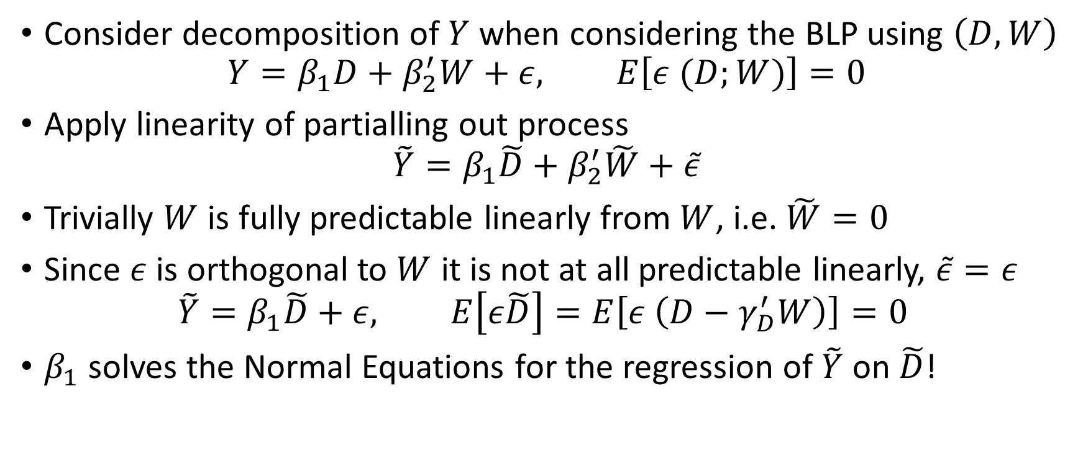
Some Magic
Consider decomposition of $Y$ when considering the BLP using $\left(D, W\right)$
$$Y=β_{1}D+β_{2}^{′}W+ε, E\left[ε (D;W)\right]=0$$
Apply linearity of partialling out process
$$\tilde{Y}=β_{1}\tilde{D}+β_{2}^{′}\tilde{W}+\tilde{ε}$$
Trivially $W$ is fully predictable linearly from $W$, i.e. $\tilde{W}=0$
Since $ε$ is orthogonal to $W$ it is not at all predictable linearly, $\tilde{ε}=ε$
$$\tilde{Y}=β_{1}\tilde{D}+ε, E\left[ε\tilde{D}\right]=E\left[ε \left(D−γ_{D}^{′}W\right)\right]=0$$
$β_{1}$ solves the Normal Equations for the regression of $\tilde{Y}$ on $\tilde{D}$!

Slide 38
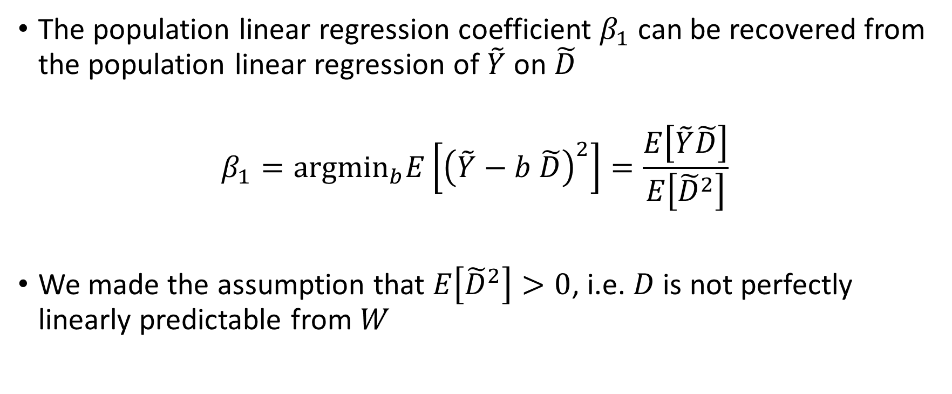
Frisch-Waugh-Lovell (FWL) Theorem!
The population linear regression coefficient $β_{1}$ can be recovered from the population linear regression of $\tilde{Y}$ on $\tilde{D}$
$$β_{1}={argmin}_{b}E\left[{\left(\tilde{Y}−b \tilde{D}\right)}^{2}\right]=\frac{E\left[\tilde{Y}\tilde{D}\right]}{E\left[{\tilde{D}}^{2}\right]}$$
We made the assumption that $E\left[{\tilde{D}}^{2}\right]>0$, i.e. $D$ is not perfectly linearly predictable from $W$

Slide 39
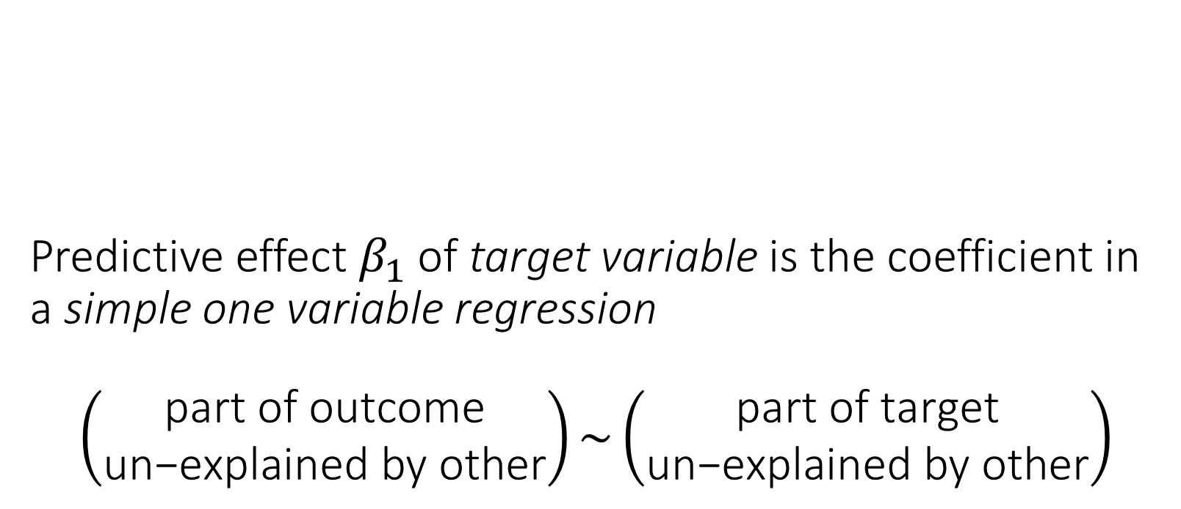
Predictive effect $β_{1}$of target variable is the coefficient in a simple one variable regression $$\left(\begin{matrix}\text{part} \text{of} \text{outcome} \\ \text{un}\text{−}\text{explained} \text{by} \text{other}\end{matrix}\right)\sim \left(\begin{matrix}\text{part} \text{of} \text{target} \\ \text{un}\text{−}\text{explained} \text{by} \text{other}\end{matrix}\right)$$

Slide 40
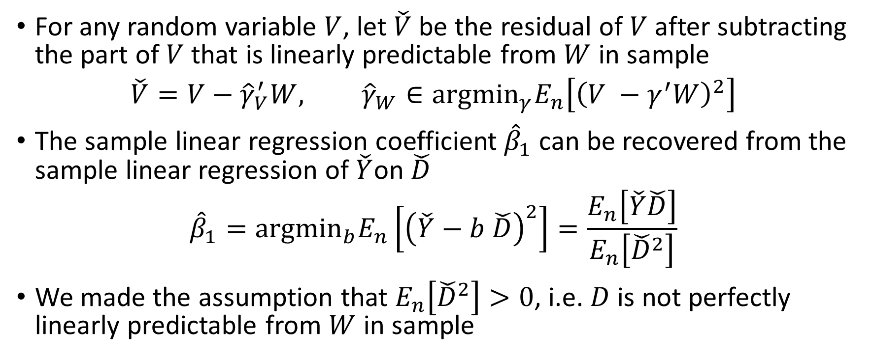
FWL in Sample: Exact same arguments can be repeated in sample
For any random variable $V$, let $\check{V}$ be the residual of $V$ after subtracting the part of $V$ that is linearly predictable from $W$ in sample
$$\check{V}=V−{\hat{γ}}_{V}^{′}W, {\hat{γ}}_{W}∈{argmin}_{γ}E_{n}\left[{\left(V −γ^{′}W\right)}^{2}\right]$$
The sample linear regression coefficient ${\hat{β}}_{1}$ can be recovered from the sample linear regression of $\check{Y}$on $\check{D}$
$${\hat{β}}_{1}={argmin}_{b}E_{n}\left[{\left(\check{Y}−b \check{D}\right)}^{2}\right]=\frac{E_{n}\left[\check{Y}\check{D}\right]}{E_{n}\left[{\check{D}}^{2}\right]}$$
We made the assumption that $E_{n}\left[{\check{D}}^{2}\right]>0$, i.e. $D$ is not perfectly linearly predictable from $W$ in sample

Slide 41
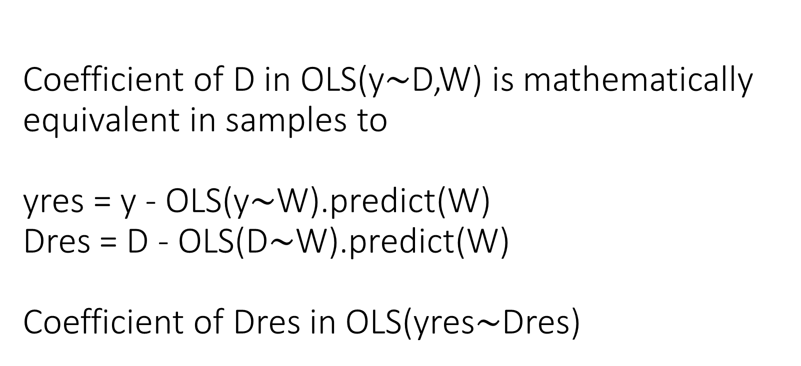
Coefficient of D in OLS(y$∼$D,W) is mathematically equivalent in samples to yres = y - OLS(y$∼$W).predict(W) Dres = D - OLS(D$∼$W).predict(W) Coefficient of Dres in OLS(yres$∼$Dres)

Slide 42
Asymptotic Distribution and Confidence Intervals

Slide 43

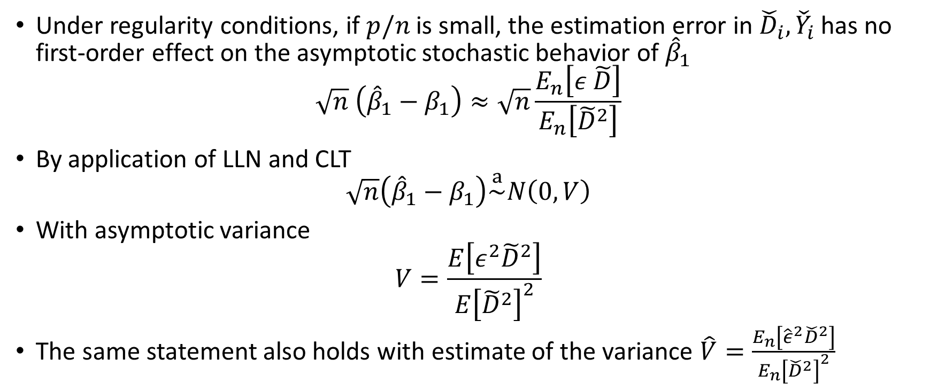
Adaptive Inference
$A_{n}\overset{a}{\sim }N\left(0, V\right)$ means that as $n→∞$:
$$\sup_{R∈ℛ}\left|P\left(A_{n}∈R\right)−P\left(N\left(0,V\right)∈R\right)\right|≈0$$
where $ℛ$ set of all hyper-rectangles
Under regularity conditions, if $p/n$ is small, the estimation error in ${\check{D}}_{i},{\check{Y}}_{i}$ has no first-order effect on the asymptotic stochastic behavior of ${\hat{β}}_{1}$
$$\sqrt{n} \left({\hat{β}}_{1}−β_{1}\right)≈\sqrt{n}\frac{E_{n}\left[ε \tilde{D}\right]}{E_{n}\left[{\tilde{D}}^{2}\right]}$$
By application of LLN and CLT
$$\sqrt{n}\left({\hat{β}}_{1}−β_{1}\right)\overset{a}{\sim }N\left(0,V\right)$$
With asymptotic variance
$$V=\frac{E\left[ε^{2}{\tilde{D}}^{2}\right]}{E{\left[{\tilde{D}}^{2}\right]}^{2}}$$
The same statement also holds with estimate of the variance $\hat{V}=\frac{E_{n}\left[{\hat{ε}}^{2}{\check{D}}^{2}\right]}{E_{n}{\left[{\check{D}}^{2}\right]}^{2}}$

Slide 44
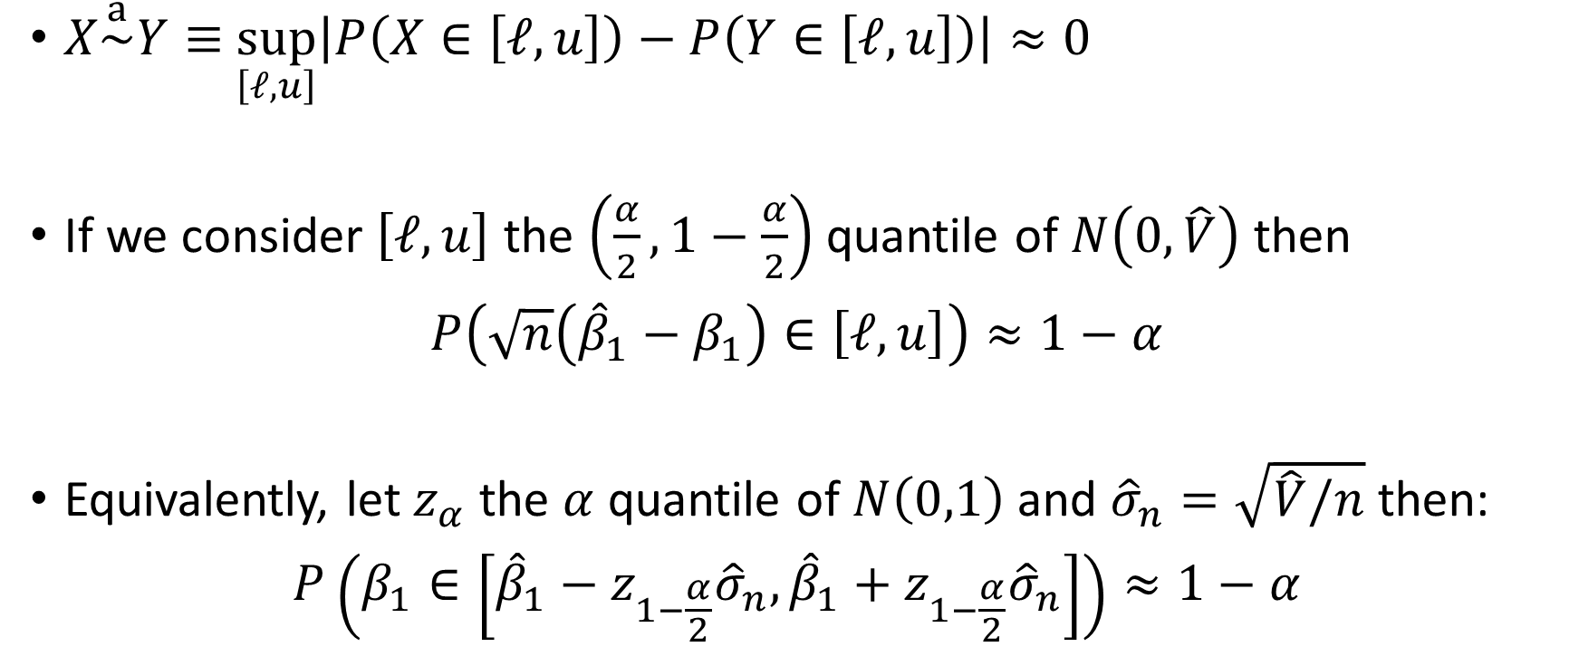
Confidence Interval
$X\overset{a}{\sim }Y≡$ $\sup_{\left[ℓ,u\right]}\left|P\left(X∈\left[ℓ,u\right]\right)−P\left(Y∈\left[ℓ,u\right]\right)\right|≈0$
If we consider $\left[ℓ, u\right]$ the $\left(\frac{α}{2},1−\frac{α}{2}\right)$ quantile of $N\left(0, \hat{V}\right)$ then
$$P\left(\sqrt{n}\left({\hat{β}}_{1}−β_{1}\right)∈\left[ℓ,u\right]\right)≈1−α$$
Equivalently, let $z_{α}$ the $α$ quantile of $N\left(0,1\right)$ and ${\hat{σ}}_{n}=\sqrt{\hat{V}/n}$ then:
$$P\left(β_{1}∈\left[{\hat{β}}_{1}−z_{1−\frac{α}{2}}{\hat{σ}}_{n},{\hat{β}}_{1}+z_{1−\frac{α}{2}}{\hat{σ}}_{n}\right]\right)≈1−α$$
Standard error

Slide 45
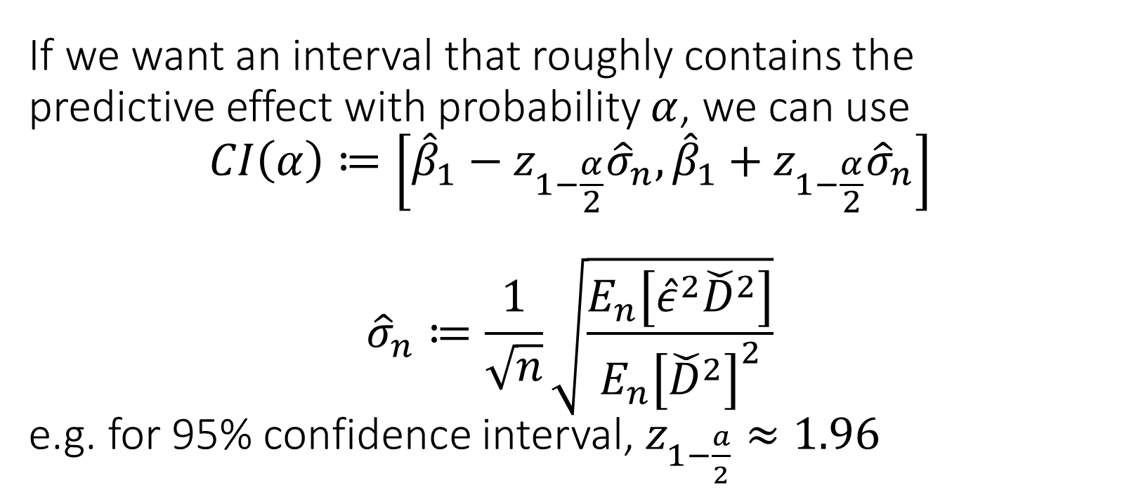
If we want an interval that roughly contains the predictive effect with probability $α$, we can use $$CI\left(α\right)≔\left[{\hat{β}}_{1}−z_{1−\frac{α}{2}}{\hat{σ}}_{n},{\hat{β}}_{1}+z_{1−\frac{α}{2}}{\hat{σ}}_{n}\right]$$ $${\hat{σ}}_{n}≔\frac{1}{\sqrt{n}}\sqrt{\frac{E_{n}\left[{\hat{ε}}^{2}{\check{D}}^{2}\right]}{E_{n}{\left[{\check{D}}^{2}\right]}^{2}}}$$ e.g. for 95% confidence interval, $z_{1−\frac{a}{2}}≈1.96$

Slide 46
Example: Wage Gap based on Sex Indicator

Slide 47
Revisit Covariate Adjustment for Effect Inference in Experiments

Slide 48
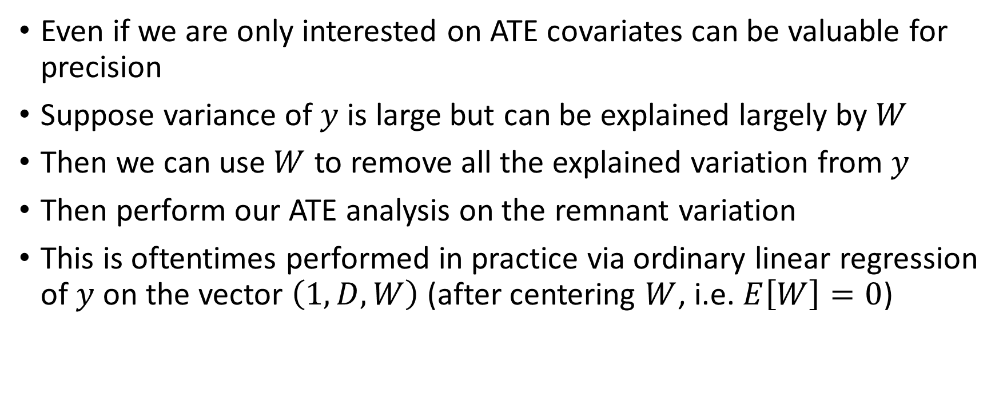
Co-variates for Precision
Even if we are only interested on ATE covariates can be valuable for precision
Suppose variance of $y$ is large but can be explained largely by $W$
Then we can use $W$ to remove all the explained variation from $y$
Then perform our ATE analysis on the remnant variation
This is oftentimes performed in practice via ordinary linear regression of $y$ on the vector $\left(1, D, W\right)$ (after centering $W$, i.e. $E\left[W\right]=0$)

Slide 49
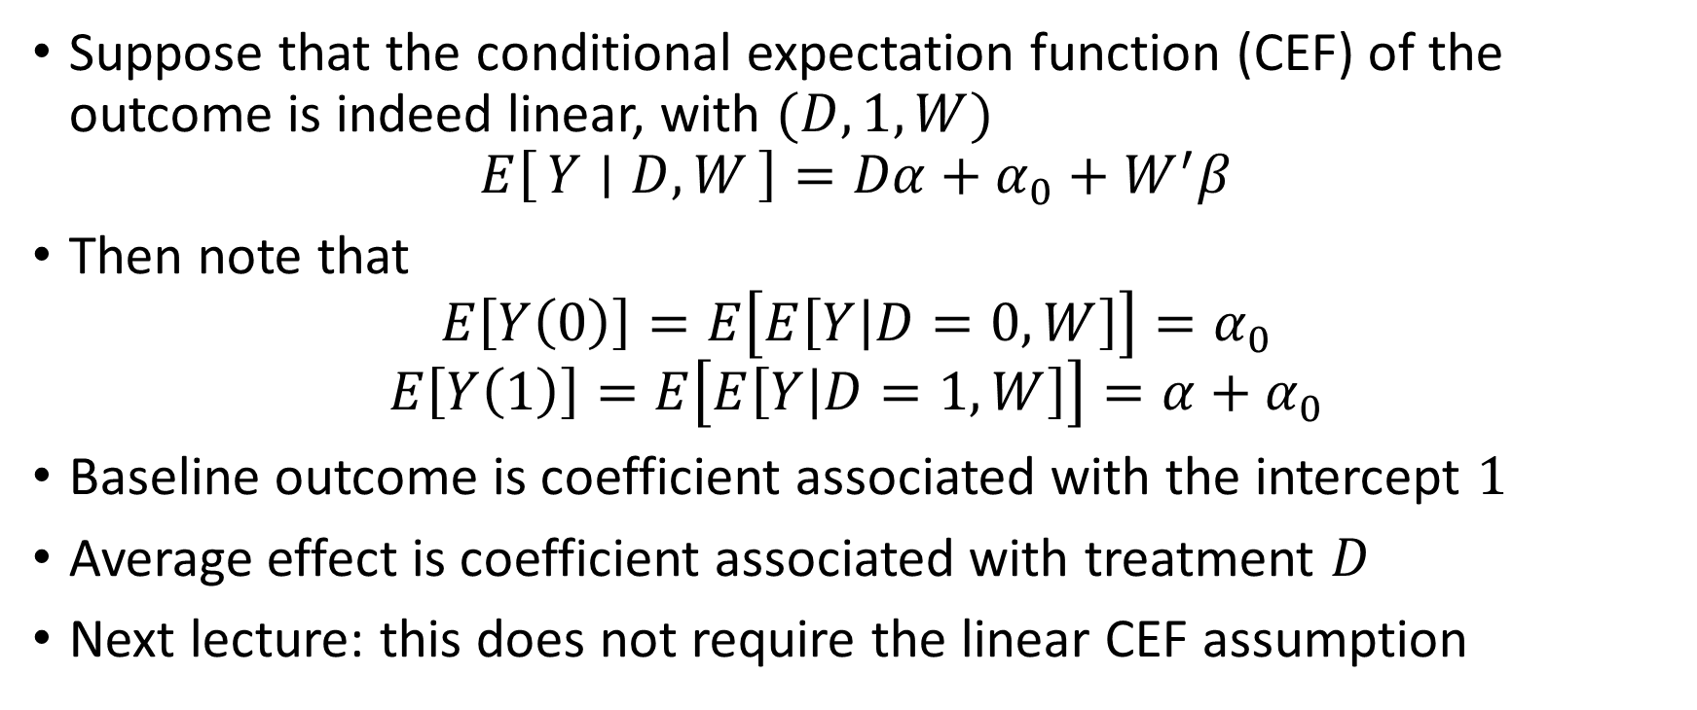
Is this consistent?
Suppose that the conditional expectation function (CEF) of the outcome is indeed linear, with $(D,1,W)$
$$E\left[Y ∣ D, W\right]=Dα+α_{0}+W^{′}β$$
Then note that
$$E\left[Y\left(0\right)\right]=E\left[E\left[Y | D=0,W\right]\right]=α_{0}$$
$$E\left[Y\left(1\right)\right]=E\left[E\left[Y | D=1, W\right]\right]=α+α_{0}$$
Baseline outcome is coefficient associated with the intercept $1$
Average effect is coefficient associated with treatment $D$
Next lecture: this does not require the linear CEF assumption

Slide 50
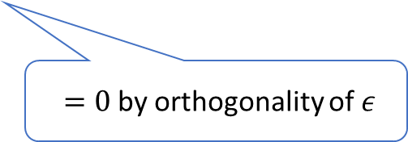
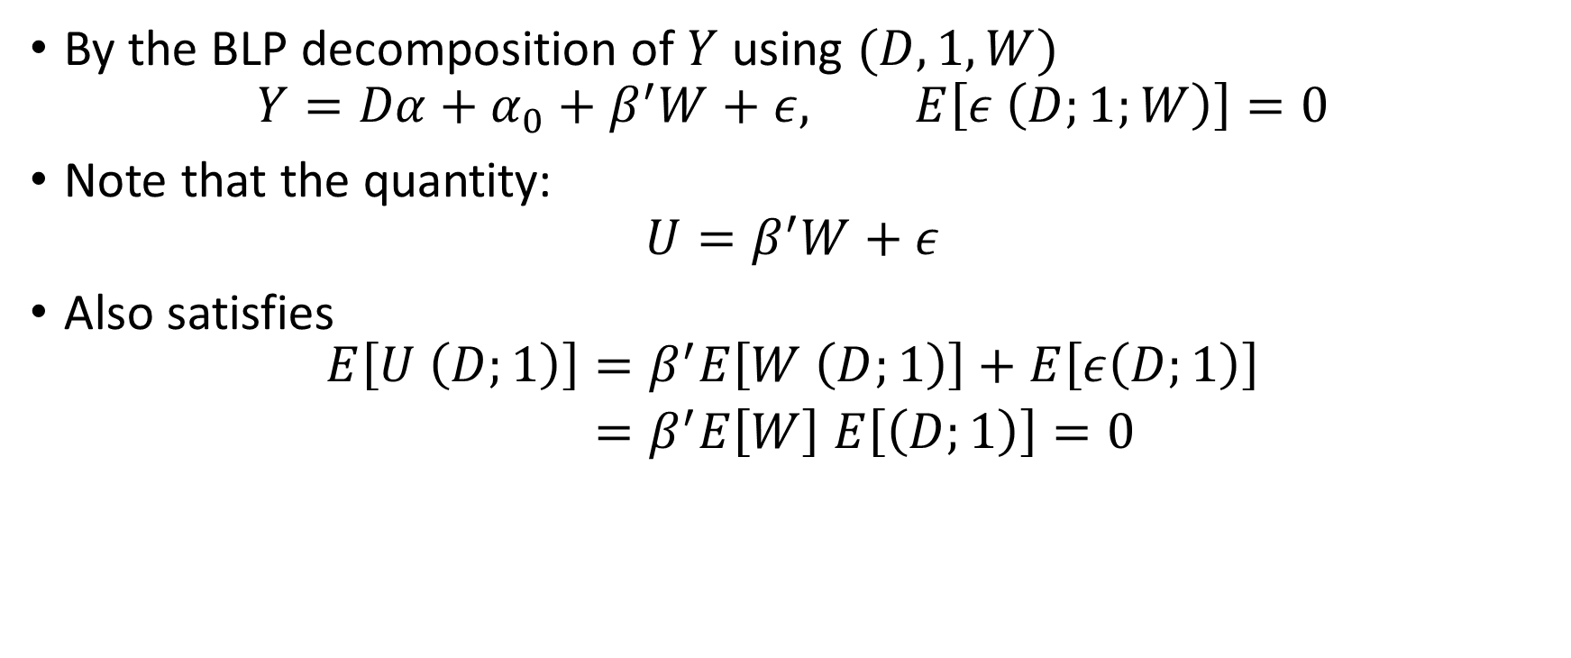
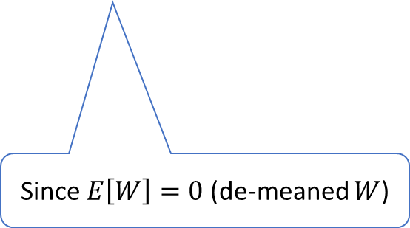
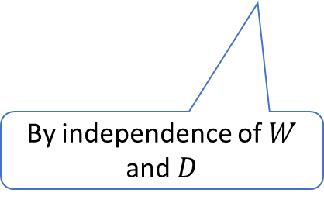
Is this consistent? Beyond Linear CEF
By the BLP decomposition of $Y$ using $(D,1,W)$
$$Y=Dα+α_{0}+β^{′}W+ε, E\left[ε \left(D;1;W\right)\right]=0$$
Note that the quantity:
$$U=β^{′}W+ε$$
Also satisfies
$$\begin{aligned}E\left[U \left(D;1\right)\right]=&β^{′}E\left[W \left(D;1\right)\right]+E\left[ε\left(D;1\right)\right] \\ =&β^{′}E\left[W\right] E\left[\left(D;1\right)\right]=0\end{aligned}$$
$=0$ by orthogonality of $ε$
By independence of $W$ and $D$
Since $E\left[W\right]=0$ (de-meaned $W$)

Slide 51
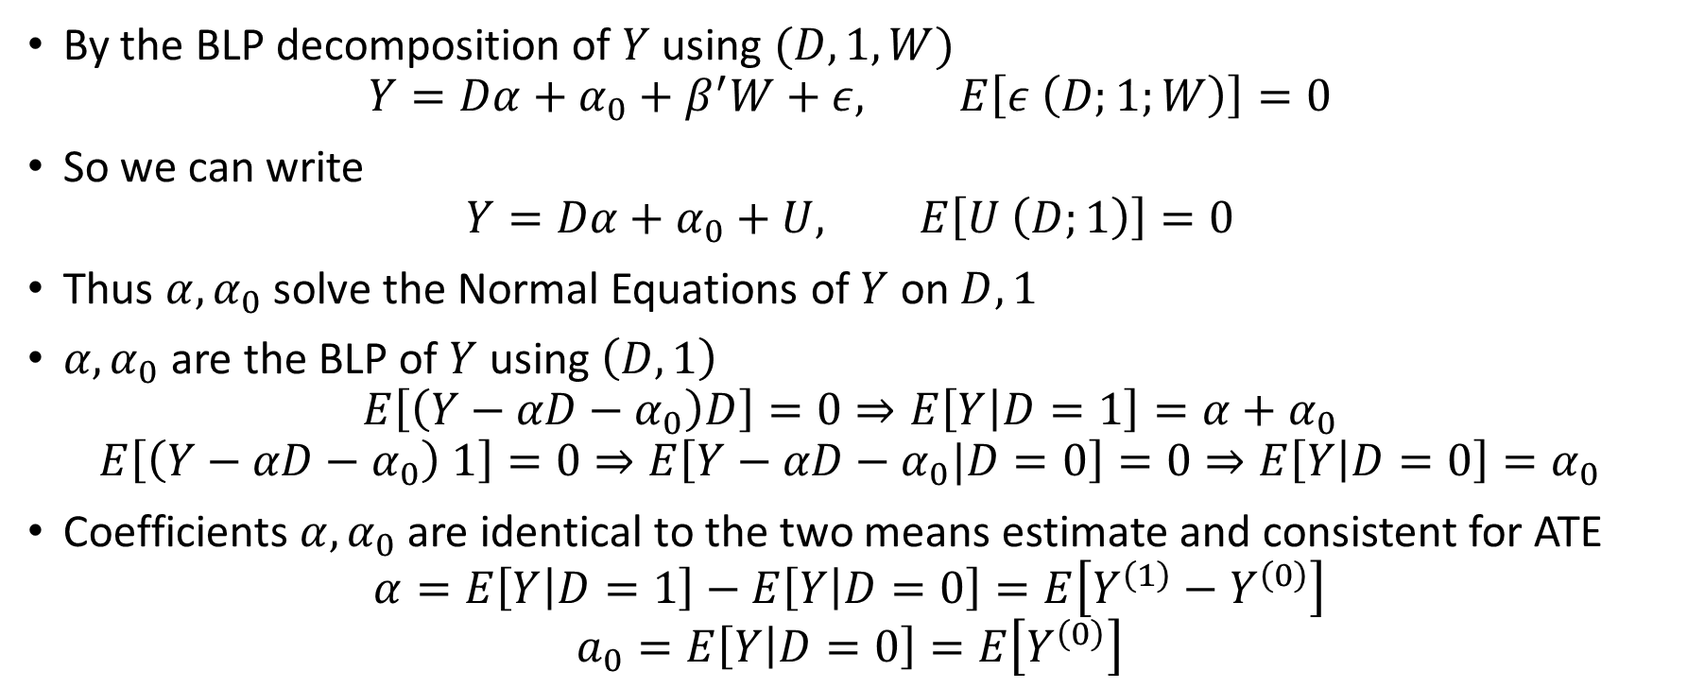
Is this consistent? Beyond Linear CEF
By the BLP decomposition of $Y$ using $(D,1,W)$
$$Y=Dα+α_{0}+β^{′}W+ε, E\left[ε \left(D;1;W\right)\right]=0$$
So we can write
$$Y=Dα+α_{0}+U, E\left[U \left(D;1\right)\right]=0$$
Thus $α,α_{0}$ solve the Normal Equations of $Y$ on $D, 1$
$α,α_{0}$ are the BLP of $Y$ using $\left(D,1\right)$
$$E\left[\left(Y−αD−α_{0}\right)D\right]=0⇒E\left[Y | D=1\right]=α+α_{0}$$
$$E\left[\left(Y−αD−α_{0}\right) 1\right]=0⇒E\left[Y−αD−α_{0}|D=0\right]=0⇒E\left[Y | D=0\right]=α_{0}$$
Coefficients $α,α_{0}$ are identical to the two means estimate and consistent for ATE
$$α=E\left[Y | D=1\right]−E\left[Y | D=0\right]=E\left[Y^{\left(1\right)}−Y^{\left(0\right)}\right]$$
$$a_{0}=E\left[Y | D=0\right]=E\left[Y^{\left(0\right)}\right]$$

Slide 52
The coefficient associated with treatment D in OLS with co-variate adjustment is always consistent for the treatment effect, when run on data from a randomized experiment, as-long-as covariates are de-meaned. The true relationship of outcome with covariates does not need to be linear.

