Slide 1
Innovation, Science and Economic Development Data
Team 2747

Slide 2
Task Overview
Determining and defining viable targets
Agreeability of current policies
Ratio of EE employees to Non-EE-employees
Identifying & Analyzing factors affecting mobility and retention of EE group members
Investigated relationships between variables

Slide 3
Finding Covariates
Initial approach was to use a random forest model
Two different approaches to cleaning the dataset
Approach #1: 70% training, 15% validation, 15% testing
Approach #2: Methodically removing data that was unhelpful
Preliminary analysis to understand the relationship between covariates
Plotted relationships between variables

Slide 4
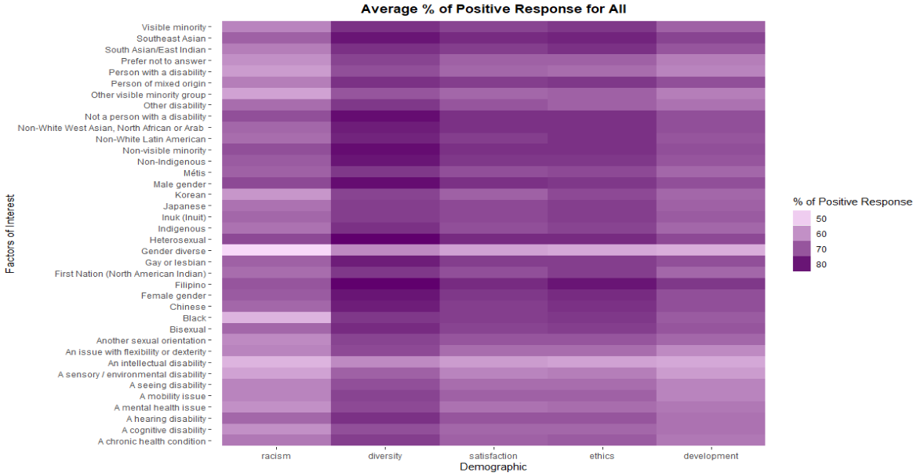
Heat Map

Slide 5
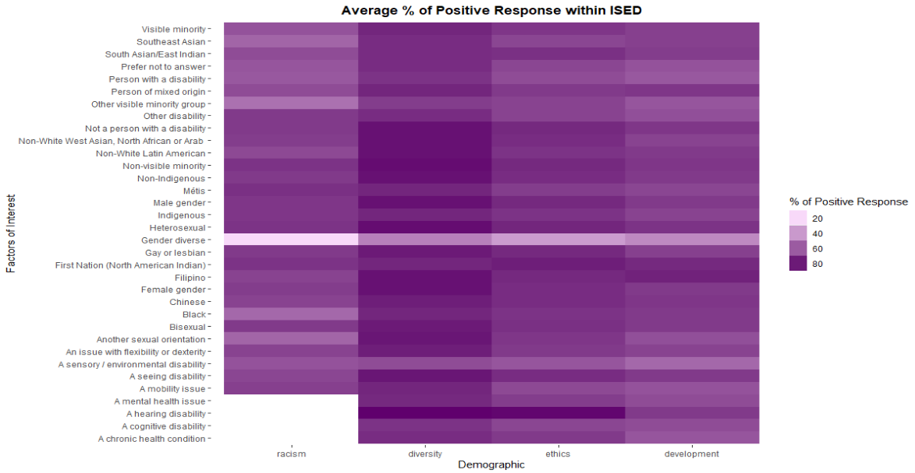
Heat Map

Slide 6
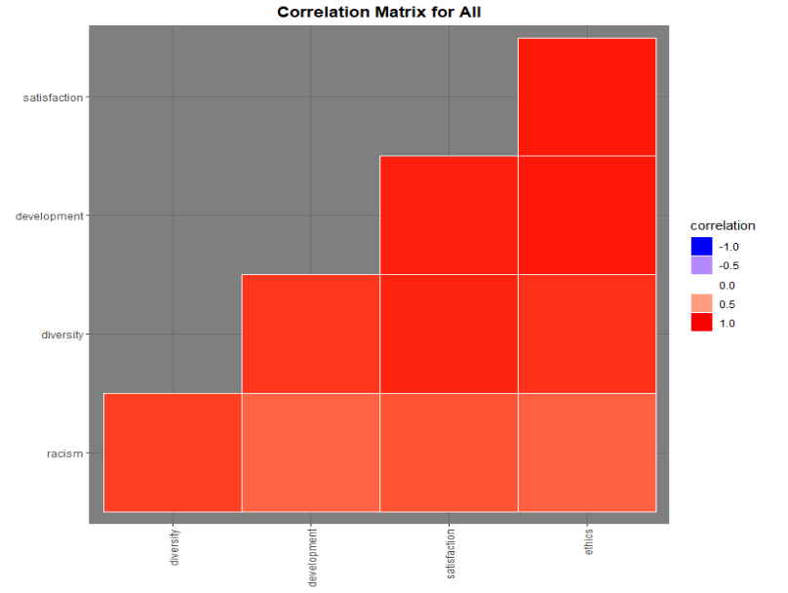
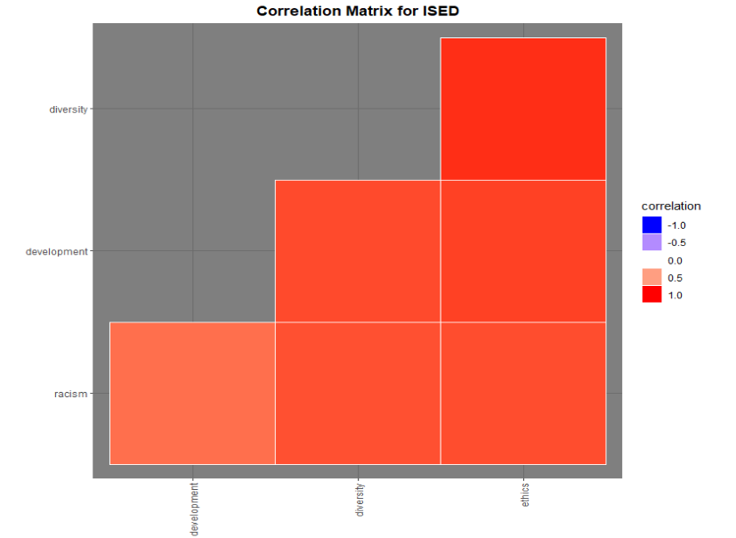
Correlation Map

Slide 7
Conclusion
Strong correlation between ethics and satisfaction
Strong relationship between demographics and average percentage of affirmative
Intriguing relationship between agreeability and percentage of first answer through percentage of seventh answer
Suggested further analysis on the relationship between responses and specific groups within the demographics

