Slide 1
Run AwAI
Kyle Chickering, Alex Mirov, Simon Wu, Xin Jin

Slide 2
Project Overview
Unsupervised training of agents.
Neural networks to control behavior of a StarCraft agent.
Easily measurable benchmarks… Time agent is alive.
Training neural networks… Neuroevolution.

Slide 3
Genetic Algorithms
Learning through evolution… Nature is the best teacher.
Populations, individuals and fitness.
Competition breeds innovation.

Slide 4
Neural Networks
Universal function approximates. ”Learn” any function.
Robust, able to handle messy data well.
Implicit and explicit (indirect and direct encoded) networks.

Slide 5
Methodology
Run genetic algorithm
Run simulations to compute the fitness
Tournament style selection

Slide 6
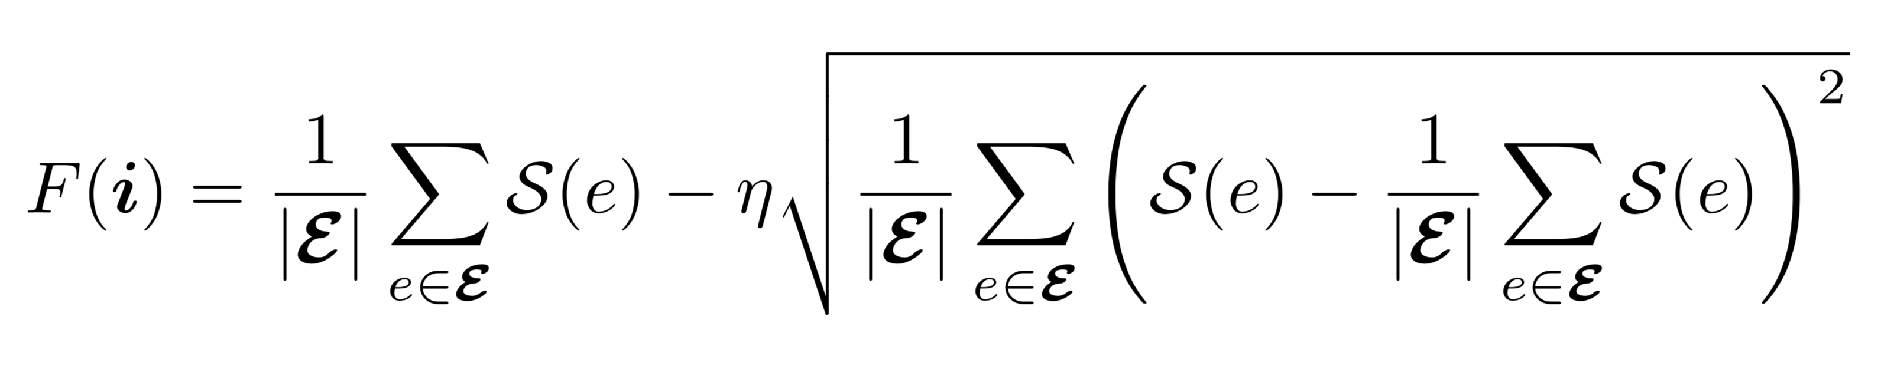
Boring Details
Our fitness function:
Average steps and standard deviation.
15 seed individuals, 5-10 trials per fitness calculation

Slide 7
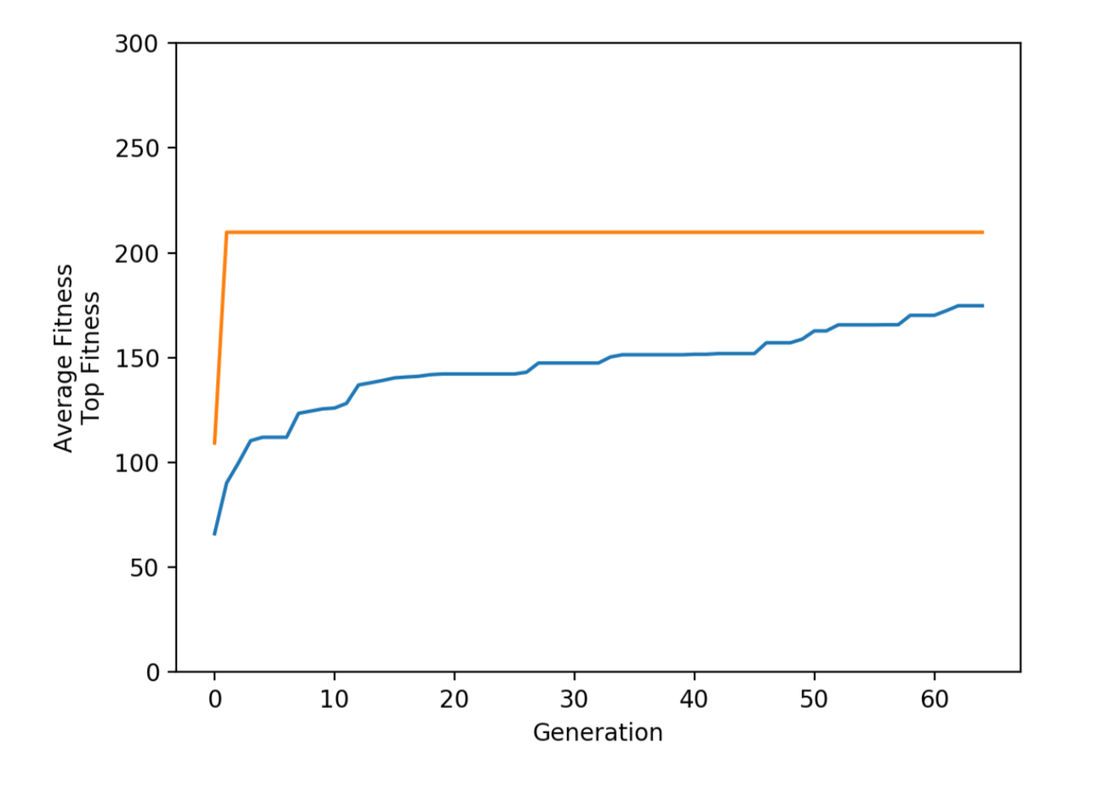
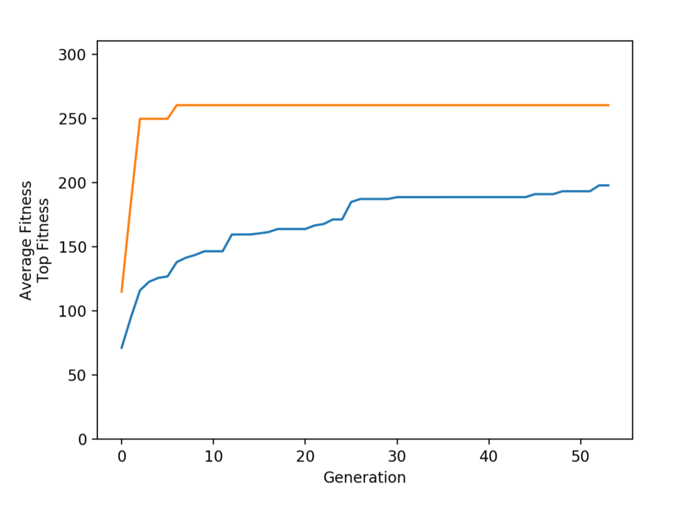
Results
~300% increase in survival time.

Slide 8
Future Work
More trials, bigger computers.
More complex tasks.
Larger input/output spaces.

