Slide 1
Implementation of algebraic cryptographic primitives in the Plonk framework
Bachelor’s Thesis
Àlex Mitjans Llorach
Supervisor: Elena Andreeva
Tutor: Stefano Trevisani

Slide 2
Outline
Motivation
Objectives & Scope
Background
Implementation
Benchmarking
Conclusions

Slide 3
Motivation
Rapid growth of zero-knowledge proofs
Traditional hash functions are not optimized for zero-knowledge proofs
Need for efficient hash functions in zero-knowledge proofs

Slide 4




Motivation
Applications
Secure logins systems
Identity management systems
Confidential payment systems
Secure financial transactions
Specially used in the blockchain technology

Slide 5
Objectives & Scope
Implement several zk-friendly hash functions
Plonk & Plonky2
Evaluate performance
Hash funcitons: Poseidon, Rescue-prime, Griffin, Anemoi, Arion
Fields: Goldilocks & BLS12-381 scalar field

Slide 6
Background

Slide 7
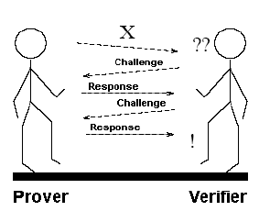
Interactive proof systems
Zero-knowledge proofs
Interactive zk proofs systems
Properties:
Completeness
Soundness
Zero-knowledge
The protocol:
P send a commitment of the private inputs to V
V creates a random challenge and sends it to P
P send to V the evaluated proof of the challenge
V verifies these evaluations

Slide 8
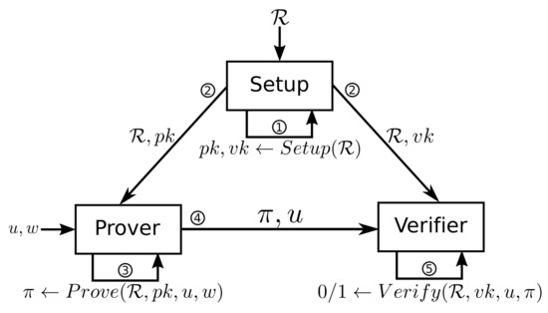
SNARKs
Succinct
Non-interactive
Argument
Knowledge-sound
Zk-SNARKs
The protocol:
Setup
Proof generation
Proof verification

Slide 9

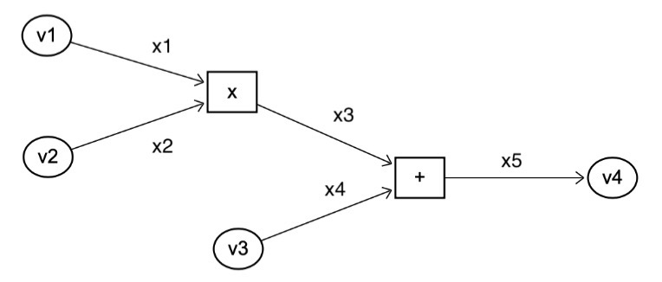
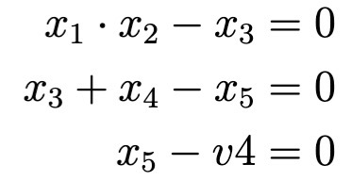
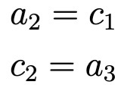
Plonk |
1. Constraint system
Gate type | q_{L} | q_{R} | q_{O} | q_{M} | q_{C}
Addition | 1 | 1 | -1 | 0 | 0
Multiplication | 0 | 0 | -1 | 1 | 0
Constant | 1 | 0 | 0 | 0 | -c_{i}
Output | 1 | 0 | 0 | 0 | -x_{i}
Example:
Constraint system
Copy constraints

Slide 10
Plonk
Plonky2
2. Compressing constraints
FRI protocol
Schwartz-Zippel lemma
Lagrange interpolation
3. Polynomial commitments
KZG commitments

Slide 11
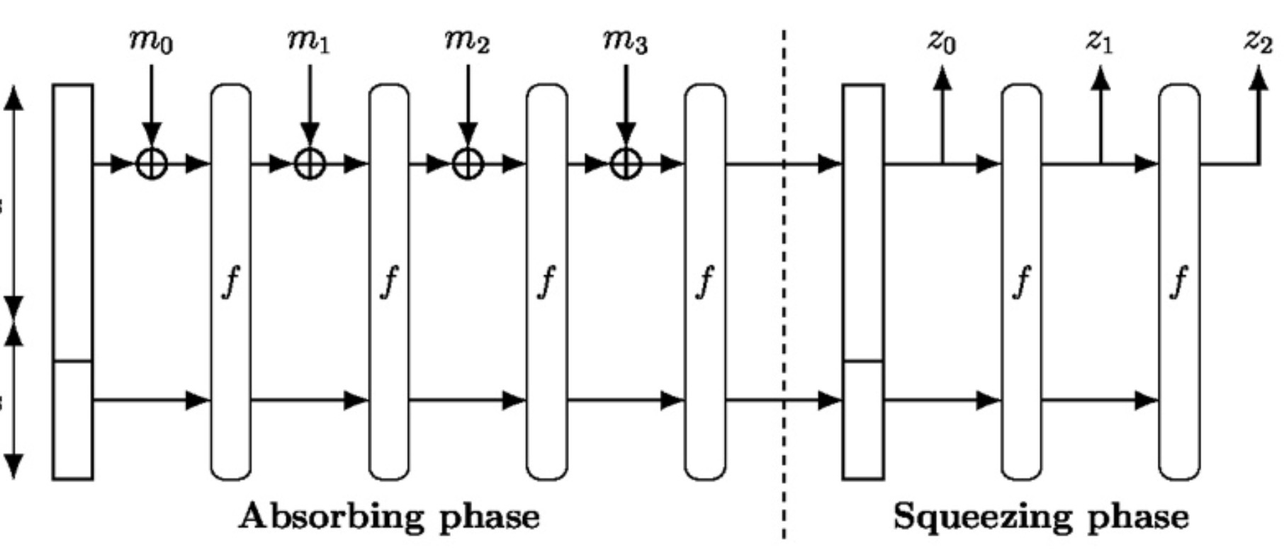
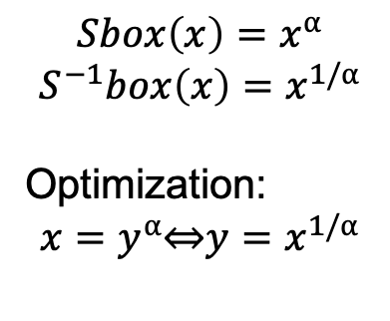
Zero-knowledge friendly hash functions
Arithmetization-Oriented (AO) hash functions
Poseidon
Rescue-prime
Griffin
Anemoi
Arion
Hash functions main components:
Horst Scheme
Open Flyestel structure
Generalized Triangular Dynamical System
Non-linear layer
$$Sbox\left(x\right)=x^{⍺}$$
$${S^{−1}box\left(x\right)=x}^{1/⍺}$$
Optimization:
$${x=y}^{⍺}\text{⇔}{y=x}^{1/⍺}$$
r
c

Slide 12
Implementation & Benchmarking

Slide 13
Implementation
Hash functions: Poseidon, Rescue-prime, Griffin, Anemoi, Arion
Plonky2 & Dusk Plonk
Implemented the code in Rust
Implemented for different configurations and optimized according to publications
Used Criterion for benchmarking

Slide 14
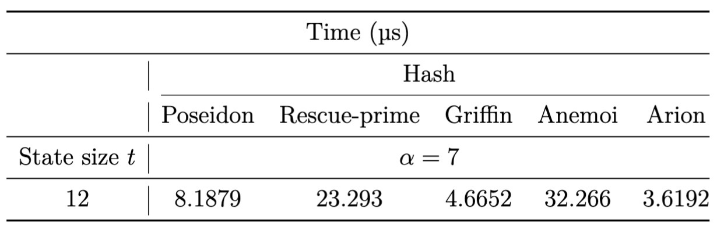
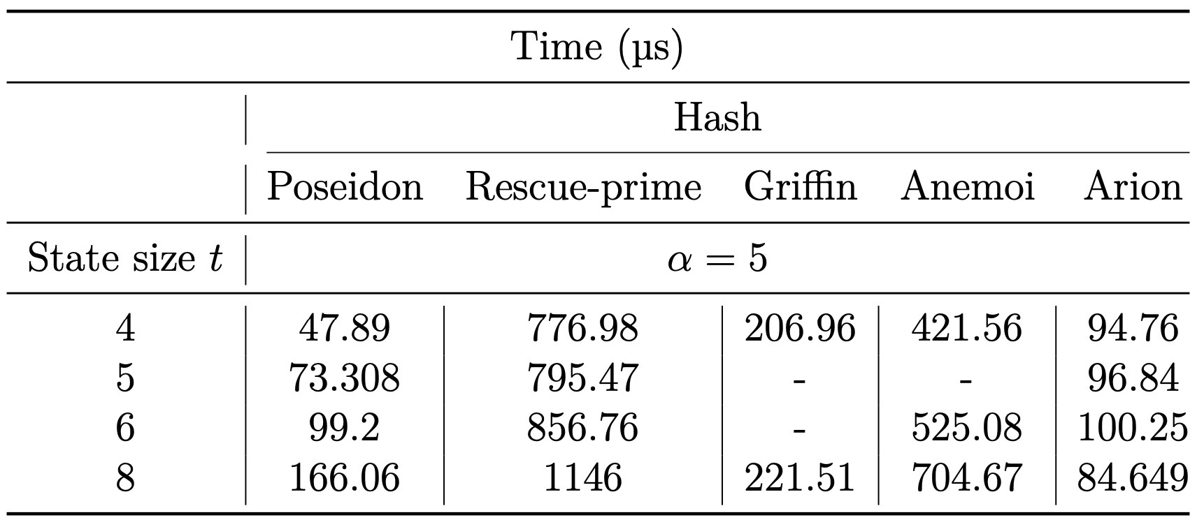
Plain performance
Goldilocks field – 64 bits
BLS12-381 scalar field – 256 bits

Slide 15
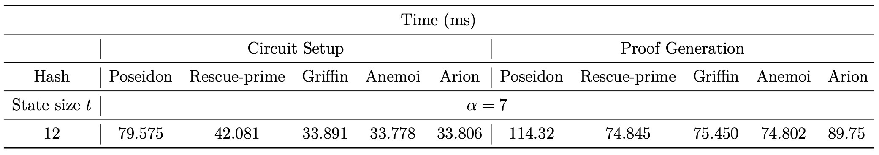
Plonky2
Performance

Slide 16
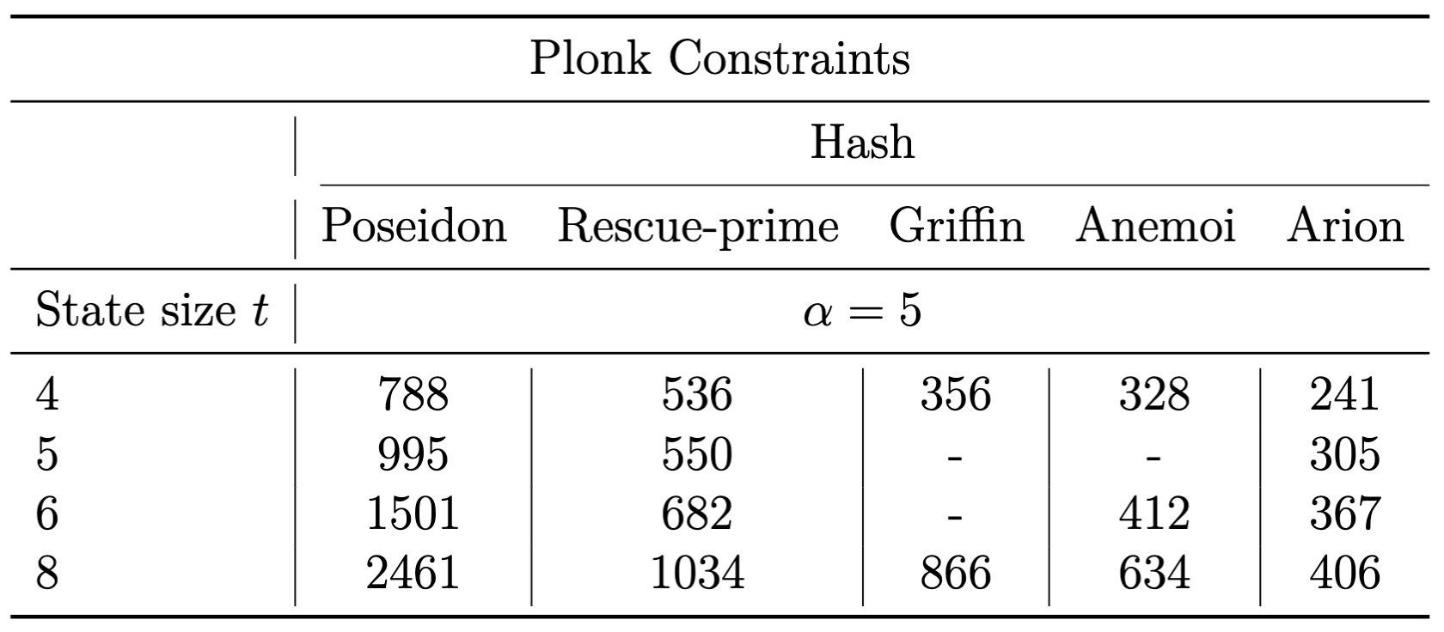
Dusk Plonk
Number of constraints

Slide 17
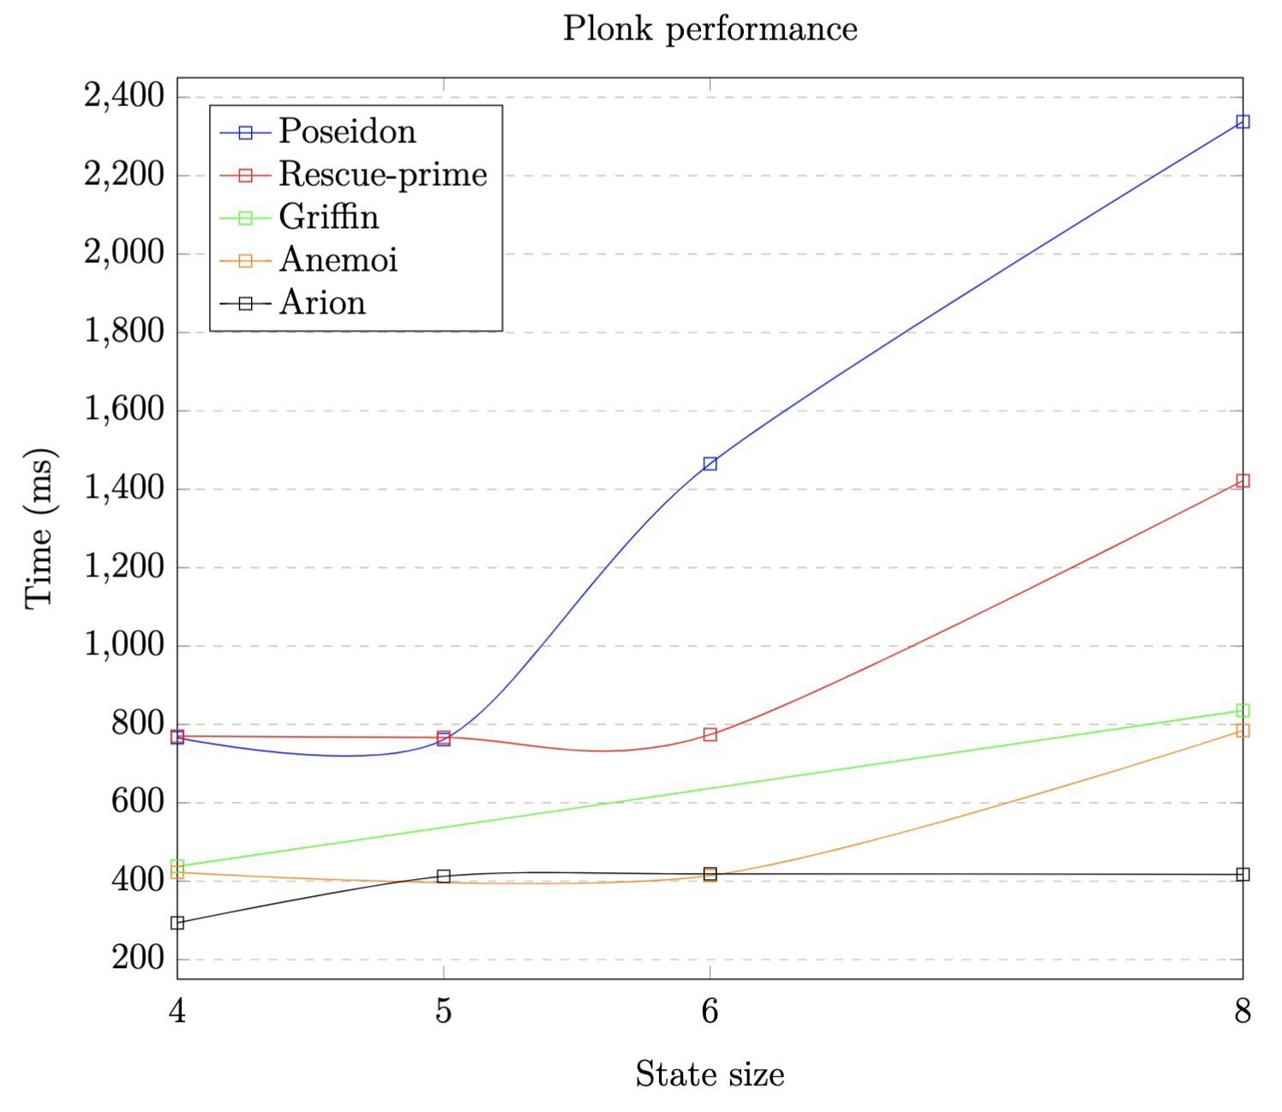
Dusk Plonk Proof verification
Proof verification (ms)
Dusk Plonk | Plonky2
13.5 | 4.4

Slide 18
Conclusions

Slide 19
Conclusions
Inside a zero-knowledge proof system:
Dusk Plonk: Arion
Plonky2: Rescue-prime, Anemoi, Griffin
Plain hashing
Goldilocks field: Arion & Griffin
BLS12-381 scalar field: Poseidon & Arion

Slide 20
Questions?

