Slide 1
Implementation of algebraic cryptographic primitives in the Plonk framework
Bachelor’s Thesis
Àlex Mitjans Llorach

Slide 2
Outline
Motivation
Objectives & Scope
Background
Implementation
Benchmarking
Conclusions

Slide 3
Motivation
Rapid growth of zero-knowledge proofs
Traditional hash functions are not optimized for zero-knowledge proofs
Need for efficient hash functions in zero-knowledge proofs

Slide 4
Objectives & Scope
Implement several zk-friendly hash functions
Plonk & Plonky2
Evaluate performance
Hash funcitons: MiMC, Poseidon, Rescue-prime, Griffin, Anemoi, Arion
Fields: Goldilocks & BLS12-381 scalar field

Slide 5
Background

Slide 6
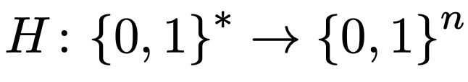

Hash functions
One way function
Target collision resistance
Collision resistance
Deterministic
Block ciphers
Feistel networks
Substitution-permutation network
Horst scheme
Open Flyestel componenent

Slide 7
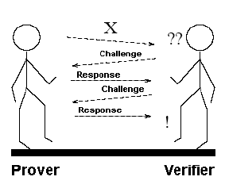
Interactive proof systems
Zero-knowledge proofs
Interactive zk proofs systems
Properties:
Completeness
Soundness
Zero-knowledge
The protocol:
P send a commitment of the private inputs to V
V creates a random challenge and sends it to P
P send to V the evaluated proof of the challenge
V verifies these evaluations

Slide 8
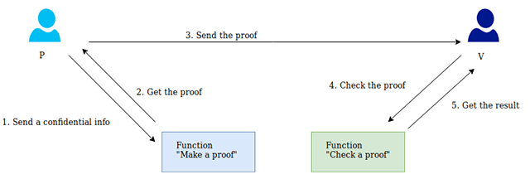
SNARKs
Succinct
Non-interactive
Argument
Knowledge-sound
Zk-SNARKs
The protocol:
Setup
Proof generation
Proof verification

Slide 9

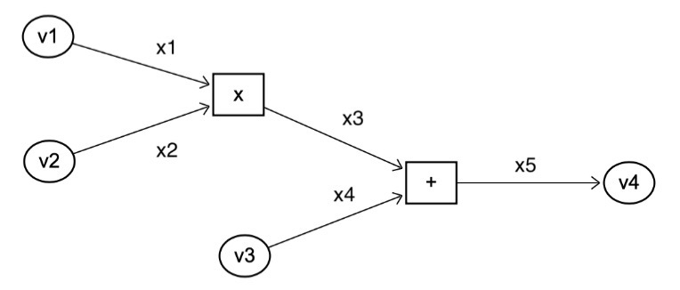
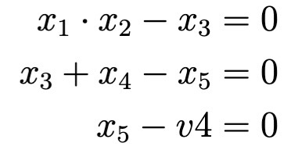
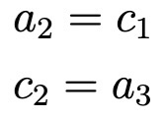
Plonk |
1. Constraint system
Gate type | q_{L} | q_{R} | q_{O} | q_{M} | q_{C}
Addition | 1 | 1 | -1 | 0 | 0
Multiplication | 0 | 0 | -1 | 1 | 0
Constant | 1 | 0 | 0 | 0 | -c_{i}
Output | 1 | 0 | 0 | 0 | -x_{i}
Example:
Constraint system
Copy constraints

Slide 10
Plonk
2. Compressing constraints
Schwartz-Zippel lemma
Lagrange interpolation
3. Polynomial commitments
KZG commitments

Slide 11
Zero-knowledge friendly hash functions
Arithmetization-Oriented (AO) hash functions
MiMC
Poseidon
Poseidon2
Rescue-prime
Griffin
Anemoi
Arion

Slide 12
Implementation

Slide 13
Implementation
Hash functions: Poseidon, Rescue-prime, Griffin, Anemoi, Arion
Plonky2 & Dusk Plonk
Implemented the code in Rust
Divided the circuit implementation
Implemented for different configurations and optimized according to publications
Used Criterion for benchmarking

Slide 14
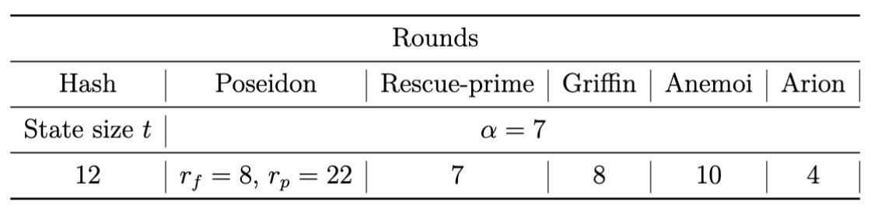
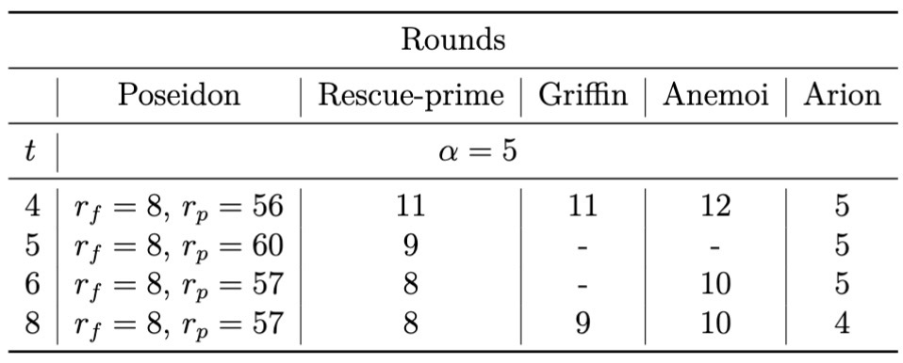
Number of rounds
Goldilocks field – 64 bits
BLS12-381 scalar field – 256 bits

Slide 15
Benchmarking

Slide 16
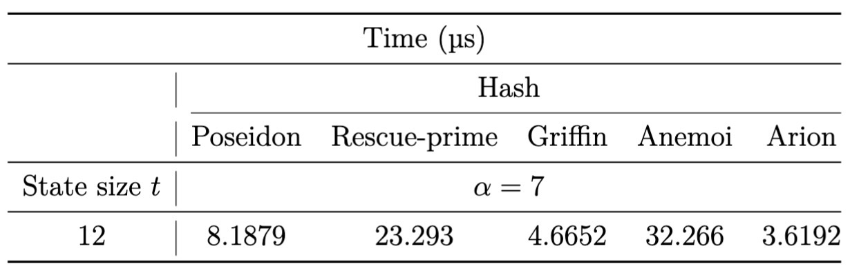
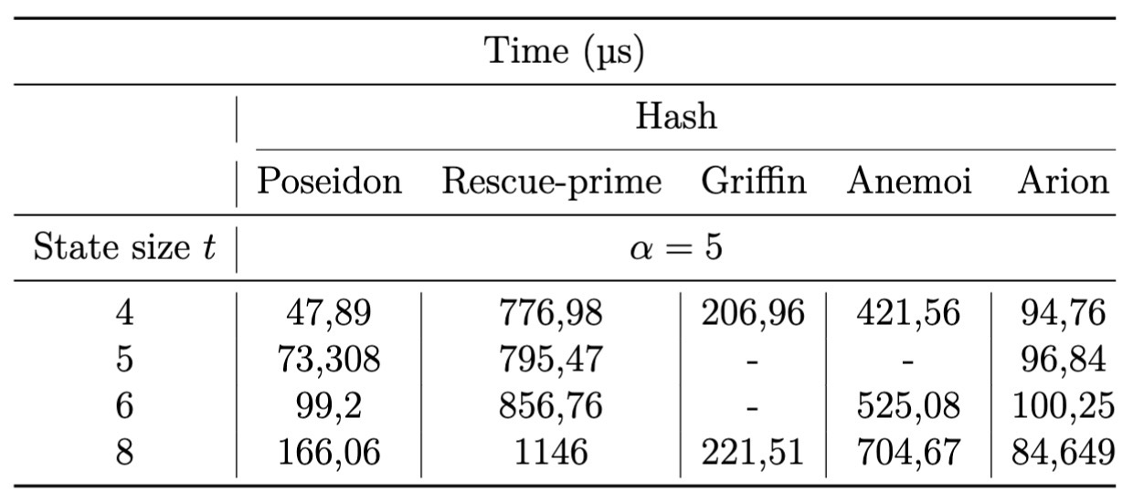
Plain performance
Goldilocks field
BLS12-381 scalar field

Slide 17
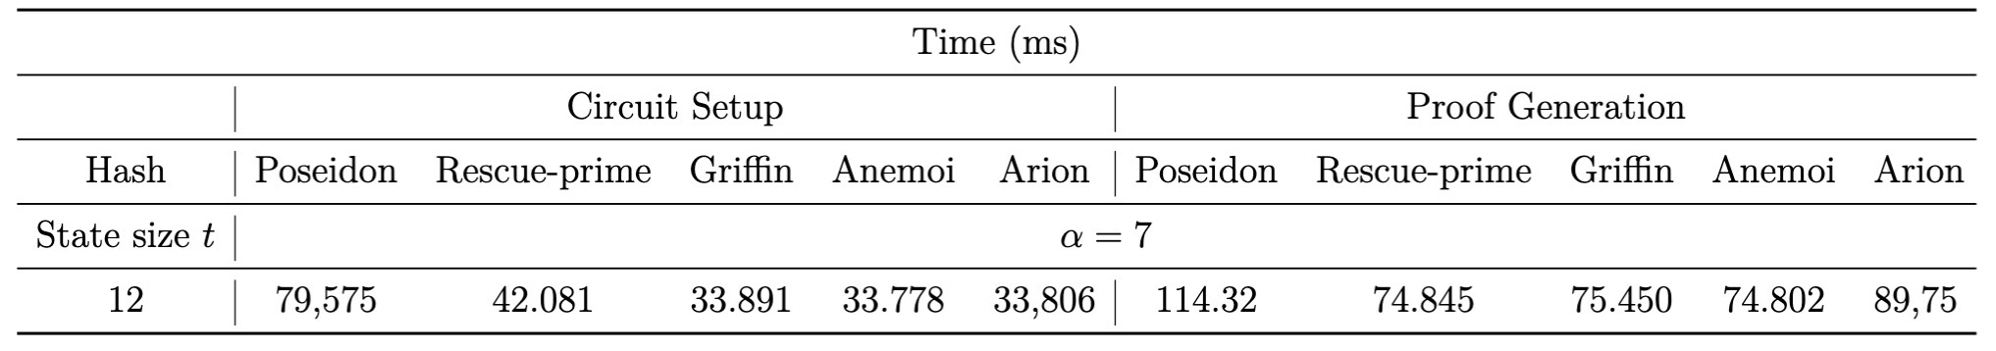
Plonky2
Performance

Slide 18
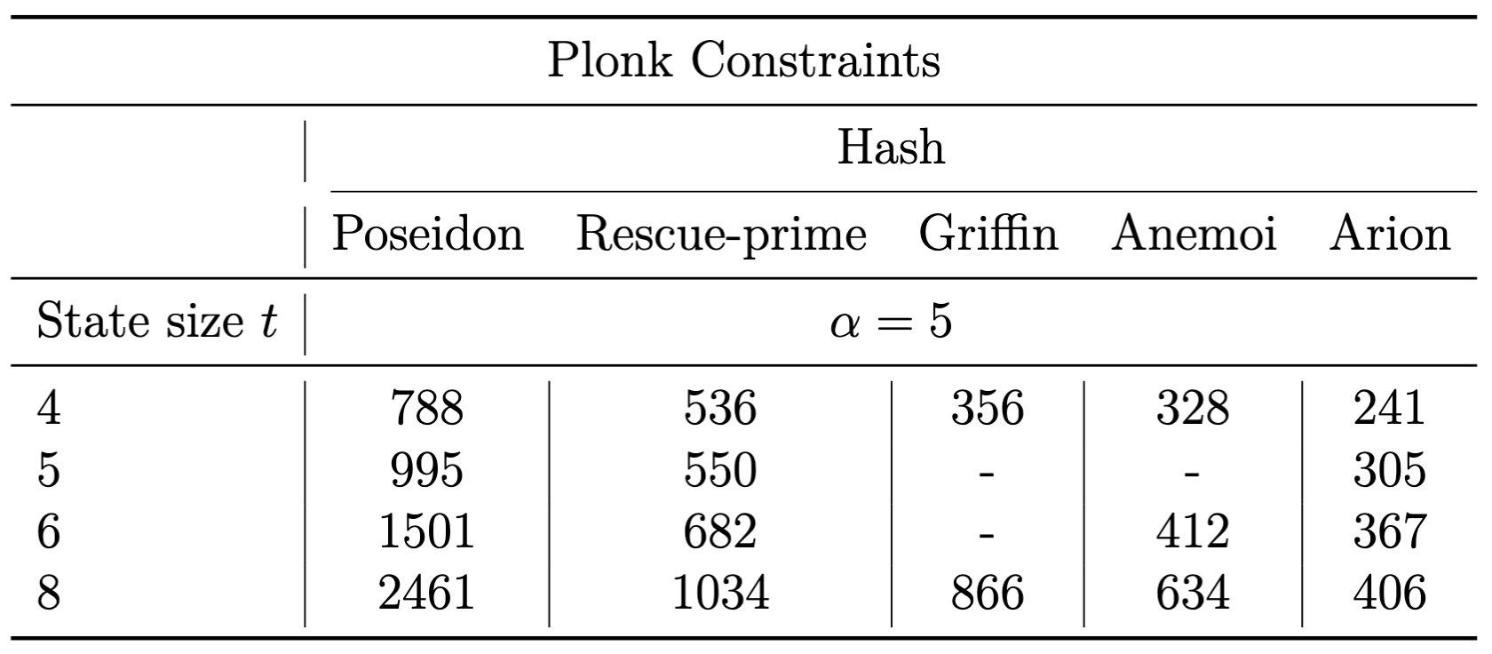
Plonk
Number of constraints

Slide 19
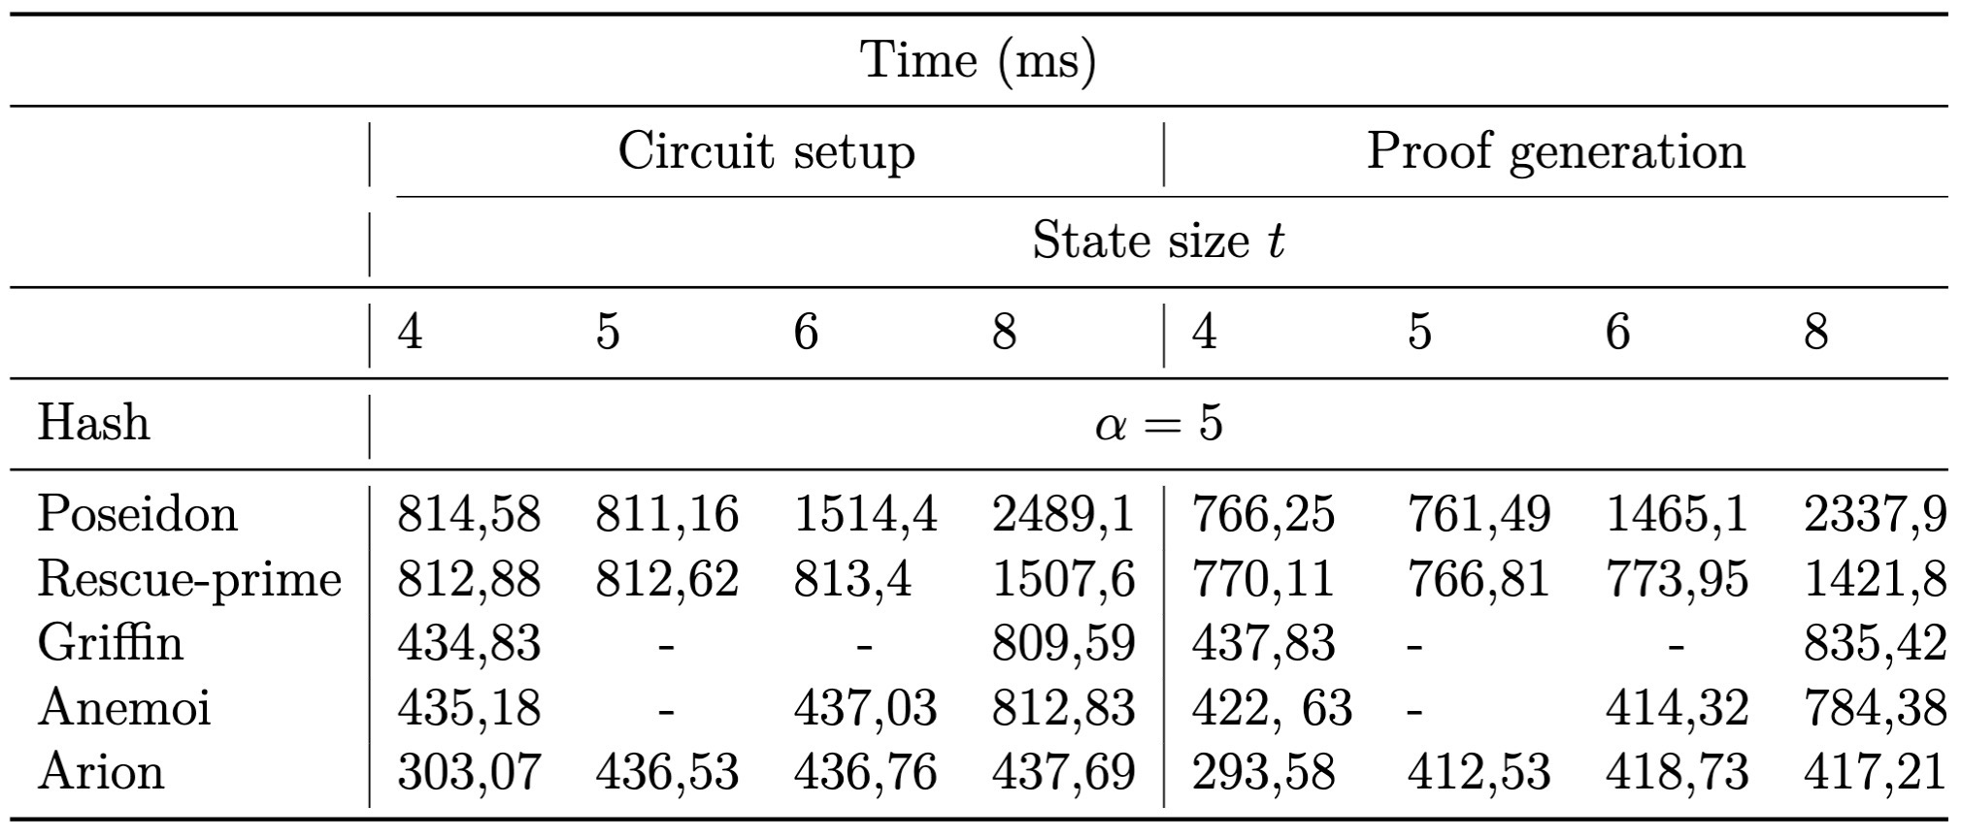
Plonk
Performance

Slide 20

Conclusions

