Slide 1
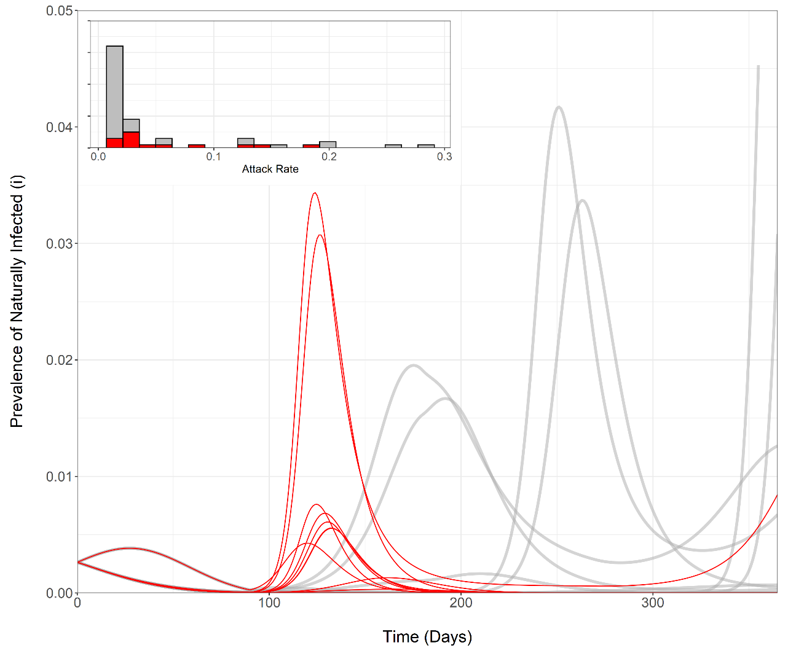
Epidemic scenarios highlighting early release of restrictions
High-risk cases (relative scale)
NOT PREDICTIONS
Early release
Varying coverage, natural protection, vaccine-induced protection and transmission-blocking, variant transmissibility, mixing patterns and relaxation

