Slide 1
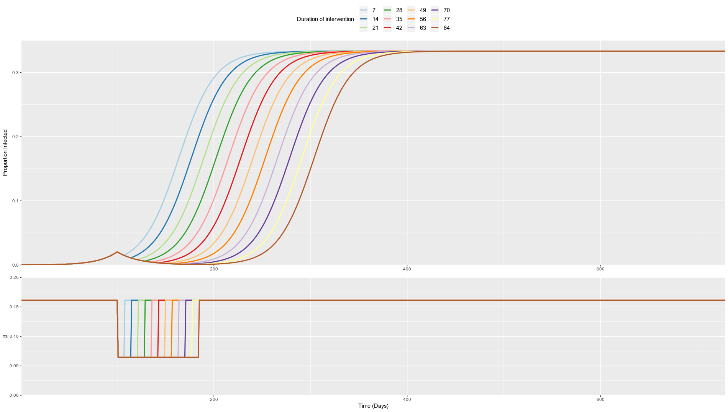

Slide 2
Peak I(t) first peak = 0.0204
2*I(t) first peak = 2*0.0204 = 0.0408
Days until doubling is number of days it takes for the epidemic to reach 2*I(t) first peak
Intervention Duration | I(t) 2nd peak | day 2*I(t) peak | days_until_doubling
1 week | 0.3333 | 127 | 27
2 weeks | 0.3333 | 140 | 40
3 weeks | 0.3333 | 152 | 52
4 weeks | 0.3333 | 165 | 65
5 weeks | 0.3333 | 178 | 78
6 weeks | 0.3333 | 191 | 91
7 weeks | 0.3333 | 203 | 103
8 weeks | 0.3333 | 216 | 116
9 weeks | 0.3333 | 229 | 129
10 weeks | 0.3333 | 241 | 141
11 weeks | 0.3333 | 254 | 154
12 weeks | 0.3333 | 267 | 167

