Slide 1
Explicit Fitness Cost Model
Parameter | Description | Value
ß | Transmission Rate | 5
µ_{T} | Rate of recovery (treated) | 1/7
µ_{R} | Rate of recovery (resistant) | 1/10
µ_{w} | Rate of recovery (wild type) | 1/12
η_{wr} | “Mutation” rate from sensitive to resistant infection (class 1) | 0.15
η_{wx} | “Mutation” rate from resistant to sensitive infection (class 1) | 0.01
σ₁ | Fraction of population treated with antibiotic class 1 | 0.25
σ₂ | Fraction of population treated with antibiotic class 2 | 0.25
σ₃ | Fraction of population treated with antibiotic class 3 | 0.25
C₁ | Fitness cost of class 1 relative to sensitive strains | 0.95
C₂ | Fitness cost of class 2 relative to sensitive strains | 0.91
C₃ | Fitness cost of class 3 relative to sensitive strains | 0.8
ρ | Probability of antibiotic failure | 0.5
W
(1-σ₁+σ₂)*η_{rw}
(1-σ₁+σ₂)*η_{wr}
σ₁*η_{wr}*ρ
σ₂*η_{rw}*ρ
R₁
µ_{T}*
(σ₁+σ₂)*(1-ρ)
R₂
ßSW
µ_{W}*
1-(σ₁+σ₂)
ßSR₁c₁
ßSR₂c₂
µ_{R}*(1-σ₂) +
µ_{T}*σ₂
µ_{R}*(1-σ₁) +
µ_{T}*σ₁
S
Notes:
Mybe multiply the sigma by a proportion - so a proportion that the wild type either goes back to being sensitive or goes to being resistant.
Then you can allow for the proportion that the WT becomes resistant to be split up between the different R1 and R2 and R3, based on the fitness cost and the relative abundance between the R1 and R2 and R3 strains.
So prop*(R1*c1/(R1*c1+r2*c2+R3*c3)
I think the reason that this works is that the beta parameter is the same so we don’t need to factor this in.
This require the addition of just the proportion parameter – but we shall see. In its current form I think the system also works.
There is also an issue with the model – where

Slide 2
Taxation Scenarios to Compare
Flat Tax Rate (uniformly tax all classes)
Single Tax Rates
Tax₁, Tax₂ and Tax₃
Dual Tax Rates
Tax₁₂, Tax₁₃ and Tax₂₃
Differential Taxation
TaxDiff₁, …, TaxDiff_{n}

Slide 3
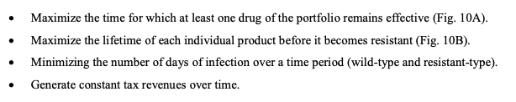
Optimisation Criteria
Currently have two optimisation criteria (which can be either absolute or relative)
Number of days spent with WT or Res infection
Average Resistance (might convert to sum of resistance – doesn’t change results)
???
What about the number of days spent with at least one antibiotic class below X% resistance (50% threshold?)
More relevant for the aims of differential taxation…

Slide 4
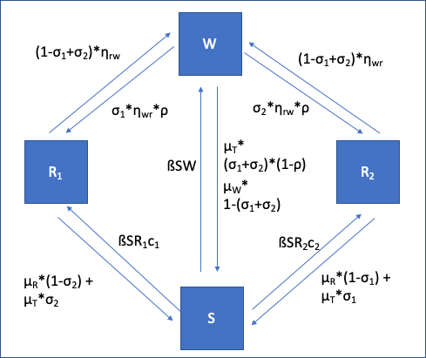
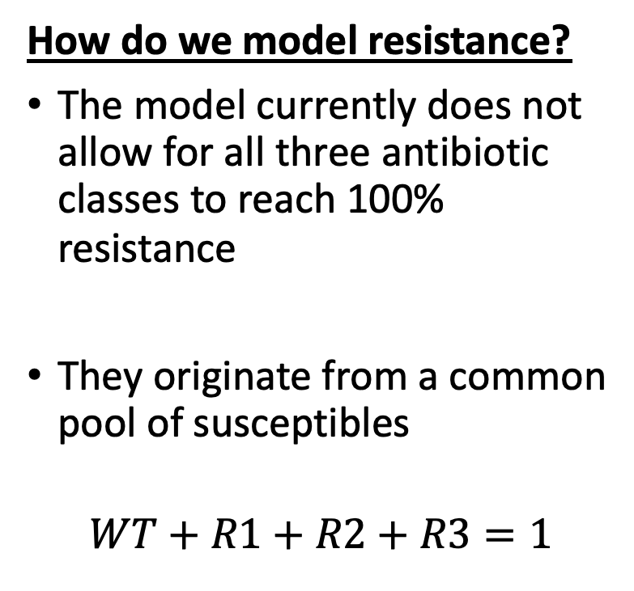
Number of days spent with at least one antibiotic class below 50%
How do we model resistance?
The model currently does not allow for all three antibiotic classes to reach 100% resistance
They originate from a common pool of susceptibles
$$WT+R1+R2+R3=1$$

Slide 5
Alternative Optimisation Criteria
Have a 3 optimisation plots next to each other (tot inf, avg res, and number of days spent with at least one antibiotic class below 50%)
We can make this a relative measure aswell.
You would want to maximise this outcome measure – per unit of antibiotic usage altered.
Maximise the number of days spent with at least one antibiotic class below X% per fraction of population treated reduced

Slide 6
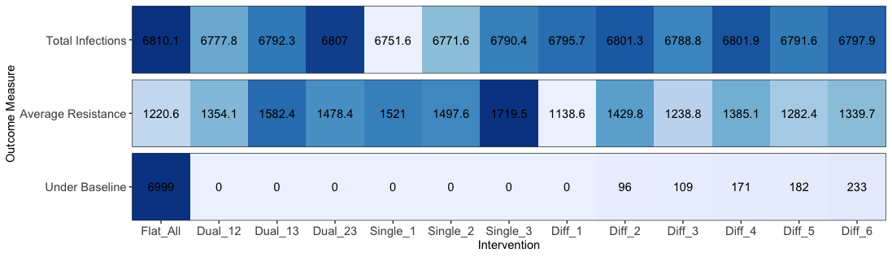

Slide 7
Optimisation Relevant Outcome Measures
Integral from the start of the intervention (t=3000) until the end of the simulation (t=10000)
Absolute Measure
Total Infection (integral)
Average resistance (integral)
Relative Measure
Relative reduction in resistance per proportion of population usage reduced
Relative increase in total infection per proportion of population usage reduced

Slide 8
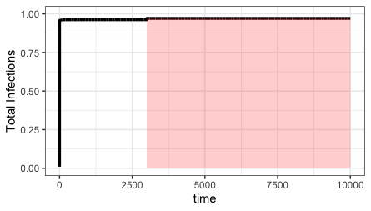
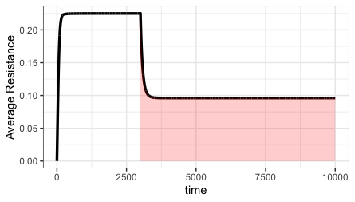
Absolute Measure
Total Infections
Average Resistance

Slide 9
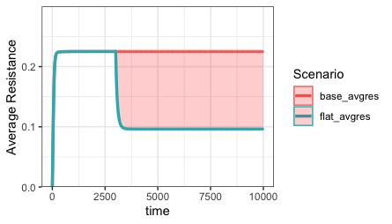
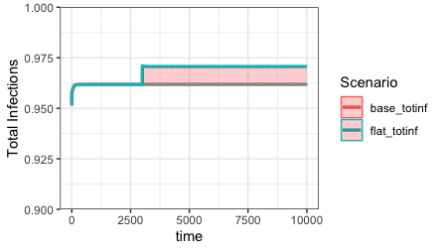
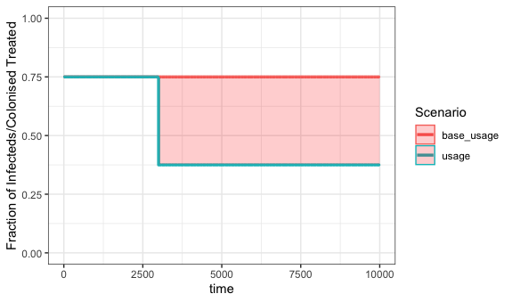
Relative Measure
Outcome measure = Relative reduction in resistance per proportion of population usage reduced (relative to no intervention) – MAXIMISE
Outcome measure = Relative increase in total infection per proportion of population usage reduced (relative to no intervention) - MINIMISE
Notes:
Think about the normalisation measure – the denominator

Slide 10
Dosage?
Parameter | Description | Value
σ₁ | Fraction of infecteds treated with antibiotic class 1 | 0.25
σ₂ | Fraction of infecteds treated with antibiotic class 2 | 0.25
σ₃ | Fraction of infecteds treated with antibiotic class 3 | 0.25
We only model the fraction of populations (total/infected) that are treated.
We do not model antibiotic concentration – so we cannot model dosage given.
Model the optimisation for both relative outcome measures – I really doubt they will be different.
For the relative outcome measures have 2 pltos - so 2 vs 2 plot
1-(σ₁+σ₁+σ₁) = Fraction of infecteds not treated

Slide 11
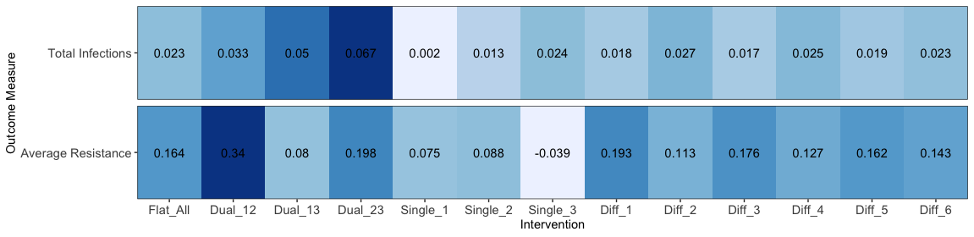
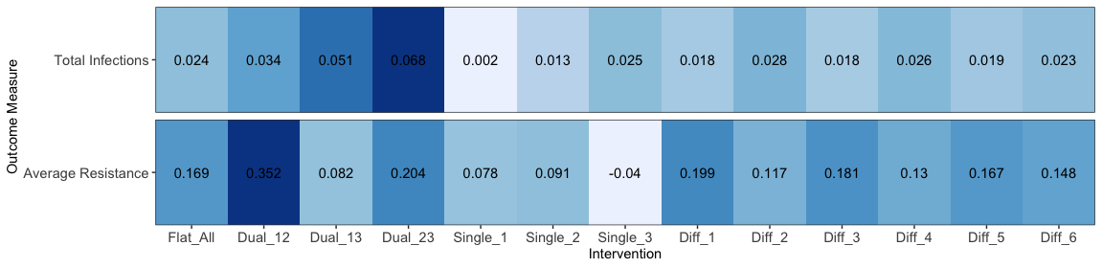
Denominator – Fraction of Infecteds Treated
Denominator – Fraction of Population Treated

Slide 12
Sensitivity Analysis
Parameter | Definition | Fixed or Sampled?
ß | Transmission Rate | Sampled
µ_{T} | Rate of recovery (treated) | Sampled
µ_{R} | Rate of recovery (resistant) | Sampled
µ_{w} | Rate of recovery (wild type) | Sampled
η_{wr} | “Mutation” rate from sensitive to resistant infection (class 1) | Sampled
η_{wx} | “Mutation” rate from resistant to sensitive infection (class 1) | Sampled
σ₁ | Fraction of infecteds treated with antibiotic class 1 | 0.25
σ₂ | Fraction of infecteds treated with antibiotic class 2 | 0.25
σ₃ | Fraction of infecteds treated with antibiotic class 3 | 0.25
C₁ | Fitness cost of class 1 relative to sensitive strains | Sampled
C₂ | Fitness cost of class 2 relative to sensitive strains | Sampled
C₃ | Fitness cost of class 3 relative to sensitive strains | Sampled
ρ | Probability of antibiotic failure | Sampled
Base Tax | Basic | Sampled
PEDs |  | {1, 1, 1}
Need to make analysis have some applied questions
How often is differential taxation successful?
We can use monte-carlo sampling to create parameter sets to explore which of the different interventions “wins”

Slide 13
Sensitivity Analysis
Caveats
If the sampled paramaeter returns 0,0, 0 for the baseline run, then we resample the model parameters.
If during one of the rounds of differential taxation R1, R2 or R3 = 0, then release all taxation for that specific round of taxation
Equaivalent ot saying…

Slide 14
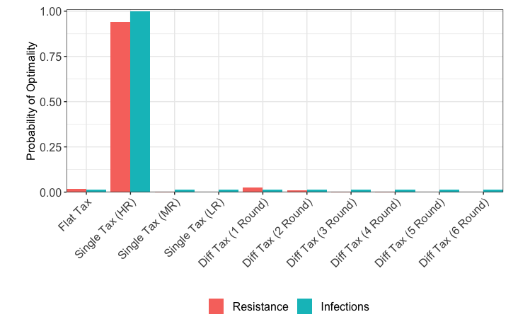
Sensitivity Analysis

Slide 15
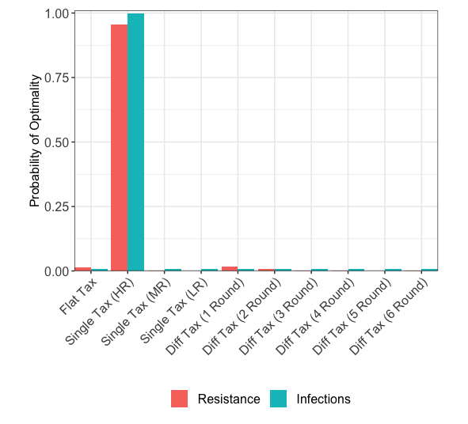
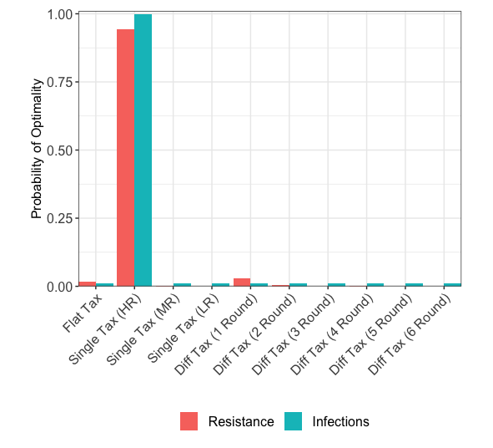
Sensitivity Analysis – Different PED scenarios
PED1 = 1, PED2 = 0.75, PED3 = 0.5
PED1 = 1.75, PED2 = 1.5, PED3 = 1.25

Slide 16
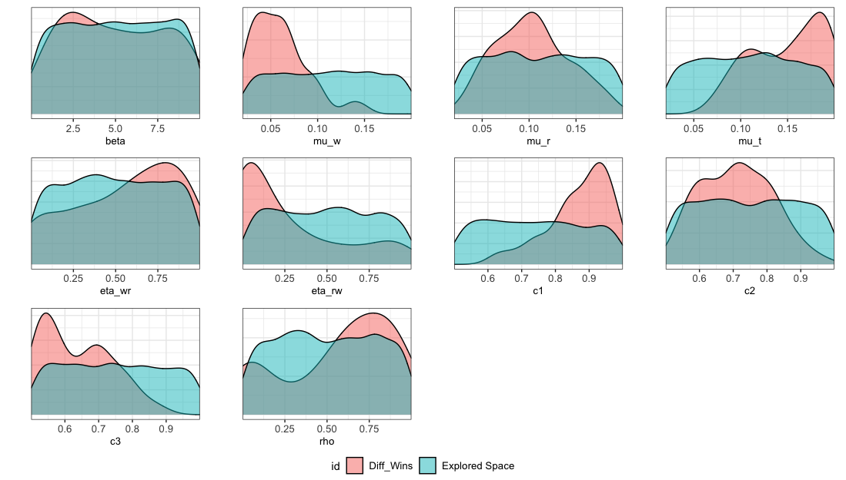

Slide 17
Differential Taxation Works
When the certain aprameter combinations…

Slide 18
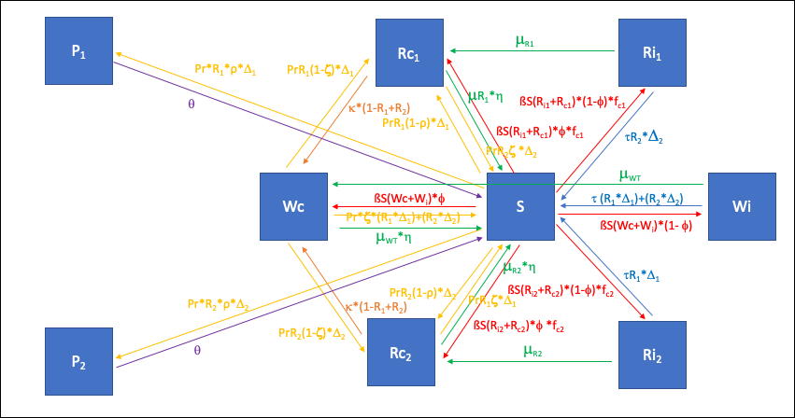
Prophylaxis
Example 2-Strain Model
Parameter | Description
β | Transmission rate
λ | Birth/death rate
μ_{x} | Natural recovery rate
η | Scaling factor reducing the rate of natural recovery for those who are colonised
ρ | Probability that prophylaxis that results in failure
τ | Rate of treatment-mediated recovery
φ | Probability that transmission results in infection rather than colonisation
θ | Rate of loss of protection from prophylaxis
κ | Rate of reversion from resistant colonised to WT colonisation
Pr | Rate of prophylaxis
f_{cx} | Transmission related fitness cost for class X
R_{x} | Fraction of population that is treated with antibiotic class X
Compartment | Description
P_{X} | Prophylaxed by antibiotic class X
Wc | Colonised with WT
Wi | Clinically infected with WT
Rc_{X} | Colonised with bacteria resistant to antibiotic class X
Ri_{X} | Clinically infected with bacteria resistant to antibiotic class X
S | Suscpetible
Prophylaxis
Loss of Prophylaxis
Protection
Natural Recovery
Reversion from R -> WT
Treatment
Transmission

Slide 19
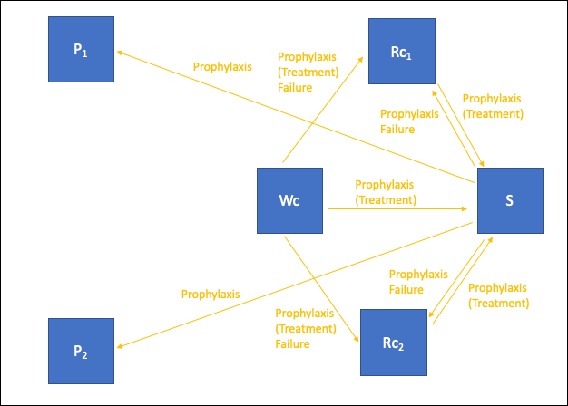
What does prophylaxis do?
Prophylaxis Causes
Decrease in Resistance
Protection from future infection in fully susceptible individuals
Treatment of those who are resistant and WT (WT, R1 and R2)
Treatment of those who are WT colonised
Increase in Resistance
Prophylaxis failure in those who are prophylaxed and susceptible.
Treatment failure in those who are treated and WT.
Withdrawing antibiotic usage:
Decreases protection from prophylaxis
Decreases prophylaxis failure
But also decreases prophylaxis treatment

Slide 20
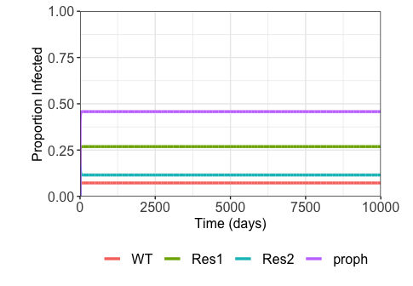
Baseline Model Output
Prophylaxed Compartment
Resistant Class 1
Resistant Class 2

Slide 21
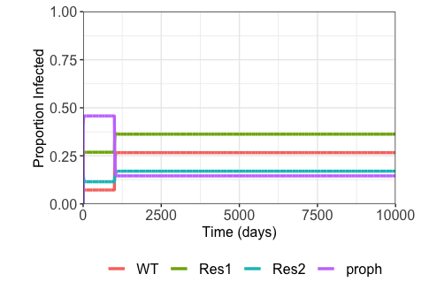
Why do we see increases in resistance?

Slide 22
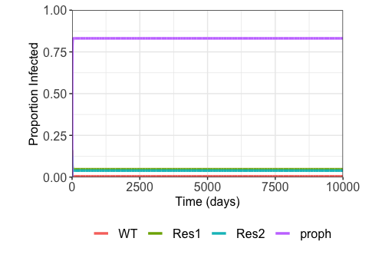
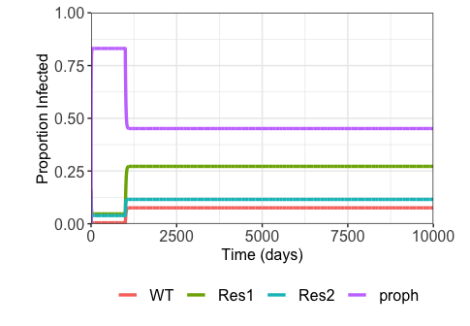
If a high propiortion of the populaiton is prophylaxed then the loss of antibiotic pressure causes resistance to increase

Slide 23
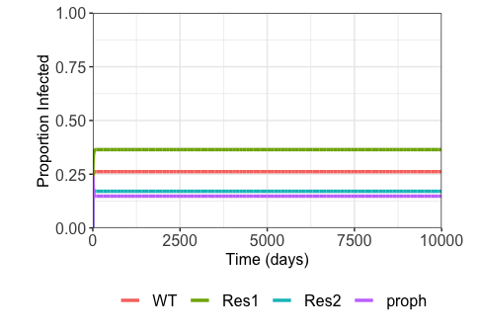
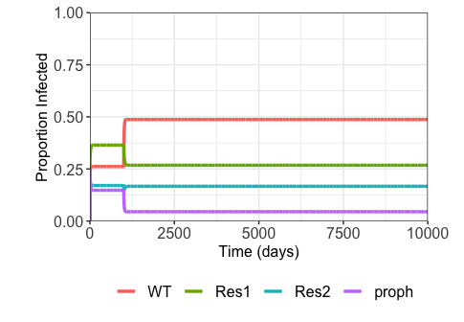
If a low propiortion of the populaiton is prophylaxed then the loss of antibiotic pressure causes resistance to decrease

Slide 24
Interim Conclusions from Prophylaxis Model
Prophylaxis has a protective effect against infection.
If a high proportion of the populaiton is completely prophyalxed then the withdrawl of antibiotic usage has causes a large loss in the protective effects of prophylaxis (against transmission)
If a low proportion of the popualtion is prophylaxed then the withdrawl of aantibioticv pressiure – affects mostly those who are colonised and then treated – meaning less antibiotic treatment failure and a decrease in resistance
Primary interim conclusion – having prophylaxis completely protecting a large proportion of your population means that withdrawing antibiotic usage is bad
If treatment failure is higher – then the proportion of your populaiton prophylaxied completely protected is actually lower – and withdrawing antibiotic usage is beneficial.

Slide 25
Do a probabilrty win analysis with the high and low prophylaxis model

Slide 26
Narrative of Work So Far
What are the dynamics of the different strains when we introduce differential taxation
What parameters are important for our optimisation criteria?
Explaining the dynamics of differential taxation
How often is differential taxation successful?
Is the PED important for differential taxation?
How do the results change regarding differing assumptions about the model structure

Slide 27
Overview of Results so Far

Slide 28
How to tackle remaining questions

