Slide 1
Octopus Cloud Interactive Platform (Octopus CIP)
It works, because it's simple
Lisa Park Confidential, all Rights reserved.
Notes:
‹#›

Slide 2
Content
Introduction to Octopus CIP
Base principles
Octopus CIP foundation
Octopus building blocks: processors and models
Octopus CIP Formation (architecture)
Octopus CIP web services:
Interactive Statistical Analysis as a Service (iSaaS)
Interactive Optimization as a Service (iOaaS)
Interactive Network management as a Service (iNaaS);
Octopus CIP User Interfaces (UI):
Octopus IDE plug-ins and Designer
Octopus Elastic Spread Sheet (Octopus ES2)
Google Spread Sheet as a UI for Octopus CIP
Custom UI and visualizations
Octopus CIP integration with existing applications
Lisa Park Confidential, all Rights reserved.
Notes:
‹#›

Slide 3
Introduction to Octopus CIP
Corporations and governments are collecting data in real time. This data reflects changing status and the dynamics of enterprise or government entity. Different data feeds require different processing algorithms and they, in turn, need to be adapted to the changing nature of data processing .
Some surveys are suggesting that more than 90% of corporations put real-time predictive analytics at the top of their list of most wanted IT improvements.
Octopus CIP was created to address these and other problems of real-time data processing.
Lisa Park Confidential, all Rights reserved.
Notes:
‹#›

Slide 4
Fundamentals
All Octopus CIP applications are developed and deployed as a separate VM (virtual machine) on the Octopus Cloud. VM has a minimal configuration to only support the needs of a given application. As a consequence, the deployment of a new version of the application is, in the essence, creation and deployment of the new VM. This approach allows us to implement the following principles:
Applications and their VM images are not patchable, but rather disposable. All changes are implemented by replacing the image of an old application’s version with a new virtual machine that contains the new version of an application;
Each application is executed on multiple devices simultaneously. This ensures that failure of one instance will not cause failure of the whole application;
There are no direct tightly coupled connections between applications or even components of the same application;
Current application status, wherever is possible, persists on the separate physical device. This allows lossless transition of the application from a broken device on the new one.
Lisa Park Confidential, all Rights reserved.
Notes:
‹#›

Slide 5
Processors and Models are building blocks of Octopus CIP’s data processing
Octopus applications process data in real-time as a stream, often before data gets to the Database. This approach is radically different from the traditional method, when data is processed only after having been saved in the Database. This makes information system more agile and proactive in providing current information for decission making support in real time.
Data processing in Octopus CIP consists of executing one or several models. Each model is a composition of interconnected processing units, or processors. Octopus CIP provides a graphical interface, the Octopus Designer, to simplify building and executing models.
Octopus CIP supports parallel data processing, allowing concurrent execution of multiple models. Octopus CIP’s built-in support for parallel processing is the foundation of Octopus Map-reduce implementation.
Lisa Park Confidential, all Rights reserved.
Notes:
‹#›

Slide 6
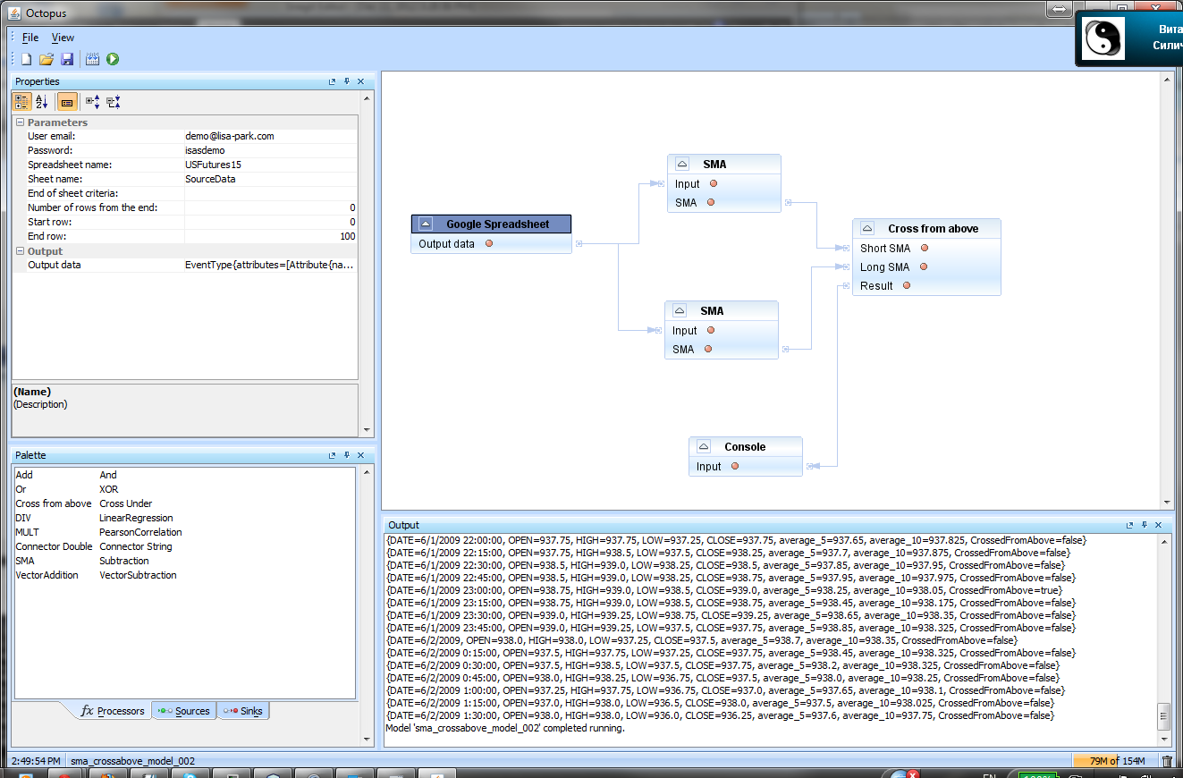
Octopus designer
Lisa Park Confidential, all Rights reserved.
Notes:
‹#›

Slide 7
Octopus designer : Canvas
This window serves as a work bench for composing models from processors presented on the Palette. Items can be moved from palette to the canvas using mouse drag-and-drop method. Selected items can then be connected with each other. Output of one processor can be connected to the input of another, but only if they have compatible data types.
Each model has two special processors: source and sink. First one provides input data for the model, the second one is used to output results.
Octopus Designer builds models using variety of available processors. Examples of common models are: simple and weighted moving averages, correlation analysis, regression models, arithmetic and logical operations on results.
Models can use data from both local and remote data sources. Data can be output to a file, a console or a table.
In the example above, model presented on the canvas, takes data from a Google Spreadsheet and outputs calculated results back to another Google Spreadsheet.
Lisa Park Confidential, all Rights reserved.
Notes:
‹#›

Slide 8
Octopus designer : Palette and Property windows
Palette holds all of the available for a given user processors. Set of available processors reflects user preferences and access limits, exposed by his/her role. There are three groups of processors: Sources, regular Processors and Sinks.
Property window provides detailed information about a selected processor. Properties can have default values. By changing property values, user can change processor’s behavior and the results of calculation.
User can use Source and Sink processor properties to change data’s source and output destination. This allows us to run the same model against different data sources and redirect results to different destination points.
Lisa Park Confidential, all Rights reserved.
Notes:
‹#›

Slide 9
Octopus designer : Tool bar and Output windows
Toolbar and menues provide access to Octopus Designer ‘s controls. These controls allow building of a new Model or Open and an existing one, Save new model or the changes in existing one, Compile and Run model.
New Model
Open Model
Save Model
Compile Model
Run Model
Output window is a place where Octopus Designer displays calculated results and info and error messages generated by processors during Model execution.
In this example, the list of US Futures data and Simple Moving Average is presented as the result of the Model run.
Lisa Park Confidential, all Rights reserved.
Notes:
‹#›

Slide 10
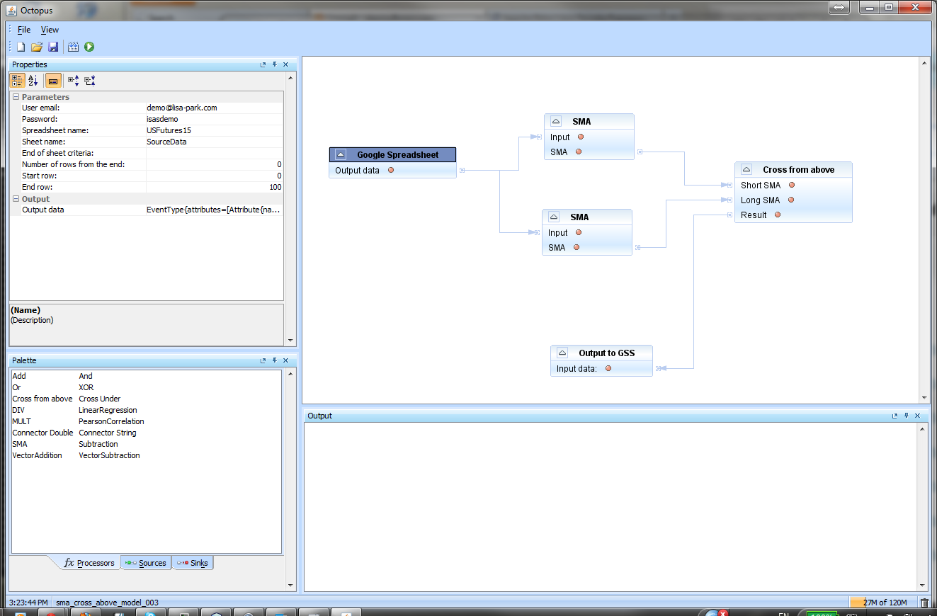
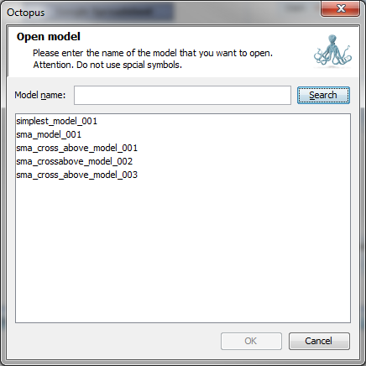
Octopus designer : Object Database
All Octopus models are persisted in Object Database - db4o. Object Database is implemented as a separate Virtual Machine. Models in the database are available to all authorized users with access to the database.
Use of the models:
Run models from Octopus Designer – this mode can be used during model’s development and testing. It can also be used to perform complex analytical work that requires multiple runs of the same model with different parameter setup ;
Run model on Octopus Server – this is the main execution mode;
Run model as a part of custom application or web service (web or desktop).
Lisa Park Confidential, all Rights reserved.
Notes:
‹#›

Slide 11
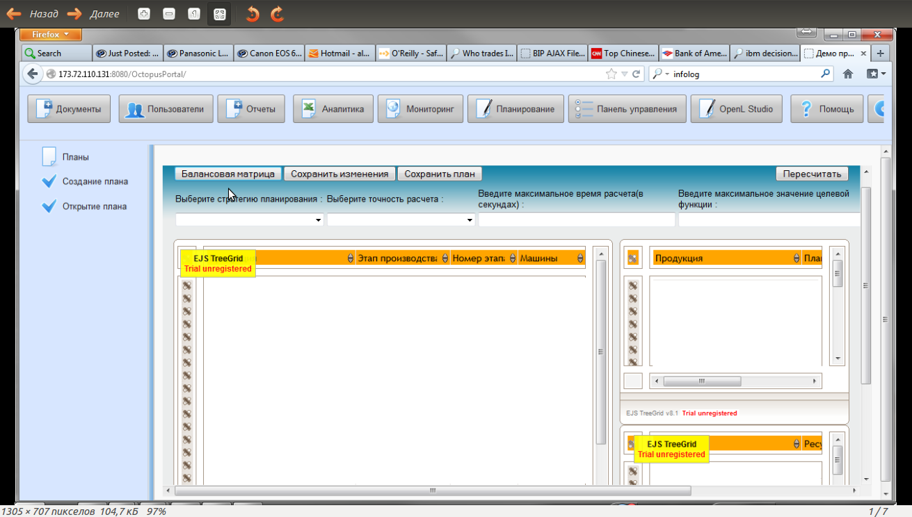
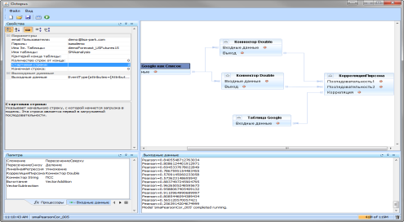
Octopus CIP Architecture
Octopus Cloud
Berkeley
XML DB
Mongo
DB
MySQL
Redis
DB
db4o
Octopus
Web DAV
Server
Virtual Machine
Octopus BDB
Virtual Machine
Octopus Mongo
Virtual Machine
Octopus MySQL
Virtual Machine
Octopus Redis
Virtual Machine
Octopus db4o
Virtual Machine
Octopus Server (VM):
- Scheduler (*1);
- Model Runner (*2);
- START(*3);
- Portal
Octopus Mapreduce Service VM
Octopus Rabbitmq VM
iSaaS VM
(interactive Statistical analysis as a Service)
iOaaS VM
(interactive Optimization
as a Service)
iNaaS VM
(interactive Network
architecture as a
Service)
Custom applications
Octopus designer
Octopus portal
*1 – Scheduler provides support for running Octopus models in certain order and at specific time;
*2 – Model Runner – run-time environment for Octopus model execution;
*3 – START (STAtistical Research Table) – server side support for Octopus ES2
Lisa Park Confidential, all Rights reserved.
Notes:
‹#›

Slide 12
Octopus CIP web services
Octopus CIP Web services are built using Octopus models and are implemented as an image of the specifically configured Virtual Machine. This VM serves as a container for one or several Octopus models. Each image has built-in support for the following:
- self monitoring and self diagnostics;
- input request queue management;
- input request filtering;
- Octopus models execution control and model’s state persistence.
There are two major types of services:
- common services:
- Interactive Statistical Analysis as a Service (iSaaS);
- Interactive Optimization as a Service (iOaaS);
- Interactive Network management as a Service (iNaaS);
- internal services, that provide support for Octopus Mapreduce and access to system databases.
Octopus web services interact with each other in process of delivering required results.
Lisa Park Confidential, all Rights reserved.
Notes:
‹#›

Slide 13
Interactive Statistical Analysis as a Service (iSaaS)
Let's look at iSaaS using Agricultural subsidy management as an example.
Subsidizing is a common way to smoothing out the risks of doing business in agricultural sector. The volume of subsidies is dependent on production volume and specific agricultural product’s price. Uncertainties that are accompanying agricultural business, require continuous price and production monitoring.
The next slide presents a typical Octopus model that can be used to monitor some process with constantly changing parameters. This model can use feed from one or several data sources. Databases, raw data streams or message queues are possible types of such data sources. Octopus models can handle those sources using specialized source processors. Different sources can be synchronized using time stamp or any other auto increment parameter from the data stream.
Algorithm, presented by the model, is very simple. We are using Simple Moving Average (SMA) to smouth out prices on agricultural products. SMA is recalculated whenever new price value becomes available. We are calculating two SMAs simultaneously: one, with a short time window and the other one with a longer time window. Short SMA reflects more current price trend while the longer one represents a long term trend. Each SMA can be associated with a corresponding graph. Those graphs can behave differently, sometimes they can cross each other. There are two types of intersections:
- Short SMA can cross long one from above;
- Short SMA can cross long one from under.
The first type of intersection can be interpreted as an indicator of decreasing price. The second one is an indication of an increase in the price. These intersections are the signals of trend changes, that should be addressed by subsidy distribution adjustments .
Lisa Park Confidential, all Rights reserved.
Notes:
‹#›

Slide 14
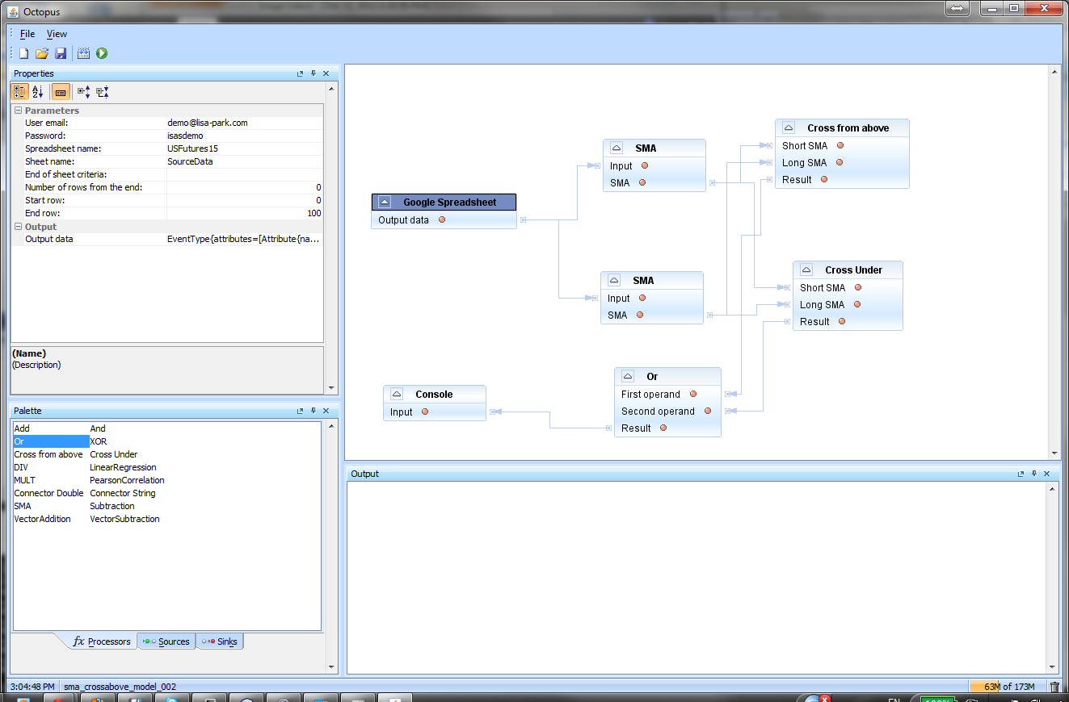
Agricultural products price monitoring
Lisa Park Confidential, all Rights reserved.
Notes:
‹#›

Slide 15
Interactive Optimization as a Service (iOaaS)
Constraint Programming (CP) is a relatively new direction in software development to address optimization problems in Enterprise Resource planning.
There are several established implementations available as Open Source or with commercial licensing (Choco, Constrainer – OSS; Gurobi, IBM ILOG – commercial licensing). Most of these systems are developed in Java or can be used as part of Java applications. JSR-331 (Java Constraint Programming API) is a standard base that provides compatibility between applications, developed using different implementations of Constraint Programming.
iOaaS is an interactive container that provides support for the Octopus optimization models. CP functionality is implemented as a set of Octopus processors.
iOaaS can work with all JSR-331 compatible API.
Lisa Park Confidential, all Rights reserved.
Notes:
‹#›

Slide 16
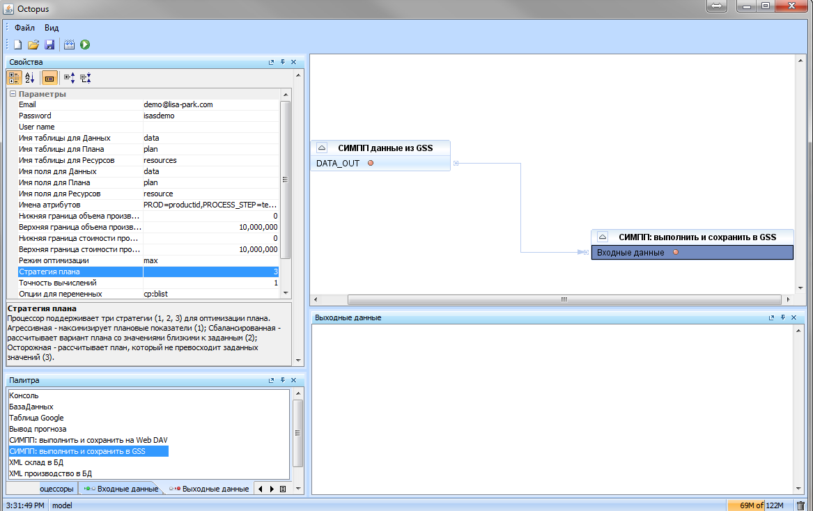
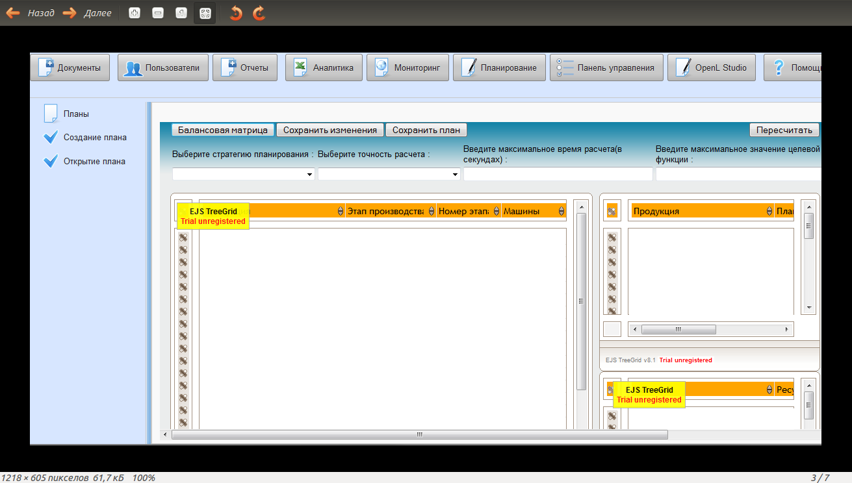
Two ways of iOaaS installation and usage:
Enterprise Data Center local installation (Private Cloud)
VM structure
Object DB
for Octopus
models
Octopus Designer
Web DAV
File System
MySQL
DataBase
Octopus Portal
Octopus Server
Octopus Model Runner
Octopus Work Flow
Lisa Park Confidential, all Rights reserved.
Notes:
‹#›

Slide 17
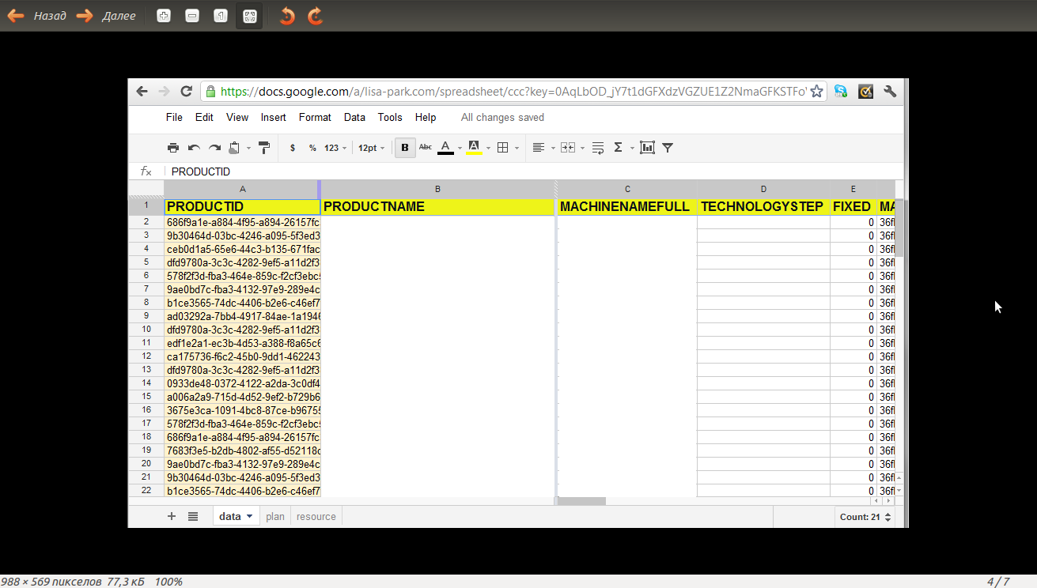
Using iOaaS on Public Cloud as SaaS
Octopus Designer
Virtual
Machine
structure
Object DB
For Octopus
models
Web DAV
File System
MySQL
DataBase
Google Spread Sheet
Octopus
Server
Both installations are using the same set on the server side and slightly different in the user interface. Public Cloud version is using Google Spreadsheets as source and destination data and, as a consequence, it does not require modules that provide support for Octopus Portal.
Lisa Park Confidential, all Rights reserved.
Notes:
‹#›

Slide 18
Interactive Network management as a Service (iNaaS)
Cloud technology providers offer virtual resource monitoring tools that can be used to optimize utilization of those resources. Monitoring data can be supplied on regular basis with predefined intervals.
For example, Amazon CloudWatch offers following indicators:
CPUUtilization;
DiskReadBytes;
DiskReadOps;
DiskWriteBytes;
DiskWriteOps;
NetworkIn;
NetworkOut.
Octopus real-time statistical analysis models can dramatically improve quality of such monitoring.
Statistical analysis of cloud resource utilization, can use the approach, very similar to the one we have demonstrated earlier, with an example of agricultural product price monitoring and statistical analysis. Such models will ignore short time picks in resource usage and react by reconfiguring virtual resources in the case of sagnificant changes in usage trends.
Lisa Park Confidential, all Rights reserved.
Notes:
‹#›

Slide 19
Concurrent real-time analysis
Octopus CIP organically supports parallel and concurrent model based data processing and analysis. Bellow is an example, demonstrating use of three different models to manage company’s cash flow. Each model assumes different dynamics of cash flow and predicts some future cash level value. The fourth model calculates the final cash level value using weighted average. This model recalculates each of the previous three models (1, 2, 3) weights, based on their performance using very simple criteria: the closer model’s results are to the factual data - the greater weight this model receives in the calculating algorithm.
Model 1
Result 1
Model 2
Result 1
Model 4
Cash Forecast
Model 3
Result 1
Fact value
Lisa Park Confidential, all Rights reserved.
Notes:
‹#›

Slide 20
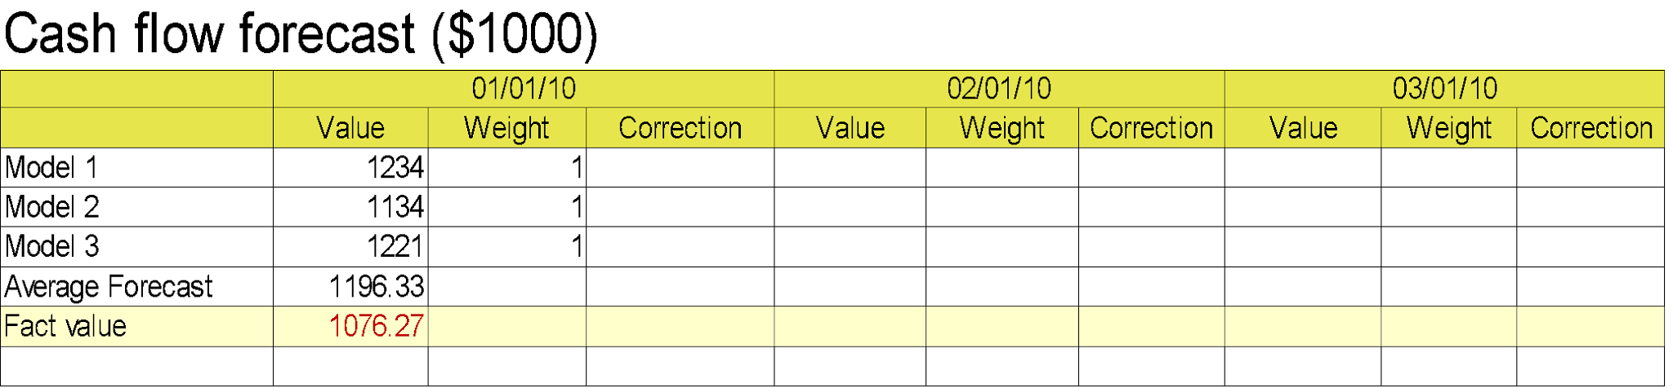
Applying ES2 to Cash-flow Forecast
ES2 allows us to run several forecasting models simultaneously to produce multiple forecasts. The final result is a weighted average of the forecasts, calculated using different models.
At the end of the month ES2 will get a factual value for the Cash flow:
- $1076.27 * 1000
To equate forecast to the factual cash flow value, ES2 will correct weights for each model. Correction can be performed using a simple criteria that makes minimal total changes in the weight coefficients, assigned for each model.
On the next slide we can see the corrected coefficients.
Lisa Park Confidential, all Rights reserved.
Notes:
‹#›

Slide 21

Applying ES2 to Cash-flow Forecast
ES2 uses the same models to make forecast for the next month and then calculates the final result as a weighted average, using corrected coefficients.
The result of these calculations is on the next slide.
Lisa Park Confidential, all Rights reserved.
Notes:
‹#›

Slide 22
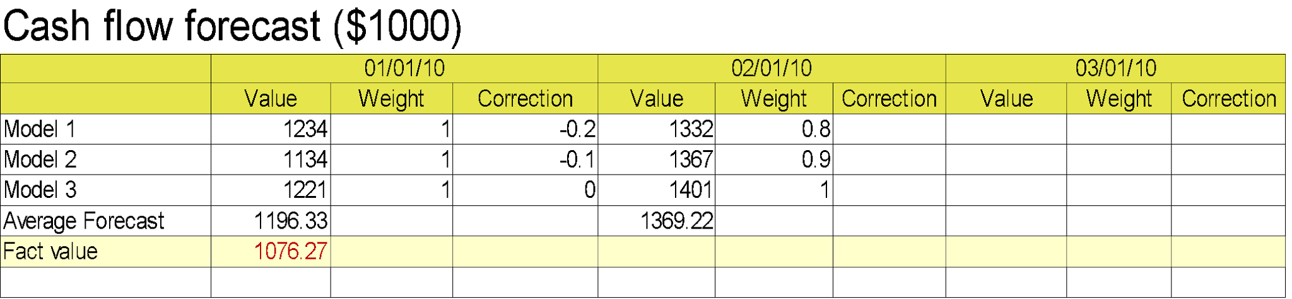
Applying ES2 to Cash-flow Forecast
As soon as ES2 receives the new factual cash flow data, it can recalibrates forecasting models by correcting weight coefficients for each one. After that ES2 can calculate cash flow forecast for the next month.
ES2 performs this kind of processing automatically, every time a new factual cash flow value is available. Factual data fires an event that initiates a new forecast calculations cycle.
On next slide we can see cash flow forecast for three months.
Lisa Park Confidential, all Rights reserved.
Notes:
‹#›

Slide 23
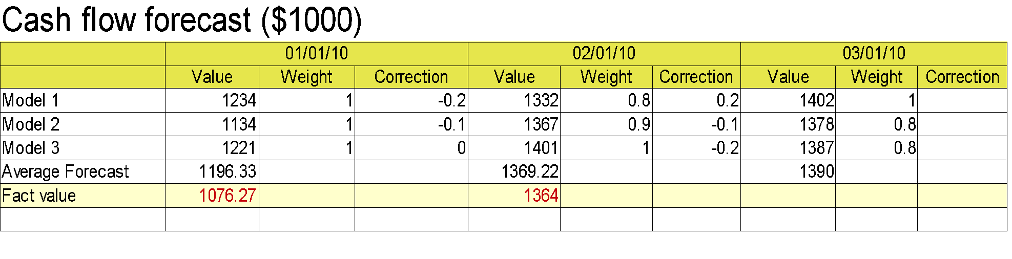
Applying ES2 to Cash-flow Forecast. Final result
Lisa Park Confidential, all Rights reserved.
Notes:
‹#›

Slide 24
Continuous. Concurrent. Interactive. Predictive. Adaptive. Consistent. Real-time.
Analyze
Applications built on iSaaS and iOaaS, perform continuous monitoring and real-time analysis. Results of analysis can be used to predict future behavior of the system. Changes in system’s behavior patterns can trigger a decision making process based on Octopus optimization models, provided by iOaaS. This will complete adaptation loop.
Monitor
Optimize
Analyze
The same approach to monitoring and analysis can be applied to managing cloud environment, used to run user applications. Octopus models from iSaaS and iOaaS enable optimization of Cloud environment configuration in real time. iNaaS models deliver optimal decisions for scaling underlying cloud resources in and out.
Monitor
Optimize
Lisa Park Confidential, all Rights reserved.
Notes:
‹#›

Slide 25
Application life cycle, provided by iNaaS
External IP address:
octopusserver.lisa-park.ru:8080
DNA reference
Internal IP addresses:
Version 1.
PROD
192.68.0.61:8080
Application production version VM.
DEV
192.68.0.62:8080
Application development VM.
Version 2.
After completion DEV version is promoted to PROD, PROD is referenced as a BACKUP, and a new VM with internal address – 192.68.0.63:8080 is implemented to provide support for development.
BACKUP
192.68.0.61:8080
PROD
192.68.0.62:8080
DEV
192.68.0.63:8080
Version 3.
For the version 3 and further, the following schema is using to switch references in DNA:
DEV ===> PROD
PROD ===> BACKUP
BACKUP ===> DEV.
This schema guaranties that previous version of the application is always working in parallel with the new one, serving as a back up in case of a failure.
DEV
192.68.0.61:8080
BACKUP
192.68.0.62:8080
PROD
192.68.0.63:8080
Lisa Park Confidential, all Rights reserved.
Notes:
‹#›

Slide 26
Octopus CIP user interfaces
The base of Octopus CIP is Octopus Core Java API library. It includes the following parts:
- base classes and interfaces for creation of new Octopus processors and models;
- durable out of memory support for persistence and access to Octopus processors and models in the Object database (Octopus Repository);
- Octopus run-time environment;
- In-memory durable run-time persistence - Octopus Memory.
Octopus processors and models cannot run outside of Octopus run-time environment, they also do not provide GUI for source and output data – those functions are delegated to special Octopus CIP GUI modules.
Lisa Park Confidential, all Rights reserved.
Notes:
‹#›

Slide 27



Octopus IDE plug-ins and Designer
Octopus processors are regular Java classes (POJO). They can be created using any of available Java IDE (Integrated Development Environment) or even Notepad. However, to perform debugging, testing and saving of processors in the Object Database we need special tools.
As of time of this writing, two plug-ins for Eclipse and Netbeans are in the late stages of development.
Both plug-in's are functionally identical. The differences are mainly due to the implementation of GUI API in Eclipse and Netbeans.
Plug-ins create an Octopus project that includes predefined project structure and auto-generated code for basic Octopus processors (Source.java, Sink.java, Processor.java). Plug-ins also provide support for testing, debugging and deployment of Octopus processors to the Octopus Cloud.
Plug-ins are, basically, specialized versions of Octopus designer adapted for Eclipse and Netbeans.
Octopus Designer is the only environment where Octopus models can be created. It supports all steps of Octopus model development cycle.
Octopus designer can also be used as an analytical tool in cases when statistical or simulation models require input from the experts as part of analytical process.
Lisa Park Confidential, all Rights reserved.
Notes:
‹#›

Slide 28
Octopus Elastic Spread Sheet (Octopus ES2)
Starting from original VisiCalc for Apple II, Spreadsheet is holding a position as a perfect tool for complex analytical work and statistical data analysis.
MS Excel is the most widely used Spreadsheet implementation. But many users found themselves in love-hate relationships with this tool.
Legacy of MS Excel:
The most intuitive and widely used application for Data Analysis;
Capable of connecting to almost anything;
Very flexible and can be employed by almost anybody;
Finally, and what is really bad, it is almost totally unmanageable.
How to fix Excel:
- The cause of manageability problems, is in what was originally presented as an advantage of Spreadsheets – cell based computational model;
- This model works perfect with relatively simple computations and turns into a nightmare attempting to perform complex data processing, that is implemented in latest versions of Excel;
- The Solution is in separation of Data Presentation and Data Processing. Excel broke all known rules of object oriented programming.
Lisa Park Confidential, all Rights reserved.
Notes:
‹#›

Slide 29
Octopus ES2 solution
The solution for MS Excel shortcomings is in creating of totally new kind of Spreadsheets that will support Separation of Data Presentation and Data Processing.
This new Enterprise level Elastic Spreadsheet is presented by Octopus ES2. This implementation includes the following features:
It makes it possible to keep data, processing models and presentation -separate;
Source processors of the Octopus models provide access to wide variety of external data sources using data queries or filters, streaming data feeds or any kind of messaging system outputs;
Calculating procedures (Octopus Models) are attached to data logically and are capable of dynamic data processing; this allows using calculating models and processes with data from different spreadsheets;
The same data can be subject to processing by different models;
Octopus Cloud turns ES2 into scalable, sharable and collaborative environment;
The presentation is very customizable and can mimic any existing Spreadsheet Graphical User Interface.
Lisa Park Confidential, all Rights reserved.
Notes:
‹#›

Slide 30
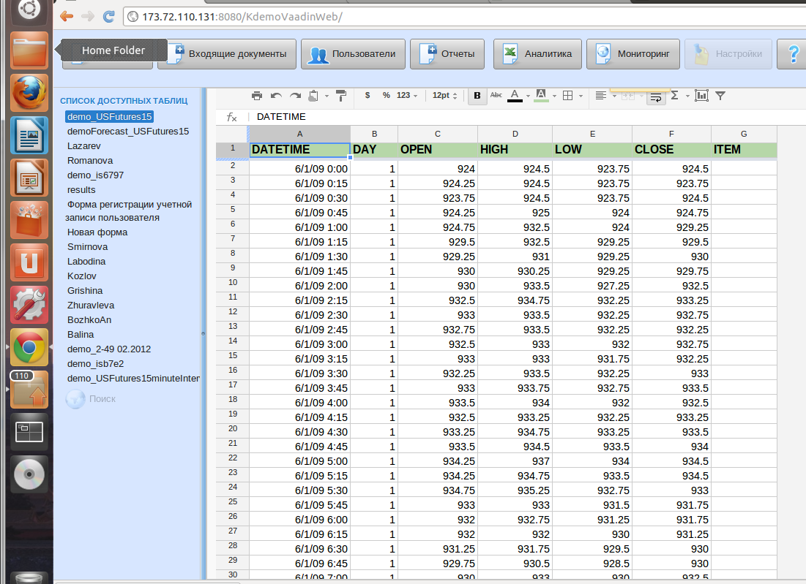
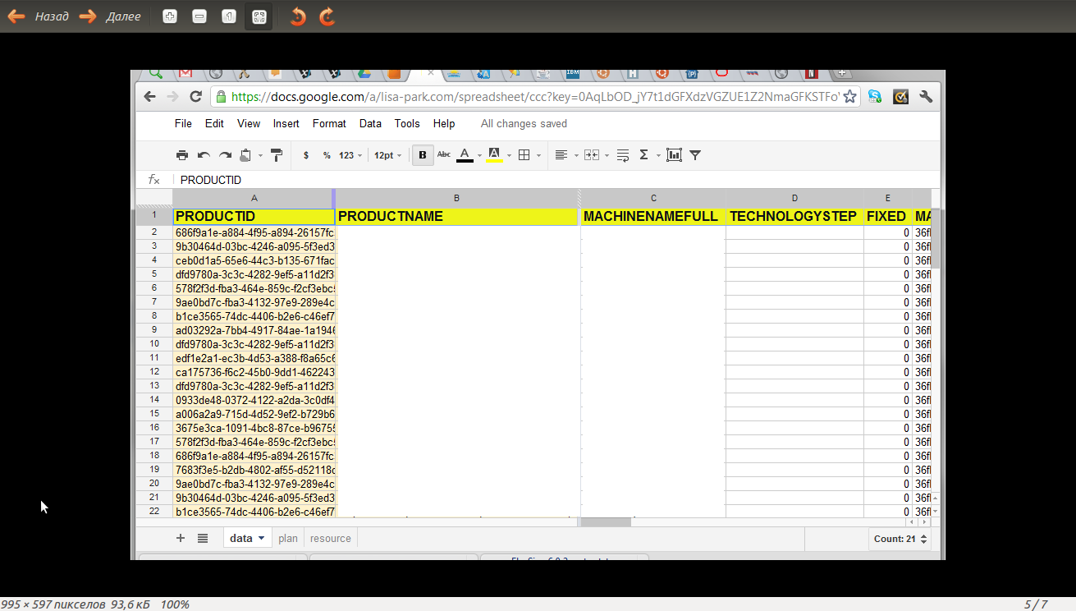
Google Spreadsheet as an UI for Octopus CIP
Octopus CIP turns Google Spreadsheet (GSS) into a perfect, highly customizable implementation of the Elastic Spreadsheet concept. Octopus models equipped with specialized Source and Sink processors can use Google Spreadsheets for interactive data exchange. Octopus models can use Google spreadsheets directly or as a part of custom web application.
Lisa Park Confidential, all Rights reserved.
Notes:
‹#›

Slide 31
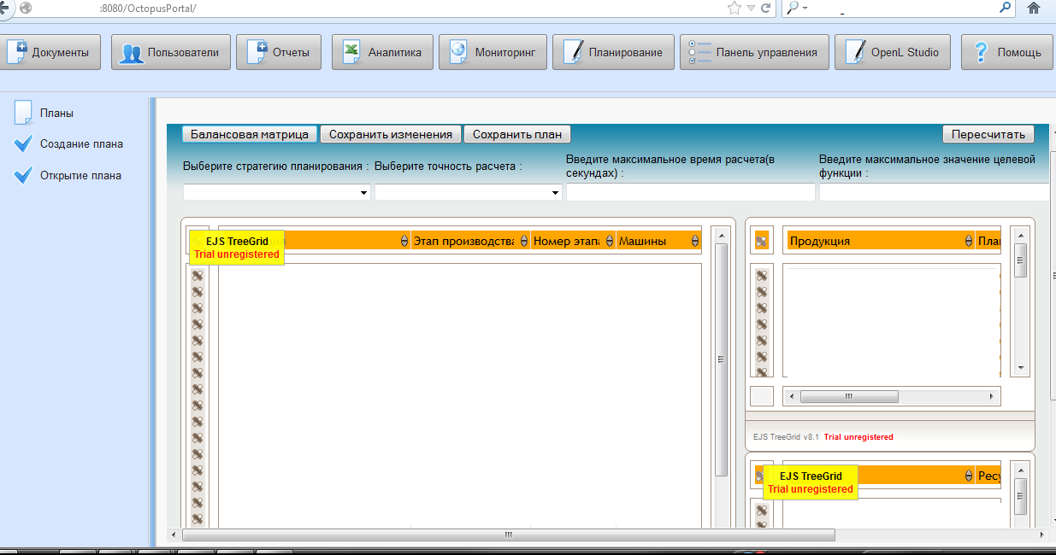
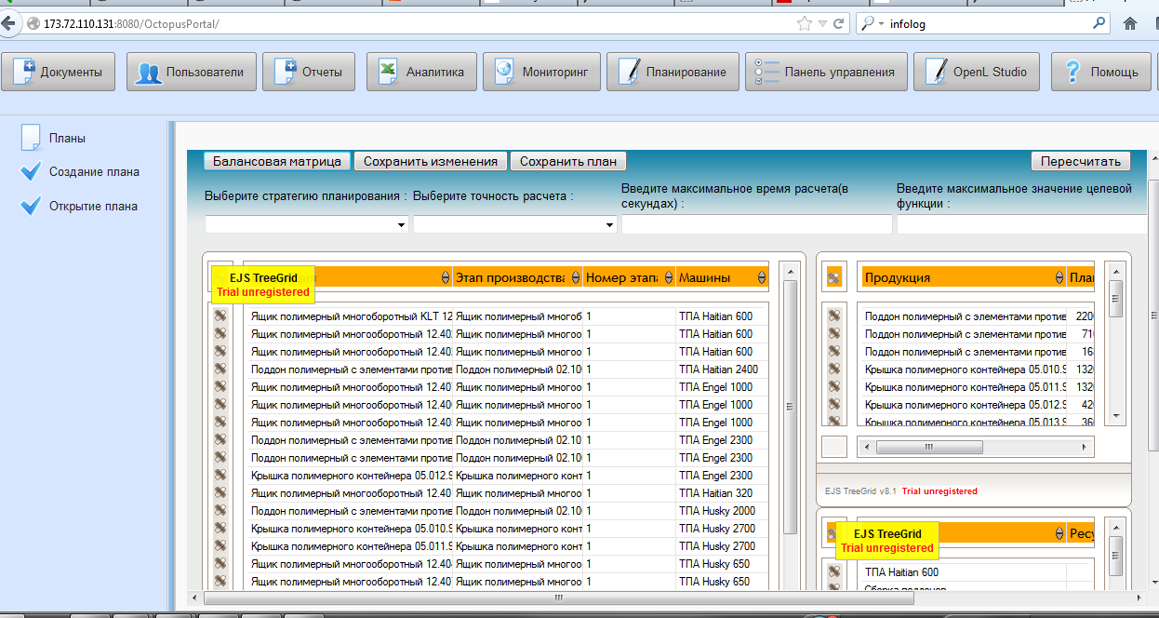
Custom UI and visualizations
Octopus CIP supports major data exchange formats, used in web applications. Bellow, is an example demonstrating use of EJS TreeGrid JavaScript library, to provide data grid based user interface.
Lisa Park Confidential, all Rights reserved.
Notes:
‹#›

Slide 32
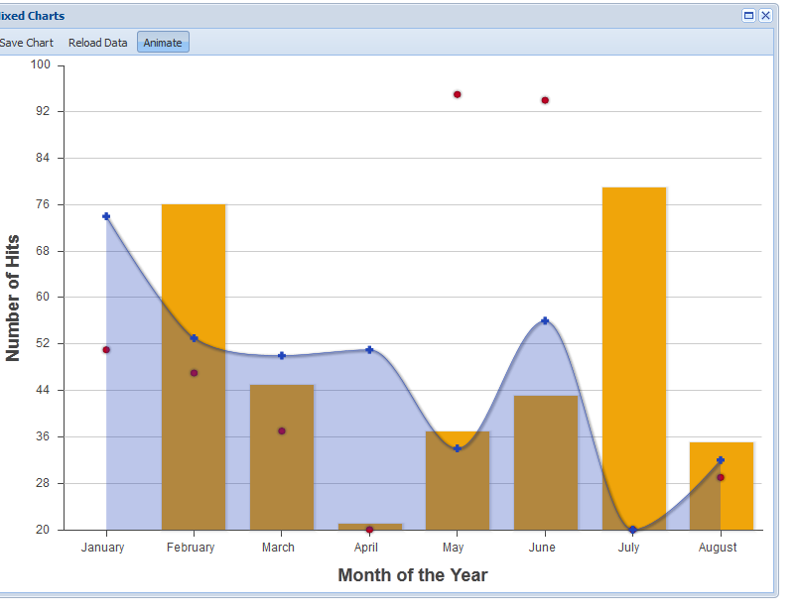
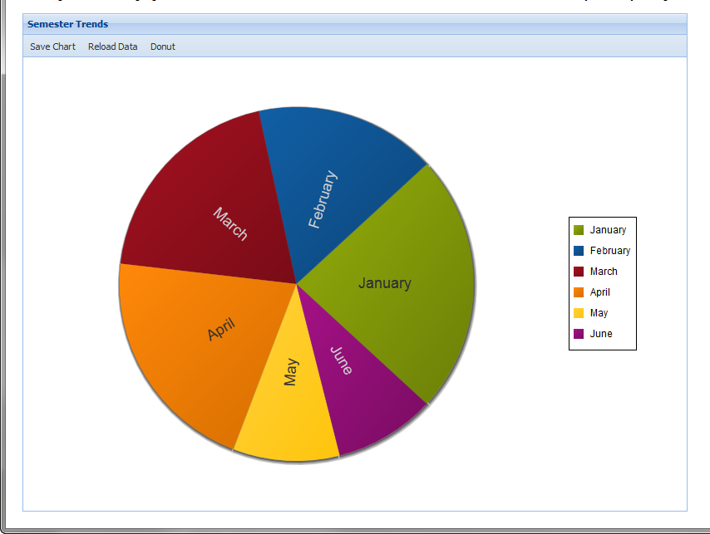
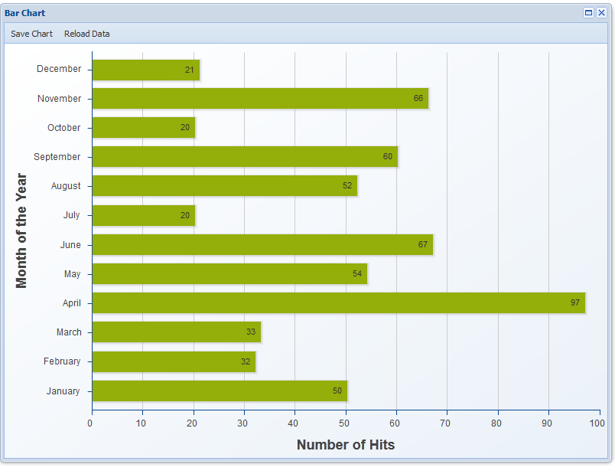
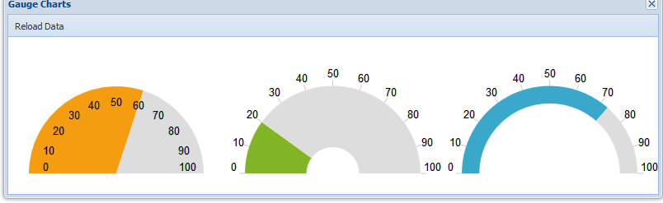
Custom UI and visualizations (continue)
Most of the API libraries, written for web application development, have a rich set of graphical visualization tools. The following snapshots are taken from Sencha web site (http://www.sencha.com/). It distributes very fine JavaScript library Sencha Ext JS.
Lisa Park Confidential, all Rights reserved.
Notes:
‹#›

Slide 33
Octopus CIP integration with existing applications
Octopus CIP applications are open for integration with other applications. The foundation of Octopus applications, the Octopus model, is essentially, a minimal Octopus application. As an application, Octopus model provides a wide variety of methods for communication, based on data exchange. The important feature of these data exchange methods, is that they are asynchronous. There is no way to send data directly to the Octopus model in run-time, except by use of parameters, sent to the model at the starting point.
There are three main integration strategies that can be applied:
Octopus models and elements of Octopus CIP infrastructure can be used in external applications as web services;
Octopus CIP applications can be integrated with external applications using asynchronous data exchange;
Octopus models and applications in concert with asynchronous tools, like Rabbit MQ, can serve as flexible and adaptive data exchange bridges connecting multiple heterogeneous applications.
Lisa Park Confidential, all Rights reserved.
Notes:
‹#›

