Slide 1
Phys 217 Measurements & Units
Santa Ana College

Slide 2
Chapter 1: “Units and Measurement”
This module will cover Chapter 1 of OpenStax College Physics (2e).
It covers the following topics and sections:
1.1 Physics: An Introduction
1.2 Physical Quantities and Units
1.3 Accuracy, Precision, and Significant Figures
1.4 Approximation
The Chapter Summary (list of equations) is available here.

Slide 3
Learning Objectives
Express quantities given in SI units using metric prefixes.
Use conversion factors to express the value of a given quantity in different units.
Determine the correct number of significant figures for the result of a computation.
Describe the relationship between the concepts of accuracy, precision, uncertainty, and discrepancy.
Calculate the percent uncertainty of a measurement, given its value and its uncertainty.

Slide 4
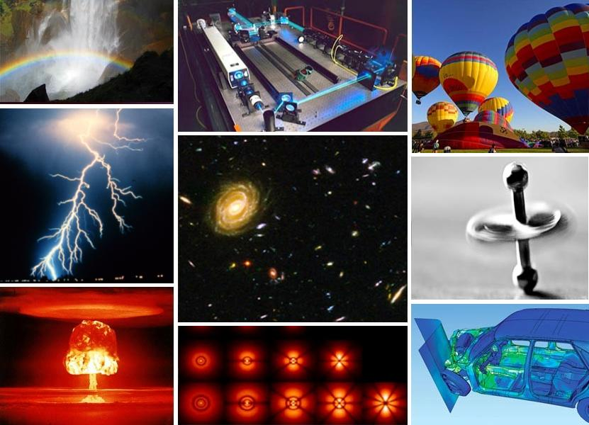
What is physics?
Physics is the systematic, formalized, study of the natural world.
Specifically, it is formalized through the use of mathematical descriptions of the universe around us.
Measurement and comparison is key.
PC: wikipedia

Slide 5
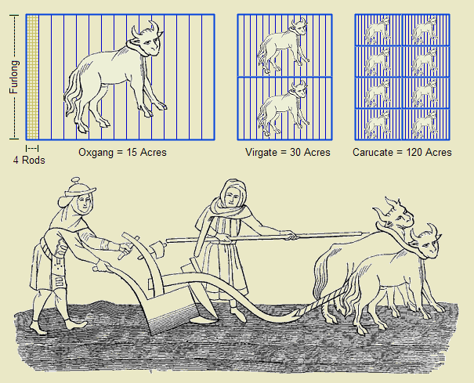
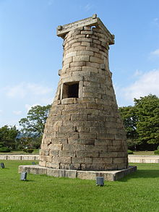
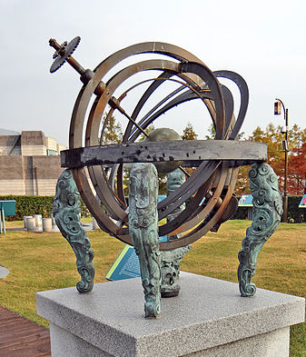
How can we measure things?
Anthropic units:
While more “prone to error,” these anthropic measurements still allowed for burgeoning sciences, such as astronomy, particularly as they were ‘standardized’
PC: wikimedia [1] [2] [3]

Slide 6
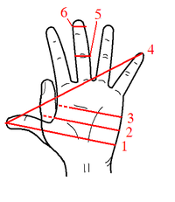
So, what did I mean by ‘prone to error’?
A “span” was a unit of measurement defined by the length of ‘4’ on this diagram, and it is now treated as a standard length of
9 inches or 0.2286 m
PC: wikipedia

Slide 7
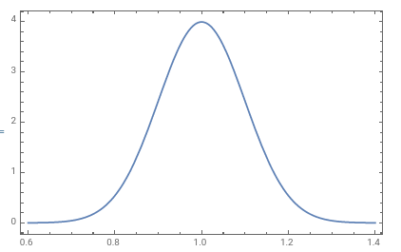
Repeated Measurements
In practice we often perform the same experiment more than once and then average it. Each measurement might differ a little from the previous one (error). If we were to plot out the number of times a measurement result is found on the y axis for a given measurement, we get a distribution of measurements.
For a “normal” aka Gaussian distribution:

Slide 8
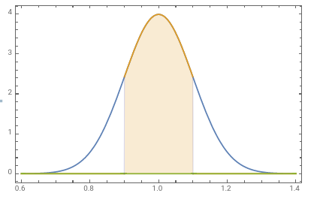
1 Standard Deviation
1 standard deviation covers 68% of the area

Slide 9
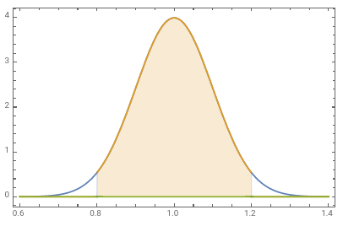
2 Standard Deviations
2 standard deviation covers 95% of the area

Slide 10
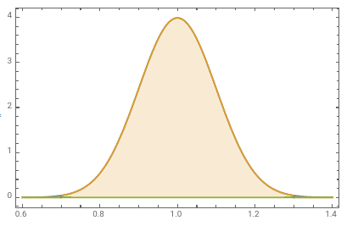
3 Standard Deviations
3 standard deviation covers 99.7% of the area

Slide 11
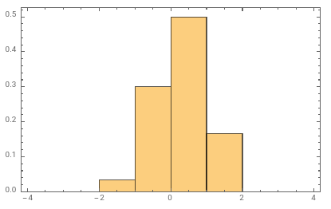
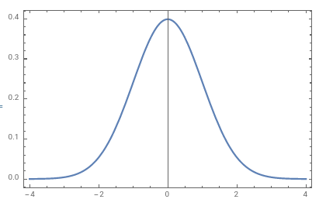
Ideal picture vs Reality
If we assume random error is Gaussian, then when we take N measurements our error will have additional sampling error illustrated below:

Slide 12
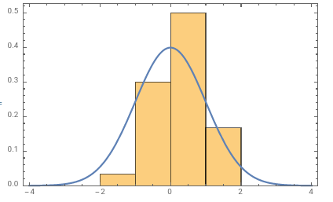
Ideal picture vs Reality
If we assume random error is Gaussian, then when we take N measurements our error will have additional sampling error illustrated below:

Slide 13
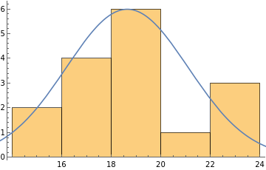

Back to hand spans…
Hand spans vary between individuals.
Here’s some real data:$mean=18.6 cm$ $$standard deviation=2.5 cm$$

Slide 14
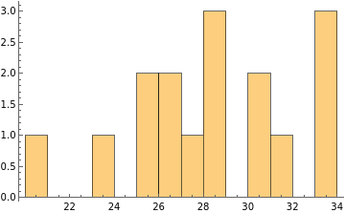
So, what did I mean by ‘prone to error’?
Using each lab group’s average hand span, the length of an object in cm was found, here is all of the data:
“True Value” 28.1 cm

Slide 15
Accuracy vs Precision
True Value
One Measurement
Suppose you’re trying to use a Map app and GPS to find where you are. There’s where the GPS says you are, and there’s where you are in fact. From experience, we know you aren’t always where the app says you are. This is shown above in cartoon form.

Slide 16
Accuracy vs Precision
If we make many measurements, say using different GPS apps or using your friend’s phone, and display them all at once we can make distributions of measurements (ideally we’d use the same tool and repeat it many times with the same setup):
Precision implies the measurements have a small neighborhood
Accuracy implies the neighborhood includes the “true value”
Accurate (includes ‘true value’)
Precise (does not include ‘true value’)

Slide 17
Accuracy vs Precision
Ideal is to have both.
Precise and accurate

Slide 18
Types of error & Measurement
If I use the same experimental apparatus, and get a spread of values, this is
Random error (related to the precision)

Slide 19
Types of error & Measurement
If I use the same experimental apparatus, and get a spread of values, this is
Random error (related to the precision)
But the distance to the “true value” is systematic error
Think of it like a mistake in the experiment systematically skewing the result

Slide 20
So, what did I mean by ‘prone to error’?
Anthropomorphic can be accurate, making them useful, but being imprecise is a limitation.
“True Value” 28.1 cm

Slide 21
Quick Check 1.1
Accuracy is the measure of how close two different measurements with the same instrument are:
True
False

Slide 22
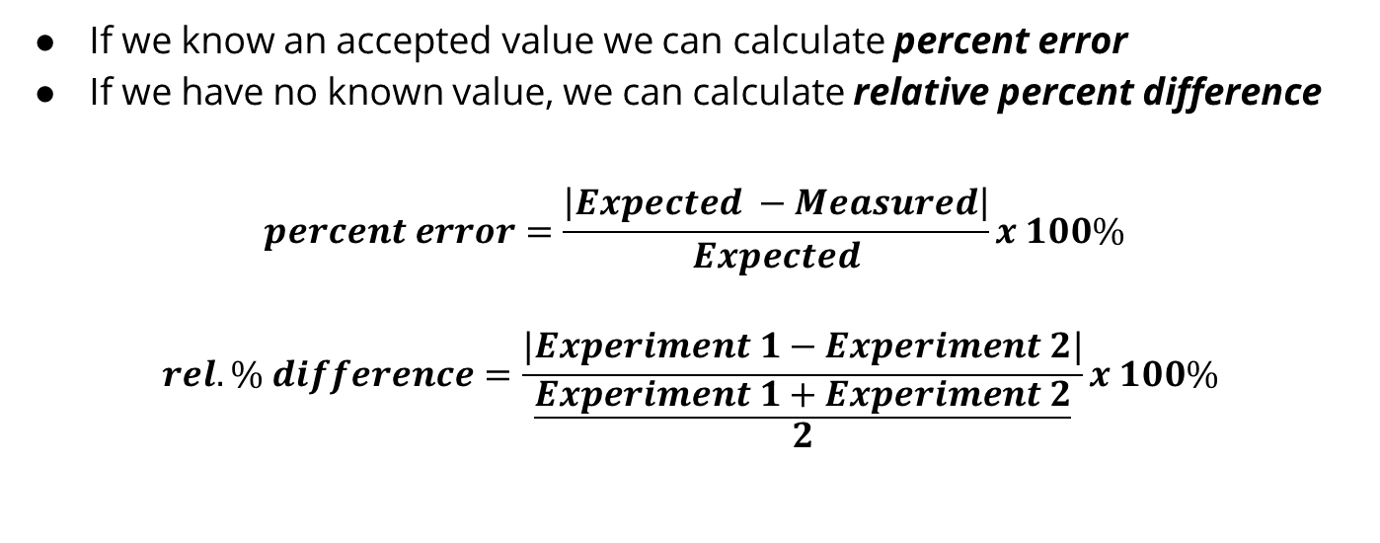
Quantifying error, first steps
If we know an accepted value we can calculate percent error
If we have no known value, we can calculate relative percent difference
$$percent error=\frac{\left|Expected −Measured\right|}{Expected}x 100\%$$
$$rel. \% difference=\frac{|Experiment 1−Experiment 2|}{\frac{Experiment 1+Experiment 2}{2}}x 100\%$$

Slide 23
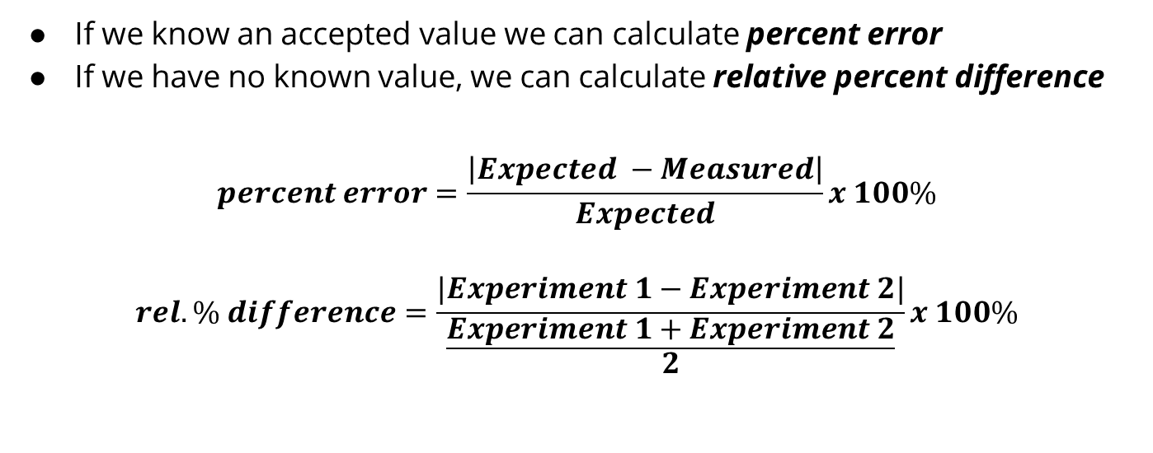
Quantifying error, first steps
If we know an accepted value we can calculate percent error
If we have no known value, we can calculate relative percent difference
$$percent error=\frac{\left|Expected −Measured\right|}{Expected}x 100\%$$
$$rel. \% difference=\frac{|Experiment 1−Experiment 2|}{\frac{Experiment 1+Experiment 2}{2}}x 100\%$$
I expect to find g = 9.81 m/s² instead find it to be 10.0 m/s²
I do the experiment twice, finding 10.0 m/s²
and 9.59 m/s²

Slide 24
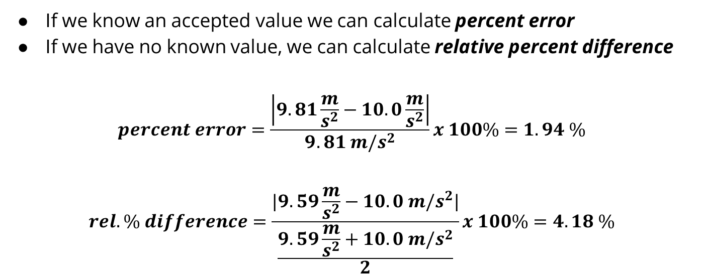
Quantifying error, first steps
If we know an accepted value we can calculate percent error
If we have no known value, we can calculate relative percent difference
$$percent error=\frac{\left|9.81\frac{m}{s^{2}}−10.0\frac{m}{s^{2}}\right|}{9.81 m/s^{2}}x 100\%=1.94 \%$$
$$rel. \% difference=\frac{|9.59\frac{m}{s^{2}}−10.0 m/s^{2}|}{\frac{9.59\frac{m}{s^{2}}+10.0 m/s^{2}}{2}}x 100\%=4.18 \%$$
I expect to find g = 9.81 m/s² instead find it to be 10.0 m/s²
I do the experiment twice, finding 10.0 m/s²
and 9.59 m/s²

Slide 25
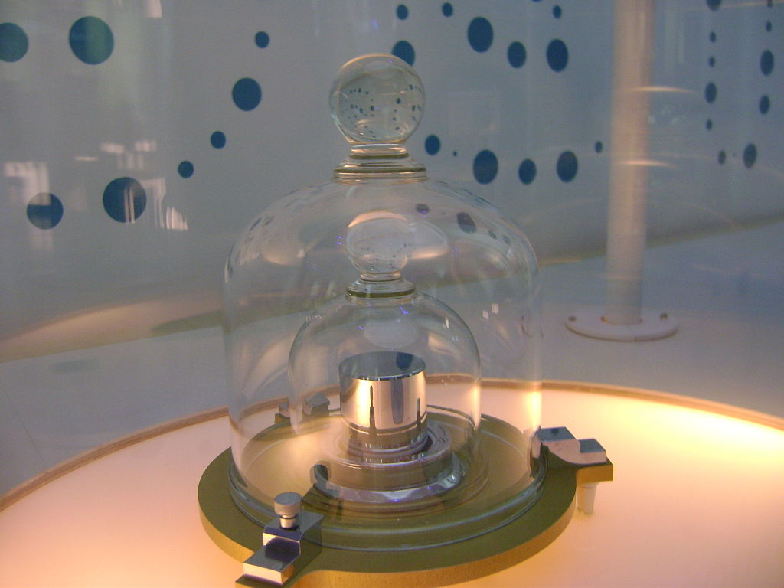
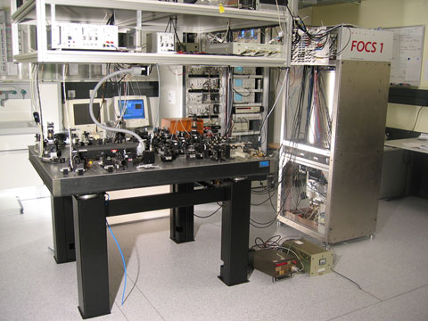
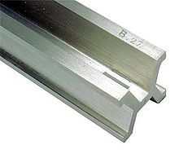
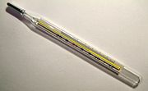
Back to Measurements
Where did something occur? Length
When did it occur? Time
How much stuff was involved? Mass
How much energy was involved? Temperature*
Four “base” units: Length, mass, time, temp.

Slide 26
SI Unit System
The International System (SI for Système International) is the most widely used system of units. SI base units include:
Meters (length)
Seconds (time)
Kilograms (mass)
SI is one type of metric system, but not the only one (defined by base units).
SI has many derived units, which are written in terms of base units
Joules (work-energy): 1 J = 1 kg m²/s²
Watts (power): 1 W = 1 J/s = 1 kg m²/s³

Slide 27
Need for Accuracy & Precision
Needs for accuracy in science have driven changes in the standards for units
In the past, 1 meter of length has been defined by:
One ten-millionth of the distance from the North pole to the equator
A platinum-iridium standard meter bar kept in France
1 650 763.73 wavelengths of an emission line of Kr-86
In each transition, the new distance was chosen so that the approximate length of 1 meter was preserved, but accuracy, precision, and reproducibility changed as systems of measurement were changed.

Slide 28
From Standards To Universality
Second: caesium frequency ∆ν of caesium 133 atom is measured, think of this as the atom wiggling for 9,192,631,770 times and this time frame is 1 s.
Meter: the distance light travels in vacuum in 1/299792458 of a second, where the second is defined in terms of the caesium frequency ∆ν
Kilogram: is defined by taking the fixed numerical value of the Planck constant, ℎ, to be 6.62607015 × 10⁻³⁴ kg m² s⁻¹which can be measured through any number of fundamental physics processes (some necessary to modern technology)
We will discuss Kelvin (K) and how it is defined later in the semester.

Slide 29
Unit Consistency and Conversions
An equation must be dimensionally consistent. Terms to be added or equated must always have the same units. (Be sure you’re adding “apples to apples.”)
Always carry units through calculations.
Convert to standard units as necessary, by forming a ratio of the same physical quantity in two different units and using it as a multiplier.
For example, to find the number of seconds in 3 min, we write:

Slide 30
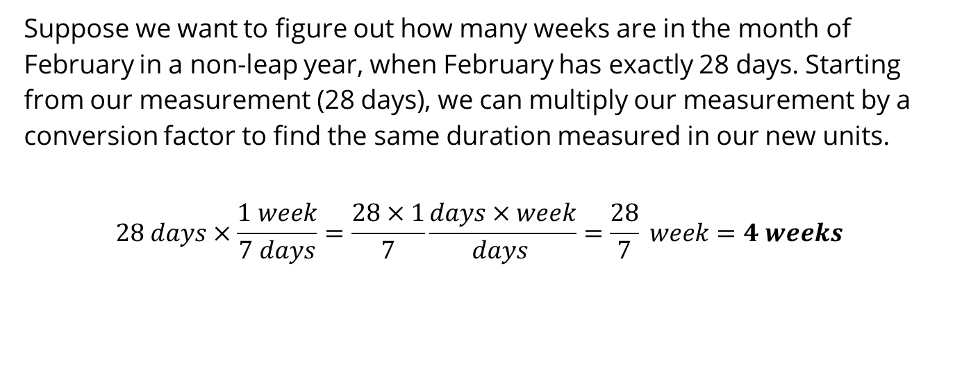
Unit Conversions
Suppose we want to figure out how many weeks are in the month of February in a non-leap year, when February has exactly 28 days. Starting from our measurement (28 days), we can multiply our measurement by a conversion factor to find the same duration measured in our new units.
$$28 days×\frac{1 week}{7 days}=\frac{28×1}{7}\frac{days×week}{days }=\frac{28}{7} week=4 weeks$$

Slide 31
Quick Check 1.2
The basic SI units are
Second, meter, gram.
Second, meter, kilogram.
Second, centimeter, gram.
Meter, meter/second, meter/second².
Yard, span, cubit.

Slide 32
A metric system: base 10 units
SI is a “metric” system
ALL units can be shifted by powers of 10
This is different from other systems:
Prefix | Power of 10 | Abbreviation
giga- | 10⁹ | G
mega- | 10⁶ | M
kilo- | 10³ | k
centi- | 10⁻² | c
milli- | 10⁻³ | m
micro- | 10⁻⁶ | µ
nano- | 10⁻⁹ | n
pico- | 10⁻¹² | p
PC: wikimedia [1]

Slide 33
Unit Prefixes and Scientific Notation
Scientific notation employs powers of 10 to write large or small numbers by using exponents to express powers of 10 in terms of exponents.
Prefixes can be used to create larger and smaller units for the fundamental quantities. Some examples are:
(size of some bacteria and living cells)
(distance of a 10-minute walk)
(mass of a grain of salt)
(mass of a paper clip)
(time for light to travel 0.3 m)

Slide 34
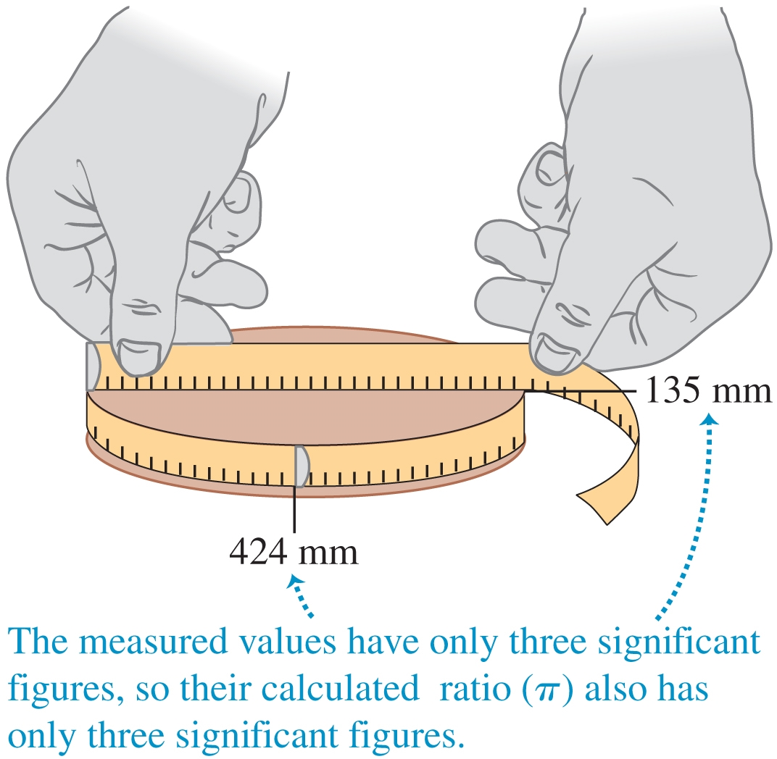
Sig Figs
Significant figures are meaningful digits (rough quantity of uncertainty)
Generally, round to the least number of significant figures of the given data
25 x 18 → 2 significant figures; 25 x 18975 → still 2
Round up for 5+ (13.5 → 14, but 13.4 → 13)
Significant figures are not decimal places
0.00356 has 5 decimal places, 3 significant figures
In general, trailing zeros are not significant
In other words, 3000 may have 4 significant figures
but usually 3000 will have only 1 significant figure!
When in doubt, use scientific notation 3.000 x 10³ or 3 x 10³

Slide 35
Operations with Significant Figures
Video Tutor Solution: Example 1.3
For multiplication and division, the answer can have no more significant figures than the smallest number of significant figures in the factors.
For addition and subtraction, the number of significant figures is determined by the term having the fewest digits to the right of the decimal point.

Slide 36

Example of multiplication with Constants
The area of a circle can be calculated from its radius using $A=πr^{2}$. Let us see how many significant figures the area has if r = 1.2 m (two significant figures):

Slide 37
Example of addition
Suppose that you buy 7.56-kg of potatoes in a grocery store as measured with a scale with precision 0.01 kg. Then you drop off 6.052-kg of potatoes at your laboratory as measured by a scale with precision 0.001 kg. Finally, you go home and add 13.7 kg of potatoes as measured by a bathroom scale with precision 0.1 kg. How many kilograms of potatoes do you now have, and how many significant figures are appropriate in the answer?

Slide 38
Quick Check 1.3
The density of a material is equal to its mass divided by its volume. What is the density in kg/m³ of a rock of mass 1.80 kg and volume 6.0 x 10^{–4} m³?
A. 3 x 10³ kg/m³
B. 3.0 x 10³ kg/m³
C. 3.00 x 10³ kg/m³
D. 3.000 x 10³ kg/m³
E. Any of these — all of these answers are mathematically equivalent.

Slide 39
Unit Conversions Examples [Group Exercise]
A light-year is a unit of measurement of distance that is equal to the amount of distance an object traveling at 3 x 10⁸ m/s travels in 1 year worth of time. To find this distance, you can multiply 1 year in seconds by the speed in m/s. If 1 mile = 1609 m, how many miles is a distance of 40 light years?

Slide 40
Unit Conversions Examples [Group Exercise]
A light-year is a unit of measurement of distance that is equal to the amount of distance an object traveling at 3 x 10⁸ m/s travels in 1 year worth of time. To find this distance, you can multiply 1 year in seconds by the speed in m/s. If 1 mile = 1609 m, how many miles is a distance of 40 light years?

