Slide 1

Concept Video Design of Prestine Papes
Sebastian St Johnston, Nischal Malla, Alexandros Neofytou, Jounaid Ruhomaun, Christo Wilson

Slide 2


Problem found
Have lots of adds that pop up to the user.
Don’t have that nice wallpapers.
No discussion platform for wallpapers uploaded on a website
Most need account for the user to upload his design onto the website.

Slide 3
Solution thought off
Create a wallpaper website add-free.
Have cool wallpapers for all kinds of device platforms.
Add a discussion platform for each single wallpaper uploaded on the website.
No need to have an account for a user to upload a wallpaper on the website.

Slide 4
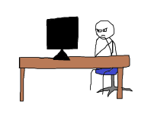
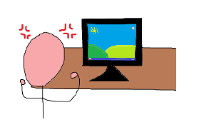
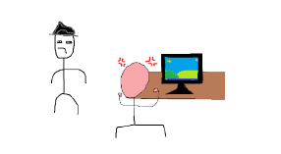
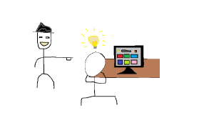
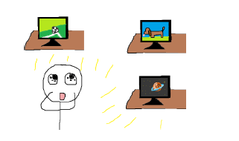
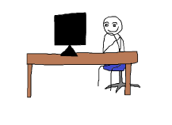
Our full task storyboard (created mem-like)
1
2
3
5
6
4

Slide 5
Explained Storyboard

Slide 6
Scene 1 : Main person sitting at the computer with the person visually annoyed at the computer.

Slide 7
Scene 2 : Main person annoyed at the typical basic desktop background.

Slide 8
Scene 3 : Man still annoyed at the screen with another man seeing his annoyed state.

Slide 9
Scene 4 : Other man shows the annoyed man the new website and has an idea.

Slide 10
Scene 5 - Annoyed man is now fascinated by the website’s backgrounds.

Slide 11
Scene 6 : Original man is now happy with the knowledge of the new background website.

Slide 12
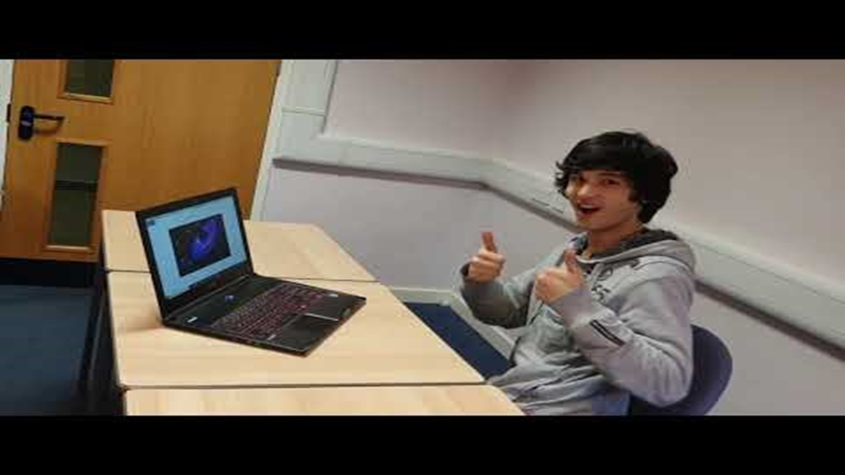
Concept Video Link:
https://www.youtube.com/watch?v=ogdG64Hs0fs&feature=youtu.be

