Slide 1

High- Fi Prototyping of Prestine Papes
Sebastian St Johnston, Nischal Malla, Alexandros Neofytou, Jounaid Ruhomaun, Christo Wilson

Slide 2
Introduction
Prestine Papes were created due as an ideal solution for a coursework of a Computer Science module. Pristine Papers incorporates all those things that we though is an ideal for a wallpaper website through thorough research techniques.
It has stylish and cool wallpapers in an add free environment, and the ability for the user to upload his wallpaper without actually registering. Moreover, it gives the user to register through an external online platform called “Disqus” and upvote and comment on each individual wallpaper inside the website.

Slide 3
How to use / navigate the website.
Navigate to the website.
Click on any wallpaper to view it in a new window.
Login to “Disqus” under the wallpaper to upvote and comment for it.
Click on it to open it for downloading.
Press “back”.
Click on the website logo to go back to the home wallpaper page.

Slide 4
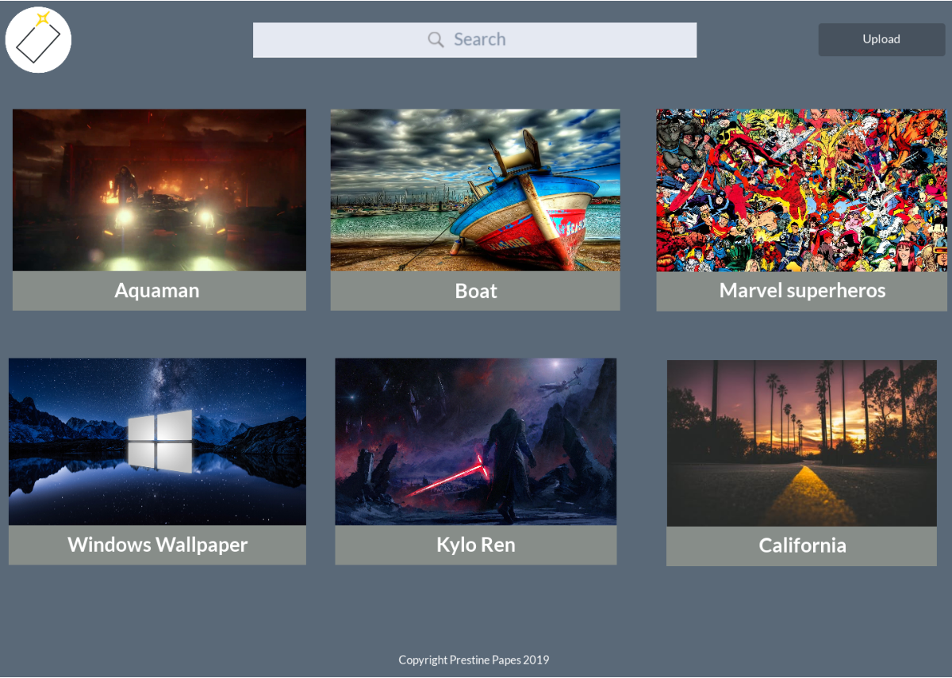
How to use / navigate the website.
This is the main page of Pristine Papers showing all the wallpapers uploaded inside the website.

Slide 5
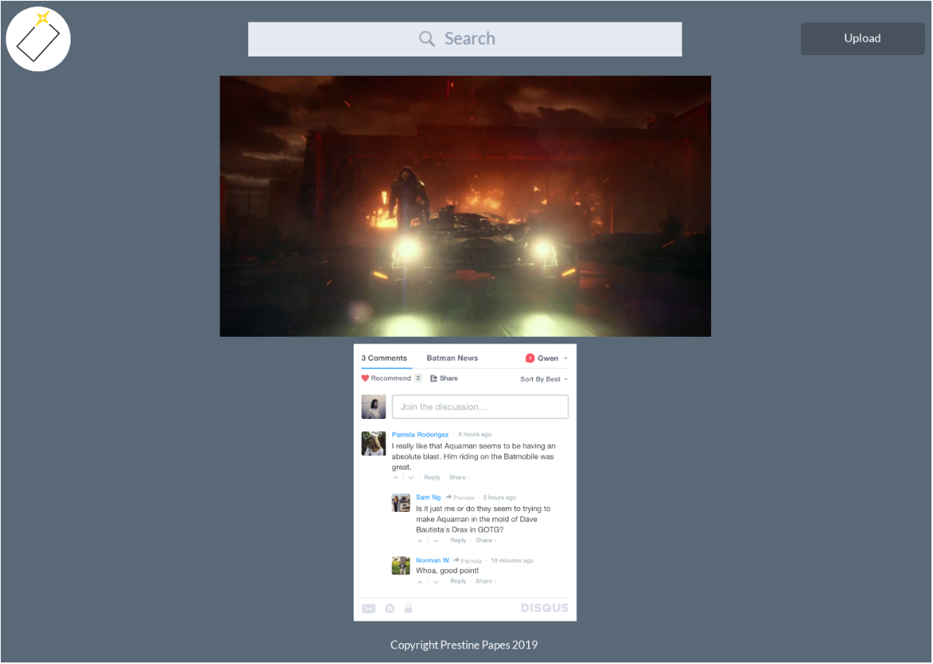
How to use / navigate the website.
When clicking on a particular wallpaper, a new window (wallpaper individual page) will open showing the wallpaper enlarged and the “Disqus” platform underneath. Clicking on the “Disqus” platform, the user can login to upvote and comment on the particular wallpaper. By clicking on the Pristine Papers logo, the user is redirected back to the main wallpaper page.

Slide 6
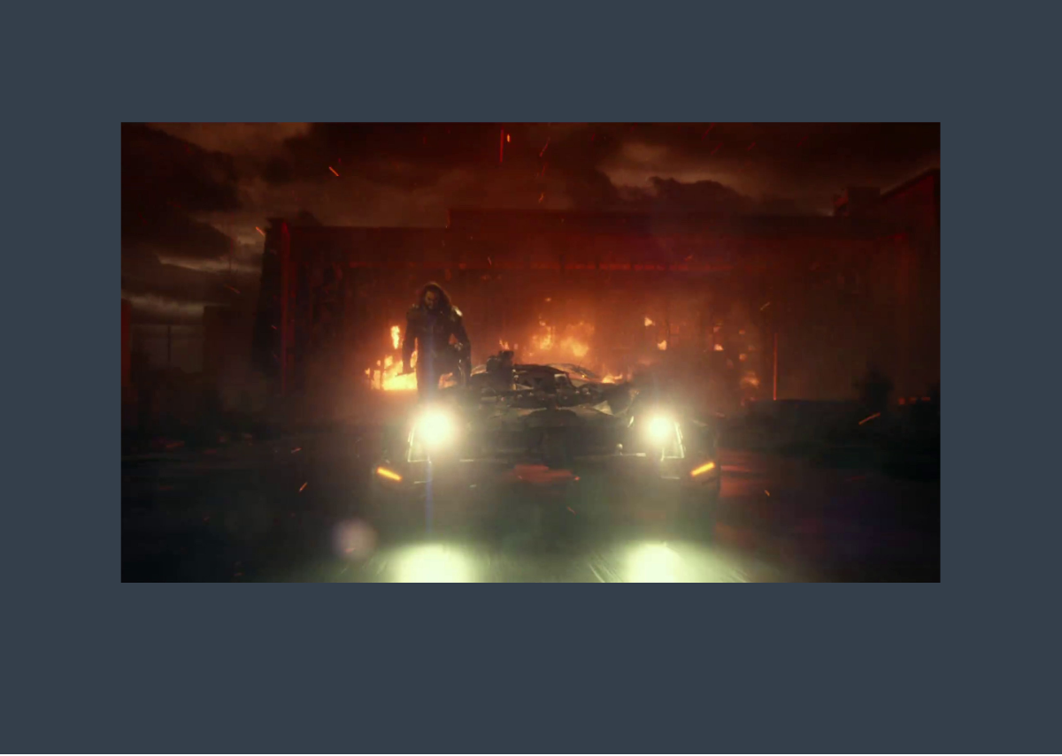
How to use / navigate the website.
This is the window when the user clicks on a wallpaper inside the individual wallpaper page. The wallpaper is again more enlarged and ready to be downloaded. When the user clicks on back he is redirected back to the wallpaper individual page.

Slide 7
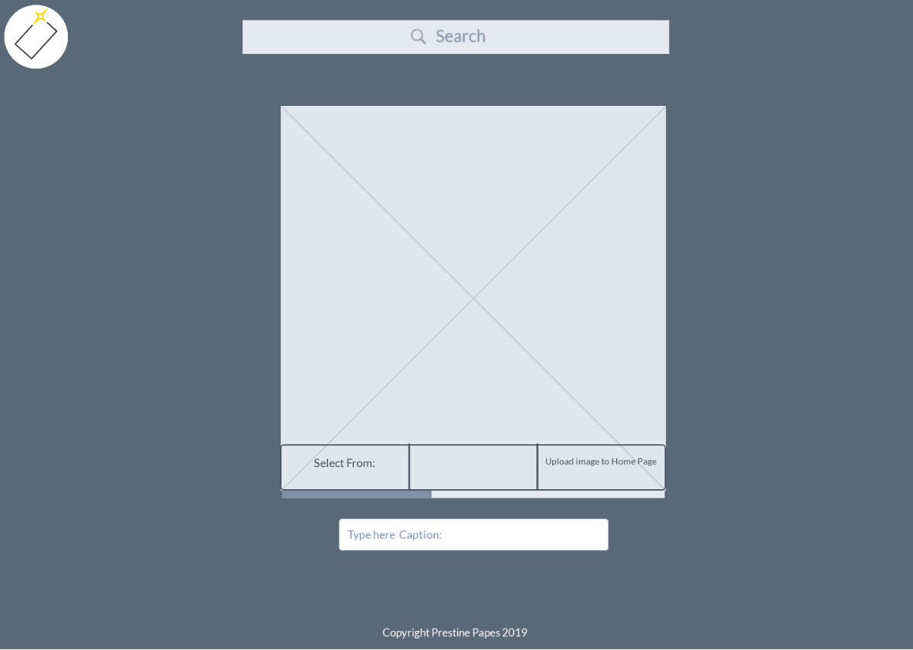
How to use / navigate the website.
When clicking on the Upload button on any page (it is always visible), a new window will appear enabling the user to upload his wallpaper to the page by following the on screen instructions. By clicking on the Pristine Papers logo he is then redirected back to the main wallpaper page.

