Slide 1

Low Fi Prototyping of Prestine Papes
Sebastian St Johnston, Nischal Malla, Alexandros Neofytou, Jounaid Ruhomaun, Christo Wilson

Slide 2
Designed Interfaces

Slide 3
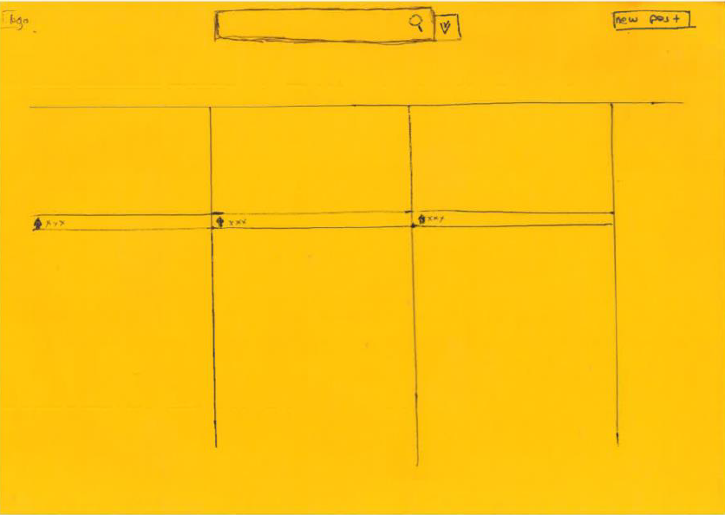
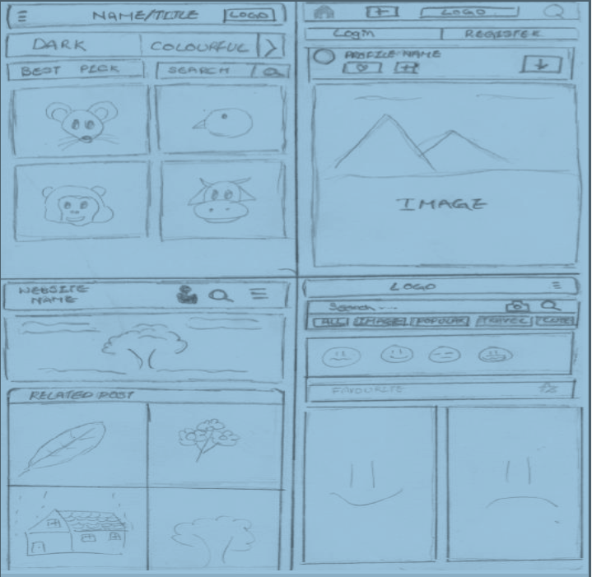
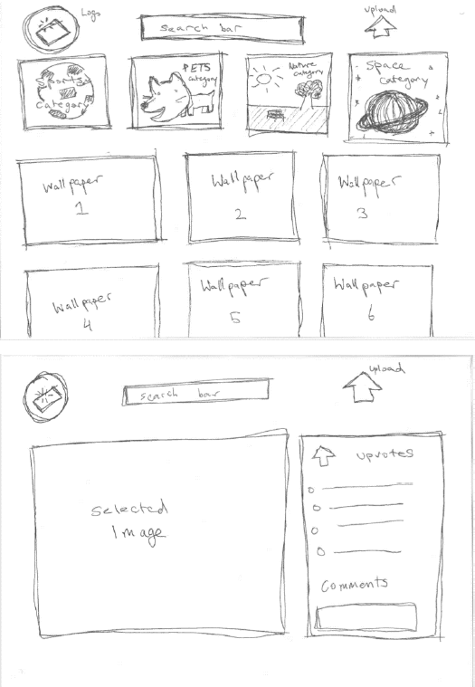
Designed Interfaces

Slide 4
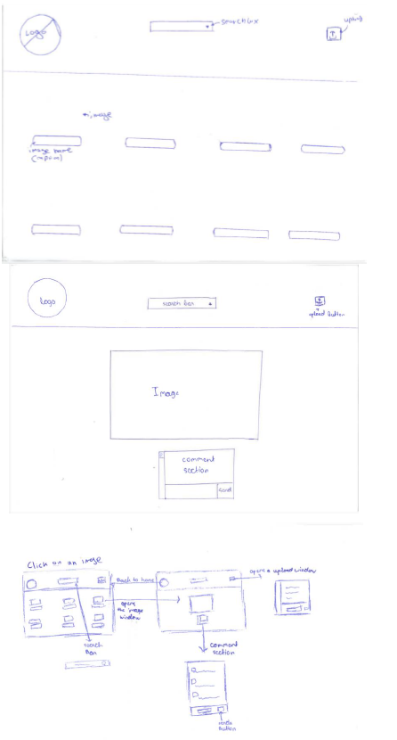
Selected Interface in Detail

Slide 5
Why is this selected?
The menu features are the ones that were defined in the original design: the logo, search bar and upload button.
The first image illustrates the design at the homepage with the series of images.
The second image illustrates the specific image, enlarged and metadata outlined.
The third image explaines the designs’ workflow where selecting an image from the first image would result in a visit to the selected image’s metadata.

Slide 6
Low-fi Prototype Structure Design Designed online using proto.io tool
Sebastian St Johnston, Nischal Malla, Alexandros Neofytou, Jounaid Ruhomaun, Christo Wilson

Slide 7





Slide 8
Task Flows

Slide 9
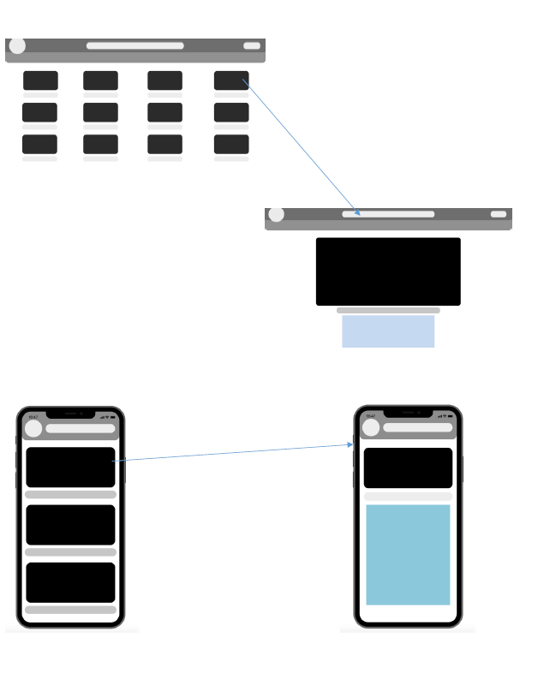
Task Flow of the System

Slide 10
Experimental Methods

Slide 11
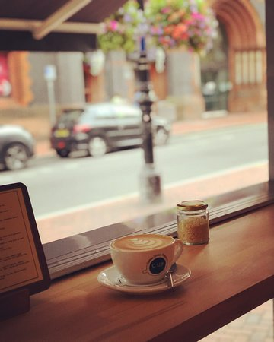
Experimental Methods
Component
Content
Environment
Participants
Procedure & Member
Tasks
Test Measure
CUP Café Reading

Slide 12
Experimental Methods
Component
Content
Environment
Participants
Procedure & Member
Tasks
Test Measure
Our survey was conducted using Google Forms. We selected 10 participants from different social, economical and ethnic backgrounds. Also these participants had different ages and different non-matching personalities. On the following slides, are 3 of them showing this justification.

Slide 13
Experimental Methods
Component
Content
Environment
Participants
Procedure & Member
Tasks
Test Measure
Participant #1
^{1st} year Law student at the University of Reading
From Uruguay
20 years old
Likes playing video games
Likes playing sports

Slide 14
Experimental Methods
Component
Content
Environment
Participants
Procedure & Member
Tasks
Test Measure
Participant #2
^{2nd} year Computer Science student at the University of Reading
From Cyprus
22 years old
Likes hanging out with his friends
Downloads wallpapers once a week

Slide 15
Experimental Methods
Component
Content
Environment
Participants
Procedure & Member
Tasks
Test Measure
Participant #3
25 years old from England
Works at Starbucks

Slide 16
Experimental Methods
Component
Content
Environment
Participants
Procedure & Member
Tasks
Test Measure
Member Role
Alexandros Neofytou
Facilitator

Slide 17
Experimental Methods
Component
Content
Environment
Participants
Procedure & Member
Tasks
Test Measure
Step 1
Ask for their time to explain about the nature of the task
Step 2
Explain the survey
Step 3
Wait for the participant to finish and process the data afterwards

Slide 18
Experimental Results Data Analysis from Google Forms

Slide 19
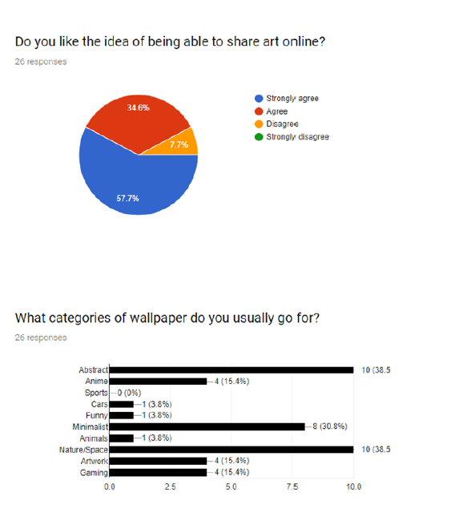

Slide 20
UI Changes

Slide 21
In reference of the tests we made including our survey some of our raw data indicated that participants of our survey wanted a website with abstract wallpapers referring to simplistic design and abstraction of colors.

Slide 22
Thank you
Any Questions?

