Slide 1

Med- Fi Prototyping of Prestine Papes
Sebastian St Johnston, Nischal Malla, Alexandros Neofytou, Jounaid Ruhomaun, Christo Wilson

Slide 2
Overview
Value Proposition
“Only The Finest Wallpapers”
Problem
Wallpaper websites nowadays are not satisfying the many users that use them. The addition of adds, as well as the many limited features that these have, decrease the lack of usability that users want.
Solution
Pristine Papers does all that by receiving feedback from different types of users to incorporate all that in such a wallpaper site.

Slide 3
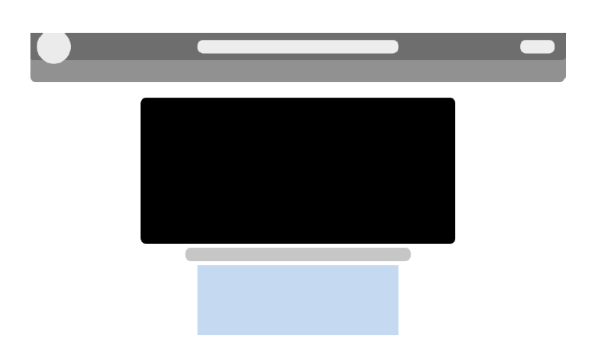
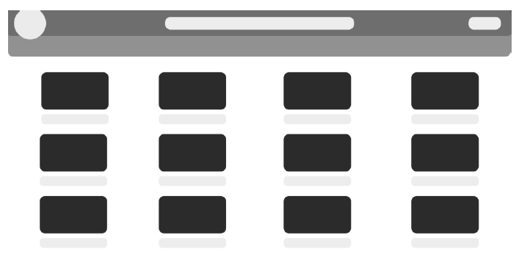
Revised Interface
Website logo in the wallpaper image page links back to the homepage (desktop view)

Slide 4
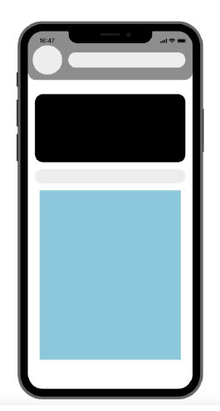
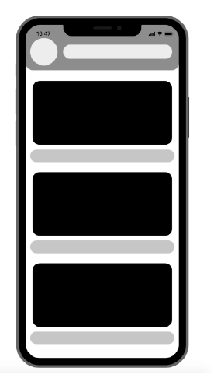
Revised Interface
Website logo in the wallpaper image page links back to the homepage (mobile view)

Slide 5
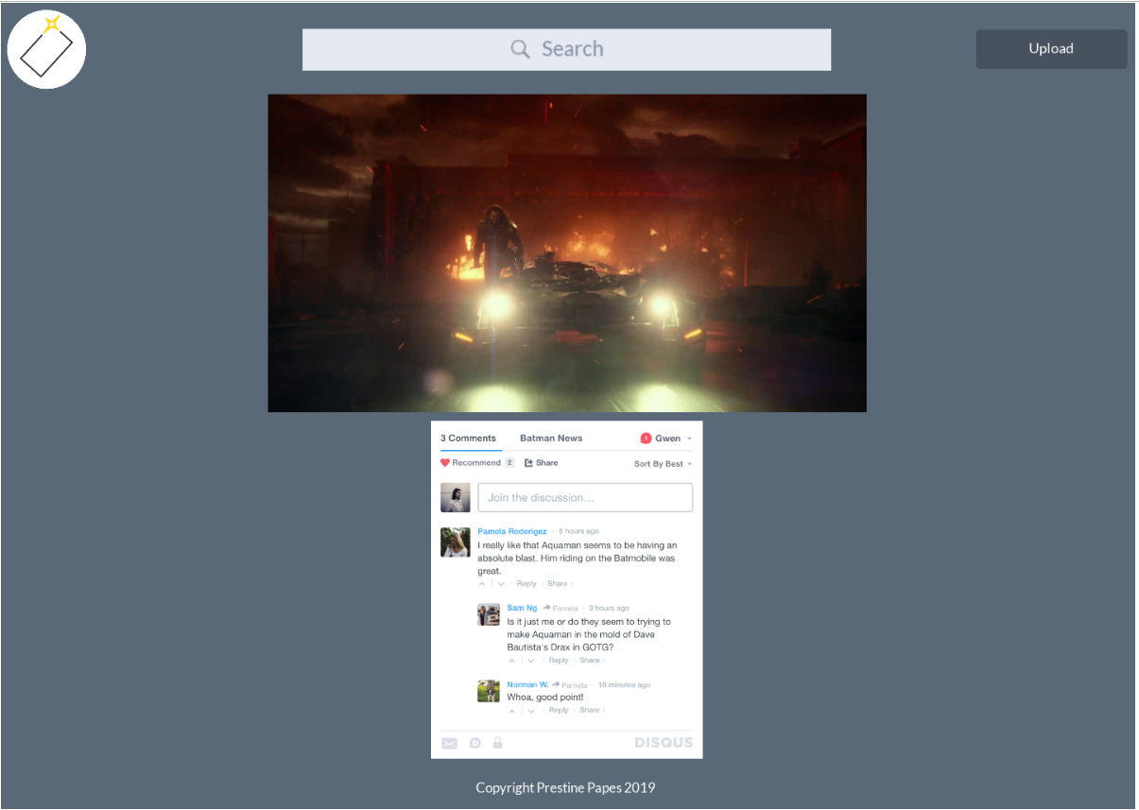
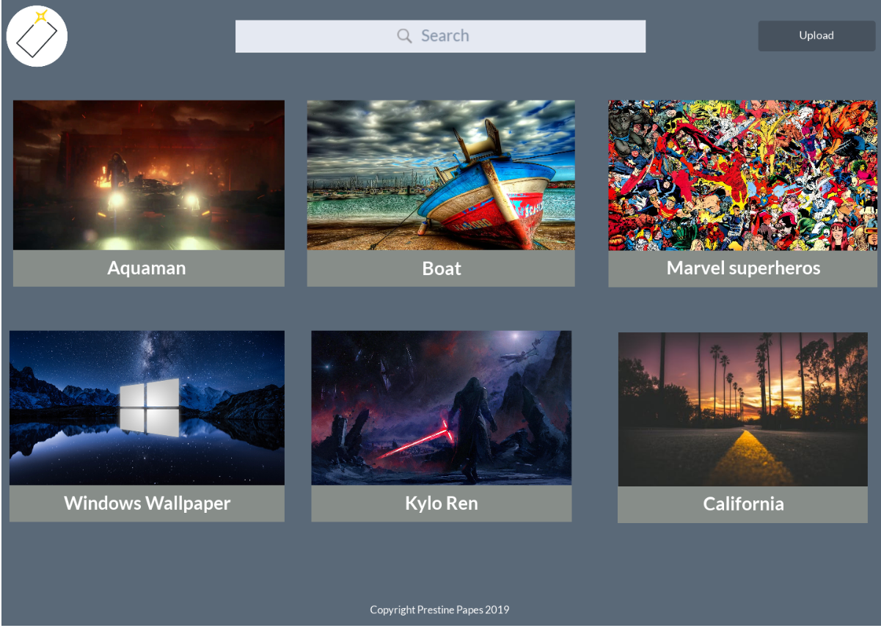
Revised Interface
Website logo in the wallpaper image page links back to the homepage (desktop view)

Slide 6
Prototype Overview - Tools
We used proto.io to design the individual screens of the wallpaper website.
Based on these, we applied the same concept to design our med-fi prototype
We used the Marvel to the med- fi prototype that are based on the prototypes designed in proto, the low-fi sketches and the user requirements that were found through the different surveys.

Slide 7
Prototype Overview - Limitations
We couldn't actually embed the Disqus platform inside the med fi demo in the Marvel Application as it is not possible and we just use an image of it to show how the actual website will be designed and we just link that image to the Disqus website to demonstrate the concept of our idea.
We couldn’t apply the actual colors that the website will have and the places where they are going to be implemented due to limitations of the Marvel application (only allows one color font as background inside each window).

Slide 8
Thank you
Any Questions?

