Slide 1
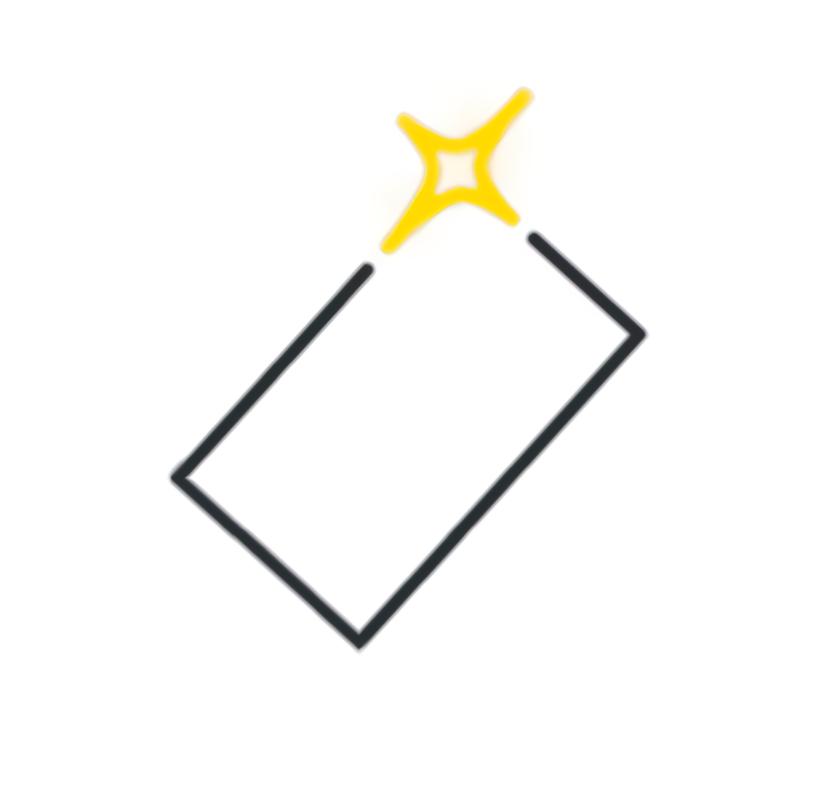
Needfinding of Prestine Papes
Sebastian St Johnston, Nischal Malla, Alexandros Neofytou, Jounaid Ruhomaun, Christo Wilson

Slide 2
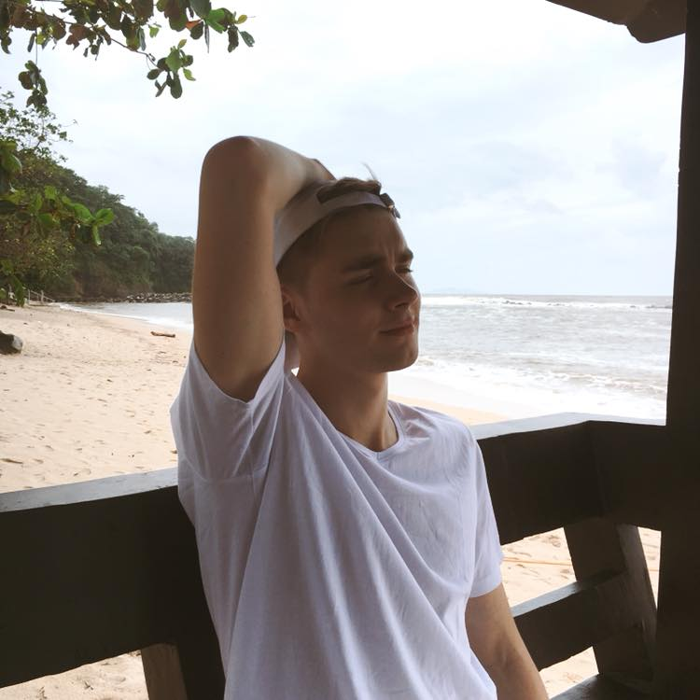
Lukas Ramonas
21 years old (04/12/1998)
Staff at ShowCase Cinema de Lux Reading
From Siauliai

Slide 3
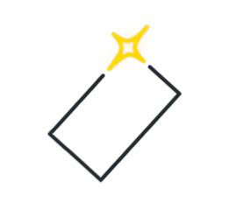
Mike Neele
BSc Computer Science Student at the University of Reading

Slide 4
Olgierd Jurzyk
Random Member of the Public
Friend of ours

Slide 5
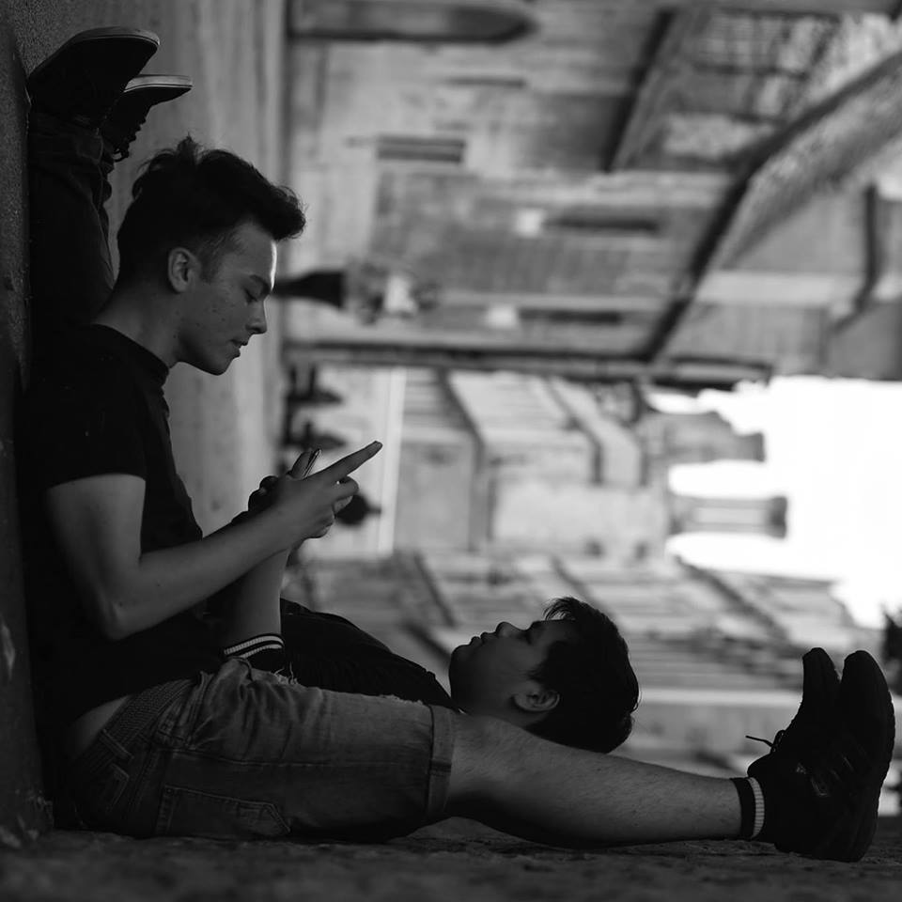
Ad Thonsiriaram
From Kanchanabury
Lives in Reading UK
Frequent Gym Member

Slide 6
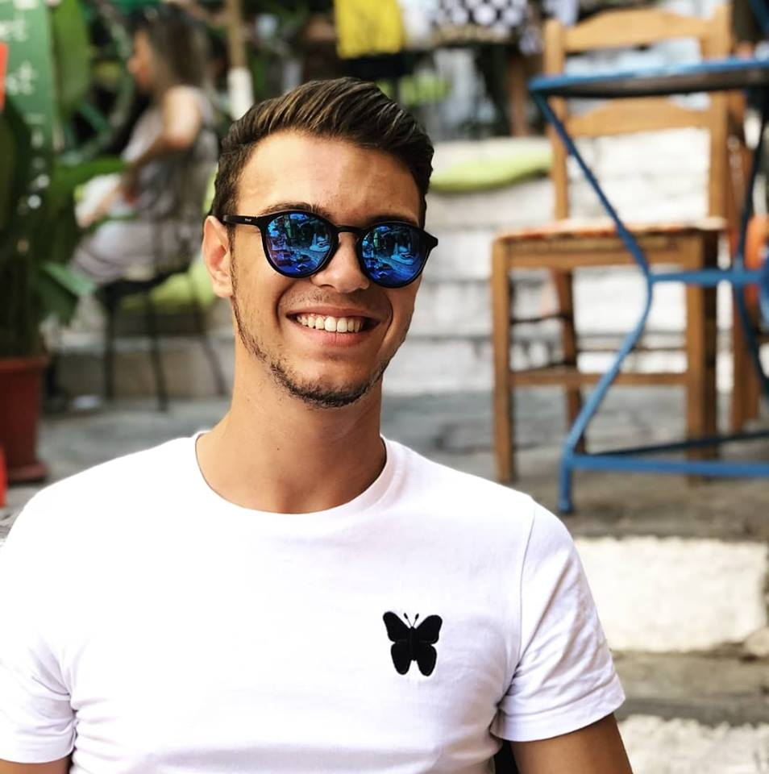
Dimitri Dimitriadis
21 years old (27/12/1997)
From Nicosia, Cyprus
Unemployed Individual

Slide 7
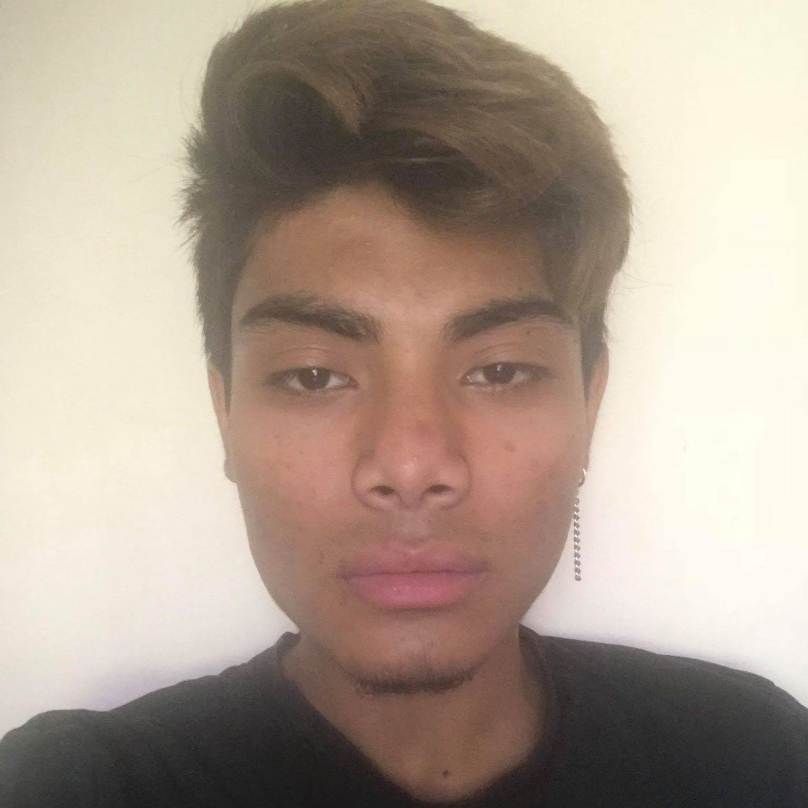
Binaya Arayal
20 years old (12/06/1998)
From Nepal
Lives in Woking

Slide 8
QUESTIONS ASKED
What are your thoughts on a dedicated wallpaper website?
What other features would you like to see on a dedicated website?
What are your thoughts and opinions on Abstract wallpaper?
How would you rate the functionality of current modern wallpaper websites?
What are some good wallpaper websites that you recommend and why?

Slide 9
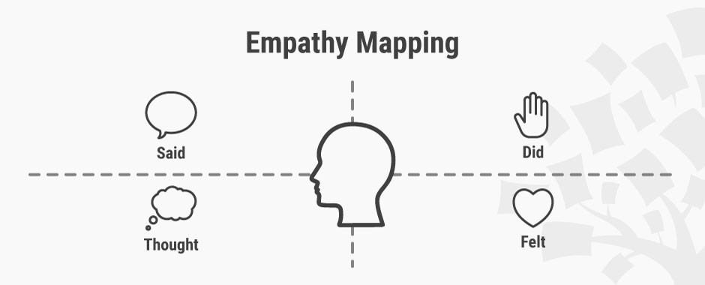
Empath Map Design

Slide 10
Empath Map Design
“I always spend time looking through google for particular wallpapers, but I feel a dedicated wallpaper website would be beneficial for me to save time” B.A.
“(I would like to) customize a wallpaper (e.g. choose pattern, choose color, choose resolution)” D.D.
“(I dislike) graphic intensive wallpapers that show battery” L.R.
“(I avoid) completely plane ones, hinders me from getting motivated” M.N.
“Current wallpaper website make you skip onto pages instead of infinite scrolling.” O.J.
“(I would like an) AI that can learn what type of wallpapers you like from previous settings and give you suggestions”. A.T.
“(I would like) suggested wallpapers based on what you’ve viewed before. D.D.
(“I avoid) anything that catches too much attention”. O.J.
“(I would like to) be able to receive automatic suggestions for wallpapers”. A.T.
“Many (wallpaper websites) do not enable you to comment your views on a particular wallpaper”. B.A.

Slide 11
Empath Map Design
“(I dislike) anything that catches too much attention”. L.R.
“(I dislike) ones with people or dark colors at it puts me off” D.D.
“I think I would like abstract wallpapers”. O.J.
“They (wallpaper websites) do not let you upload your own to share your ideas”. A.T.

Slide 12
Empath Map Design
Uses wallpapers over flat colors. A.T.
Changes wallpaper every 30 days. D.D
Makes sure downloads are secure. B.A.
Sometimes use wallpaper websites NOT for wallpapers. O.J.
Chooses abstract/space and nature/ minimalistic category wallpapers. M.N.
Uses mainly google image and reddit to find wallpapers. L.R.
Shares art online. D.D.
Considers resolution when selecting wallpaper. M.N

Slide 13
Empath Map Design
Facebook and reddit have the best user interfaces. A.T.
I expect a NFSW filter. D.D.
I prefer reddit upvoting system B.A.
Current wallpaper websites don’t let me discuss the wallpapers. M.N.
Wallpapers effect my mood. L.R.
I want to upload my own wallpaper ideas. O.J.
Why don’t wallpaper websites give me suggestions. D.D.
Wallpapers effect my mood and productivity a lot. L.R.
I want a dedicated wallpaper website. M.N.

Slide 14
Empath Map Design
Excited – about being able to share their own art. D.D.
Frustrated – with certain UI. O.J.
Annoyed – at no discussion features. M.N. L.R.
Content – with the current scene of wallpaper websites.
Scared – that current wallpaper websites lack security. B.A.
Anxious – about trying a new source of wallpaper. A.T.
Fed Up – with adverts and pop-ups on current wallpaper websites. L.R.

Slide 15
Point of View (PoV) and How We Might (HWM)

Slide 16
Point of View (PoV) and How We Might (HWM)
Point of view of each interviewee is highlighted in yellow and the crucial part of his form of view in green.

Slide 17
Olgierd Jurzyk POV
We met with Olgierd, a BSc Computer Science student, who uses wallpapers and various websites daily.
He was the first top be interviewed and suggested multiple useful ideas for the website that could be implemented that he has learned over his experience with the internet and computers. He had a mindset regarding wallpaper websites that were very similar to our project goal, a wallpaper website being more than just a wallpaper website.

Slide 18
Ad Thonsiriaram POV
We met with another Ad Thonsiriaram a Computer Science student who also had useful ideas and a good mindset.
Viewing the idea as file sharing website opened more opportunities for the website and made us understand what the goal is; that being mainly wallpaper sharing. We gathered ideas regarding how the upvoting systems and UI should look like. He mentioned several popular wallpaper sources that we were able to research and use ourselves to compare to.

Slide 19
Lukas Ramonas POV
We met with Lukas, a member of cinema staff.
He was able to explain to use what some members of our target audience may look like. As he works in a cinema, there are so many people asking him if there are wallpapers which would portray the movie they watched and where they can get it from, but as Lukas does not know of many websites that provide the quality, he said pristinepapes.com would be a great idea for those people.

Slide 20
How Might We: Olgierd Jurzyk
Catch the attention of wallpaper users who have a palate of many websites?
Enable users to use our website for more than just standard wallpapers?
Get better wallpapers than our competitors?
Get users like Olgierd to use our website and stay loyal to it?
Instead of being just for wallpapers, be able to branch into other website ideas?

Slide 21
How Might We: Ad Thonsiriaram
Enable efficient wallpaper sharing?
Integrate a good upvoting system?
Gather and cherry-pick ideas from existing wallpaper websites?
Avoid making mistakes that are in other websites?
Let the users have freedom over which wallpapers are while keeping it safe for work?

Slide 22
How Might We: Lukas Ramonas
Enable the website to gain revenue from the traffic it will receive?
Let people be aware of the website (publicity)?
Work with cinemas to bring this service to more people?
Keep up to date with movies?
Use the upvoting system on the movie wallpapers to see which one was the most popular?

Slide 23
Conclusion
Create a good structured website for users with cool wallpapers inside it
Have an upvoting system for users to register, upvote and comment on each individual photo.
Allow users to upload their wallpapers, photos and designs.
Wallpaper website with no ads.

Slide 24
Thank you

