Slide 1
A Survey of Virtualization Techniques for Embedded Devices
Master Project – January 2016
Nicolae-Alexandru Ivan
nicolae.ivan@stud.acs.upb.ro
Mihai Carabaș

Slide 2
Contents
Virtualization
bhyve
FreeBSD on Arndale
KVM on Arndale
Conclusions

Slide 3
Virtualization
Simulating an execution environment
Predominantly used on servers
Advances in hardware made it feasible on embedded devices
Necessary to provide separation and abstraction

Slide 4
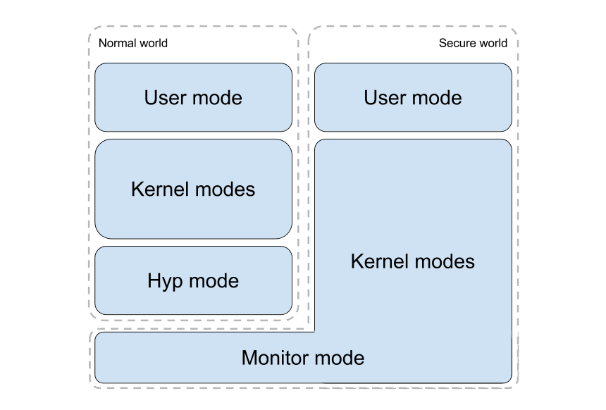
Virtualization on ARM

Slide 5
bhyve
FreeBSD hypervisor
Supports BSD, Linux and Windows guests
Similar to Linux KVM

Slide 6
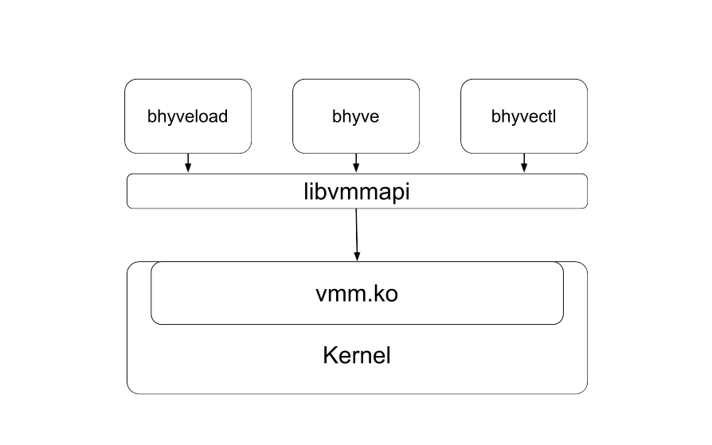
bhyve

Slide 7
FreeBSD on Arndale
Compile FreeBSD
Obtain bootloader components
Assemble bootable image

Slide 8
KVM on Arndale
Compile modified host kernel
Build system
Build qemu
Compile guest kernel

Slide 9
Conclusions
Virtualization is necessary in embedded systems to enable server-like functionality
Chosen board is suitable environment for further research

