Slide 1
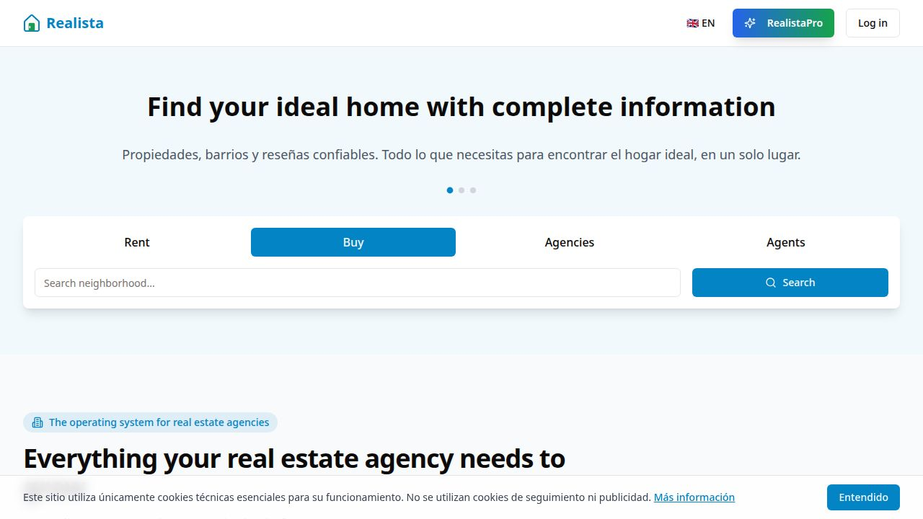
Realista
PRODUCT STRATEGY · 2026
Realista
The Operating System
for Real Estate Agencies
From lead management to home services in one platform.
A platform thesis for Papernest
One workspace. One customer journey.

Slide 2
01 · THE GAP
Agencies run on a patchwork of tools.
Every handoff creates friction—and every disconnected system loses context.
▦
CRM
◌
WhatsApp
▤
Excel
◷
Calendar
✉
Email
⌂
Portals
Lost productivity
Poor collaboration
Manual processes
Realista · one platform
The opportunity is not another tool. It is the connective tissue.

Slide 3
02 · THE PRODUCT
Realista centralizes the complete workflow.
A horizontal operating layer for the people, properties, and processes that make an agency run.
●
CRM
⌂
Property Management
◷
Calendar
✉
Messaging
Clients, pipeline, relationships
Inventory, documents, incidents
Visits, team availability, actions
Conversation in context
⌕
Search Preferences
↔
Intelligent Matching
▦
Agency Administration
Intent captured early
Client ↔ property fit
The operating backbone
Horizontal by design

Slide 4
03 · THE SYSTEM
The platform compounds as context moves with the customer.
Each layer enriches the next—turning isolated records into an operating system.
Clients
who
The agency’s data model becomes the agency’s operating model.
Client Preferences
why
Properties
what
One record. More context. More moments to create value.
Recommendations
fit
Relationship Management
action
Agency Operations
scale

Slide 5
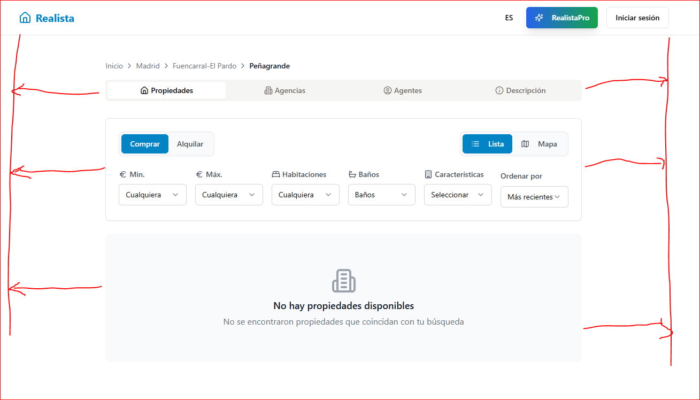
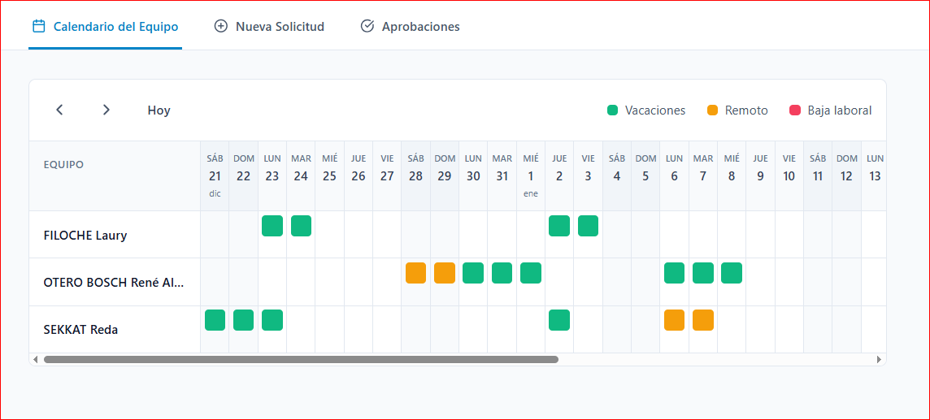
04 · CRM
Manage every client from lead to closing.
A single relationship layer for the agent’s daily work.
CALENDAR
CLIENTS
The operating rhythm of the agency lives here.

Slide 6
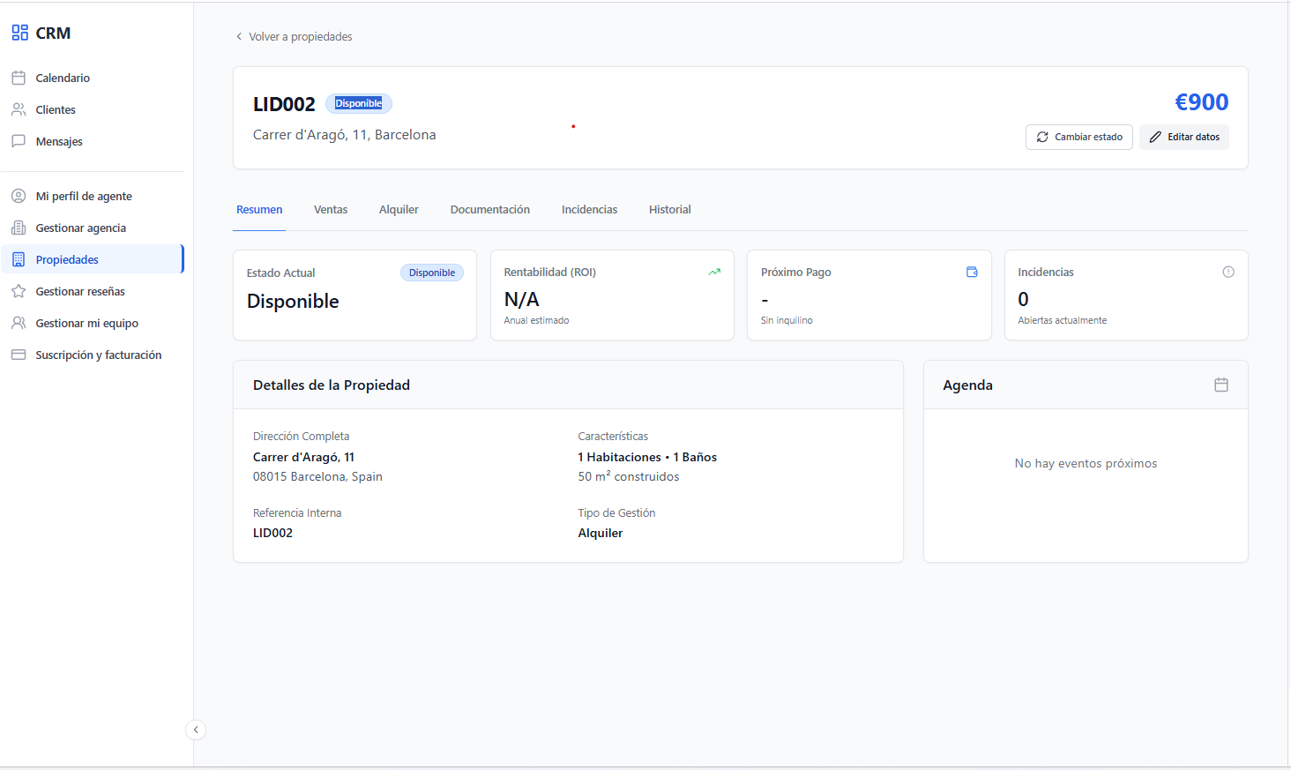
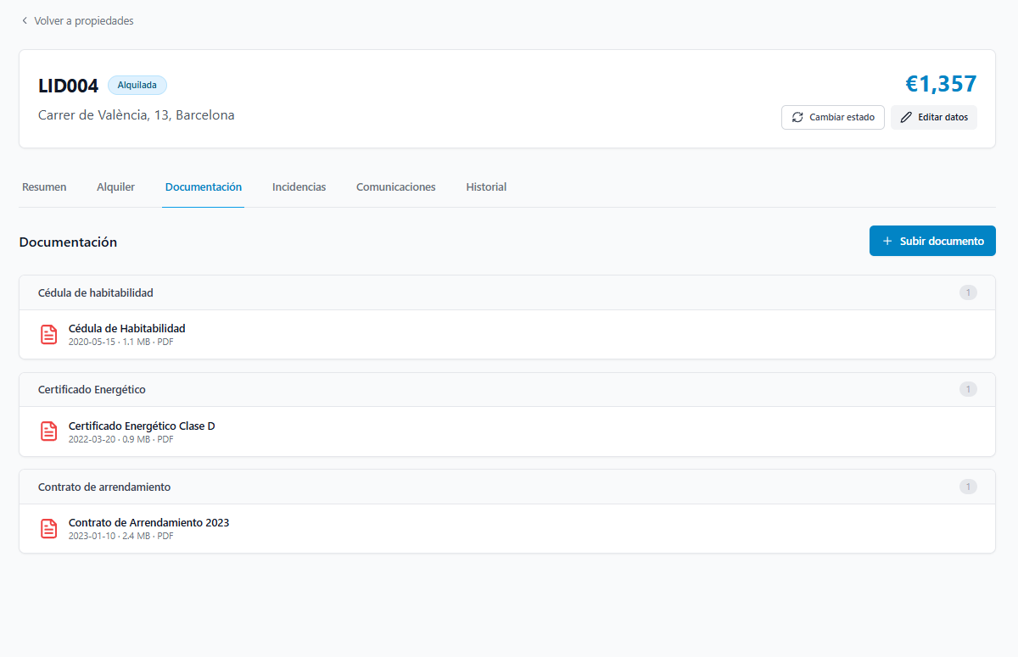
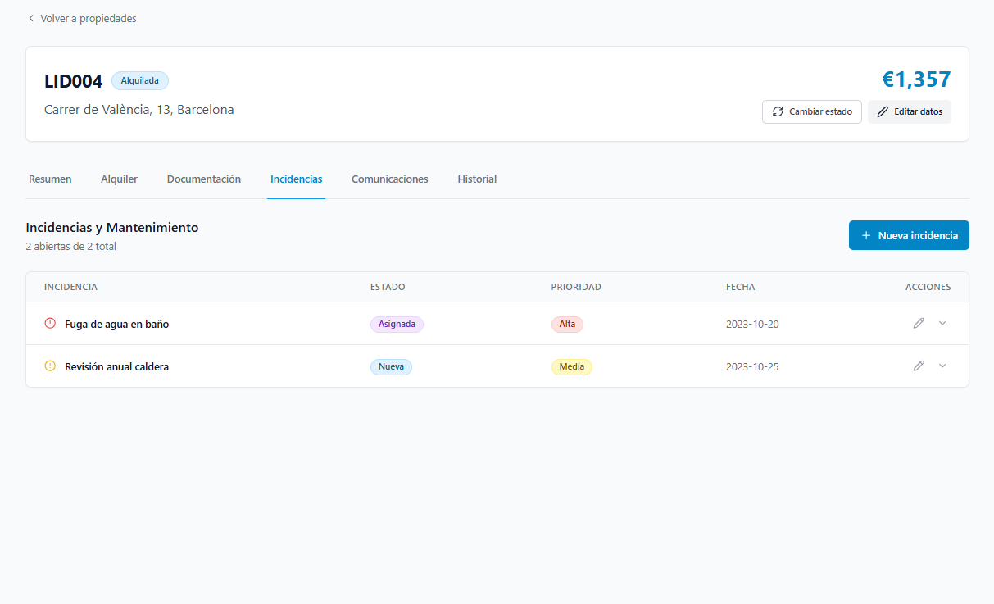
05 · PROPERTY MANAGEMENT
The inventory is not a database. It is an active workspace.
Property, contract, documents, incidents, communications, history—connected.
PROPERTY
From listing to lifecycle management.

Slide 7
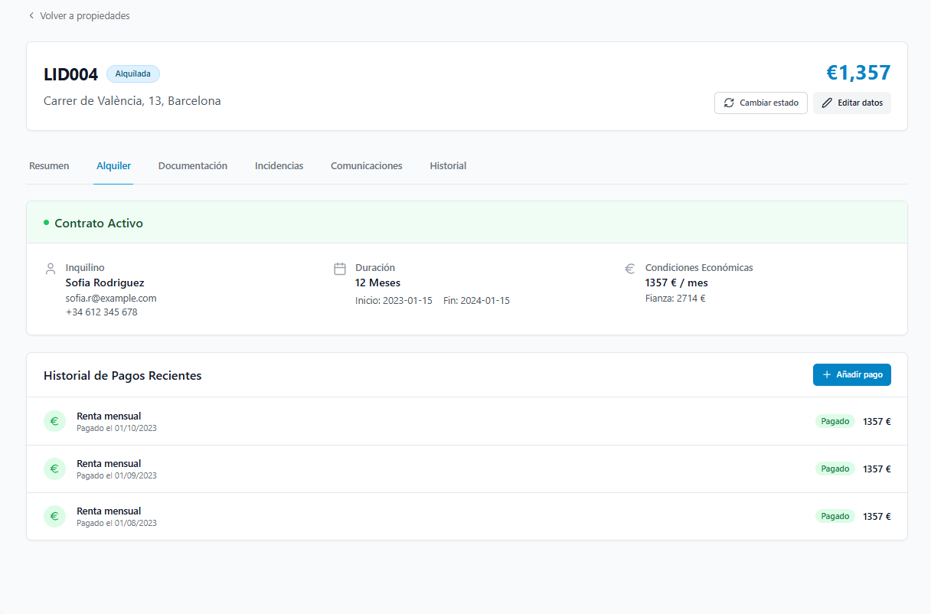
06 · INTELLIGENT MATCHING
Realista is not just a CRM.
It actively connects intent with inventory—so the next best property is already in context.
Client intent
Budget
Matching layer
Location
Context turns search
into recommendation.
Moving date
Property type
RECOMMENDATION

Slide 8
07 · ONE PLATFORM
Every step is connected inside Realista.
The value is not in any single screen. It is in the handoff-free journey.
01
02
03
04
05
Client
Property
Recommendation
Visit
Closing
No context switching. No duplicated records. No lost momentum.
Everything happens inside Realista.

Slide 9
08 · VISION
From CRM to Agency Operating System
The platform expands across the customer journey—not just the transaction.
Lead
Property
Move
Client
Transaction
Post-sale
The agency becomes the distribution layer for the entire home journey.

Slide 10
09 · APPPRO INSIDE REALISTA
AppPro is not replaced. It becomes native.
Realista is horizontal. AppPro is vertical. Together they cover the journey without context switching.
REALISTA
• Calendar
Home Services
POWERED BY APPPRO
• Clients
When a client reaches the moving stage, the agent simply opens the Services workspace.
• Messages
• Properties
Electricity
Gas
Internet
★ Services
Insurance
Water
No duplicated client information. No duplicated property information.
Agent
Agency

Slide 11
10 · FUTURE JOURNEY
Papernest enters before the move—and stays through it.
The move becomes a moment in a much larger, already-contextualized customer journey.
Lead
Client created
Recommendations
Visits
Offer accepted
Move detected
Home Services · AppPro
Customer moved
Electricity
Gas
Internet
Insurance
Water
Papernest becomes part of the complete customer journey.

Slide 12
11 · STRATEGIC VALUE
A larger platform creates more valuable moments for Papernest.
Four ways the operating layer compounds the value of AppPro.
↗
Earlier customer acquisition
◷
Agency daily engagement
★
Natural AppPro integration
◎
More customer context
Present from the first agency interaction—not only at move-in.
Agents spend their day inside Realista, where services are one click away.
Home services become a native workflow, not a separate destination.
Budget · location · moving date · property · intent—available earlier.
From owning the moving moment → to owning the journey that creates it.

Slide 13
12 · PRODUCT MATURITY
The core operating system is already in place.
The next unlock is not rebuilding the foundation—it is activating more value on top of it.
CRM
READY
Property Management
READY
Recommendations
READY
Messaging
READY
Calendar
READY
Agency Administration
READY
Client–Property Relationship
READY
Transaction Workspace
FUTURE
AI Copilot
FUTURE
Automation
FUTURE
The platform is broad enough for AppPro to land with leverage.

Slide 14
13 · LONG-TERM PLATFORM VISION
One operating layer. A wider ecosystem.
Realista owns the workflow; Papernest owns the service moments that follow.
REALISTA
CRM
Properties
Calendar
Messaging
AI
HOME SERVICES · APPPRO
Electricity
Gas
Internet
Insurance
Water
Papernest ecosystem

Slide 15
Realista
THE THESIS
The Future of
Agency Software
Realista provides the operating system for agencies.
AppPro becomes the native Home Services workspace.
Together, they enable Papernest to own the customer journey from the first property search to post-move services.
Realista × Papernest

