Slide 1
Alex Spending Analysis
All amounts in Kenyan Shillings (KSh) | Period: 2024-01-14 to 2024-05-26
Summary, trends, and merchant/location insights

Slide 2
Executive summary
• Total spend: KSh 120,208 across 60 transactions
• Average transaction: KSh 2,003 (median: KSh 500)
• Highest month: 2024-01 (KSh 43,108)
• Lowest month: 2024-04 (KSh 7,000)
• Top category: Rent (31.6%)
• Top payment method: Mpesa (81.4%)
• Top merchant: Home (KSh 51,948)
• Top area: Kikuyu Road (KSh 54,198)

Slide 3
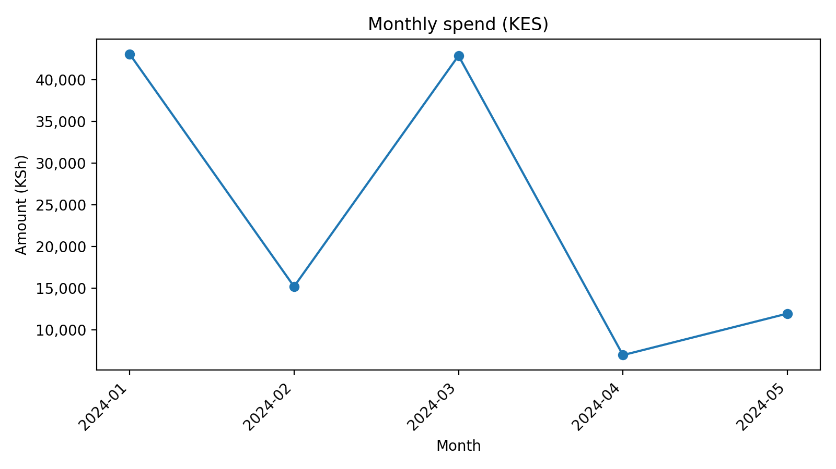
Monthly spend trend
Monthly totals (KSh)

Slide 4
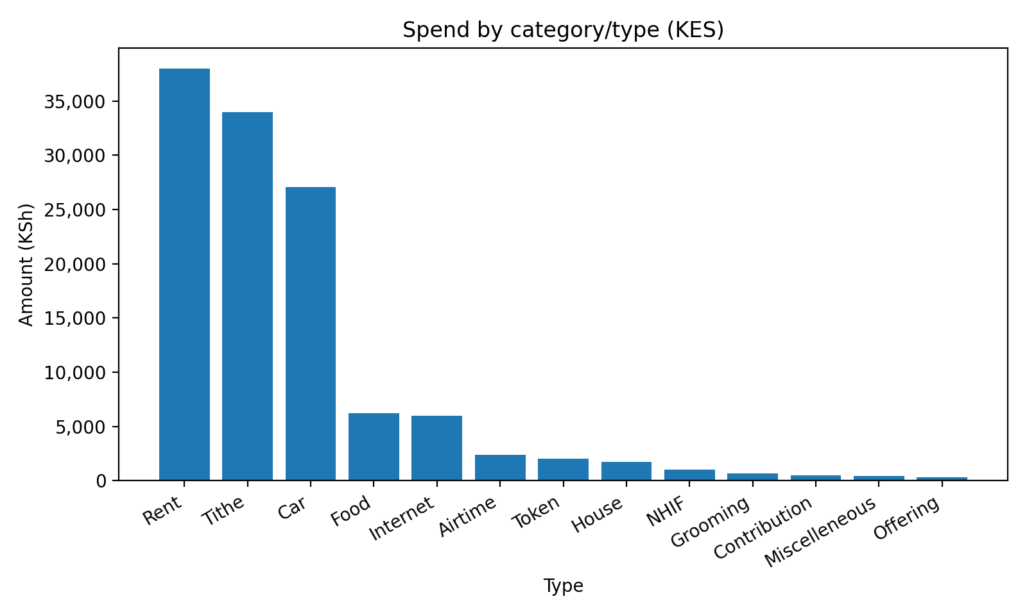
Spend by category/type
Totals by spending type (KSh)

Slide 5
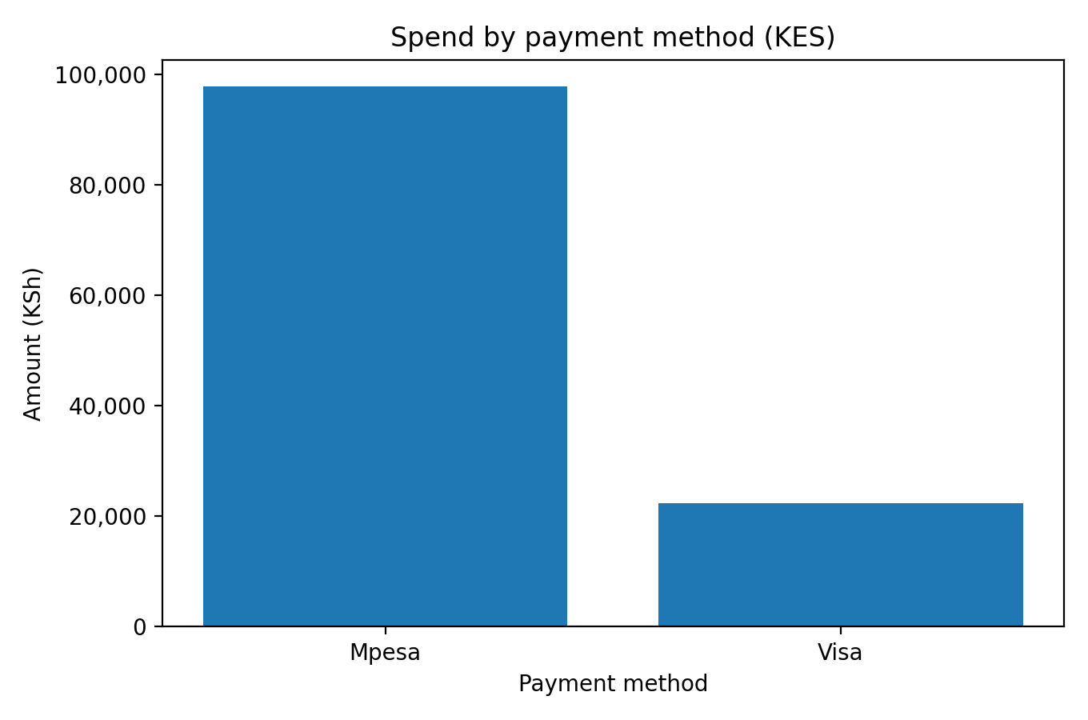
Payment method mix
Totals by payment method (KSh)

Slide 6
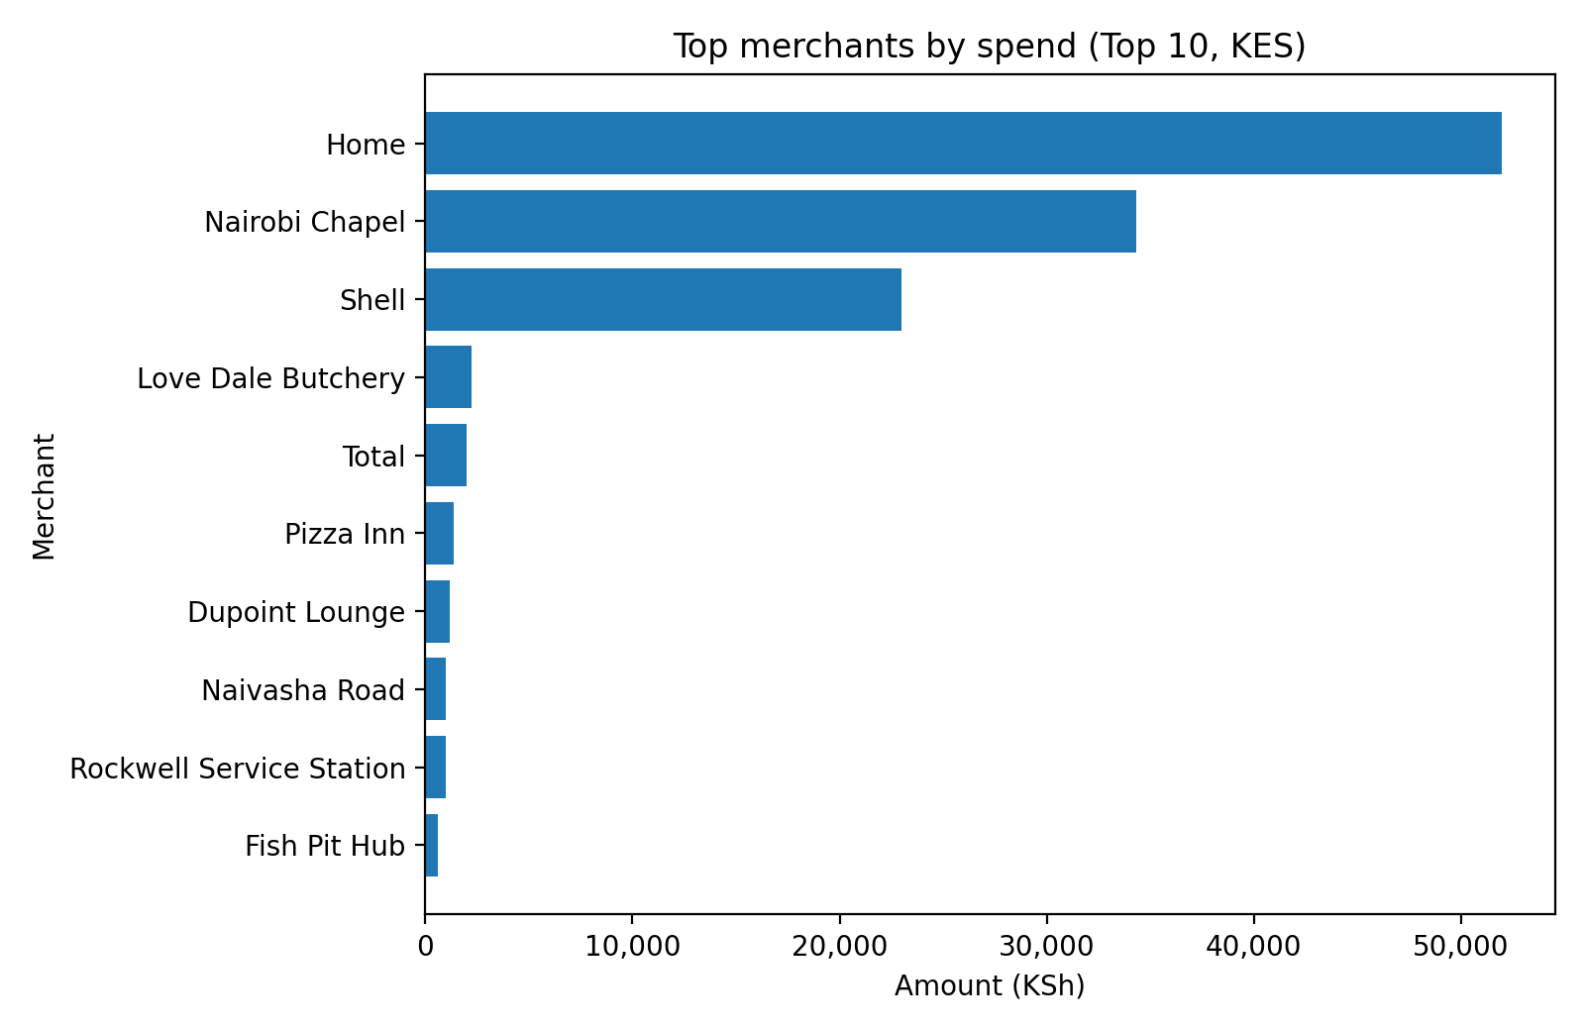
Top merchants
Shell station detail (from Location):
• Baraka Waiyaki way: KSh 7,980
• Dagoretti: KSh 5,000
• Dagoretti ,Kikuyu: KSh 3,000
• Kamiti Road: KSh 2,000
• Northlands: KSh 2,000
Top merchants by spend (KSh)

Slide 7
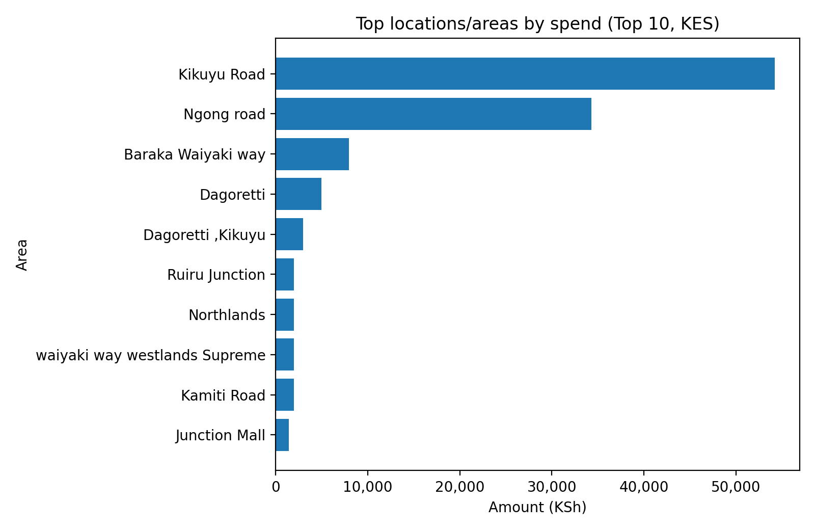
Top locations/areas
Top areas (quick list):
• Kikuyu Road: KSh 54,198
• Ngong road: KSh 34,300
• Baraka Waiyaki way: KSh 7,980
• Dagoretti: KSh 5,000
• Dagoretti ,Kikuyu: KSh 3,000
• Ruiru Junction: KSh 2,000
Top areas by spend (KSh)

Slide 8
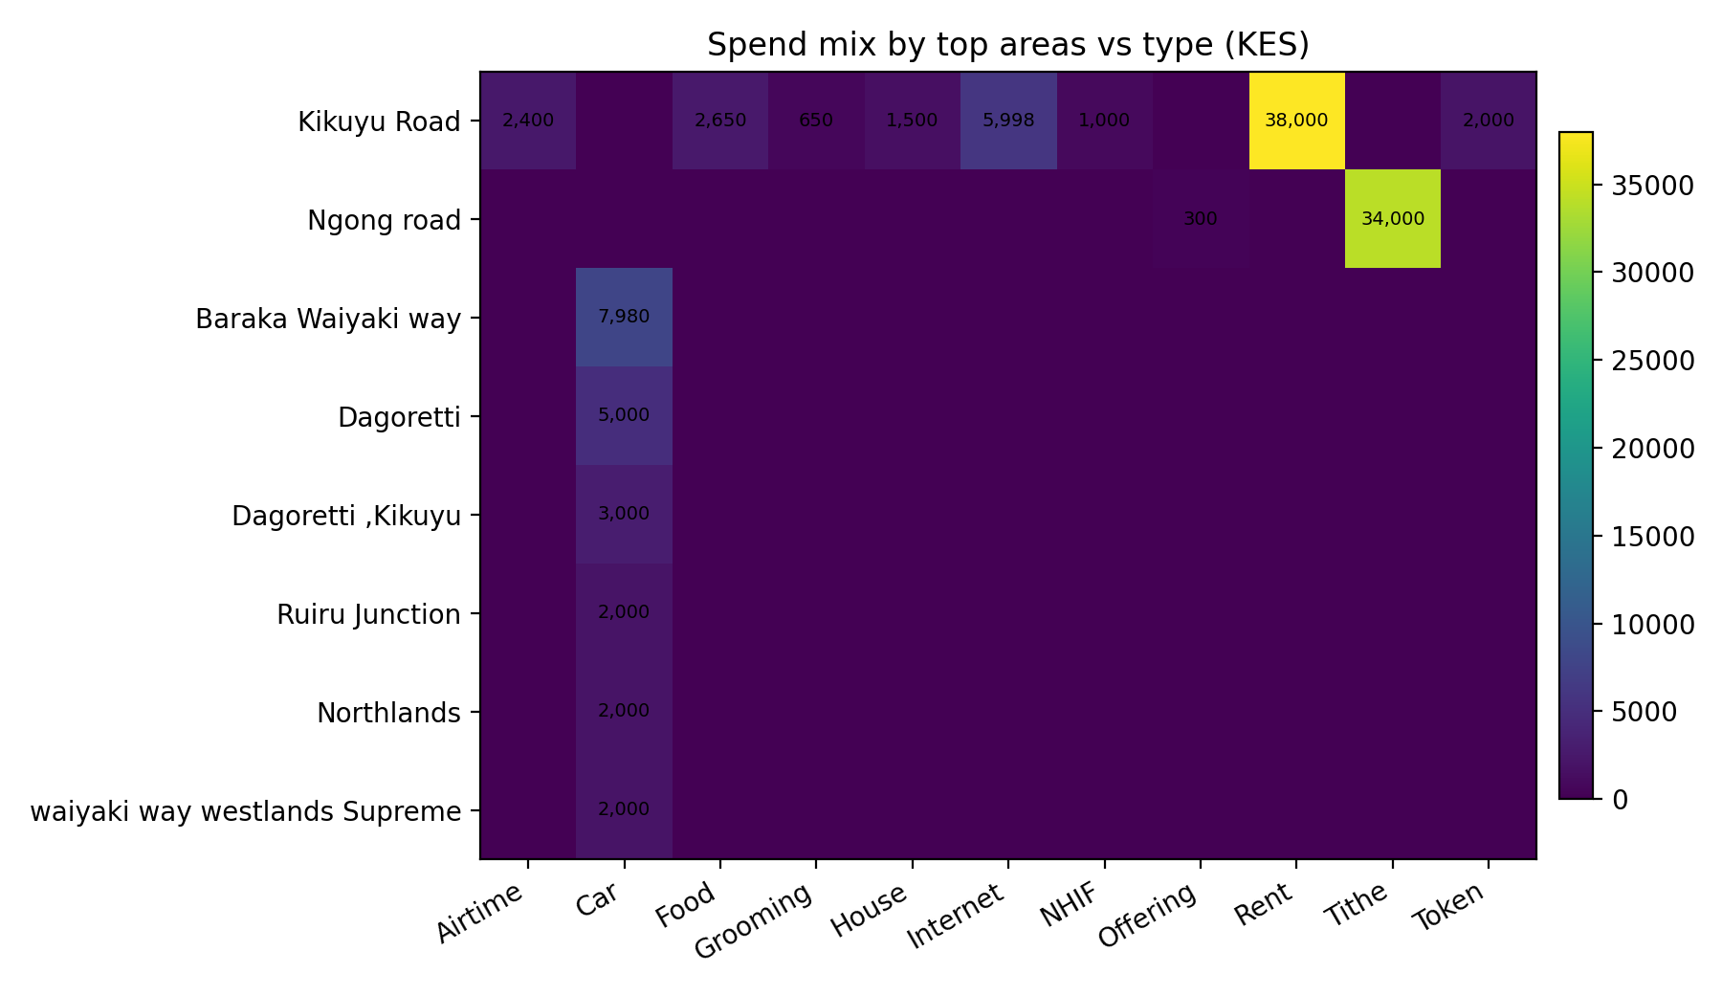
Spend mix by area vs category
Heatmap: spend totals by area and type (KSh)

Slide 9
Practical next steps
• Track a monthly budget vs actual for the largest categories (Rent, Tithe, Car).
• For fuel/transport, monitor spend by station (Shell locations) to spot price/volume changes.
• If possible, separate 'Merchant' from 'Location' in the data capture to improve accuracy and automation.
• Add a 'Purpose/Notes' field for large or unusual expenses to improve explainability.

