Slide 1
Titanic Group Findings
Wesley Cheung, Jeffrey Luo, Alex Oshin, Alen Polakof

Slide 2
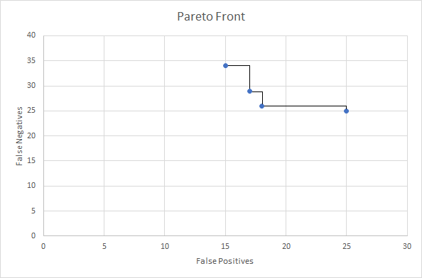
Boosted decision tree
Random forest
SVM
K-nearest neighbors

Slide 3
Final Algorithms
Boosted Decision Tree
False positives: 15
False negatives: 34
K-Nearest Neighbors
False positives: 25
False negatives: 25
Random Forest
False positives: 17
False negatives: 29
SVM
False positives: 18
False negatives: 26

Slide 4
Challenges
Data cleaning
Missing values
Continuous attributes – replace with median of all samples
Discrete attributes – replace with the mode / most common of all samples
Discrete to one hot encoding
Gender
Departing city
Removed unnecessary attributes
Name
Data augmentation
Cabin number can be split into floor level and room location
Turn floor level into a continuous variable

Slide 5
Finding pareto optimal models
Tune hyper parameters
Varying algorithms
Print confusion matrix and compare
Setting up work environments
Help new members get started
Install needed frameworks and packages

Slide 6
Experiences gained
First time for many members
Python
Discrete classification algorithms
Data parsing and cleaning
Getting used to sklearn and panda
Couple members only familiar with WEKA framework
Data cleaning is crucial
Get in what you get out
Cleaned and augmented data performed

