Slide 1
570 Programming Project
Kiwi Trail
A web application for planning outdoor activities in New Zealand
Team: [Team name]
Members: [Member 1] • [Member 2] • [Member 3] • [Member 4]
Date: [Presentation date]
Notes:
[~30 sec] Greet the audience and introduce the team. Say: 'Hi everyone, we are Team [name] and today we will introduce Kiwi Trail — a web application that helps people plan outdoor activities in New Zealand.' Briefly mention each presenter and the section they will cover.

Slide 2
Problem & Motivation
Presenter: [Member 1]
• Why Kiwi Trail?
NZ outdoor data lives in many places
What users actually want
• DOC: tracks, huts, campsites
• LINZ: maps and place names
• NIWA: weather forecasts
• Council sites: regional parks
• Find places nearby quickly
• Filter by region & difficulty
• See details, map, and weather
• Plan trips in one place
The Problem
Outdoor activity information is scattered across many sources. Users have to switch between websites to find tracks, check maps, and view the weather — making trip planning slow and frustrating.
Kiwi Trail | 570 Programming Project
2 / 12
Notes:
[~45 sec] Explain that New Zealand has rich outdoor data, but it is spread across DOC, LINZ, NIWA, and council websites. Give an example: 'Imagine you want to go hiking this weekend — you might need 4 or 5 tabs to figure out which track, where it is, how hard it is, and what the weather will be.' This motivates building Kiwi Trail.

Slide 3
Objective & Target Users
Presenter: [Member 1]
• One platform for outdoor planning
● Combine NZ outdoor datasets in one app
Tracks, huts, campsites, weather, maps
● Help users plan trips faster
Search, filter, view details, navigate
● Provide a clean and modern map-based UI
Built for both desktop and mobile browsers
Local Kiwis
• Plan weekend hikes
• Discover new tracks
Visitors / Tourists
• Explore NZ outdoors
• Quick & easy planning
Casual Campers
• Find nearby campsites
• Check weather first
Kiwi Trail | 570 Programming Project
3 / 12
Notes:
[~45 sec] State the goal in one sentence: 'Make outdoor planning easier by combining NZ datasets into one web app.' Highlight three user groups — locals, visitors, and casual campers — and how each benefits.

Slide 4
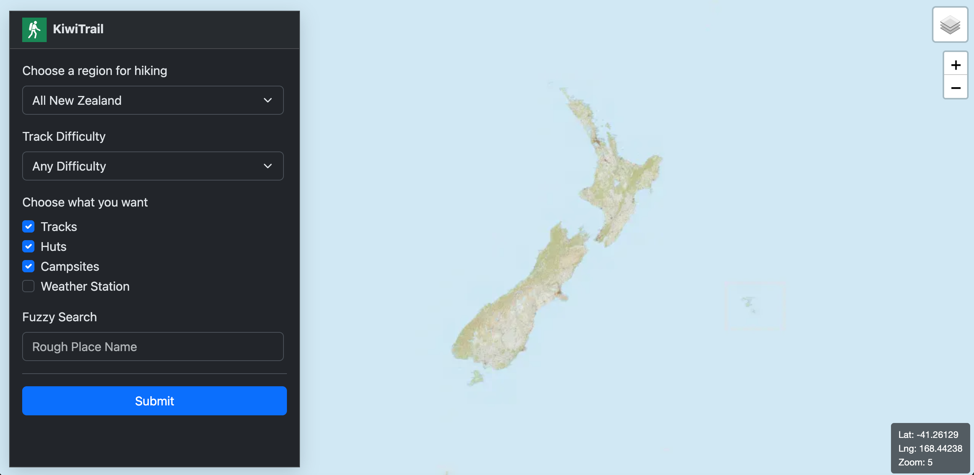
Proposed Solution
Presenter: [Member 2]
• A map-based web app with planning tools
Discover places
● Select region & difficulty
● Filter track / hut / campsite
● Fuzzy place-name search
● Nearby within 15 km
Plan your trip
● View item details
● Open Google Maps directions
● View NIWA weather
● Save favourites & comments
Preview. KiwiTrail home page — search panel on the left, interactive map of New Zealand on the right.
Kiwi Trail | 570 Programming Project
4 / 12
Notes:
[~45 sec] Walk the audience through the two halves of the app: 'Discover' (how users find places) and 'Plan' (what they do once they've picked one). Emphasise that the 15 km nearby search and fuzzy search make discovery very fast.

Slide 5
System Architecture
Presenter: [Member 2]
• React • FastAPI • PostgreSQL
Technology Stack
User (browser)
• Frontend: React
• Backend: FastAPI (Python)
• Database: PostgreSQL
React Frontend — UI / map / search
FastAPI Backend — REST APIs
Data Sources
PostgreSQL — app database
• DOC: tracks, huts, campsites
• LINZ: map tiles + gazetteer
• Region boundary data
• NIWA weather widget
DOC / LINZ / Region / Weather sources
Kiwi Trail | 570 Programming Project
5 / 12
Notes:
[~45 sec] Explain the three-tier architecture briefly. React talks to FastAPI, FastAPI talks to PostgreSQL, and we imported DOC, LINZ, regional, and NIWA data into the database. Mention why we chose this stack (fast, light, easy to deploy).

Slide 6
Key Features
Presenter: [Member 3]
• What users can do
Region selection
Difficulty filter
Type filter (track / hut / camp)
Fuzzy search
Nearby within 15 km
Interactive map
Detail pages
Google Maps directions
Weather forecast
User comments
Favourites list
Mobile-friendly UI
Kiwi Trail | 570 Programming Project
6 / 12
Notes:
[~45 sec] Walk the audience through the headline features at a high level — don't list every single one. Group them: 'discovery features' (search / filter / nearby), 'detail features' (page / weather / map link), and 'user features' (comments / favourites). Tell the audience they'll see these in action in the demo.

Slide 7
Implementation
Presenter: [Member 3]
• Frontend • Backend • Database
Frontend (React)
Backend (FastAPI)
Database (PostgreSQL)
• Interactive map view
• Search & filter panel
• Item detail pages
• Comments section
• Favourites list
• REST API endpoints
• Region / difficulty filters
• Nearby (15 km) search
• Fuzzy search logic
• Comments & favourites
• tracks, huts, campsites
• regions
• users
• comments
• favourites
1. Collect data
2. Clean & import
3. Expose APIs
4. Show on map
Kiwi Trail | 570 Programming Project
7 / 12
Notes:
[~45 sec] Explain how the project is divided across the three layers. Mention what each team member worked on if relevant. Briefly call out the data pipeline at the bottom: collect → clean → import → expose → display.

Slide 8
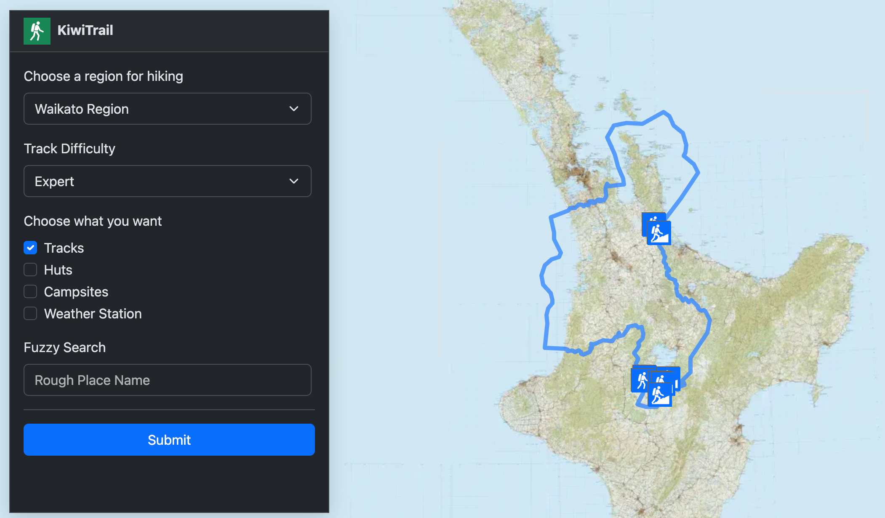
Demo — Home Page
Presenter: [Member 4]
• Search panel + region map
Search panel features
• Region selector
• Track difficulty filter
• Type filter — tracks, huts, campsites, weather stations
• Fuzzy place-name search
• Region boundary drawn on the map
• Live latitude / longitude readout
Figure 1. The KiwiTrail home page and search panel. Users choose a region, set the track difficulty, pick the item types (tracks, huts, campsites, weather stations) and optionally use a fuzzy search.
Kiwi Trail | 570 Programming Project
8 / 12
Notes:
[~45–60 sec] Open the demo with the home page. Walk through the search panel: pick a region (e.g. Waikato), choose difficulty, tick the item types you want, and optionally type a rough place name in fuzzy search. Point out that the map highlights the selected region's boundary so the user immediately sees the area they will explore.

Slide 9
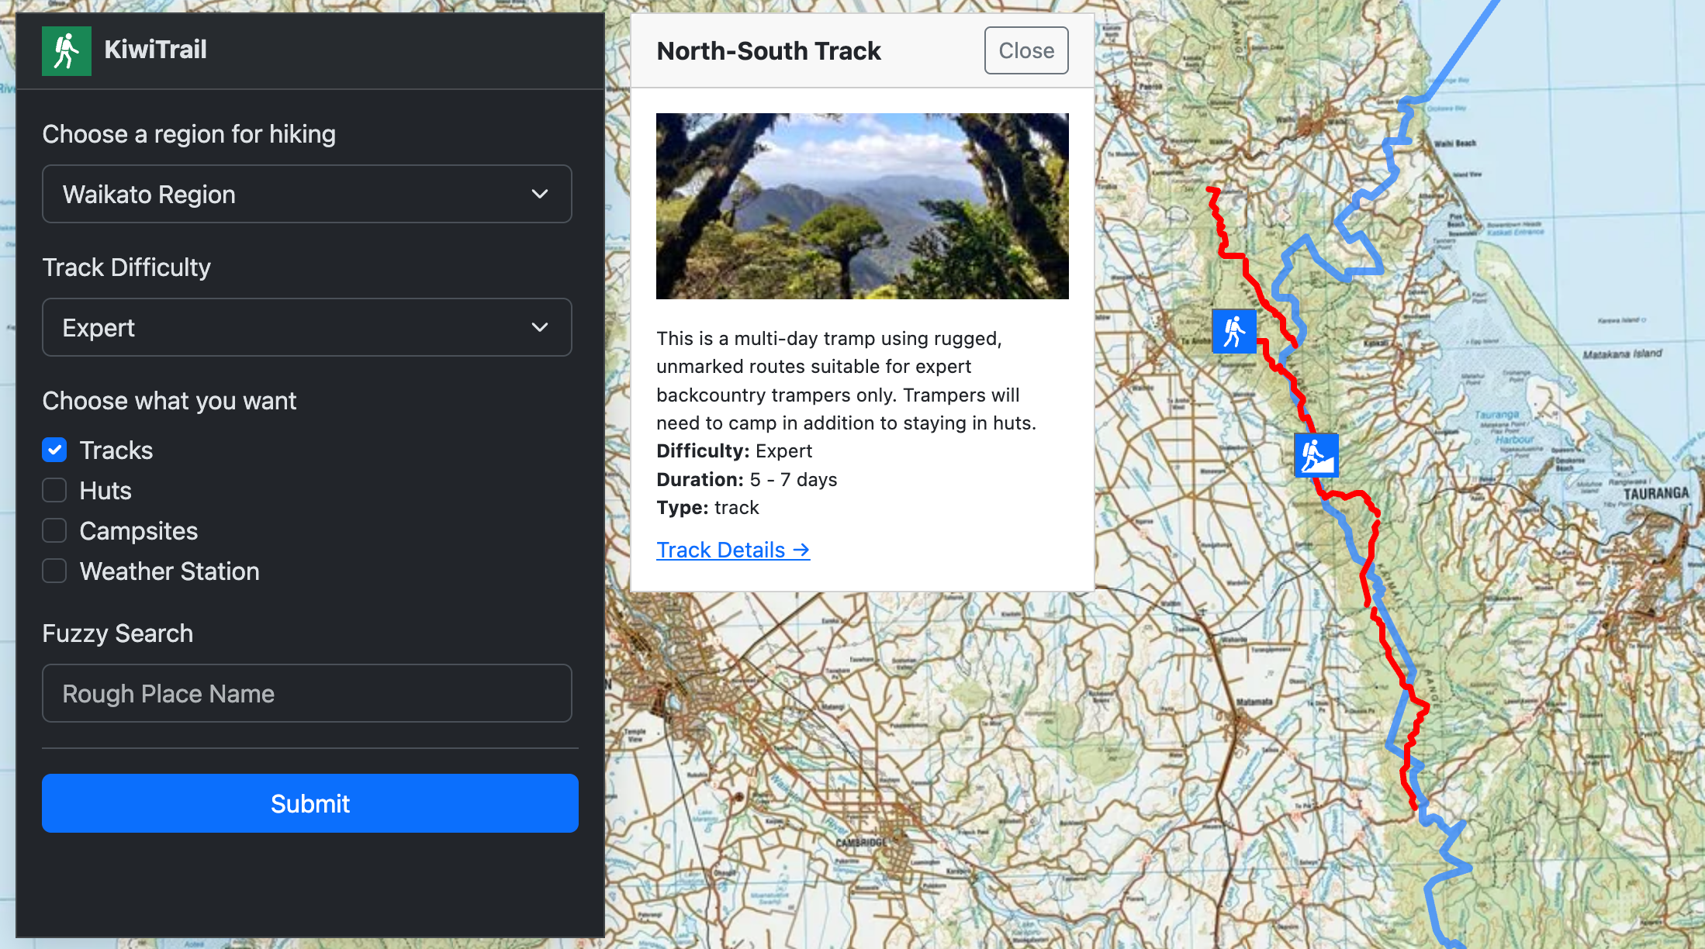
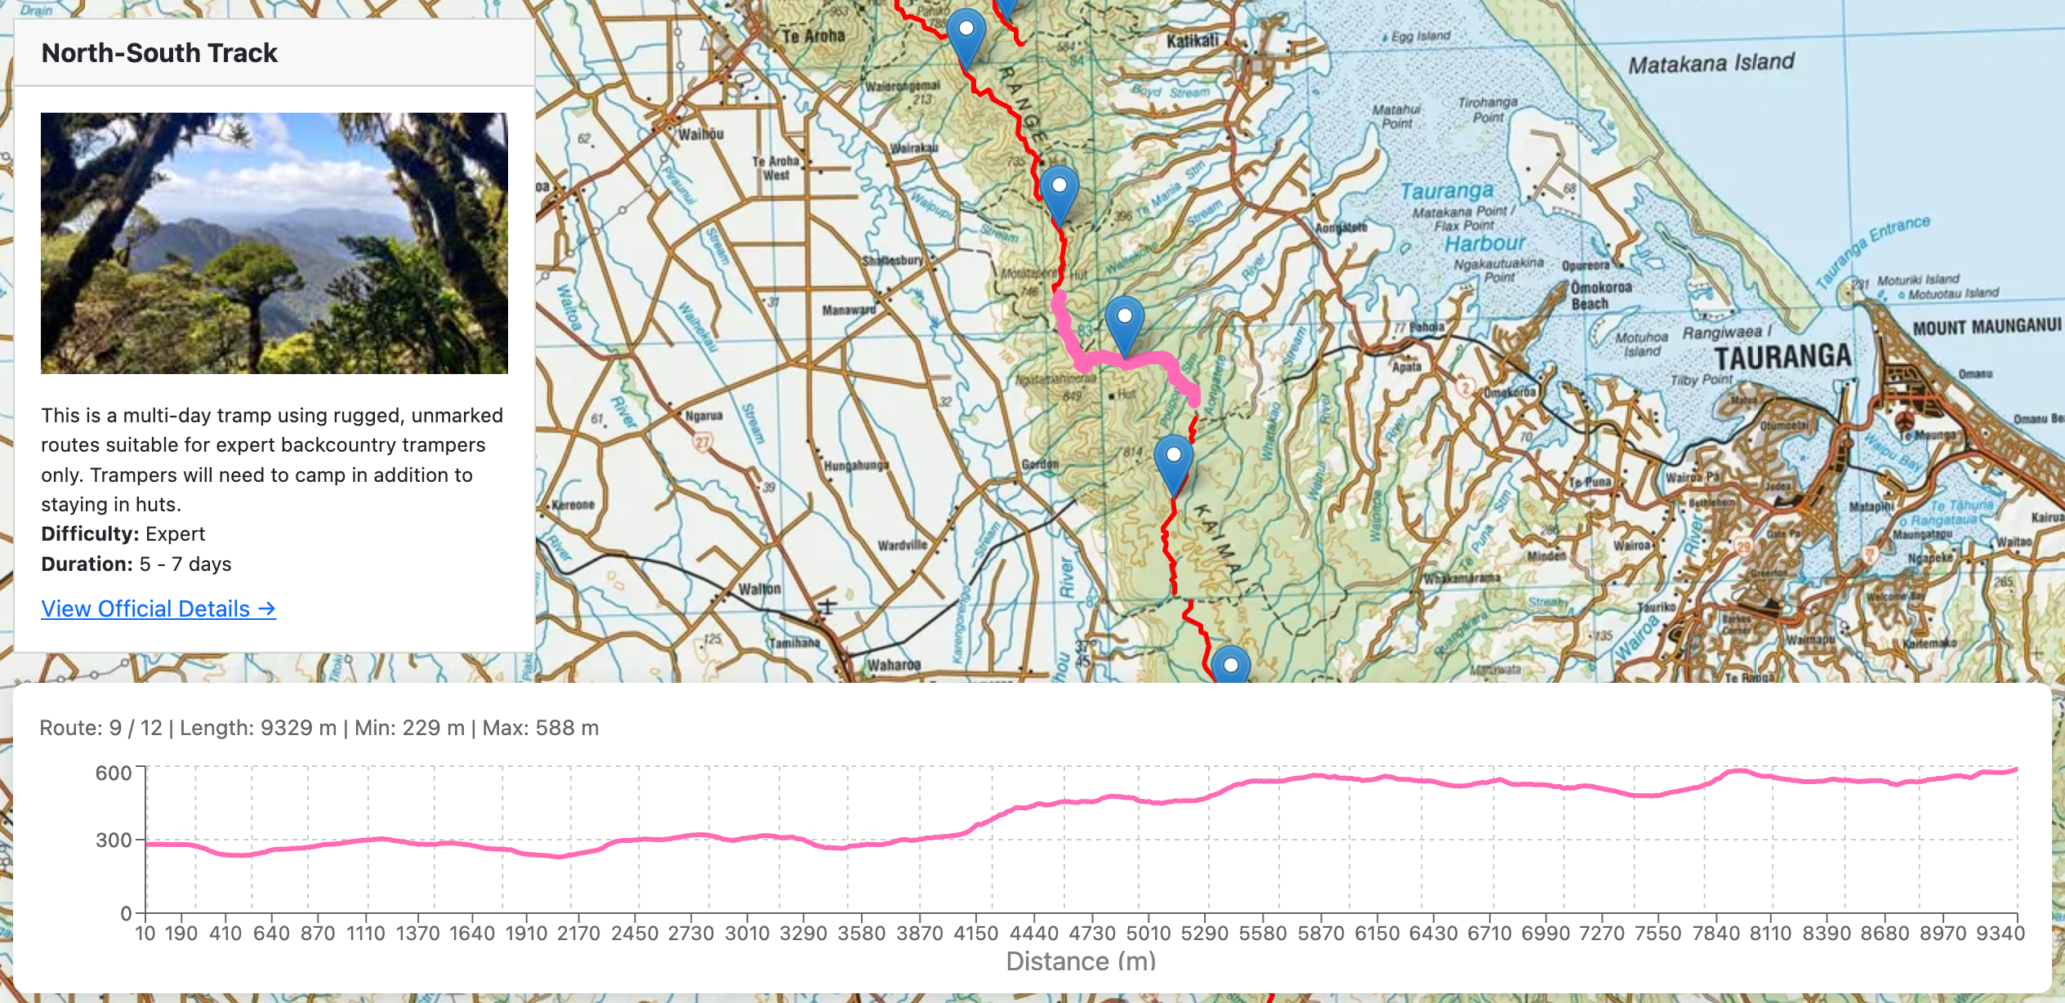
Demo — Search Result
Presenter: [Member 4]
• Track on map, detail panel, 3D elevation
Figure 2a. Track shown on the 2D map with the detail panel: photo, description, difficulty, duration, type, and 'Track Details' link.
Figure 2b. Route view with elevation profile — distance vs. elevation for the selected track (route 9 / 12, length 9329 m).
Directions
Weather
Comments
Favourites
Open in Google Maps
NIWA forecast widget
Read & post comments
Save for later
Detail panel actions — Directions, Weather, Comments, and Favourites — for each selected track.
Kiwi Trail | 570 Programming Project
9 / 12
Notes:
[~60–75 sec] Pick a track on the map (e.g. Karioi Track or North-South Track). Show the detail panel: photo, description, difficulty, duration, type, and the 'View Official Details' link. Then open the 3D elevation view to show distance-vs-elevation. Finish by demonstrating the four action buttons: Directions (Google Maps), Weather (NIWA), Comments, and Favourites.

Slide 10
Challenges & Solutions
Presenter: [Member 4]
• What we learned along the way
Challenge 1: Data from multiple sources
Challenge 2: Showing geographic data on a map
Solution: Cleaned and unified DOC, LINZ and region data in PostgreSQL.
Solution: Used LINZ map tiles and lat/long coordinates for visual display.
Challenge 3: Helping users find places fast
Challenge 4: Better trip-planning experience
Solution: Added fuzzy search, filters, and 15 km nearby search.
Solution: Added weather, Google Maps links, comments and favourites.
Kiwi Trail | 570 Programming Project
10 / 12
Notes:
[~45 sec] Don't read every card. Pick the most interesting one or two and tell a short story — e.g. 'integrating data from DOC and LINZ was tricky because formats and coordinate systems differed; we wrote import scripts that normalise everything before inserting into PostgreSQL.'

Slide 11
Future Work & Conclusion
Presenter: [Member 4]
• Where Kiwi Trail can go next
Future Improvements
Conclusion
• Kiwi Trail brings NZ outdoor data together in one place.
• Search, filter, map, weather, navigation — all in one app.
• Helps both locals and visitors plan trips quickly & safely.
Thank you!
• User login & profiles
• Trip planning itinerary
• Offline map support
• Safety alerts & track condition updates
• User-uploaded photos
• Mobile app version
• Personalised recommendations
Kiwi Trail | 570 Programming Project
11 / 12
Notes:
[~45 sec] Summarise the project in 2–3 sentences. Mention 1–2 future directions that excite you. End with a warm 'thank you' and invite questions from the audience.

Slide 12
Q & A
We'd love to hear your questions and feedback.
Kiwi Trail • 570 Programming Project
Notes:
[Remaining time / discussion] Open the floor for questions. Be ready to answer about: tech stack choices, data sources, how nearby search works, scalability, and future plans. If you don't know an answer, say so honestly and offer to follow up.

