Slide 1
Cyprus Community Bank
Loan Default Prediction
DSC 550 — Group Project
Alexandros Panayi · Maria Michaelidou · Thanasis Kalos

Slide 2
Agenda
01
The Problem
Predicting loan defaults for a Cyprus community bank
02
Exploratory Data Analysis
Understanding the data landscape & class imbalance
03
Model Training & Evaluation
7 classifiers, SMOTE vs. unbalanced comparison
04
Model Selection & Calibration
Choosing the best model for threshold optimization
05
Stakeholder Cost Structures
Three executives, three different cost functions
06
Threshold Optimization
From probabilities to business-optimal decisions
07
Stakeholder Tradeoff Analysis
The 3×3 payoff matrix: who wins, who loses
08
CEO Decision Framework
A range of defensible options — not one answer
09
Post-Deployment Monitoring
Keeping the model and thresholds current

Slide 3
01 The Problem
Cyprus Community Bank needs a data-driven system to decide which loan applications to approve or reject.
A single wrong approval of a defaulting borrower can cost up to €45,000 in losses.
A single wrong rejection of a good borrower sacrifices up to €10,000 in lost growth revenue.
Three senior executives — CFO, CRO, CGO — each define "optimal" differently:
CFO (Maria Georgiou): Maximize profit — willing to accept moderate risk
CRO (Andreas Konstantinou): Minimize risk exposure — nearly zero tolerance for defaults
CGO (Elena Papadopoulou): Maximize growth — approves unless near-certain default
Our task: Build a predictive model and find the optimal decision threshold
for each stakeholder — then present the CEO with a range of defensible options.

Slide 4
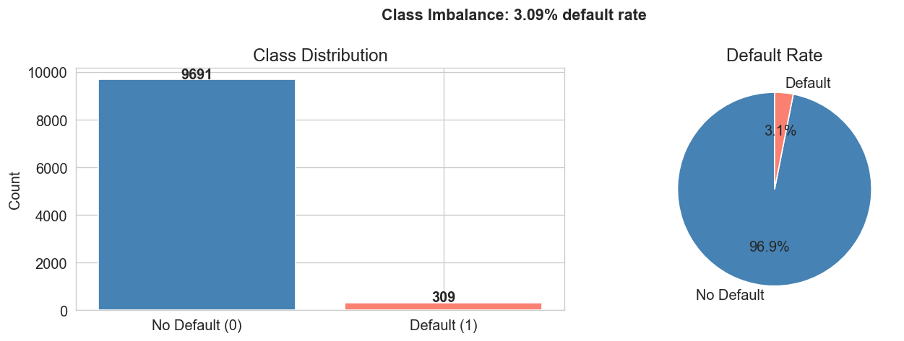
02 Exploratory Data Analysis
Severe Class Imbalance: ~3.1% Default Rate
Only ~310 out of 10,000 loans default
A naive "approve all" baseline achieves 96.9% accuracy
→ Accuracy is a misleading metric here
We must focus on AUC, Recall, and cost-sensitive metrics

Slide 5
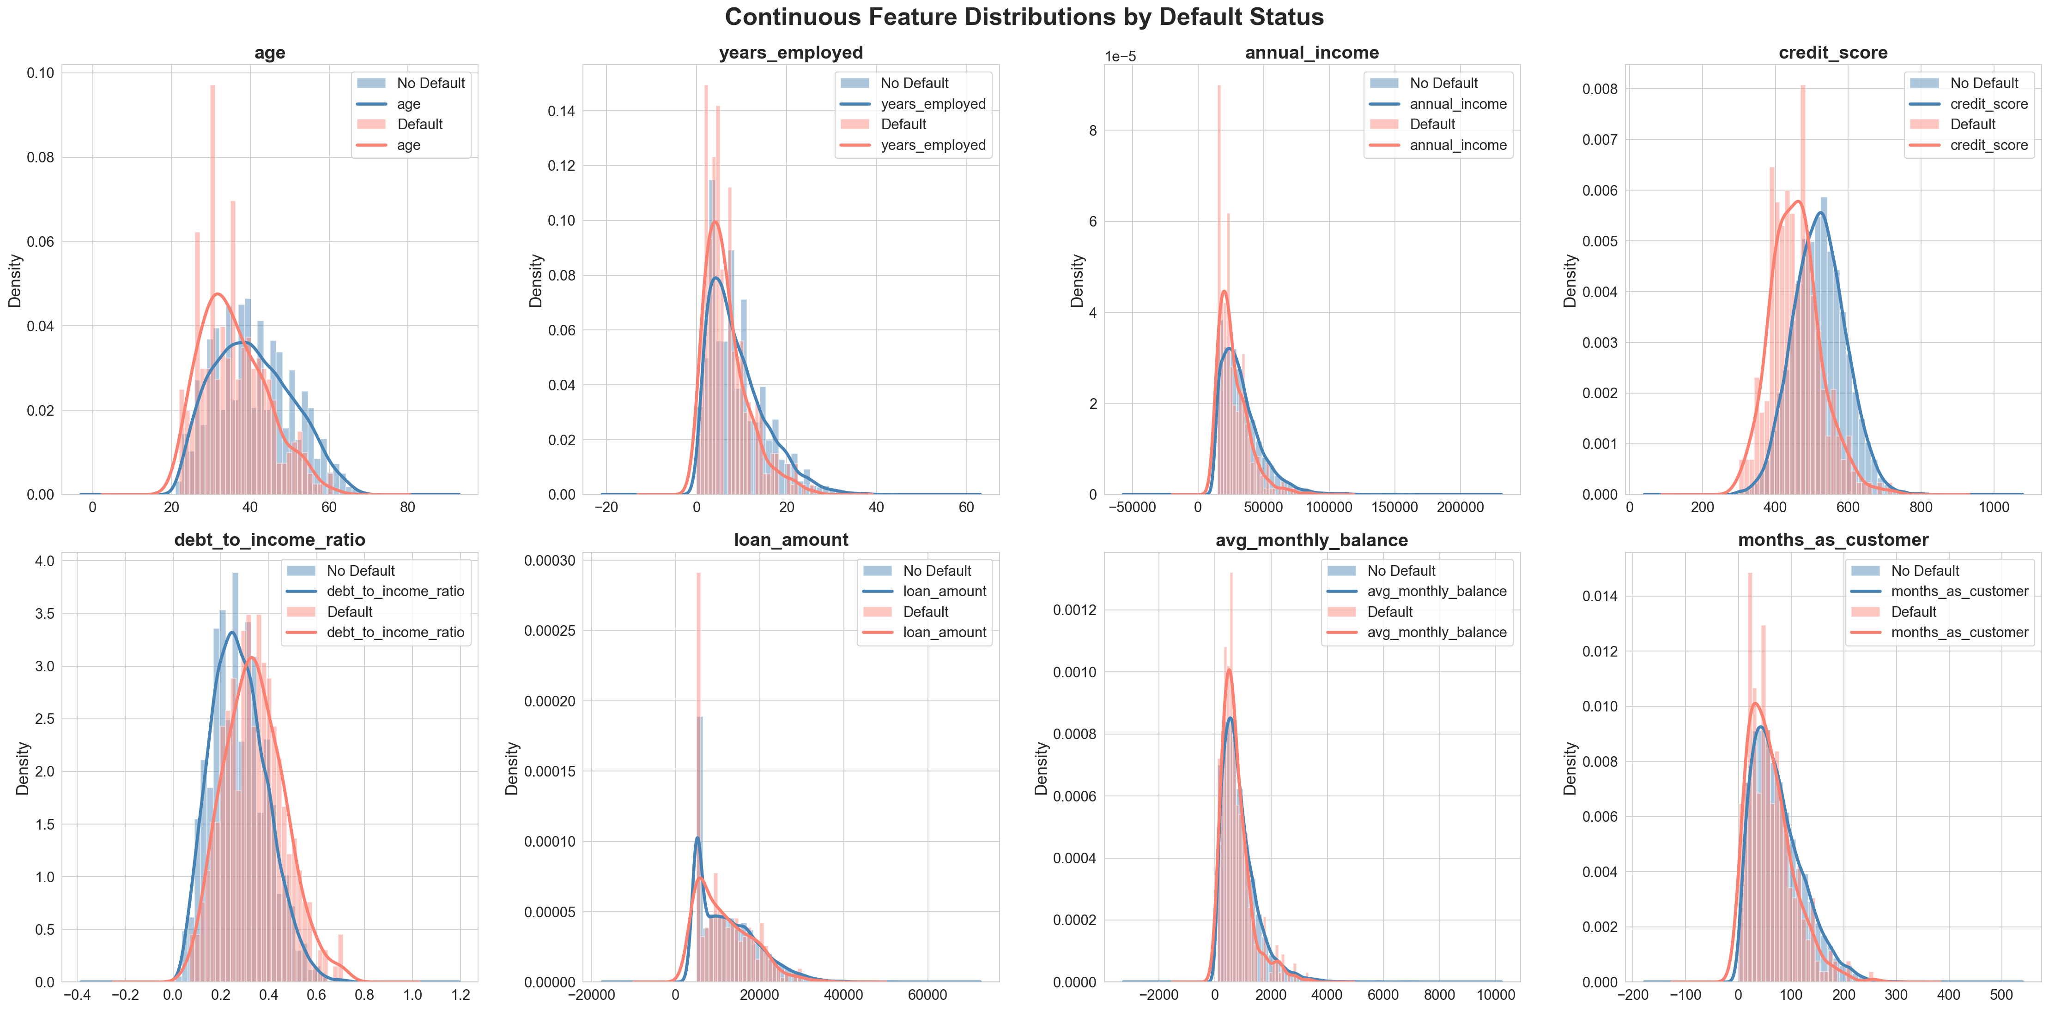
02 Feature Distributions by Default Status

Slide 6
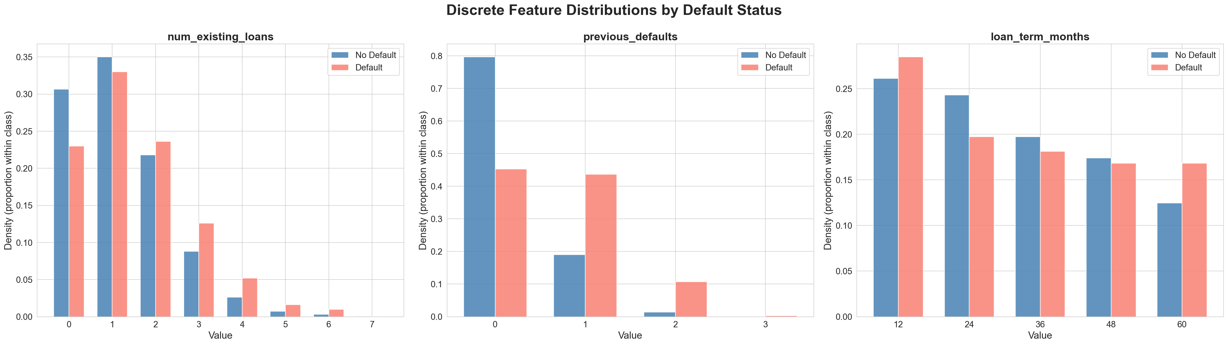
02 Discrete Feature Distributions

Slide 7
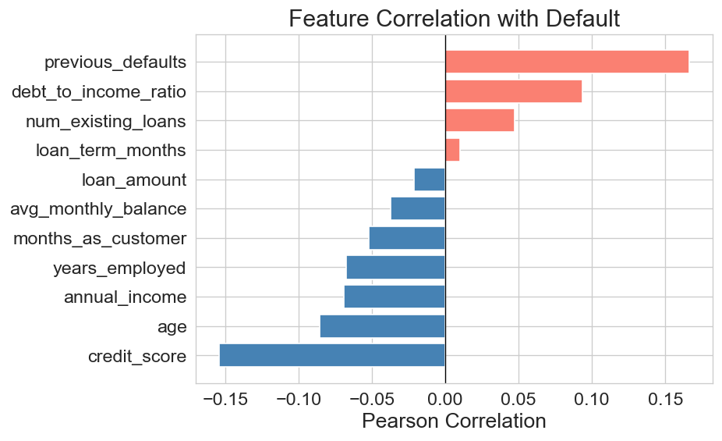
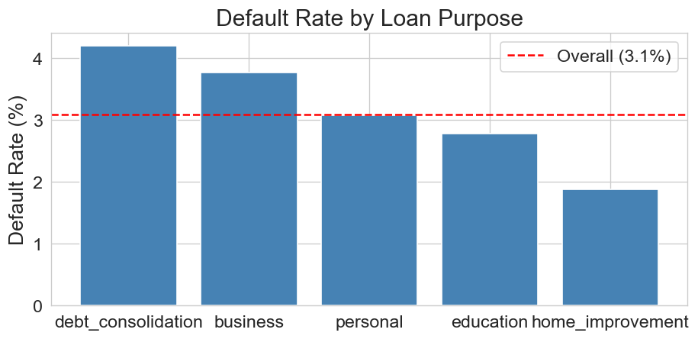
02 Key Predictors of Default
Strongest predictors: previous_defaults (+), debt_to_income (+)
Protective: credit_score (−), age (−), income (−)
Highest risk: debt_consolidation (4.2%), business (3.8%)

Slide 8
02 EDA — Key Takeaways
1. Severe Imbalance (~3.1% defaults) — naive baseline = 96.9% accuracy → misleading
2. Continuous Features: Defaulters tend to be younger, lower income, lower credit score,
fewer years employed — indicating financially unstable profiles
3. Discrete Features: previous_defaults is the single strongest signal;
more existing loans and longer loan terms also increase risk
4. Correlation: previous_defaults and debt_to_income_ratio are the two strongest
positive predictors; credit_score is the strongest protective factor
5. Loan Purpose: debt_consolidation (4.2%) and business (3.8%) carry the most risk;
home_improvement (1.9%) is safest

Slide 9
03 Model Training & Evaluation
7 classifiers trained on SMOTE-balanced data, evaluated on held-out test set
Model | Accuracy | Precision | Recall | F1 | AUC
Logistic Regression | 0.7880 | 0.0923 | 0.6613 | 0.1621 | 0.8161
LDA | 0.7800 | 0.0891 | 0.6613 | 0.1571 | 0.8143
Gradient Boosting | 0.9570 | 0.2273 | 0.1613 | 0.1887 | 0.7610
Random Forest | 0.9620 | 0.2308 | 0.0968 | 0.1364 | 0.7415
Naive Bayes | 0.6735 | 0.0583 | 0.6290 | 0.1067 | 0.7337
KNN | 0.8275 | 0.0673 | 0.3548 | 0.1131 | 0.6360
Decision Tree | 0.9295 | 0.1376 | 0.2419 | 0.1754 | 0.5967
→ Top 2 by AUC: Logistic Regression (0.816) and LDA (0.814) — selected for tuning

Slide 10
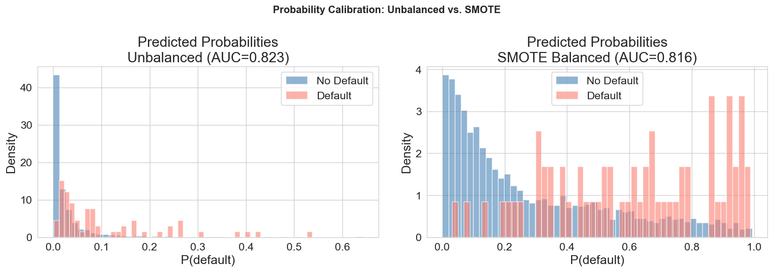
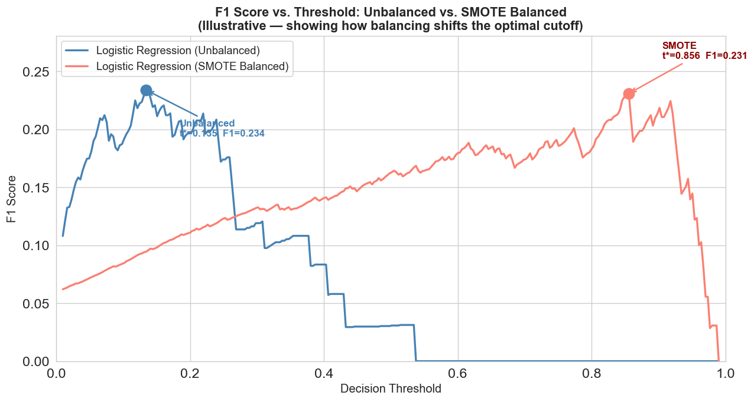
04 SMOTE vs. Unbalanced — Why Calibration Matters
SMOTE inflates predicted probabilities
→ shifts optimal F1 threshold from 0.13 to 0.86
Unbalanced model keeps calibrated probs
→ P(default) = 10% genuinely means 10% risk
Since we optimize by sweeping thresholds,
we DON'T need SMOTE to boost recall at 0.5
AUC comparison:
LR: Unbalanced 0.823 vs SMOTE 0.816
LDA: Unbalanced 0.810 vs SMOTE 0.814
→ Proceed with UNBALANCED training

Slide 11
04 Model Selection & Hyperparameter Tuning
Why AUC-ROC as the selection metric?
AUC measures ranking ability across ALL thresholds
We need a model that separates defaults from non-defaults
well regardless of which cutoff each stakeholder picks
Unlike accuracy/F1, AUC is threshold-agnostic
— perfect for our multi-stakeholder problem
Tuning Results (5-fold Stratified CV, scored by AUC)
Model | Best Params | CV AUC | Test AUC
Logistic Regression | C = 1, penalty = L2 | 0.8369 | 0.8227
LDA | shrinkage = auto | 0.8303 | 0.8104
→ Final model: Tuned Logistic Regression (AUC = 0.823) — trained on unbalanced data

Slide 12
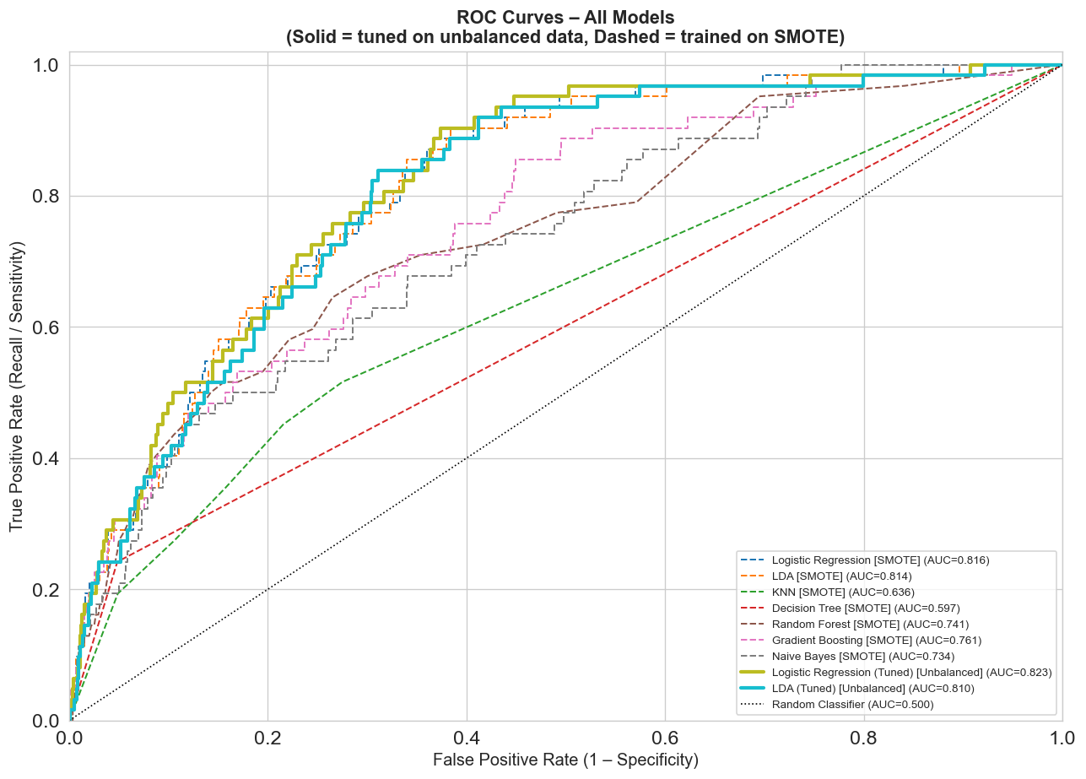
04 ROC Curves — All Models

Slide 13
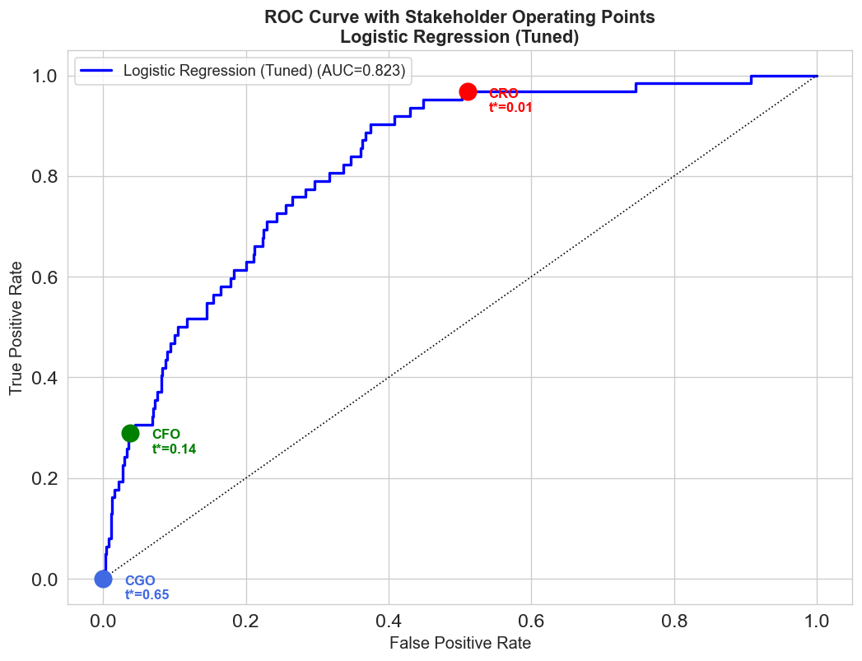
04 Why Logistic Regression?
Highest AUC (0.823)
Calibrated Probabilities
Full Transparency
Best ability to separate defaults from non-defaults across all possible thresholds
Predicted P(default) = 10% genuinely means ~10% real risk → thresholds are interpretable
Odds ratios explain exactly why each loan is approved/rejected → regulatory compliance advantage
Unlike black-box models (Random Forest, GBM),
Logistic Regression lets us explain every decision
to regulators, customers, and the CEO

Slide 14
05 Stakeholder Cost Structures
Each executive values loan outcomes differently — this drives their preferred threshold
CFO — Maria Georgiou
CRO — Andreas Konstantinou
CGO — Elena Papadopoulou
Maximize Profit
Minimize Risk
Maximize Growth
Approving a good loan: +€2,400 Approving a default: −€15,000 Rejecting a good loan: €0 Rejecting a default: €0
Approving a good loan: €0 Approving a default: −€45,000 Rejecting a good loan: −€500 Rejecting a default: €0
Approving a good loan: +€8,000 Approving a default: −€12,000 Rejecting a good loan: −€10,000 Rejecting a default: €0
Break-even: 13.8% → Reject only if >13.8% default risk
Break-even: 1.1% → Reject if >1.1% default risk
Break-even: 60.0% → Reject only if >60% default risk
Ordering: CRO (1.1%) < CFO (13.8%) < CGO (60.0%) — from most conservative to most aggressive

Slide 15
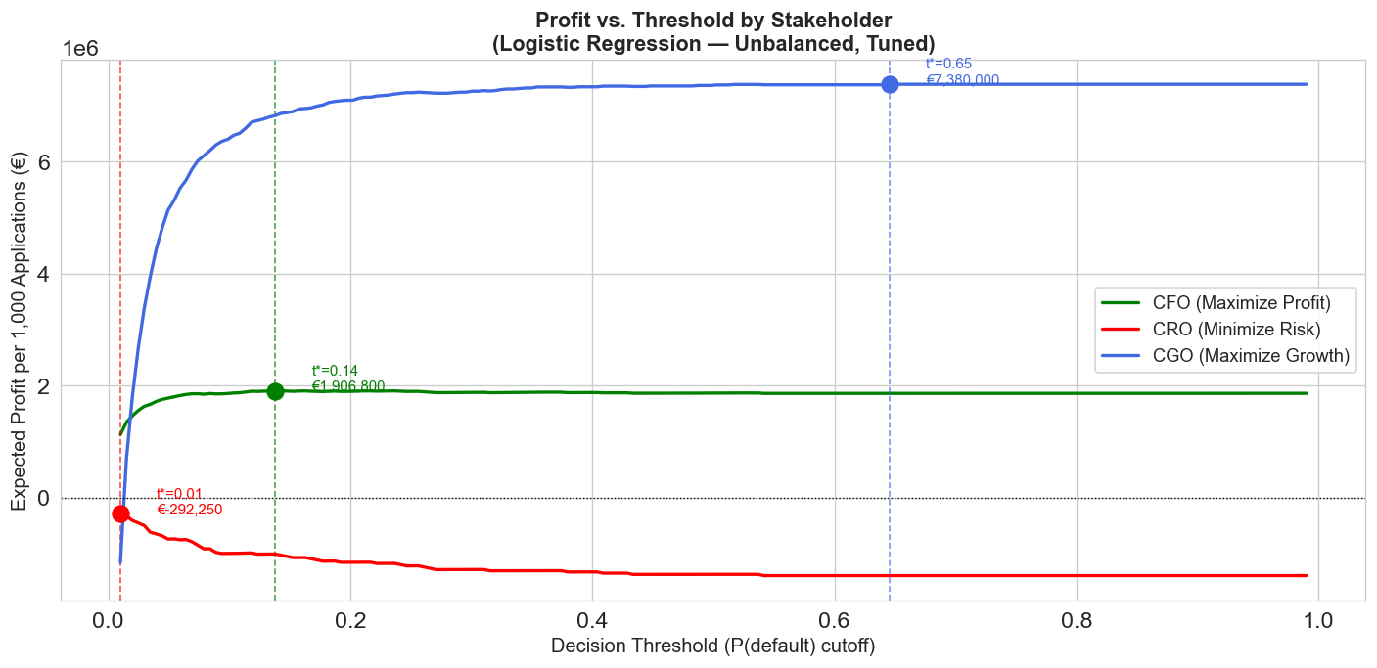
06 Threshold Optimization — Profit vs. Threshold
Optimal Thresholds:
CFO: t* = 0.14
→ €1,906,800 profit/1k apps
→ 95.4% approval rate
CRO: t* = 0.01
→ €−292,250 cost/1k apps
→ 47.6% approval rate
CGO: t* = 0.65
→ €7,380,000 growth/1k
→ 100% approval rate

Slide 16
06 Stakeholder Operating Points on the ROC Curve

Slide 17
07 Stakeholder Tradeoff Analysis
If we adopt one executive's preferred threshold, what does each stakeholder gain or lose?
Strategy | CFO €/1k | CRO €/1k | CGO €/1k | Approval % | Sensitivity | Specificity
CFO (t=0.14) | €1,906,800 | −€1,008,500 | €6,822,000 | 95.4% | 0.290 | 0.962
CRO (t=0.01) | €1,123,800 | −€292,250 | −€1,161,000 | 47.6% | 0.968 | 0.490
CGO (t=0.65) | €1,860,600 | −€1,395,000 | €7,380,000 | 100% | 0.000 | 1.000
Key Tradeoffs for the CEO:
CRO vs. CFO: Adopting the CRO's threshold costs the CFO €783,000/1k in profit,
but reduces risk exposure by €716,250/1k. Approval rate drops from 95.4% → 47.6%.
CGO vs. CFO: Adopting the CGO's threshold gains €558,000/1k in growth value,
but zero defaults are caught (sensitivity = 0%). Risk exposure worsens by €386,500/1k.
CGO vs. CRO (the extremes): Moving from CRO to CGO increases risk exposure by €1,102,750/1k.

Slide 18
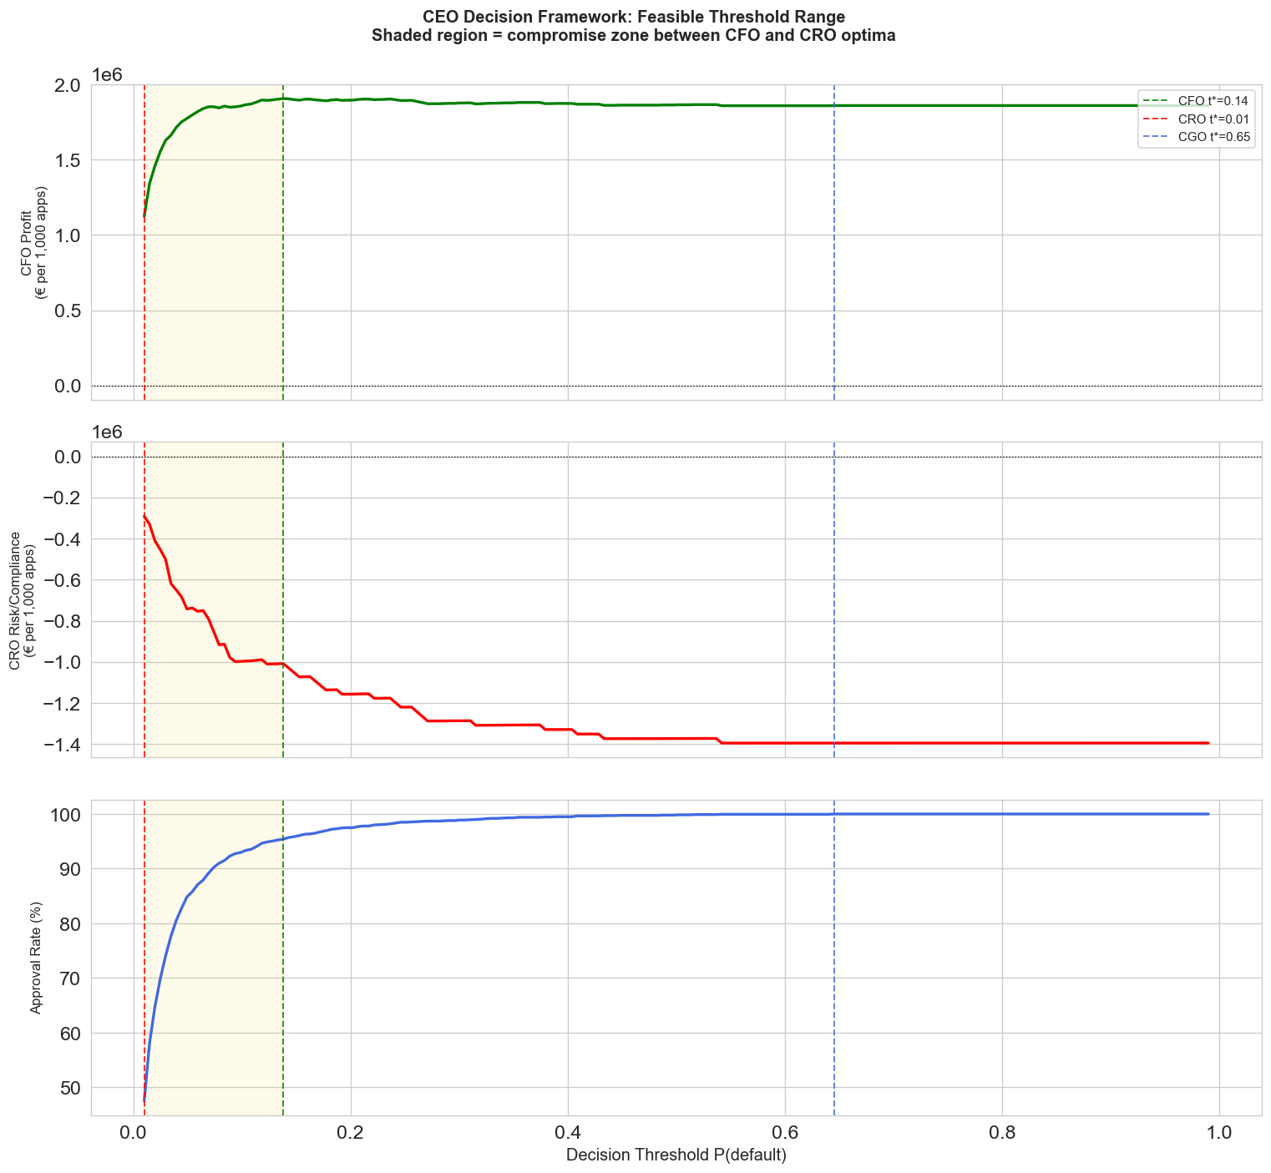
08 CEO Decision Framework
There is no single "right" threshold. The CEO must choose within a range of defensible options based on the bank's strategic priorities.
The feasible range:
CRO extreme → t = 0.01
CFO optimum → t = 0.14
CGO extreme → t = 0.65
Gold zone: compromise
region between CRO & CFO
where small profit sacrifices
yield large risk reductions
The threshold is NOT fixed —
it's a dynamic control lever

Slide 19
08 Finding the "Cheap Compromises"
Moving from the CFO's optimum (t=0.14) toward the CRO (t=0.01):
Threshold | CFO €/1k | CRO €/1k | CGO €/1k | Approval % | CFO Cost | CRO Gain
0.138 (CFO) | 1,906,800 | −1,008,500 | 6,822,000 | 95.4% | — | —
0.120 | 1,899,900 | −989,000 | 6,720,000 | 94.8% | −€6,900 | +€19,500
0.101 | 1,862,700 | −996,750 | 6,441,000 | 93.2% | −€44,100 | +€11,750
0.065 | 1,844,700 | −749,250 | 5,703,000 | 88.1% | −€62,100 | +€259,250
0.047 | 1,761,900 | −682,750 | 4,881,000 | 83.2% | −€144,900 | +€325,750
0.028 | 1,604,100 | −506,250 | 3,195,000 | 73.0% | −€302,700 | +€502,250
0.010 (CRO) | 1,123,800 | −292,250 | −1,161,000 | 47.6% | −€783,000 | +€716,250
Key Insight:
Moving from t=0.14 to t=0.12 costs CFO only €6,900 but gains €19,500 in risk reduction
→ This is a high-value, low-cost compromise the CEO should consider
The marginal cost of further tightening accelerates — diminishing returns below t ≈ 0.05

Slide 20
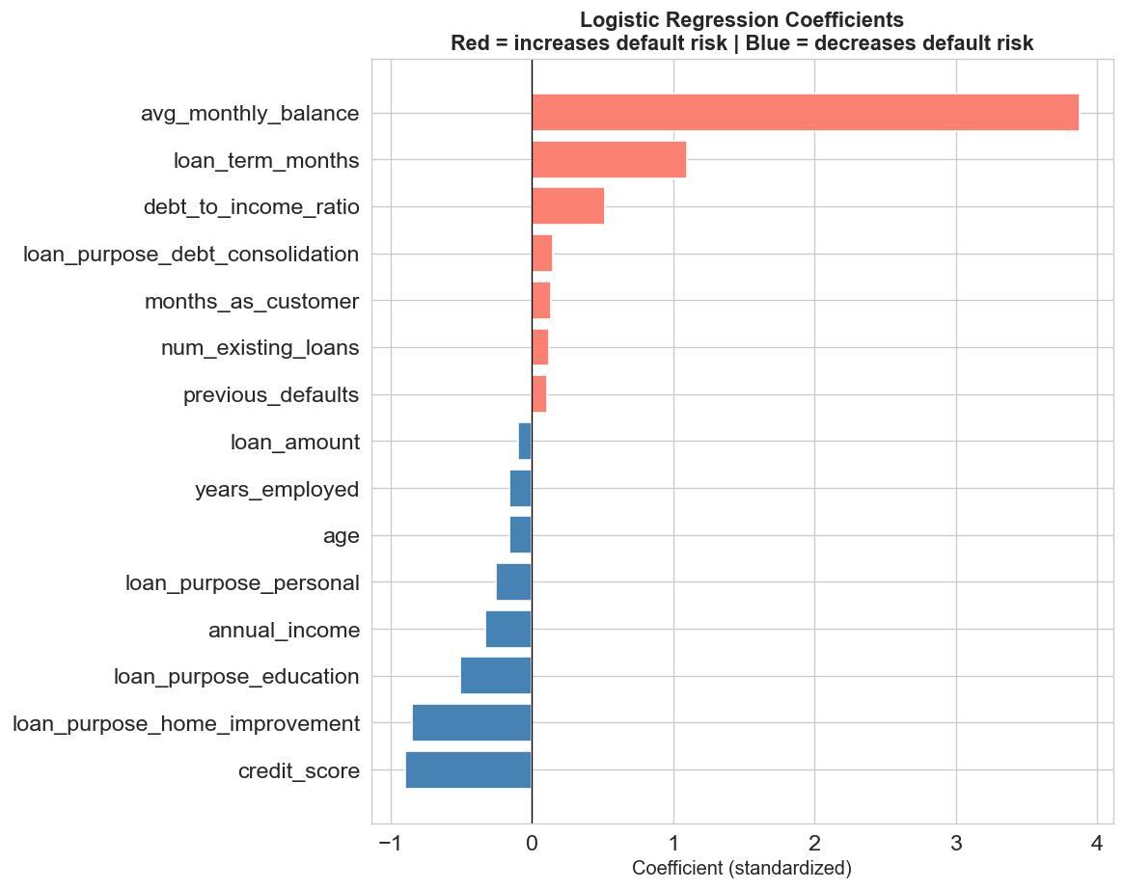
08 What Drives Default Risk — Model Interpretability
Top Risk Factors (increase default risk):
• avg_monthly_balance — strongest risk signal
• loan_term_months — longer terms = higher risk
• debt_to_income_ratio — moderate risk signal
Top Protective Factors (decrease default risk):
• credit_score — strongest protection
• home_improvement purpose — lower risk
• education purpose — lower risk
Why this matters for the CEO:
For CRO → risk flags are exactly what regulators watch
For CGO → protective factors identify safe customers to approve
For CFO → risk is concentrated in specific profiles,
enabling targeted rules rather than blanket rejection

Slide 21
09 Post-Deployment Monitoring & Threshold Management
The threshold is a dynamic control lever — not a one-time decision
Default Rate Tracking
Cost Sensitivity
Model Performance
Threshold Recalibration
Monitor monthly default rate vs. ~3% baseline If default rate > 3.5%: → Shift threshold toward CRO (tighter) If default rate < 2.5%: → Consider relaxing toward CFO/CGO
Monitor changes in cost assumptions If regulatory penalties increase: → Move threshold lower (more conservative) If customer lifetime value grows: → Move threshold higher (more approvals) Re-evaluate quarterly
Track AUC and feature distributions monthly If AUC drops below 0.75: → Retrain model on fresh data Monitor credit_score & debt_to_income distributions for drift
CEO treats threshold as movable within the feasible range (≈ 0.01 – 0.14) Adjust based on: • Current risk tolerance • Regulatory pressure • Growth targets • Macroeconomic conditions

Slide 22
09 Decision Trigger Rules
Connecting metrics to concrete actions:
Trigger Condition | Action | Direction
Default rate rises above 3.5% | Tighten threshold | → Move toward CRO (lower t)
Default rate drops below 2.5% | Consider relaxing threshold | → Move toward CFO (higher t)
Profit declining but risk stable | Re-optimize for profit | → Move toward CFO optimum
Loan approvals stagnating / growth down | Relax threshold | → Move toward CGO (higher t)
Regulatory penalties increase by >20% | Shift threshold left | → More conservative
Customer lifetime value increases | Shift threshold right | → More approvals
Model AUC drops below 0.75 | Retrain model entirely | → New model + recalibrate
Macro shift (recession, policy change) | Full threshold review | → CEO convenes stakeholders

Slide 23
Summary & Recommendation
1. We built a transparent, calibrated Logistic Regression model (AUC = 0.823)
that separates defaulting from non-defaulting borrowers effectively.
2. Three stakeholders have fundamentally different optimal thresholds:
• CRO: t = 0.01 (reject almost all risk → 47.6% approval, catches 96.8% of defaults)
• CFO: t = 0.14 (maximize profit → 95.4% approval, catches 29.0% of defaults)
• CGO: t = 0.65 (approve everyone → 100% approval, catches 0% of defaults)
3. The threshold is not a fixed number — it is a dynamic control lever within a range
of defensible options (~0.01 to ~0.14). The CEO adjusts based on strategic priorities.
4. "Cheap compromises" exist: moving from t=0.14 to t=0.12 costs the CFO only €6,900
but reduces risk exposure by €19,500 — high-value, low-cost middle ground.
5. Post-deployment: monitor default rates, cost assumptions, and model performance.
Specific trigger rules (e.g., default > 3.5% → tighten, AUC < 0.75 → retrain)
keep the system adaptive and aligned with evolving bank strategy.

Slide 24
Thank You
Questions?
Alexandros Panayi · Maria Michaelidou · Thanasis Kalos

