Slide 1
MECOP Presentation
Second Internship
Summer - Fall 2017
Dylan Hewitt

Slide 2

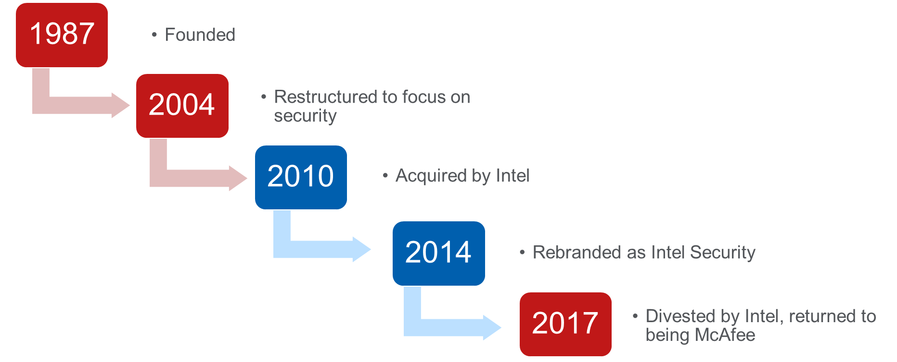
McAfee History

Slide 3

Time and Money
Hours
Standard 40 hours/week
Flexible schedule
Overtime rate
Work from home if needed
Compensation
Paid holidays
2 floating holidays
4.6 hours of PTO/pay period

Slide 4
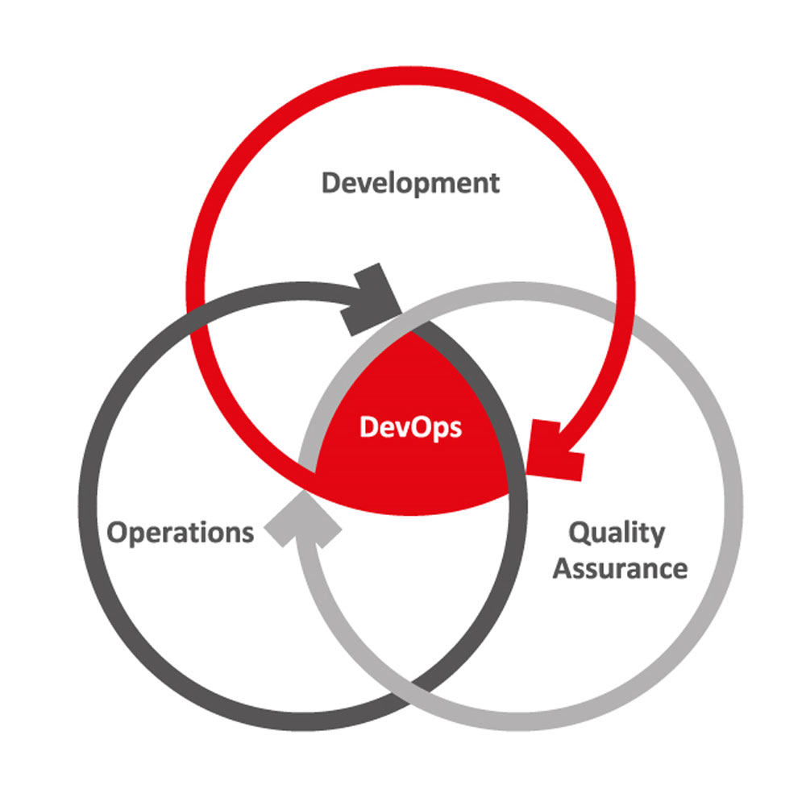
DevOps
What is it?
Operations and development engineers participating together in the entire service lifecycle.
Rapid Delivery
Continuous Integration
Continuous Delivery
Communication

Slide 5
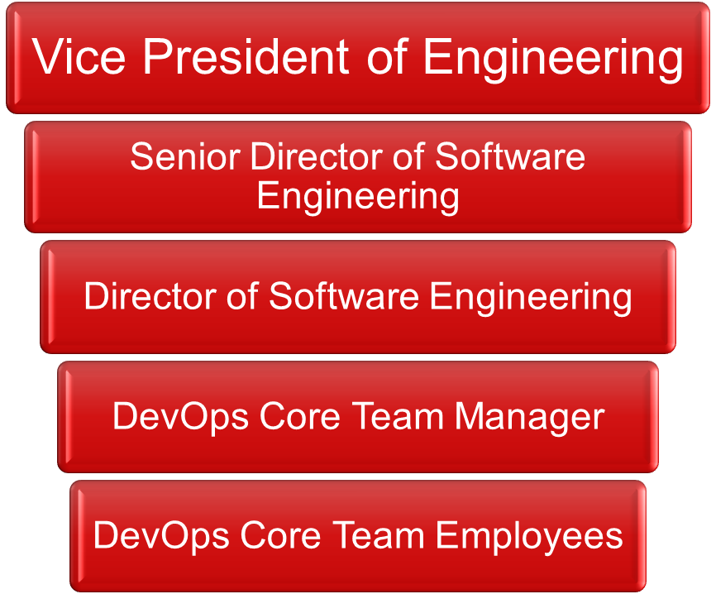
The DevOps Team
Twice weekly Scrum meeting
Monthly all-employee conference
Interact with
  Multiple departments
  Employees around the world
    Occasional 6am meetings

Slide 6
Projects
Fixed build servers
Virtual Machine Decommissioning
Virtual Machine creation and configuration
VM database information gathering
Server patching
Operational Maturity Matrices
Malware scanning system update/cleaning
Process definition documentation

Slide 7
Most Valuable Projects
Fixing build servers
  Broken build servers delay releases
  Delayed releases upset customers
Cleaning samples from malware scanners
  No space for new samples
  Can’t process new virus samples from customers
Server patching
  Mitigate potential vulnerabilities
  Prevent issues from occurring in the first place

Slide 8

Useful Courses
Junior/Senior Project
UNIX
Documentation
Tech Writing
Computer Networks
Speech

Slide 9
1st and 2nd Internships
First – Portland General Electric PSES
Second – McAfee DevOps
Downtown Portland
Occasional travel for work
Mostly independent work
Same people involved in all projects
Projects
  Change Management API
  Audit Preparation
  Data Processing Scripts
  Quickbase User Guide
Hillsboro
Most projects require communication
Work with multiple team members/ departments
Smaller projects, but also a wider range
Relaxed dress code
Board game Fridays

Slide 10
Takeaways
Important Skills
Technical
Professional
Virtual Machines
Linux command line
Sharepoint
JIRA
McAfee tools and products
Automation tools
Time Management
Communication
  Ask for help if you need it
  Design Specs

Slide 11
Questions?

