Slide 1
Processor Defense
Alex Penne
ECE350, Spring 2024
March 29, 2024

Slide 2
Contents
Baby CPU
pipelining structure, mult/div preparation
Hazardous CPU
the terrible mult/div, early branching
Complete CPU
easy bypassing, hard stalling
Testing and Bugs

Slide 3
Baby CPU
Latch | Pass Through Values
F/D | Current Insn, PC
D/X | Current Insn, PC, into ALU A, into ALU B, isMult, isDiv
X/M | Current Insn, PC, ALU Output, ALU Exceptions
M/W | Handled by Wrapper (data_writeReg, ctrl_writeReg, ctrl_writeEnable)
making latches (DFFs)
running numbers testbench
pass through table (prevent extra decoding)
prepping for a mult/div stall
add stalling to running numbers testbench
adding my alu
running smoothly, minimal debugging

Slide 4
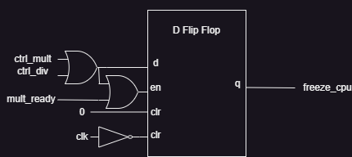
Hazardous CPU
spent most time fixing mult/div
fix mult/div_on signal latch
latching mult/div_on wire
enable DFF logic
don’t skip an insn
halt entire processor (will suck later)
early branching
determine if branching in decode (more alus)
if branch, insert only one nop
more efficient cpu, more hardware needed

Slide 5

Complete CPU
bypassing multiplexers
used “one-hot” multiplexers
got lucky with only needing 32-bit multiplexers (5-inputs)
would change if more time
stalling changes
needed stall that only stopped F/D, D/X (unlike mult/div)

Slide 6
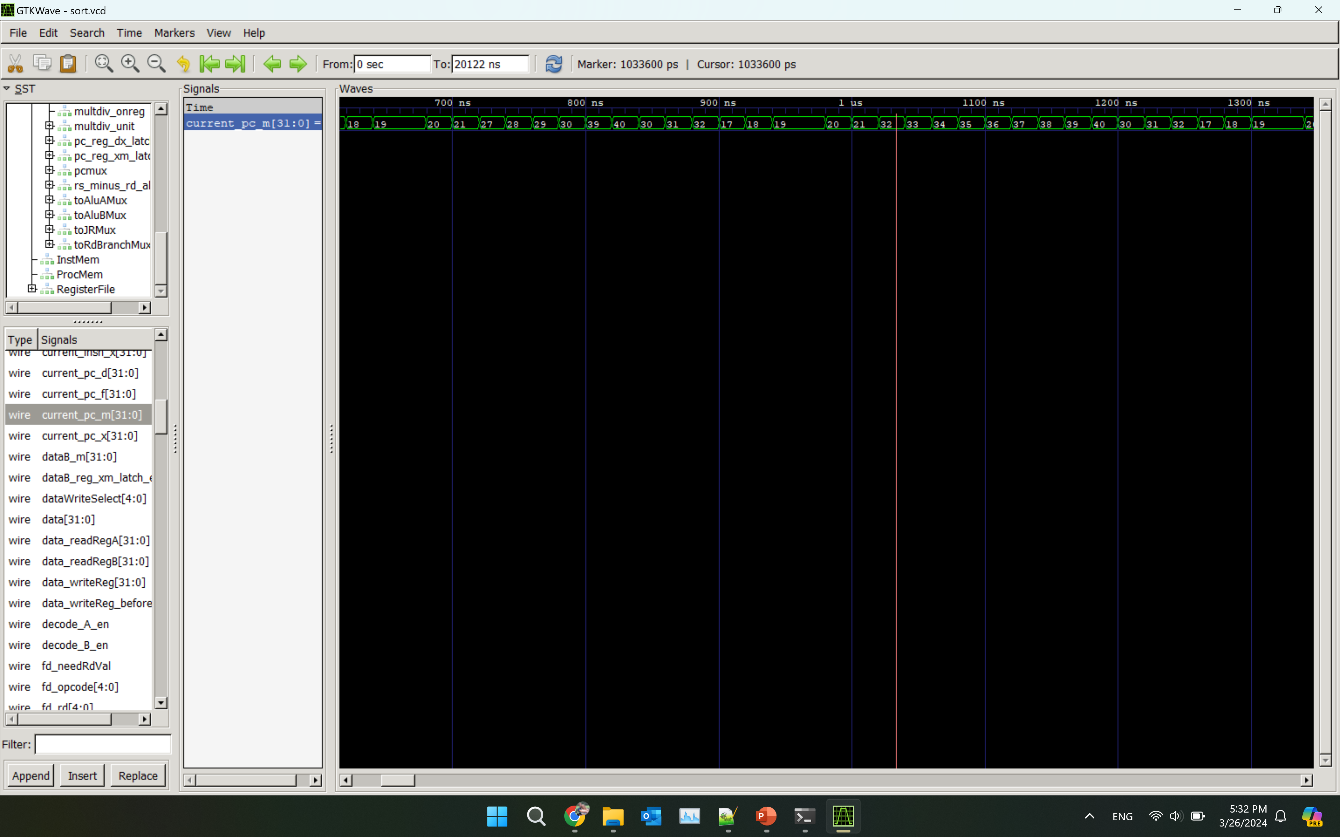
Testing and Bugs
made testbenches for every instruction
used gradescope test cases to finalize (no long uploading)
passing all tests except for sort (0/10)
stuck in a never-ending loop in malloc
branch won’t bypass without skipping next instruction
works for sort debug tests and branch bypassing tests
if more time, would try and fix
solution: add nops when branching for final project

