Slide 1

TREES DATA QYALITY ASSESSMENT
BY ALEKSANDAR PESHEV

Slide 2
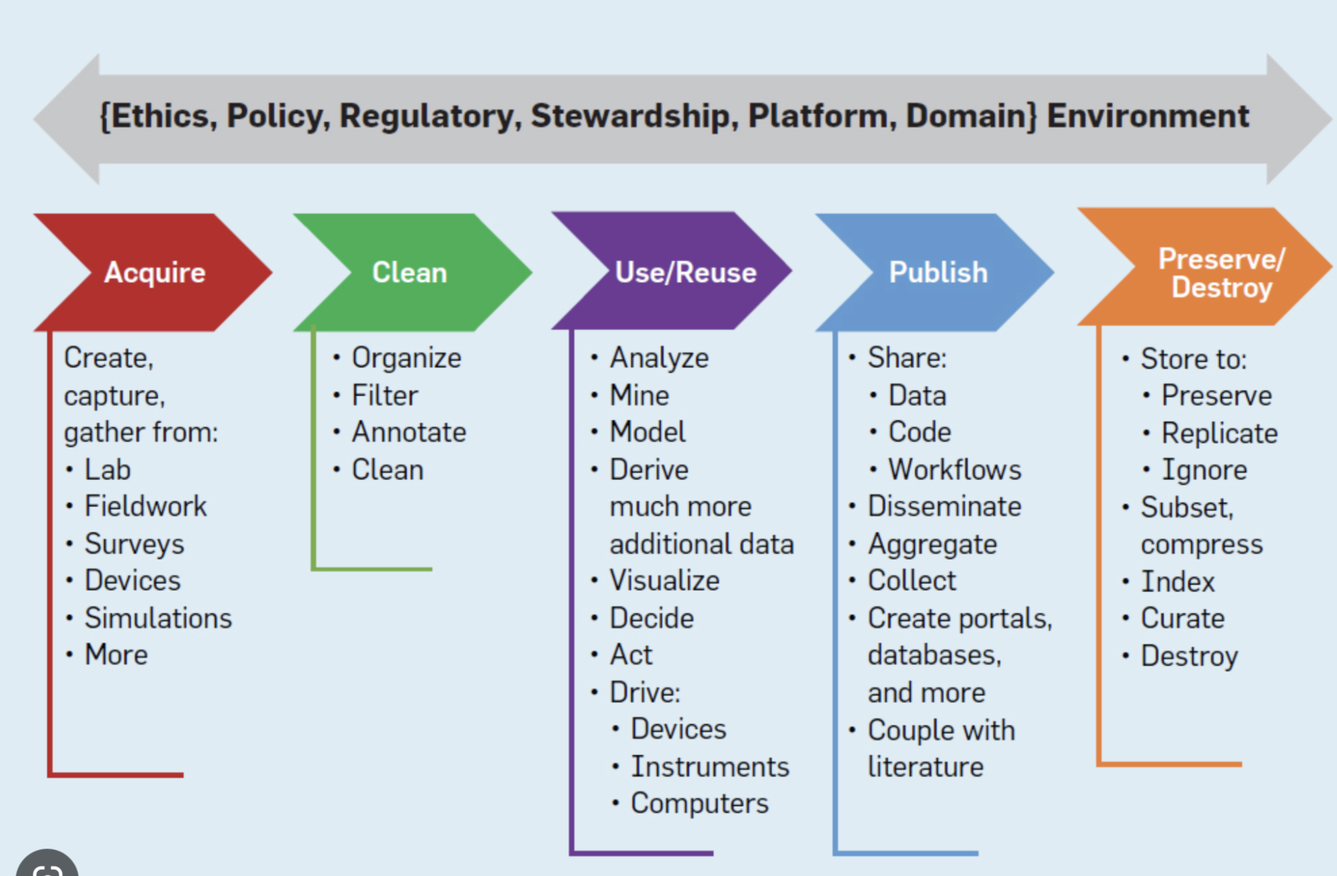
DATA ANALYSIS LIFECYCLE
How does this project fit into a broader data lifecycle?

Slide 3
Data Acquisition
What are the different ways that you created or acquired data for this project? - Web scraping, Downloaded form website, Acquired/extracted from a database
Could your analysis be used to update the original data at its source? If so, what are the challenges? If not, why not? - Data usage or re-usage/updating
What is the impact of the different sensitivity and ownership scenarios that you captured in the data source list? - Privacy and ownership of data

Slide 4
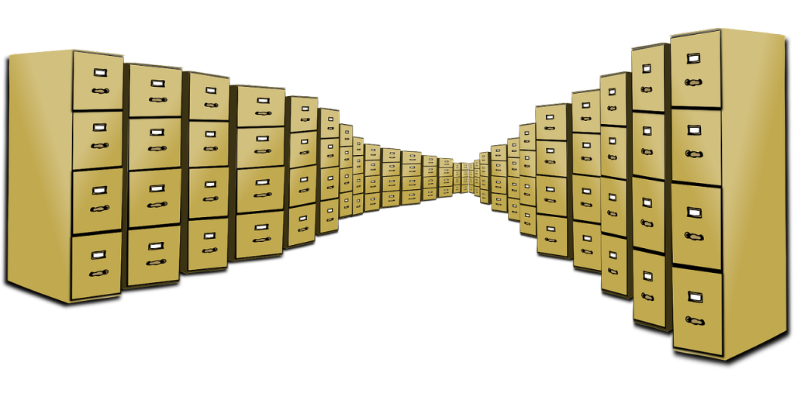
Requirements

Slide 5
Requirements - How does this project fit into a broader data lifecycle?
How would the data requirements you produced help the council understand the feasibility of the three initiatives? - Understanding of data feasibility
Are there any limitations in the data which may prevent the requirements from being met? - Limitations
When classifying the data columns as qualitative/quantitative and binary/nominal/ordinal and discrete/continuous, were there any situations where the classification was ambiguous? How did you resolve the ambiguity? - Data categorization

Slide 6
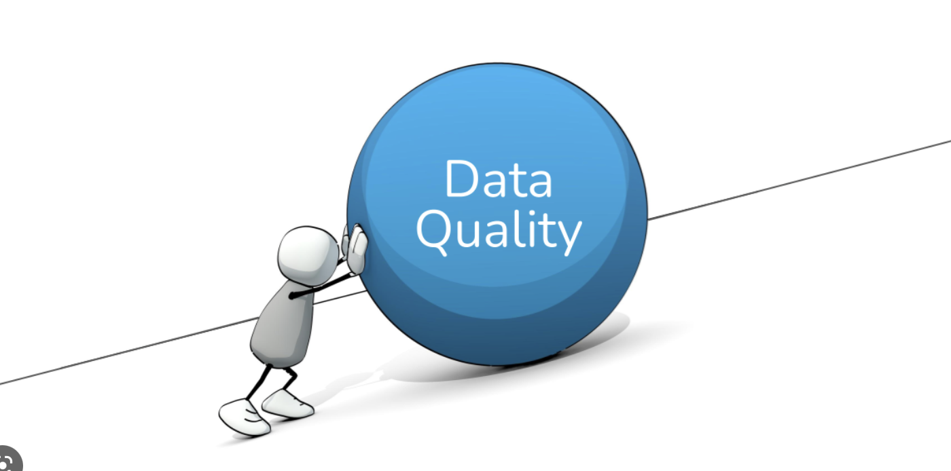
Quality

Slide 7
Quality
How did you approach evaluating the data quality, and how did you record the issues you identified? - Evaluation of data quality
Reflect on how the data quality might impact the council’s ability to meet the requirements of the initiatives. - Reflection on data quality impact
What are the risks to the council of having poor quality data? In other words, what could be the impact if they don’t improve the data quality? - Risks in regard to poor data quality
What challenges did you encounter with combining the 3 different data files for this project? - Challenges from combining three different data sources
What risks should an analyst be aware of when acquiring data from different sources? Risks Analysts should be aware when acquiring data from different sources

Slide 8
Statistics (the meaning of boxplot, scatter plot, histograms)
Boxplot
Scatter Plot
Histograms

Slide 9
https://cacm.acm.org/magazines/2020/7/245700-the-data-science-life-cycle/abstract
https://www.businessbullet.co.uk/business-analysis/gathering-data-requirements/
https://lakefs.io/blog/data-quality-testing/
https://pressbooks.montgomerycollege.edu/statcalcs/chapter/graphs-boxplots-dotplots-histograms-scatterplots/
https://en.wikipedia.org/wiki/Imputation_(statistics)

Slide 10


