Slide 1

Project Insights Visualization
By Aleksandar Peshev

Slide 2
Introduction to Dental Pharma Project
This document consists of an overview of the Dental Pharma Data Visualization document created by Aleksandar Peshev.
The first part will cover an overview of the aspect of the data lifecycle used for the creation of the Dental Pharma Dashboards.
The next part will cover an overview of the requirements used for designing the dashboards and production of a final data product.
Lastly, I have included a couple of slides containing different visualizations based on the requirements as well links underneath each one of them. Furthermore, I also included all links in the reference list. There will also be an overview of the other visualizations created based on the requirements in Tableau.
The visualizations included are:
Main dashboard containing map of the regions and countries, as well as table with information about the projects, and four bar charts with countries over duration, countries over cost, and countries under delivering which have an option for the general, regional and local managers to select their location.
The second one is a bar chart visualizing countries that went over duration based on a parameter chosen by the user, currently is filtering between -1% and 168%, for central, eastern and western Europe/Africa.
The last two contain dashboards showing Planned vs actual duration, and planned vs actual cost per country - This is a collection of bar charts showing comparison of the duration per country, where it allows regional, general, country management to select from various countries and measures. Therefore, the user will have the ability to review and compare the different measures per country or for a certain or all countries and regions.

Slide 3
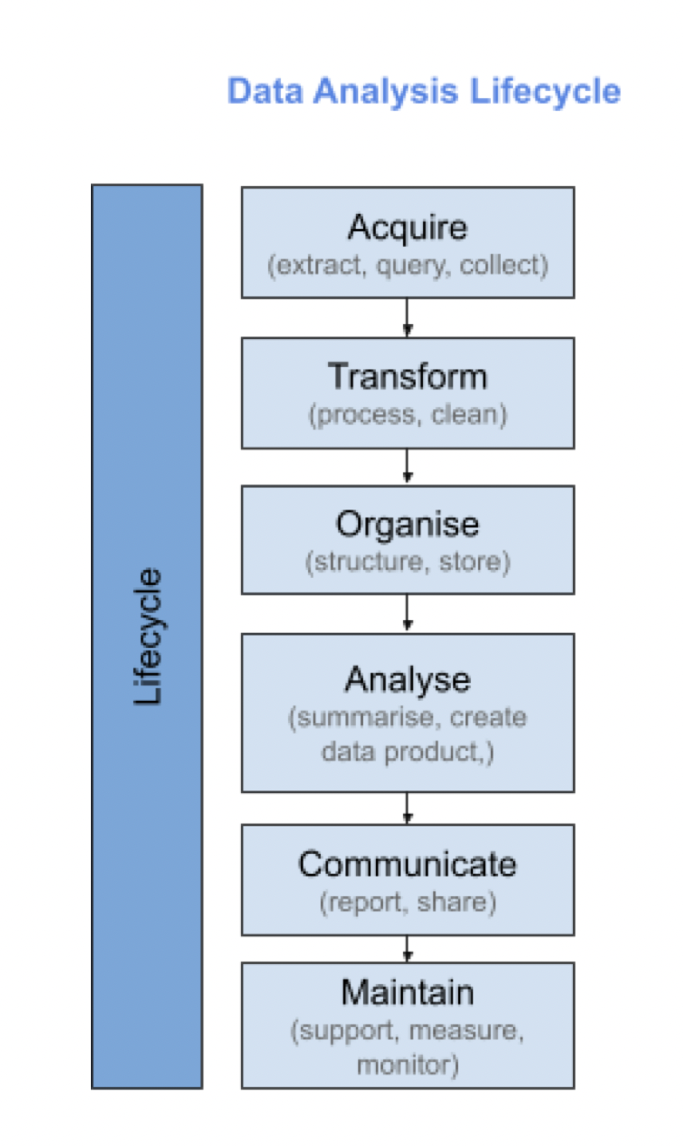
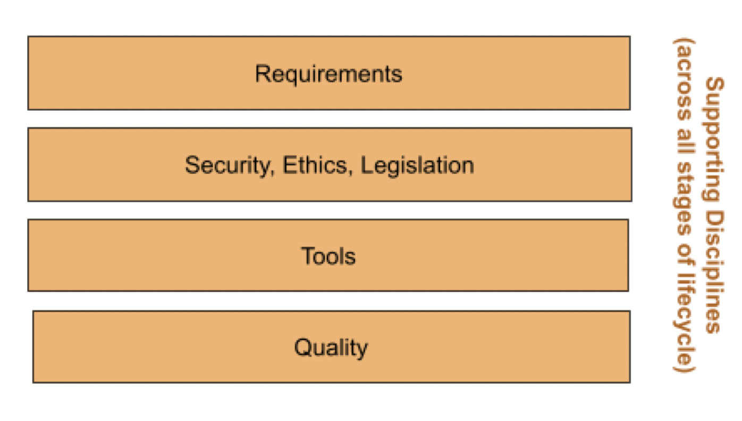
“Lifecycle”

Slide 4
“Lifecycle”
• Which aspects of the data analysis lifecycle are you primarily involved with in this project? –
The data was Acquired by extraction in the form of CSV format.
After that Transformed into an Excel file.
Organized and cleaned (although it was pretty clean, apart from some minor things), it is also stored in an Excel spreadsheet and Tableau public server.
It was loaded in Tableau and then used to generate reports, and produced a final data product.
The data was communicated in a form of a dashboard and shared to Dental Pharma business executives.
Maintain if the client requires any further changes.
However the main stages that are concerned with the project are analysis in Tableau and communicating the results with Dental Pharma’s executives.
What activities would you need to do before undertaking this project? - To source it from the internet. The data was in a raw data format so it needed to be extracted from the web in the form of a CSV file. It was afterwards loaded and organized in Excel format. The data sets were very clean so the project data required a minimal cleansing. There was a slight duplication of Belarus projects without the project ID that needed to be removed from the dataset, and some of the years needed to be corrected because the number wasn’t completed.
What would you need to do if the data changed? – Because the project’s visualizations were primarily done in Tableau, the results were created by saving to Tableau Public’s servers. If new data was brought in then the dashboard needed to be connected to the new data source, and upload the new data but the main way is by If you are connected to a data source that has been modified, you can immediately update Tableau Desktop with the changes by selecting a data source on the Data menu and then selecting Refresh.

Slide 5
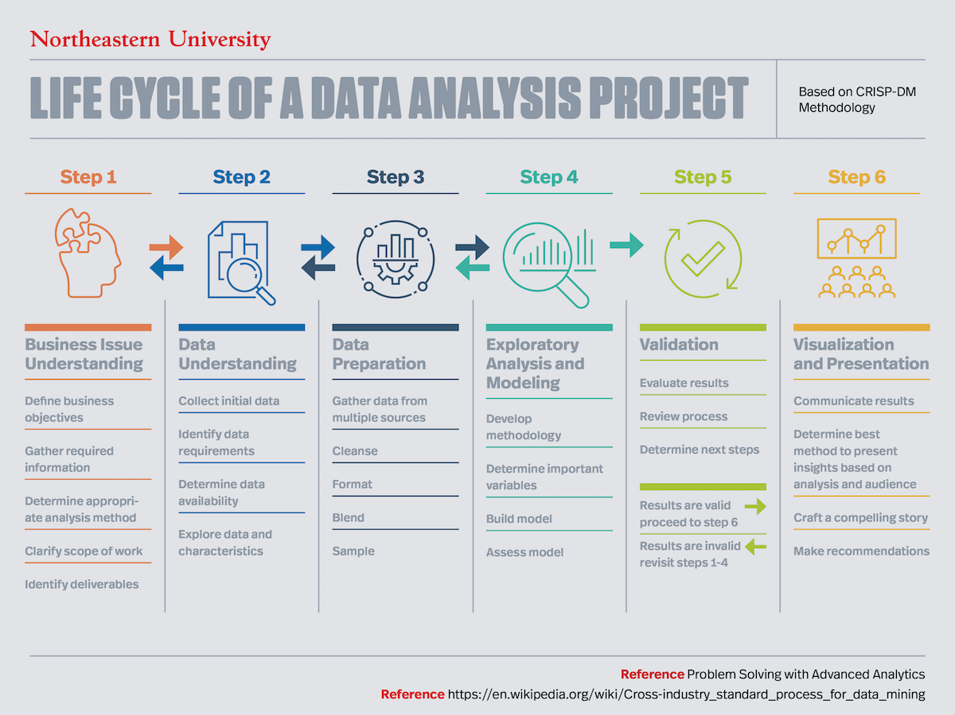

Slide 6
“Requirements”
Summarize the process you used from the business requirements to a clear - I spoke to the stakeholders at hand (Sophie). Followed the blueprint and notes from the meeting. After Understanding the Data Set, I used Excel to convert the CSV files into ordered data files. After this I performed a minor cleaning and loaded them into Tableau where I continued building the dashboard.
How would you make sure this design actually met the needs of the business? – Regular communication with the stakeholders and Sophie, as well as I followed Andrea’s instructions. Getting Sophie’s approval for the project. I have filled out a dashboard blueprint. I read the meeting notes. I also did a blueprint which was okayed by Sophie. I followed the instructions and communicated with Sophie back and forth.
What other techniques could you use to make the design clearer? -I used a lot of colour in some of the graphs and dashboards in order to ensure they are interactive.
Build a model (the UX mock up), Prototyping, Storyboarding, Figma.

Slide 7
“Requirements”
To understand the business issues and the data set
Reviewed, prepare and cleanse the data.
Build a model ( the UX mockup)
Validate and visualize the data
Design is approved by the stakeholders
Prototyping
Storyboarding
Figma

Slide 8
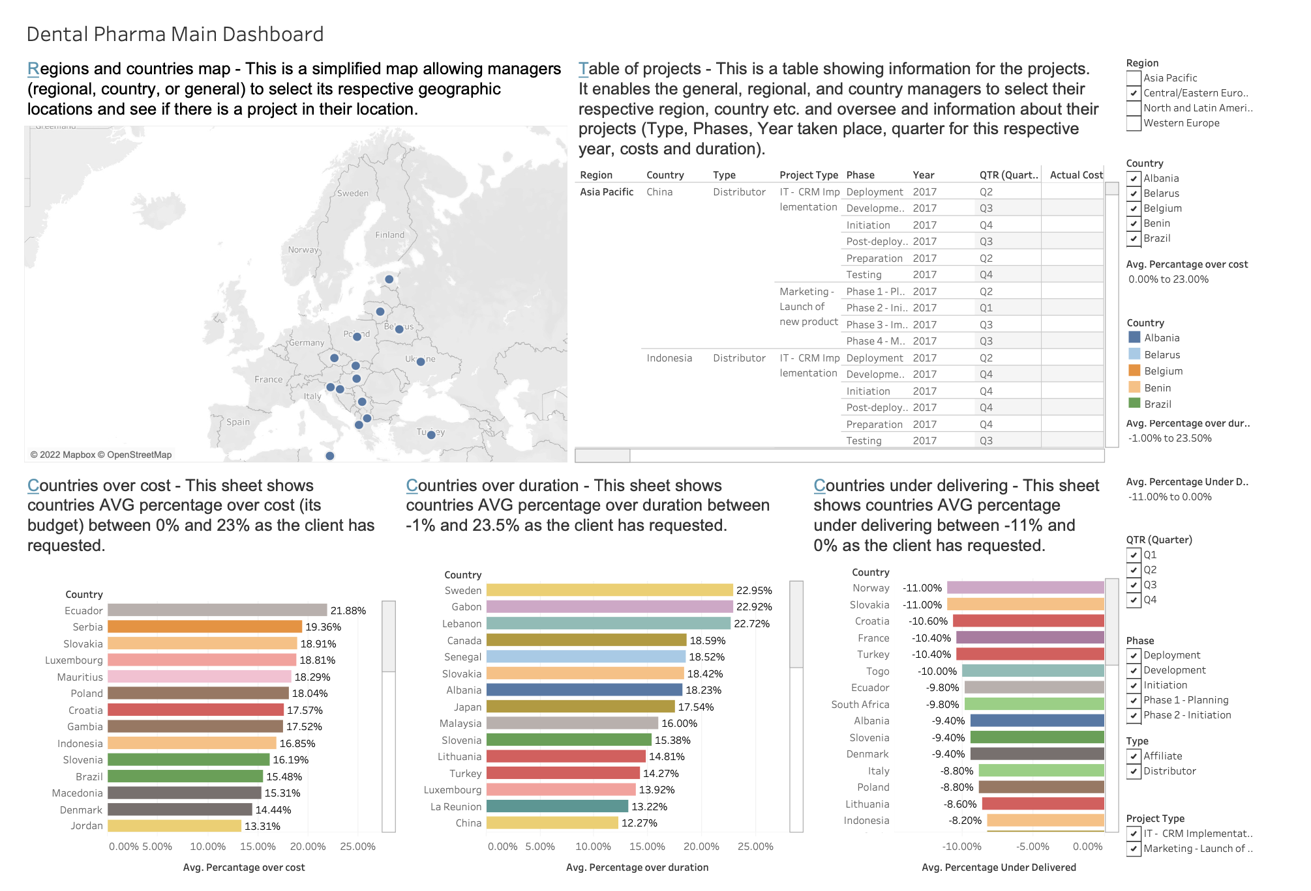
Dental Pharma Main Dashboard
https://public.tableau.com/app/profile/aleksandar.peshev/viz/DentalPharmaCountriesThatWentOverDuration/Countriesoverdurationbycertain

Slide 9
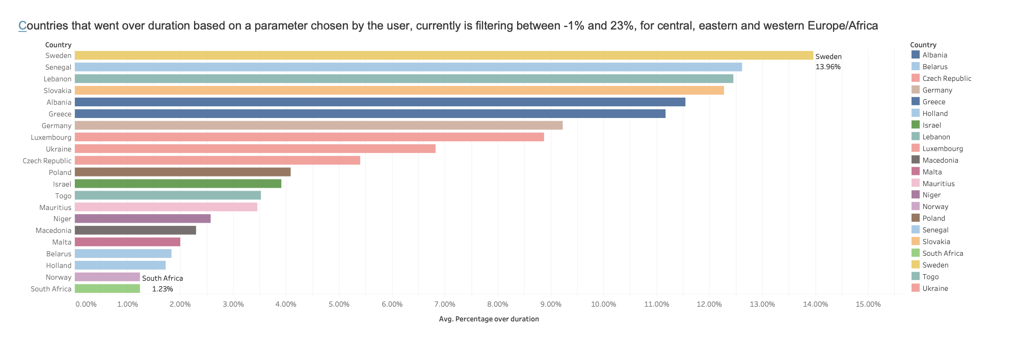
Dental Pharma Countries over duration Dashboard
https://public.tableau.com/app/profile/aleksandar.peshev/viz/DentalPharmaCountriesoverduration/Countriesoverdurationbycertain

Slide 10
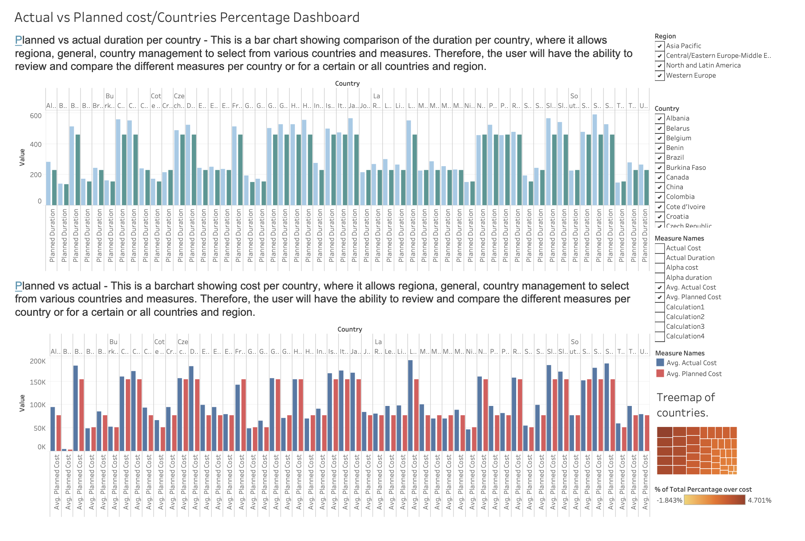
Dental Pharma Actual vs Planned Cost
https://public.tableau.com/app/profile/aleksandar.peshev/viz/DentalPharmaActualvsPlannedCost/Measuresdashboard

Slide 11
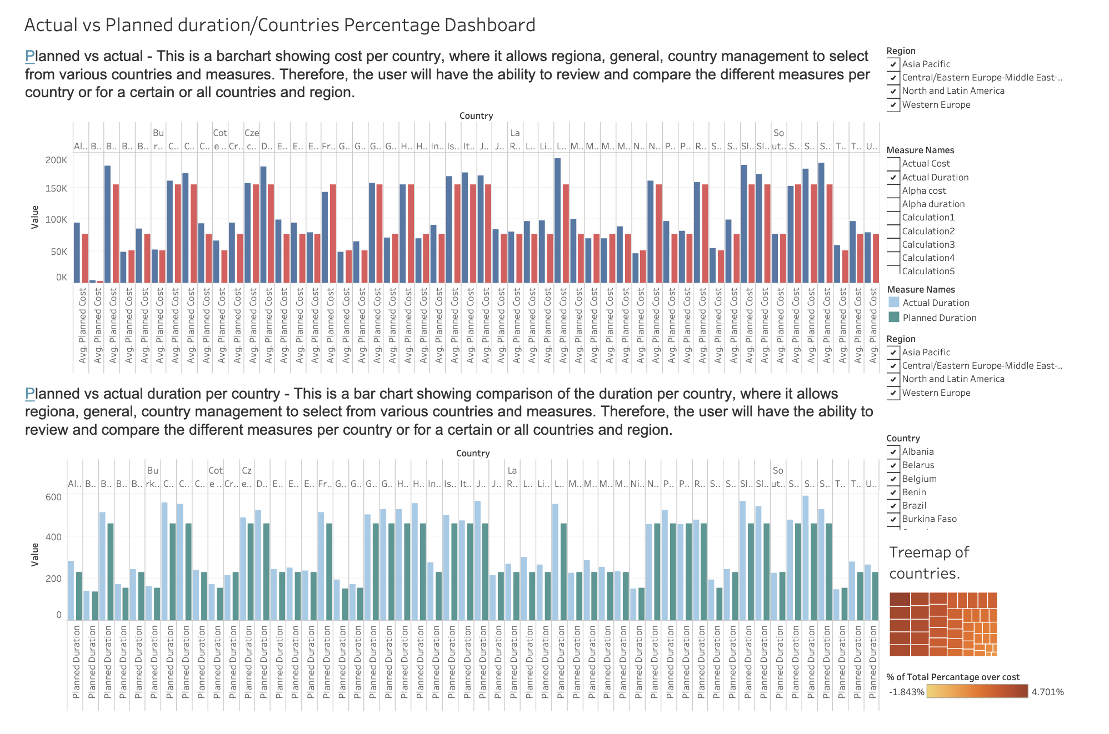
Dental Pharma Actual vs Planned Duration
https://public.tableau.com/app/profile/aleksandar.peshev/viz/DentalPharmaActualvsPlannedDuration/Measuresdashboard2

Slide 12
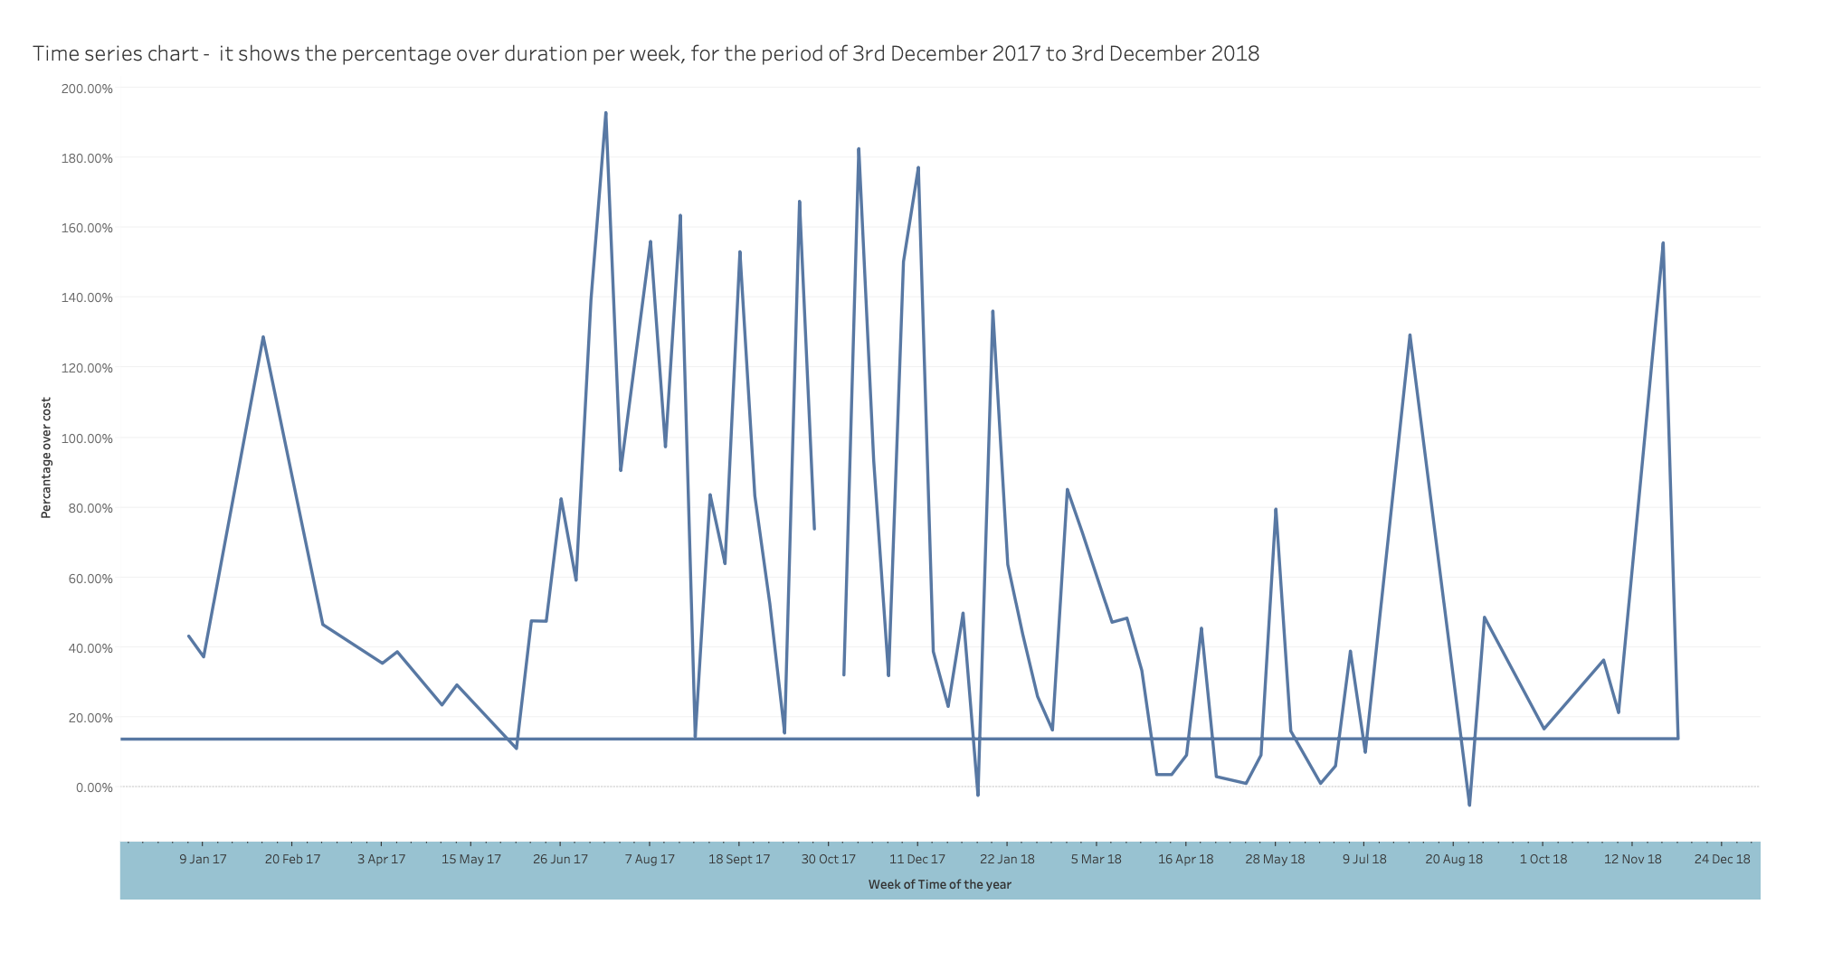
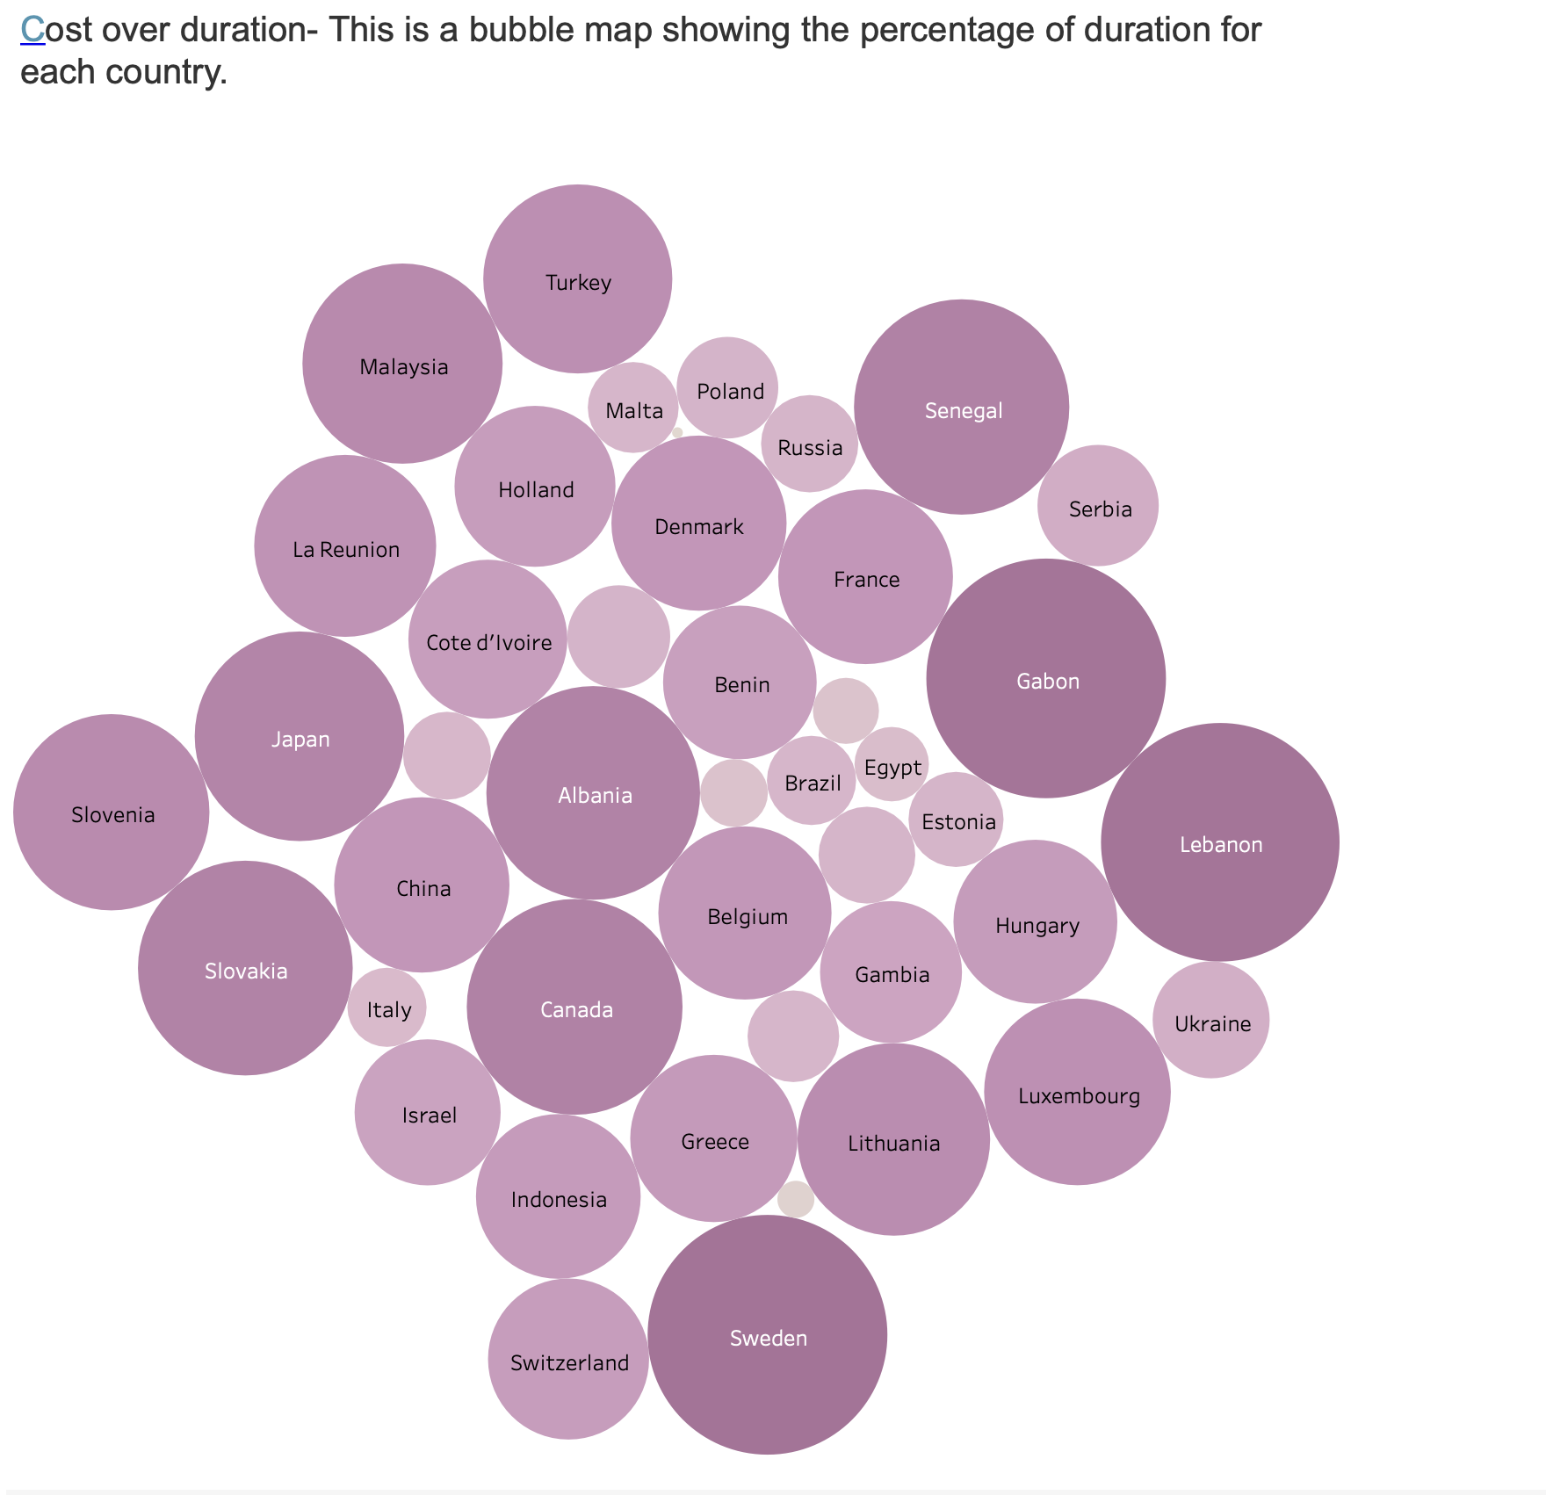
Dental Pharma Time Series and Bubble Map
https://public.tableau.com/app/profile/aleksandar.peshev/viz/DentalPharmaTimeSeries/Timeseries
https://public.tableau.com/app/profile/aleksandar.peshev/viz/DentalPharmaBubbleMap/Costoverbubble

Slide 13
References
https://www.northeastern.edu/graduate/blog/data-analysis-project-lifecycle/
https://towardsdatascience.com/excel-tableau-power-bi-what-should-you-use-336ef7c8f2e0
https://s3.eu-west-1.amazonaws.com/course.oc-static.com/projects/DAN_UK_App_P1/Data+Lifecycle.pdf
https://public.tableau.com/app/profile/aleksandar.peshev
https://public.tableau.com/app/profile/aleksandar.peshev/viz/DentalPharmaCountriesThatWentOverDuration/Countriesoverdurationbycertain
https://public.tableau.com/app/profile/aleksandar.peshev/viz/DentalPharmaCountriesoverduration/Countriesoverdurationbycertain
https://public.tableau.com/app/profile/aleksandar.peshev/viz/DentalPharmaActualvsPlannedCost/Measuresdashboard
https://public.tableau.com/app/profile/aleksandar.peshev/viz/DentalPharmaActualvsPlannedDuration/Measuresdashboard2
https://help.tableau.com/current/pro/desktop/en-us/refreshing_data.htm
Https://public.tableau.com/app/profile/aleksandar.peshev/viz/DentalPharmaTimeSeries/Timeseries
https://public.tableau.com/app/profile/aleksandar.peshev/viz/DentalPharmaBubbleMap/Costoverbubble

Slide 14



