Slide 1


Introduction to DataSpace BI Tools and Data Lifecycle
An overview of Tableau, SQL, Python and Data Lifecycle

Slide 2
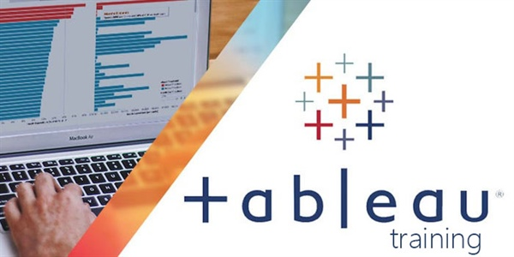

Slide 3
Tableau overview
Sophisticated BI platform
The idea is for everyone to be able to use Tableau
They have number of software products
Tableau Public vs Tableau Desktop

Slide 4
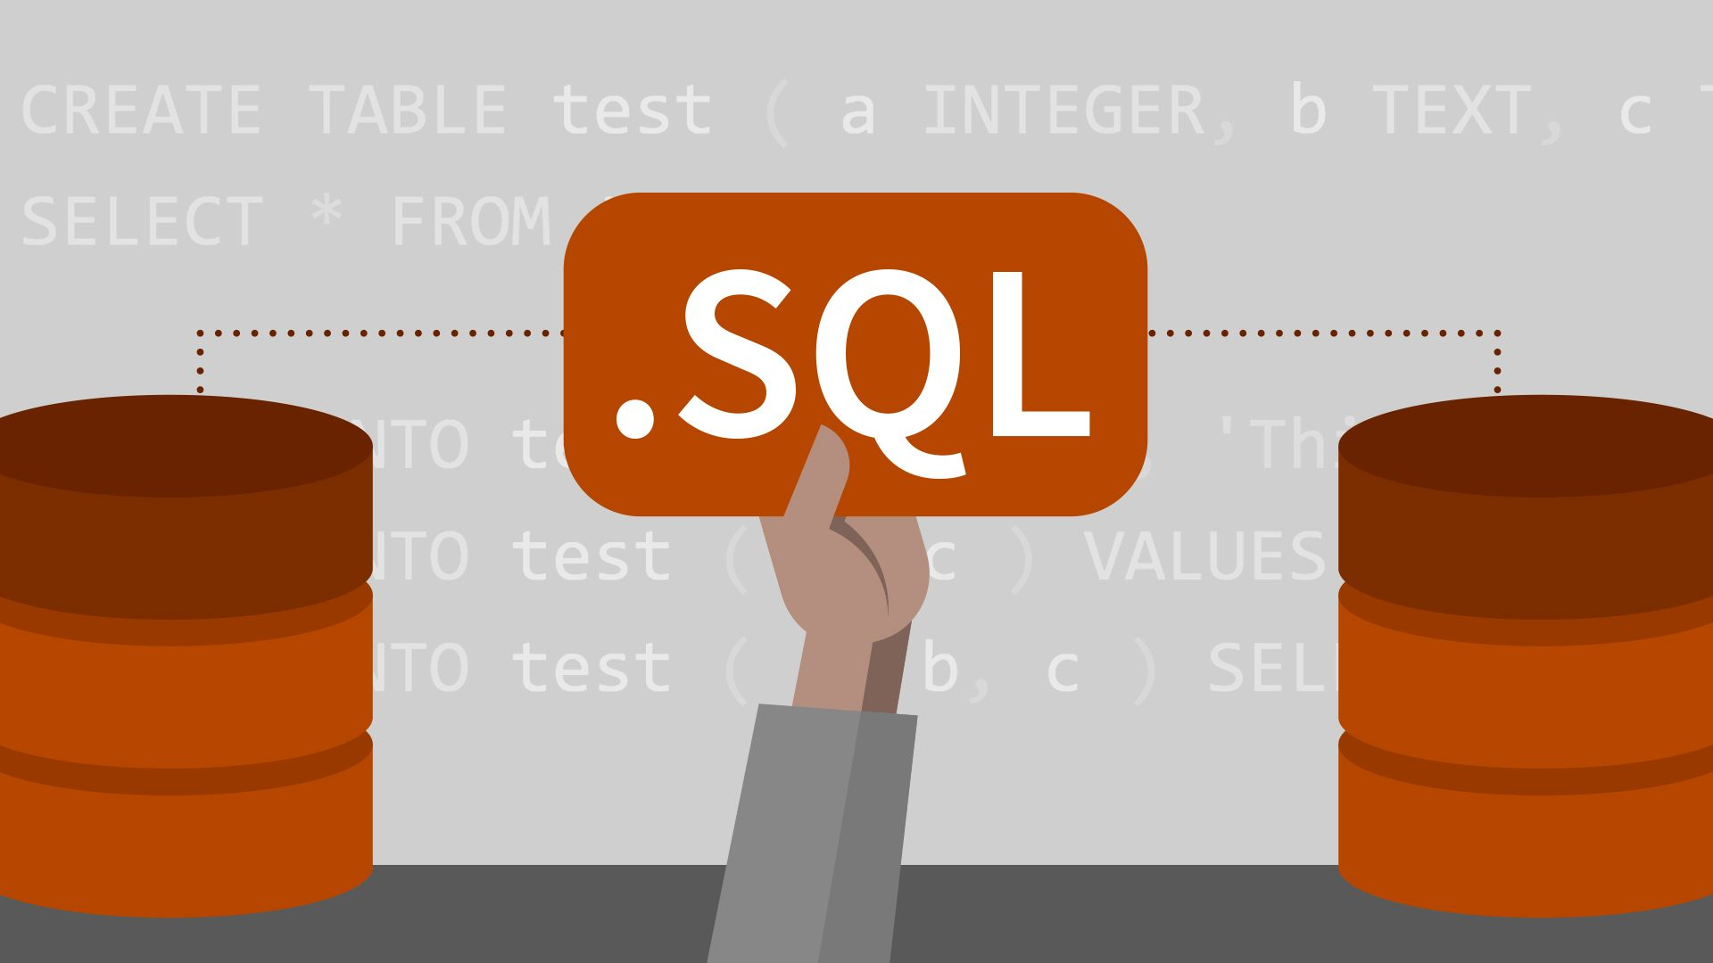

Slide 5
SQL overview
SQL stands for Structured Query Language
Used by both IT and business professionals
SQL database also known as relational database
Different RDBMSs (MySQL Workbench, PostgreSQL, Oracle DB, MS SQL Server, and others)
Benefits of using SQL

Slide 6
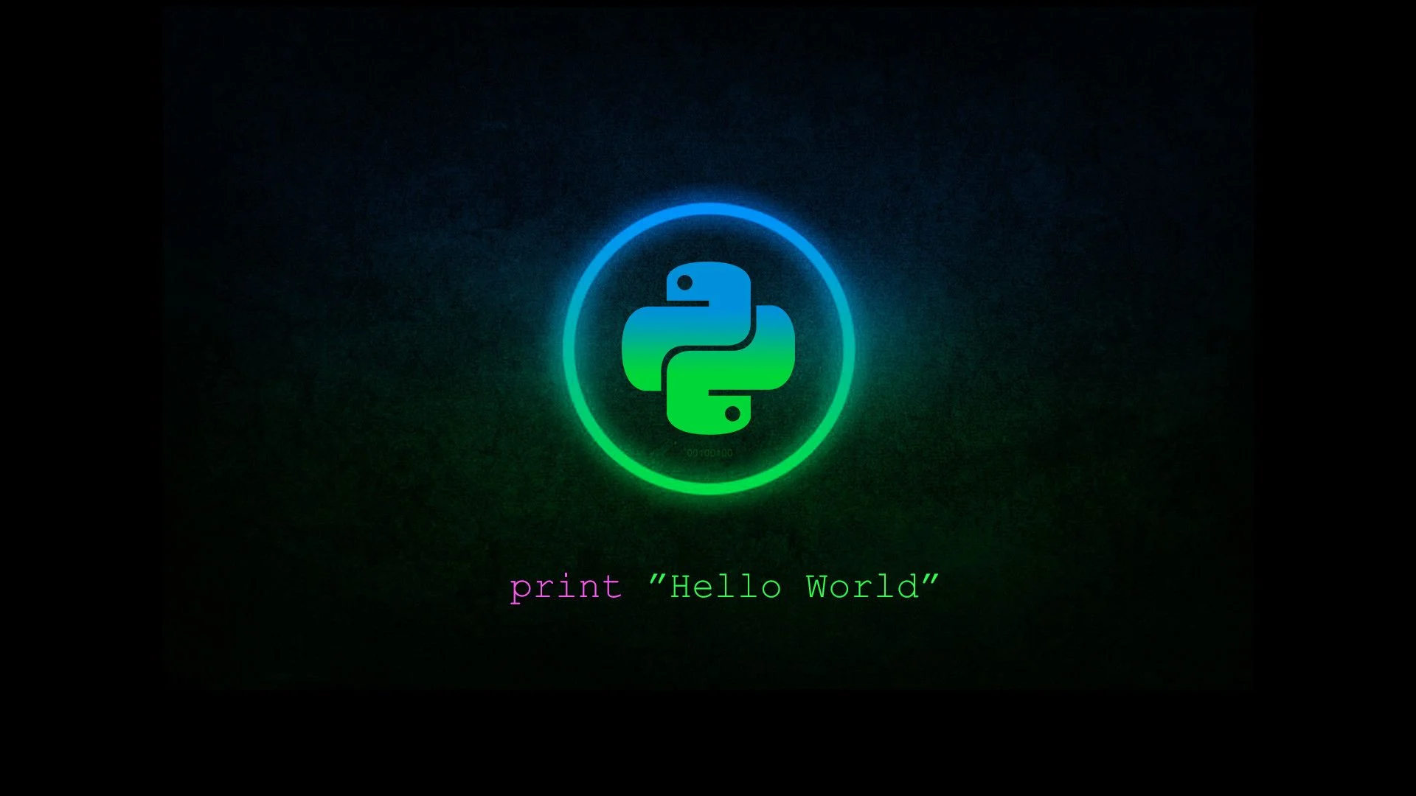

Slide 7
Python overview
Python is a general-purpose programming language
Aims to make coding easier and has emphasis on readability
Used for software and web development it has a wide application in the data visualisation, analytics and engineering, and AI and machine learning
Adopted by Wide range of financial institutions, government agencies, as well as companies like Intel, IBM, NASA, Google, Reddit, YouTube and many more

Slide 8
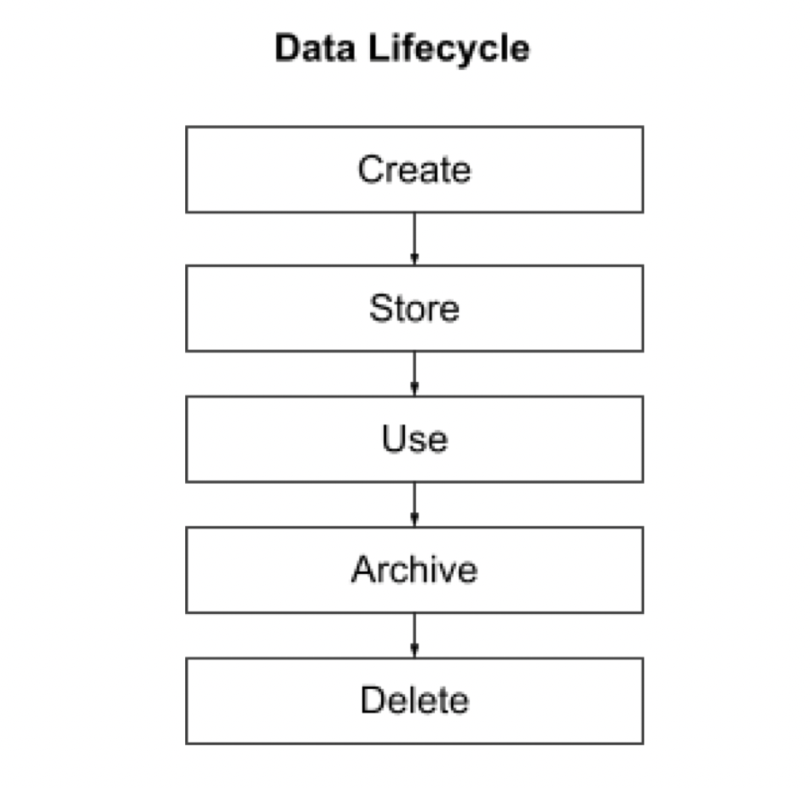
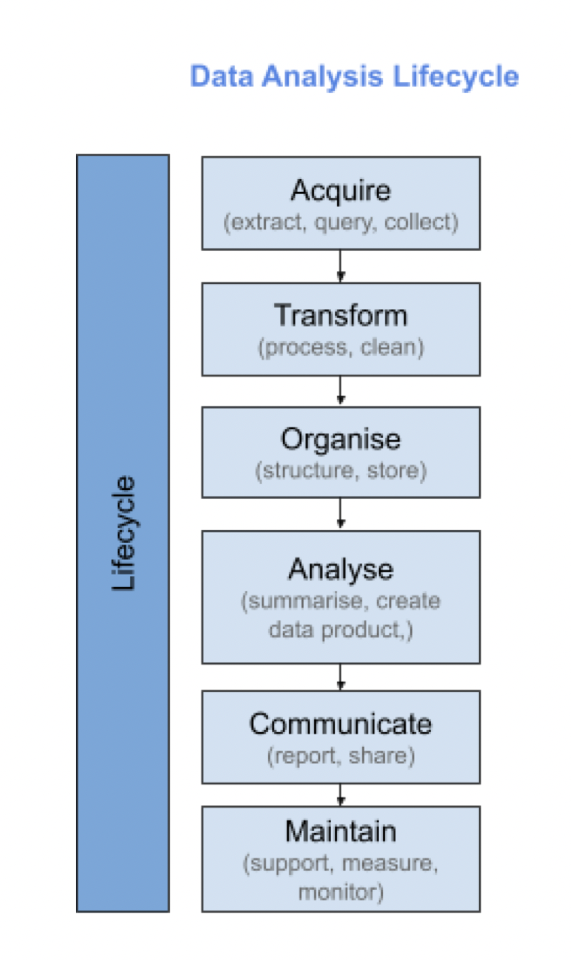
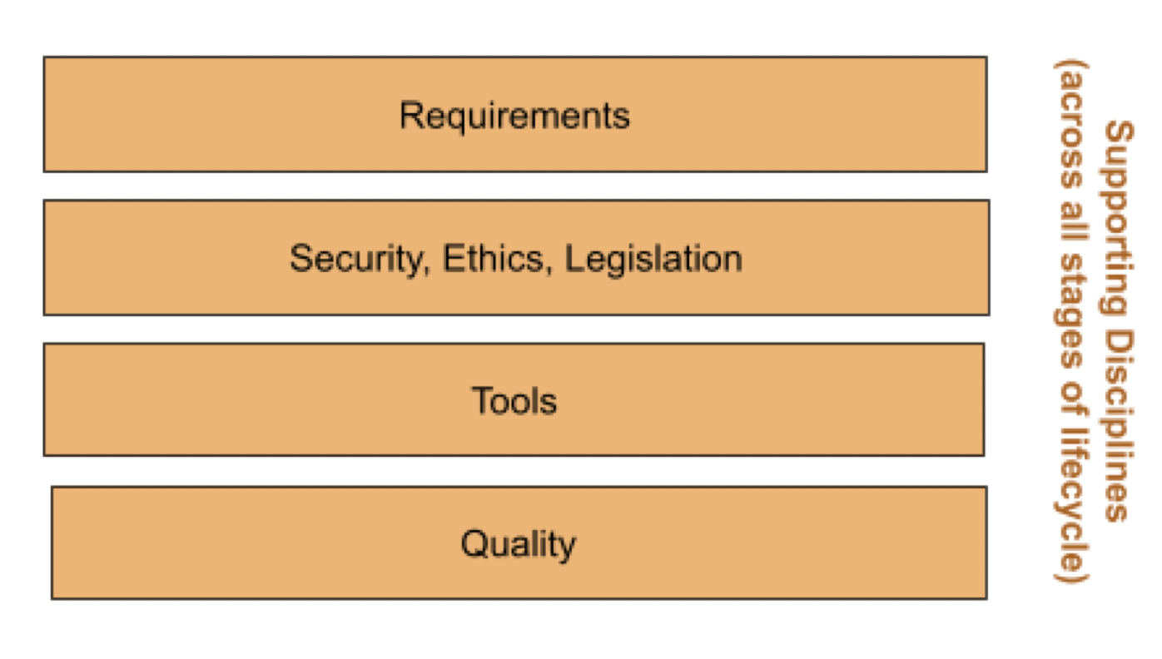
Data Lifecycle
The journey of the data from ‘birth to death’
The Data Analysis Lifecycle

Slide 9
Data Lifecycle Followed by DataSpace
Data Lifecycle
Data Analysis Lifecycle
Creating the data
Stored the data
Using the data
Archiving the data
Deleting the data
Acquiring the data (collection)
Transforming and organizing the data.
Analyzing the data (graphs and charts)
Communicating the data (reporting)
Maintaining the data.

Slide 10
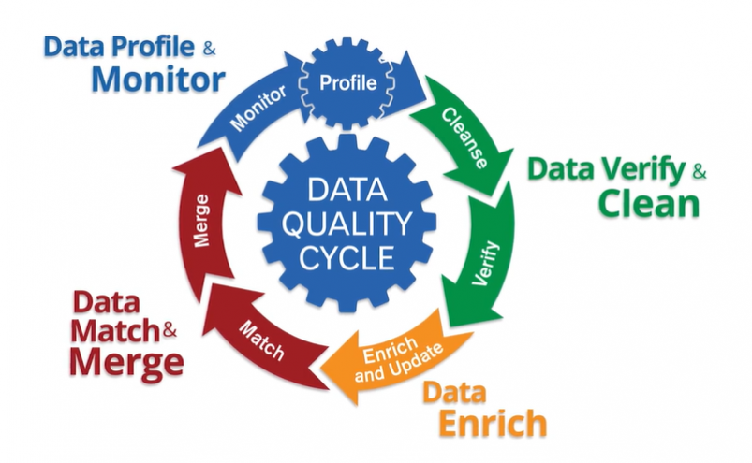
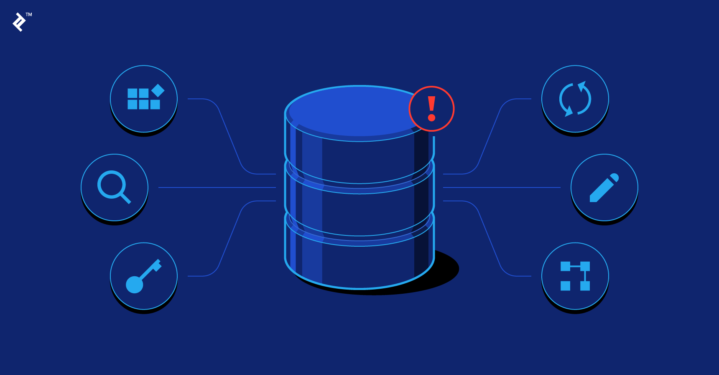
Solutions by
Storing the data in a database
through continued maintenance or the use of data quality cycle

Slide 11
References
https://s3.eu-west-1.amazonaws.com/course.oc-static.com/projects/DAN_UK_App_P1/Data+Lifecycle.pdf
https://en.wikipedia.org/wiki/Tableau_Software
https://en.wikipedia.org/wiki/SQL
https://en.wikipedia.org/wiki/Python_(programming_language)
https://developers.google.com/edu/python/introduction
https://www.datacamp.com/promo/cyber-monday-2022
https://www.mysql.com
https://www.tableau.com/en-gb/trial/tableau-software?utm_campaign_id=2017049&utm_campaign=Prospecting-CORE-ALL-ALL-ALL-ALL&utm_medium=Paid+Search&utm_source=Google+Search&utm_language=EN&utm_country=UKI&kw=%2Bwhat%20%2Bis%20%2Btableau&adgroup=CTX-Brand-General-EN-B&adused=532018551512&matchtype=b&placement=&d=7013y000000vYhH&nc=7013y0000029zDnAAI&cq_cmp=13796808384&cq_net=g&cq_plac=&gclid=Cj0KCQiAvqGcBhCJARIsAFQ5ke6djAwmuVGySdvNv7ypC3h_1CWji36TbnHO1JpPSRZa3OGaDhf6EIYaArgEEALw_wcB&gclsrc=aw.ds
https://www.tableau.com/why-tableau/what-is-tableau
https://365datascience.com/tutorials/sql-tutorials/database-vs-spreadsheet/https://365datascience.com/tutorials/sql-tutorials/database-vs-spreadsheet/
https://www.coursera.org/articles/what-is-python-used-for-a-beginners-guide-to-using-python
https://www.youtube.com/watch?v=7Jl-RwkzqQ4
https://www.youtube.com/watch?v=gfT7EGibry0
https://www.youtube.com/watch?v=tXPVZBnAZIA

Slide 12



