Slide 1

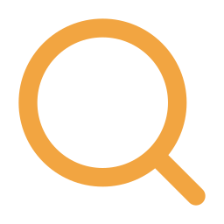

Do mosquito photos predict West Nile virus?
75,798 iNaturalist mosquito sightings by 23,078 people vs. CDC West Nile cases, 2016–2025
Nationally: a loose link
Why: only 10% of sightings are Culex, the main carrier, and they peak after the outbreak
Mosquito-heavy seasons were worse WNV seasons (r = 0.39, p = 0.02), but only season-wide, not month to month.
Within a state: no signal
A mosquito-heavy spring did not predict a worse season (p = 0.25), and the crane-fly placebo looked no different.
As a forecast: no gain
Adding sightings to each state’s own history made its forecasts slightly worse, not better.
Share of 2016–2025 records by month, each line scaled to its own peak
What we learned: people photograph the mosquitoes that bother them, not the ones that carry the virus, so sightings track bad years but can’t say where West Nile will strike.
Notes:
Our question: can the mosquito photos people post to iNaturalist for biodiversity reasons act as an early signal of West Nile virus? We matched 75,798 sightings from 2016–2025 to CDC case data. Nationally there is a loose link: seasons with more mosquito sightings than usual were worse West Nile seasons. But within a state, a mosquito-heavy spring did not predict a worse season, a crane-fly placebo behaved the same, and adding sightings to a state’s own history made forecasts slightly worse. The likely reason is what people photograph: only 10% of sightings are Culex, the main carrier, and Culex sightings peak in October, after the August peak in human cases.

