Slide 1
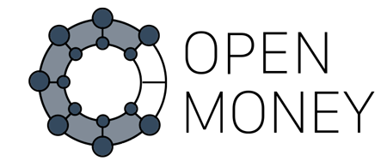

Slide 2

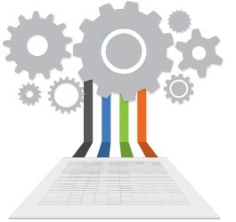

IT in data transparency

Slide 3
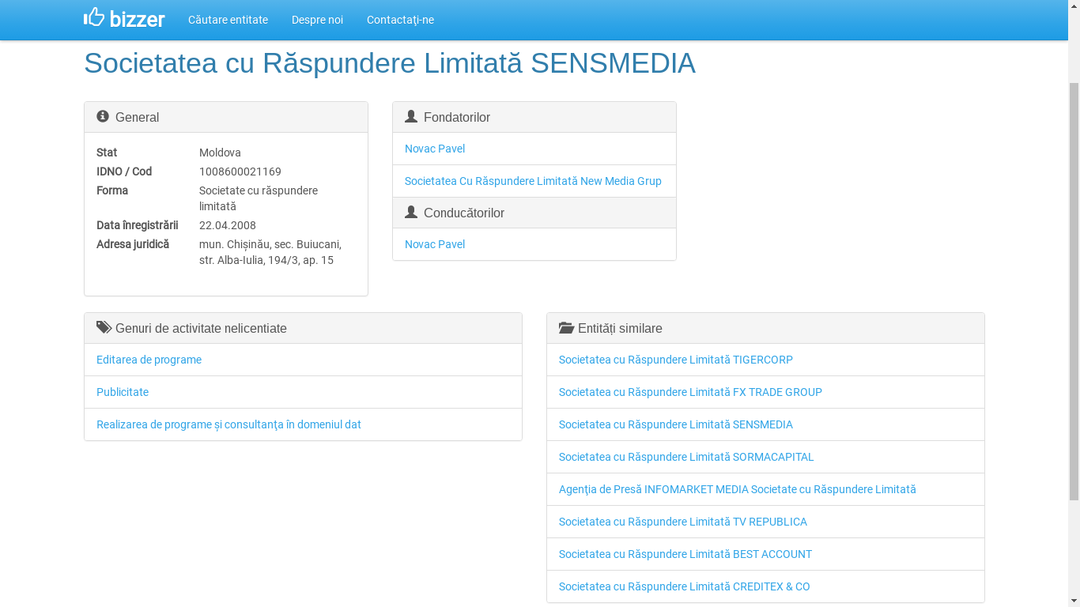
Similar systems – bizzer.md

Slide 4
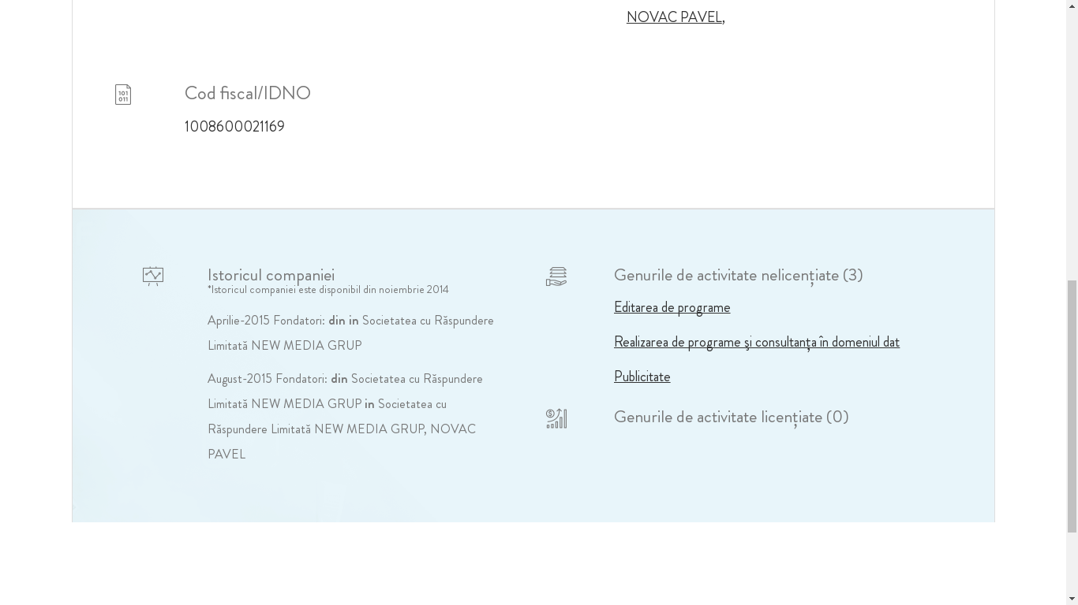
Similar systems – idno.md

Slide 5
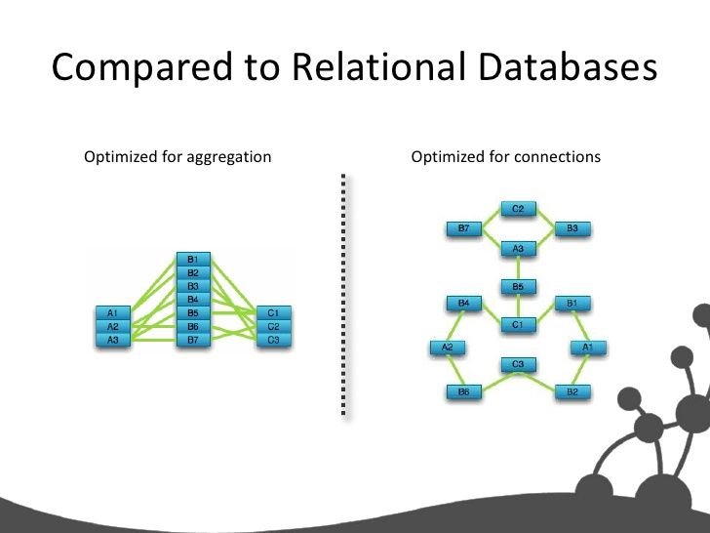

Key point

Slide 6
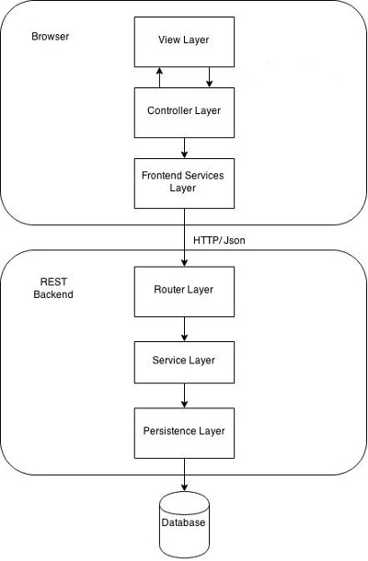




Architecture
Javascript framework for SPA
- Spring Core (DI library)
- Spring MVC (web layer)
NoSQL DBMS (graph model)

Slide 7
Graph database - key technology
Reasons:
- big chains of relations between entities of the same type
- natural and intuitive data model
- facilitation of integrated graph theory algorithms in engine of DBMS

Slide 8
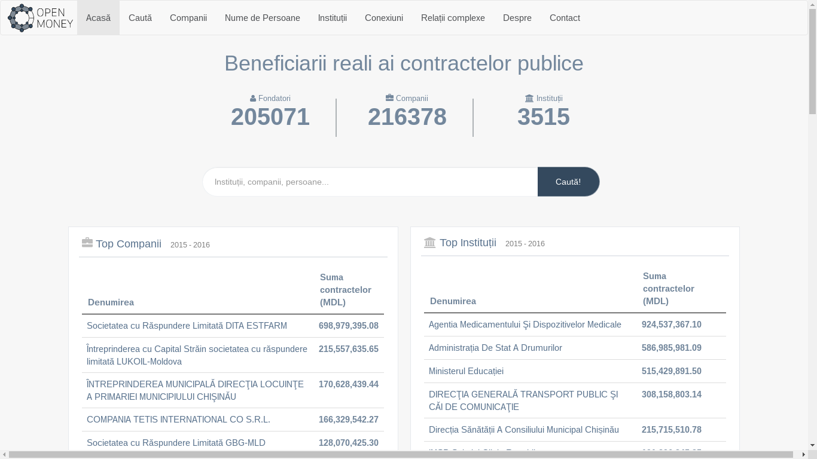
Main page

Slide 9
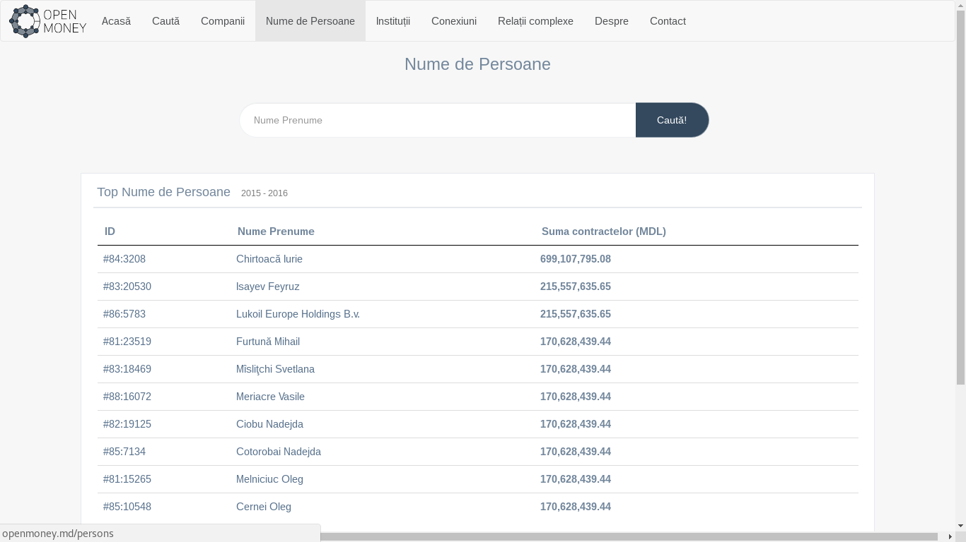
Search through entities

Slide 10
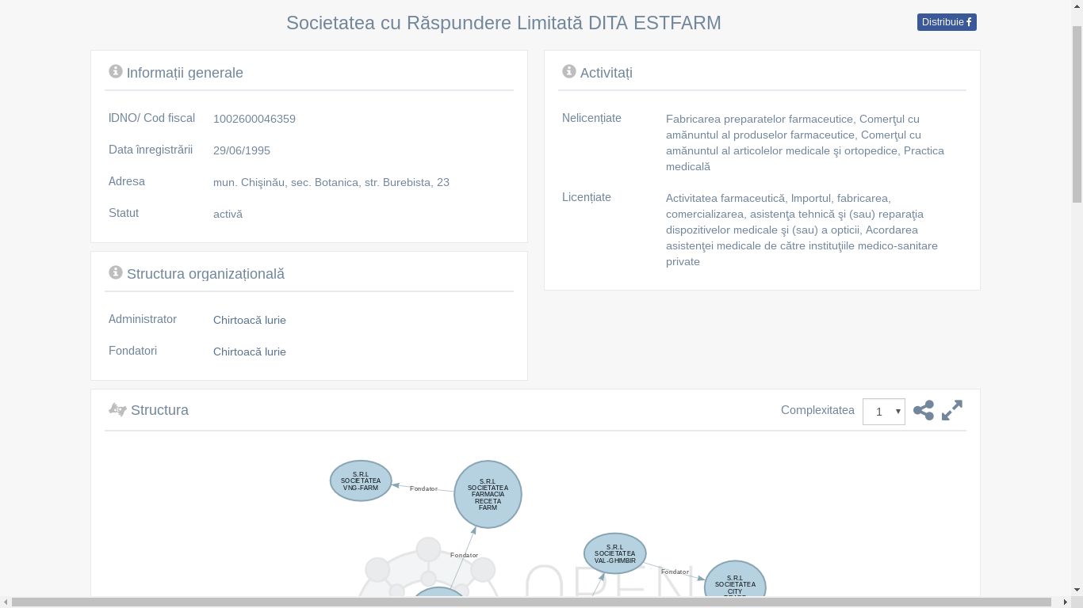
Main information about company

Slide 11
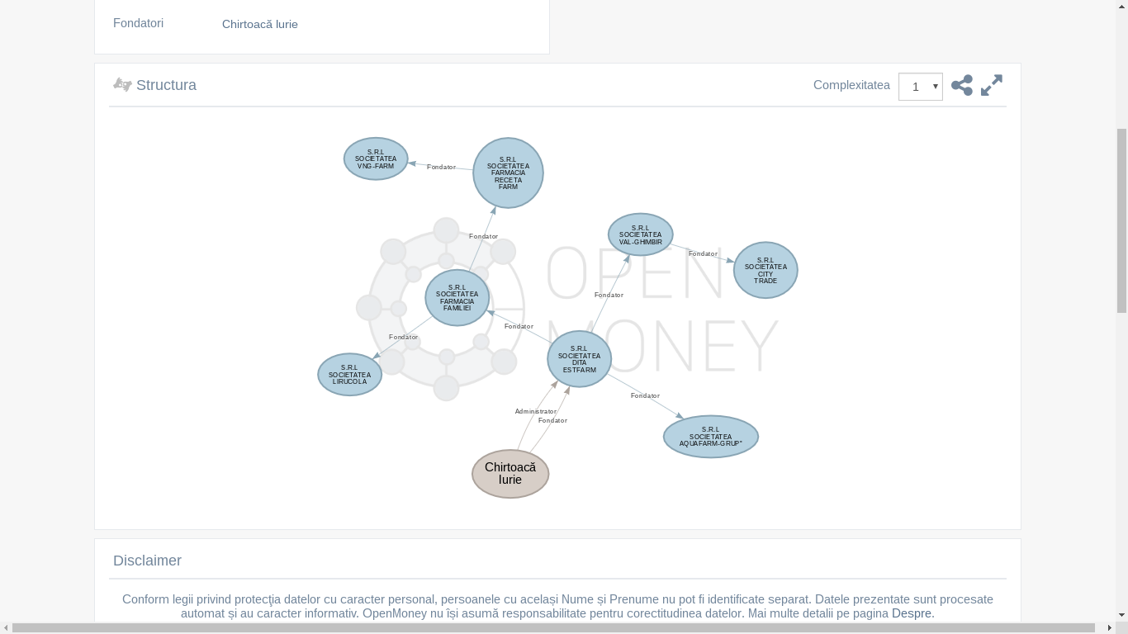
UNIDIRECTIONAL graph of relations

Slide 12
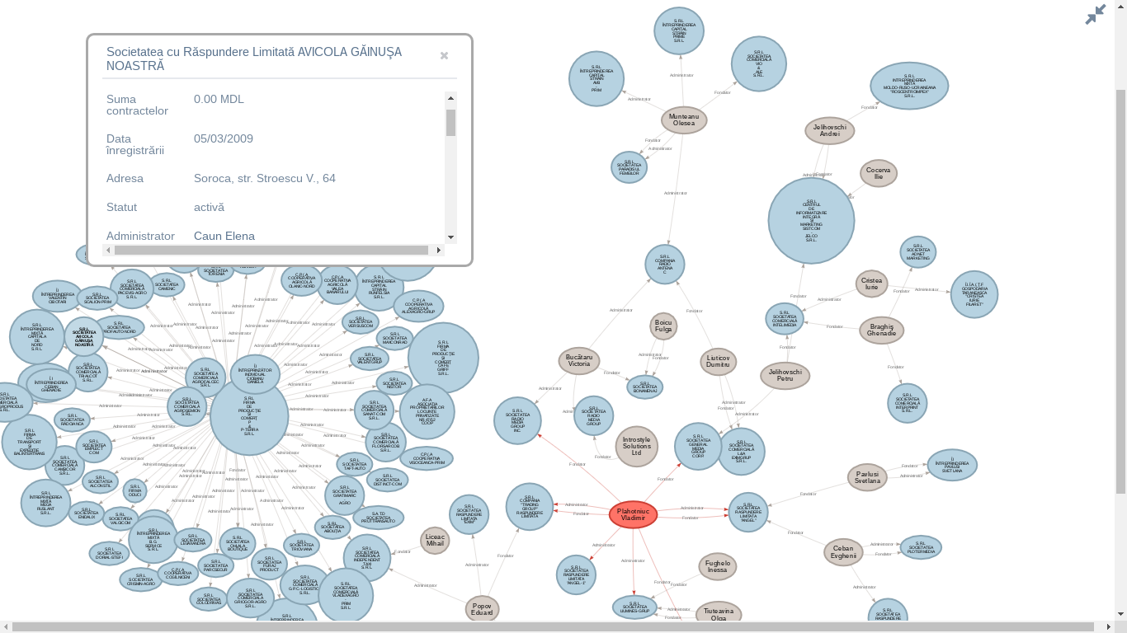
BIDIRECTIONAL graph of relations

Slide 13
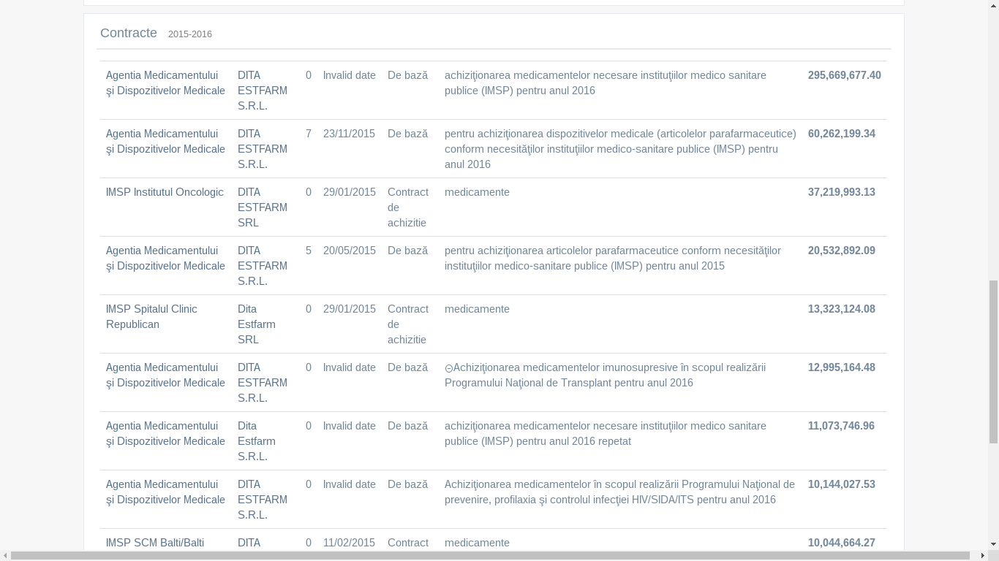
Acquisitions of entity

Slide 14
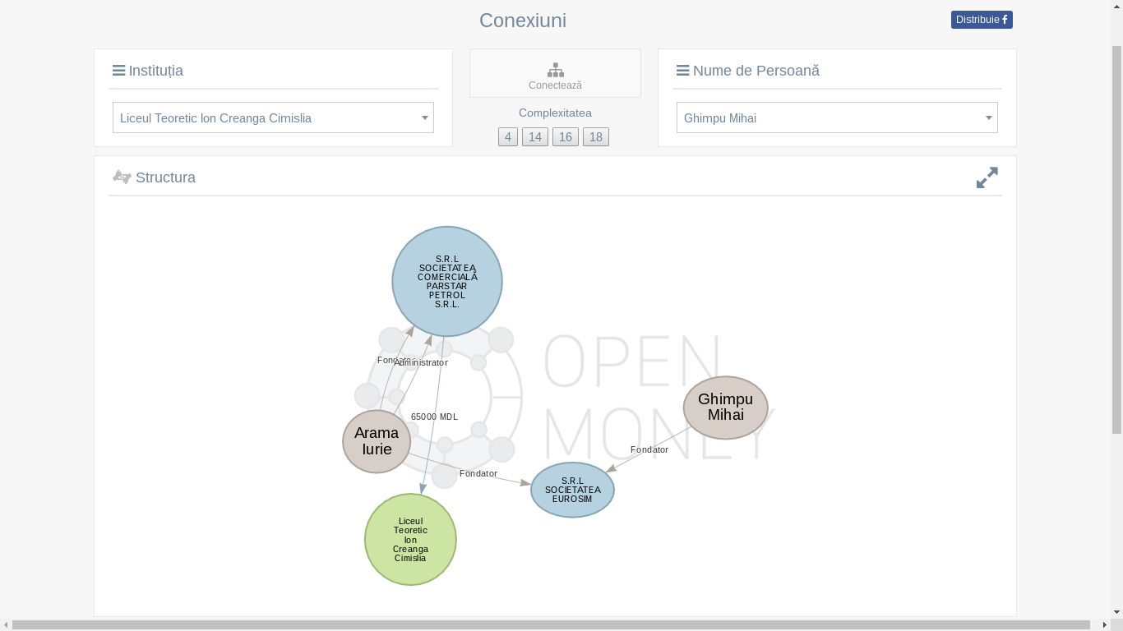
Connections

Slide 15
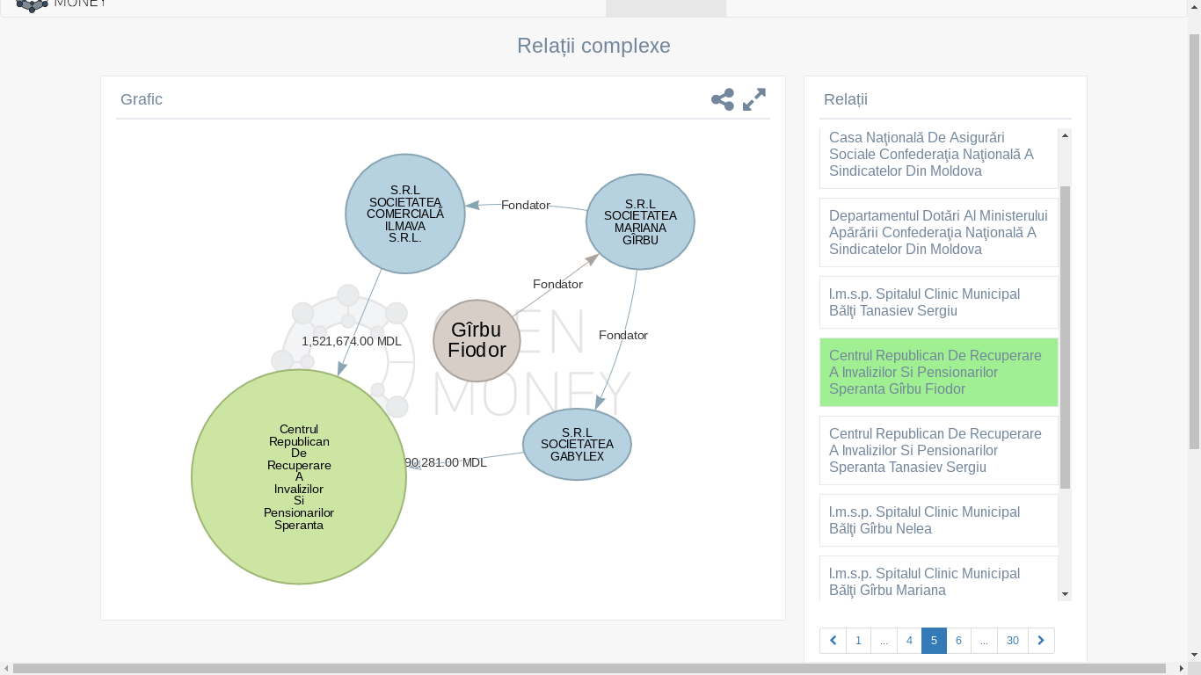
Complex relations

Slide 16

Target group
Simple users
Investigative journalists

Slide 17

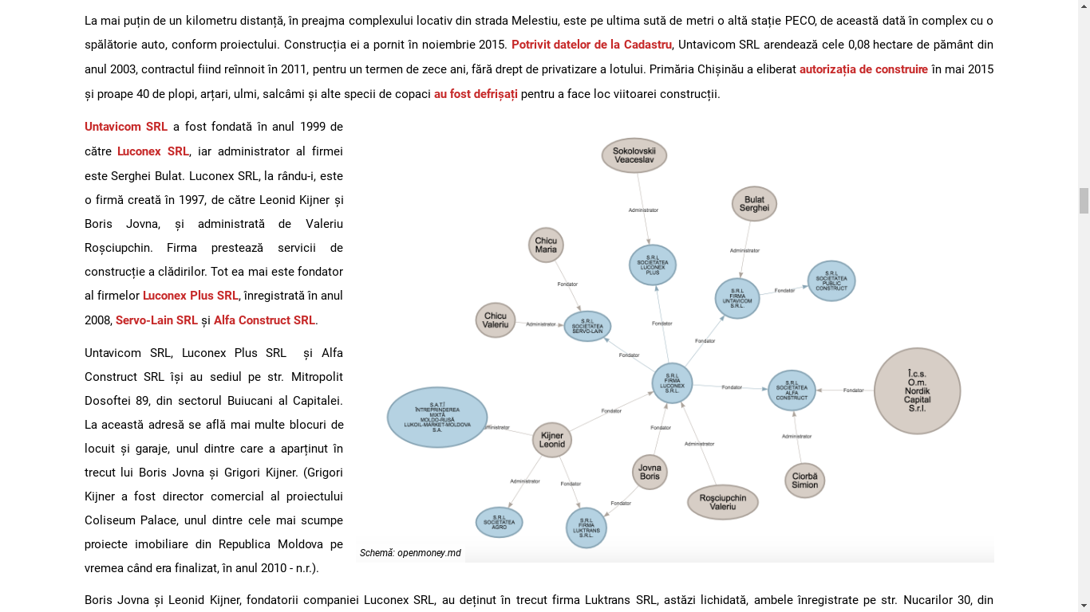
“Moratoriu de ochii lumii. Cine construiește benzinării în Capitală”
dsa

Slide 18
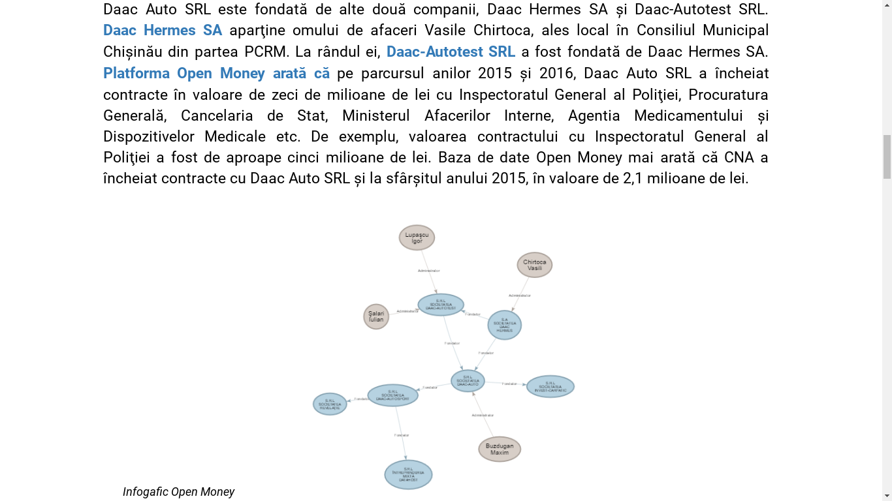
“Achiziţiile CNA // Şase maşini Skoda Rapid, cumpărate cu 1,5 milioane de lei”

Slide 19
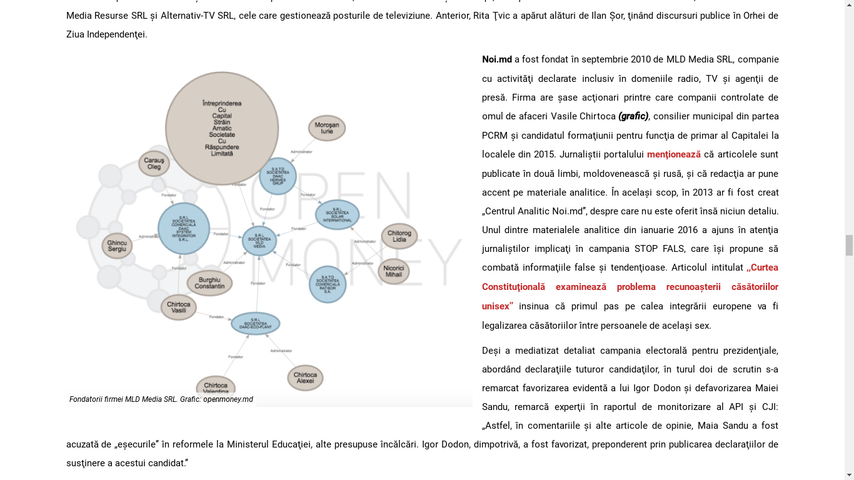
"Proprietarii site-urilor de ştiri şi interesele pe care le promovează"

Slide 20
Conclusions
- used and mentioned in more than 10 investigative articles
- problems with open data offered by egov.md (lack of entity ID, instable structure)
- future plans: graph versioning in time

Slide 21
Thank you!

