Slide 1
Predictive Factors of Dementia
CKME136 Capstone Presentation
Alexander Wong (500 390 804)

Slide 2
Outline
Dementia Overview
Dataset
Research Question
Approach
Conclusion & Recommendation

Slide 3


Dementia Overview
Defining Dementia
Dementia is an overall term used to describe a group of symptoms caused by diseases affecting the brain
Diseases | Impacts | Statistics
Alzheimer's Disease Parkinson’s Disease Lewy Body Dementia Frontotemporal Dementia | Memory loss and decreased problem solving Financial impact Relationship difficulties
3 seconds
$818 Billion USD/year
Icons made by fjstudio from www.flaticon.com

Slide 4
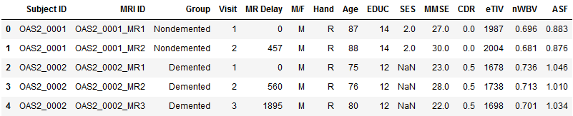
Dataset
MRI Data from the OASIS Project
Subject ID: Unique identifier by subject MRI ID: Unique identifier by MRI session Group: Class (dependent) variable Visit: Visit # for each Subject and MRI session MR Delay: Number of days since the first visit | M/F: Gender of the subject Hand: Dominant hand of the subject Age: Age of the subject EDUC: Years of education SES: Socioeconomic Status | MMSE: Mini-Mental State Exam score (0 to 30) CDR: Clinical Dementia Rating (0 to 2) eTIV: Estimated Total Intracranial Volume (cm³) nWBV: Normalized Whole Brain Volume ASF: Atlas Scaling Factor

Slide 5
Research Question
Can a combination of MRI scans, screening test results, and demographics from the OASIS project be early predictors of the onset of dementia?

Slide 6
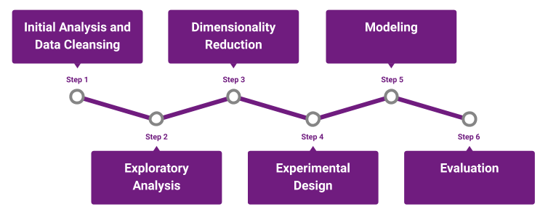
Approach

Slide 7
Initial Analysis & Data Cleansing
Data types
Missing values
Outliers
Bivariate Analysis
Class Imbalance

Slide 8
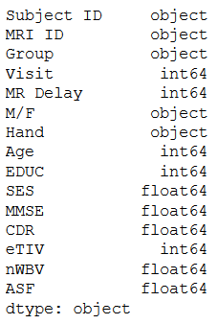
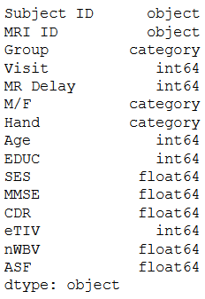
Initial Analysis & Data Cleansing
Data Types
1
2
3
4
5
6
Before
After

Slide 9
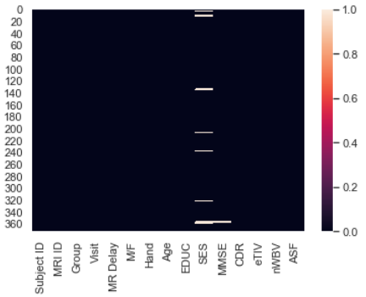
Initial Analysis & Data Cleansing
Missing Values
1
2
3
4
5
6
The heatmap shows that there are missing values in SES and MMSE
For MMSE, the missing values were filled in using the median score
For SES, the missing values were filled in based on Education level
Education 12 years median: 3.0
Education 16 years median: 2.0

Slide 10
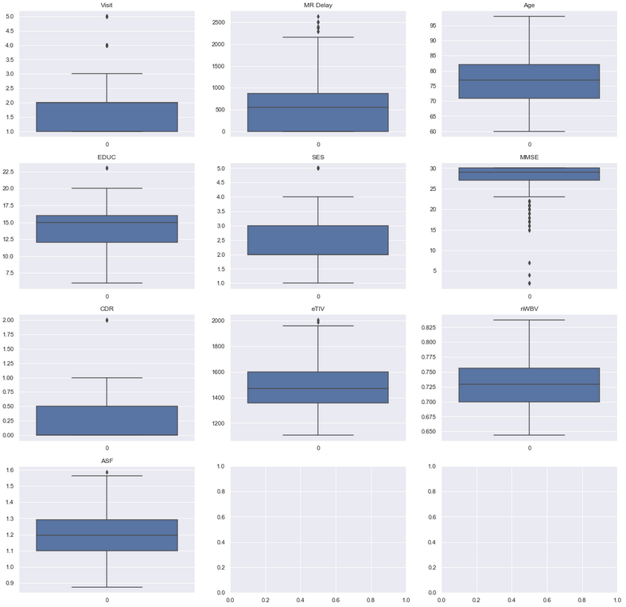
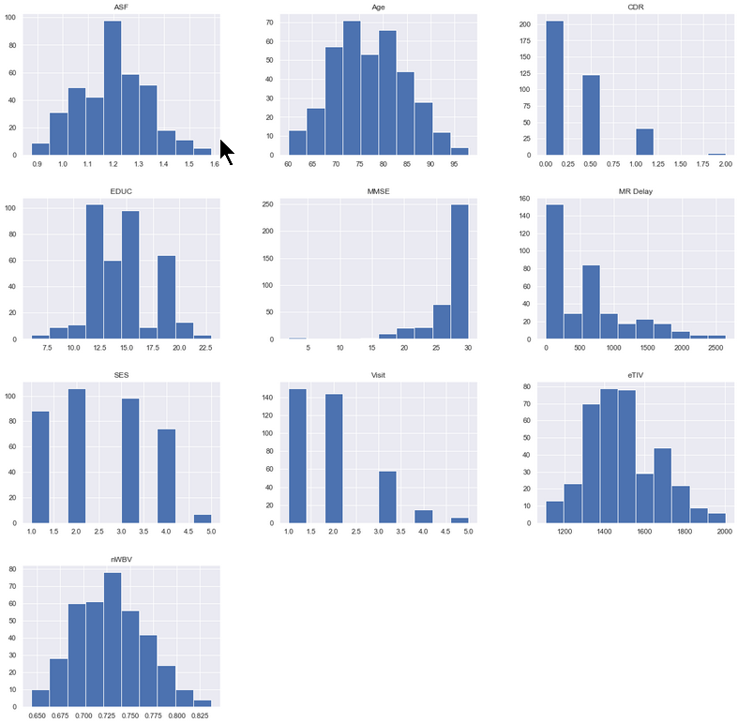
Initial Analysis & Data Cleansing
Outliers
1
2
3
4
5
6

Slide 11
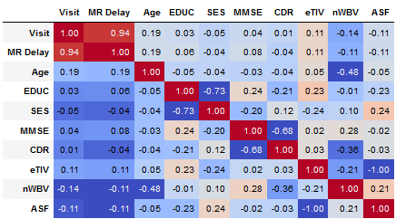
Initial Analysis & Data Cleansing
Bivariate Analysis
1
2
3
4
5
6
Noteworthy relationships:
Strong negative correlation between EDUC and SES.
Very strong negative correlation between the eTIV and ASF
Moderate correlation between MMSE and CDR

Slide 12
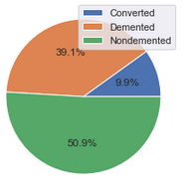
Initial Analysis & Data Cleansing
Class Imbalance
1
2
3
4
5
6
Considering that the 'Converted' subjects are technically 'Demented'
No balancing required

Slide 13
Exploratory Data Analysis
Subsetting
Normalization
Clustering

Slide 14
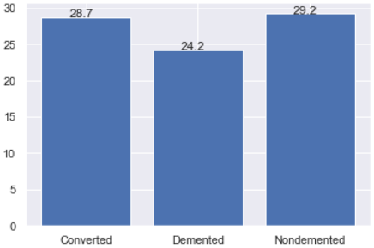
Exploratory Data Analysis
Subsetting
1
2
3
4
5
6
Average MMSE Scores by Group

Slide 15
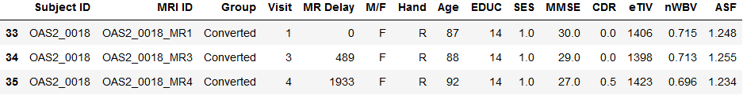
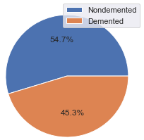
Exploratory Data Analysis
Subsetting
1
2
3
4
5
6
Subjects labeled converted should actually be ‘Nondemented’ on the first visit

Slide 16
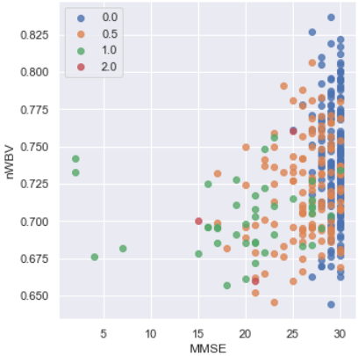
Exploratory Data Analysis
Subsetting
1
2
3
4
5
6
Scatter Plot by MMSE, nWBV, and CDR
All subjects with a Clinical Dementia Rating of 0 have an MMSE score consistently above 25
Subjects with CDR greater than 0 are more spread in terms of MMSE score results
CDR greater or equal to 1, have consistently smaller Normalized Whole Brain Volumes

Slide 17
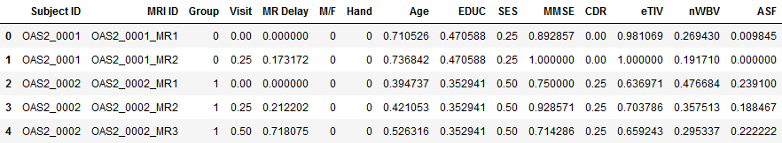
Exploratory Data Analysis
Normalization
1
2
3
4
5
6
Numeric values are scaled down to a range of 0 to 1

Slide 18
Exploratory Data Analysis
Clustering
1
2
3
4
5
6
K-Means K=2
These results could suggest that education, socioeconomic status, and brain volume are more significant predictors of dementia. However, it is odd to see that the age of the high risk cluster (Cluster 1) is younger than Cluster 2.
Cluster | Age | Education | Socioeconomic Status | MMSE | CDR | eTIV | nWBV
Cluster 1 | Younger | High school | Middle Class | Lower | Higher | Lower | Higher
Cluster 2 | Older | Post secondary | Upper Class | Higher | Lower | Higher | Lower

Slide 19
Dimensionality Reduction
Correlated Attributes
Univariate Feature Selection
Low Variance Filter

Slide 20
Dimensionality Reduction
1
2
3
4
5
6
Correlated Attributes Univariate Feature Selection Low Variance Filter
Remove
Remove
Remove

Slide 21
Experimental Design
10-Fold Cross Validation

Slide 22
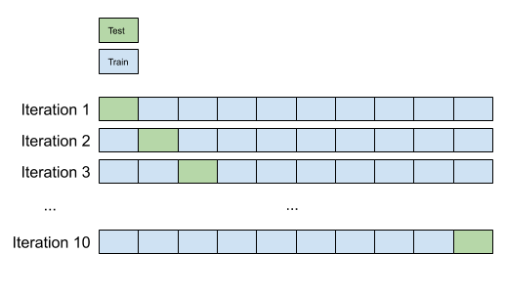
Experimental Design
1
2
3
4
5
6
10-Fold Cross Validation
The dataset is separated into 10 distinct folds of equal sizes.
Models will be validated throughout 10 iterations, each one using 9 out of 10 folds to train, and the remaining fold to test
Each model for each iteration is tested in the same fold (paired)

Slide 23
Modeling
Logistic Regression
Decision Tree
Random Forest
Naïve Bayes
K-Nearest Neighbors

Slide 24
Modeling
Logistic Regression
1
2
3
4
5
6
Trial | Trial Description | Accuracy
1 | All attributes post-dimensionality reduction | 98%
2 | Remove CDR and MMSE attributes | 66%
3 | Add back Age attribute | 69%

Slide 25
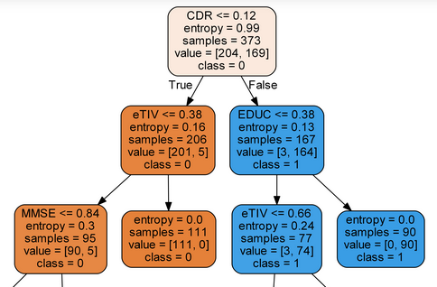
Modeling
Decision Tree
1
2
3
4
5
6
Trial | Trial Description | Accuracy
1 | All attributes post-dimensionality reduction | 91%
2 | Remove CDR and MMSE attributes | 61%
3 | Reduce max depth of tree to 5 levels. | 60%
4 | Reduce max depth of tree to 5 levels and add back Age attribute | 59%

Slide 26
Modeling
Remaining Results
1
2
3
4
5
6
Random Forest
Trial | Trial Description | Accuracy
1 | Remove CDR and MMSE attributes | 63%
2 | Reduce max depth of tree to 5 levels | 62%
3 | Reduce max depth of tree to 5 levels and add back Age attribute | 63%
Naïve Bayes
Trial | Trial Description | Accuracy
1 | Remove CDR and MMSE attributes | 65%
2 | Add back Age attribute | 65%
K-Nearest Neighbors
Trial | Trial Description | Accuracy
1 | K = 3 | 56%
2 | K = 5 | 54%
3 | K = 3 and add back Age attribute | 60%

Slide 27
Evaluation
Comparing Models
Hypothesis Testing

Slide 28
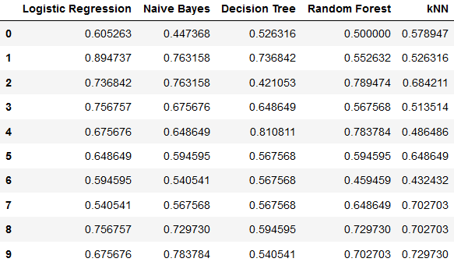

Evaluation
Accuracy for each classification method by cross validation iteration
1
2
3
4
5
6

Slide 29
Evaluation
Hypothesis Testing
1
2
3
4
5
6
H₀ (null): The mean accuracies are equal among classification models H_{A} (alternative): The mean accuracies are different among classification models
data is non-parametric
more than two samples
observations are paired
Friedman test: p-value = 0.277 > 0.05 (alpha)
Fail to reject the null hypothesis; that is, it cannot be proven with 95% confidence that there is a statistically significant difference among classification methods

Slide 30
Conclusion & Recommendations
If the goal is to predict with the highest accuracy then use Logistic Regression
If the goal is to optimize runtime then use Naïve Bayes
Additional data and attributes recommended to produce more performant models
Further optimization on Decision Tree and Random Forest models can be made
Model | Mean Accuracy | Runtime
Logistic Regression | 68.9% | 0.0156
Naïve Bayes | 65.1% | 0.0038
Random Forest | 63.3% | 0.2724
K-Nearest Neighbors | 60.1% | 0.0035
Decision Tree | 59.8% | 0.0049

Slide 31
Thank You

Slide 32
My Github:
https://github.com/alexplainlaterr/CKME136/

Slide 33
Appendix

Slide 34
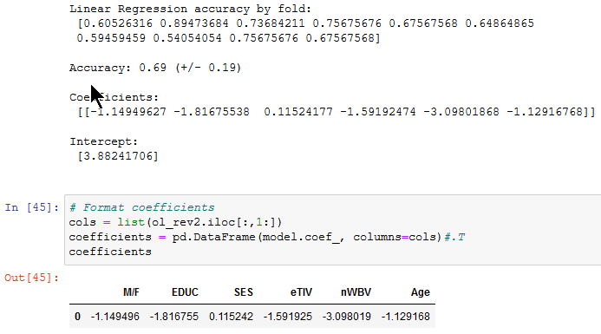
Logistic Regression Formula - Trial 3

Slide 35
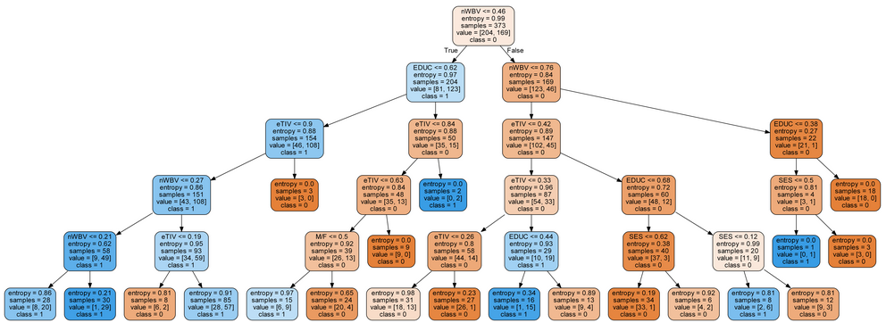
Full Decision Tree - Trial 3

Slide 36
References
Marcus, D. S., Fotenos, A. F., Csernansky, J. G., Morris, J. C., & Buckner, R. L. (2010).
Open Access Series of Imaging Studies: Longitudinal MRI Data in Nondemented and
Demented Older Adults. Journal of Cognitive Neuroscience, 22(12), 2677-2684. doi:
10.1162/jocn.2009.21407

