Slide 1
Monitoring Infrastructure Transition from Graphite/Seyren to New Relic
Alex Pogue
July 5, 2018

Slide 2
Agenda
Background / Rationale
Phases of work
Takeaways

Slide 3
Background / Rationale
Past few months we’ve been transitioning our monitoring infrastructure from Graphite/Seyren to New Relic
Rationale: IBM consolidating to a single monitoring system for all cloud services – New Relic and TIP (Technical Integration Point)
Gain complete control over monitoring and alerting of our service
New Relic:
  Integrates with TIP, Slack, PagerDuty, etc.
  More informative visual metrics charts and alert views
  Simple to make changes via web interface or API
TIP:
  Every services’ alerts will go there
  Standardized alert flow: New Relic→TIP→ServiceNow
  Enables TOC (technical operations center) to work better

Slide 4
Why integrate with TIP?
TIP integrates with ServiceNow:
  CIE (customer impacting event) handling
  AVM (Availability Manager) integration
TIP integrates with TOC tooling:
  Alert dashboards (Kibana)
  TOC console for their responders
New Relic is the recommended way to integrate with TIP

Slide 5
Phases
Use New Relic to send a simple subset of alerts to our existing PagerDuty – completed May 30
Add alerts for system metrics (Memory, CPU, etc.) - completed June 14
Expand alerts to include LDAP, Redis, Zookeeper monitors – completed June 15
Integrate with TIP – completed July 9
Leveraging new monitoring infrastructure for further improvements

Slide 6
Phase 1
Use New Relic to send a simple subset of alerts to our existing PagerDuty
- completed May 30

Slide 7
Phase 1 End-to-End Big Picture
Gathering
Metrics
Gathering
Metrics
Storing
Metrics
Defining
Alert
Thresholds
Firing
Alerts
Before
Cloudant
collectd
Graphite
Seyren
PagerDuty
After
Cloudant
New Relic
Python agent
New Relic
Insights
New Relic
Alerts
PagerDuty
= custom code

Slide 8
Gathering metrics
Our IBM Cloud service applications gather metrics and store them in our Cloudant database. This is where our monitoring infrastructure pulls its metrics.
Before:
  We forward these metrics to our existing monitoring system using a program called collectd running on a system in our backend
After:
  Replace collectd with custom New Relic Python agent
Cloudant
collectd
Existing
monitoring
Cloudant
New Relic
Python agent
New
monitoring

Slide 9
Storing Metrics
Before: Collectd sends metrics to Graphite
After: New Relic agent sends metrics to New Relic Insights
collectd
Graphite
New Relic
Python agent
New Relic
Insights

Slide 10
Defining Alert Thresholds
When a metric value hits a certain threshold, we fire an alert. We need to define these thresholds
Before: Graphite sends metrics to Seyren
After: New Relic Insights sends metrics to New Relic alerts
Graphite
Seyren
New Relic
Insights
New Relic
Alerts

Slide 11
Defining Alert Thresholds
Technical challenge: Defining alerts
We currently have 105 different alerts to define
New Relic allows us to define alerts via web UI
  User friendly, but
  Time consuming to change alert thresholds
  We have to open the UI and painstakingly compare with our desired alert thresholds
  Can’t store alert thresholds in version control
Solution: Custom script that syncs alert configuration file with New Relic backend via New Relic API

Slide 12
Firing Alerts using PagerDuty
Before: Seyren sends alerts to PagerDuty
After: New Relic Alerts sends alerts to PagerDuty
Seyren
PagerDuty
New Relic
Alerts
PagerDuty

Slide 13
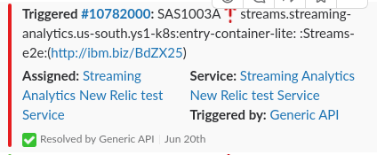
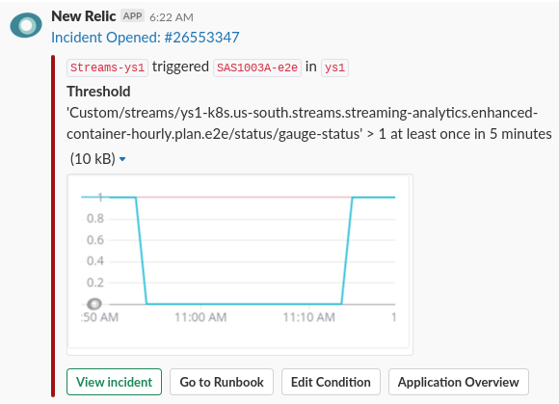

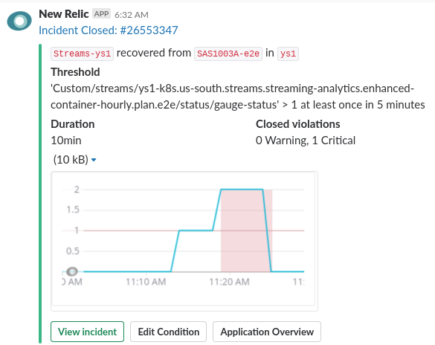
Before and After: Alerts in Slack

Slide 14
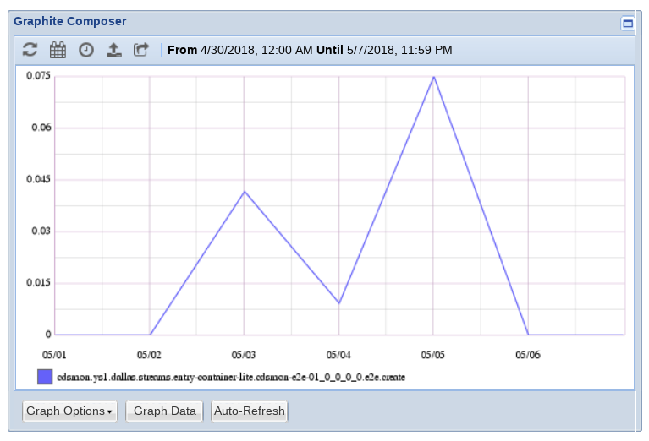
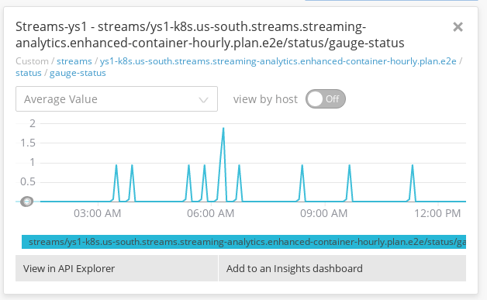
Before and after: View metrics graph

Slide 15
Phase 2
Add alerts for system metrics (Memory, CPU, etc.)
- completed June 14

Slide 16
New Relic Infrastructure
Before: Only collecting metrics from Cloudant via New Relic Python agent
After: Also collect from New Relic Infra agent
New Relic
Python agent
New Relic
Insights
New Relic
Python agent
New Relic
Insights
New Relic
Infra agents
New Relic
Infra agent
New Relic
Infra agent

Slide 17
Benefits of New Relic Infrastructure
Before:
  Collect strictly CPU, Memory, Network
  Graph views only have one host per graph, hard to compare hosts
After:
  Collect much more information (load average, disk usage, disk reads/writes per second, swap space usage, etc.)
  Much better graph views that combine all systems for comparison
  Less custom code to manage, maintain, and ensure correctness

Slide 18
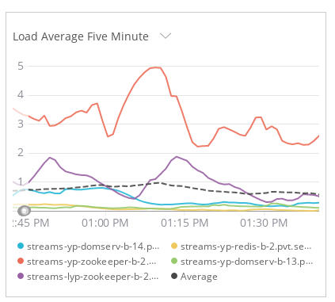
Before and After: System metrics

Slide 19
Phase 3
Expand alerts to include LDAP, Redis, Zookeeper monitors
- completed June 15

Slide 20
System Service Monitoring
Before: Collectd checks and reports whether system services are up and running
After: New Relic Agent checks whether system services are up and running

Slide 21
System Service Monitoring
Existing New Relic Agent runs on a single container - “the monitoring container”
Needed new set of New Relic agents that run on the LDAP/Redis/Zookeeper nodes themselves and reports metrics directly to New Relic Insights
Match old collectd functionality in New Relic

Slide 22
System Service Monitoring
New Relic
Python agent
New Relic
Insights
Before:
After:
New Relic
Infra agents
New Relic
Infra agent
New Relic
Infra agent
New Relic
Python agent
New Relic
Insights
New Relic
Infra agents
New Relic
Infra agent
New Relic
Infra agent
New Relic
Service Monitor
agents

Slide 23
Phase 4
Integrate with TIP
- completed July 9

Slide 24
TIP Integration Process
Send alerts to the test TIP server
Comply with the concern format from TIP documentation
Verify the format with TOC leadership
Start sending alerts to production TIP server without TOC enablement
Test CIE process
Start sending alerts to TIP server as “TOC-enabled”

Slide 25
TIP Format
TIP expects alerts to come in a specific format called “concern”
Coordinated multiple teams’ needs:
  Follow TIP “concern” format
  TOC needs the right information in order to resolve alerts
  New Relic only allows access to certain fields of the triggering alert
Eventually found format that works for everyone

Slide 26
TIP Integration
Simple “switch” to direct the alert to be routed to TOC team to handle
We turned off old Pager Duty integration
Completed July 9
TOC team reported success in the migration to TIP

Slide 27
Phase 5
Leverage new monitoring infrastructure for further improvements

Slide 28
Further Improvements
Continue to improve TIP format per TOC feedback
Leverage greater monitoring control to create new alerts as needed
Fine-tune alerting thresholds
Educate team on management of New Relic via runbooks

Slide 29
My Takeaways
Lessons learned:
  Independent component ownership
  Being a main point of contact
  Delivering a working solution
Best parts:
  Lots of code and technical challenges
  Business impact

Slide 30
Summary
Completely transitioned to New Relic
Integrated with TIP
Benefits: internal ops and for larger business
Leverage our new infrastructure to provide greater benefits in the future

