Slide 1
Banking System
Filip Alina
Popescu Alexandru
Radoi Teodora

Slide 2
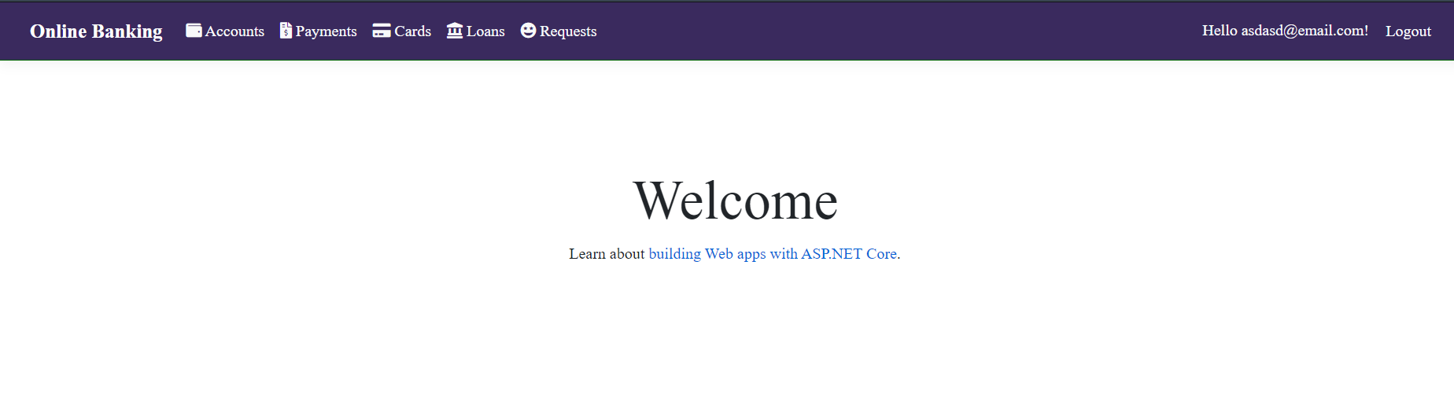
Application for account banking management
The application is used for managing the customer’s bank account, transactions, different accounts and cards.

Slide 3
Specifications:
Accounts management
Cards payments and management
Transactions list and filtres

Slide 4
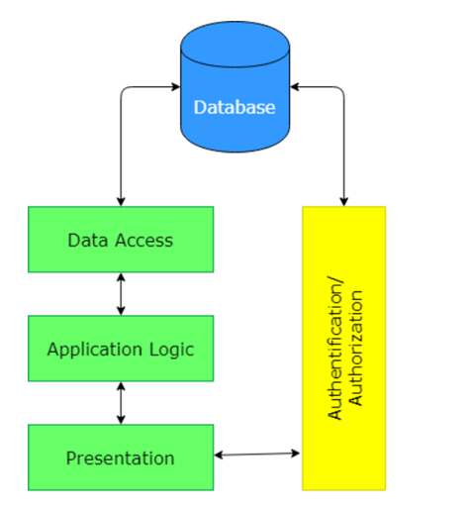
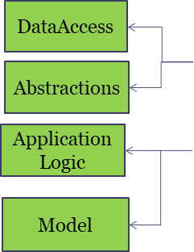
Architecture

Slide 5

Technology
•ASP .NET Core MVC
•Identity
•Entity Framework Core
•Bootstrap, CSS, HTML
•jQuery/Java Script
•Version-control system (Git)

Slide 6
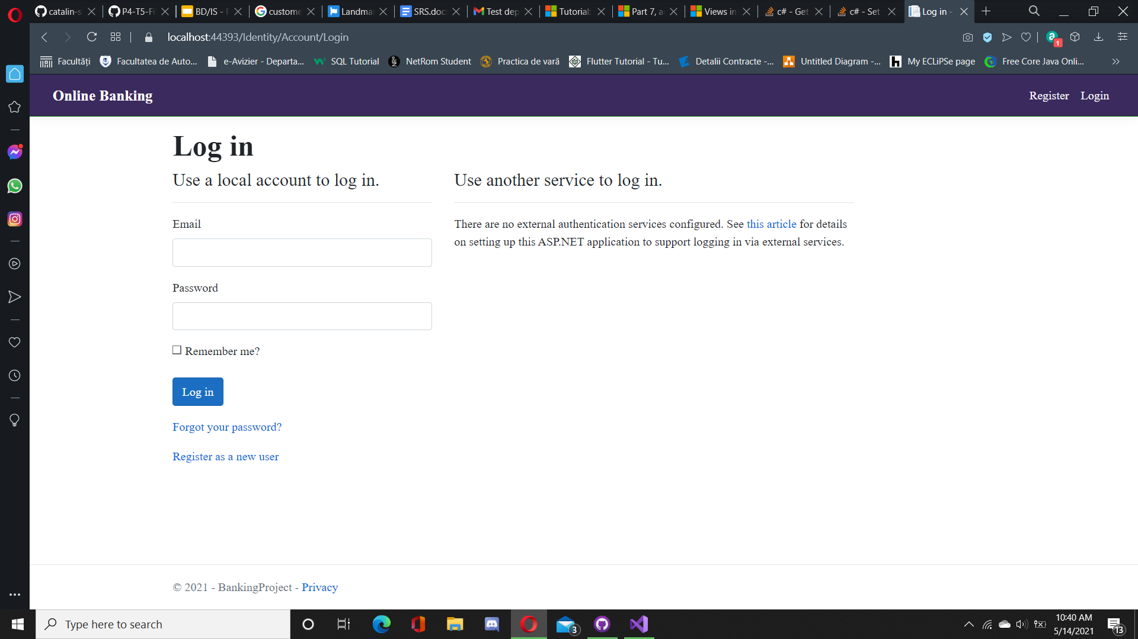
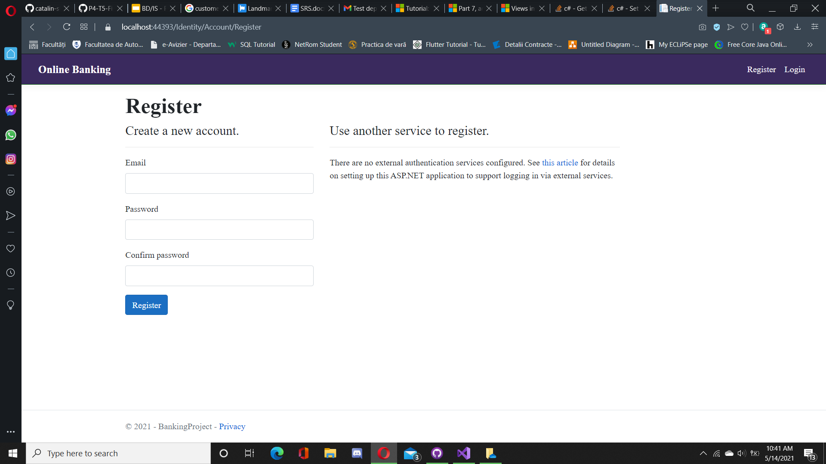
Login and Register
The authentication of the application is made with Identity.

Slide 7
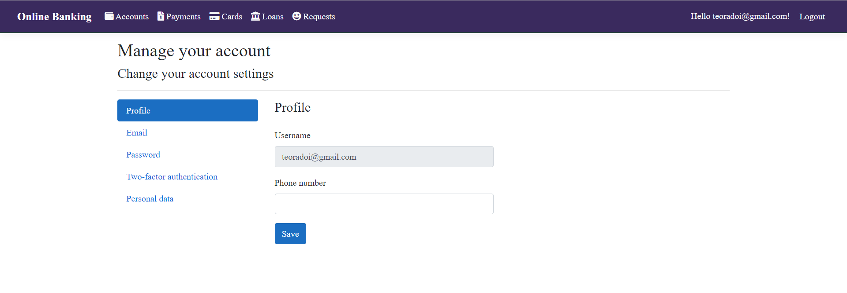
Account settings
The user is able to modify their account data.

Slide 8
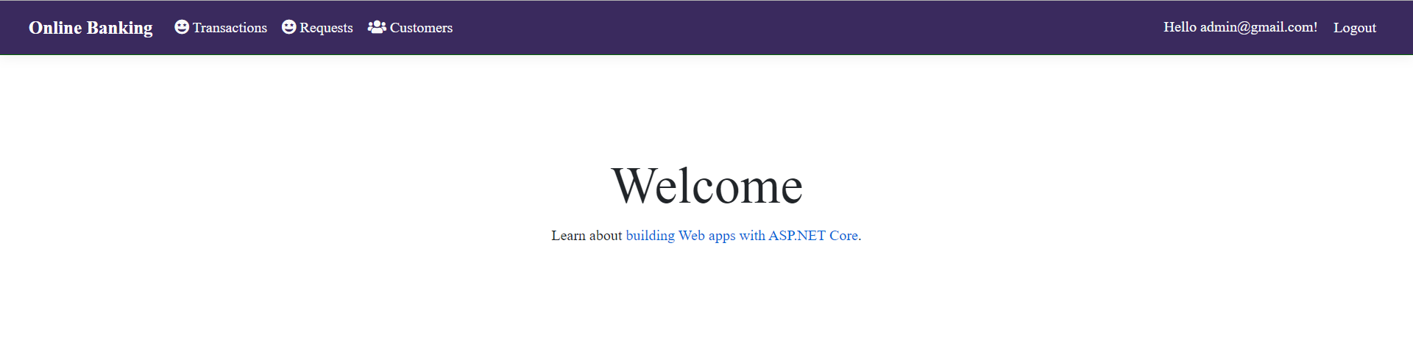

User Interface
There are two two types of users, admin and client, and the application has different functionalities for each. The menu bar is different for each type of user, as seen below.

Slide 9
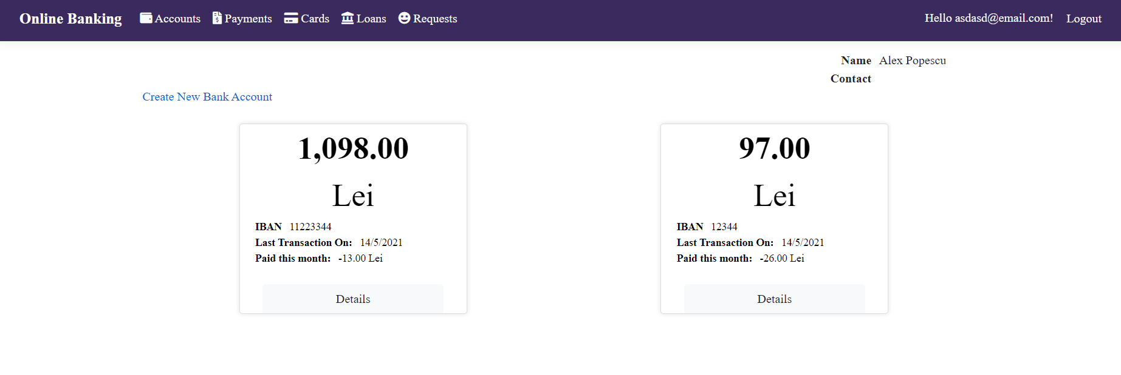
Accounts page
(for clients)
After login into their account, the client can create a new bank account as well as view all of the already existing bank accounts and minimal data about them, such as balance, IBAN, the date of the last transaction and how much they have spent in that month. For more details about their account, the clients will click on the “Details” button for each bank account.

Slide 10
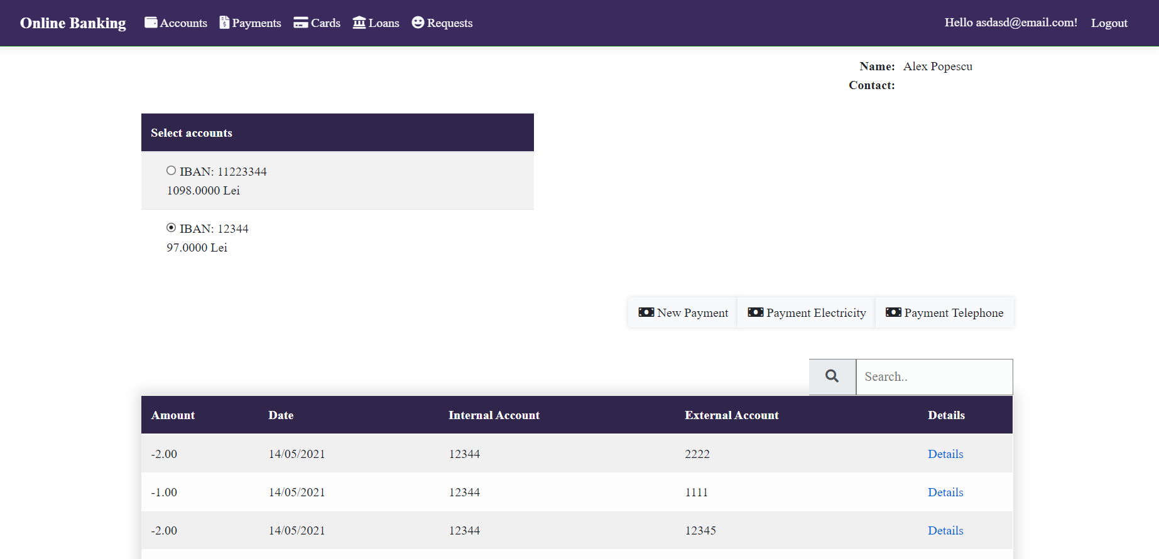
Payments for an account
(for clients)
After clicking on the “Details” button, the customer is redirected to a page where they can view their the transactions made with that bank account, as well as initiate a new payment to another account or make a payment to the Electricity or Telephone company. They also have the possibility of requesting a loan or request to attach a card to that certain account.

Slide 11
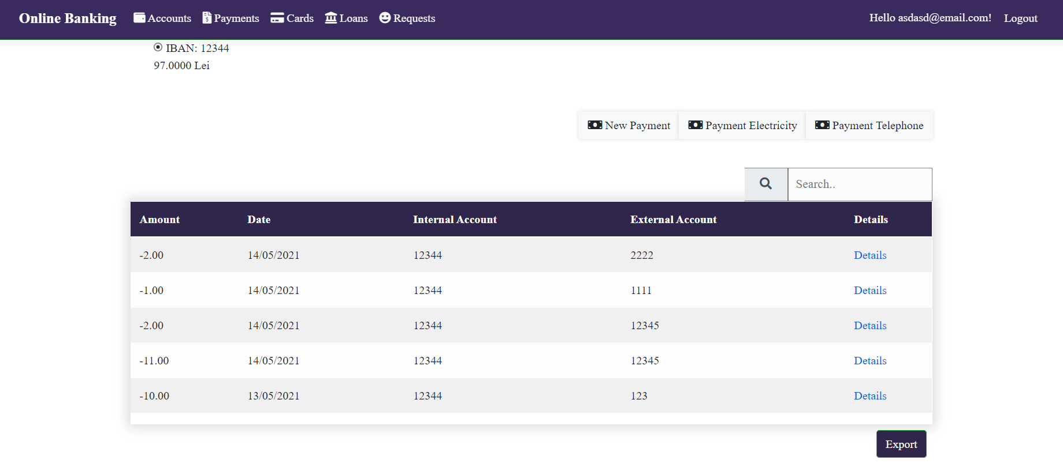
Payments page
(for clients)
On the Payments page, the client can choose between their account and view a table with the transactions made with that account as well as initiate a new payment or pay some utilities.

Slide 12
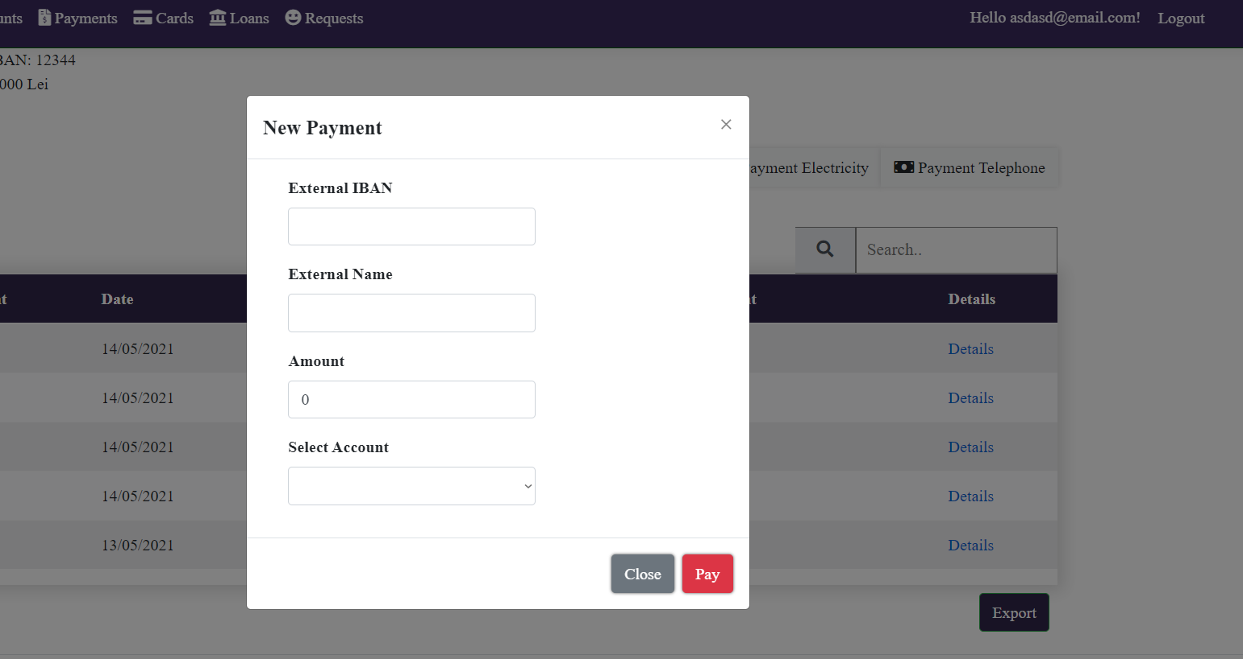
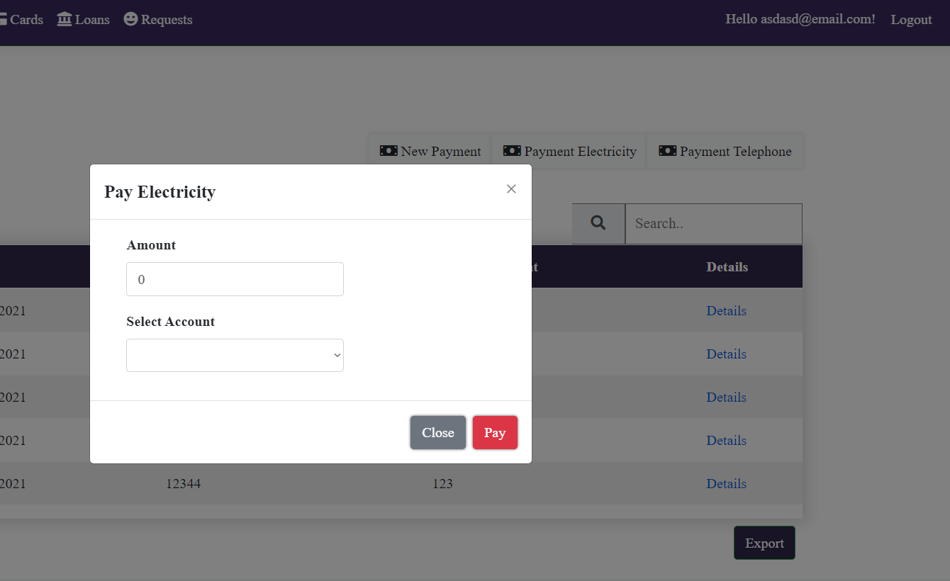

New Payment and Utility Payments
(for clients)
In the New Payment modal, the client will input data such as amount, name of the destination account and IBAN as well as details for the payment. For the utilities payment functionality, the client only has to input the amount and which one of their account the transaction is being made from.

Slide 13
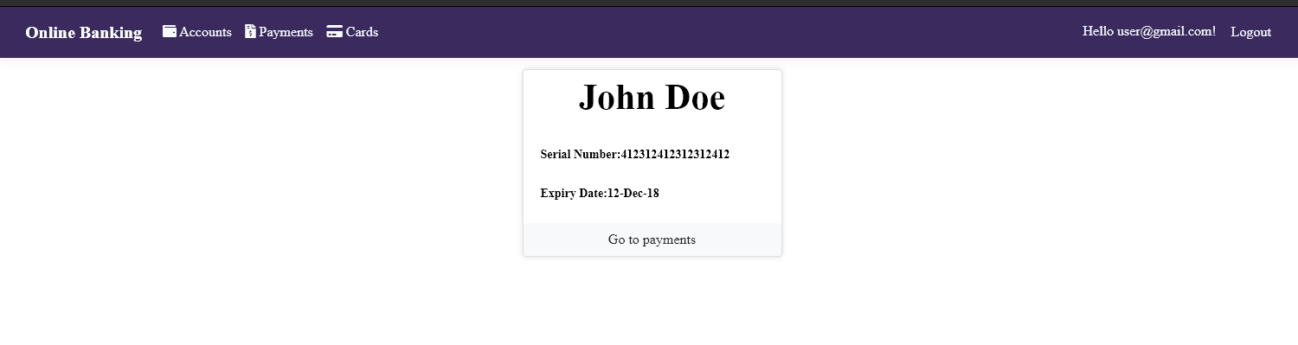
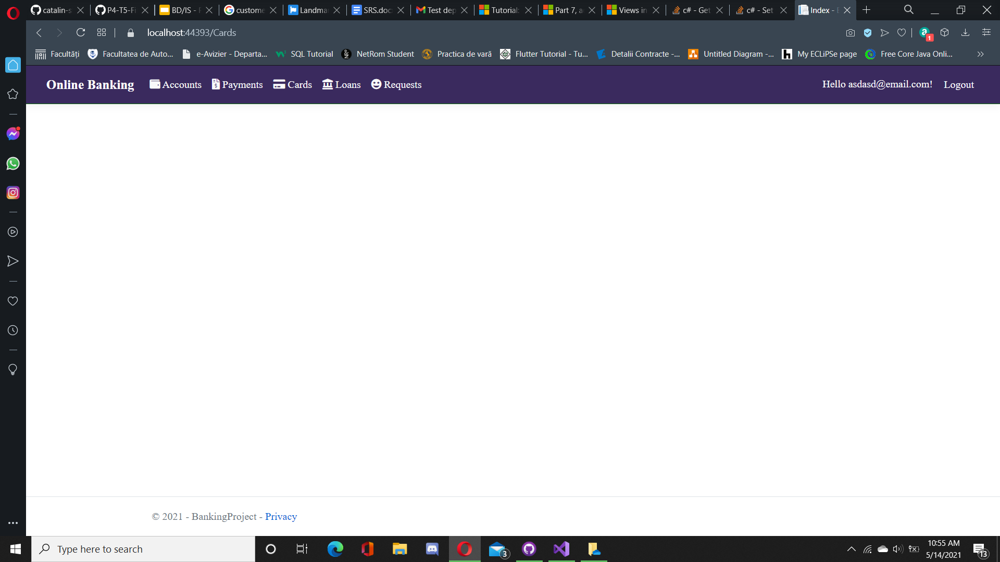
Cards page
(for clients)
On the Cards page, the client will be able to view all of their cards as well as the serial number and expiry date.

Slide 14

Loans page
(for clients)
On the Loans page, the client will be able to view all of their loans as well as the value, lunar fee and end date.

Slide 15
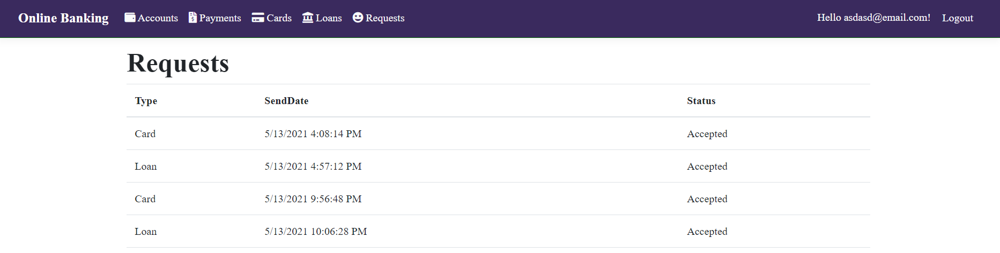
Requests page
(for clients)
On the Requests page, the client will be able to view all of their requests as well as the type, date and status of the request.

Slide 16
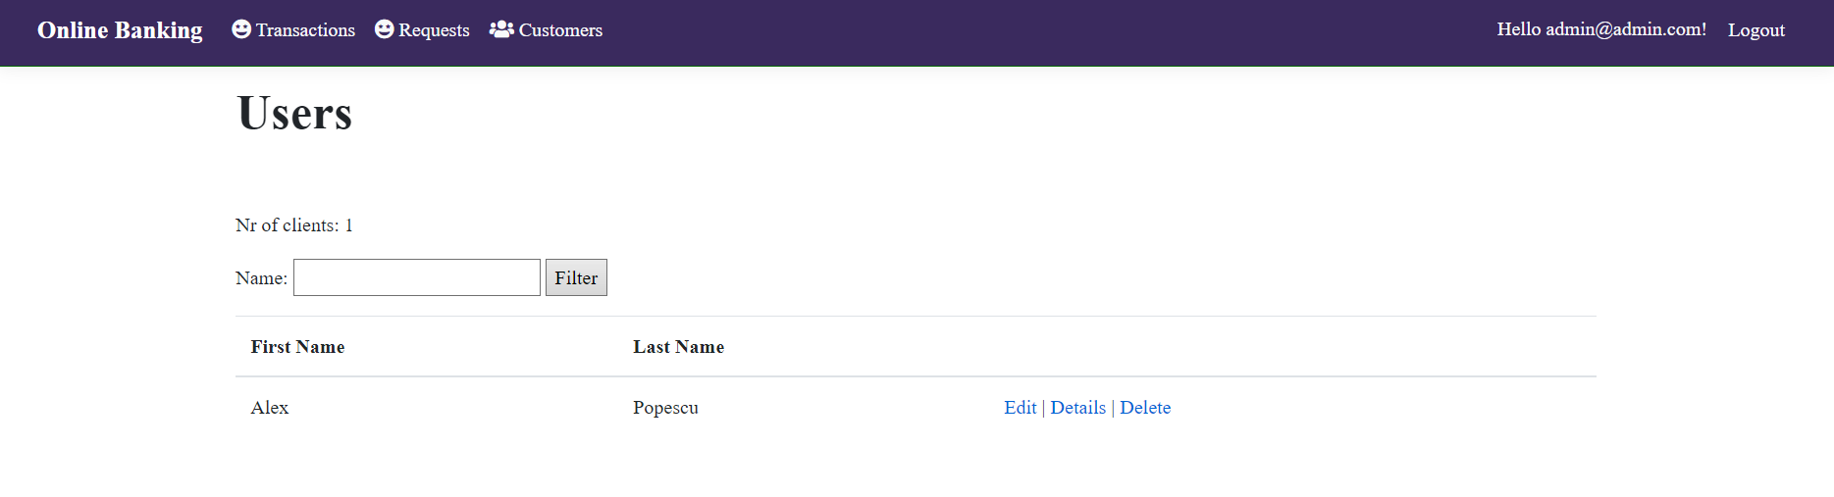
Customers
(for admin)
The admin can view all the customers or search some specific customers by their name, and read details about them. The admin can also remove and edit a customer. The number of customers is always shown above the table.

Slide 17
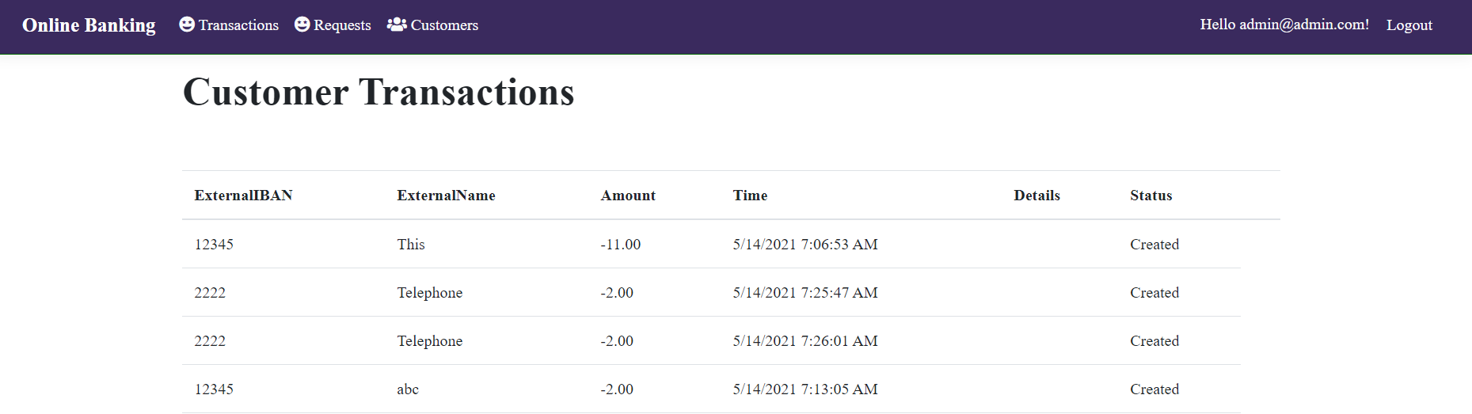

Customer Transactions
(for admin)
The admin is able to view a list of transactions made by a client by accessing the Details page of the client.

Slide 18
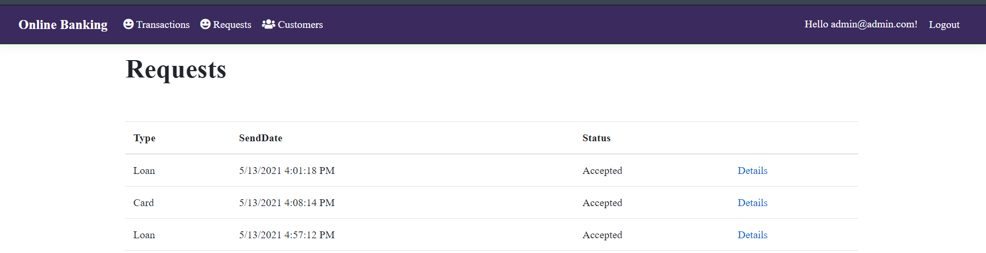
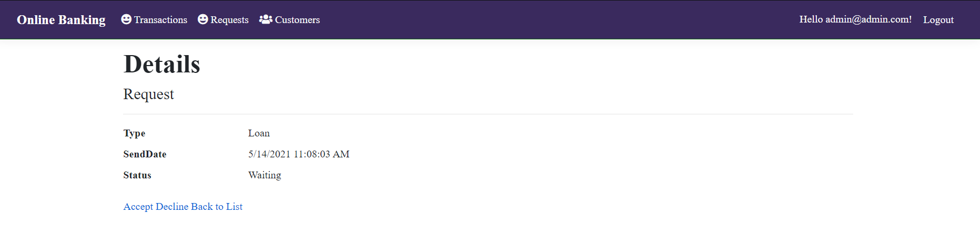
Requests
(for admin)
The admin will accept and decline the requests made by the customers by accessing the Details page.
Accept and Decline are present only for the waiting requests.
After being accepted, the loan will have a value, a start and end date and lunar fee.

Slide 19

Transactions
(for admin)
The admin is able to view a list of all transactions made by customers as well as the details for each transaction.

Slide 20
Thank you for your attention! :)

