Slide 1
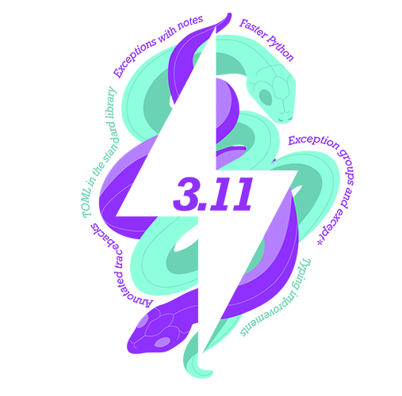
Python 3.11 aNd BEYOND
Alex PRENGERE

Slide 2
Python 3.11
Released on 2022-10-24 (1 year after 3.10)
As any release since 3.8, it will be followed by:
1.5 years of bugfix releases (~ every 2 months)
3.5 years of security releases after that (source only)

Slide 3
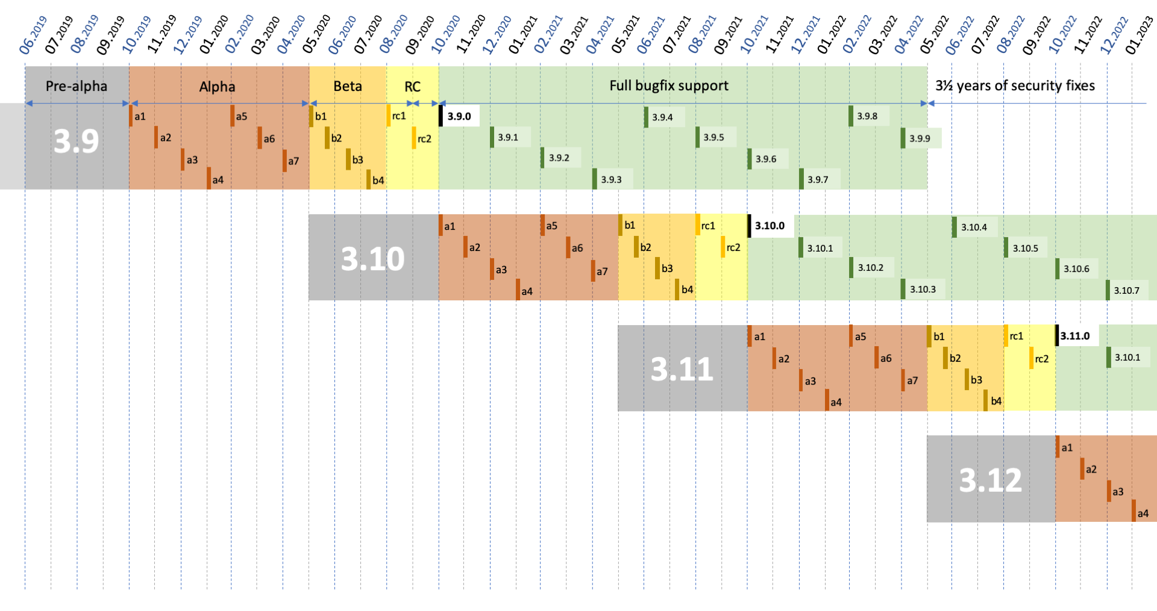

Slide 4
3.0
3.1
3.2
3.3
3.4
3.5
3.6
3.7
3.8
3.9
3.10
3.11
3.12
Alpha releases
Beta release
Stable release
F-strings
ASync
Type Annotations
Walrus
Typing improvements
Pat. Mat.
Performance
improvements

Slide 5
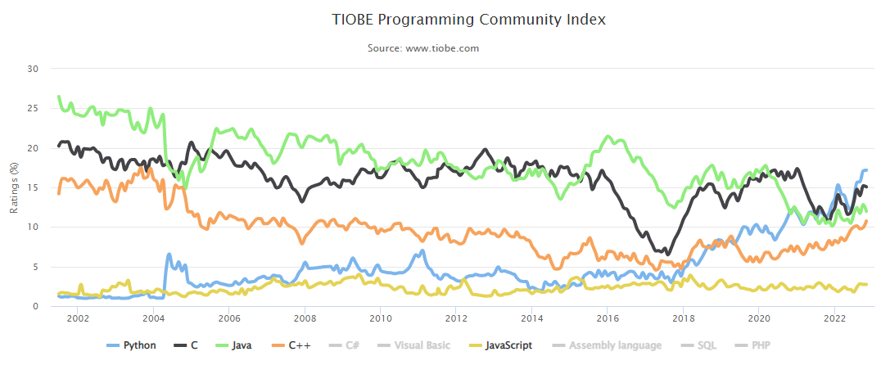

Slide 6
USING python 3.11

Slide 7
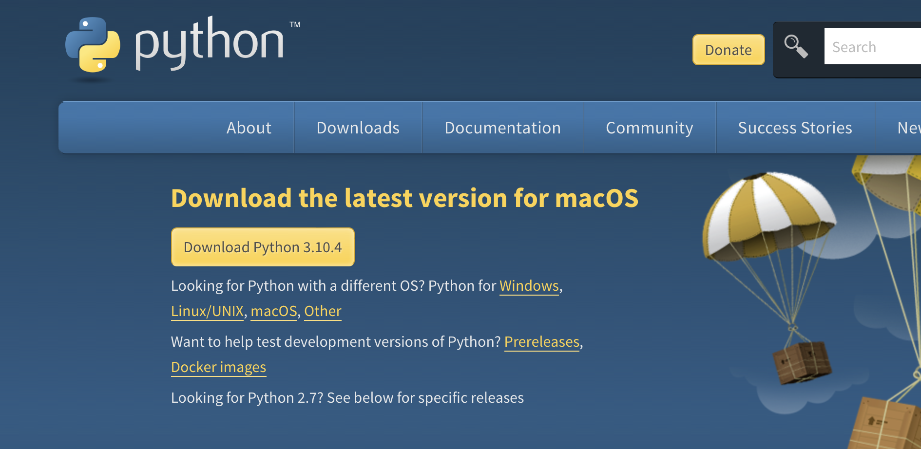
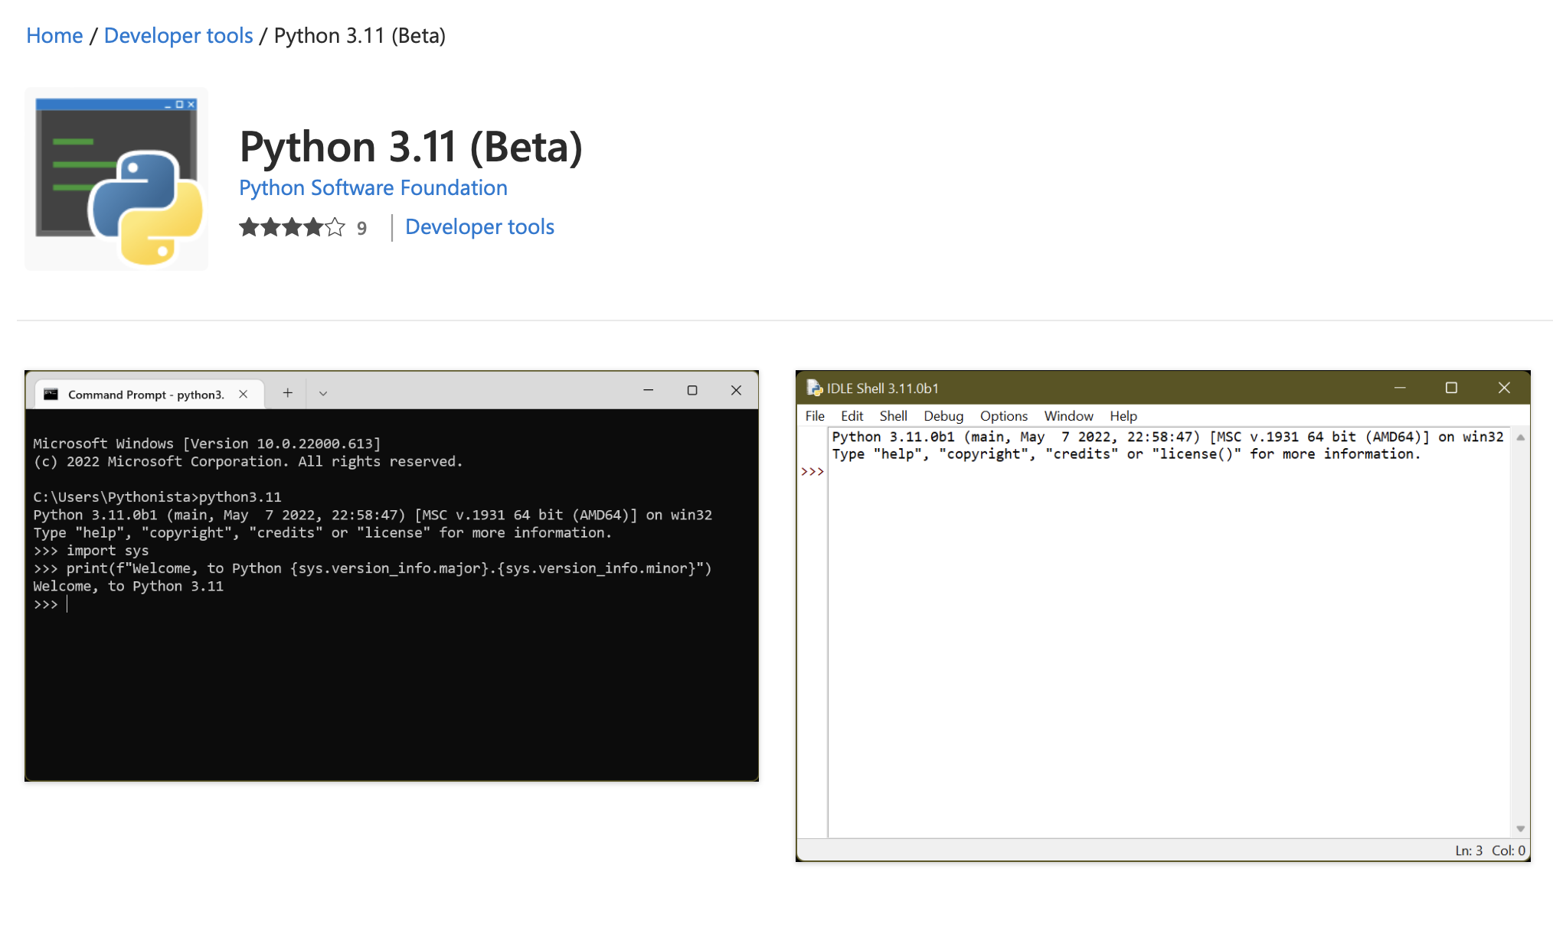
INSTALLING PYTHON 3.11
Use python.org:
Windows Users use the Store:

Slide 8
FROM SOURCES
git clone https://github.com/python/cpython.git cd cpython git checkout v3.11.0 ./configure --enable-optimizations make sudo make altinstall # install python3.11 to /usr/local/bin/

Slide 9
WITH DOCKER
FROM python:3.11
FROM python:3.11-slim [gcc not available, you need wheels for all packages]

Slide 10
WITH Continuous integration
With tox: add py311 to your tox.ini
With GitHub actions: use python-version: ["3.11"]

Slide 11
WHAT IS NEW
Exception handling
Asyncio
Typing
Standard library
Misc.
Performance

Slide 12
EXCEPTION UPDATES
Better tracebacks
Notes
Exception groups

Slide 13
REMEMBER THIS IN 3.10?
print("Hello, World!)
^
SyntaxError: unterminated string literal (detected at line 3)

Slide 14
BETTER ERROR TRACEBACKS
graph = {
"friends": [
{"name": "Alice"},
{"name": "Bob"},
]
}
graph["friends"][0]["age"]
Traceback (most recent call last):
graph["friends"][0]["age"]
~~~~~~~~~~~~~~~~~~~^^^^^^^
KeyError: 'age'

Slide 15
ENRICHING EXCEPTION WITH NOTES
graph = {
"friends": [
{"name": "Alice"},
{"name": "Bob"},
]
}
try:
graph["friends"][0]["age"]
except KeyError as e:
e.add_note("Check data")
raise
Traceback (most recent call last):
graph["friends"][0]["age"]
~~~~~~~~~~~~~~~~~~~^^^^^^^
KeyError: 'age’
Check data
e.__notes__ # ["Check data"]

Slide 16
EXCEPTION GROUPS
graph = {
"friends": [
{"name": "Alice"},
{"name": "Bob", "age": 28},
{"name": "Kevin"},
]
}
ages = []
errors = []
for friend in graph["friends"]:
try:
ages.append(friend["age"])
except KeyError as e:
errors.append(e)
if errors:
raise ExceptionGroup("Data issues", errors)
+ Exception Group Traceback:
| raise ExceptionGroup("Data issues", errors)
| ExceptionGroup: Data issues (2 sub-exceptions)
+-+---------------- 1 ----------------
| Traceback (most recent call last):
| ages.append(friend["age"])
| ~~~~~~^^^^^^^
| KeyError: 'age'
+---------------- 2 ----------------
| Traceback (most recent call last):
| ages.append(friend["age"])
| ~~~~~~^^^^^^^
| KeyError: 'age'
+------------------------------------

Slide 17
EXCEPTION GROUPS
def process(graph):
ages = []
errors = []
for friend in graph["friends"]:
try:
ages.append(friend["age"])
except KeyError as e:
errors.append(e)
if errors:
raise ExceptionGroup("Data issues", errors)
return statistics.mean(ages)
try:
process(graph)
except ExceptionGroup as e:
print(f"{len(e.args[1])} invalid entries")
graph = {
"friends": [
{"name": "Alice"},
{"name": "Bob", "age": 28},
{"name": "Kevin"},
]
}
2 invalid entries

Slide 18
EXCEPTION GROUPS
def process(graph):
ages = []
errors = []
for friend in graph["friends"]:
try:
ages.append(friend["age"])
except KeyError as e:
errors.append(e)
if errors:
raise ExceptionGroup("Data issues", errors)
return statistics.mean(ages)
try:
process(graph)
except* KeyError as e:
print(f"{len(e.exceptions)} invalid entries")
graph = {
"friends": [
{"name": "Alice"},
{"name": "Bob", "age": 28},
{"name": "Kevin"},
]
}
2 invalid entries

Slide 19
EXCEPTION GROUPS
def process(graph):
ages = []
errors = []
for friend in graph["friends"]:
try:
ages.append(int(friend["age"]))
except (KeyError, TypeError) as e:
errors.append(e)
if errors:
raise ExceptionGroup("Data issues", errors)
return statistics.mean(ages)
try:
process(graph)
except* KeyError as e:
print(f"{len(e.exceptions)} invalid entries")
except* TypeError as e:
print(f"{len(e.exceptions)} wrong type")
graph = {
"friends": [
{"name": "Alice"},
{"name": "Bob", "age": 28},
{"name": "Kevin"},
{"name": "Marie", "age": None},
]
}
2 invalid entries
1 wrong type

Slide 20
ASYNCIO UPDATES

Slide 21
TASK GROUPS in ASYNCIO
# BEFORE: asyncio.gather API
import asyncio
async def task(friend):
print(friend["age"])
async def main():
await asyncio.gather(
*(task(f) for f in graph["friends"])
)
try:
asyncio.run(main())
except Exception as e:
print(e)
# AFTER: asyncio.TaskGroup + ExceptionGroup
import asyncio
async def task(friend):
print(friend["age"])
async def main():
async with asyncio.TaskGroup() as tg:
for friend in graph["friends"]:
tg.create_task(task(friend))
try:
asyncio.run(main())
except* KeyError as e:
print(f"{len(e.exceptions)} failed")

Slide 22
TYPING UPDATES
PEP 646: Variadic generics
PEP 655: Marking individual TypedDict items as required or potentially missing
PEP 673: Self type
PEP 675: Arbitrary literal string type
PEP 681: Data class transforms

Slide 23
SELF TYPE
from dataclasses import dataclass
from typing import Any, Type, TypeVar
TPerson = TypeVar("TPerson", bound="Person")
@dataclass
class Person:
name: str
age: int
@classmethod
def from_dict(cls: Type[TPerson], info: dict[str, Any]) -> TPerson:
return cls(name=info["name"], age=info["age"])

Slide 24
SELF TYPE
from dataclasses import dataclass
from typing import Any, Self
@dataclass
class Person:
name: str
age: int
@classmethod
def from_dict(cls, info: dict[str, Any]) -> Self:
return cls(name=info["name"], age=info["age"])

Slide 25
STANDARD LIBRARY UPDATES

Slide 26
NEW TOMLlib MODULE
# units.toml
[second]
label = { singular = "second", plural = "seconds" }
aliases = ["s", "sec", "seconds"]
[minute]
label = { singular = "minute", plural = "minutes" }
aliases = ["min", "minutes"]
multiplier = 60
to_unit = "second"
>>> import tomllib
>>> with open("units.toml", mode="rb") as f:
... units = tomllib.load(f)
...
>>> units
{'second':
{'label':
{'singular': 'second',
'plural': 'seconds’},
... }}

Slide 27
CONTEXTLIB CHDIR
import os
import contextlib
with contextlib.chdir("/home"):
print(os.getcwd()) # /home

Slide 28
RE ATOMIC GROUPS & POSSESSIVE QUANTIFIERS
Use ?> to mark a group as atomic:
>>> reg = re.compile('a(bc|b)c')
>>> reg.match('abc')
<re.Match object; span=(0, 3), match='abc'>
>>> reg = re.compile('a(?>bc|b)c')
>>> reg.match('abc') # no match because no backtracking after bc
Possessive quantifiers (+) work similarly for patterns: '0*+\d{3,}'

Slide 29
DATETIME FROMISOFORMAT PARSES MORE THINGS
>>> from datetime import datetime
>>> datetime.fromisoformat("2020-01-01T01:05:10Z")
datetime.datetime(2020, 1, 1, 1, 5, 10, tzinfo=datetime.timezone.utc)

Slide 30
ENUM CHANGES
>>> from enum import StrEnum # new!
>>>
>>> class Geography(StrEnum):
... domestic = "domestic"
... continental = "continental"
...
>>> Geography.domestic == "domestic"
True
>>> str(Geography.domestic)
'domestic' # was 'Geography.domestic' before 3.11
All enum values now have identical str() and format()

Slide 31
MISC.

Slide 32
NEGATIVE ZERO FORMATTING
>>> -0.0
-0.0
>>> 0.0
0.0
>>> -0.0 == 0.0
True
>>> small = -0.00311
>>> f"A small number: {small:.2f}"
'A small number: -0.00' ☹
>>> small = -0.00311
>>> f"A small number: {small:z.2f}"
'A small number: 0.00' ☺

Slide 33
Python –P “PYTHONSAFEPATH”
$ touch random.py
$ python -c "import random; print(random)"
<module 'random' from '/home/user/random.py'>
$ python -P -c "import random; print(random)"
<module 'random' from '/usr/lib64/python3.11/random.py'>

Slide 34
PERFORMANCE IMPROVEMENTS

Slide 35
More
Scale-out Infrastructure
Rewrite in Cython
Use PyPy
Optimize Existing Code
Optimize DB/IO
Impact
Caching Tiers
Minor-Version Python Upgrades
Less
Less
Code Changes
More

Slide 36
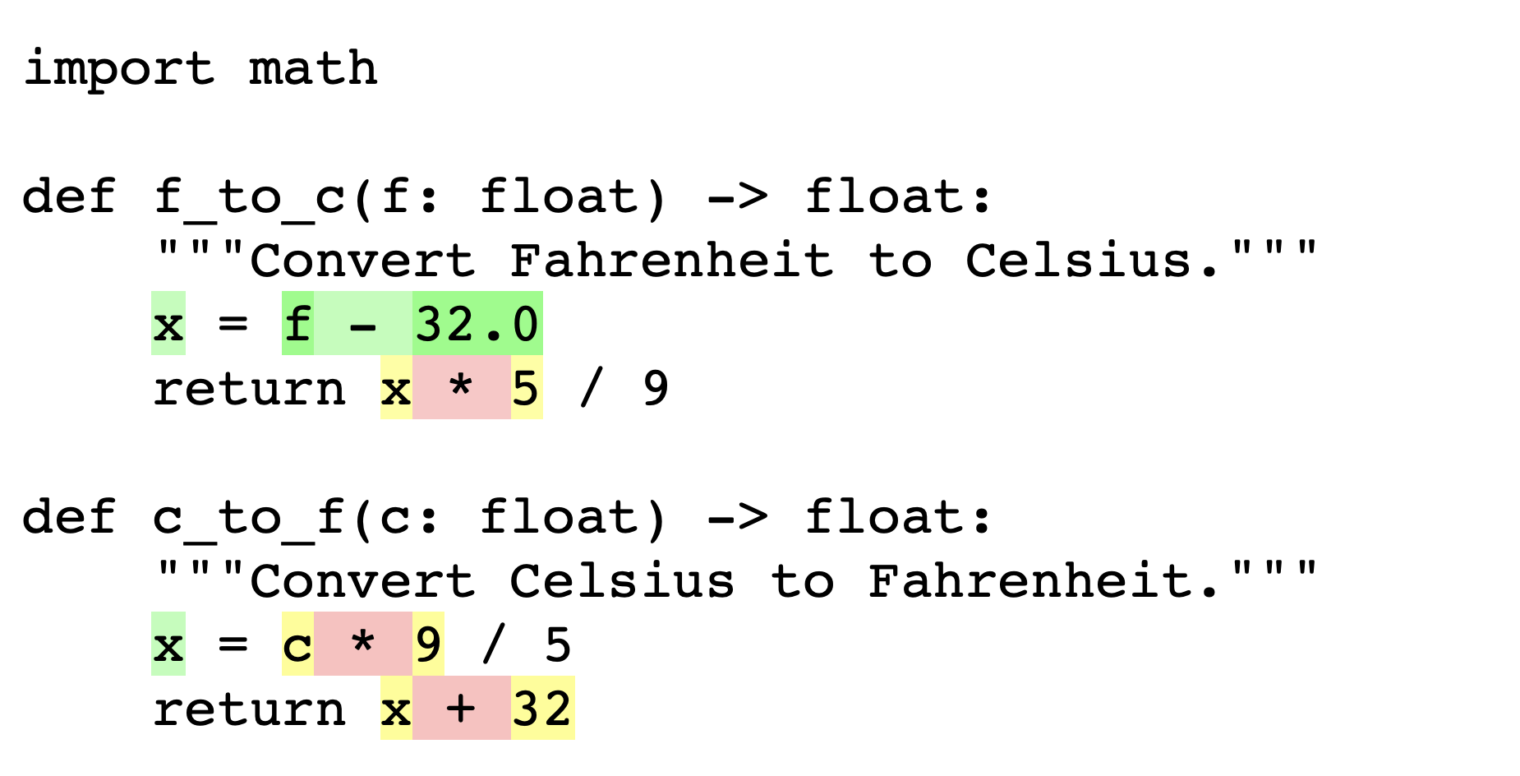
Specializing Adaptive Interpreter
Python 3.11 will optimize this to a float subtraction instead of a generic subtraction
10-60% faster(!)

Slide 37
Assorted performance updates
Exception handling goes from 10-15% overhead to ~1% overhead
Regular expressions are ~10% faster
Function calls are 10-20% faster
Startup is 30% faster

Slide 38
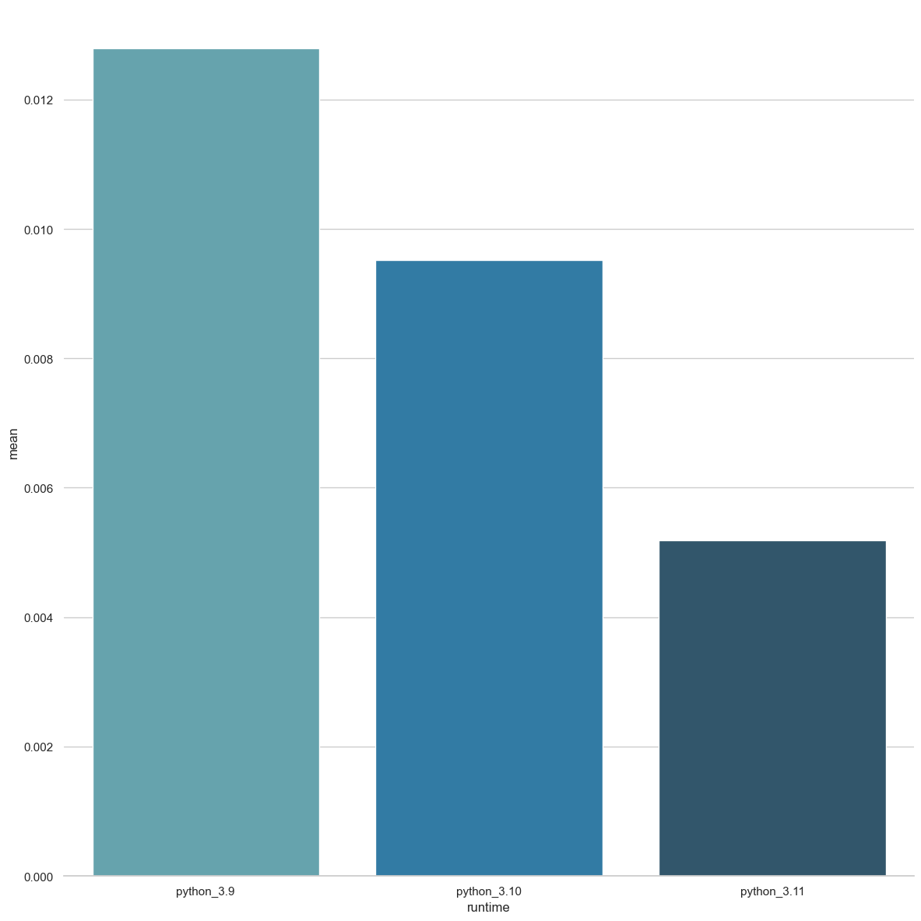
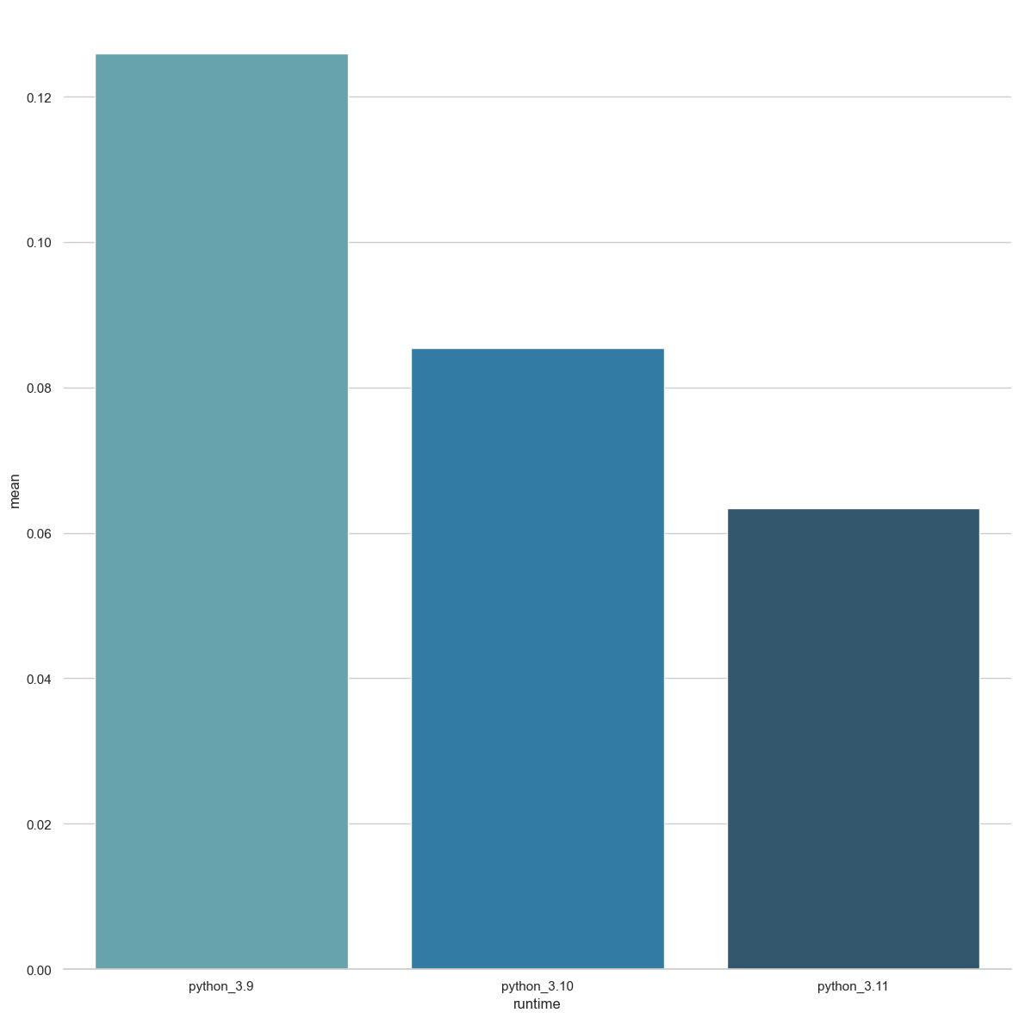
Realistic Benchmark results
Delta Blue benchmark uses:
- Classes, method calls and class methods
- Loops
Richards benchmark uses:
- Classes, method calls and class methods
- Loops
-20%
-30%
-20%
-60%
-50%
-60%
3.9
3.10
3.11
3.9
3.10
3.11

Slide 39
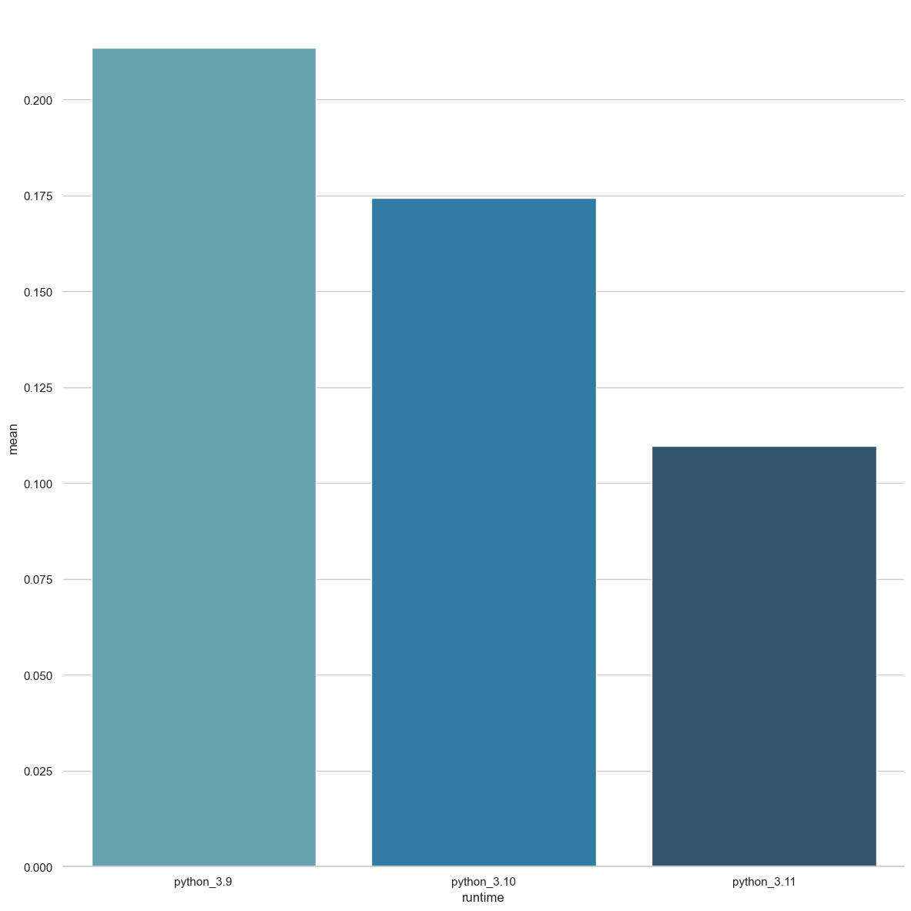
Math Benchmark results
Nbody benchmark uses:
- Tight, nested loops
- Floating point arithmetic
If your code is float-heavy, this is a good representation
-20% vs 3.9
-50% vs 3.10
-60% vs 3.9
3.9
3.10
3.11

Slide 40
And FOR ME?
Expect ~20-30% performance improvement in most applications
Benchmark your code
Transition from 3.9 – 3.11 could show a 2x performance gain

Slide 41
What can we expect in the future?
Python 3.12 is currently under development:
Lazy Imports
Even better error messages
Even more performance improvements (already ~5% faster than 3.11)
Per interpreter GIL (was called sub-interpreters)
Improved WASM support (currently tier 3 support)
Ongoing PEPs:
PEP 649 – Deferred Evaluation Of Annotations Using Descriptors
PEP 695 – Type Parameter Syntax
PEP 701 – Syntactic formalization of f-strings
Expect a JIT in 3.12 – 3.15

Slide 42
CONCLUSION
Better error messages
Task and exception groups
New typing features
Native TOML support
Faster code execution

