Slide 1

Python PACKAGING, in 2021
Alex PRENGERE

Slide 2
Things we will discuss
Import mechanism
Libraries vs applications
Wheels
Manylinux
Packaging with setuptools
PEP 517
setuptools_scm
poetry, flit, pipenv, pipx, conda

Slide 3
Prelude: Import mechanism
Python looks for imports in a list of directories in sys.path, configurable with $PYTHONPATH
Typically:
Local directory
Standard library: /usr/lib[64]/python3.X
User site-packages: $USER/.local/lib/python3.X/site-packages
Global site-packages: /usr/lib[64]/python3.X/site-packages
When working in a virtualenv: $VIRTUAL_ENV/lib[64]/python3.X/site-packages

Slide 4
2 FLAVOURS
Are you developing libraries?
Declare dependencies constraints, the dependency resolver will work on them during installation. Relevant tools:
setuptools (configured with setup.py and/or setup.cfg)
poetry
flit
Are you developing applications?
Pin exact dependencies to get reproducible builds. Relevant tools:
requirements.txt
pipenv (Pipfile/Pipfile.lock)
pip-tools

Slide 5
2 TYPES OF PACKAGES
Source distribution, also “sdist”: a distribution format that provides metadata and the essential source files needed for installing by a tool like pip
Wheels: a distribution format that contains compiled code, with a specially formatted filename and the .whl extension:
{dist}-{version}(-{build})?-{python}-{abi}-{platform}.whl
pandas-1.0.3-cp37-cp37m-manylinux1_x86_64.whl

Slide 6
Wheels ARE GREAT
Wheels install faster than source distributions for both pure-Python packages and extension modules.
Wheels are smaller than source distributions.
Wheels can be cached.
No setup.py execution, which is arbitrary code execution.
No need for a compiler to install wheels that contain compiled extension modules. The extension module comes included with the wheel targeting a specific platform and Python version.

Slide 7
TYPES OF Wheels
A universal wheel contains py2.py3-none-any.whl. It supports both Python 2 and Python 3 on any OS and platform.
A pure-Python wheel contains either py3-none-any.whl or py2.none-any.whl. It supports either Python 3 or Python 2, but not both. It’s otherwise the same as a universal wheel, but it’ll be labeled with either py2 or py3 rather than the py2.py3 label.
A platform wheel supports a specific Python version and platform. It contains segments indicating a specific Python version, ABI, operating system, or architecture.

Slide 8
MANYLINUX
manylinux1, manylinux2010, manylinux2014, manylinux_x_y… are platform tags that define compatibility for linux variations.
At its core, manylinux is a Docker image built off a certain version of the CentOS operating system. It comes bundled with a compiler suite, multiple versions of Python and pip, and an allowed set of shared libraries.
manylinux Tag | Architecture | Docker Image
manylinux1 | x86-64 | quay.io/pypa/manylinux1_x86_64
manylinux1 | i686 | quay.io/pypa/manylinux1_i686
manylinux2010 | x86-64 | quay.io/pypa/manylinux2010_x86_64
manylinux2010 | i686 | quay.io/pypa/manylinux2010_i686
Notes:
Manylinux1: CentOS5
Manylinux2010: CentOS6
Manylinux2014: CentOS7

Slide 9
PACKAGING WITH SETUPTOOLS

Slide 10
SETUP.PY
SETUP.CFG
import setuptools
with open("README.md", "r", encoding="utf-8") as fh:
long_description = fh.read()
setuptools.setup(
name="example-pkg-YOUR-USERNAME-HERE",
version="0.0.1",
author="Example Author",
author_email="author@example.com",
description="A small example package",
long_description=long_description,
long_description_content_type="text/markdown",
url="https://github.com/pypa/sampleproject",
project_urls={
"Bug Tracker": "https://github.com/pypa/sampleproject/issues",
},
classifiers=[
"Programming Language :: Python :: 3",
"License :: OSI Approved :: MIT License",
"Operating System :: OS Independent",
],
package_dir={"": "src"},
packages=setuptools.find_packages(where="src"),
python_requires=">=3.6",
)
[metadata]
name = example-pkg-YOUR-USERNAME-HERE
version = 0.0.1
author = Example Author
author_email = author@example.com
description = A small example package
long_description = file: README.md
long_description_content_type = text/markdown
url = https://github.com/pypa/sampleproject
project_urls =
Bug Tracker = https://github.com/pypa/sampleproject/issues
classifiers =
Programming Language :: Python :: 3
License :: OSI Approved :: MIT License
Operating System :: OS Independent
[options]
package_dir =
= src
packages = find:
python_requires = >=3.6
[options.packages.find]
where = src

Slide 11
MANIFEST.in
Adding & removing files to/from the source distribution is done by writing a MANIFEST.in file at the project root.
include *.txt
recursive-include examples *.txt *.py
prune examples/sample?/build

Slide 12
Repository [PyPI, …]
$ pip install toto
Compatible wheel available?
Yes:
download & cache wheel if not cached
install wheel
No:
download sdist
build wheel from sdist using setup.py
cache wheel
install wheel
$ python setup.py sdist upload $ python setup.py bdist_wheel upload
Library developer
Library user

Slide 13
BUT WAIT, THERE IS MORE
1991
distutils
setuptools
2008
wheels
2016
2000
pypi.org
2004
pip
2021
Python creation
pyproject.toml

Slide 14
Issue with setup.py
Extract from PEP517:
You can't execute a setup.py file without knowing its dependencies, but currently there is no standard way to know what those dependencies are in an automated fashion without executing the setup.py file, where that information is stored. It's a catch-22 of a file not being runnable without knowing its own contents which can't be known programmatically unless you run the file.

Slide 15
PEP 517 & PEP 518: pyproject.toml
A way to specify the build tools
The mere presence of pyproject.toml in the directory changes the sdist layout, and needs pip 10+ to be installed
[build-system] requires = ["setuptools>=42", "wheel"] build-backend = "setuptools.build_meta"
And now other build tools can be used!
poetry
flit

Slide 16
Repository [PyPI, …]
$ pip install toto
Compatible wheel available?
Yes:
download & cache wheel if not cached
install wheel
No:
download sdist
use pyproject.toml build-backend data to install build dependencies
build wheel from sdist using build tool
cache wheel
install wheel
$ python setup.py sdist upload $ python setup.py bdist_wheel upload
$ poetry publish
$ flit publish
$ python -m build && twine upload
Library developer
Library user

Slide 17


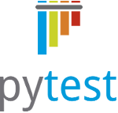

PEP 517 & PEP 518: pyproject.toml
Also used to store tools config, like Black & pytest
Tox will use it with isolated_build=true
Wait, can’t we store data from setup.cfg? Almost!
PEP 621 -- Storing project metadata in pyproject.toml
Not currently supported by setuptools ☹
Other build tools like poetry already use pyproject.toml as config file
What about lock files to manage transient dependencies?
Probably in 2022 with PEP 665 -- Specifying Installation Requirements for Python Projects

Slide 18
CONCLUSION

Slide 19
Modern packaging guidelines
Always use the latest pip
Publish sdist & wheels
Use a pyproject.toml to leverage PEP517 sdist
For now, store metadata in setup.cfg, and keep an empty setup.py for compatibility
Direct setup.py invocation are deprecated: use python –m build and twine upload
Don’t use Alpine Linux for containers (yet)

Slide 20
BUT WAIT, THERE IS MORE

Slide 21
Issue with versioning
Tracking the version information in multiple locations is error prone:
In build metadata like setup.cfg
Sometimes, within source for introspection: library.__version__
Sometimes, in git tags, to be able to install from the git repo & trigger CI/CD

Slide 22
SETUPTOOLS_SCM
setuptools_scm is an alternative to setuptools (thanks PEP517!)
setuptools_scm unifies the 3 typical version locations:
Dynamically computes version info from git/svn/hg, at sdist/wheel creation time
Can write “version file” in sources
Completely transparent for consumers of the packages
Also, setuptools_scm handles the role of the MANIFEST.in based on versioned files (you can override it still)

Slide 23
SETUPTOOLS_SCM
# Example of pyproject.toml with setuptools_scm
[build-system]
requires = [
"setuptools>=42",
"wheel",
"setuptools_scm[toml]>=3.4"
]
build-backend = "setuptools.build_meta"
[tool.setuptools_scm]
write_to = "toto/_version.py"

Slide 24
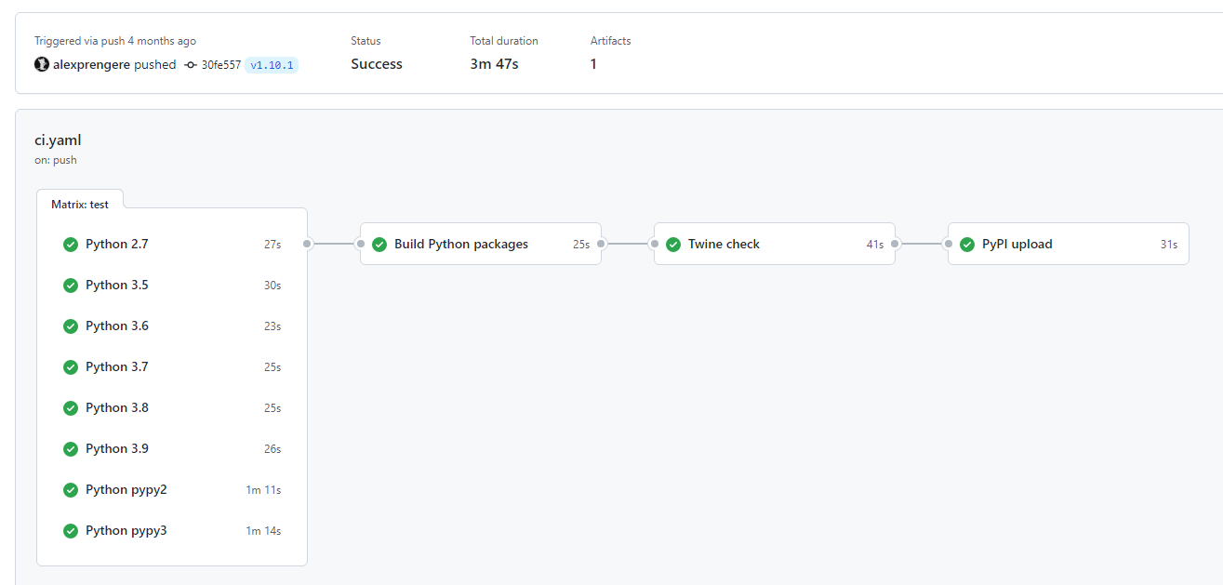
SETUPTOOLS_SCM
Writes toto/_version.py based on tag name
Writes version in METADATA/PKG-INFO in sdist/wheel

Slide 25
“OTHERS”

Slide 26
Conda
Another packaging system
Completely separated from PyPI
Key difference:
pip installs Python packages
conda installs packages which may contain software written in any language

Slide 27
pipx
Install and run applications in isolated virtual environments:
python3 -m pip install --user wheel pipx
pipx install virtualenv
pipx install tox
pipx install black
pipx install pylint
pipx install flake8

Slide 28
QUESTIONS?

