Slide 1

What seems to be a problem?
Imagine yourself:
Stuck with a math problem for the last few days
Have a deadline for an assignment approaching
Missed group tutoring or couldn’t attend a session
Seems like everyone in class gets a concept but you
Has just a tiny questions not worth attending group 3hr session

Slide 2

What seems to be a problem?
Nothing seems to work:
Contacted the professor but still have questions
Didn’t find a logical answer online
Was shy to ask during class
Can’t drop the class because your dad already promised you a car ☺

Slide 3


Ment4U
Instant results.

Slide 4





How does it work? MobileApp
Potential tutors
Students
instaTutor
Student
Tutor
Register

Slide 5
Tutoring: why would I use it. Why to get a tutor
Free and convenient location time
Urgent help
Concept help chapter help
Learning from another prospective
Get it explained in your language (including translating if required)
One – to – one
Why would you wait for a cab when you can get an Uber

Slide 6
Mentoring. Why would I do it?
By tutoring you’re repeating and consolidating your knowledge
“Learn by teaching” method
Developing teaching skills
Getting new friends, social experience
Earning college credit, cash rewards
Giving back to the community
Moral satisfaction

Slide 7
Why would university want it?
University of the future, high-tech and innovations. Finish in 4!
Helps with classes to improve grades and socialize on the way
Get the load off the teachers
Cut the endless lines to their offices
Build a community spirit
Urgent help for left behind students
Finding talents and potential future teachers
Create a competition on a tutoring market, improve quality
You can actually make money out of it
One more product to reach out for shy students

Slide 8
Who’s qualified to be a tutor
“A” student in a specific course. Matching/Different professor
Good moral conduct
30 mins “Effective tutoring” class attendee
15 mins “Behavior & Attitude” class attendee
Available on campus

Slide 9
Who’s qualified to get tutoring
Student enrolled in this class
Who needs help
Good moral conduct

Slide 10
Safety & Reward measures
Agreement for a tutor: no harassment, no personal information, professional behavior, liability for misconduct
Waiver of legal responsibility for a college from a student side.
Record a session, extra psychological assessment if required.
Girl to girl, boy to boy rule if necessary (culturally, religiously).
Report a tutor -> not efficient, abusive
Rate my tutor -> rate your experience, give feedback, suggestions, ways to improve
More satisfied students with improved grades more hours of tutoring -> financial reward, other benefits like job opportunities
College credit

Slide 11
Tutor registration: Step 1
Tutor
Enter your
Student ID:
Student signs-in as a tutor with his college ID. The app connects to the server and pulls out his transcript with grades. Program will only allow a student to tutor a course that he got “A” in. It will either hide or disable all the other courses.
W1570808
Math 400
A
Math 401
A
Stats 300
C
CISP 310
A

Slide 12
Tutor registration: Step 2
Select timing:
Student selects courses he’s willing to tutor and the time he’s usually available on is on campus
Select courses:
Select timing:
Select courses:
1000-1030
X
W1570808
Mon
1000-1030
X
W1570808
Mon
1500-1530
Math 400
A
X
Tue
1000-1030
Math 400
A
X
Tue
1500-1530
A
1000-1030
A
Wed
Math 401
Wed
Math 401
1500-1530
C
Thu
1000-1030
X
Stats 300
Thu
X
Stats 300
1500-1530
Fri
1000-1030
CISP 310
A
Fri
CISP 310
A
X
X
1500-1530

Slide 13
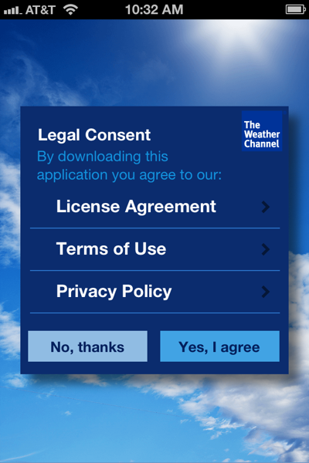
Tutor registration: Step 3
Tutor name | Courses | Timing
Jason Smith | Math 400, Stats 300, CISN305 | MON1000-1030, FRI1100-1200
Larry Jones | Math 400, Stats 315, CISN306 | TUE1000-1030, FRI1100-1201
Leroy Brown | Math 401, Stats 300, CISN307 | WED1000-1030, SAT1100-1202
Jerome White | Math 260, CISP 310, CISN308 | MON1000-1030
Student accepts the terms of using the app including legal responsibilities as well as waives any legal actions against college. At this point a record created in the database on the server with tutor details

Slide 14
Student registration: Step 1
Enter your
Student ID:
Student registers to receive help from tutors by entering his student ID number. The application contacts the server and pulls out the list of courses the student is currently enrolled.
W1570808
Math 400
Math 401
Stats 300
CISP 310

Slide 15
Student registration: Step 2
Select a
course:
At this step a student selects timing at which he wants to receive tutoring.
Select timing:
1000-1030
W1570808
Mon
1000-1030
1500-1530
1500-1530
Math 400
Tue
1000-1030
X
Math 401
X
Wed
1000-1030
1500-1530
Stats 300
Thu
1000-1030
1500-1530
CISP 310
Fri
1000-1030
1500-1530

Slide 16
Student registration: Step 3
Select a
tutor:
At this step a student selects an available tutor, agrees to the terms and conditions of the tutoring and is ready to go
W1570808
Jason Lee
OJ Smith
X
Gary Lyn
Ann Moor

Slide 17

Tutor notification
Tutoring request:
Math 360
Jerome Smith
Today 300pm-330pm
The app sends a notification to the selected tutor. If the job is accepted the student will get a confirmation about the meeting with details and location. If declined the job s passed to the next tutor in line.
Confirmed. Thanks

Slide 18
Selling the advantage
Registration fee for student($0.99)/tutor ($1.99)
VIP. Fast-track. Urgent button – extra charge in-app purchases.
Trademark, patent and domain name are available
Easy cross-platform mobile app
Number of Colleges & Universities: 4084 Breakdown: 4 year: 2363; 2 year: 1721

Slide 19
More statistics
“ In fall 2015, some 20.2 million students are expected to attend American colleges and universities, constituting an increase of about 4.9 million since fall 2000. Females are expected to account for the majority of college students: about 11.5 million females will attend in fall 2015, compared with 8.7 million males.
More students are expected to attend full time than part time (an estimated 12.6 million, compared with about 7.6 million). About 7.0 million students will attend 2-year institutions and 13.2 million will attend 4-year institutions in fall 2015. Some 17.3 million students are expected to enroll in undergraduate programs and about 3.0 million will enroll in post baccalaureate programs.”

Slide 20
Graduation statistics
Degrees Awarded Annually: | Number
Associate | 696,660
Bachelor’s | 1,439,264
Master’s | 574,618
Doctorate | 52,631
Professional | 87,289
Enrollment Demographics:
Women | 57.4%
Full-time | 61.7%
Minority | 30.9%
Foreign | 3.3%

Slide 21
Enrollment statistics
Number of U.S. Colleges and Universities | Number | Enrollment
Public 4-year institutions | 629 | 6,837,605
Private 4-year institutions | 1,845 | 4,161,815
Public 2-year institutions | 1,070 | 6,184,229
Private 2-year institutions | 596 | 303,826
Total | 4,140 | 17,487,475
Undergraduate |  | 14,473,884
Graduate |  | 2,097,511
Professional |  | 329,076
What??? Why can’t so many people reach the finish line and graduate? Does everyone become Bill Gates or Sergey Brin or just they don’t get proper help?

Slide 22




Are you on board?
Reach 500’000 tutors across the nation to reach millions of students

