Slide 1
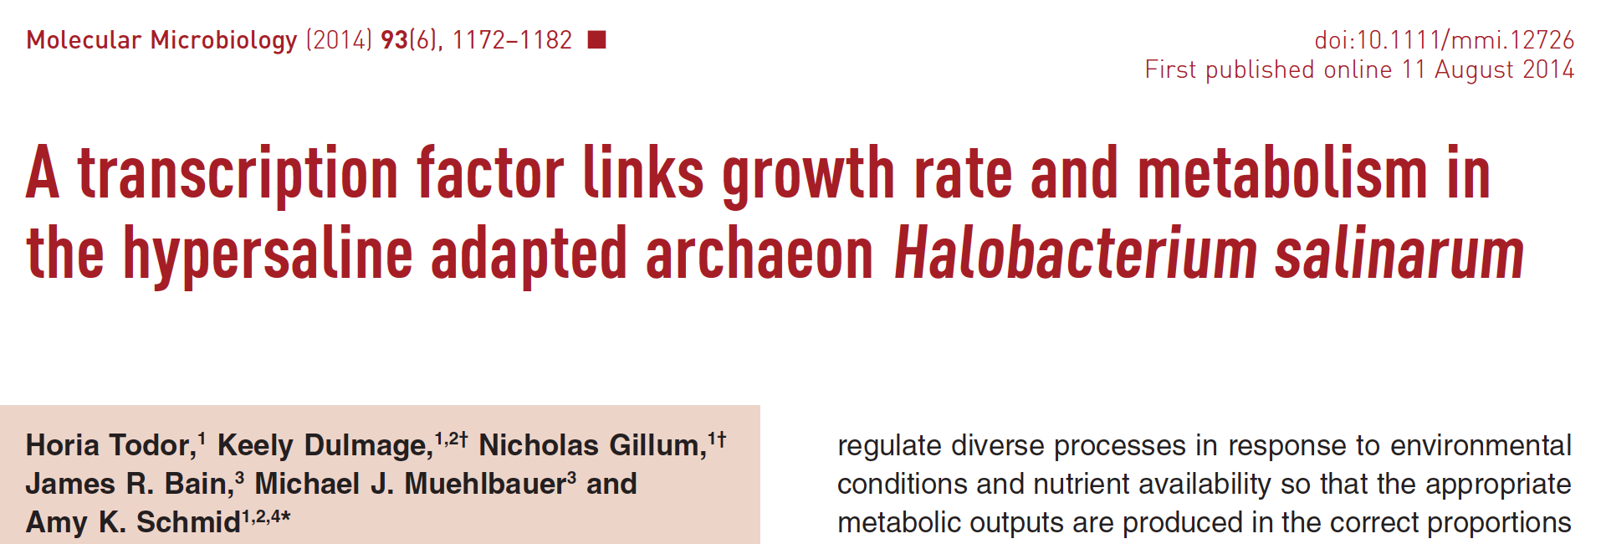

Slide 2
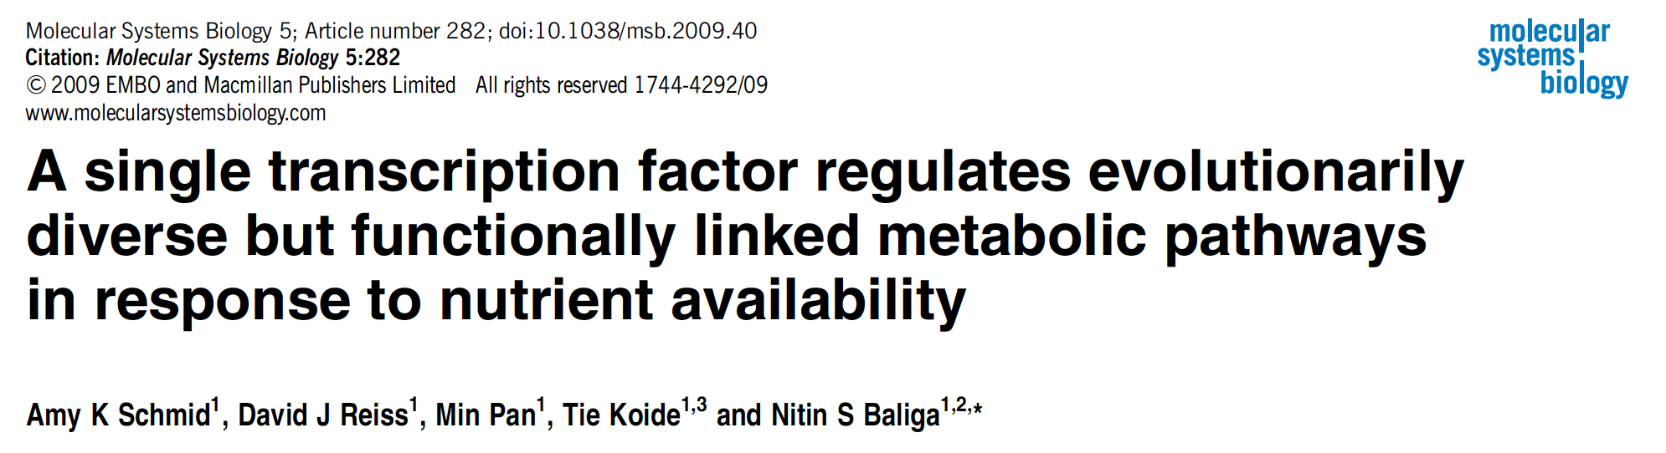

Slide 3
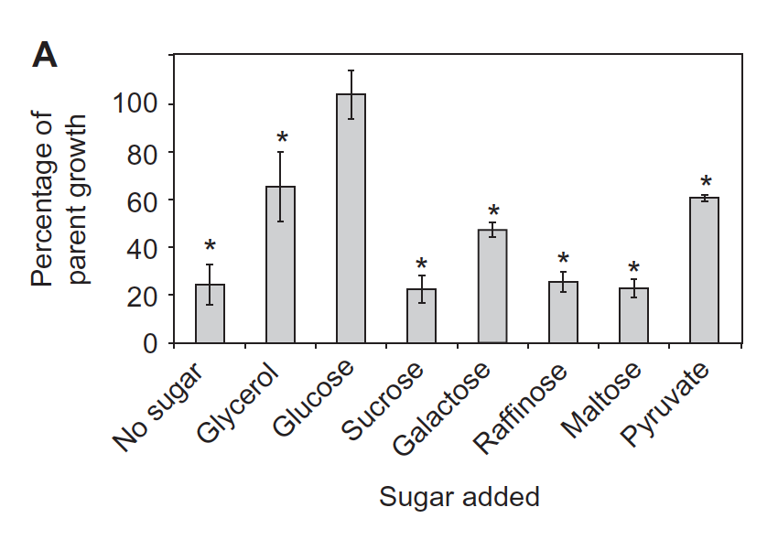
Comparison of growth of the parent strain versus ΔtrmB mutant in complete defined medium supplemented with various sugars

Slide 4
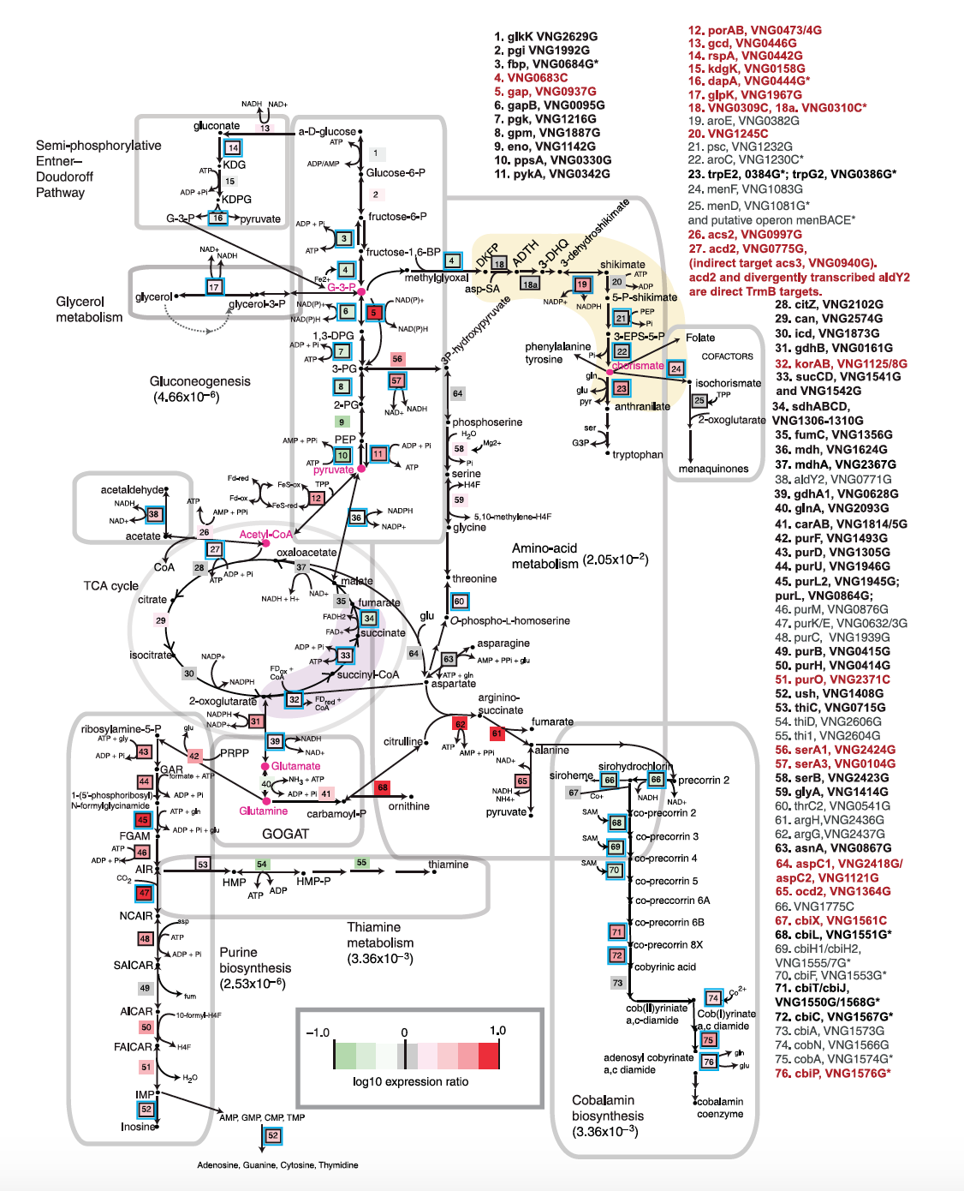
TrmB is a global bifunctional regulator, which coordinates the expression of evolutionarily diverse metabolic enzyme genes. Pathway diagram represents the
reconstructed TrmB-specified metabolic network for H. salinarum.
Glycolysis, etc
Gluconeogenesis

Slide 5
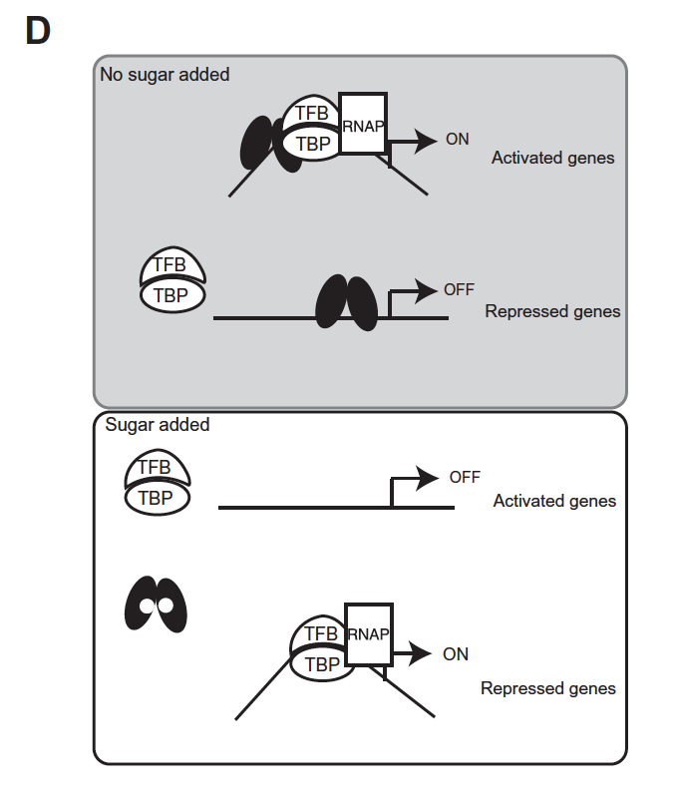
Model for the TrmB mechanism of interaction with the general transcription factor machinery (TFB/TBP) at target promoters.
Black ellipses represent TrmB. Small white circles inside TrmB represent the binding effector, which enables TrmB to dissociate with the DNA in the presence of glucose.

Slide 7
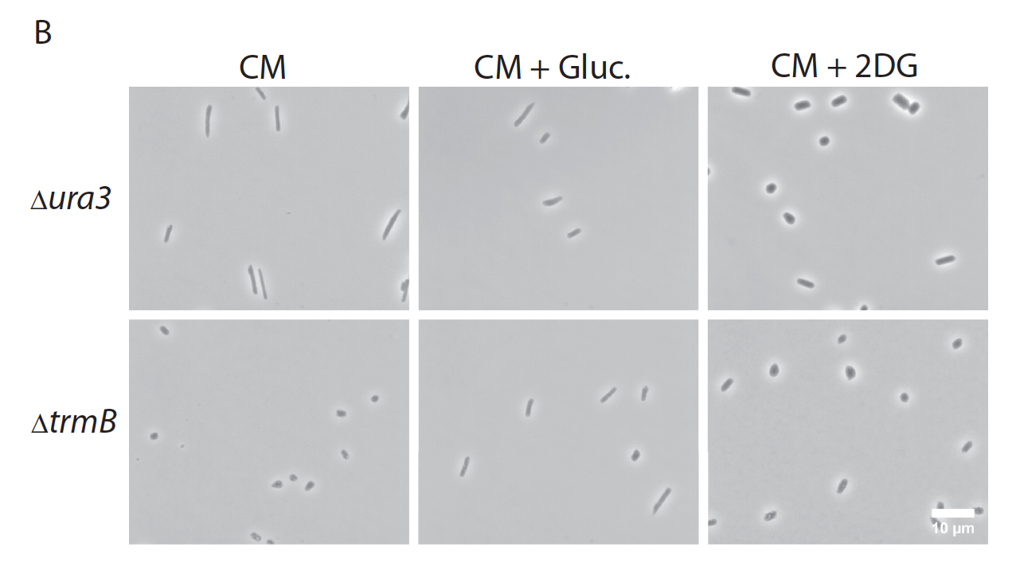
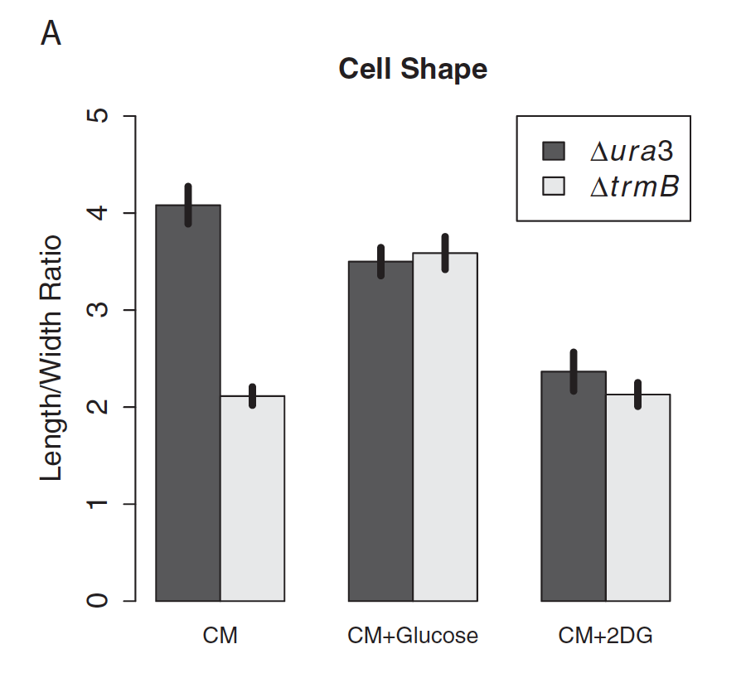
The ΔtrmB mutant strain exhibits altered cell morphology in the absence of glucose.

Slide 8
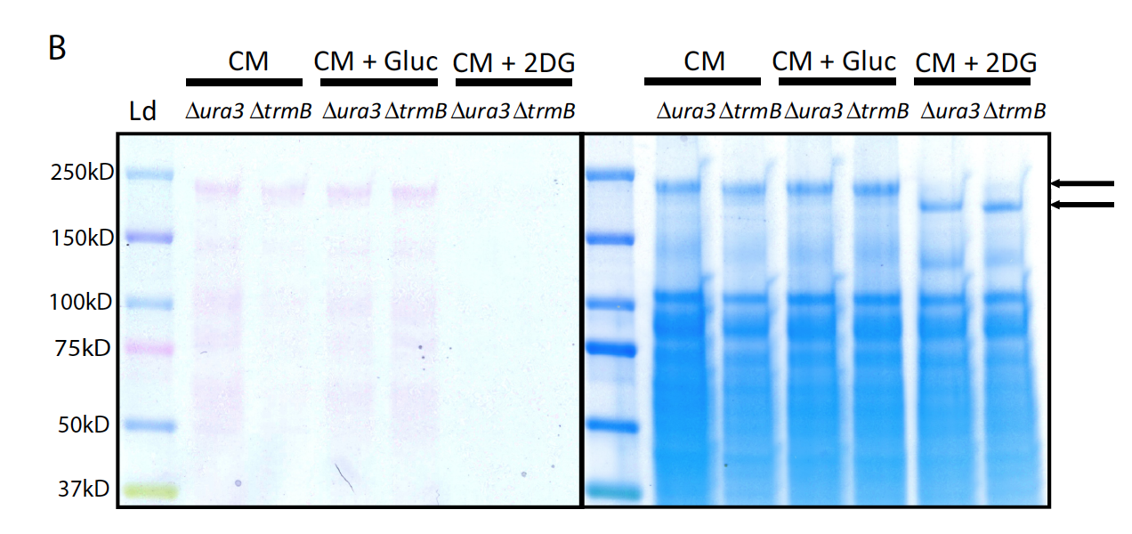
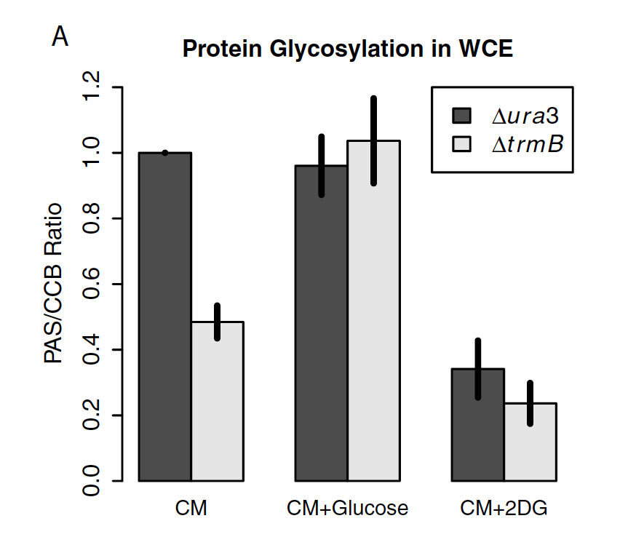
S-layer protein glycosylation is deficient in the ΔtrmB mutant strain in the absence of glucose.

Slide 9
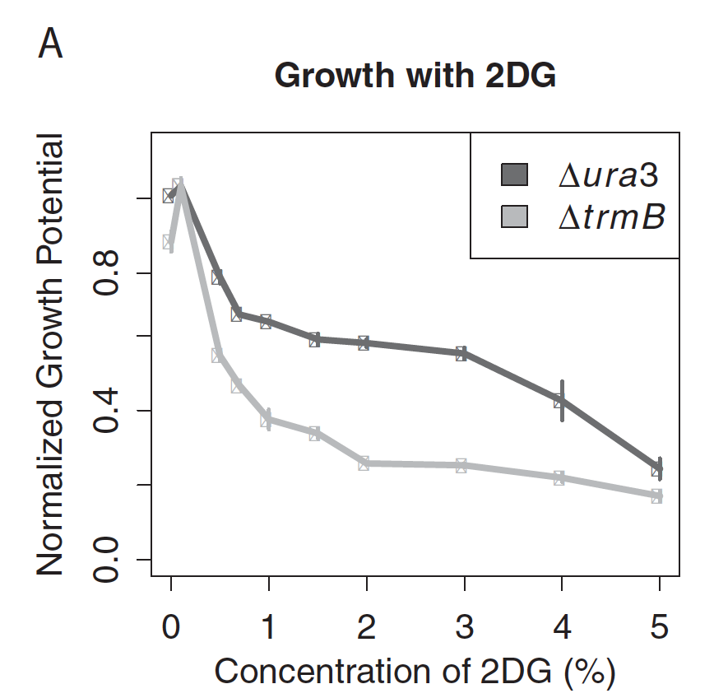
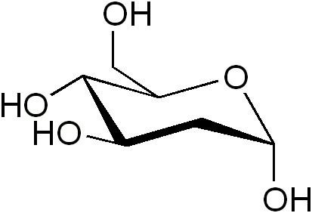
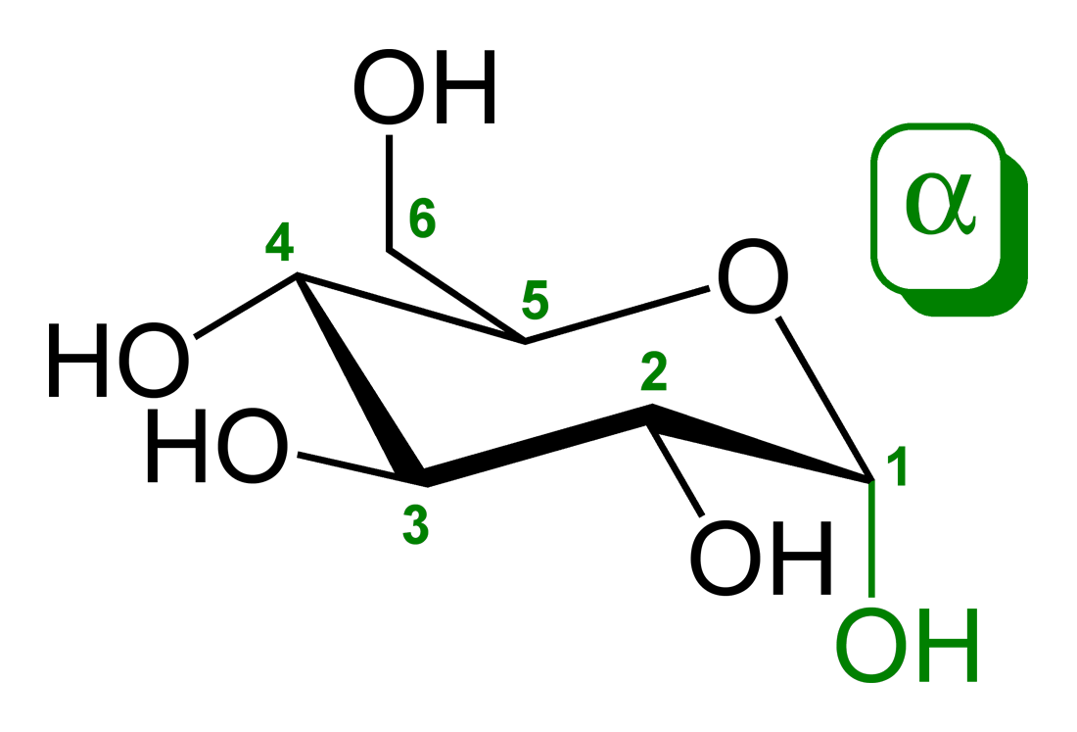
The ΔtrmB mutant exhibits impaired growth at lower 2DG concentrations than the Δura3 parent strain. In contrast, the growth inhibition due to bacitracin is constant between the ΔtrmB mutant and the Δura3 parent strain.
2-deoxy-glucose
glucose

Slide 10
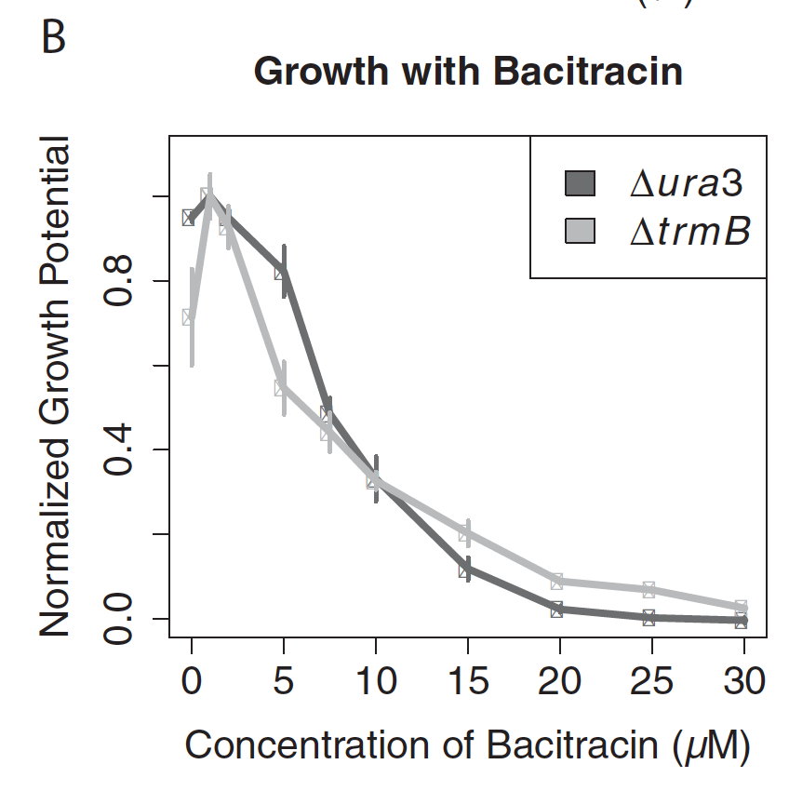
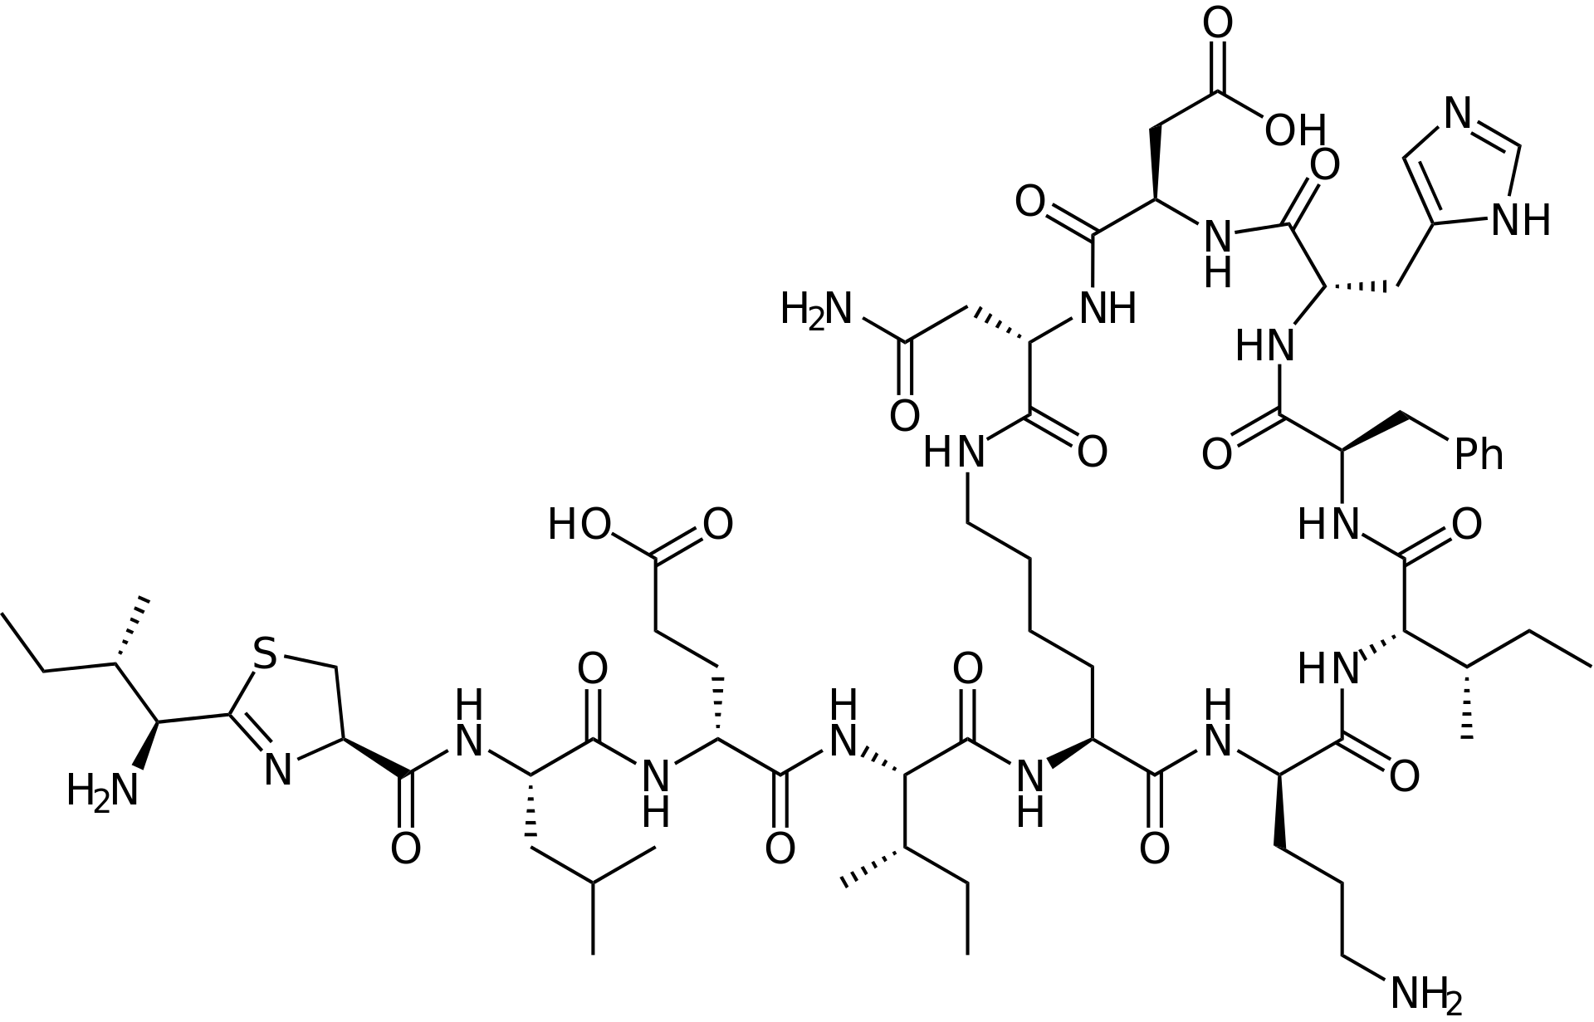
The ΔtrmB mutant exhibits impaired growth at lower 2DG concentrations than the Δura3 parent strain. In contrast, the growth inhibition due to bacitracin is constant between the ΔtrmB mutant and the Δura3 parent strain.

Slide 11
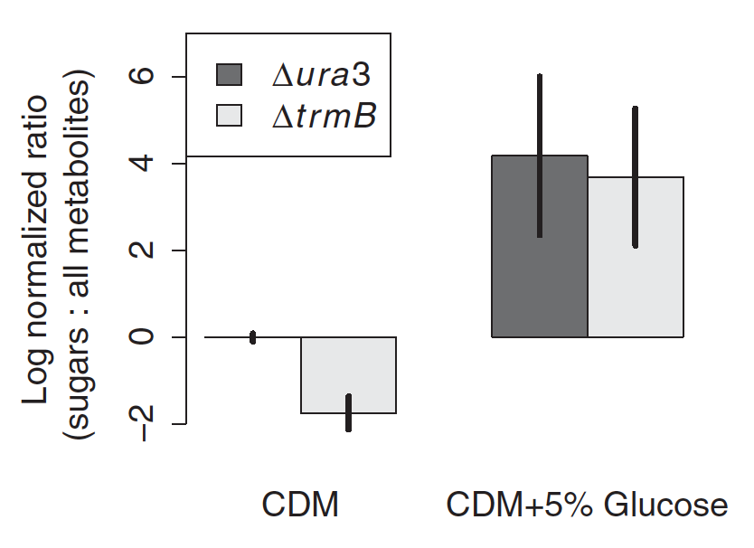
The ΔtrmB mutant strain is deficient in sugars in the absence of glucose. Glucose complements this phenotype,
returning sugar levels to those of the Δura3 isogenic parent strain.

Slide 12
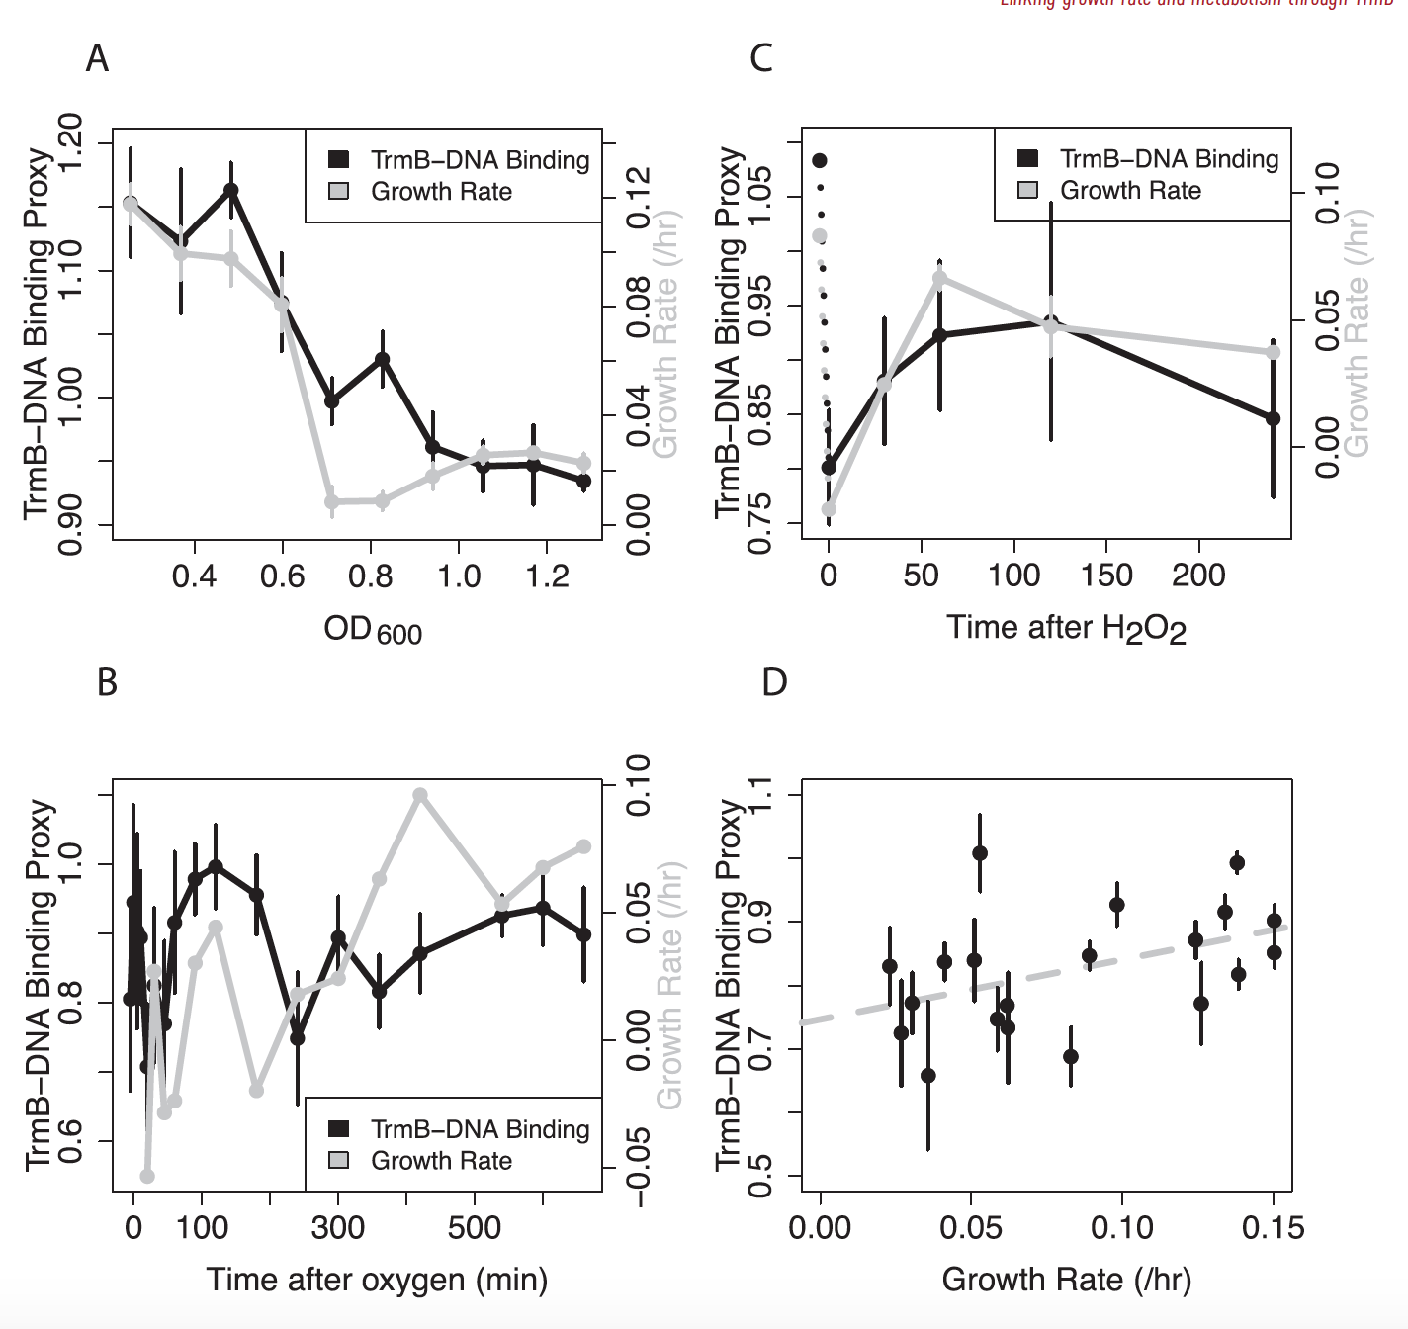
Inferred TrmB–DNA binding correlates with growth rate across growth in batch culture (A), during the shift from anoxic to oxic conditions in a turbidostat (B), during a sublethal challenge with H₂O₂ (C), and during mid-log phase growth in media of varying salinity (D).
The proxy was defined as the average of gene expression of 6 TrmB-activated genes coding for enzymes in the hypothesized gluconeogenic pathway and the reciprocal of 2 TrmB-repressed genes coding for enzymes that catalyse the reverse reactions.
Gene expression values were obtained from published microarray data for H. salinarum.

Slide 13
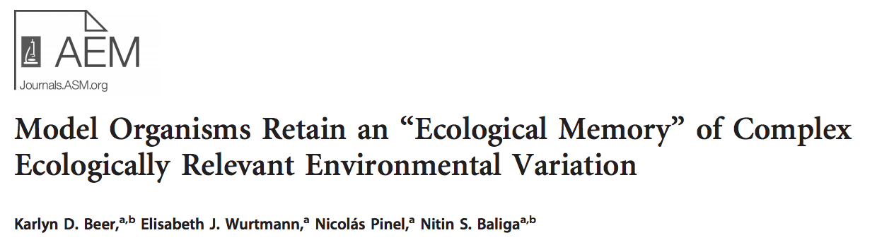
Inferred TrmB–DNA binding correlates with growth rate across growth in batch culture (A), during the shift from anoxic to oxic conditions in a turbidostat (B), during a sublethal challenge with H₂O₂ (C), and during mid-log phase growth in media of varying salinity (D).
Here, we used a multifactorial approach to assay the contributions of three components of salinity on fitness in H. salinarum NRC-1: total salinity, [NaCl], and [Mg]/[K] ratio. We designed a full-factorial set of 75 growth media around these three factors, and this set included the standard rich Halobacterium CM medium as a control.

Slide 14
What over-arching question did the authors aim to address?
What are the main conclusions from the paper?
Why is this research important?
How do your experiments tie in with this work?

