Slide 1
Scientific Papers

Slide 2
Who has read a scientific publication before?
What have you been taught about how to do so?

Slide 3


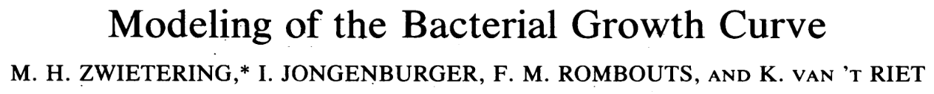

Types
Original articles
Experimental
A series of experiments done that show a novel finding
Modeling/tools/theory
Developing methods for use by the field
Comparing/contrasting approaches
Review articles
Periodic summary of existing literature
Helps consolidate information and references
Show a specific point of view

Slide 4
Keep hand raised if. . .
You opened any of them
You started on at least 1 study guide
You completed at least 1 study guide
You read any in their entirety
Papers aren’t meant to be read start to finish!
Extract the information you need, skip/skim that which you don’t

Slide 5
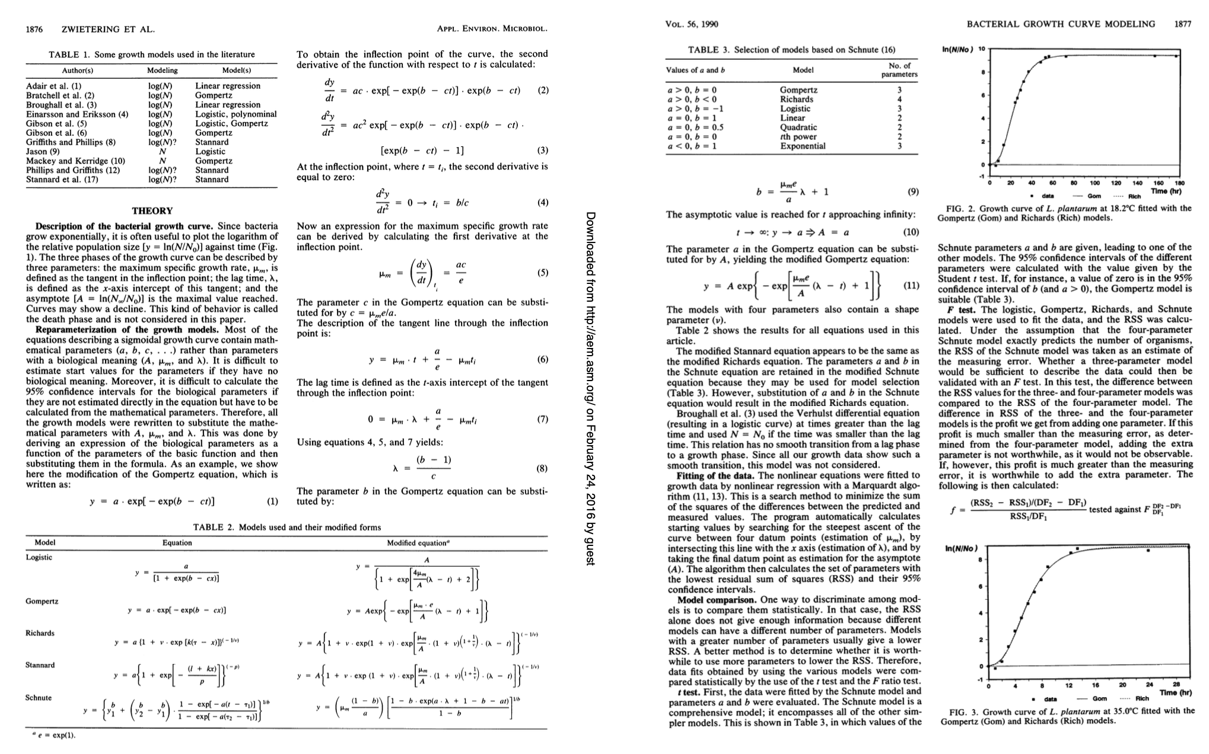
Don’t need to read Zwietering start to finish

Slide 6
Structure
Title
Authors + Affiliations
Abstract
Introduction
Results
Discussion
Methods
References

Slide 7
Structure
Title
Authors + Affiliations
Abstract
Introduction
Results
Figures
Discussion
Methods
References
Essential
Try to read parts, at least skim
Only read closely if you really need to

Slide 8
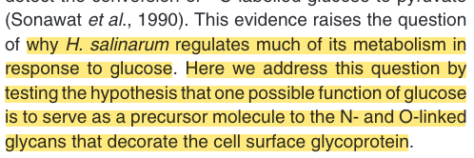
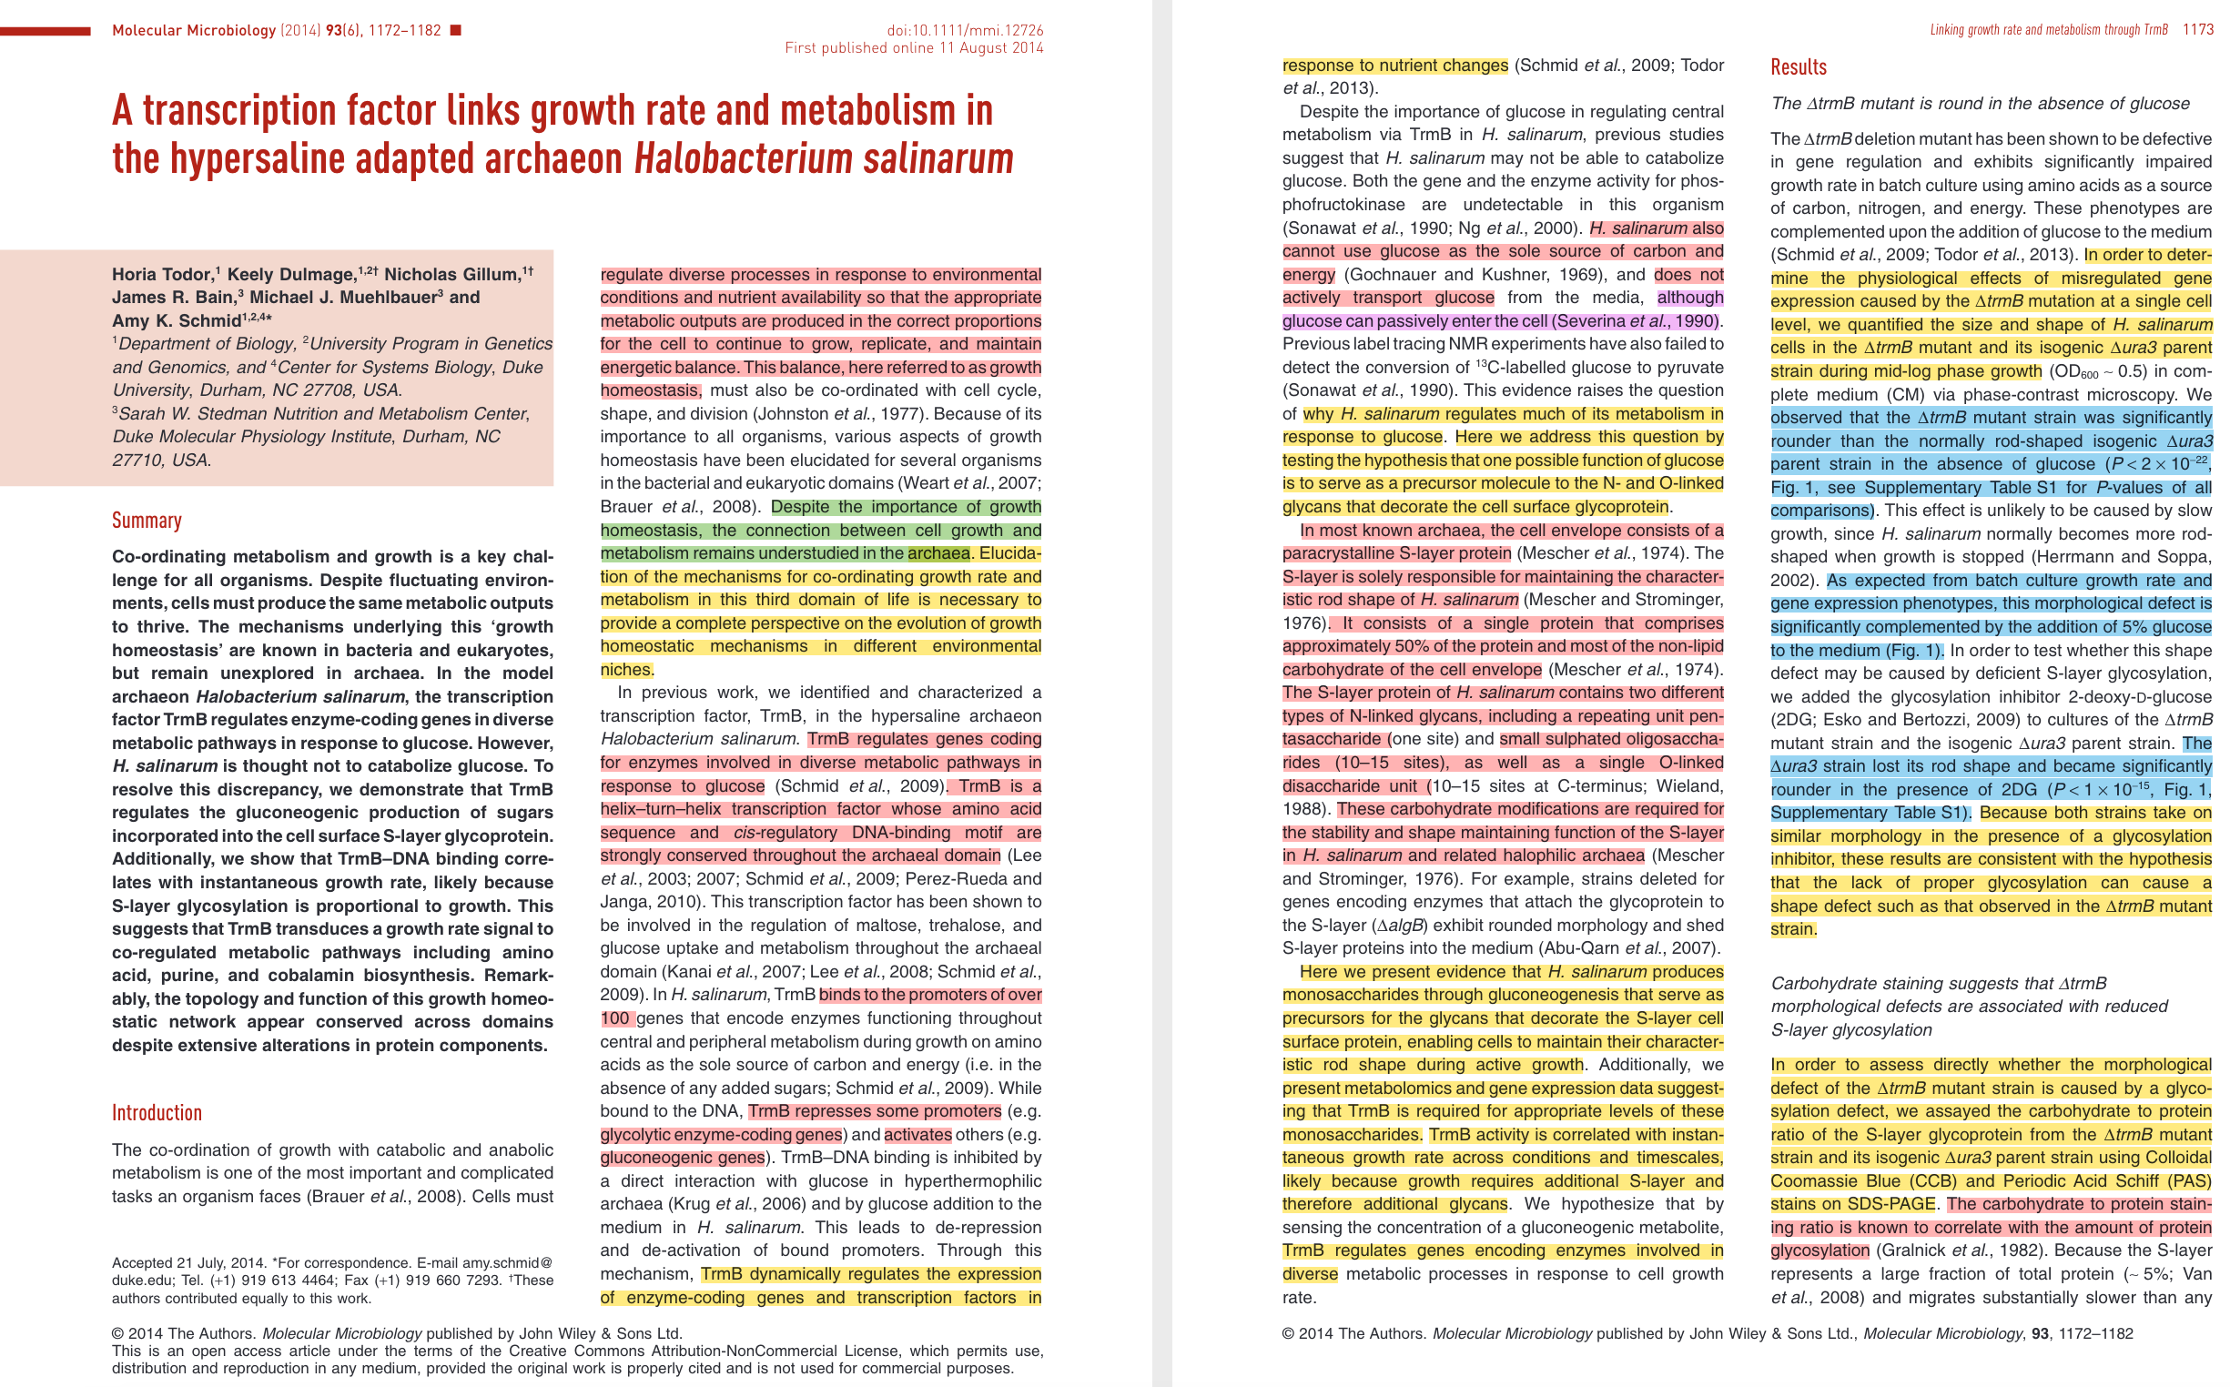
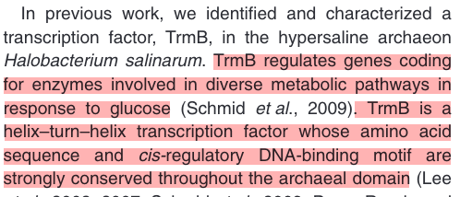
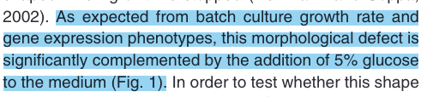

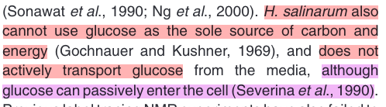
My approach
Key points
Definitions
Figure mentions
Shortcomings
Read this reference
Afterwards, answer questions similar to study guide
For each figure: What does it show? What is its purpose? Does it succeed?

Slide 9
Title
Should be
Informative
Unique
Eye-catching

Slide 10
Authors + Affiliations
Who did it? Where?
First author: often did most of the work and is most “credited;” it’s their name + others.
Last author: often lab leader supervising the first author.
Middle: made various contributions; some journals require listing these out.

Slide 11
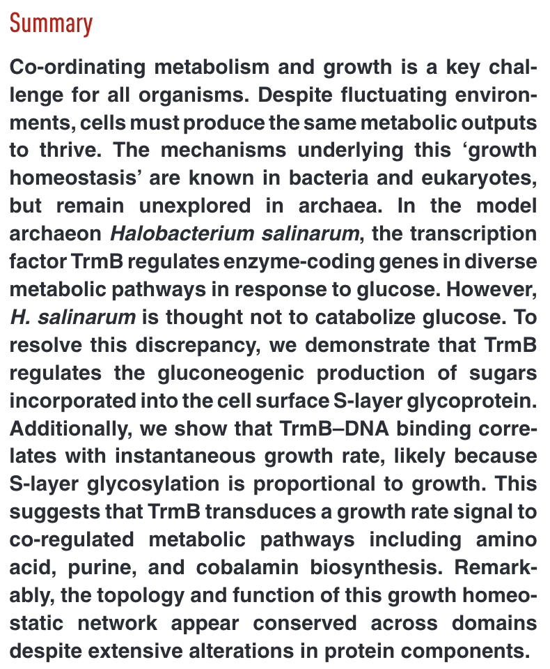
Abstract/Summary
A succinct summary of the entire paper:
Background
Findings
Usually written last, but is the first (and often only) thing someone sees.

Slide 12
Introduction
Importance
Why do we care?
Previous findings
What has been found already?
What questions remain?
Brief description of the study
What was the question?
Sometimes a teaser of the findings
What did we find?
Helps preview a structure and tells you what to look out for.

Slide 13
Results
All the stuff that was done
Question
Hypothesis
Approach
Findings
Figures
Statistics
Logical flow from one to the next
”. . . Thus, we found XYZ. However, that could be due to <such and such>, or <something or another>. If it was <such and such>, we would expect <this>, and to test that we <the next experiment>.”

Slide 14
Discussion
In results, you avoid too much interpretation; that is for this section
What do the results mean?
Summarize the results more plainly with interpretations.
Re-summarize results in the context of previous knowledge.
Interpret them
State weaknesses/ambiguities
Point towards future studies that could be done.

Slide 15
Materials/Methods
Showing the work
Theoretically allows for replication of results by someone else
Anyone else can often skip these
Very dry, matter-of-fact, but essential.

Slide 16
Supplementary Material
Extra stuff
Raw data
Giant tables
Less important but still informative
Often not checked by journal editorial staff
For transparency, public resources, and for the real nerds that want to dig in deeper.

