Slide 1
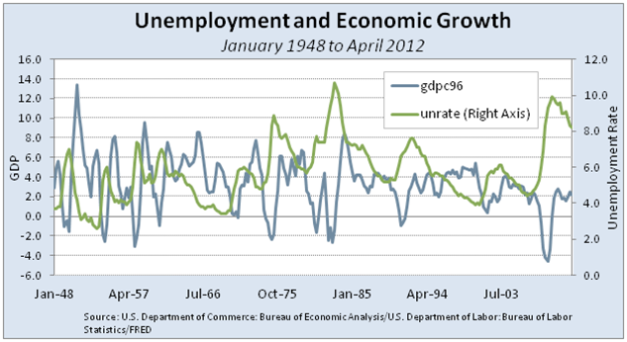
Motivation
Economy is a importance source of big data
GDP, Stock market, business statistics, social related statistics
Data from different sources are potentially related ( infrastructure based on nation or local region)
Interesting trend and pattern
Data source
Bureau of Labor Statistics of United States
City or county based unemployment rates (multiple data sets need to be integrated)
Bureau of Economic analysis of United States
City or county based GDP data
Regional per capita income
Execution plan
Data preprocessing and integration will be performed using Scala with Spark
Create of a regression model to predict the GDP based on income, location and unemployment rate using python with sciki-learn

