Slide 1
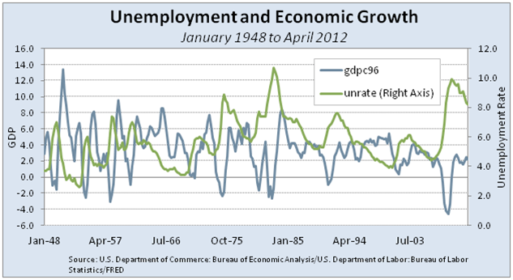
Motivation
Economy is a importance source of big data
GDP, Stock market, business statistics, social related statistics
Data from different sources are potentially related ( infrastructure based on nation or local region)
Interesting trend and pattern
Execution plan
Data preprocessing and integration will be performed using Scala with Spark (DONE)
Create of a regression model to predict the GDP based on income, location and unemployment rate using python with sciki-learn
Challenge: need to integrate several heterogenous data together since the unemployment data, GDP, income, location data are from different sources with different format (~ 500 lines of scala code)
Data source
Bureau of Labor Statistics of United States
City or county based unemployment rates (multiple data sets need to be integrated)
Bureau of Economic analysis of United States
City or county based GDP data
Regional per capita income

Slide 2
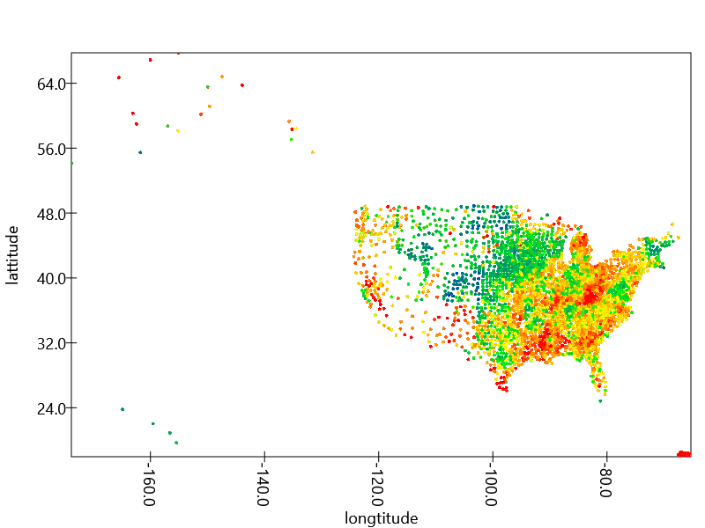
Unemployment rate 2015 county based (> 400k data points)
Blue -> low rate (<= 4%)
Red -> high rate (>= 8%)
Problem:
No GDP data available for
counties; only metro data
available

Slide 3
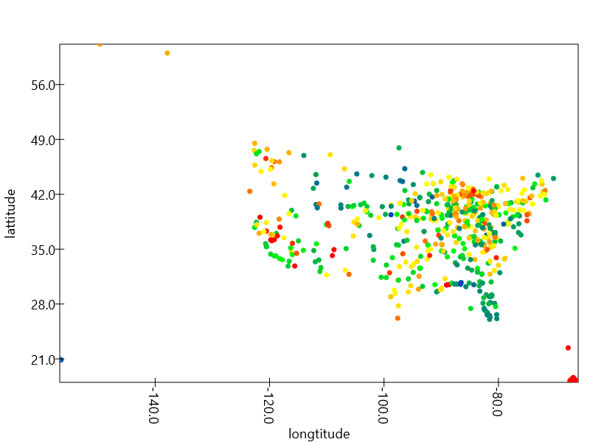
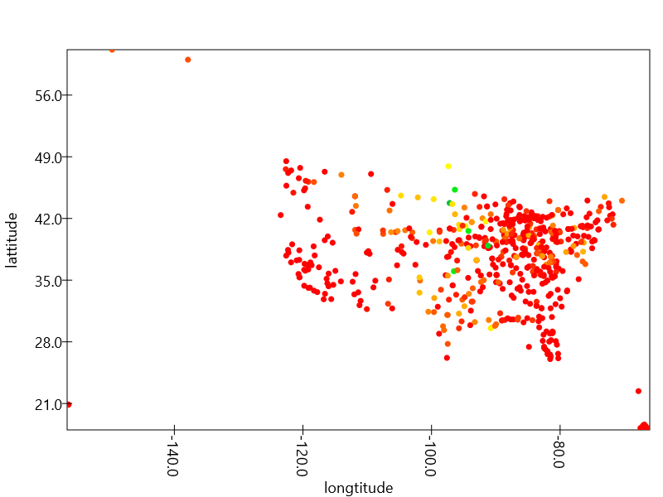
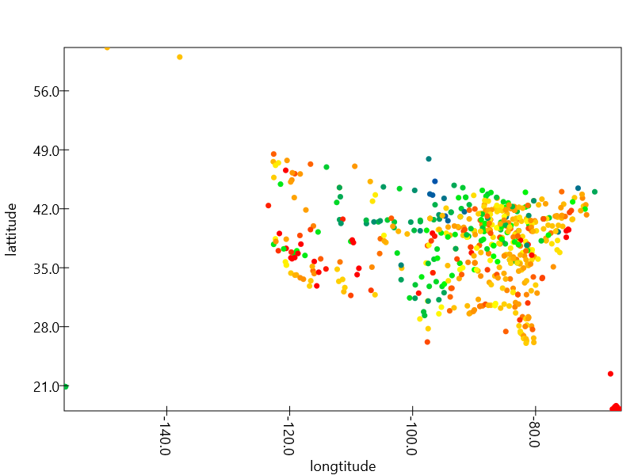
Unemployment rate metro area based (~ 600 points) data for 2006, 2009 and 2015
Blue -> low rate (<= 4%)
Red -> high rate (>= 8%)
2006
2009
2015

Slide 4
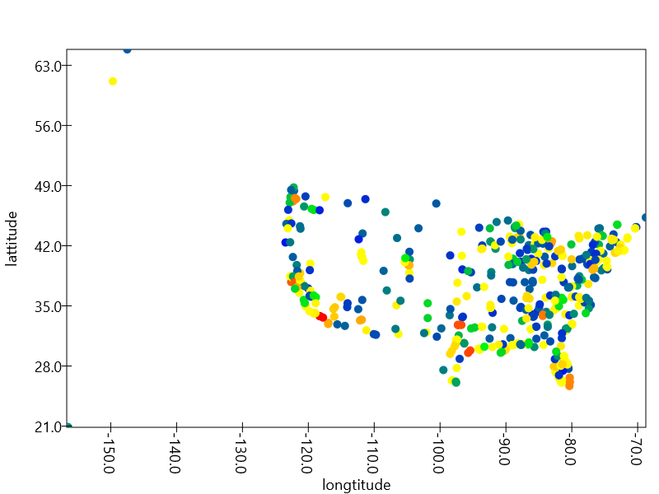

GDP data metro area based (~ 500 points)
Blue -> low GDP (<= 1800)
Red -> high GDP (>= 50000)
2009
2015

Slide 5
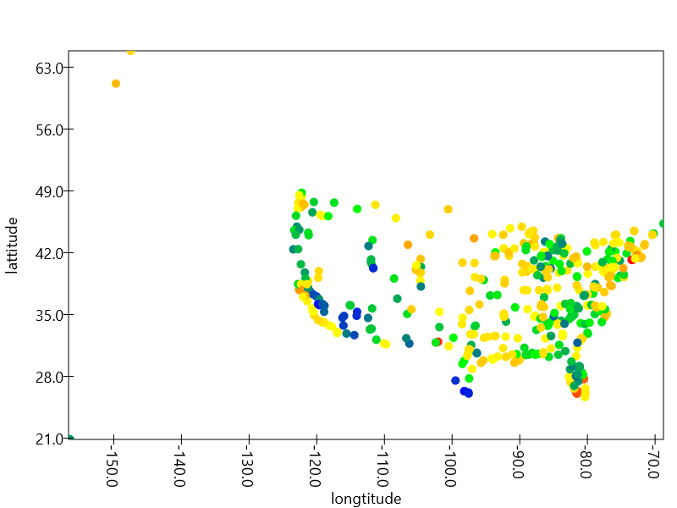
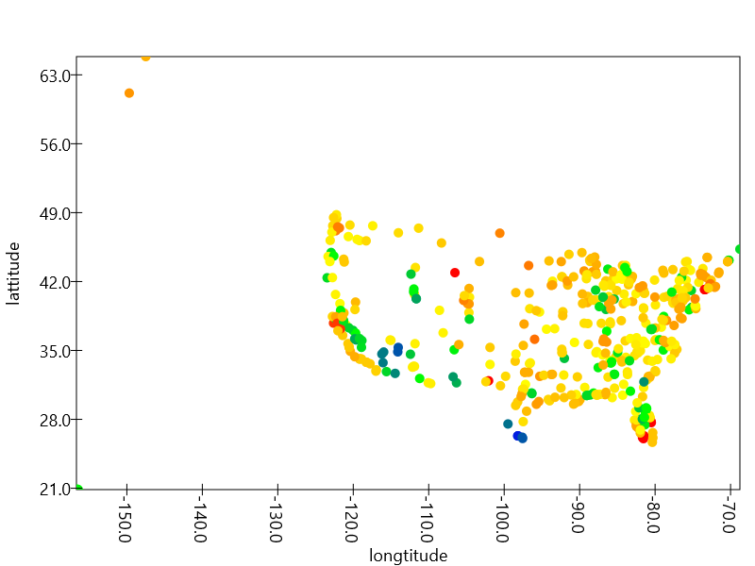
Personal income data metro area based (~ 500 points)
Blue -> low income (<= 12000)
Red -> high income (>= 68000)
2009
2015

Slide 6
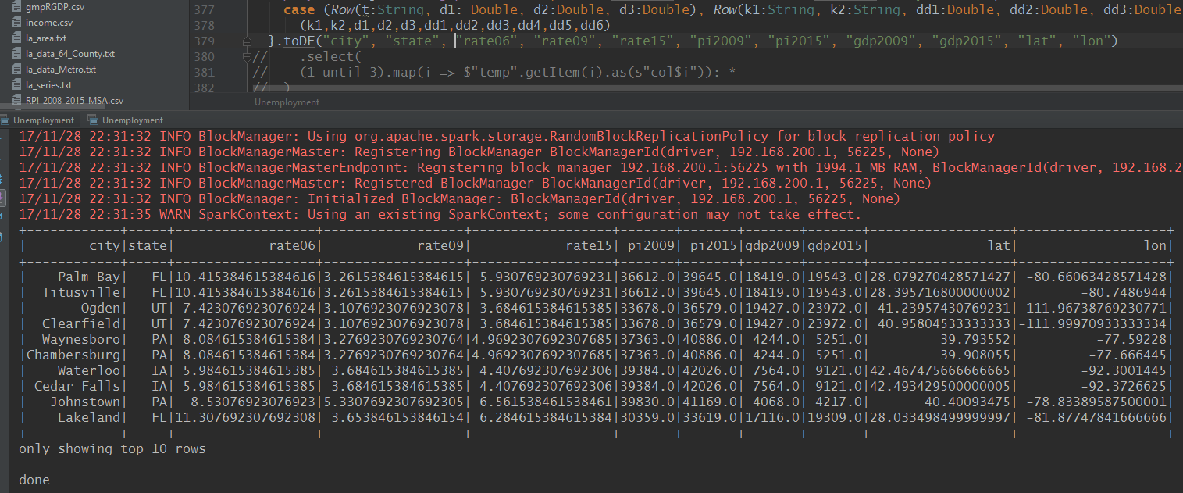
Final data set sample:

Slide 7
