Slide 1
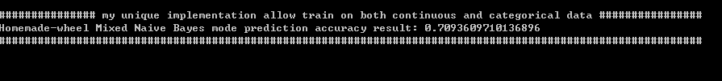
Self-implemented Naïve Bayes method vs Sciki-learn Naïve Bayes (Both using Gaussian function on continuous data set)
Self-implemented Naïve Bayes method featured combining both categorical and continuous data as training and testing sample (Sciki Learn provided methods only work on either categorial or continuous data set)
Both experiments above are using the same training and testing data set (100000 total, train:test = 0.8:0.2)
Each Exp is run 5 times and results are averaged
First Exp showed that my wheel performed a little bit better than scikilearn method
Second Exp showed that including both categorical and continuous data can significantly improve the performance based on accuracy. (In exp1, only the categorical data are used because of limitation on nature of the sciki-learn inmplementation)

Slide 2
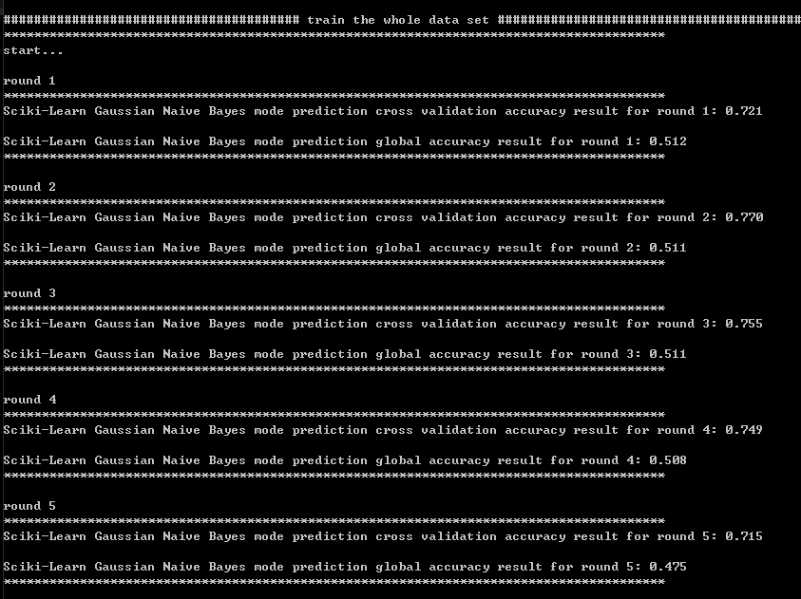
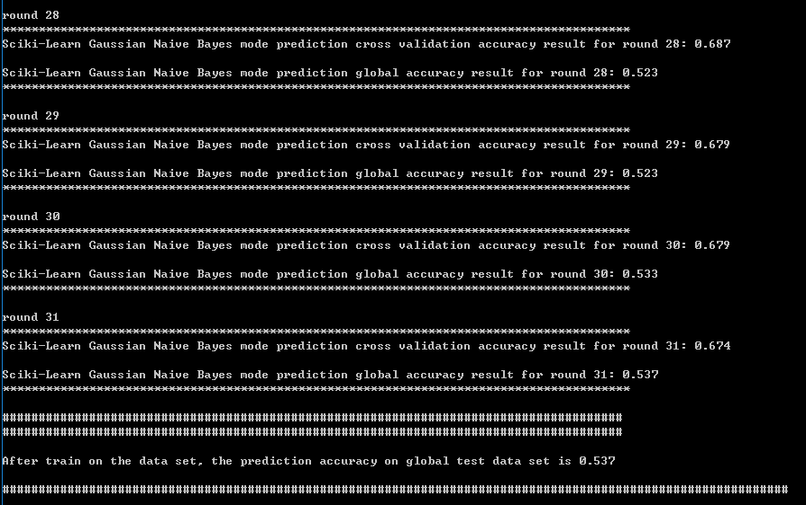
Sciki-learn Gaussian Naïve Bayes method provides partial training function which allows batch-to-batch training. We can divide large training set (not fit for memory space) into chunks and training on one chunk each time (total 9 millions rows, train on 300k rows each round, save 200k rows as global test set for performance evaluation). (not implemented in my own methods but can be added if more time given)

Slide 3
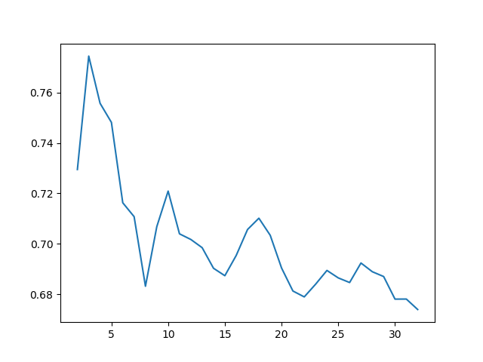
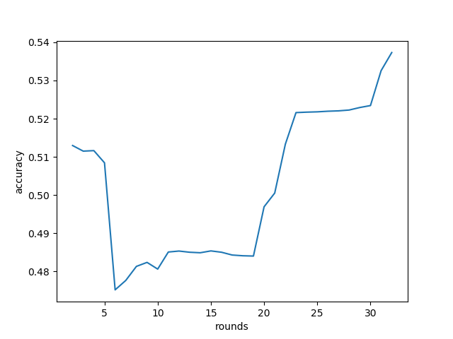
Training performance based on batch-to-batch training (blue: from experiments, red: expected)
Data preparation: not using stratify method. Data may be biased.

