Slide 1



ADAS Forecasting Contest Kick-Off
Alex Rabeau, Will Pearse

Slide 2



Outline
Introduction from SPHERE-PPL Team
Contest, Timeline & Communication
Getting Started

Slide 3
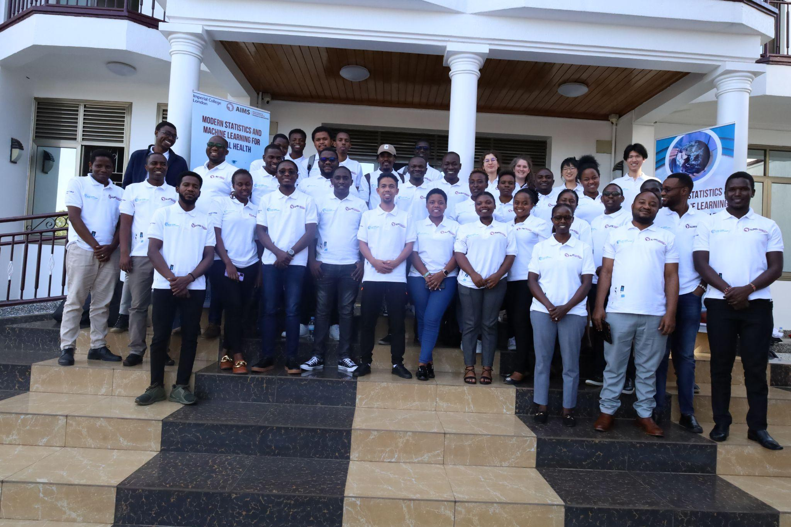
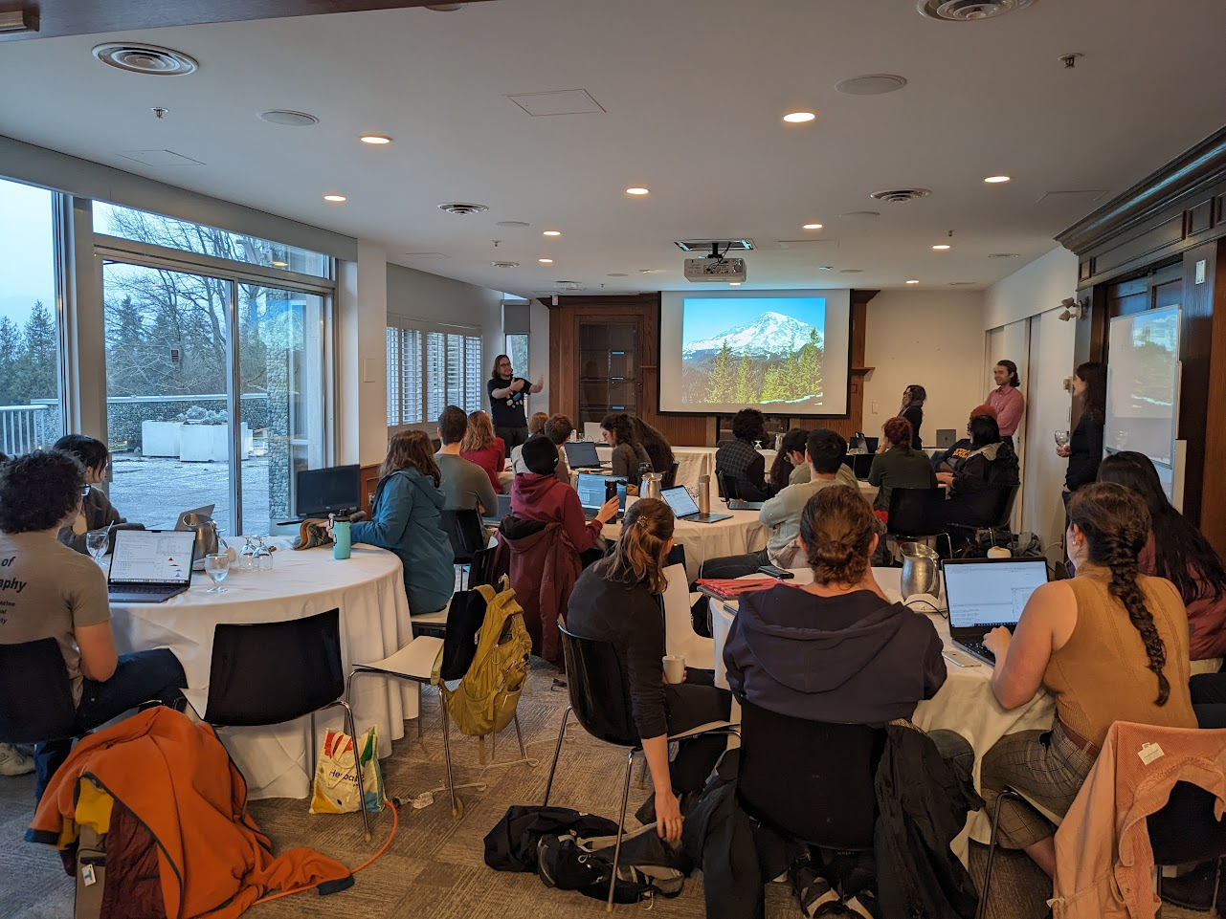
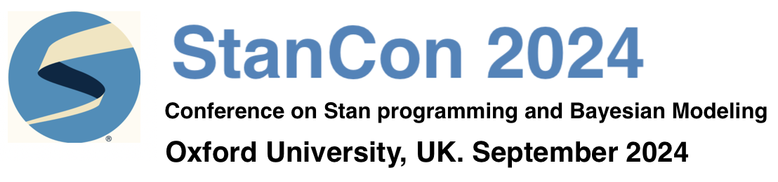
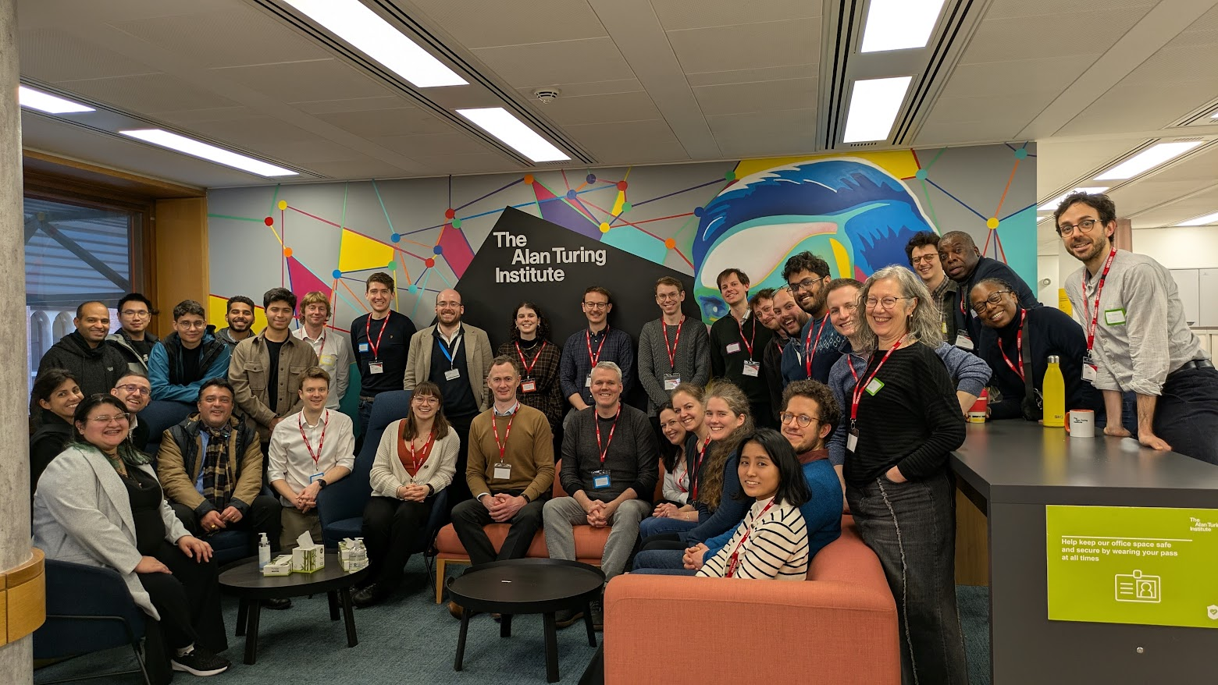
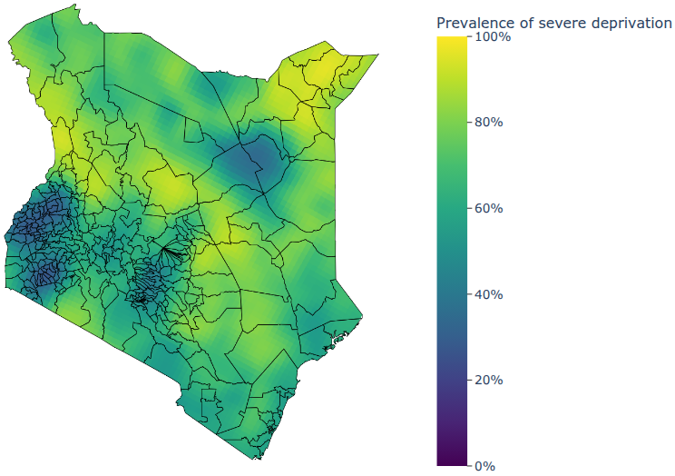
What is SPHERE-PPL doing?
Contests
Training
Networking
Research

Slide 4
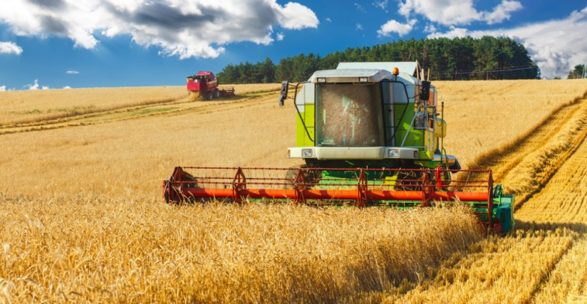
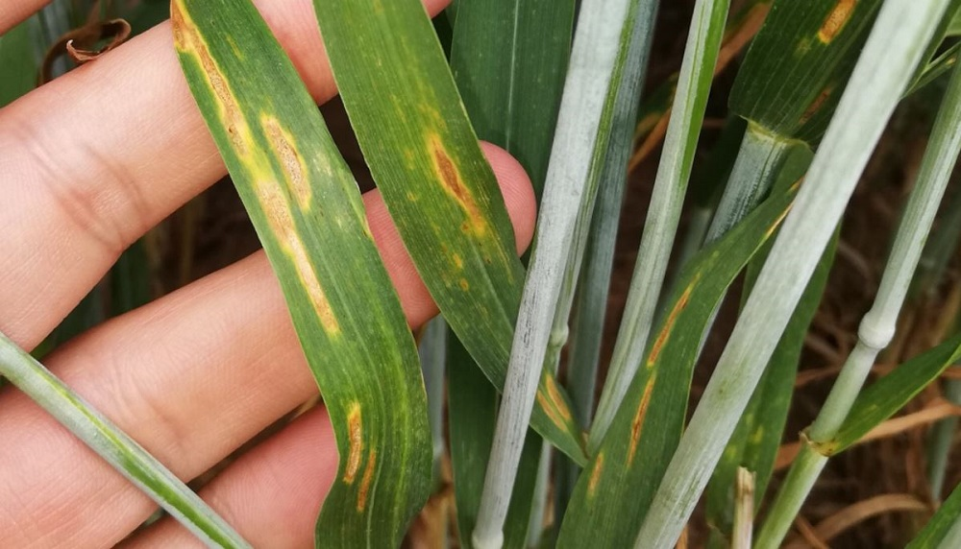
Introduction
Zymoseptoria tritici and yellow rust reduce green leaf area, limiting photosynthesis and ultimately lowering both yield and grain quality
Estimated to cost the agricultural industry up to £250million annually through yield losses and fungicide expenditure
In severe cases, yield losses can reach up to 50%

Slide 5
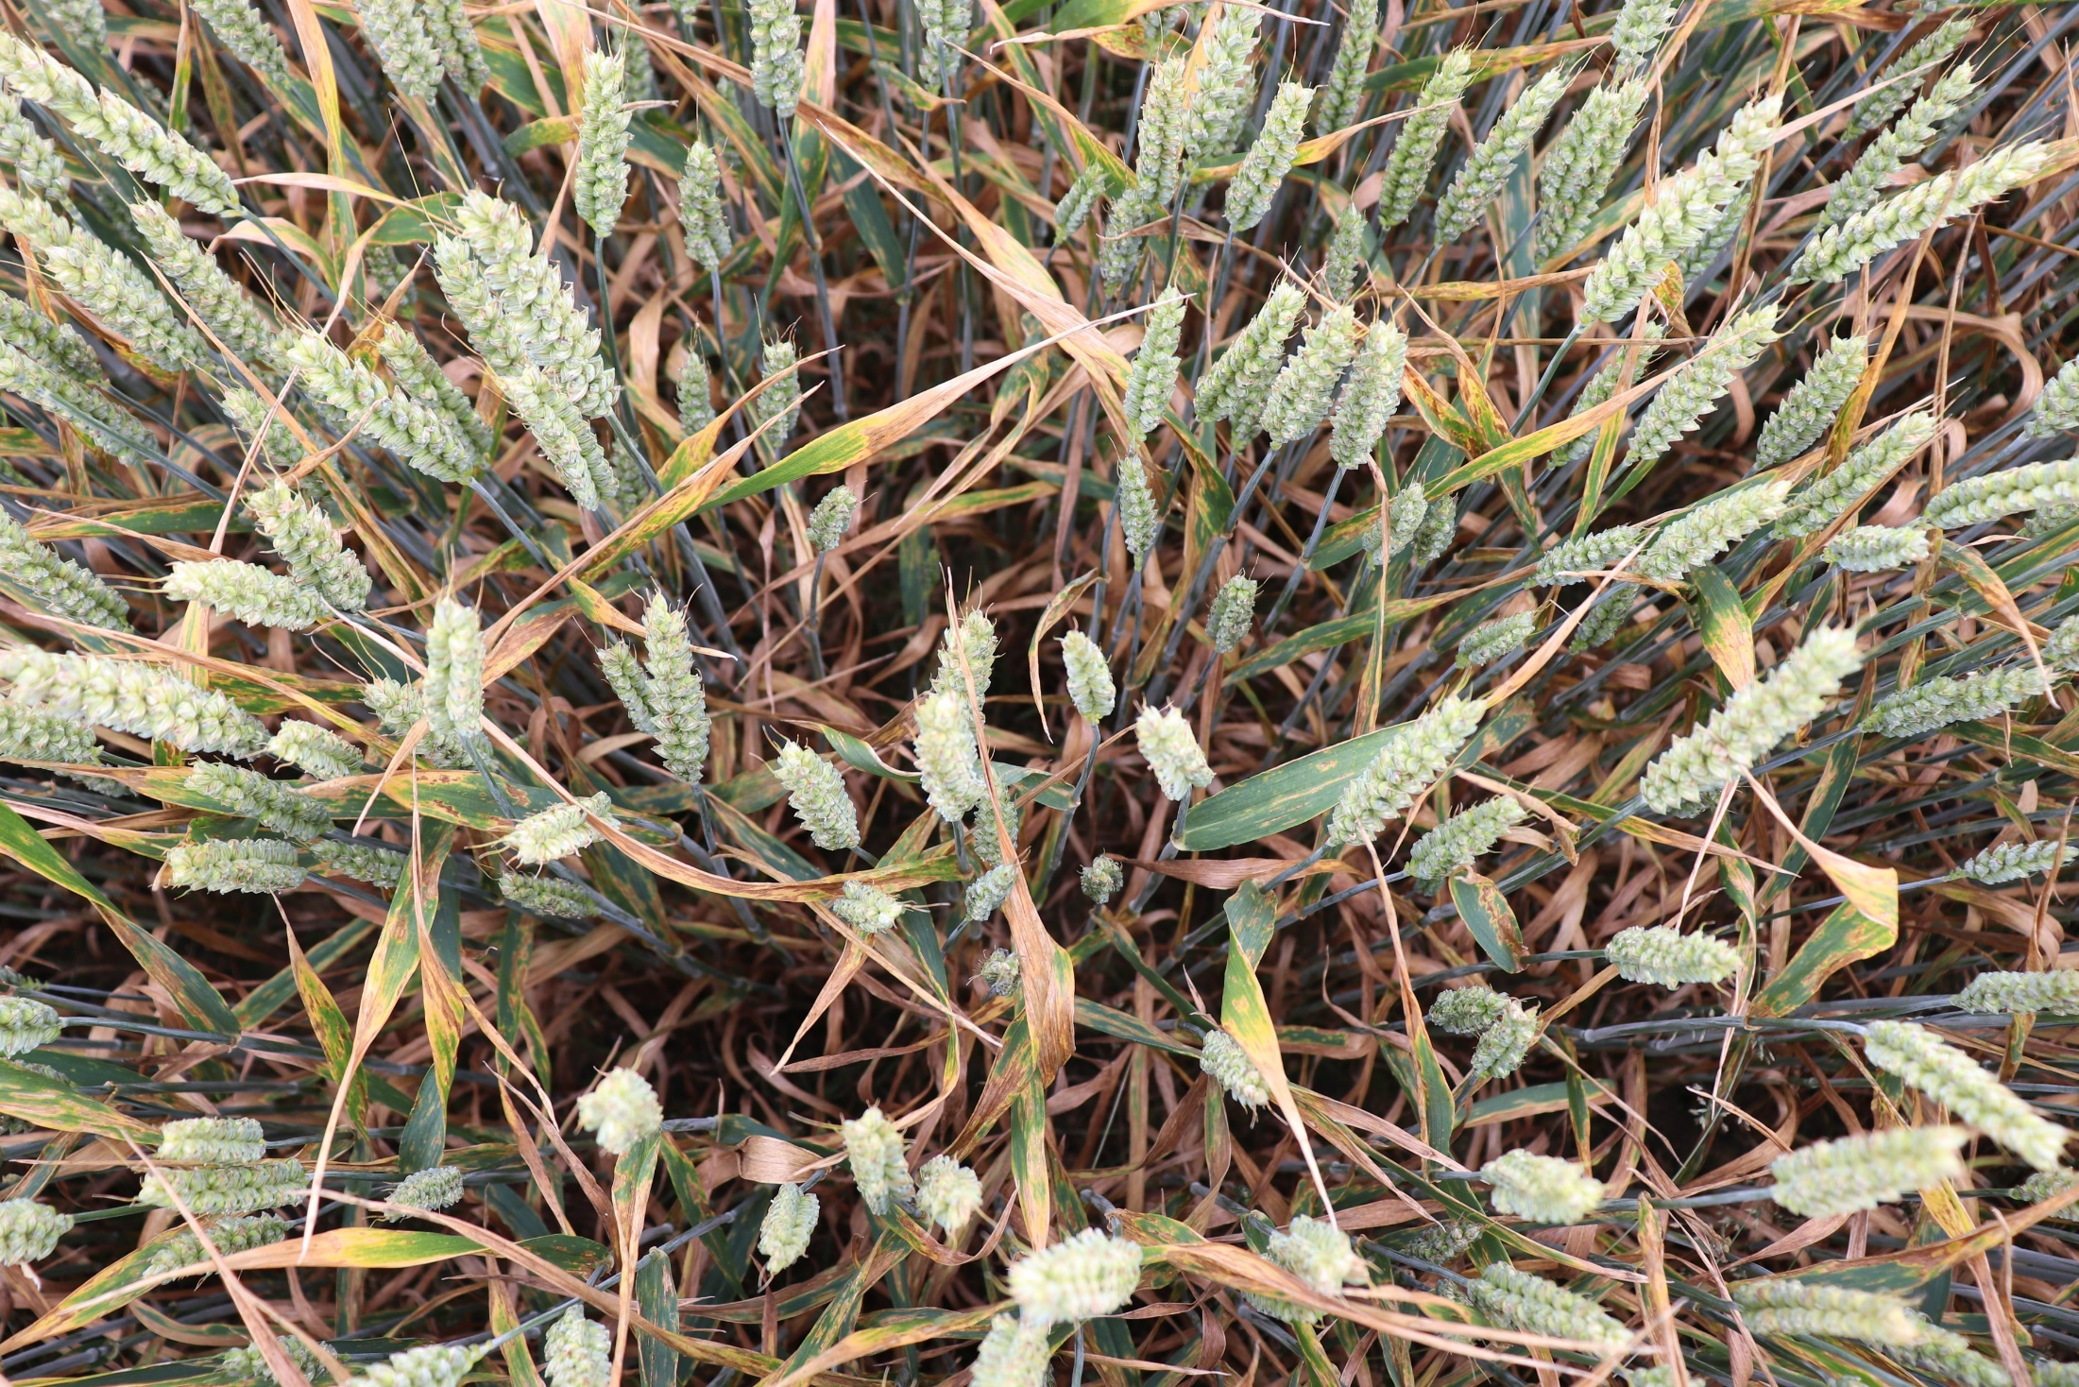
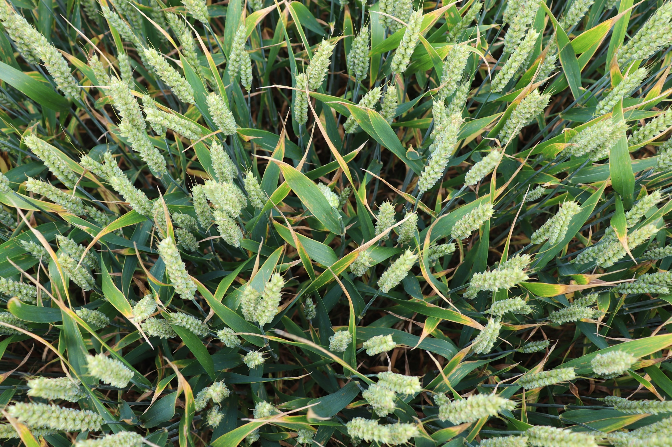
Septoria leaf blotch (Zymoseptoria tritici)
Healthy crop
Healthy and diseased plots in a field trial, Herefordshire, June 2019

Slide 6
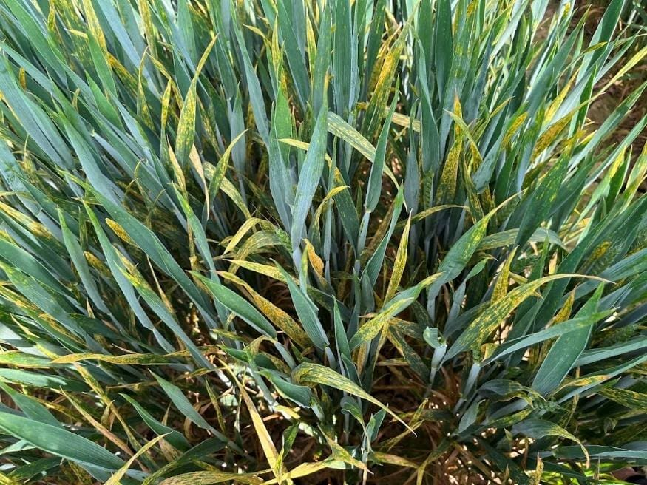
Yellow rust

Slide 7
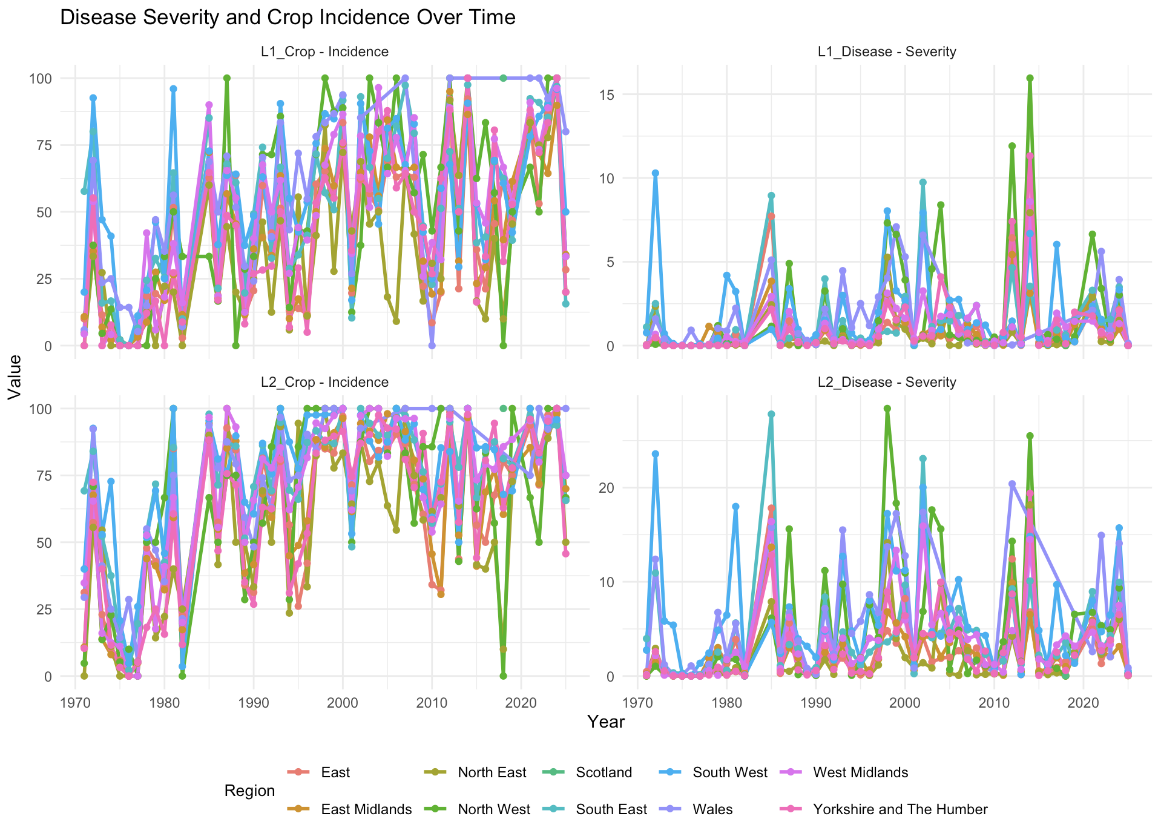
Data
Outcome variable:
Zymoseptoria tritici Yellow rust severity and crop incidence
Wheat leaves 1 and 2
UK regions
50 years of data (1971 - 2025)
Candidates invited to combine with external explanatory variables

Slide 8
Contest Outputs
The aim of this contest is to develop a model capable of forecasting the incidence and severity of Zymoseptoria tritici and Yellow rust on wheat crop across UK regions for 2026.
Forecasts and reports should be saved into the submission folder, matching the template found within.

Slide 9


Contest Rules
Any coding languages are allowed but all analyses must be reproducible by the panel.
All entries must be loaded into a public Github repo.
All entries must follow the submission formats outlined below.
All entries must include a max 1000 word report to accompany the forecast analyses. This can be as a separate PDF/hmtl or incorporated into a quarto/jupyter notebook.
All submissions must be complete by 6th September 2026

Slide 10
Contest Winners
Awards will be given across three categories:
1. The team with the most accurate forecast of Zymoseptoria tritici, as measured by Root Mean Squared Error.
2. The team with the most accurate forecast of Yellow rust, as measured by Root Mean Squared Error.
3. The team with the most interesting report.
The winners will be selected by the SPHERE-PPL Team and will be invited to present their forecasts at the next Annual Meeting, with travel covered by the project.

Slide 11
Contest Timeline
6th June 2026
Competition launch, including the release of the development dataset.
6th September 2026
Deadline for competitors to submit their final algorithms
14th September 2026
The assessment dataset is released
28th September 2026
Deadline for competitors to submit their forecasts.
16th October 2026
Winners announced

Slide 12

Communication
We have a SPHERE-PPL Zulip group (akin to Teams or Slack) where we will be available to answer questions and interact with the community.
Please also use it for communicating within your own teams!
Join Here

Slide 13
Getting Started
Main Link: https://github.com/SPHERE-PPL/ADAS-pest-forecasting
Resources
Overview & Quick-Start Videos
Example Contest – Mpox

Slide 14
Thanks For Joining!
Get more information at our website: www.sphere-ppl.org
Email us at: info@sphere-ppl.org

