Slide 1
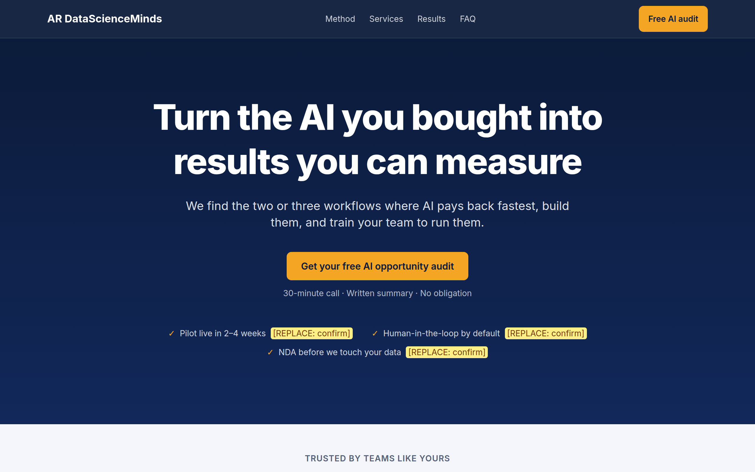
AI Consulting
Landing Page
AR DataScienceMinds
Designed for conversion, built by a pipeline of AI agents
Hero section of the live page
Notes:
A conversion-focused landing page for an AI consulting service, built end to end: research, copy, application and QA.

Slide 2



The goal: turn visits into leads
Goal
A visitor clicks a call-to-action, fills a short form, and the business reaches out.
HERO HEADLINE
Turn the AI you bought into results you can measure
Audience
Owners of 10 to 500 person firms who bought AI tools but see no results.
Offer
Get your free AI opportunity audit
A free AI opportunity audit: a 30-minute call plus a written summary.
Notes:
One conversion goal drives every decision. The offer is deliberately low risk: free, no obligation, with a tangible deliverable.

Slide 3





A five-agent pipeline
Researcher
Consolidator
Copywriter
Builder
QA (Codex)
01-research.md
02-brief.md
copy.json
app/
04-qa-report.md
Sourced market and buyer research
Positioning, pains, objections
All page text for 13 sections
Next.js app and lead API
Read-only independent review
Each agent reads one file and writes one file, so any stage can be re-run. Claude builds and fixes; Codex only reports.
Notes:
Single-purpose agents with file handoffs keep context clean. QA is read-only so two tools never edit the same files.

Slide 4

What the research found
33%
78%
70%
of small businesses say data security holds back deeper AI use
of owners don't fully trust AI on basic tasks without oversight
of owners say they need more training to use AI properly
Source: Bluevine survey, 2026
Source: Stacker / KVIA, 2026
Source: Thryv survey, April 2026
Only approved, cited statistics reach the page. No invented clients, testimonials or numbers.
Notes:
Research drove the messaging: data security, trust in accuracy and the training gap became the objections the page answers.

Slide 5





Thirteen sections, one job each
Hook
Credibility
Pain
Nav with CTA · Hero
Social proof bar
Problem · Cost of inaction
Clear who, what, next step
Data before the ask
The buyer's own words
Answer
Proof
Close
Solution · Services · Process
Case studies · Testimonials · About
FAQ · Final CTA and form
Find · Prove · Scale
Named results and voices
Answer doubts, then ask
Notes:
Sections follow a persuasion arc: hook, credibility, pain, answer, proof, close. Every section serves the single call-to-action.

Slide 6




Conversion principles
One goal, one CTA
Proof early and often
Every button leads to the same form.
Cited statistics, then case studies and quotes.
Five-second clarity
Remove risk
The hero says who it is for, the outcome and the next step.
Free audit, no obligation, security answered in the FAQ.
Outcome over feature
Short form
Benefits come first and jargon is explained.
Four required fields, two optional.
Notes:
These principles are written into SYSTEM.md and enforced by tests, for example every call-to-action must point at the form.

Slide 7
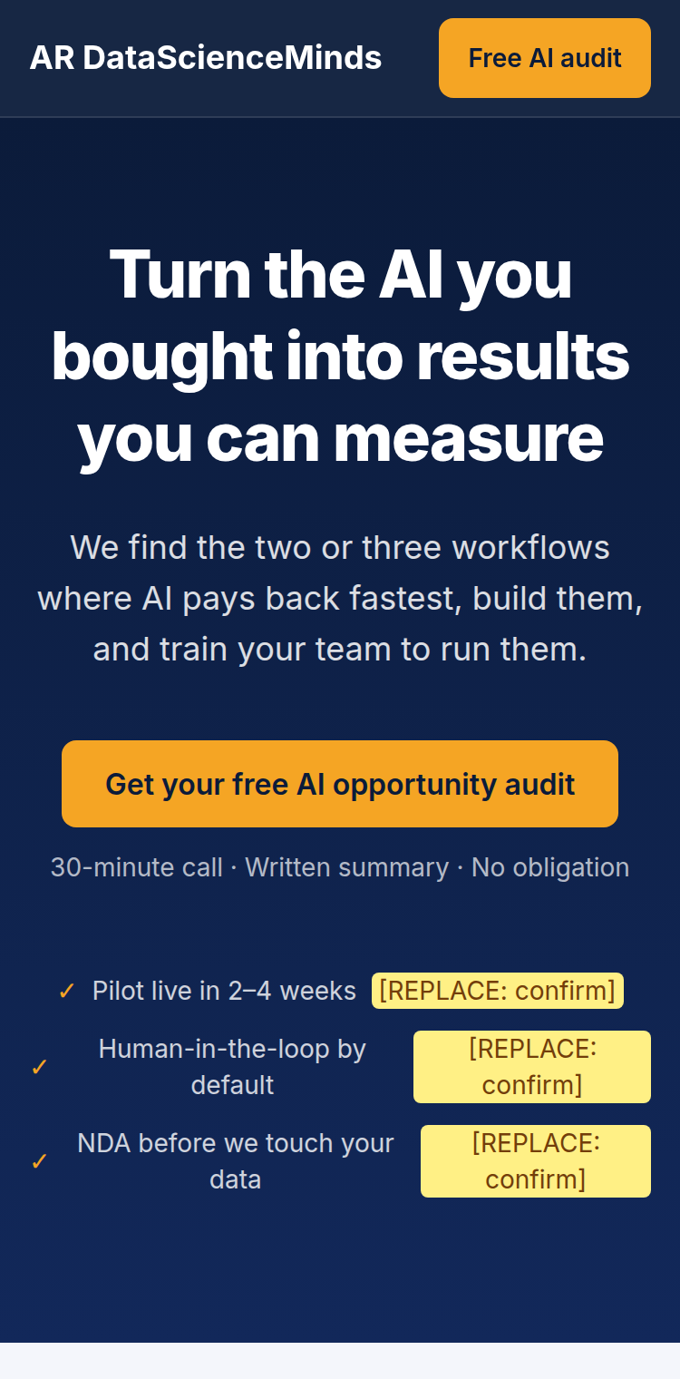
The page: desktop and mobile
Notes:
Yellow highlights mark placeholders and unconfirmed promises that the owner must replace or confirm before launch.

Slide 8
Architecture
content/copy.json: all page text
Browser
Next.js server
Supabase
POST
JSON
insert with
secret key
13-section page
Lead form, Zod checks
Hidden honeypot field
Prerendered page
POST /api/lead
CSP and security headers
leads table
Row-level security on
No public access
The browser never talks to Supabase. The secret key stays on the server.
Notes:
A static page plus one API route keeps the system small, fast and cheap to host.

Slide 9
Inside the lead API
1
2
3
4
5
Rate limit
Size cap
Honeypot
Validate
Store
5 requests per 10 minutes per IP
Bodies over 10 KB are rejected with a 413
A filled hidden field gets a fake success and a log line
The same Zod schema as the browser
The secret key writes to Supabase; failures are never hidden
Row-level security is on with no policies, so even a leaked public key cannot read leads.
Notes:
Defence in depth: each step rejects a different kind of bad request before anything reaches the database.

Slide 10
Tech stack
Area | Choice | Why
Framework | Next.js (App Router), TypeScript | Fast, SEO-friendly, one codebase
Styling | Tailwind CSS v4 | Theme tokens in one file, easy to re-skin
Validation | Zod | One schema shared by browser and server
Database | Supabase (Postgres) | Hosted, with row-level security
Testing | Playwright, ESLint | Real browser at two screen sizes
Hosting | Vercel (planned) | Not deployed yet
Notes:
The stack favours small and boring: one framework, one validation library and one managed database.

Slide 11
Quality and safeguards
52
2
4
0
Playwright tests passing
screen sizes tested: 375px and 1280px
regressions reintroduced to prove the tests catch them
known vulnerabilities in dependencies
Honesty gate: the production build fails while any [REPLACE] placeholder remains.
The test server blanks database keys, so tests never write real leads.
Notes:
Tests cover structure, form, API, headers, contrast, tap targets and copy sync. The npm audit figure covers production dependencies.

Slide 12


Status and next steps
Done
Next
Five-agent pipeline, research to QA
13-section page with sourced copy
Secured lead API and Supabase table
52 passing tests, QA findings fixed
Exports: PDF and PNGs
Fill the 40 placeholders with real proof
Run a live database test (blocked in this environment)
Rotate the Supabase key
Run Codex QA on your own machine
Deploy to Vercel
Notes:
The page is built and tested but not deployed. The remaining work needs real proof from the business and a few account-level steps.

