Slide 1


Inverse Polynomial Reconstruction
$$\int_{−1}^{1}{{\left(1−t^{2}\right)}^{\left(α−1/2\right)}C_{k}^{α}\left(t\right)C_{n}^{α}\left(t\right)dt = δ_{n,k}ρ_{n}^{α}}$$
Alex Reigle
CEG 7580 Fall 2021
Dr. Arnab Shaw

Slide 2
Outline
High-level overview of problem
Mathematical/Algorithmic Background
Gegenbauer Coefficients
Polynomial Reconstruction
Project Goals
Current Progress

Slide 3
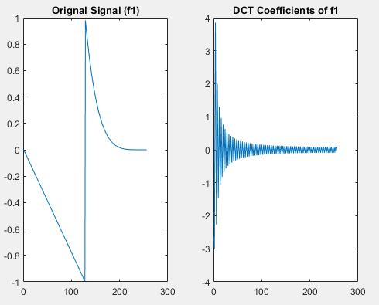
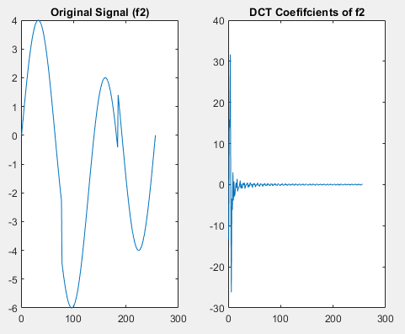
DCT Image Compression
The DCT transform of a signal/image produces a periodic signal that is convergent.
This simplifies compression: simple zero out the signal oscillations closest to zero amplitude (at the end of the signal in frequency domain).
Figure 1: Example of DCT transform (of Signal f1 from article [1]) converging to zero.
Figure 2: Example of DCT transform (of Signal f2 from article [1]) converging to zero.

Slide 4
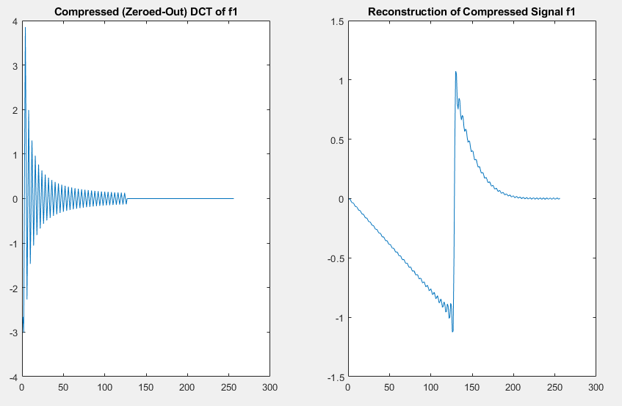
Image Noise ‘caused by’ DCT Transforms
Noise gets introduced to images from compression (a.k.a. truncation).
This is known as the Gibbs Phenomenon (see images)
Gibbs Phenomenon: A periodic artifact of Fourier and DCT transform compression.
Figure 3: Recreation of article [1] Fig. 2a-b. The original signal in space (left) and frequency (right) domain.
Figure 4: The (left) result of compressing Fig 1b to ½ its original size. This causes periodic noise (right).

Slide 5
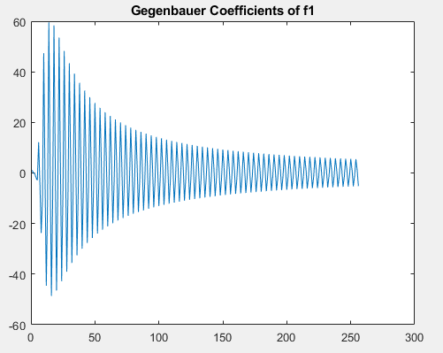
Noise Removal Using Polynomial Reconstruction
Change the basis (linearly independent weighting function) of the transformation
The transform in this case is DCT
The selected basis is known as Gegenbauer polynomials.
Figure 5: Gegenbauer Coefficients of Signal f1

Slide 6

Gegenbauer (Ultraspherical) Polynomials and Coefficients
Orthogonal on the interval [-1, 1]
Definition:
Where α is the order of the polynomial, n is the nth DCT coefficient, and for n=0 C(t) = 1 and for n=1 C(t)= 2*α*t
For all results shown, α = 0
Equation 1: Gegenbauer polynomial definition from referenced article [2].
Notes:
Note: The Gegenbauer Polynomial is a special case of the Jacobi Polynomial, where alpha = beta, so the polynomial reduces to (1-x)^lambda. Keep in mind that the general literature will refer to it this way, and in the referenced article [1] uses alpha in place of lambda.

Slide 7

Polynomial Reconstruction
Consider the definition of a DCT transformation, fk
Replace the weighting function, f(xn), with the Gegenbauer Polynomial.
Represent this function in matrix form (each row represents an increment in polynomial order)
Separate out the weighting function (G) and the transformation function (W)
Now use the pseudo-inverse of W (the DCT transform) to solve for the Gegenbauer Coefficients (allowing for recreation of the original signal).
Equation 2: Equation 6 from referenced paper [1]. Definition of DCT expansion.
Equation 3: Equation 17 from referenced paper [1]. Matrix form definition of DCT expansion.
Equation 4: Equation 18 from referenced paper [1]. Definition of iPRM for DCT.
Notes:
We can approximate G to the original F

Slide 8
Project Goals
Recreate 1D test signals shown in article [1] Figures 2a-b and 4a-b. (i.e. show the DCT transform to recreate the Gibbs phenomenon discussed in article [1]).
Execute the Inverse Polynomial Reconstruction Method (IPRM) introduced in the article [1] and recreate the error plots shown in Figures 3a-b and 5a-b.
Apply the IPRM row-by-row to images (with noise) that are included with MatLab, to show a practical application. I’ll test this on various noise levels.

Slide 9
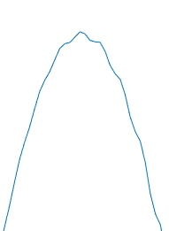
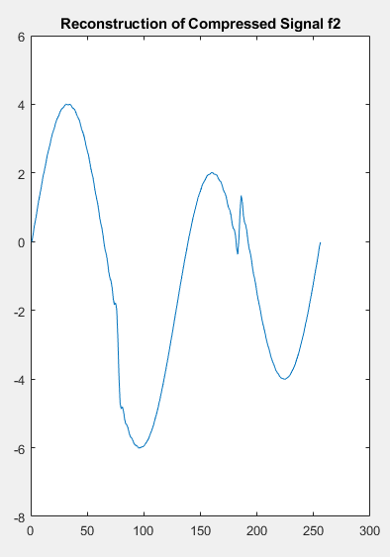
Current Progress
I have recreated the signals from article [1] (Fig 6 & 7)
I have recreated the Gibbs phenomenon
I have generated the Gegenbauer coefficients. (Shown in Fig. 5)
Figure 6: Recreation of article [1] Fig. 2a-b. The original signal in space (left) and frequency (right) domain.
Figure 8: (left) Figure 6a reconstructed with the Gibbs phenomenon present.
Figure 9: (right) Figure 7a reconstructed with the Gibbs phenomenon present.
Figure 7: Recreation of article [1] Fig. 4a-b. The original signal in space (left) and frequency (right) domain.

Slide 10
Conclusion
Next Steps
Implement IPRM using existing Gegenbauer and DCT coefficients.
Apply IPRM to 1D simple signal and select images
References:
Dadkhahi et al.: Inverse polynomial reconstruction method in DCT domain. EURASIP Journal on Advances in Signal Processing 2012:133. doi:10.1186/1687-6180-2012-133.
C. S. MacInnes, "The reconstruction of discontinuous piecewise polynomial signals," in IEEE Transactions on Signal Processing, vol. 53, no. 7, pp. 2603-2607, July 2005, doi: 10.1109/TSP.2005.849217.

