Slide 1
Audio Band OFDM System

Slide 2
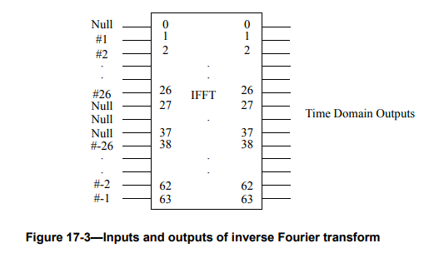
System Parameters
Speaker Range: 85Hz – 18kHz
Microphone Range: 20Hz – 20kHz
BW = 8000Hz
T_{symbol} = 1 / BW = .125 ms
Sampling Rate = 48000kHz
T_{sample} = 1 / 48000 = .0208 ms
Num Carriers = 64
Δf = BW / 64 = 125 Hz
f_{C} = 9042 Hz
Num Data Carriers = 48
Num Pilots = 4
Num Nulls = 12
Sub-channels 1, 28-38 (See 802.11 note on digital implementation of IFFT + diagram below)

Slide 3
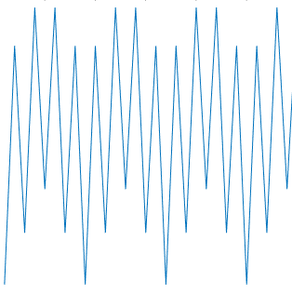
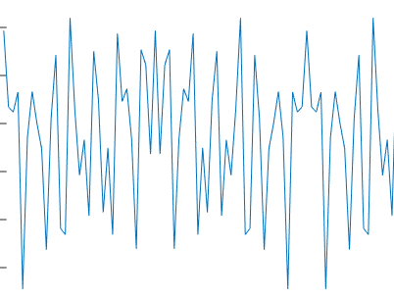
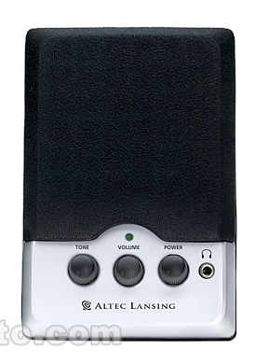
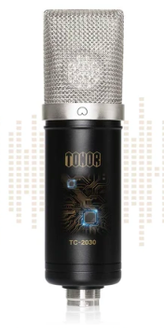
Num Carriers = 64
-Data Carriers = 48
-Num Pilots = 4
-Num Nulls = 12
(1, 28-38)
TX –> RX Chain
s_{I}
b_{i}
I
s_{i}
1001110…
S/P
…
IFFT₆₄
STF
LTF
CP
CP
Q
s_{Q}
Passband = ± BW/2 = ± 4800Hz
s_{I}
T_{s} = 1 / 48000Hz
R_{I}
T_{s} = 1 / 48000Hz
s
s_{Q}
ymbol
R_{Q}
Altec Lansing 120i
85Hz — 18kHz
https://www.bhphotovideo.com/c/product/403036-REG/Altec_Lansing_120I_120i_2_0_Two_Piece_Computer.html/specs
T_{symbol} = 1 / BW = 1/9600 Hz
ymbol
î
TONOR TC-2030 USB MICROPHONE
20Hz — 20kHz
192kHz / 24bit Sampling
https://www.tonormic.com/products/tonor-tc-2030-usb-microphone-kit
T_{symbol} = 1 / BW = 1 / 9600 Hz
f_{C} = 10010Hz

Slide 4
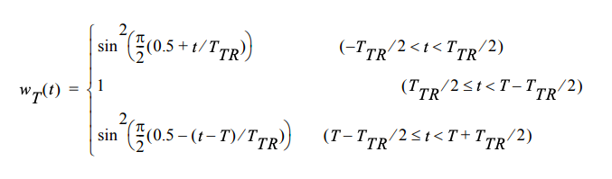
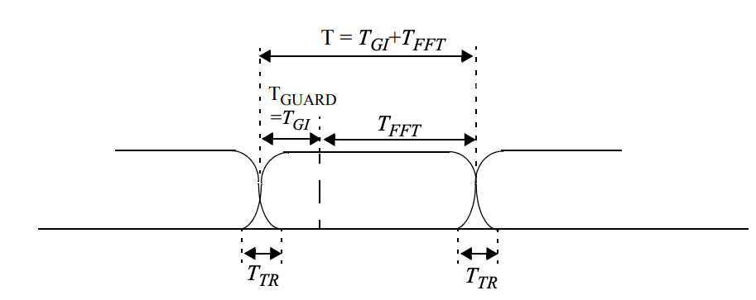
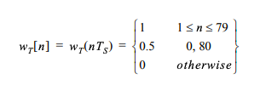
Windowing
Digital approximation:
T_{TR} = .25 ms ~ 2 samples

Slide 5
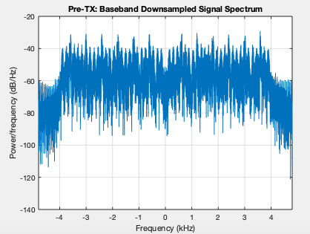
Pre-TX Baseband (1 sample per symbol)

Slide 6
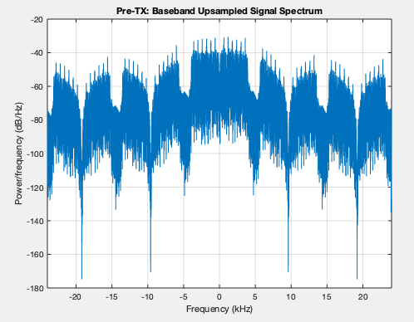
Pre-TX Baseband (Upsampled to 48kHz)

Slide 7
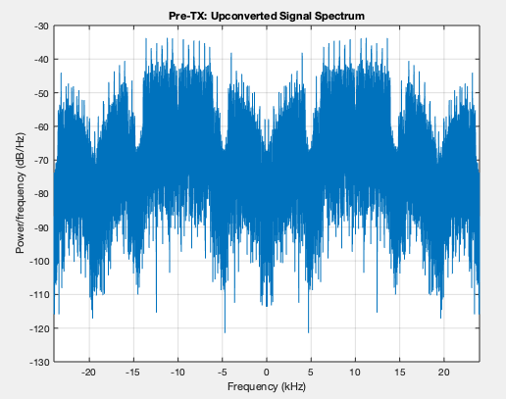
Pre-TX Carrier Frequency

Slide 8
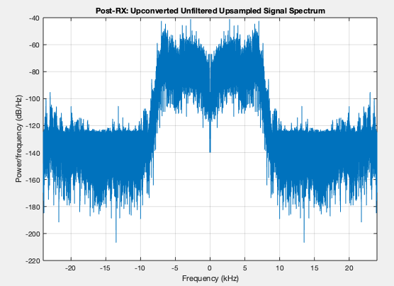
Post-RX Carrier Frequency
Note: this was actually recorded with
a laptop, not USB microphone.
Appears to have more limited spectrum
of sensitivity
(0:10kHz instead of 0:20kHz)

Slide 9
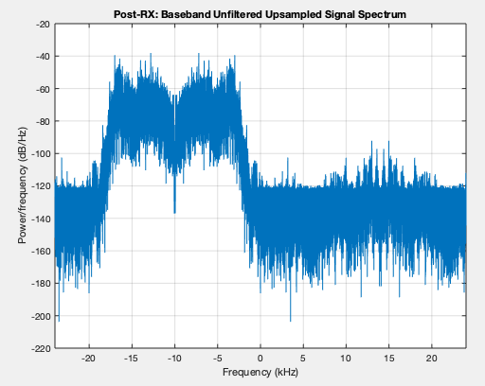
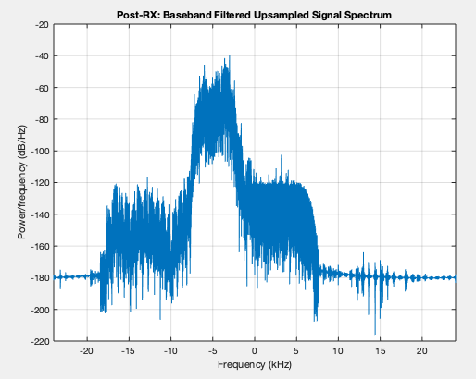
Post-RX BB (Pre & Post Low-Pass filter with passband = ±BW / 2)

Slide 10
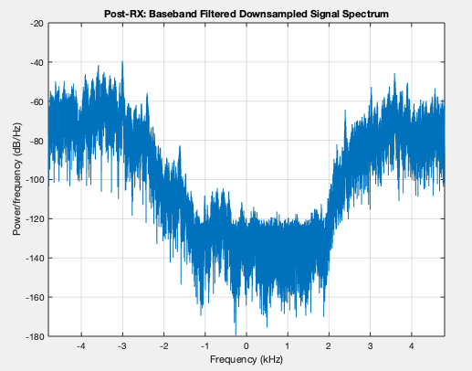
Post-RX BB (Downsampled to 1 symbol / sample)

Slide 11
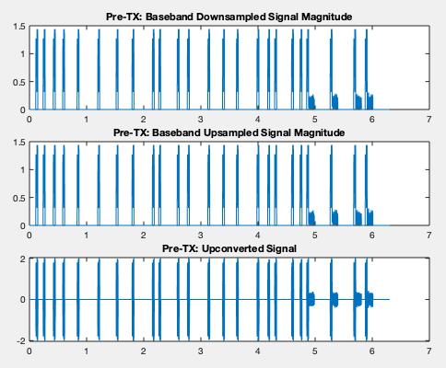
Pre-Tx Time Signal

Slide 12
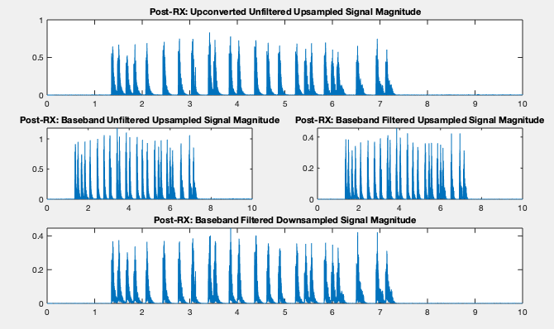
Post-Rx Time Signal

Slide 13


Packet Detection
STF Generation:
STF Detection:
Correlate with first repetition of STF
in time (i.e. first 16 samples)
Find points with 10 equally spaced
Peaks in correlation

Slide 14
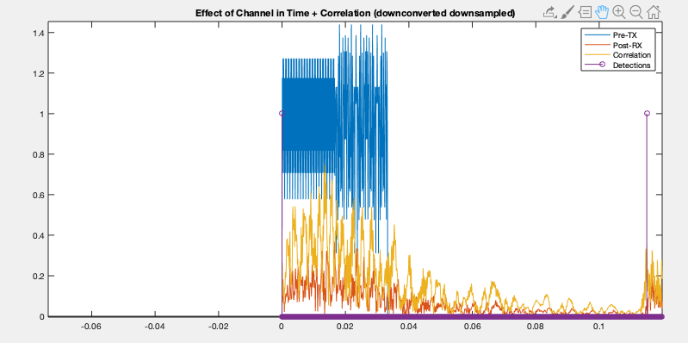
First detected packet

Slide 15
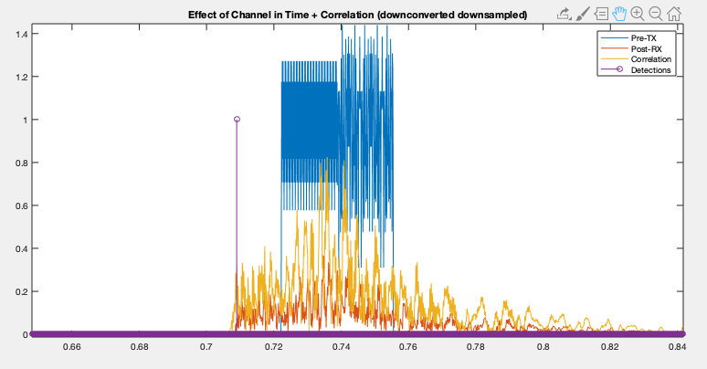
mis detection (to early)

Slide 16
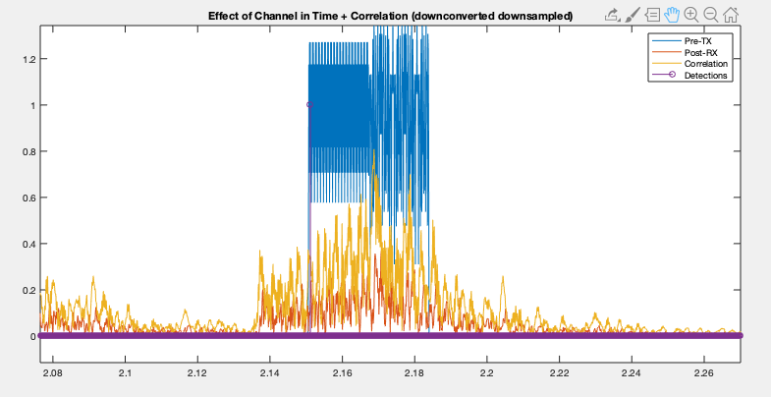
Successful detection

Slide 17
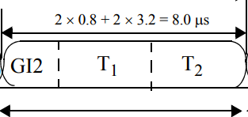
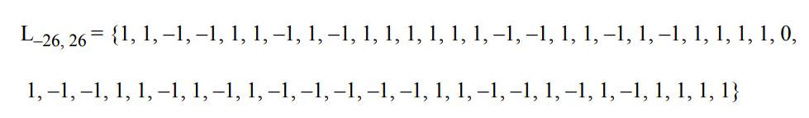
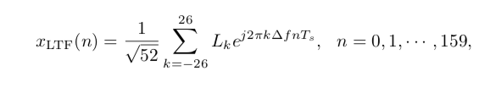
Channel Estimation
Generating Long Training Field…

Slide 18

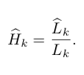
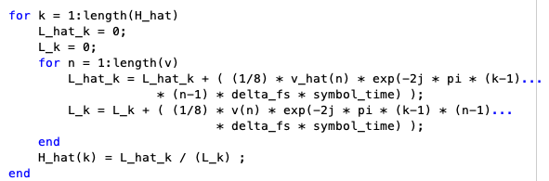
Channel Estimation
Decoding LTF:

Slide 19

Channel Estimation
Still not working, even in sim…
Simulated 3 tap channel:
Note: simultation includes upsampling to 48000Hz sampling rate + upconversion/downconversion to/from 10000Hz carrier frequency

Slide 20
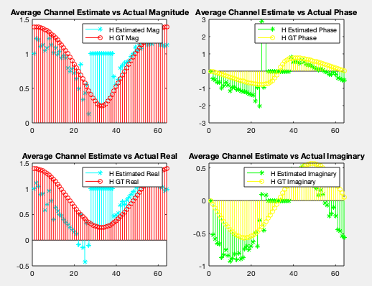
Nulls on carriers 1, and 28-38 (52 active carriers)

