Slide 1
How Solar Panels Turn Sunlight into Electricity
A beginner-friendly journey from photons to power

Slide 2
Sunlight and Solar Panels
01

Slide 3
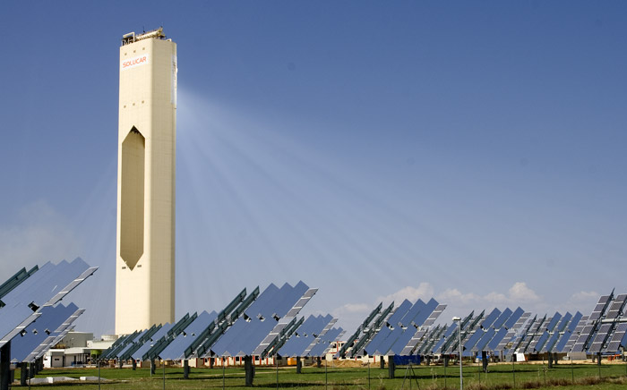
Sunlight: The Original Energy Source
Sun fuses hydrogen into helium, releasing photons
Photons take about 8 minutes to reach Earth
Earth receives 173,000 terawatts of solar power continuously
Solar panels convert a fraction of this into electricity
Sunlight is renewable and available daily
afloresm / CC BY 2.0 / Wikimedia Commons
How Solar Panels Turn Sunlight into Electricity · Sunlight and Solar Panels
Notes:
The sun is a massive fusion reactor, turning hydrogen into helium and releasing photons. These photons travel 93 million miles in about 8 minutes. Earth intercepts about 173,000 terawatts continuously—far more than humanity uses. Solar panels capture just a fraction of this free, renewable energy. Understanding this flow is the first step to seeing how a panel turns light into electricity.
Image: afloresm / CC BY 2.0 / Wikimedia Commons (https://commons.wikimedia.org/wiki/File:PS10_solar_power_tower.jpg)

Slide 4
Inside a Solar Panel
Glass protects cells and lets sunlight through
Silicon cells are sandwiched between protective layers
Metal frame holds panel, wires carry current out
Photons hit silicon, excite electrons into motion
Electric field pushes electrons, creating usable current
How Solar Panels Turn Sunlight into Electricity · Sunlight and Solar Panels
Notes:
A solar panel is a sandwich of layers. Tempered glass on top protects the silicon cells while letting light pass. Below the glass, silicon wafers are encased in protective polymers. A metal frame holds everything together, and a junction box routes the electricity out. When photons strike the silicon, they knock electrons loose. A built-in electric field, created by the p-n junction, pushes those electrons through wires as direct current.

Slide 5
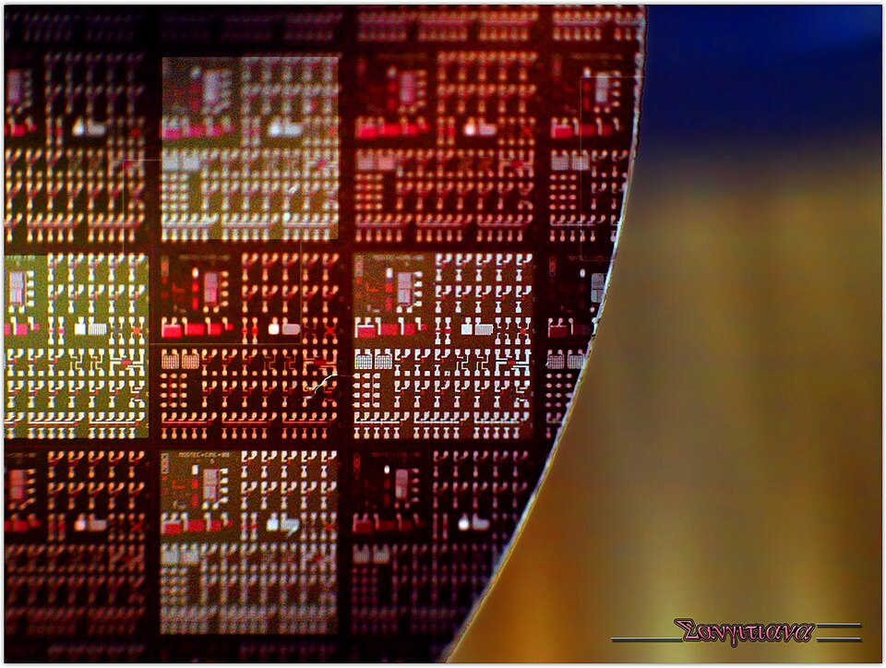
Silicon: The Light-Sensitive Material
Silicon is second most abundant element in Earth's crust
Pure silicon is a semiconductor, not a perfect conductor
Doping with phosphorus or boron creates n-type and p-type
Light knocks electrons loose, creating electron-hole pairs
Crystalline silicon dominates over 90% of solar panels
Sangitiana Fararano / CC BY-SA 2.0 / Wikimedia Commons
How Solar Panels Turn Sunlight into Electricity · Sunlight and Solar Panels
Notes:
Silicon sits just below oxygen in crustal abundance, making it cheap and plentiful. As a semiconductor, pure silicon barely conducts electricity. But doping it with phosphorus creates n-type silicon with extra electrons, while boron creates p-type with missing electrons. When sunlight hits the junction between them, electrons break free and flow. Silicon’s bandgap of about 1.1 electron volts matches visible light well. Over 90% of panels use crystalline silicon.
Image: Sangitiana Fararano / CC BY-SA 2.0 / Wikimedia Commons (https://commons.wikimedia.org/wiki/File:Wafer_20110212.jpg)

Slide 6
How Photons Create Current
02

Slide 7
Photons Knock Electrons Loose
Photons from sunlight hit silicon atoms in panel
Photon energy transfers to electron, exciting it
Electron breaks free, leaving a hole
Silicon is doped to create p-type and n-type layers
Only photons above bandgap energy free electrons
How Solar Panels Turn Sunlight into Electricity · How Photons Create Current
Notes:
Sunlight arrives as packets of energy called photons. When a photon hits the silicon cell, it can transfer its energy to an electron. If the energy is large enough, the electron breaks free from its atom, leaving behind a vacancy called a hole. Pure silicon is not ideal, so manufacturers add dopants to create layers that help manage these freed charges. Not every photon works; low-energy photons pass through or create heat.

Slide 8
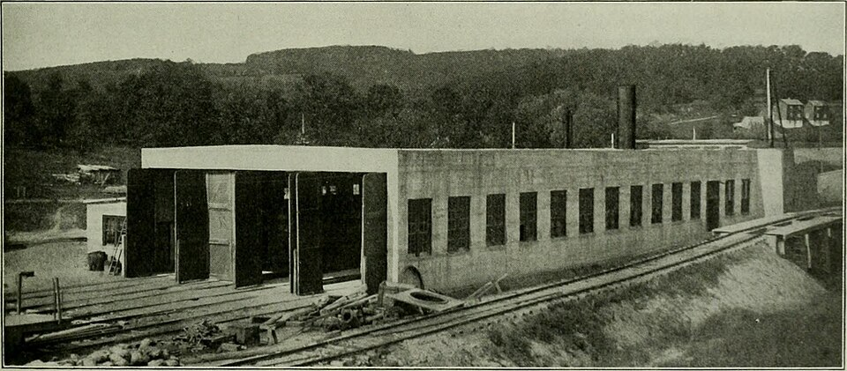
Electric Field Pushes Electrons
P-n junction creates built-in electric field
Field separates freed electrons from holes
Electrons pushed toward n-type layer
Holes pushed toward p-type layer
This separation creates voltage across cell
Internet Archive Book Images / No restrictions / Wikimedia Commons
How Solar Panels Turn Sunlight into Electricity · How Photons Create Current
Notes:
Once electrons and holes are freed, they would normally recombine. The p-n junction prevents that. Where p-type and n-type silicon meet, an electric field forms. This field acts like a slope, pushing freed electrons toward the n-type side and holes toward the p-type side. That charge separation builds a voltage across the cell. This voltage is what can drive current when a circuit is connected.
Image: Internet Archive Book Images / No restrictions / Wikimedia Commons (https://commons.wikimedia.org/wiki/File:Electric_railway_review_(1906)_(14761039055).jpg)

Slide 9
DC Electricity Flows Out
Electrons travel through external circuit as direct current
Metal contacts collect electrons from n-type layer
Current flows one direction, from negative to positive
Inverter later converts DC to AC for home use
Cell voltage about 0.5 to 0.6 volts per silicon cell
How Solar Panels Turn Sunlight into Electricity · How Photons Create Current
Notes:
With a voltage established, connecting the cell to an external circuit lets electrons flow. Metal contacts collect them from the n-type layer and send them through wires to do useful work, such as lighting a lamp. The flow is direct current, meaning it moves in one direction. A single silicon cell produces only about half a volt, so panels wire many cells in series. Later, an inverter can convert this DC into household AC.

Slide 10
From Panel to Plug
03

Slide 11
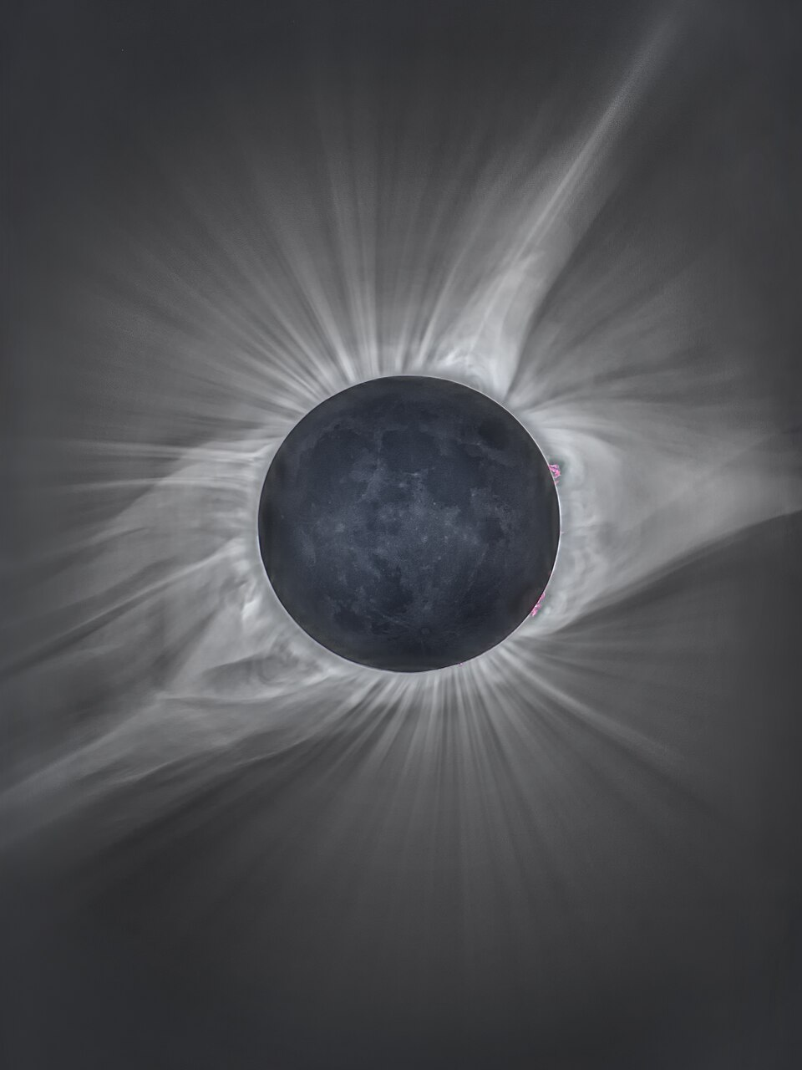
Inverter Turns DC into AC
Solar panels make DC electricity, flowing one direction
Inverter converts DC into AC for home use
Inverters switch DC rapidly, creating 60 Hz AC
String inverters connect many panels to one unit
Microinverters sit behind each panel, optimizing output
Michael S Adler / CC BY-SA 4.0 / Wikimedia Commons
How Solar Panels Turn Sunlight into Electricity · From Panel to Plug
Notes:
Solar panels generate direct current, where electrons flow in one direction. The inverter takes that DC and rapidly switches it to create alternating current, the type your wall outlets use. In the U.S., AC alternates 60 times per second, at 120/240 volts. String inverters handle many panels together, while microinverters convert at each panel. Modern inverters are about 96–98% efficient, so little energy is lost in conversion.
Image: Michael S Adler / CC BY-SA 4.0 / Wikimedia Commons (https://commons.wikimedia.org/wiki/File:Total_Solar_Eclipse_8-21-17.jpg)

Slide 12
Powering Homes and Devices
Breaker panel routes AC to outlets and appliances
Electricity powers lights, fridge, TV, EV charger
Surplus flows to grid, spinning meter backward
Battery stores excess for night, then inverter converts
Typical U.S. home uses about 30 kWh daily
How Solar Panels Turn Sunlight into Electricity · From Panel to Plug
Notes:
Once AC leaves the inverter, it enters your breaker panel and is distributed to circuits around the home. That electricity runs lights, refrigerators, computers, and EV chargers. Any surplus can flow back to the grid, often earning net-metering credits. With a battery, extra DC or AC can be stored for night use. An average U.S. home uses roughly 30 kilowatt-hours per day.

