Slide 1
data
Generated on 08 Feb 2022, 20:10 by SpmImageTycoon
https://github.com/alexriss/SpmImageTycoon.jl

Slide 2
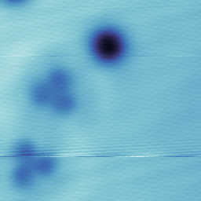
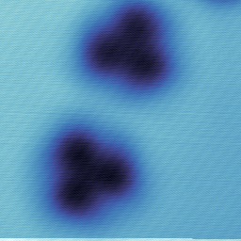
Cu(111)
3TCNE 0.8A, 30sec
Image_002.sxm
Image_004.sxm
STS003.dat
Z: 500.0mV, 40.0pA
1 nm
Z: 1.0V, 40.0pA
1 nm
LI Y: z=const
STS005.dat
LI Y: z=const

Slide 3
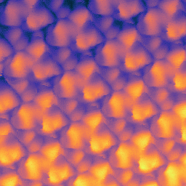
gated graphene
3TCNE
Image_166.sxm
Z: -400.0mV, 2.0pA
1 nm

Slide 4
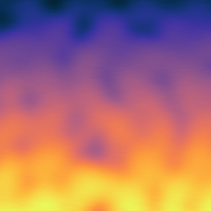
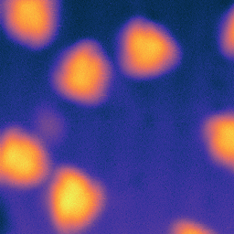
Au(111)
Image_398.sxm
Image_412.sxm
Z: 100.0mV, 42.6pA
2 nm
Z: 2.0V, 1.0pA
2 nm

Slide 5
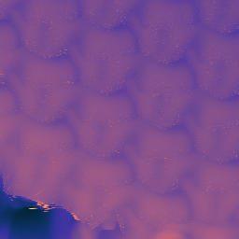
gated Graphene
3TCNE
RT
Image_526.sxm
Z: 2.0V, 2.0pA
1 nm

Slide 6
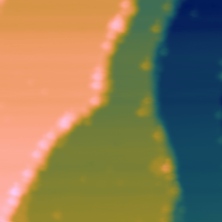
Cu(111)
3TCNE
Image_661.sxm
Follow Me_Bias Spectroscopy054.dat
Follow Me_Bias Spectroscopy059.dat
Z: 1.0V, 121.2pA
10 nm
LI Y: z=const
LI Y: z=const

Slide 7

Cu(111)
3TCNE
Image_671.sxm
Follow Me_Bias Spectroscopy064.dat
Z: -1.0V, 229.8pA
10 nm
LI Y: z=const

Slide 8
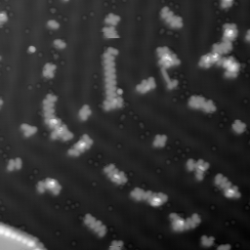
Au(111)
z molecules, 2sec LL
Image_110.sxm
Z: 60.0mV, 10.0pA
4 nm

Slide 9


Au(100); z molecules, ~2sec LL; 10 min 1.5A; 10 min 2.0A; 10 min 2.5A
Image_177.sxm
Image_212.sxm
Δf: 200.0mV, z=const
0.5 nm
Δf: 200.0mV, z=const
0.5 nm

Slide 10
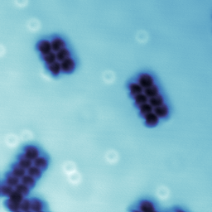
Cu(111)
z RT, LL, 3sec
CO
Image_695.sxm
Z-Spectroscopy__012.dat
Z-Spectroscopy420.dat
Z: 50.0mV, 20.0pA
2 nm
Δf: 0V, z=const
Δf: z=const
Z-Spectroscopy507.dat
frq-sweep001.dat
Δf: -2.0mV, z=const
Amplitude: z=const

Slide 11

Au111
old NPG sample
anneal 2.05A 12min
TPP-Fe-Cl: 330C, 35sec
empty.sxm
Δf: -2.0mV, z=const
1 nm

