Slide 2
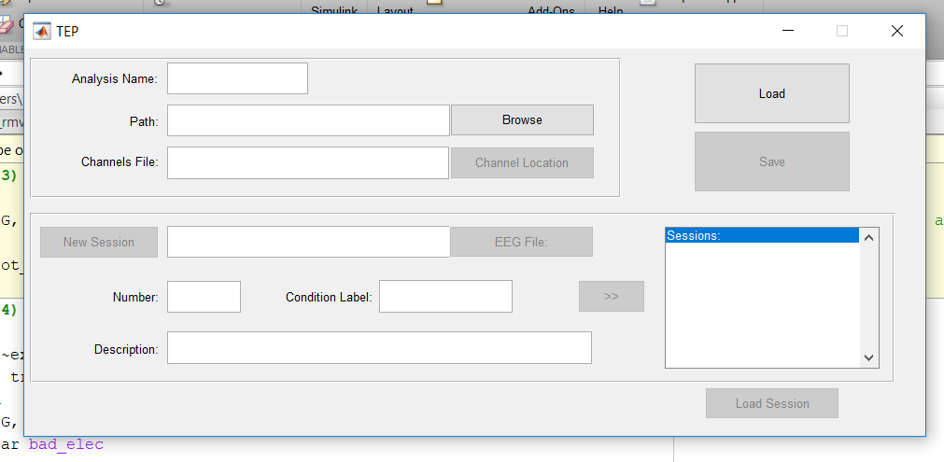
Here the basic information we need for a TMS-EEG session
Name of each experiment (many sessions)
The file with the coordinates of the channels
The EEG file (different format?)
The session number or name
For example EO/EC, awake/sleep
Everything else

Slide 3
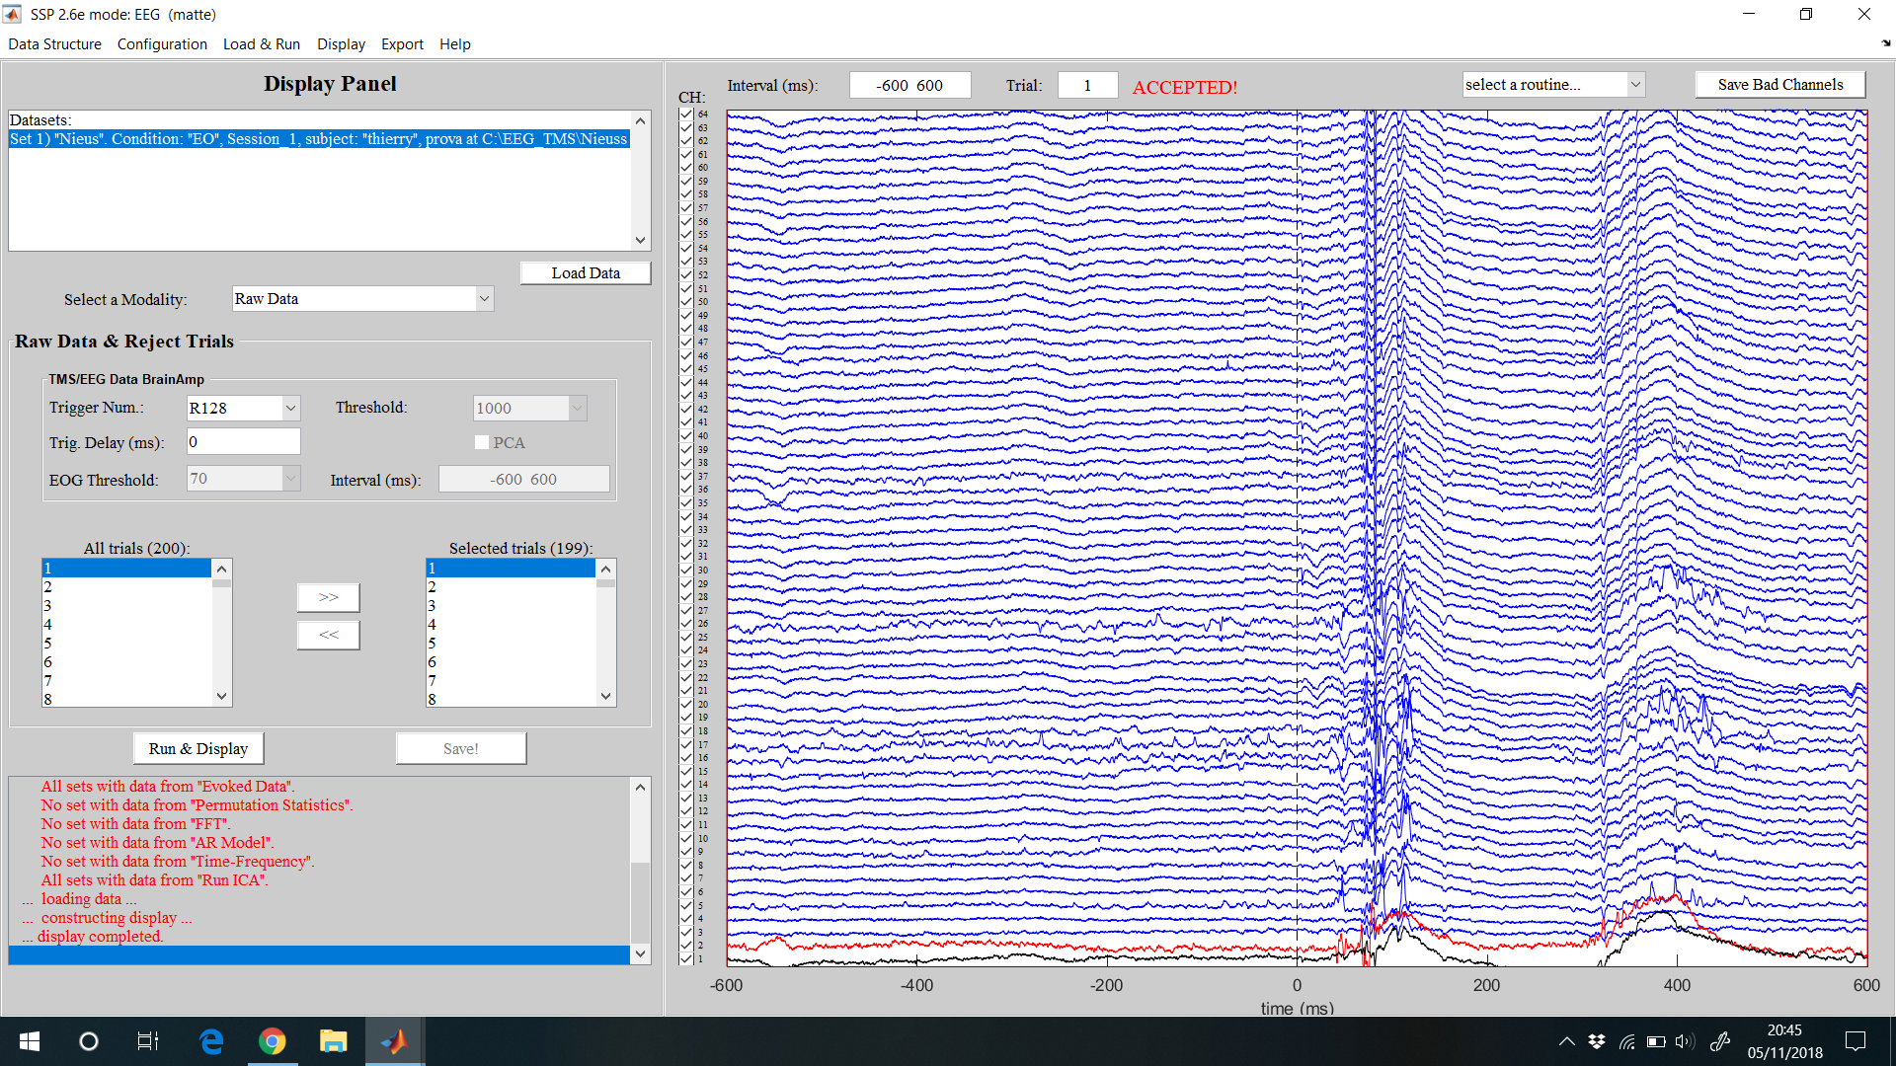
Trials rejection: here we should have the possibility to select the trigger, scroll every trials and select the bad ones. We should have the possibility to increase or decrease the time window, to filter the trial we are visualizing and to remove the TMS step artifact (next slide)

Slide 4
I was thinking to have a matrix that can help to understand if one channel is bad in many trials or just in a few of them.
Something like that
N
Ch
1
ch bad for the entire recording
ch bad just for a few trials
Tr bad
1 Tr m trials

Slide 5
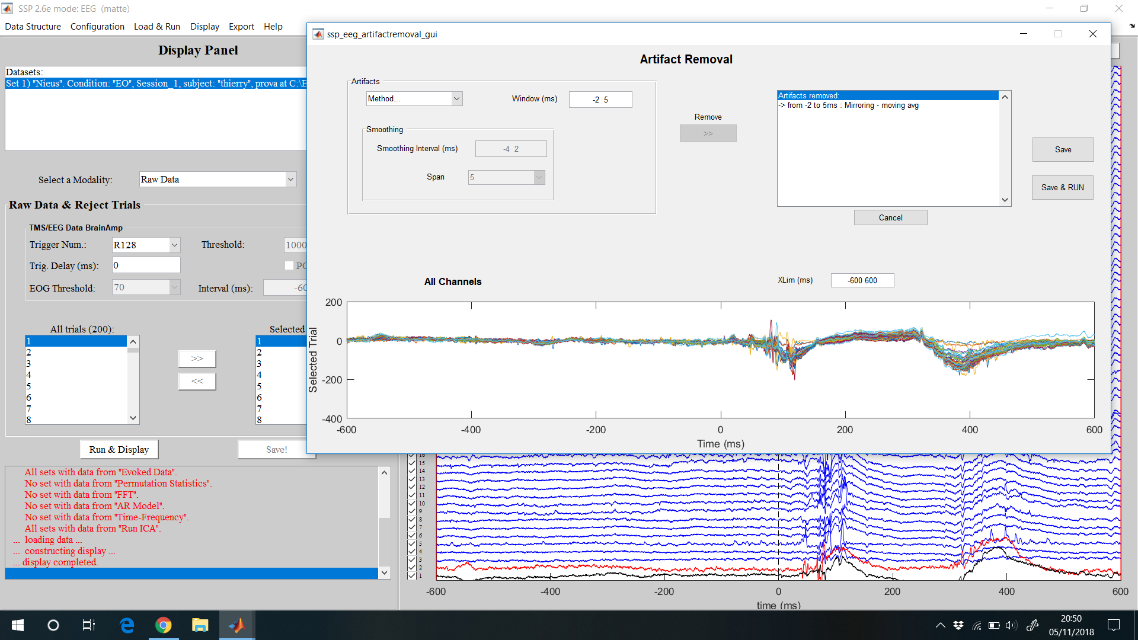

Slide 6
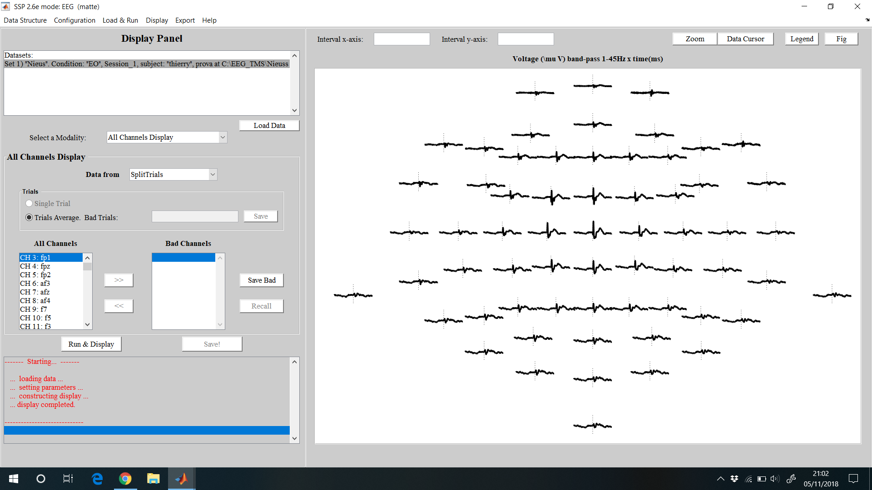
All channels display

Slide 7
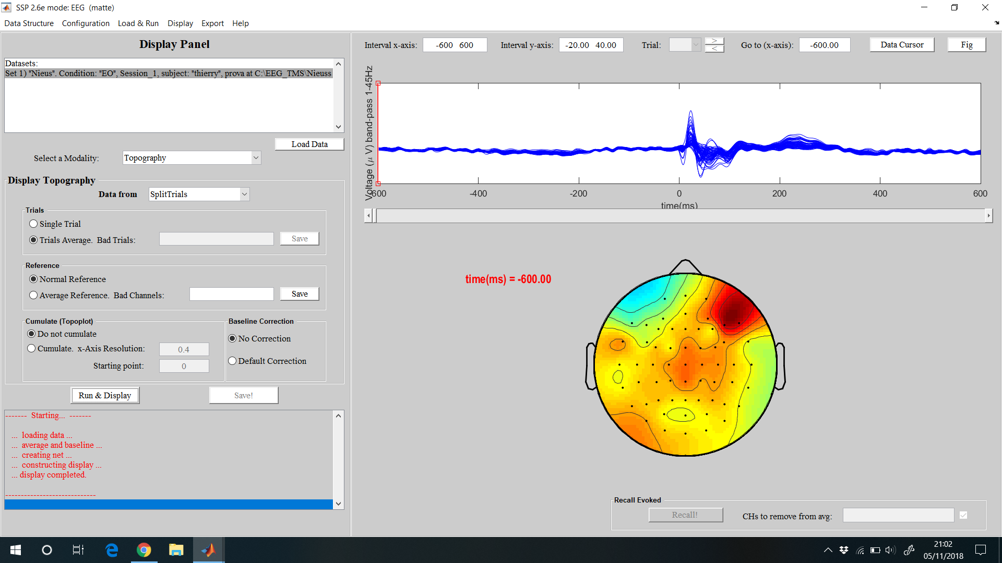
Butterfly plot + topography
Here you can choose to see the average of all good trials or just one trials per time

Slide 8
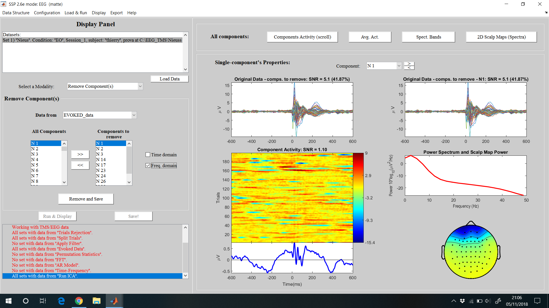
ICA – we have to understand which is a good ICA

